Slide 1
MIRA
AI-assisted preparation
for remote photographers
IRONHACK CAPSTONE · ROUND 1
Marija Kavaliauskaite
Working prototype · commercial journey in progress
Notes:
SPEAKER NOTES
Open with the problem MIRA solves: remote photographers need the client prepared before the camera turns on. This deck distinguishes what works now from what is still being implemented.
STATUS
Presentation starter ready; replace name/date only if needed.
NEXT AGENT TODO
None
[Sources]
- User-provided MIRA project context and screenshots.

Slide 2
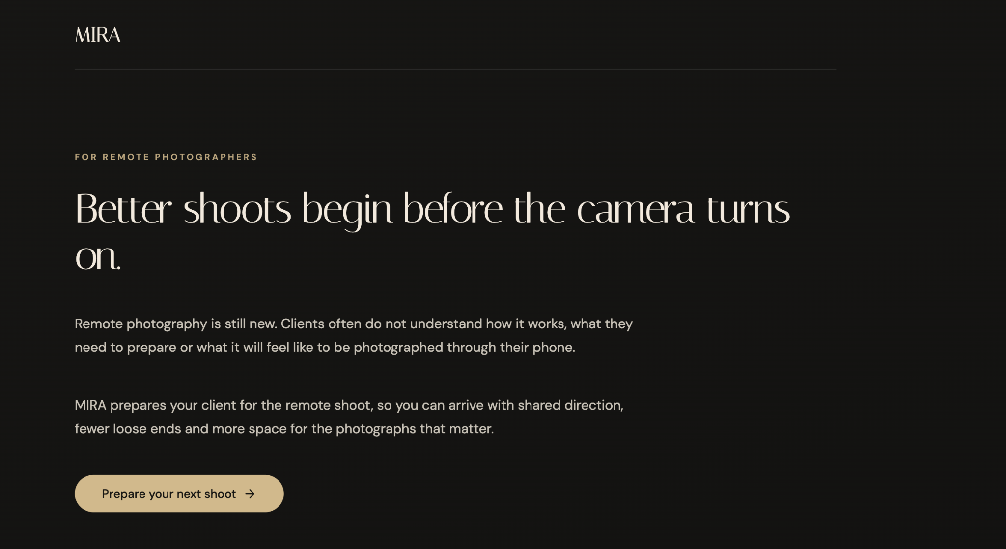
MIRA
PROBLEM
Remote shoots fail before the camera turns on
RESEARCH SYNTHESIS
Clients often arrive uncertain about the process, practical setup and creative direction. The photographer repeats the same preparation work in messages and calls.
TOOLS USED · Sector research · Manus
Notes:
SPEAKER NOTES
Explain the business problem in plain language. Avoid inventing statistics. Position this as a synthesis of sector research and practical workflow observations.
STATUS
Research narrative drafted; quantitative evidence still needs citations.
NEXT AGENT TODO
Add 2–3 cited sector findings from research/sector_research.md.
[Sources]
- User-supplied MIRA landing-page screenshot: Screenshot 2026-09-03 at 19.50.27.png

Slide 3
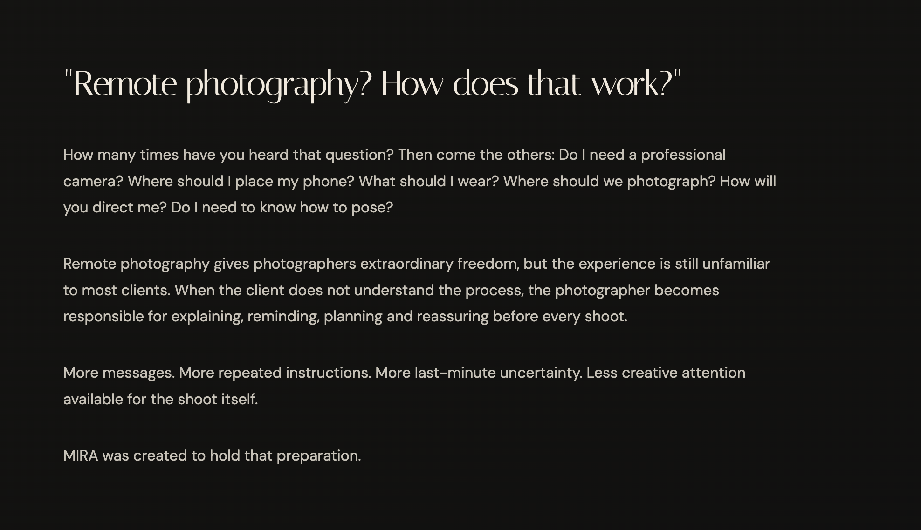
MIRA
RESEARCH INSIGHT
The preparation gap becomes the photographer’s workload
RESEARCH SYNTHESIS
01
Client uncertainty
What happens, what to prepare and how the remote shoot works.
02
Fragmented communication
Creative references and logistics live across email, chat and calls.
03
Inconsistent readiness
Missing details surface on shoot day, when they are expensive to solve.
TOOLS USED · Sector research · UX mapping
Notes:
SPEAKER NOTES
Use this slide to connect the user problem to operational cost. The current claims are qualitative; support them with the research pack before final submission.
STATUS
Problem themes ready; evidence citations pending.
NEXT AGENT TODO
Insert research citations and, if available, one interview quote with permission.
[Sources]
- User-supplied MIRA problem screenshot: Screenshot 2026-09-03 at 19.50.33.png

Slide 4
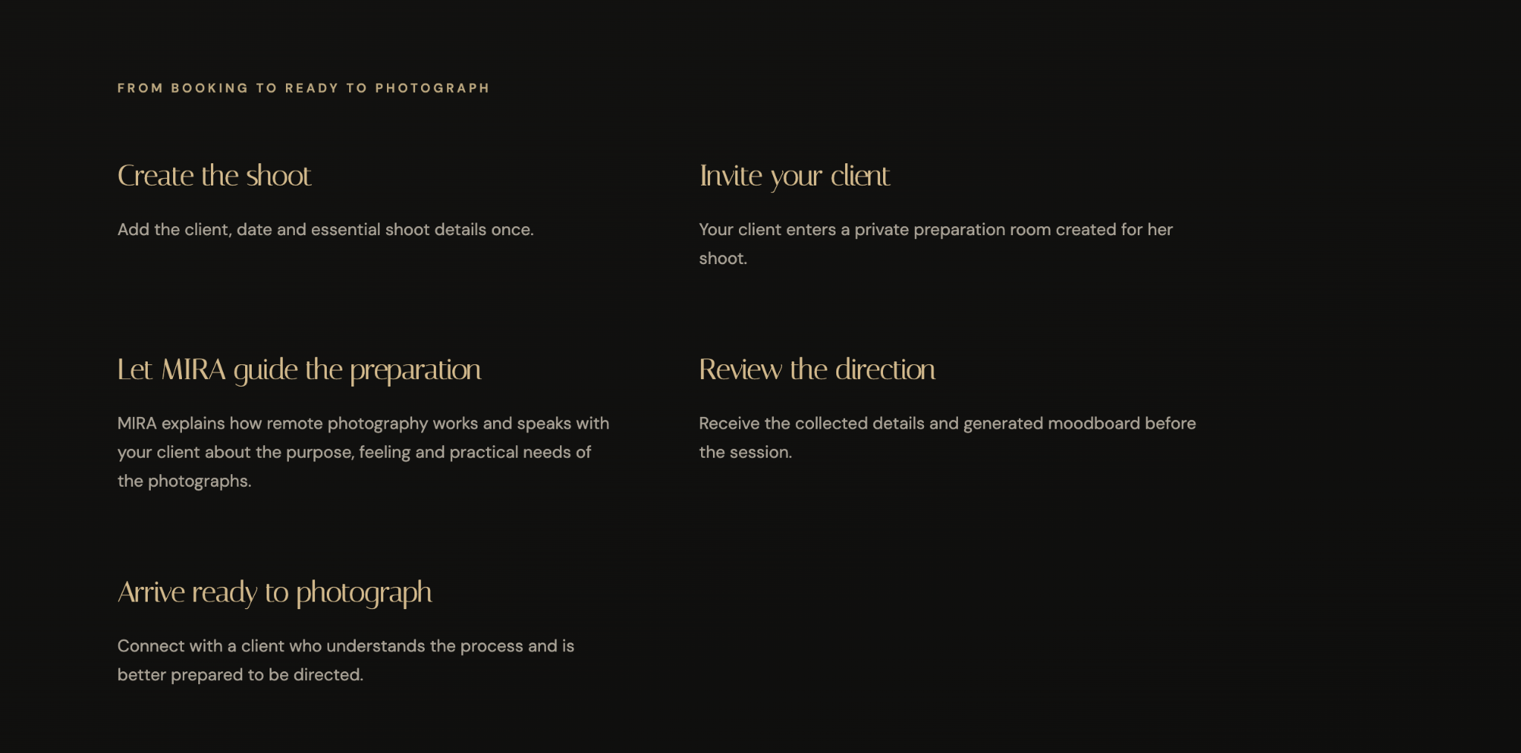
MIRA
SOLUTION
MIRA turns scattered preparation into one guided path
DESIGNED FLOW
TOOLS USED · Manus · React · TypeScript
Notes:
SPEAKER NOTES
Walk through the intended journey: photographer creates the shoot, invites the client, MIRA guides preparation, the photographer reviews direction, and both arrive ready.
STATUS
Core journey is designed; later dashboard, AI conversation and moodboard steps require full end-to-end verification.
NEXT AGENT TODO
Replace this overview with final dashboard screenshots when Segment 2 is complete.
[Sources]
- User-supplied MIRA workflow screenshot: Screenshot 2026-09-03 at 19.50.39.png

Slide 5
MIRA
SOLUTION DESIGN
AI is used only where interpretation adds value
ARCHITECTURE
AI LAYER
DETERMINISTIC LAYER
Adaptive conversation
Interpret qualitative answers
Synthesize creative direction
Translate references into moodboard prompts
Account and authentication
Payments and access control
Invitations and consent
Storage, email and status tracking
Human review remains the final creative decision.
TOOLS USED · LLM concept · React · Express
Notes:
SPEAKER NOTES
This separation is central to responsible design. AI handles ambiguity and synthesis. Ordinary software handles identity, money, permissions and records. The photographer remains accountable for the creative outcome.
STATUS
Conceptual architecture; individual integrations are at different maturity levels.
NEXT AGENT TODO
Confirm the exact model/provider used before naming it on the final slide.
[Sources]
- User-provided MIRA project context and screenshots.

Slide 6
MIRA
CLIENT PREPARATION SYSTEM
ONE LINK. A FULLY PREPARED CLIENT.
ADAPTIVE JOURNEY
MIRA adapts the preparation journey to the time remaining before the shoot.
01 CREATE SHOOT
React/TypeScript
02 SEND PRIVATE LINK
Resend · IN IMPLEMENTATION
03 FIVE REFERENCES
Client upload
04 VISUAL TEST
Existing preference test
05 VOICE PREP
Realtime · IN IMPLEMENTATION
→
→
→
→
↓
10 READY TO SHOOT
Approved preparation
09 REVIEW
Photographer · PLANNED
08 MOODBOARD + PLAN
Five images · PARTIAL
07 ORCHESTRATE
n8n · PARTIAL
06 CREATIVE DNA
Structured synthesis
ONE PERSISTENT SHOOT ROOM LINK
Every Resend email returns the client to the same remembered preparation room.
MORE THAN 7 DAYS
3 sessions · foundation → direction + wardrobe → readiness
4–7 DAYS
2 combined preparation sessions
2–3 DAYS
1 focused session · 15–20 minutes
LESS THAN 24 HOURS
1 essentials-only session
AI · Voice conversation · qualitative understanding · Creative DNA · creative direction
ORDINARY SOFTWARE · Stripe · auth · permissions · dates · Resend scheduling · storage · status
STATUS · Stripe WORKING · private link WORKING · Voice / Resend / LangSmith IN IMPLEMENTATION · Moodboard PARTIAL · Approval PLANNED
TOOLS · Stripe · Resend · OpenAI Realtime · LangSmith · n8n · React/TypeScript · Photographer approval
Notes:
SPEAKER NOTES
This is the intended end-to-end preparation journey. The client always returns through the same private Shoot Room link, so visual references, the preference test, conversation memory, Creative DNA and generated direction stay attached to one shoot. Timing adapts to the remaining days rather than forcing every client through the same sequence.
AI versus ordinary software
AI handles voice conversation, qualitative understanding, Creative DNA and creative direction. Ordinary software handles Stripe, authentication, permissions, shoot dates, Resend scheduling, storage and status tracking.
STATUS
Stripe: WORKING.
Private client link: WORKING.
Voice: IN IMPLEMENTATION until verified.
Resend: IN IMPLEMENTATION until a real email is verified.
LangSmith: PLANNED / IN IMPLEMENTATION until a real MIRA trace is visible.
Moodboard automation: PARTIAL until five images are generated.
Photographer approval: PLANNED unless demonstrated.
[Sources]
- User-provided MIRA workflow and implementation status, 3 September 2026.

Slide 7
MIRA
IMPLEMENTATION STATUS
VALIDATED IN CONTROLLED STAGES
EVIDENCE
PAYMENTS
EMAIL AUTOMATION
CREATIVE PIPELINE
PREVIOUSLY LIVE-VERIFIED · 62/62 tests
Hosted payment + webhook confirmed
LIVE-VERIFIED
Branded invitation delivered; delivery webhook HTTP 200
LIVE-VERIFIED
Five demo references → Creative DNA → five-scene demo moodboard
Full suite: 460 passed · 24 identical pre-existing failures · 3 skipped. Staged validation protects working functionality, limits regression risk, and creates traceable GitHub evidence.
TOOLS USED · GitHub · Automated tests · Isolated preview · TypeScript
Notes:
SPEAKER NOTES
Frame LangSmith as observability rather than decoration. It should show how you inspect traces and evaluate output quality. Only add a result after running a MIRA-specific sample.
STATUS
Ironhack LangSmith work may exist, but MIRA-specific evidence is not verified.
NEXT AGENT TODO
Add one dataset/experiment screenshot and define 3–4 evaluation criteria.
[Sources]
- User-provided MIRA project context and screenshots.

Slide 8
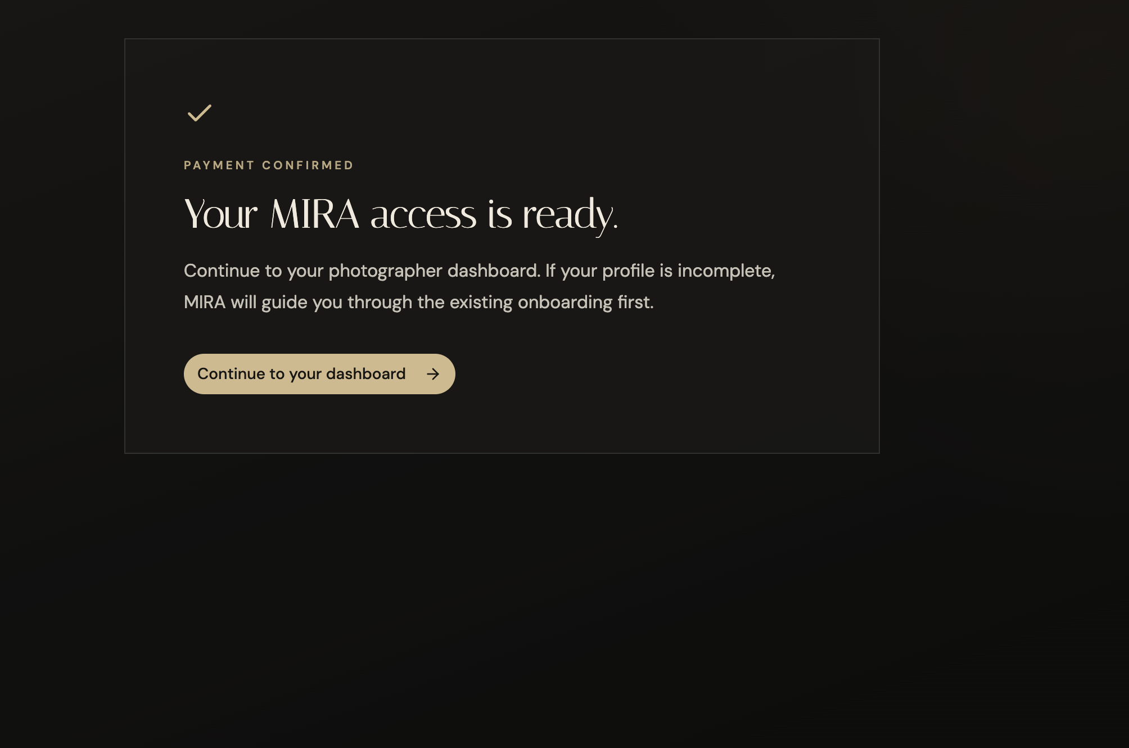
MIRA
IMPLEMENTATION
Payment now opens the photographer journey
BROWSER-VERIFIED
A €0 promotion-code checkout returned to MIRA, confirmed access and routed the authenticated photographer into onboarding. The commercial path was tested without charging real money.
TOOLS USED · Stripe Checkout · Webhook · Authentication · Manus private preview
Notes:
SPEAKER NOTES
I tested the commercial access path in the browser using Stripe and a 100% promotion code, so no real charge was made. The payment confirmation now leads the authenticated photographer into the existing onboarding flow.
STATUS
Working in the current Manus private preview; browser-verified on 3 September 2026.
[Sources]
- User-provided MIRA browser screenshot: Screenshot 2026-09-03 at 23.27.29.png
- User-provided implementation report, 3 September 2026.

Slide 9
MIRA
PAYMENT + ACCESS
FROM CHECKOUT TO VERIFIED ACCESS
WORKING · TESTED · SAVED TO GITHUB
Stripe securely connects each completed purchase to the correct photographer account.
01 PHOTOGRAPHER ACCOUNT
Create account or log in
02 STRIPE CHECKOUT
Secure hosted checkout
03 PAYMENT
€33.33 · MIRADEMO €0 test
04 SIGNED WEBHOOK
checkout.session.
completed
05 ACCESS ACTIVATION
Verify event + correct account
06 DASHBOARD
Continue to /mira/dashboard
→
→
→
→
→
VERIFIED CHECKPOINT
The browser success page cannot grant access. The signed server event does.
62 / 62
Stripe + payment tests passed
PRODUCTION BUILD
PASSED
WORKSPACE
0 uncommitted changes
GITHUB CHECKPOINT
fix/mira-final-ux-runtime
e2e99e1f47c5d749d6ca91281e24c00a51f10931
STRIPE CHECKOUT · STRIPE WEBHOOKS · EXPRESS · AUTHENTICATION + SESSIONS
REACT + TYPESCRIPT · DATABASE / DATA LAYER · GIT + GITHUB · MANUS
Production access is granted only after server-side Stripe verification.
TOOLS · Stripe Checkout · Stripe Webhooks · Express · Auth + sessions · React/TypeScript · Data layer · Git/GitHub · Manus
Notes:
SPEAKER NOTES
The Stripe integration is now complete. The customer first creates or accesses a photographer account, and MIRA links that authenticated account to a Stripe Checkout Session. After payment, Stripe sends a signed checkout.session.completed webhook directly to the MIRA server.
The browser success page alone cannot grant access. MIRA verifies the server-side webhook, connects it to the correct photographer account and only then activates the dashboard.
The main difficulty was maintaining account continuity between MIRA and Stripe. Stripe could successfully complete checkout, but some events were initially rejected because the payment information did not match the validation expected by MIRA. We inspected the event deliveries and server response, corrected the validation mismatch and verified the complete journey.
The final implementation passed 62 out of 62 payment and Stripe tests. The production build passed, the workspace had no uncommitted changes, and the verified code was saved to a dedicated GitHub branch without exposing credentials.
[Sources]
- User-provided verified GitHub checkpoint: branch fix/mira-final-ux-runtime, commit e2e99e1f47c5d749d6ca91281e24c00a51f10931.
- User-provided verification report: 62/62 Stripe and payment tests passed; production build passed; 0 uncommitted changes.
- GitHub checkpoint screenshot was referenced by the user but was not available in the current working files, so no screenshot was fabricated.

Slide 10
MIRA
DELIVERY STRATEGY
A HYBRID BUILD STRATEGY
Using each development environment where it creates the most value.
01
MANUS
02
◇ GITHUB CHECKPOINT ✓
03
VS CODE + CODEX
CLOUD INTEGRATION + LIVE VERIFICATION
Hosted preview · Stripe Checkout · public webhook
Browser E2E · cloud debugging
VERIFIED · Stripe working
62/62 tests · build passed
CONTROLLED BRIDGE
mariacavali/MIRA-asignment-
fix/mira-final-ux-runtime · e2e99e1f
Reproducible · secrets excluded
Working function protected · main unchanged
VERIFIED
CONTINUED PRODUCT DEVELOPMENT
Resend · client preparation · five-image input
Voice + visual journey · LangSmith
Moodboard · dashboard · local testing
IN PROGRESS
04
WHY THIS APPROACH?
+
SAFER + MORE PORTABLE
→
THE DELIVERY DECISION
Lower cloud-agent credit usage
Faster code iteration
Clear version history
Reduced vendor dependency
Verified vs experimental separation
Product code remains portable
MANUS verified the cloud payment flow.
GITHUB protected the checkpoint.
CODEX continues the product build.
MANUS → GITHUB → VS CODE + CODEX · VERIFIED CHECKPOINT PROTECTED
Notes:
SPEAKER NOTES
This was a deliberate delivery decision. Manus was valuable for the hosted Stripe and webhook verification, while continuing every development stage in the same cloud-agent environment would increase cost and dependency. I created a tested GitHub checkpoint and moved ongoing development into VS Code with Codex. This keeps the product portable, protects the verified payment flow and allows longer development and testing cycles with better cost control.
[Sources]
- User-provided MIRA delivery strategy and verified implementation checkpoint.
- Repository: github.com/mariacavali/MIRA-asignment-
- Verified branch: fix/mira-final-ux-runtime
- Verified commit: e2e99e1f
- Verification evidence: Stripe payment flow working; 62/62 payment tests passed; production build passed.
- No screenshot was inserted because the referenced checkpoint image was not available in the supplied working files.

Slide 11
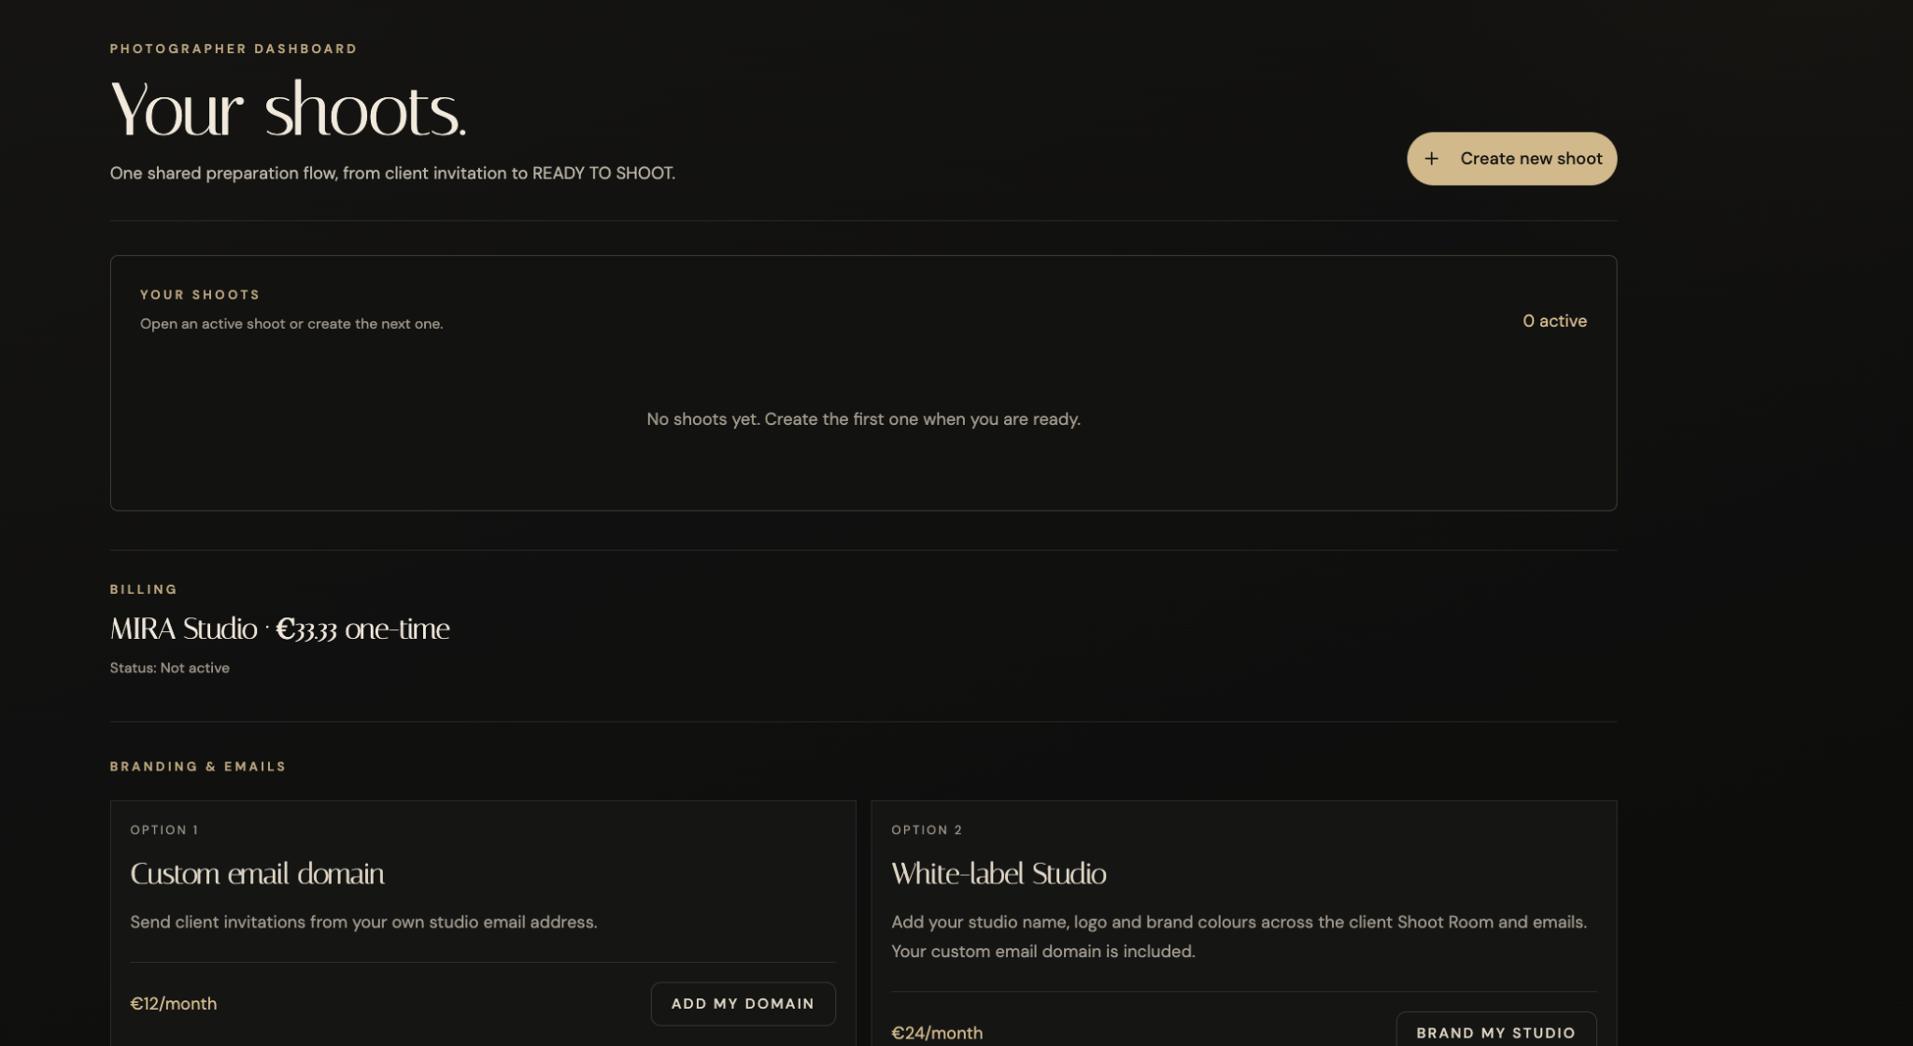
MIRA
IMPLEMENTATION
The subscription opens a photographer workspace
WORKING
After onboarding, the photographer reaches a dedicated dashboard, can create a shoot and can return to active shoots. Visual alignment is still being refined; the core workflow is available.
TOOLS USED · React · TypeScript · tRPC · Drizzle · Manus private preview
Notes:
SPEAKER NOTES
The photographer now has a dedicated workspace. The dashboard is intentionally part of the commercial product architecture: it connects account access, shoot creation and future client preparation records. The layout still needs visual refinement, but the workflow is functioning.
STATUS
Core dashboard workflow working; interface polish in progress.
[Sources]
- User-provided MIRA browser screenshot: Screenshot 2026-09-03 at 23.28.45.png.

Slide 12
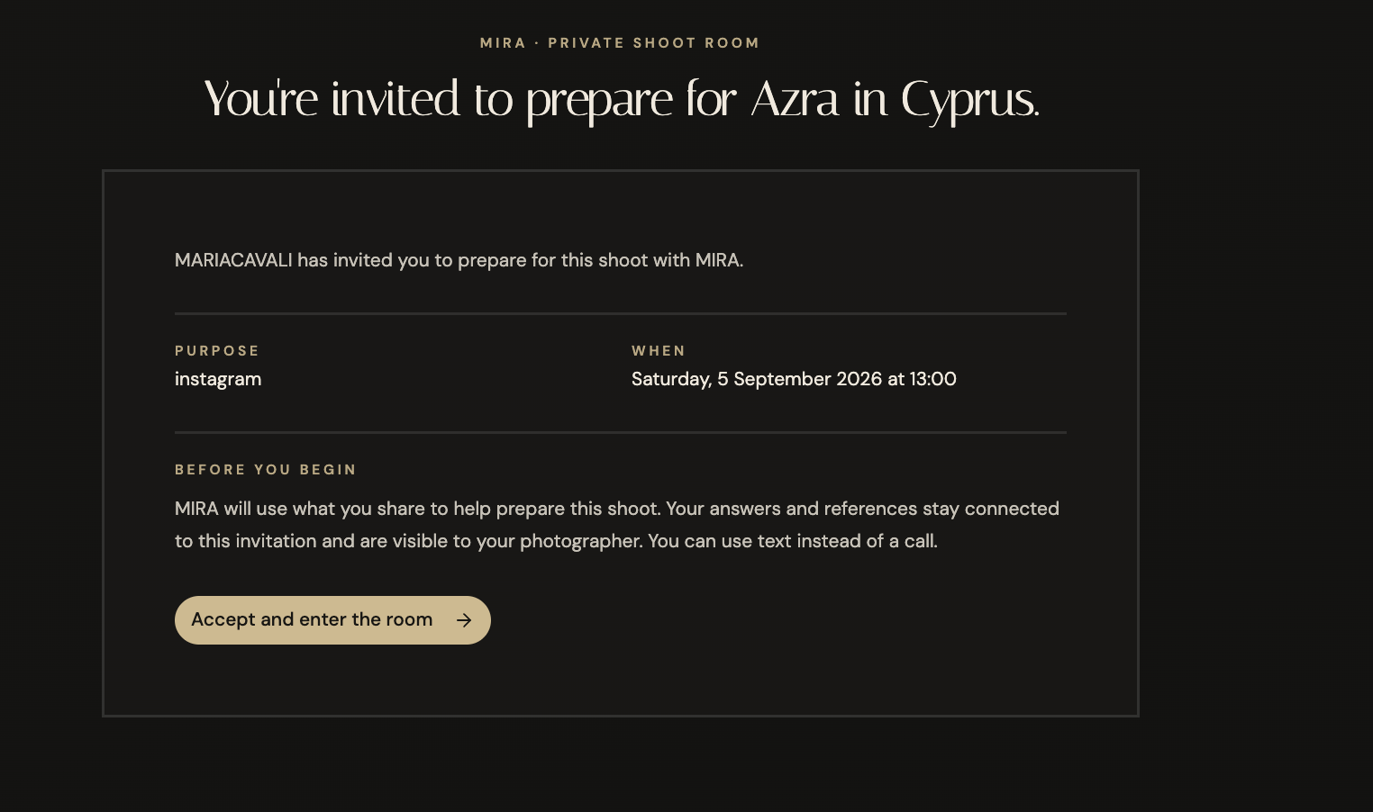
MIRA
IMPLEMENTATION
One private link moves the client into preparation
WORKING
The photographer creates a shoot and shares one private link. The client reviews the shoot details, accepts the preparation conditions and enters a room connected to that exact shoot.
TOOLS USED · Signed invitation link · tRPC · Consent gate · Shared shoot data
Notes:
SPEAKER NOTES
This is the bridge between the photographer and the model or client. The invitation is tied to one shoot and carries the shared details into the private preparation room. The client must actively accept before continuing.
STATUS
Private link, shoot details and entry consent are working in the current preview.
[Sources]
- User-provided MIRA browser screenshot: Screenshot 2026-09-03 at 23.32.51.png.

Slide 13
MIRA
IMPLEMENTATION STATUS
The paid journey now reaches the private client room
BROWSER-VERIFIED
Payment → onboarding → dashboard → shoot → private link
Voice · timed email delivery · generated moodboard
WORKING
NEXT
TOOLS USED · Stripe · Webhook · Auth · React · tRPC · Drizzle · Manus
Notes:
SPEAKER NOTES
The implementation moved beyond the original payment boundary. In the current preview I can complete payment confirmation, onboarding, dashboard access, shoot creation and the private client invitation. The AI preparation layer is the remaining stabilization focus: realtime voice is unavailable, timed Resend delivery is not yet verified, and the final moodboard output still needs end-to-end proof.
STATUS
Commercial access and invitation path browser-verified; AI completion path incomplete.
[Sources]
- User-provided MIRA browser screenshots: Screenshot 2026-09-03 at 23.27.29.png and Screenshot 2026-09-03 at 23.32.51.png.
- User-provided implementation report, 3 September 2026.

Slide 14
MIRA
DEMO STRATEGY
The safest classroom demo separates proof from production
RECOMMENDED
COMMERCIAL PROOF
DEMO CONTINUITY
Show the real Stripe-hosted checkout and the €0 MIRADEMO confirmation as evidence of the payment integration.
Use a clearly labelled demo-only access button to continue into the dashboard without pretending that payment activated the account.
Never enable the bypass in production.
TOOLS USED · Manus private preview · Demo mode
Notes:
SPEAKER NOTES
This approach lets you demonstrate Stripe as a real tool and still complete the classroom journey. Say clearly that the bypass is isolated to demo mode; production access remains webhook-controlled.
STATUS
Fastest low-credit demo strategy; not yet confirmed implemented.
NEXT AGENT TODO
Have the next developer add and browser-test the demo-only button, then capture one dashboard screenshot.
[Sources]
- User-provided MIRA project context and screenshots.

Slide 15
MIRA
AUTOMATION POC
n8n orchestrates the future moodboard pipeline
EVIDENCE NEEDED
1
2
3
4
5
Receive client brief
Validate consent
Structure prompt
Generate five images
Store + notify
Round 1 evidence required
Exported n8n workflow or annotated screenshots, plus limits versus production.
TOOLS USED · n8n · API workflow · File storage
Notes:
SPEAKER NOTES
Explain n8n as the automation layer for handing structured client inputs to the image-generation step and returning outputs to the project. Do not claim the export exists until it is attached.
STATUS
User reports an n8n moodboard workflow; repository evidence not yet verified.
NEXT AGENT TODO
Insert an exported .json or annotated workflow screenshot and list the exact nodes used.
[Sources]
- User-provided MIRA project context and screenshots.

Slide 16
MIRA
MONITORING
Observability makes AI behaviour explainable
EVIDENCE NEEDED
TRACE
EVALUATE
IMPROVE
What prompt, context and model produced the output?
Did the result follow the brief, remain safe and stay useful?
Which failures should change prompts, rules or human review?
Round 1 evidence: dataset/experiment link, or screenshots plus a short transparency note.
TOOLS USED · LangSmith · Evaluation dataset
Notes:
SPEAKER NOTES
Frame LangSmith as observability rather than decoration. It should show how you inspect traces and evaluate output quality. Only add a result after running a MIRA-specific sample.
STATUS
Ironhack LangSmith work may exist, but MIRA-specific evidence is not verified.
NEXT AGENT TODO
Add one dataset/experiment screenshot and define 3–4 evaluation criteria.
[Sources]
- User-provided MIRA project context and screenshots.

Slide 17
MIRA
AI EVALUATION
CREATIVE AI NEEDS MORE THAN A BEAUTIFUL OUTPUT.
VERIFIED LAB EVIDENCE
MIRA’s evaluation tests whether the system follows client evidence, preserves preferences and creates one coherent five-frame campaign.
01
Preference fidelity
02
Context preservation
03
Specificity and usefulness
4.2 / 5
5 cases · 0 failures
Consistency 5/5
Hallucination 3/5 · improvement area
MIRA OUTPUT
ONE COHERENT
FIVE-FRAME CAMPAIGN
PHOTOGRAPHER APPROVAL
Human review of the moodboard and final shoot plan
Creative direction follows the client’s evidence and visual preferences.
04
Hallucination resistance
05
Five-frame campaign coherence
CUSTOM EVALUATION LAB
OpenAI API + MIRA LLM-as-judge rubric
LANGSMITH
Traces AI stages, prompt version, latency, errors and token usage
EVIDENCE · Custom MIRA LLM-as-judge · OpenAI API · LangSmith observability · Human approval
Notes:
SPEAKER NOTES
I separated deterministic operations from creative AI. Stripe and Resend handle reliable transactions and communication. OpenAI handles the adaptive conversation and synthesis. LangSmith gives observability into the AI stages, while my custom MIRA evaluation checks creative quality. The photographer remains responsible for final approval.
The existing MIRA evaluation lab uses the OpenAI API with a custom LLM-as-judge rubric. Five test cases completed with zero execution failures and an average score of 4.2/5. Five-frame campaign consistency scored 5/5. Hallucination resistance scored 3/5, identifying the clearest improvement area.
LangSmith does not generate the moodboard. Its role is to trace voice synthesis, Creative DNA and moodboard-direction stages; record prompt version, latency, errors and token usage; and support future prompt-version comparisons. A real MIRA trace must still be visible before LangSmith is labelled working.
[Sources]
- https://github.com/mariacavali/lab-llms-grading-llms-mira
- https://github.com/mariacavali/lab-langsmith
- https://github.com/mariacavali/lab-langsmith-micromanage-agents
- User-provided verified evaluation results, 3 September 2026.

Slide 18
MIRA
BI DASHBOARD
The dashboard should measure readiness, quality and efficiency
PLANNED
01
Completion rate
02
Time to readiness
03
Missing-detail rate
Clients who finish preparation
Invite to completed brief
Shoots needing follow-up
04
Moodboard approval
05
Cycle time
06
AI exception rate
Accepted without regeneration
Brief to photographer review
Cases escalated to human review
TOOLS USED · Power BI or agreed alternative
Notes:
SPEAKER NOTES
These metrics cover three stakeholder concerns: are clients ready, are AI outputs useful, and is the workflow reducing effort? The final dashboard needs a data source and metric rationale.
STATUS
Metric set proposed; dashboard file and screenshots not yet verified.
NEXT AGENT TODO
Build 5–7 metrics in Power BI or an agreed alternative and add dashboard_documentation.md.
[Sources]
- User-provided MIRA project context and screenshots.

Slide 19
MIRA
RESPONSIBLE AI
Consent and human review define the responsible boundary
DESIGNED CONTROL
BEFORE AI
DURING AI
AFTER AI
Explicit consent
Purpose explained
Minimum necessary inputs
Traceable prompts
No payment decisions
Safe failure states
Photographer reviews
Client can correct details
Outputs remain editable
AI proposes direction. People approve the work.
TOOLS USED · Consent UI · Auth · Audit logic
Notes:
SPEAKER NOTES
Connect this to GDPR and commercial trust. Consent, access controls, data minimisation and human oversight are product requirements, not just legal text.
STATUS
Responsible design principles drafted; retention policy and production audit evidence pending.
NEXT AGENT TODO
Add the project’s actual retention, deletion and access-control assumptions.
[Sources]
- User-provided MIRA project context and screenshots.

Slide 20
MIRA
PLAN
A focused build can reach a credible Round 2 MVP
ESTIMATE
1
Stabilise
Demo access + dashboard route
1–2 days
2
Connect
Shoot form + invitations + client room
2–4 days
3
Add AI
Conversation + structured synthesis
3–5 days
4
Generate
n8n + five-image moodboard
2–4 days
5
Evidence
LangSmith, BI, docs and testing
2–3 days
TOOLS USED · GitHub · Manus · n8n · LangSmith
Notes:
SPEAKER NOTES
Present this as a rough implementation estimate with assumptions, not a guarantee. Cost estimates still need hosting, AI, image generation, email and monitoring assumptions.
STATUS
Timeline is a planning estimate; cost model pending.
NEXT AGENT TODO
Add an explicit assumptions table and monthly usage scenarios to the cost document.
[Sources]
- User-provided MIRA project context and screenshots.

Slide 21
MIRA
DECISION
Round 1 proves the direction; Round 2 proves the journey
KEEP
KEEP
01
Round 1
Research, concept, prototype evidence and decision.
Industry and use case
02
Round 2
AI-assisted preparation for remote photographers
Reliable dashboard, client journey, AI synthesis and moodboard.
03
Commercial proof
Working Stripe activation, observability and production controls.
TOOLS USED · GitHub · Research · Prototype
Notes:
SPEAKER NOTES
State the decision clearly: keep the sector and use case. Round 2 narrows the MVP to one coherent photographer-to-client journey with honest commercial boundaries.
STATUS
Draft decision based on current direction; teaching-staff feedback still needs adding.
NEXT AGENT TODO
After presentation, record 3–5 feedback bullets in feedback/round1_decision.md.
[Sources]
- User-provided MIRA project context and screenshots.

Slide 22
MIRA
Better shoots begin
before the camera turns on.
Next proof point: one reliable path from photographer account to prepared client brief.
QUESTIONS
Notes:
SPEAKER NOTES
Close by resolving the opening problem. MIRA’s value is not more AI; it is a more prepared client and a photographer who keeps creative control.
STATUS
Closing slide ready.
NEXT AGENT TODO
None
[Sources]
- User-provided MIRA project context and screenshots.

