Slide 1
MySQL replication listener
A C++ library for writing your own MySQL replication slave.

Slide 2
The big picture
MySQL is the most popular open source database.
Thousands of applications.
An entire eco-system called LAMP.
Despite this it is not always the best database solution.

Slide 3
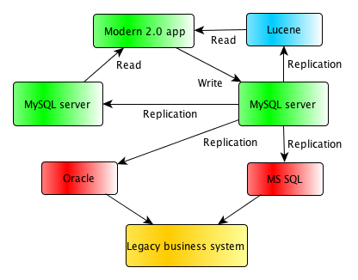
Enable the MySQL users!

Slide 4
Enable the MySQL users!
The ability to replicate from MySQL to other database systems enables a universe of applications to reach a bigger audience.
MySQL can continue to be your SQL standard.
MySQL will help developers to integrate smoothly into other stacks than just LAMP.

Slide 5
A C++ toolkit
Stand alone library
Uses STL
Boost::asio for asynchronous IO
Basic handling of query result sets
No legacy C interface → Easy to use

Slide 6
Library architecture
Library connect to the server and authenticates
Starts a new thread and run COM_BINLOG_DUMP
Reads and parsers packets asynchronously
Post events to a bounded queue
Main thread pulls the queue and acts on the events

Slide 7
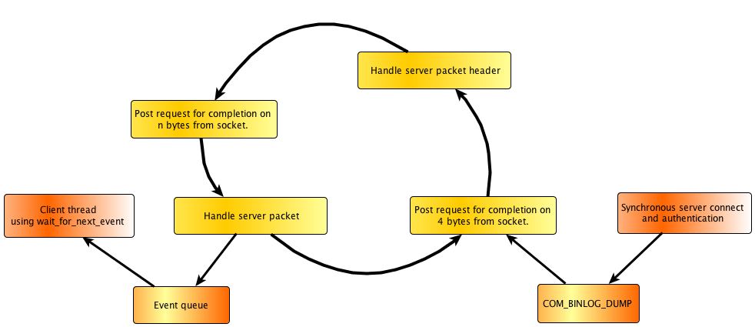
Library architecture

Slide 8
Library architecture
Three ways of getting events:
  wait_for_event() method function
  SAX-like parser interface by attaching a custom functor
  Asynchronous call back on each event completion

Slide 9
Features
Row set container with a convenient row iterator.
Each row is a standard vector.
Each value is represented by a lightweight Value object.
A value convert can easily convert Value objects into strings and numbers.

