Slide 1

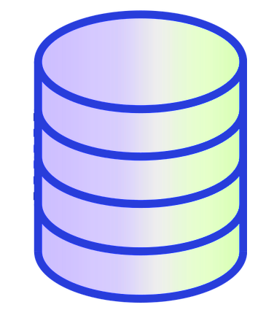
Replica can be manually switched from one Galera node to another by keeping track of gtid sequence offsets
3 Galera nodes. Typically the GTIDs do not line up among the nodes.
m1
m2
m3
GTID BINLOG POS:
0-1-274482,77-1-2
GTID BINLOG POS:
0-1-274488
GTID BINLOG POS:
0-1-274491
Documentation states:
MariaDB 10.1 and above has a feature called wsrep GTID mode. When this mode is enabled, MariaDB uses some tricks to try to associate each Galera Cluster write set with a GTID that is globally unique, but that is also consistent for that write set on each cluster node. These tricks work in some cases, but GTIDs can still become inconsistent among cluster nodes.
The galera_gtid_watch offers an alternative solution.
replica
GTID SLAVE POS:
0-1-274482,77-1-2

