Slide 1


BUILDEVCON · MARIADB / MYSQL ON KUBERNETES
Run and Operate MariaDB
in a Cloud Native Way
Using the MariaDB Operator
Martin Montes · Lead Engineer, MariaDB Corporation
Notes:
Welcome. 30 minutes: 15 slides + 15 live demo. Topic: MariaDB Operator — the cloud-native way to run and operate MariaDB on Kubernetes.

Slide 2






whoami
Creator & Lead Maintainer
mariadb-operator • Kubernetes operator for MariaDB, built with Go and controller-runtime.
Specialized in Kubernetes • Go • Databases
Maintains the operator, ships features, grows the community.
Martin Montes
Cloud-native
Open Source
Cloud-agnostic
Lead Engineer
MariaDB Corporation
mmontes11
“Run and operate MariaDB in a cloud native way, declaratively manage your database using Kubernetes CRDs rather than imperative commands.”
mmontesperez
@m_montes11
mmontes11
Notes:
Brief intro. Creator and lead maintainer. Keep this to ~1 minute.

Slide 3
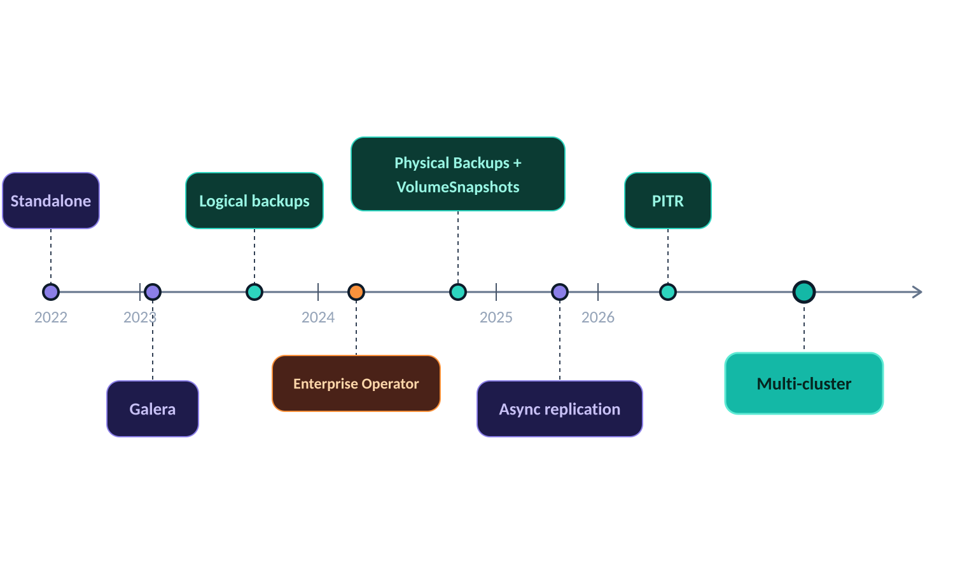
Project Timeline
From standalone MariaDB to multi-cluster topology in 4 years
Notes:
Walk the timeline left to right. Emphasize early velocity, consolidation in 2024, and the big 2025-2026 milestones. Multi-cluster is today's demo.

Slide 4





Community & Adoption
mariadb-operator · github.com/mariadb-operator/mariadb-operator
~1K
80+
1K+
8M+
GitHub Stars
Contributors
Pull requests
Image Pulls
★ GitHub Stars over time
157+
v26.06
2022
Releases
Latest
Since
Notes:
Numbers tell the story of a healthy, growing open source project. ~1K stars, 80+ contributors, 10M+ image pulls. The growth curve is steepening.

Slide 5
DAY 1
Cluster Setup
Provision a production-ready MariaDB cluster declaratively.

Slide 6
DAY 1 · 1 / 5
Topology
# Standalone: single node
apiVersion: k8s.mariadb.com/v1alpha1
kind: MariaDB
spec:
replicas: 1
---
# Replication: semi-sync, auto failover
apiVersion: k8s.mariadb.com/v1alpha1
kind: MariaDB
spec:
replicas: 3
replication:
enabled: true
semiSyncEnabled: true
primary:
autoFailover: true
---
# Galera: synchronous multi-master
apiVersion: k8s.mariadb.com/v1alpha1
kind: MariaDB
spec:
replicas: 3
galera:
enabled: true
---
# Multi-cluster: cross-cluster replication
apiVersion: k8s.mariadb.com/v1alpha1
kind: MariaDB
spec:
replicas: 3
replication:
enabled: true
multiCluster:
enabled: true
primary: mariadb-eu-south
members:
- name: mariadb-eu-south
- name: mariadb-eu-central
Choose your HA strategy
Standalone: single replica
Replication: asynchronous replication (recommended)
Galera: synchronous multi-master, alternative HA topology
Multi-cluster: cross-cluster replication for multi-region deployments and blue-green upgrades
All topologies share the same MariaDB CRD, just flip feature flags
Notes:
Start here. Choose the right topology for the workload. Galera is our go-to for production HA on a single cluster. Multi-cluster unlocks geo-HA and zero-downtime upgrades.

Slide 7
DAY 1 · 2 / 5
Storage
apiVersion: k8s.mariadb.com/v1alpha1
kind: MariaDB
metadata:
name: mariadb
spec:
storage:
# Choose any StorageClass in your cluster.
# Local storage (e.g. topolvm) avoids
# network latency.
storageClassName: topolvm
size: 100Gi
# Grow the volume at runtime: bump size and
# the operator handles the resize.
# StorageClass must have:
# allowVolumeExpansion: true
resizeInUseVolumes: true
waitForVolumeResize: true
Persistent volumes for your data
StorageClass: defaults to cluster default, you can use your own
Local storage: strongly recommended. topolvm or local-path-provisioner avoids network I/O latency
Block storage: high IOPs preferred when local isn't an option e.g. AWS io2
Volume resize: update size at runtime, operator handles the expansion (StorageClass should allow)
Notes:
Local storage is strongly recommended for MariaDB to avoid I/O latency. Volume resize works online — no downtime required.

Slide 8
DAY 1 · 3 / 5
Compute
apiVersion: k8s.mariadb.com/v1alpha1
kind: MariaDB
metadata:
name: mariadb
spec:
resources:
requests:
cpu: "4"
memory: 8Gi
limits:
cpu: "4"
memory: 8Gi
# innodb_buffer_pool_size should be
# 70-80% of the memory limit.
myCnf: |
[mariadb]
innodb_buffer_pool_size=6400M
Right-size CPU & memory for MariaDB
Requests = Limits: set both identical, Kubernetes assigns Guaranteed QoS
innodb_buffer_pool_size: set to 70–80% of memory limit for best performance
myCnf inlined in the CR, operator mounts it automatically
Notes:
Rule of thumb: 70-80% of memory for the InnoDB buffer pool. Skip CPU limits on dedicated DB nodes to avoid throttling.

Slide 9
DAY 1 · 4 / 5
Scheduling
apiVersion: k8s.mariadb.com/v1alpha1
kind: MariaDB
metadata:
name: mariadb
spec:
replicas: 3
# Spread each replica on a different node.
affinity:
antiAffinityEnabled: true
# Pin Pods to DB-dedicated nodes.
nodeSelector:
node.kubernetes.io/instance-type: m6in.xlarge
# Spread across availability zones.
topologySpreadConstraints:
- maxSkew: 1
topologyKey: topology.kubernetes.io/zone
whenUnsatisfiable: DoNotSchedule
# Tolerate the taint on dedicated DB nodes.
tolerations:
- key: "mariadb.com/dedicated"
operator: "Exists"
effect: "NoSchedule"
# Limit voluntary disruptions.
podDisruptionBudget:
maxUnavailable: "1"
# Prevent eviction under node pressure.
priorityClassName: system-node-critical
Policies to implement true high availability
Anti-affinity: Spreads replicas across different nodes
Node selector: select the right instance type (high IOPs, 10Gbps+) and pin pods to dedicated DB nodes
Topology spread: distribute evenly across availability zones
Tolerations: combine with node taints to dedicate nodes exclusively to databases
priorityClassName: system-node-critical, prevents eviction under node pressure
Notes:
Dedicated nodes + anti-affinity + zone spread is the gold standard. This prevents noisy-neighbour interference and ensures true HA across failure domains.

Slide 10
DAY 1 · 5 / 5
TLS
apiVersion: k8s.mariadb.com/v1alpha1
kind: MariaDB
metadata:
name: mariadb
spec:
tls:
enabled: true
# Reject any non-TLS connection attempt.
required: true
# Option A (default): operator issues and
# rotates certificates automatically.
# Option B: delegate issuance to cert-manager.
serverCertIssuerRef:
name: root-ca
kind: ClusterIssuer
clientCertIssuerRef:
name: root-ca
kind: ClusterIssuer
# Option C: bring your own CA stored
# in a Kubernetes Secret.
serverCASecretRef:
name: mariadb-server-ca
clientCASecretRef:
name: mariadb-client-ca
Encrypted connections by default
tls.enabled: operator auto-issues CA + server + client certs
tls.required: reject all non-TLS connections for production
cert-manager: delegate issuance to a ClusterIssuer if preferred
Bring your own CA: provide the CA keypair in a Secret
Auto-renewal: operator rotates certs before expiry without downtime
Notes:
TLS is enabled by default. For production always set required: true. The operator handles cert rotation automatically — zero downtime, zero manual intervention.

Slide 11
DAY 1 · 6 / 6
Metrics
apiVersion: k8s.mariadb.com/v1alpha1
kind: MariaDB
metadata:
name: mariadb
spec:
metrics:
enabled: true
# Operator provisions a multi-target
# Prometheus exporter — no sidecars.
exporter:
resources:
requests:
cpu: 50m
memory: 64Mi
limits:
memory: 512Mi
# Operator manages credentials automatically.
username: monitoring
passwordSecretKeyRef:
name: mariadb
key: password
# Auto-registers metrics in Prometheus.
serviceMonitor:
interval: 10s
scrapeTimeout: 10s
Prometheus-native observability
metrics.enabled: single flag — operator provisions everything
Multi-target exporter: one Deployment scrapes all replicas, no sidecars
ServiceMonitor: auto-created for prometheus-operator integration
Credentials: monitoring user + password managed by the operator
scrapeTimeout: tune interval and timeout to match your Prometheus setup
Notes:
Day 1 done. Cluster is provisioned, storage configured, compute right-sized, pods scheduled across zones, TLS enforced, and Prometheus is scraping. Now let's talk Day 2.

Slide 12
DAY 2
Operations
Backup, restoration and updates: all declarative.

Slide 13
DAY 2 · 1 / 4
Physical Backups
apiVersion: k8s.mariadb.com/v1alpha1
kind: PhysicalBackup
metadata:
name: physicalbackup
spec:
mariaDbRef:
name: mariadb
schedule:
cron: "0 2 * * *" # daily at 02:00
# Update identifier to trigger on-demand:
onDemand: "1"
target: Replica # zero impact on primary
compression: bzip2
maxRetention: 720h # 30 days
storage:
# S3-compatible (AWS S3, MinIO, GCS, …)
s3:
bucket: physicalbackups
prefix: mariadb
endpoint: s3.amazonaws.com
region: us-east-1
accessKeyIdSecretKeyRef:
name: s3-credentials
key: access-key-id
secretAccessKeySecretKeyRef:
name: s3-credentials
key: secret-access-key
# azureBlob: { … } # Azure Blob Storage
# volumeSnapshot: { … } # consistent, near-instant
Consistent full backups
mariadb-backup: MariaDB-native, hot backup, zero downtime.
VolumeSnapshots: Kubernetes-native, near-instant, CSI-driver-based
Storage: S3-compatible, Azure Blob, PVC, or Kubernetes volumes
Scheduling: cron expression or on-demand trigger
Retention: maxRetention auto-cleans old backups (e.g. 720h = 30 days)
Notes:
Physical backups are the foundation of our DR strategy. Taken from a replica so the primary is never impacted. S3 for durability + bzip2 compression for cost efficiency.

Slide 14
DAY 2 · 2 / 4
Point-In-Time Recovery
apiVersion: k8s.mariadb.com/v1alpha1
kind: PointInTimeRecovery
metadata:
name: pitr
spec:
physicalBackupRef:
name: physicalbackup
archiveTimeout: 5m
storage:
s3:
bucket: binlogs
endpoint: s3.amazonaws.com
accessKeyIdSecretKeyRef:
name: s3-credentials
key: access-key-id
secretAccessKeySecretKeyRef:
name: s3-credentials
key: secret-access-key
---
# Restore to a specific point in time:
apiVersion: k8s.mariadb.com/v1alpha1
kind: MariaDB
spec:
bootstrapFrom:
pointInTimeRecoveryRef:
name: pitr
targetRecoveryTime: "2025-06-18T14:37:52Z"
Restore to a given point-in-time
Binary log archival: agent sidecar continuously streams binlogs to S3
Base backup + binlogs: restore physical backup then replay logs
targetRecoveryTime: RFC3339 timestamp, operator finds the right backup
Last recoverable time: visible in PointInTimeRecovery status, drives RPO
Notes:
With PITR our RPO can drop to minutes. The operator handles everything: archiving binlogs, finding the right base backup, and replaying logs up to the target time.

Slide 15
DAY 2 · 3 / 4
Restoration
apiVersion: k8s.mariadb.com/v1alpha1
kind: MariaDB
metadata:
name: mariadb
spec:
replicas: 3
replication:
enabled: true
bootstrapFrom:
# A) Restore closest PhysicalBackup.
backupRef:
name: physicalbackup
kind: PhysicalBackup
# B) PITR — restore base backup then
# replay binlogs up to targetRecoveryTime.
pointInTimeRecoveryRef:
name: pitr
targetRecoveryTime: "2025-06-18T14:37:52Z"
stagingStorage:
persistentVolumeClaim:
resources:
requests:
storage: 100Gi
accessModes:
ReadWriteOnce
Bootstrap new clusters from existing data
bootstrapFrom: declare the restore source directly in the MariaDB CR
PhysicalBackup ref: restore from the closest backup before targetRecoveryTime
PITR: combine physical backup + binlog replay for point-in-time restoration
Staging storage PVC avoids exhausting node disk for large backups
Notes:
This is how we recover. bootstrapFrom works identically for a fresh cluster, a disaster recovery clone, or a PITR restore. One CRD, all scenarios.

Slide 16
DAY 2 · 4 / 4
Updates
# Default rolling strategy: replicas first,
# then the primary.
apiVersion: k8s.mariadb.com/v1alpha1
kind: MariaDB
spec:
updateStrategy:
type: ReplicasFirstPrimaryLast
autoUpdateDataPlane: true
---
# Pause all automatic image updates during
# a maintenance freeze or staged rollout.
apiVersion: k8s.mariadb.com/v1alpha1
kind: MariaDB
spec:
updateStrategy:
type: Never
---
# Full manual control: delete a Pod to
# trigger its individual update.
apiVersion: k8s.mariadb.com/v1alpha1
kind: MariaDB
spec:
updateStrategy:
type: OnDelete
Zero-downtime rolling upgrades
ReplicasFirstPrimaryLast: roll replicas one-by-one, primary last (default strategy)
Never: freeze updates, useful during maintenance windows or staged rollouts
OnDelete: full manual control, delete a pod to trigger its update
autoUpdateDataPlane: automatically updates operator init container and sidecar images to match the operator version
Notes:
ReplicasFirstPrimaryLast is designed for MariaDB — it's role-aware. If the new image fails on a replica we pause before touching the primary, protecting writes.

Slide 17
DAY 2 · 5 / 5
Configuration
# Label the ConfigMap with
# k8s.mariadb.com/watch — any edit
# triggers a rolling update.
apiVersion: v1
kind: ConfigMap
metadata:
name: mariadb-config
labels:
k8s.mariadb.com/watch: ""
data:
my.cnf: |
[mariadb]
innodb_buffer_pool_size=9600M
---
apiVersion: k8s.mariadb.com/v1alpha1
kind: MariaDB
metadata:
name: mariadb
spec:
resources:
requests:
memory: 12Gi
limits:
memory: 12Gi
myCnfConfigMapKeyRef:
name: mariadb-config
key: my.cnf
Live my.cnf changes without manual restarts
myCnf inline: changes trigger a rolling update automatically
ConfigMap ref: label it k8s.mariadb.com/watch — operator detects edits
Typical tuning: innodb_buffer_pool_size, max_connections, binlog settings
GitOps-friendly: commit the ConfigMap, CI applies it, operator reloads
Notes:
This is a very common day-2 operation. Changing innodb_buffer_pool_size after resizing nodes, or tuning max_connections after a traffic spike — all done with a kubectl edit.

Slide 18
DAY 2 · 6 / 6
Maintenance
# Suspend: pause all operator reconciliation.
apiVersion: k8s.mariadb.com/v1alpha1
kind: MariaDB
spec:
suspend: true
---
# Maintenance mode: fine-grained control
# over traffic during planned windows.
# Ideal before a multi-cluster switchover.
apiVersion: k8s.mariadb.com/v1alpha1
kind: MariaDB
spec:
maintenance:
# Block new connections at Service level.
enabled: true
cordon: true
# Gracefully terminate long-running queries.
drainConnections: true
drainGracePeriodSeconds: 30
# Prevent accidental writes.
readOnly: true
Safe operational windows with fine-grained control
Suspend: pause all operator reconciliation for fully manual control
Cordon: remove pods from Service endpoints — blocks new connections
Drain: gracefully terminate long-running queries after a grace period
ReadOnly: prevent writes — ideal before a cluster switchover
Combine cordon + drain + readOnly for a safe zero-data-loss maintenance window
Notes:
We use this before a multi-cluster switchover: cordon → drain → readOnly → wait for replica sync → promote replica → disable maintenance on old primary. Fully declarative, zero data loss.

Slide 19
DEMO
Multi-Cluster
Cross-cluster replication · Multi-region HA · Blue-green upgrades

Slide 20
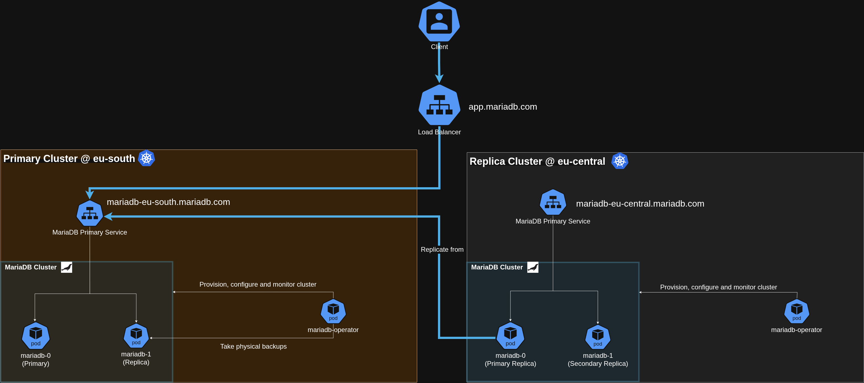
Architecture
Cross-region deployment using the multi-cluster topology
Notes:
Walk through the diagram: eu-south is the primary Galera cluster. eu-central replicates from it asynchronously. Both share an S3 bucket for physical backups and binlogs. A load balancer sits in front — updated during switchover. The operator on each side manages the full lifecycle independently.

Slide 21
Thank you!
Run and Operate MariaDB in a Cloud Native Way
Useful links
📚 Documentation
github.com/mariadb-operator/mariadb-operator/blob/main/docs/README.md
🛠️ Demo
github.com/mariadb-operator/mariadb-operator/blob/main/demos/multi-cluster
🦭 GitHub repo
github.com/mariadb-operator/mariadb-operator
Martin Montes · Lead Engineer, MariaDB Corporation
Scan to open repo
Notes:
Thank the audience. Point to the QR code for the repo. Mention the demo manifests are available under the demos/multi-cluster directory on the demos-multi-cluster branch.

