Slide 1


perr

Slide 2

perr

Slide 3
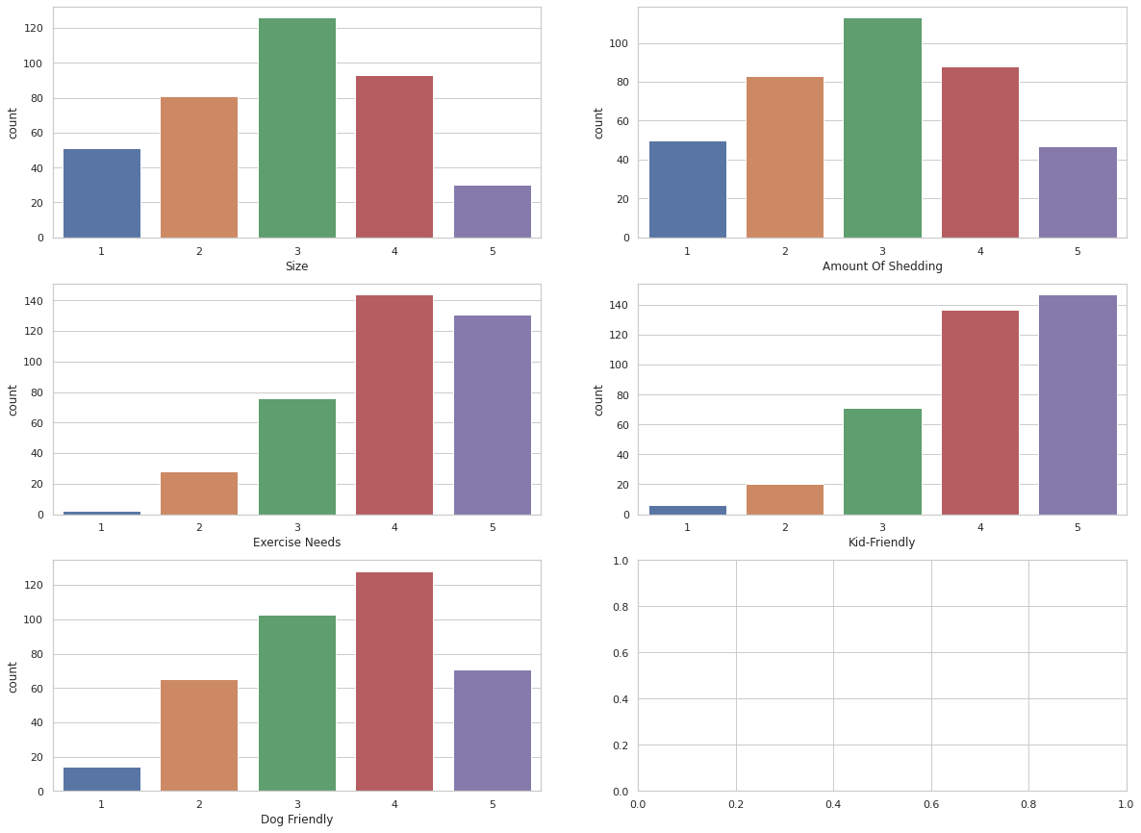

Slide 4

Thelast
Thelast
Thelast

