Slide 1


Nutriverse: The Complete App for Nutritionists and Clients
Manage Your Practice, Track Your Progress!
Laboratory of Advanced Programming
A.Y. 2023 - 2024
Elisa De Bellis 1858927
Maria Diana Calugaru 1893272
Lorenzo Mastrandrea 1892793
Lorenzo Frangella 1899674

Slide 2
Table of content
01 Project Description
02 User Stories & Mockups
03 Function points
04 Workflow organization
05 Product backlog
06 Demo

Slide 3




01 Project Description
Nutriverse is a common platform for nutritionists and their clients.
Personalized food plan creation and visualization.
Progress tracking
Appointments and check-ups management
Recipes ideas.

Slide 4








infrastructure

Slide 5
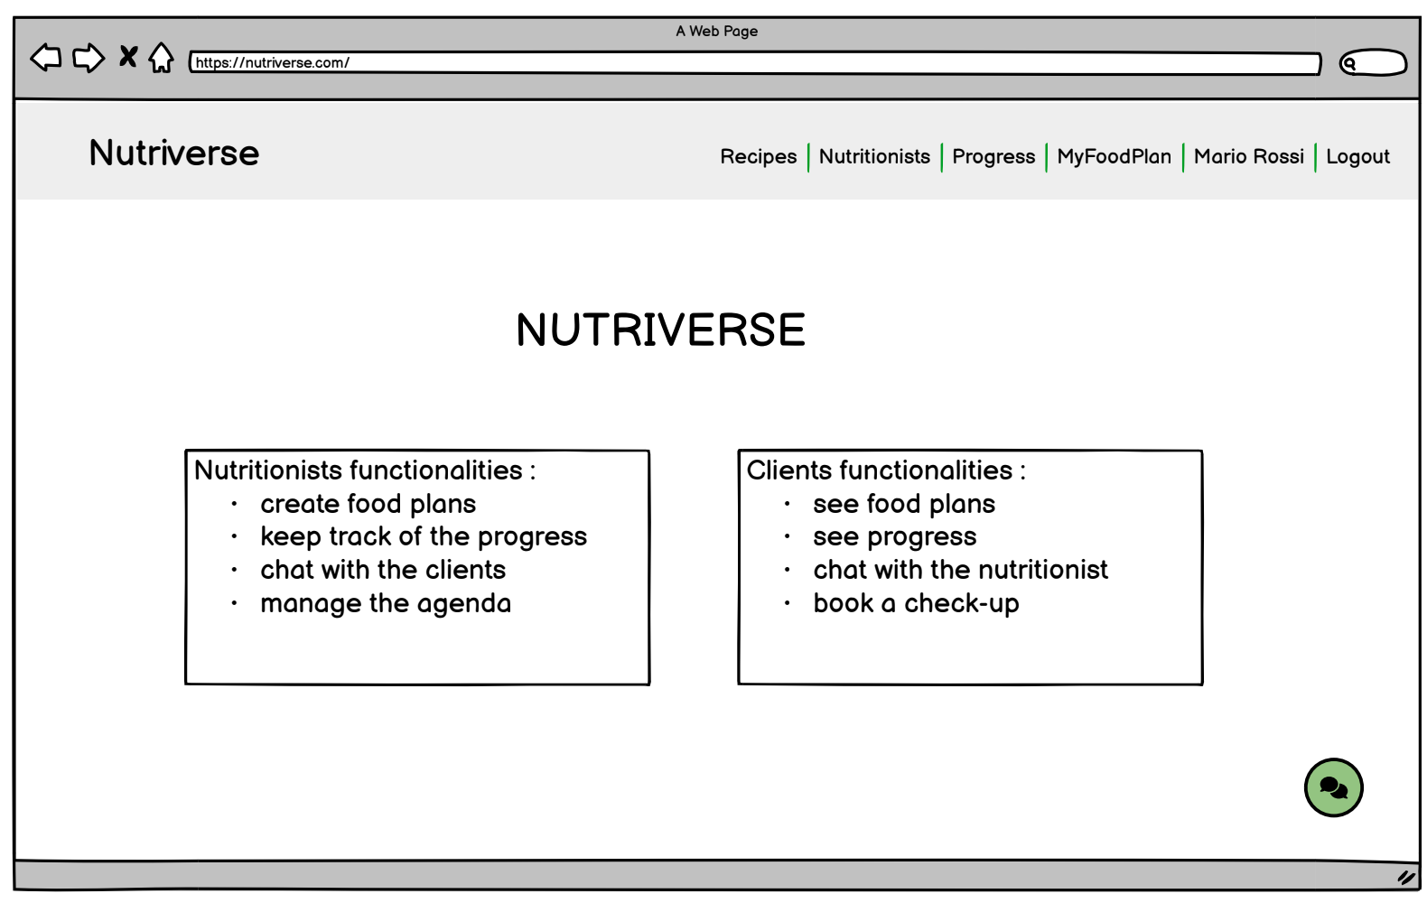
02 User Stories & Mockups
Homepage
As a website visitor, I want to read information about the services, so that I can have an overview of what I can do.

Slide 6
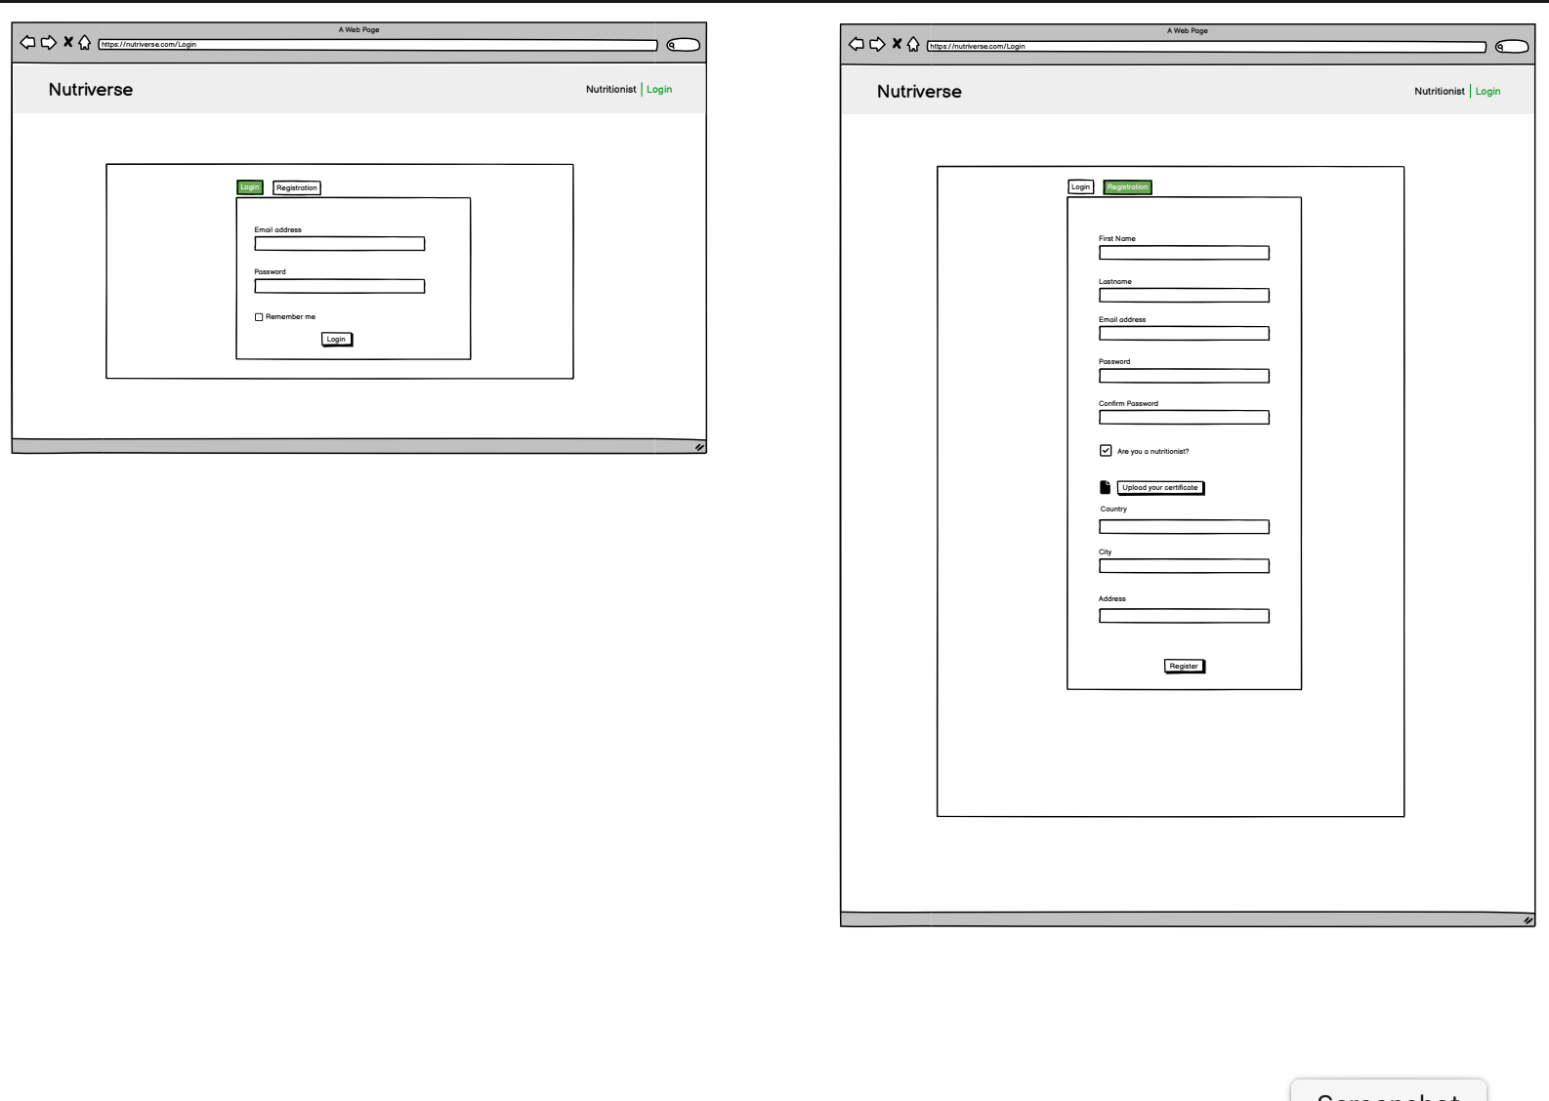
02 User Stories & Mockups
Registration
As a website visitor, I want to be able to register as a normal user, so that I can have a personalized experience.
As a website visitor, I want to be able to register as a nutritionist, so that I can have a personalized platform.

Slide 7
02 User Stories & Mockups
Login
As a user, I want to be able to login, so that I can see my personal information.
As a user, I want to be able to log out, so that I can end my session.

Slide 8
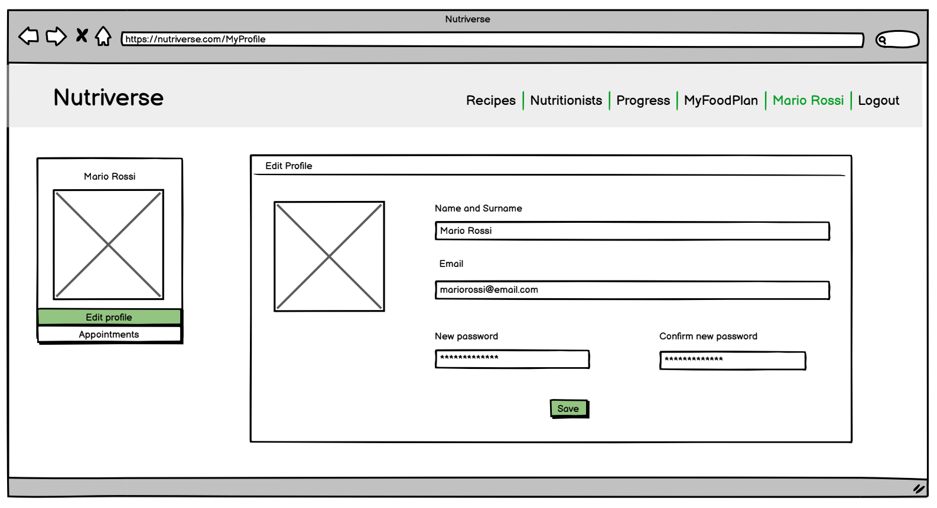
02 User Stories & Mockups
Edit Profile
As a user, I want to be able to edit my profile, so that I can customize information about me.

Slide 9
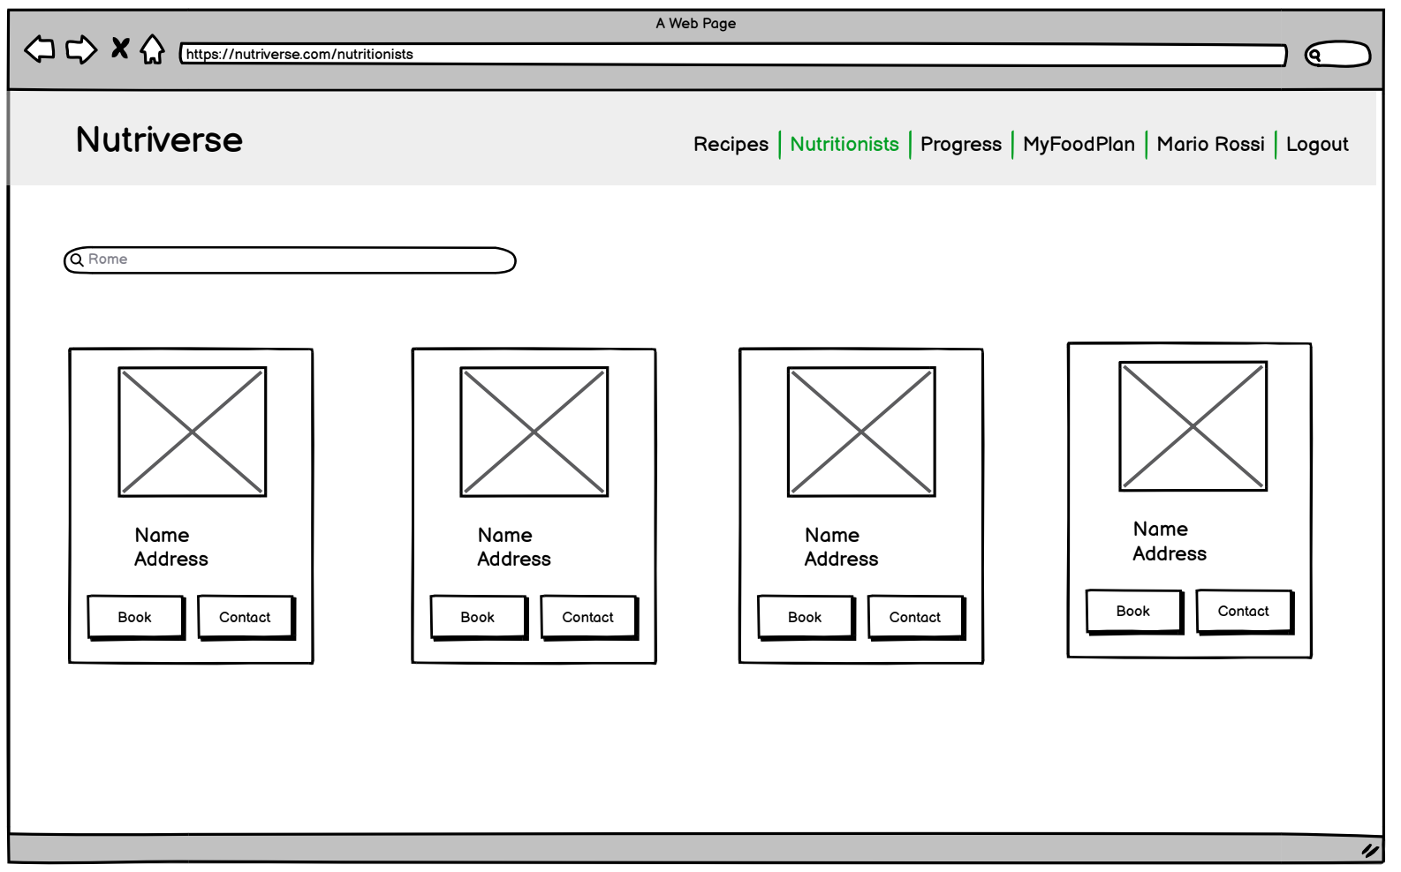
02 User Stories & Mockups
Client Section
As a client, I want to be able to search for a nutritionist, so that I can find the ones near me.
As a client, I want to be able to contact a nutritionist, so that I can ask him/her more information.

Slide 10
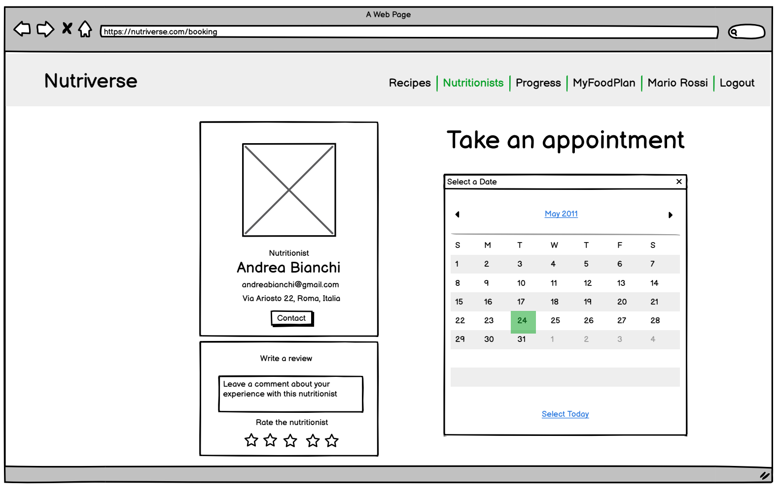
02 User Stories & Mockups
Client Section
As a client, I want to be able to see the available slots of a nutritionist, so that I can choose one among them for booking.
As a client, I want to be able to book an appointment with a nutritionist, so that I can schedule a consultation without having to make a phone call or send an email.

Slide 11
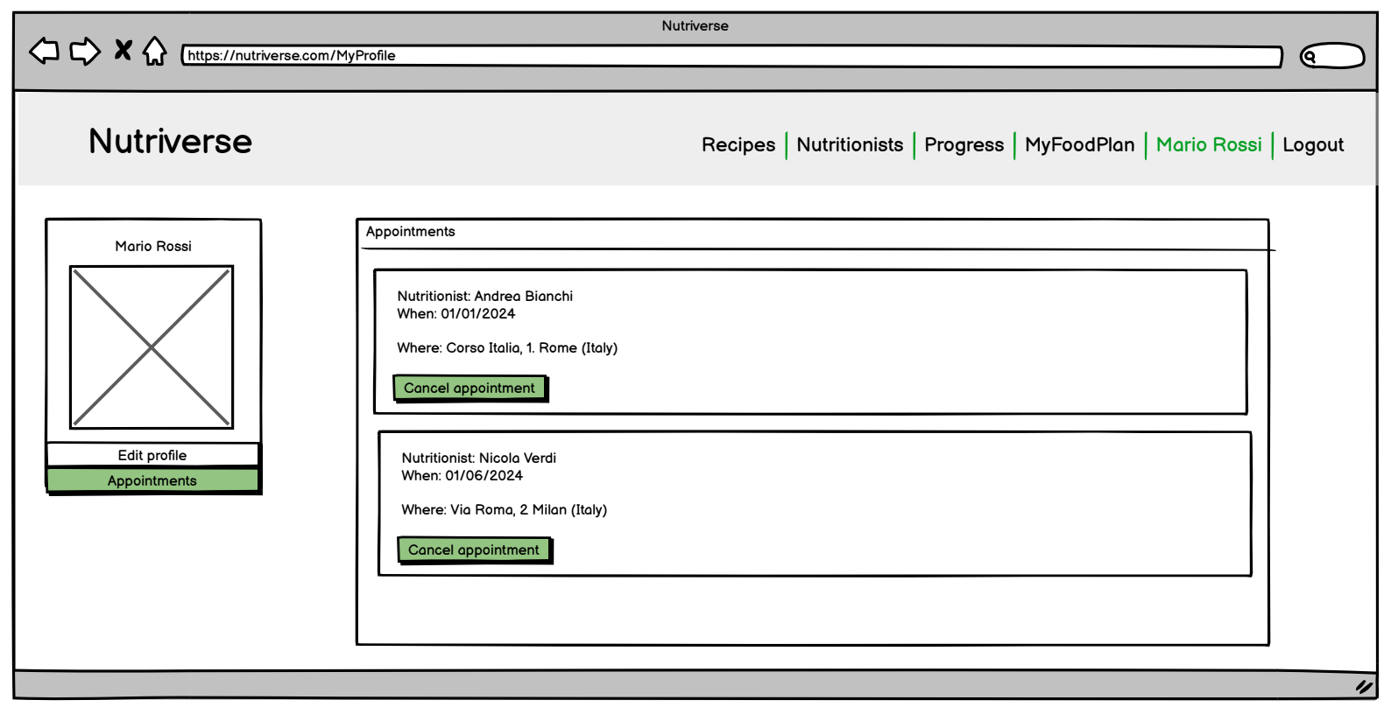
02 User Stories & Mockups
Client Section
As a client, I want to be able to see my bookings, so that I can have a history of all my consultations.

Slide 12
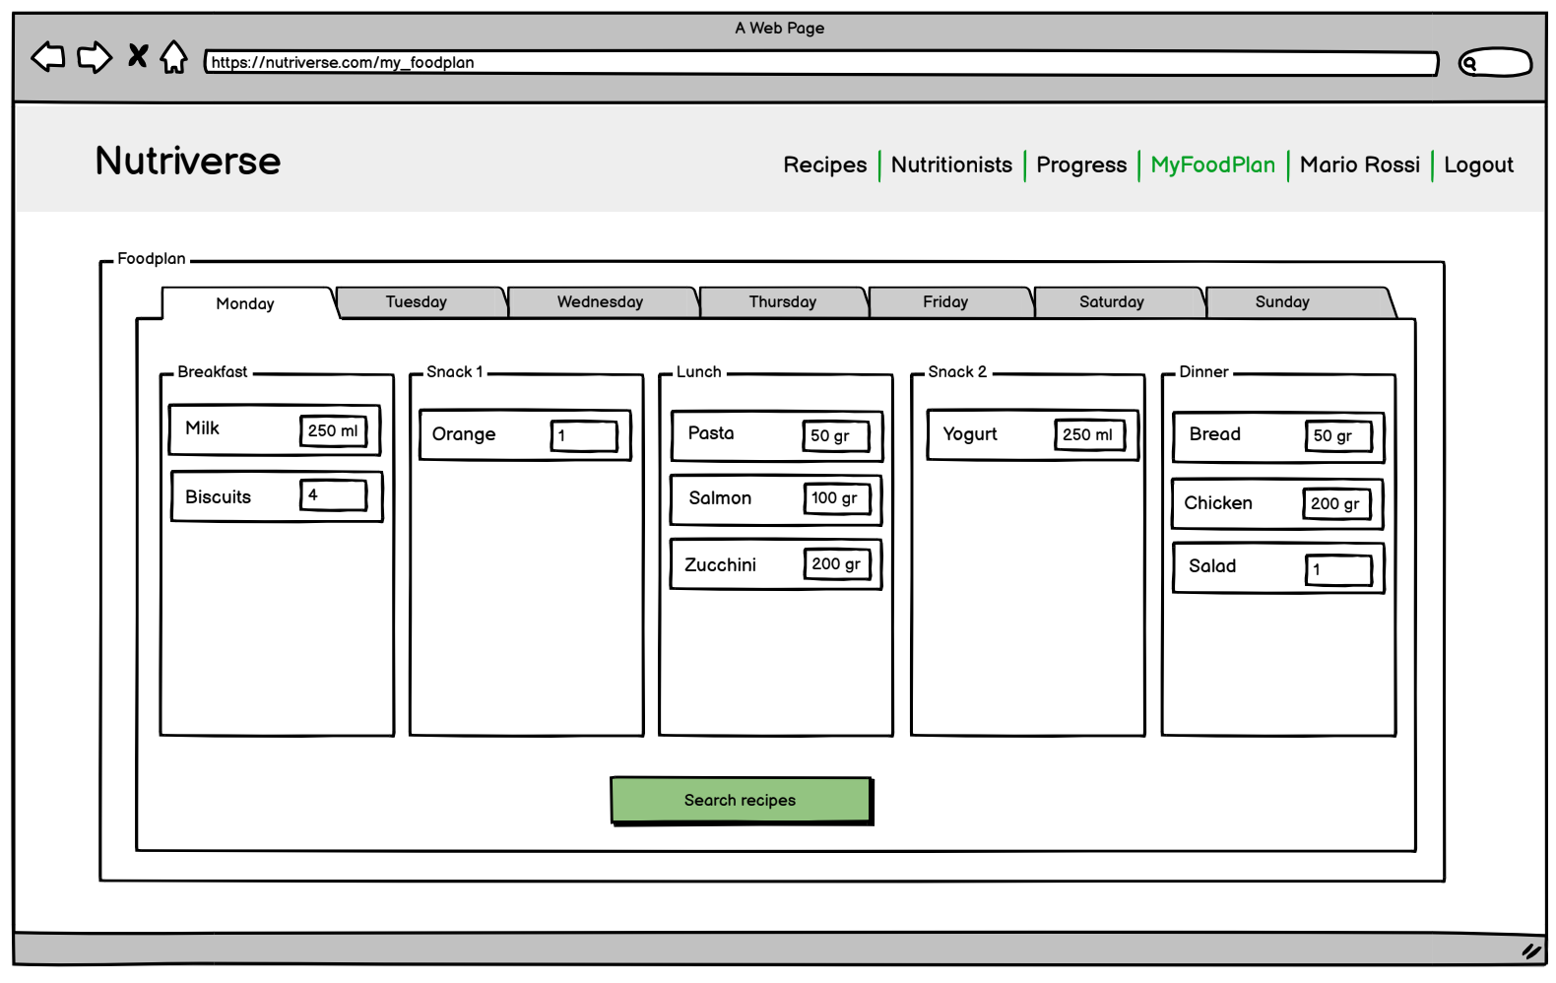
02 User Stories & Mockups
Client Section
As a client, I want to be able to access my current food plan, so that I can understand what I should eat and how much.

Slide 13
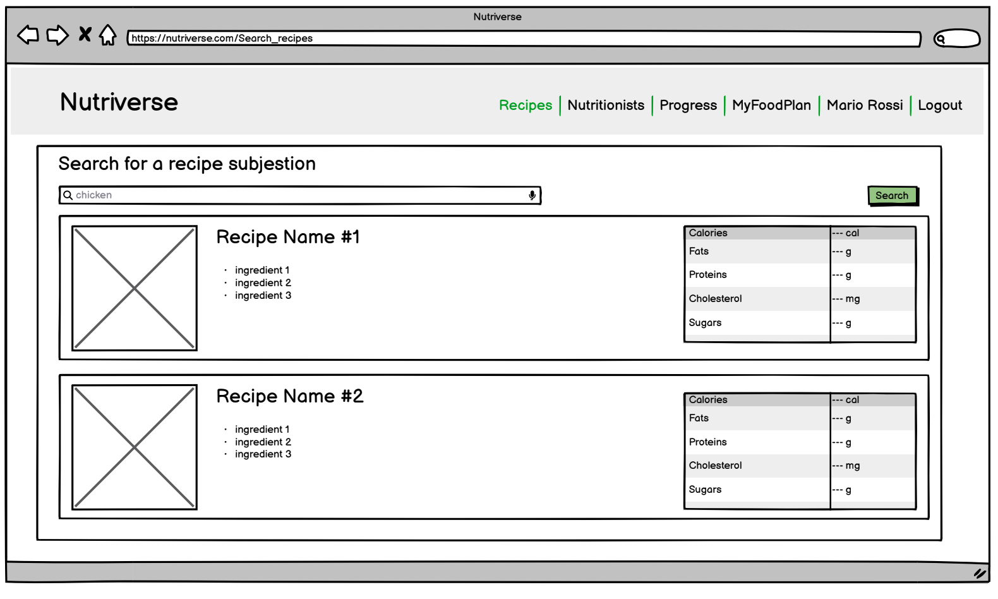
02 User Stories & Mockups
Client Section
As a client, I want to be able to search for recipes, so that I can vary meals depending on the ingredients of my food plan.

Slide 14
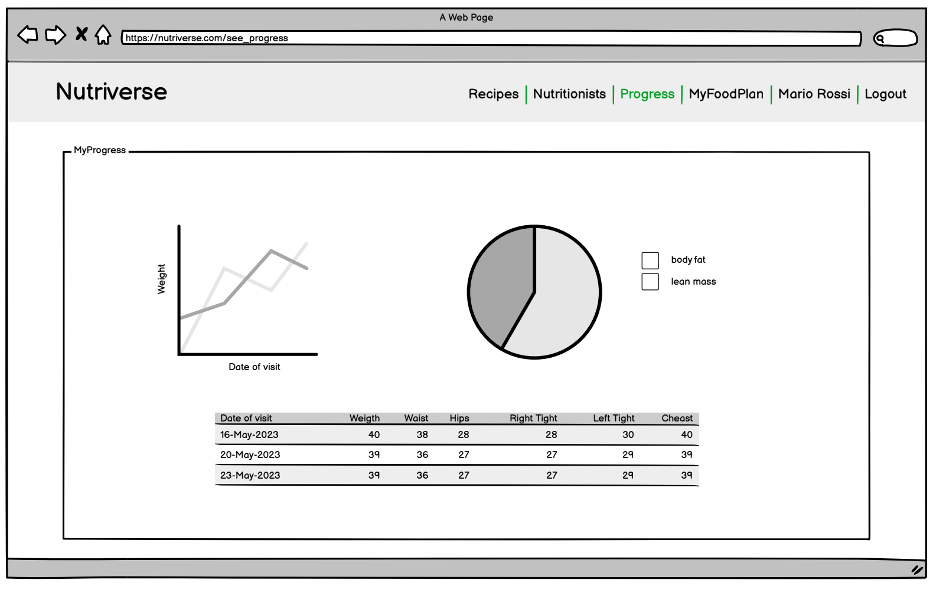
02 User Stories & Mockups
Client Section
As a client, I want to be able to see my progress, so that I can see my changes in time about weight, body fat, body cm.

Slide 15
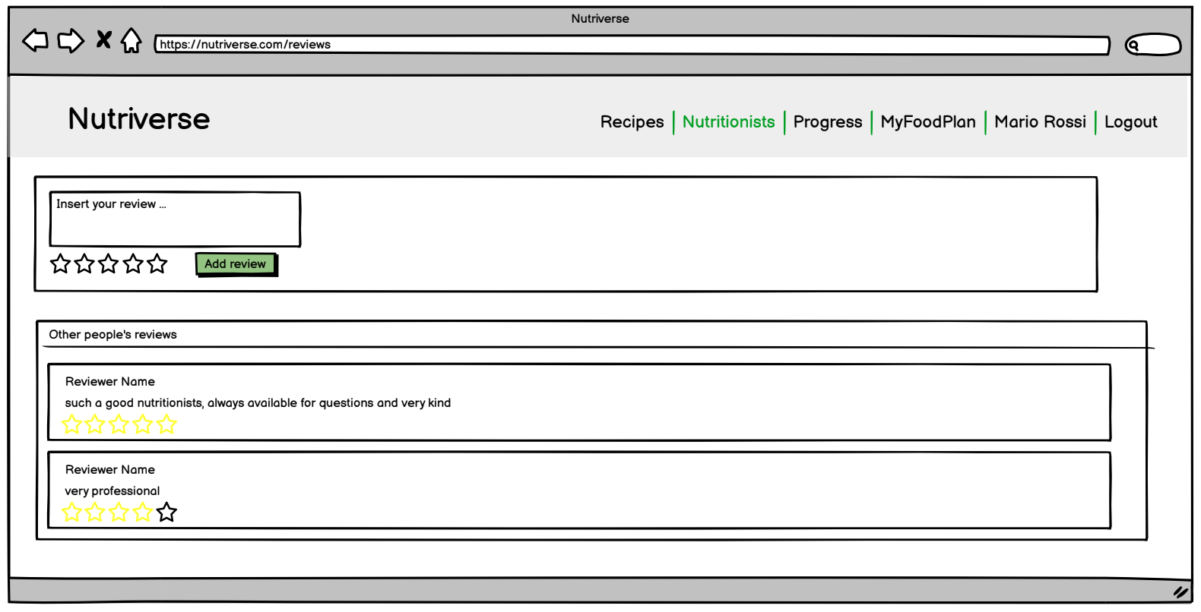
02 User Stories & Mockups
Client Section
As a client, I want to be able to see the reviews about a nutritionist, so that I can read other people's experience with him/her.
As a client, I want to be able to leave a review about a nutritionist, so that I can describe my experience with him/her.

Slide 16
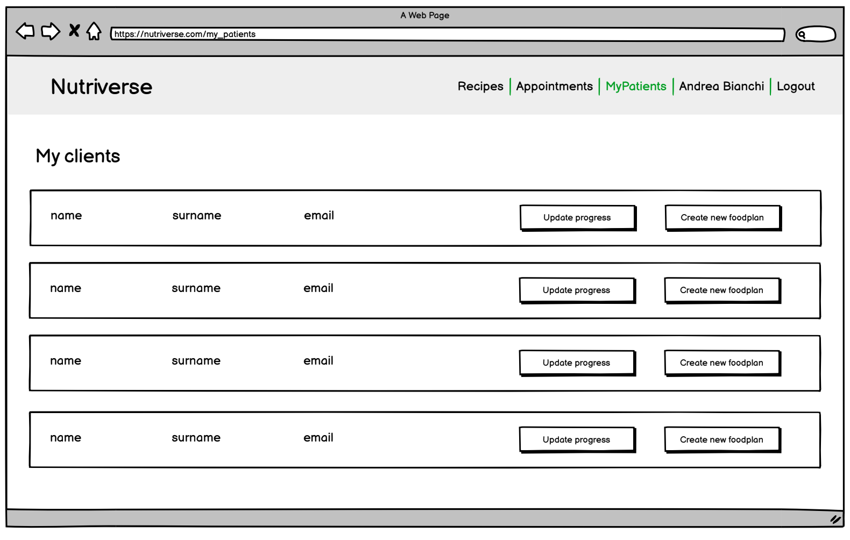
02 User Stories & Mockups
Nutritionist Section
As a nutritionist, I want to be able to see my patients, so that I can keep track of them.

Slide 17
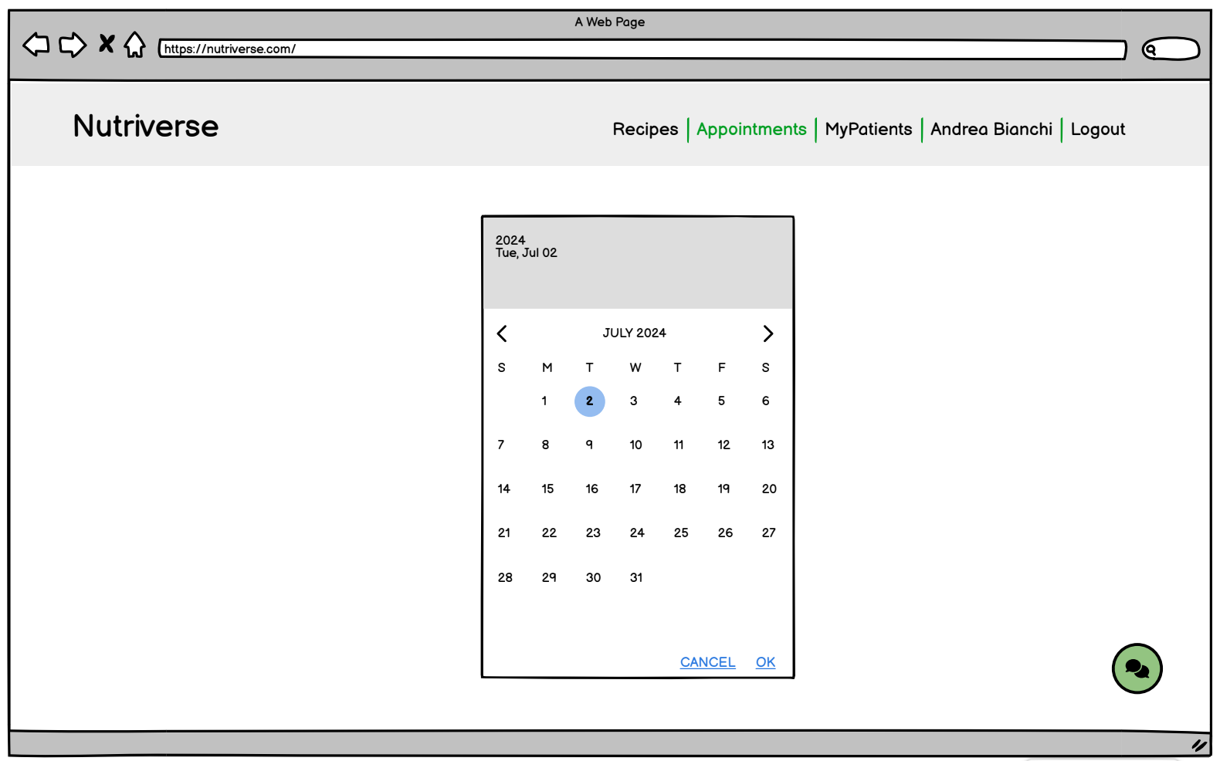
02 User Stories & Mockups
Nutritionist Section
As a nutritionist, I want to be able to see my agenda, so that I can see all the appointments with my patients.

Slide 18
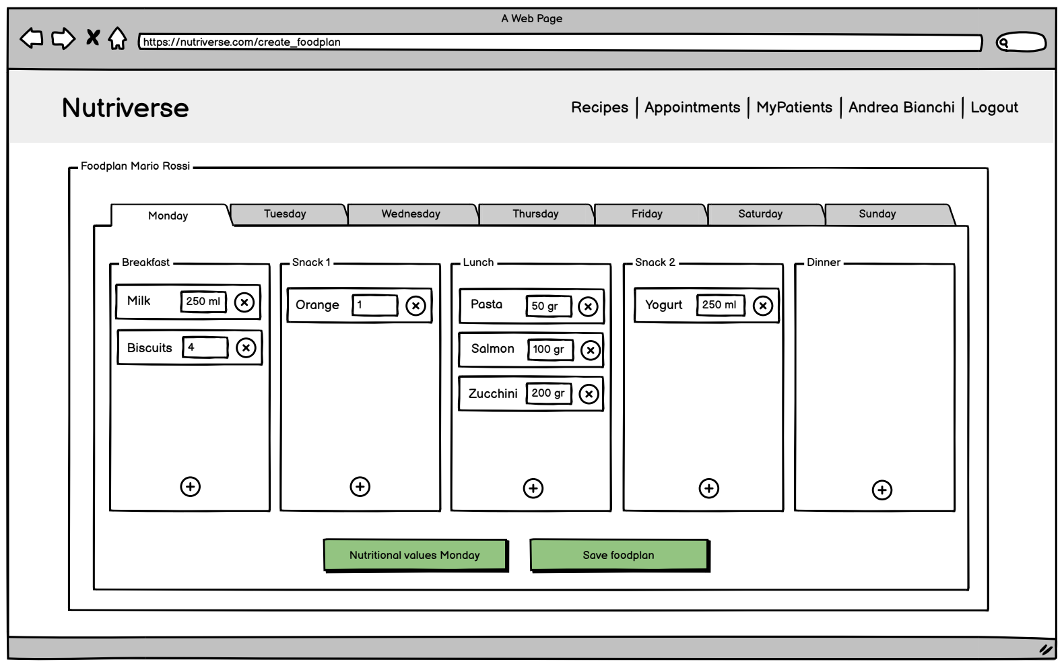
02 User Stories & Mockups
Nutritionist Section
As a nutritionist, I want to be able to create a food plan for a specific patient, so that I can schedule his/her meals.

Slide 19
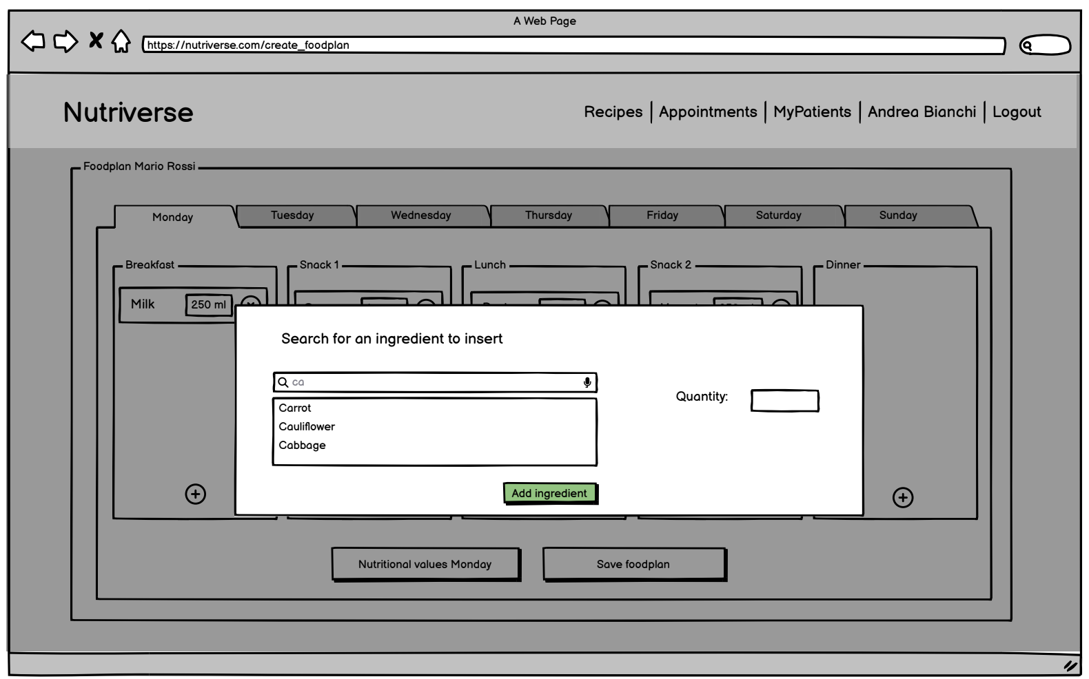
02 User Stories & Mockups
Nutritionist Section
As a nutritionist, I want to be able to search for a specific ingredient, so that I can insert it in the food plan with an associated quantity.

Slide 20
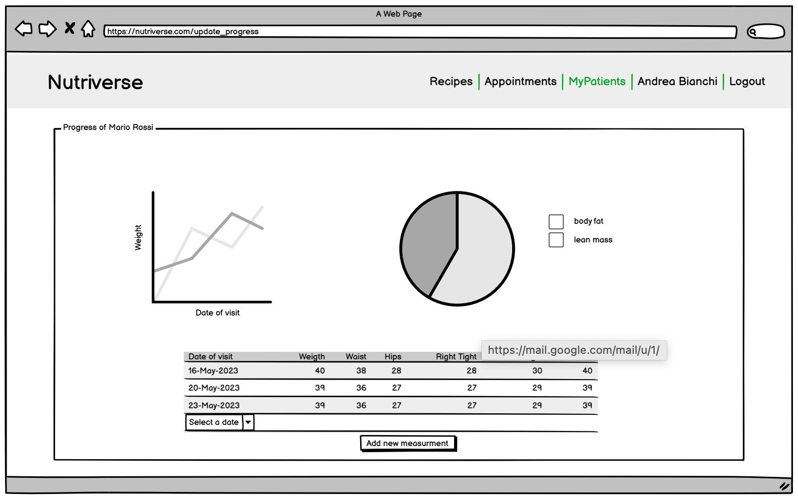
02 User Stories & Mockups
Nutritionist Section
As a nutritionist, I want to be able to update the progress of a patient, so that I can keep his/her information up to date.

Slide 21
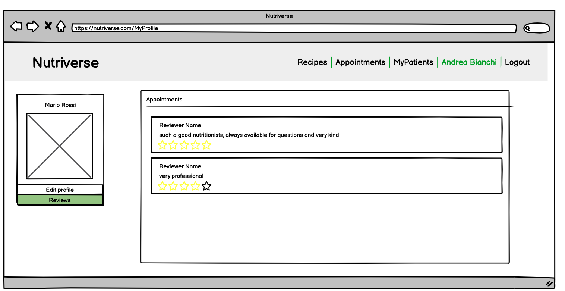
02 User Stories & Mockups
Nutritionist Section
As a nutritionist, I want to be able to read the reviews about me, so that I can see my patients' opinions.

Slide 22


03 Function points
Effort estimation
EIF
EI
Nutriverse
EQ
EO
ILF ILF
EIF

Slide 23

03 Function points
Internal logical file (ILF)
EIF
User account
1 RET - 5 DET 7 FP
EI
Nutriverse
Nutritionist account
1 RET - 9 DET 7 FP
EQ
EO
ILF ILF
Booking
1 RET - 10 DET 7 FP
EIF
Ingredients
1 RET - 2 DET 7 FP
Food plan
1 RET - 3 DET 7 FP
Progress
1 RET - 8 DET 7 FP
Reviews
1 RET - 4 DET 7 FP

Slide 24
03 Function points
External interface file (EIF)
EIF
Nutritional values
1 RET - 10 DET 5 FP
EI
Nutriverse
EQ
Recipes suggestions
1 RET - 8 DET 5 FP
EO
ILF ILF
EIF

Slide 25
03 Function points
External query (EQ)
Search a nutritionist
1 RET - 1 FTR 3 FP
EIF
EI
Nutriverse
See available slots
2 RET - 2 FTR 3 FP
EQ
Visualize my appointments
2 RET - 10 FTR 4 FP
EO
ILF ILF
Search an ingredient
1 RET - 1 FTR 3 FP
EIF
Visualize food plan
2 RET - 3 FTR 3 FP
Visualize reviews
2 RET - 4 FTR 3 FP
Visualize progress
2 RET - 8 FTR 4 FP
Visualize my patients
2 RET - 2 FTR 3 FP

Slide 26
03 Function points
External input (EI)
EIF
Create user account
1 RET - 5 FTR 3 FP
EI
Nutriverse
EQ
Create nutritionist account
1 RET - 9 FTR 3 FP
EO
ILF ILF
Login
1 RET - 2 FTR 3 FP
EIF
User profile edit
1 RET - 3 FTR 3 FP
Send message
1 RET - 3 FTR 3 FP
Create food plan
2 RET - 3 FTR 3 FP
Nutritionist profile edit
1 RET - 5 FTR 3 FP
New appointment
2 RET - 10 FTR 4 FP
Update progress
2 RET - 8 FTR 4 FP
Log out
1 RET - 1 FTR 3 FP
Ingredient quantity
1 RET - 1 FTR 3 FP
Insert review
2 RET - 3 FTR 3 FP

Slide 27
03 Function points
External output (EO)
EIF
EI
Nutriverse
Visualize progress plots
2 RET - 3 FTR 4 FP
EQ
Visualize average rating
2 RET - 2 FTR 4 FP
EO
ILF ILF
EIF

Slide 28



03 Function Points
COCOMO II
Function
points
Lines of code
Estimated time
124 unadjusted FP
9920 SLOC
10.2 Months

Slide 29
04 Workflow organization
Sprint 1
Sprint 2
Sprint 3
Sprint 4
Sprint 5
Account management
Booking and chat
Foodplan and receipes
Progress
Reviews
.

Slide 30
05 Product Backlog
PRIORITY | SPRINT | FUNCTIONALITY | TASK TITLE
High | 1 | Account management | Home Page
High | 1 | Account management | Registration (Users)
High | 1 | Account management | Registration (Nutritionists)
Medium | 1 | Account management | Insertion of certificate (Nutritionists)
High | 1 | Account management | Login (Users and Nutritionists)
High | 1 | Account management | Logout (Users and Nutritionists)
Low | 1 | Account management | Changing information into MyProfile page

Slide 31
05 Product Backlog
PRIORITY | SPRINT | FUNCTIONALITY | TASK TITLE
High | 2 | Booking and chat | Search nutritionists (Users)
High | 2 | Booking and chat | Contact nutritionists (Users)
High | 2 | Booking and chat | Chat (Nutritionists and Users)
High | 2 | Booking and chat | Booking an appointment (Users)
Medium | 2 | Booking and chat | View appointments (Users and Nutritionists)
Medium | 3 | Booking and chat | List of patients (Nutritionists)
High | 3 | Foodplan and receipes | List of ingredients in DB

Slide 32
05 Product Backlog
PRIORITY | SPRINT | FUNCTIONALITY | TASK TITLE
High | 3 | Foodplan and receipes | Creation of a new FoodPlan (Nutritionists)
High | 3 | Foodplan and receipes | View of a FoodPlan (Users)
High | 3 | Foodplan and receipes | API for recipes
Medium | 4 | Progress | Create progress history (Nutritionists)
Medium | 4 | Progress | View of progress (Users)
Low | 5 | Reviews | Allow Users to add a review (Nutritionists)
Low | 5 | Reviews | View a review (Users and Nutritionists)

