Slide 1




CHANGELENS
KNOW WHAT ELSE NEEDS TO CHANGE.
EVIDENCE-BACKED CHANGE COMPLETENESS ANALYSIS FOR REAL REPOSITORIES.
IBM Bob 2.0 Hackathon

Slide 2


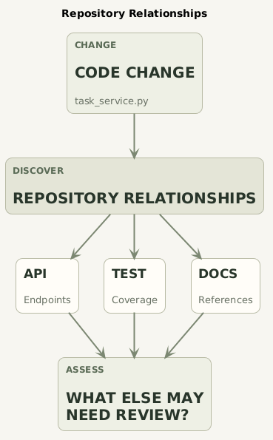
THE PROBLEM: A CODE CHANGE IS RARELY ISOLATED
When a developer changes one file, related APIs, tests, configuration, documentation, or source references may also deserve review.
The challenge is not only finding what changed — it is understanding what else is connected to that change.
CHANGELENS ANSWERS THIS QUESTION WITH REPOSITORY EVIDENCE.

Slide 3

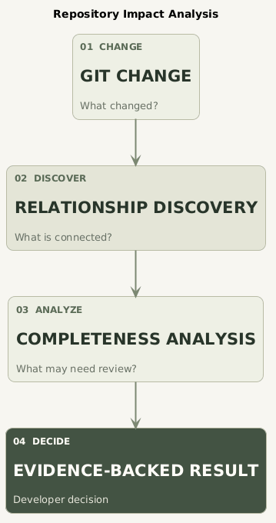



THE CHANGELENS APPROACH
ChangeLens connects the current Git changes with relationships already present in the repository.
It compares the changes with related artifacts to identify items that may still require developer review.
CHANGE
↓
RELATIONSHIPS
↓
EVIDENCE
↓
DEVELOPER REVIEW

Slide 4

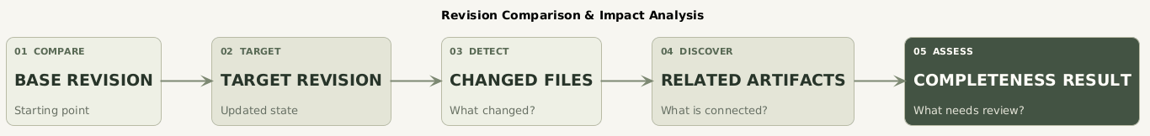


HOW CHANGELENS FINDS POTENTIALLY MISSING WORK
ChangeLens does not stop at the Git diff.
ChangeLens compares Git revisions, traces repository relationships, and identifies related work that may need review.
THE RESULT IS EVIDENCE-BACKED — NOT A GUESS ABOUT WHAT MUST CHANGE.

Slide 5

EVIDENCE, NOT GUESSWORK
ChangeLens uses repository evidence to explain why an artifact is flagged.
For each relationship, it can show the relationship type, supporting evidence, and confidence.
EXAMPLE
01.
02.
03.
04.
CHANGED
RELATED
RELATIONSHIP
RESULT
task_service.py
tasks.py
reference
Potentially incomplete
EVIDENCE
References symbol(s): get_tasks
CONFIDENCE
medium
Potentially missing ≠ definitely required
The result tells the developer where to look — not what decision to make.

Slide 6

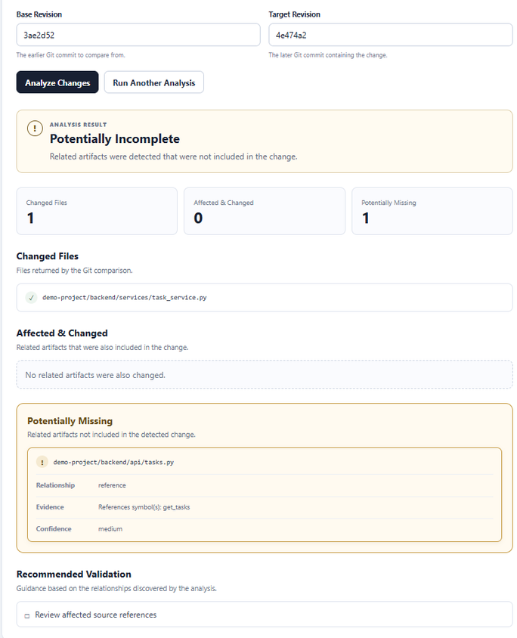
A REAL CHANGELENS RESULT
One change can reveal related work that was not part of the change.
Potentially missing ≠ definitely required

Slide 7



COMPLETE VS. POTENTIALLY INCOMPLETE
ChangeLens compares related artifacts with the actual change.
COMPLETE
POTENTIALLY INCOMPLETE
Related artifacts are already included in the change.
A related artifact was identified but was not part of the change.
RESULT: COMPLETE
RESULT: POTENTIALLY INCOMPLETE
Evidence → Recommendation → Developer Decision
Potentially missing ≠ definitely required

Slide 8

HIDDEN COLLATERAL DEPENDENCIES
VERIFIED SCENARIO
Changed
CHANGELENS CAN SURFACE DIFFERENT REPOSITORY RELATIONSHIPS THAT MAY DESERVE REVIEW.
backend/api/tasks.py
Potentially Missing
README.md
→ documentation
backend/main.py
→ reference
Evidence
Documentation explicitly references tasks, tasks.py
README.md
backend/main.py
References symbol(s): list_tasks
One change can have multiple types of related work.

Slide 9


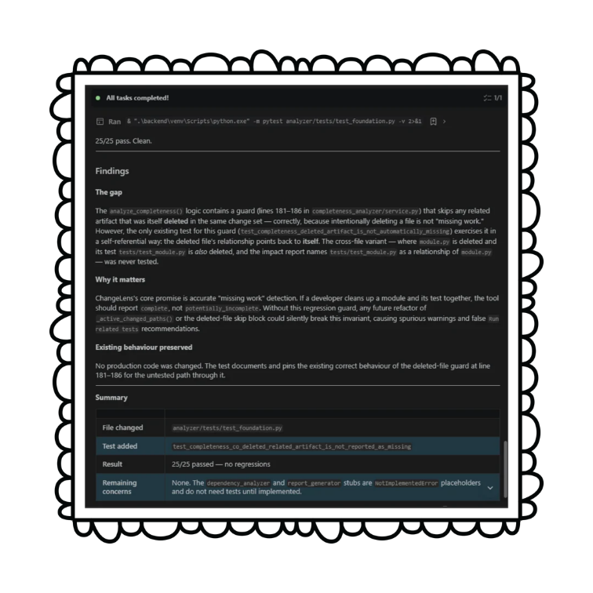
IBM BOB 2.0 IN OUR DEVELOPMENT WORKFLOW
We used IBM Bob 2.0 as part of the ChangeLens development workflow.
ACTUAL TASK
Identify one meaningful uncovered regression case in the analyzer tests and, if useful, implement the smallest focused regression test.
BOB CONTRIBUTION
Bob identified an uncovered edge case where a related artifact deleted in the same change could incorrectly be reported as potentially missing.
RESULT
Added the focused regression test
test_completeness_co_deleted_related_artifact_is_not_reported_as_missing
25/25 relevant tests passed with no regressions.
IBM Bob 2.0 — Development Workflow

Slide 10
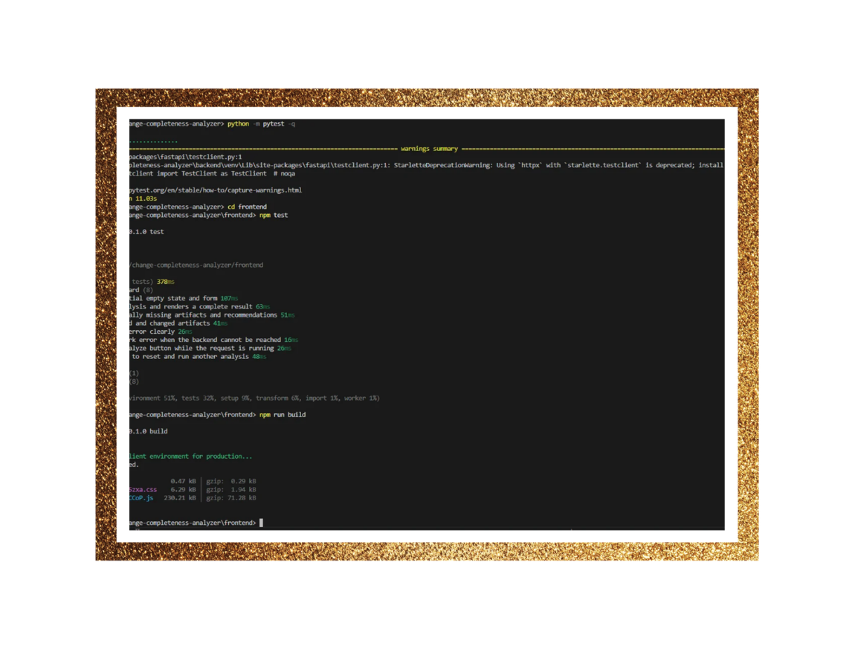
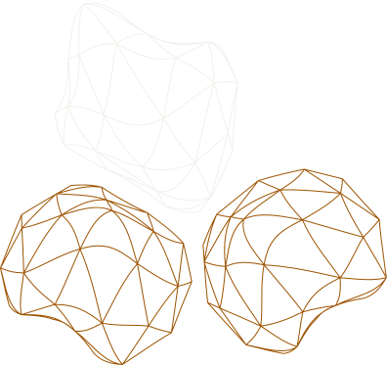
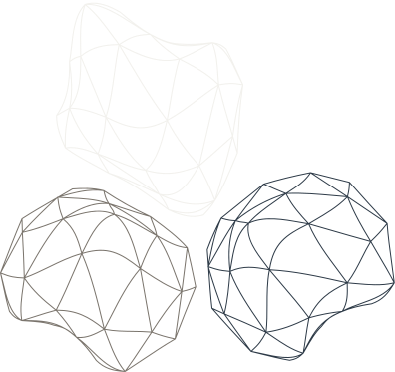
VERIFIED ENGINEERING
40
Python / Analyzer Tests Passed
9
Frontend Tests Passed
SUCCESSFUL
Production Build
VERIFIED
API / Backend Integration
VERIFIED SCENARIOS
Complete changes
Potentially incomplete changes
Hidden dependencies
Multiple relationships
Renames
Deletions
Path normalization
Unrelated-file filtering
40 passed, 1 warning

Slide 11

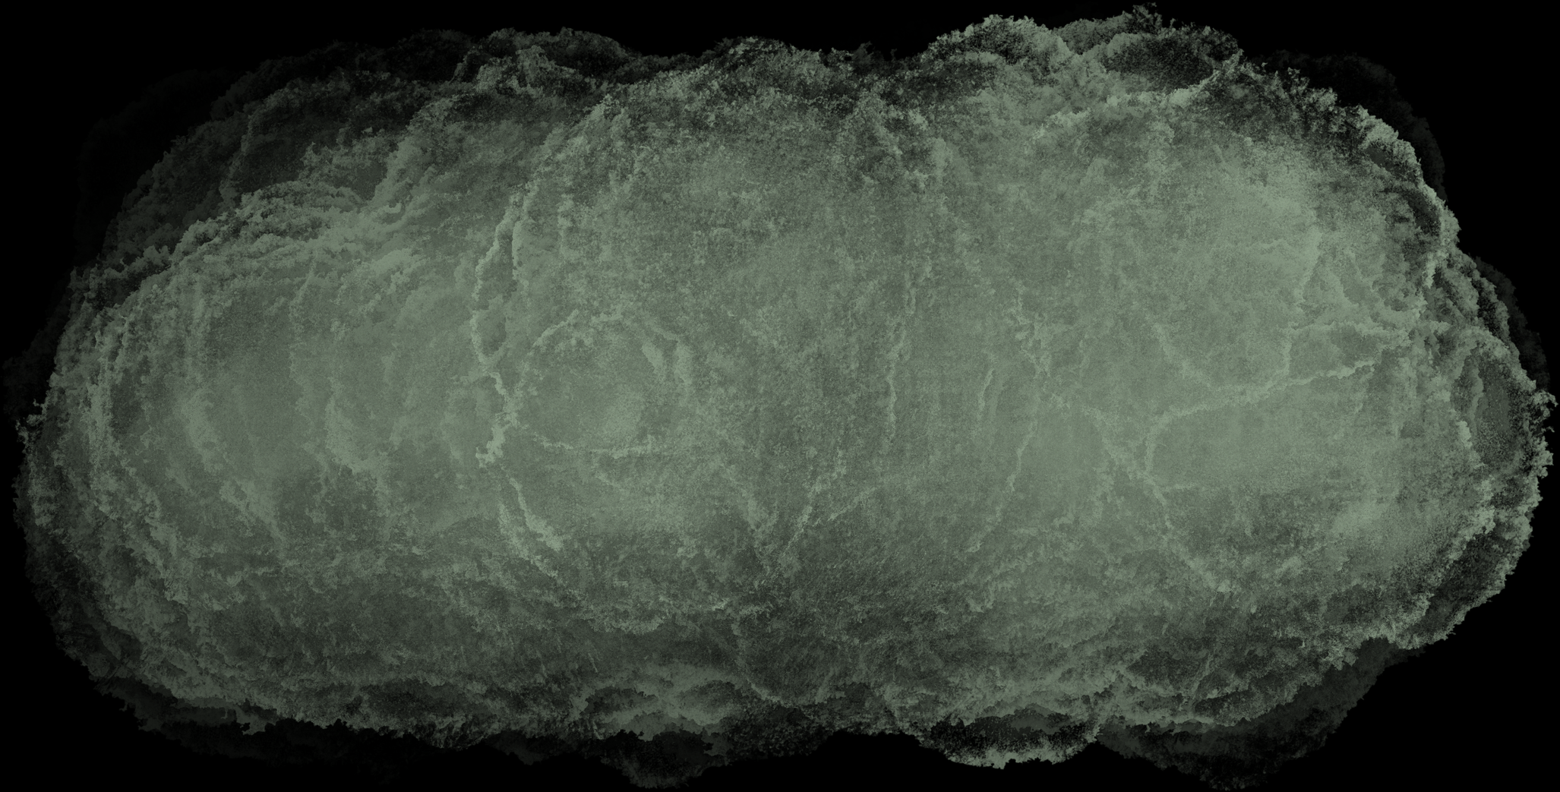

TODAY → FUTURE
TODAY — CURRENT FUNCTIONALITY
Git Changes
Compare two Git revisions
Find related repository artifacts
Relationship Discovery
Completeness Analysis
Identify potentially missing related work
Evidence-backed Report
Show evidence for developer review
  More language support
  PR integration
  CI/CD integration
  Deeper data-flow analysis
  Richer repository intelligence
FUTURE — NEXT DIRECTIONS
Built for today's developer workflow. Designed to grow with the repository.

Slide 12



WHAT ELSE NEEDS TO CHANGE?
IBM Bob 2.0 Hackathon
CHANGELENS
KNOW WHAT ELSE NEEDS TO CHANGE.
Team: CodeBloom AI
Maria Dorthy
Maria Silvia

