Slide 1
SBML
Systems Biology Markup Language (SBML)
Jannis Uhlendorf

Slide 2
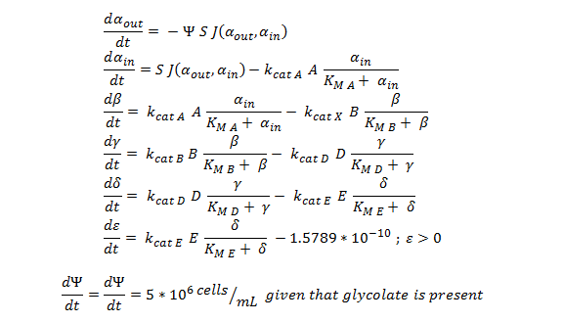
Motivation
Typical representations of biological models:
function dy = nop450(t,y)
dy=zeros(7,1);
dy(1)= -y(7)*(6*10^(-12))*0.0463067*(y(1)-y(2));
dy(2)= ((6*10^(-12))*0.0463067*(y(1)-y(2)))-3.3*25.55*(y(2)/(0.53+y(2)));
dy(3)= 3.3*25.55*(y(2)/(0.53+y(2)))-0.0871*25.55*(y(3)/(0.94+y(3)));
dy(4)= .0871*25.55*(y(3)/(0.94+y(3)))- 0.6*25.55*(y(4)/(0.16+y(4)));
dy(5)= 0.6*25.55*(y(4)/(0.16+y(4))) - 25.4*25.55*(y(5)/(20+y(5)));
if y(6) > 2*10^(-10)
dy(6)= 25.4*25.55*(y(5)/(20+y(5))) -1.5789*10^(-10)
else
dy(6) = 25.4*25.55*(y(5)/(20+y(5)))
end
if y(6) > 0.0005
if y(7) > 1.6*10^11
dy(7)=0
else
dy(7) = 5*10^6
end
else
dy(7) = 0
end
end
Problems:
  How to exchange models between different software tools?
  How to share models with other researchers?
source:http://2013.igem.org/Team:SydneyUni_Australia/Modelling_Output

Slide 3

SBML
What is SBML?
  machine readable format for computational models in biology
  aimed representing biochemical reactions
  can also be used for other processes (e.g. population models)
  based on XML (eXtensible Markup Language)
  resource for more information: http://sbml.org

Slide 4
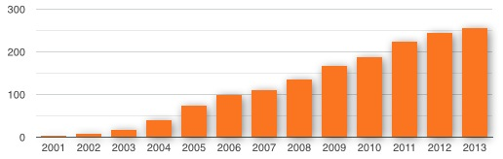

SBML software and models
> 250 software tools support SBML
Raise of the amount of SBML tools over the last decade
> 1000 SBML models available

Slide 5
SBML Structure
SBML Document (root)
Model
Compartment
Species
Reaction

Slide 6
SBML Structure
Compartment
ID: Cytosol
size: 1 fL
A compartment is a container that has a defined size (volume or area in case of membranes), for instance the cytosol or cell membrane

Slide 7
SBML Structure
Compartment
Species
ID: cytosol
size: 1 fL
ID: ATP
initial conc.: 50 mM
Compartment: cytosol
A species defines a biochemical entity that can participate in reactions, for instance Glucose-6-phospate

Slide 8
SBML Structure
Compartment
Species
ID: cytosol
size: 1 fL
ID: ATP
initial conc.: 50 mM
compartment: cytosol
Reaction
ID: Hexokinase
reactants: ATP, Glucose
products: ADP, Glc-6-Ph.
modifiers: Glc-6-Ph.
kinetic law: kf*ATP*Glc - ..
A reaction describes a transformation, transport or binding process.

Slide 9
XML
eXtensible Markup Language
standard for storing textual information
meta format that can be user defined
examples:
  OpenDocument (OpenOffice)
  XHTML
  SVG

Slide 10
XML elements
XML element with start end end tag
  (a tag starts with < and ends with >)
empty XML element
<message>
Hello World
</message>
<message/>

Slide 11
XML has a treee structure
Nesting of XML elements
<bookshelf location="hallway" >
<color>blue </color>
<book title="Momo" author="Michael E" >
<p>In old, old times, when the ...</p>
</book>
<book title="Pippi Longst" author="Astrid L" >
<p>At the end of a little ...</p>
</book>
</bookshelf>

Slide 12
Right and wrong
Well-formed
Not well-formed
<bookshelf location="hallway" >
<color>blue </color>
</bookshelf>
<bookshelf location="hallway" >
<color>blue
</bookshelf>
</color>

Slide 13
SBML code
SBML compartment
<listOfCompartments>
<compartment id="cytosol" size="1e-14"/>
</listOfCompartments>3
SBML species
<listOfSpecies>
<species compartment="cytosol" id="ES" initialAmount="0" name="ES"/>
<species compartment="cytosol" id="P" initialAmount="0" name="P"/>
<species compartment="cytosol" id="S" initialAmount="1e-20" name="S"/>
<species compartment="cytosol" id="E" initialAmount="5e-21" name="E"/>
</listOfSpecies>

Slide 14
Full SBML model
<?xml version="1.0" encoding="UTF-8"?>
<sbml xmlns="http://www.sbml.org/sbml/level2/version1" version="1" level="2" >
<model id="model" >
<listOfCompartments >
<compartment size="1" id="GO 0005623" name="cell" >
</listOfCompartments >
<listOfSpecies >
<species initialConcentration="1" compartment="GO 0005623" id="ATP" name="ATP" >
<species initialConcentration="1" compartment="GO 0005623" id="NADH" name="NADH" >
<species initialConcentration="2" compartment="GO 0005623" id="ADP" name="ADP" >
<species initialConcentration="2" compartment="GO 0005623" id="NADPH" name="NADPH" >
<species initialConcentration="1" compartment="GO 0005623" id="enzyme" name="2.7.1.86" >
</listOfSpecies >
<listOfReactions >
<reaction id="R00105" name="ATP NADH 2 phosphotransferase" >
<listOfReactants >
<speciesReference species="ATP" >
<speciesReference species="NADH" >
</listOfReactants >
<listOfProducts >
<speciesReference species="ADP" >
<speciesReference species="NADPH" >
</listOfProducts >
<listOfModiers >
<modierSpeciesReference species="enzyme" >
</listOfModiers >
</reaction >
</listOfReactions >
</model >
</sbml>
ATP + NADH ↔ ADP + NADPH

Slide 15
Model annotation
Problem:
  how to define the biological meaning of SBML elements?
  e.g. Glc stands for Glucose?, D-Glucose? L-Glucose?

Slide 16
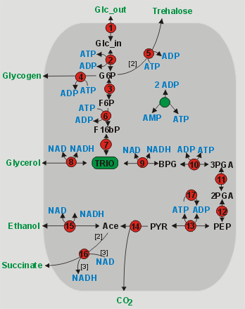
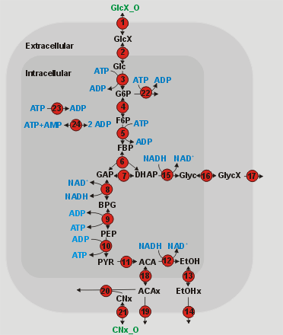
Model annotation
Hynne
Teusink
==

Slide 17
Model annotation
Solution: MIRIAM annotations
  link SBML elements to unique database entries
(some) Databases relevant for annotation:
  KEGG (reactions, species)
  GeneOntology (compartments, species, reactions)
  ChEBI (small molecules)
  UniProt (proteins)
Subject | Predicate | Object
ATP | isVersionOf | Reactome ID 154722

Slide 18
MIRIAM qualifiers
Biology Qualifiers
is
hasPart
isPartOf
isVersionOf
hasVersion
isHomologTo
isDescribedBy
isEncodedBy
encodes
occursIn
Model Qualifiers
is
isDescribedBy

Slide 19

Graphic visualization - SBGN
SBGN is an effort to standardize
the graphical notation used in maps of
biochemical and cellular processes
studied in Systems Biology.
www.sbgn.org

Slide 20
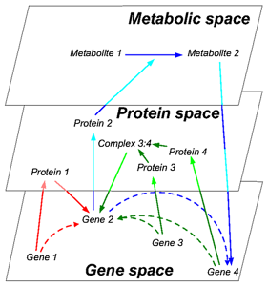
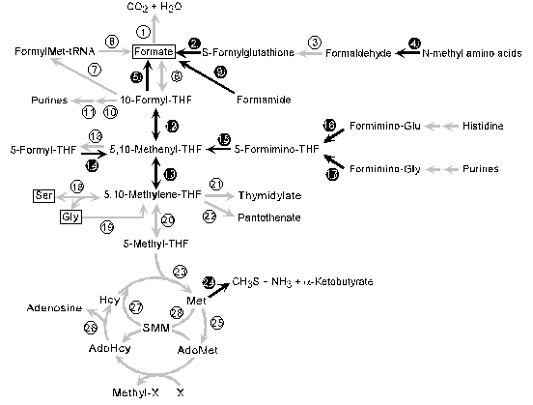
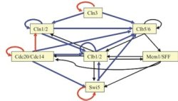
SBGN – Why is it needed?
Too many different kinds of graphical notations for biochemical network diagrams

Slide 21
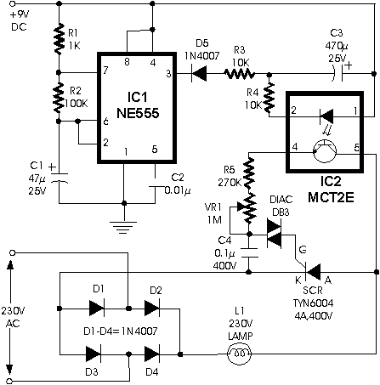
Electronic engineering has a universal graphical language

Slide 22
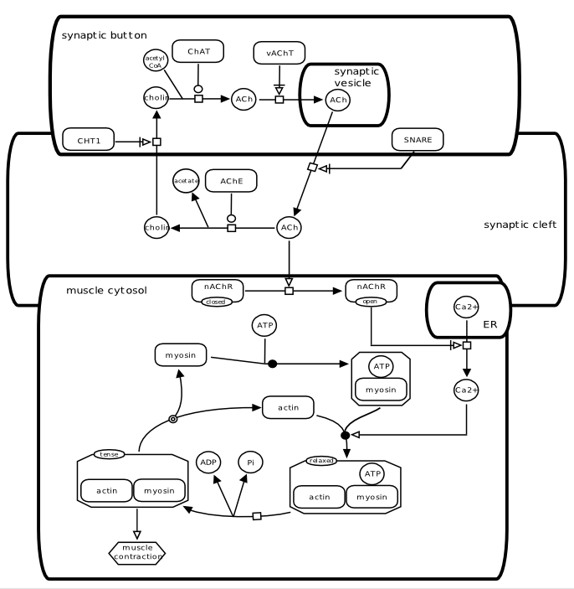
SBGN - The universal graphical language for Systems Biology

Slide 23
SBGN consists of
3 different languages
Process Description Language
Entity Relationship Language
Activity Flow Language

Slide 24

3 SBGN languages
1. Activity Flow Language (AF): depicts the information flow
between entities in a network. Used to represent
perturbation effects and describe coarse-grained
interaction networks.

Slide 25
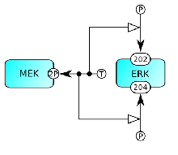
3 SBGN languages
2. Entity Relationship Language (ER): shows all relationships
in which an entity participates, regardless of temporal
aspects. Can be used to describe the molecular biology.

Slide 26
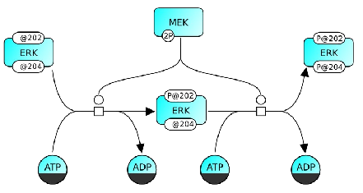
3 SBGN languages
3. Process Description Language (PD): shows temporal
courses of biochemical interactions. An entity can appear
multiple times to visualize all molecular interactions.

