Slide 1
Data Science with Python
Lesson #2
12.09.2018

Slide 2

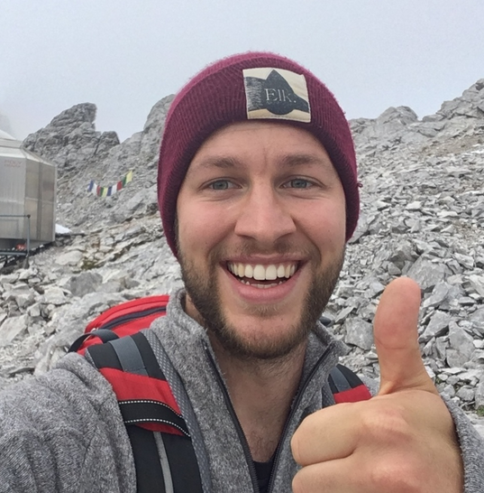
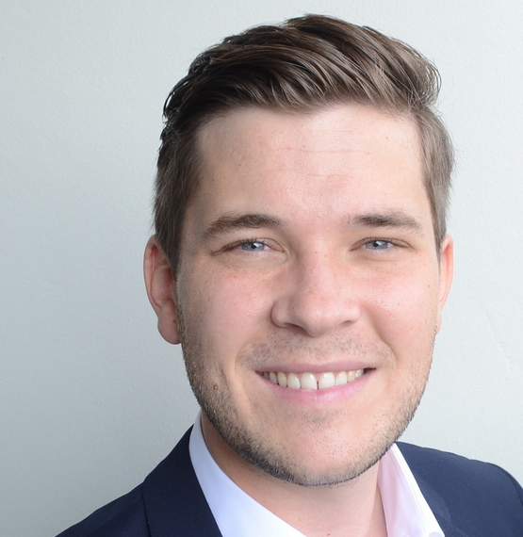
Your teachers for today
Jose Jonas Stefan

Slide 3


Did you install Python succesfully?

Slide 4
We want to learn…
… how to program in Python
… how to process data
… more about data science and machine learning
… real-world stuff
… want to start a career in Tech!

Slide 5
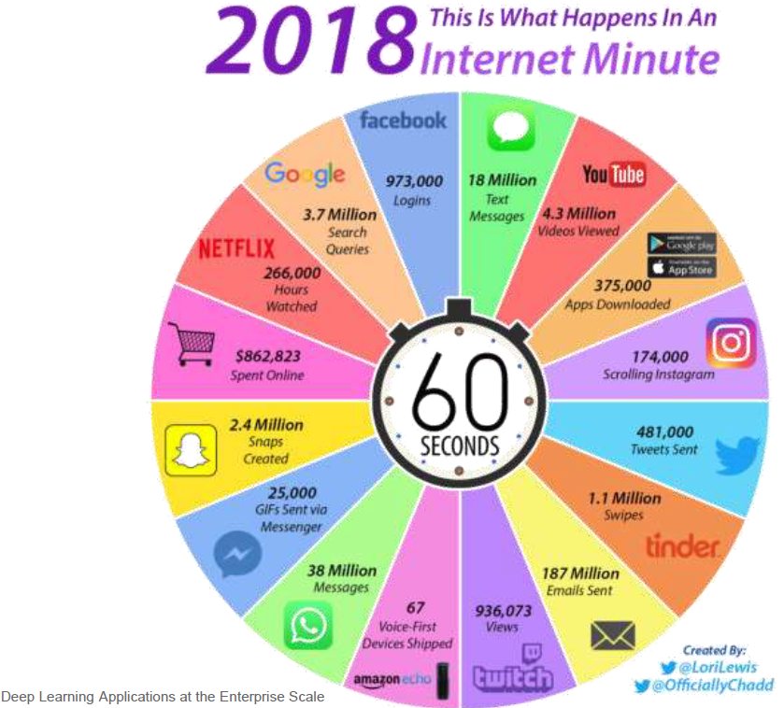
Data is everywhere

Slide 6
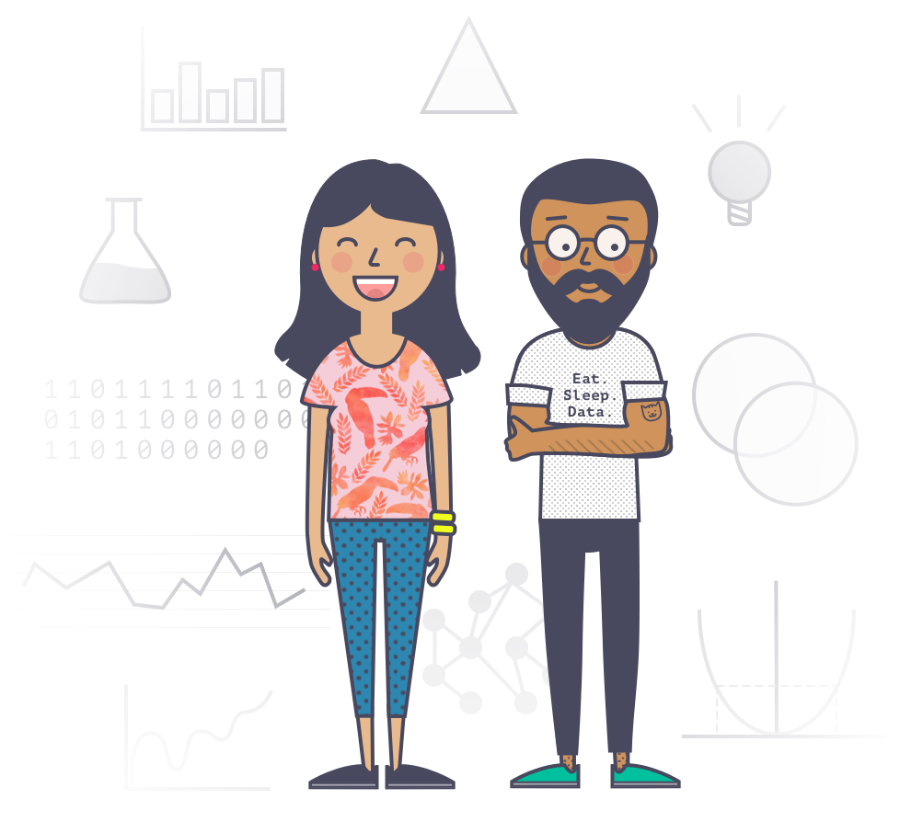
A Data Scientist turns data into business value
DATA
$
DATA SCIENTIST

Slide 7
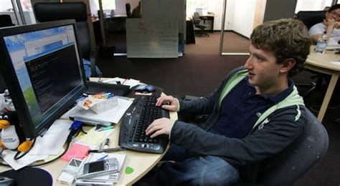
Let’s practise and learn!

Slide 8

We use Git to share our work

Slide 9
Next week
Working with data in Python

