Slide 1
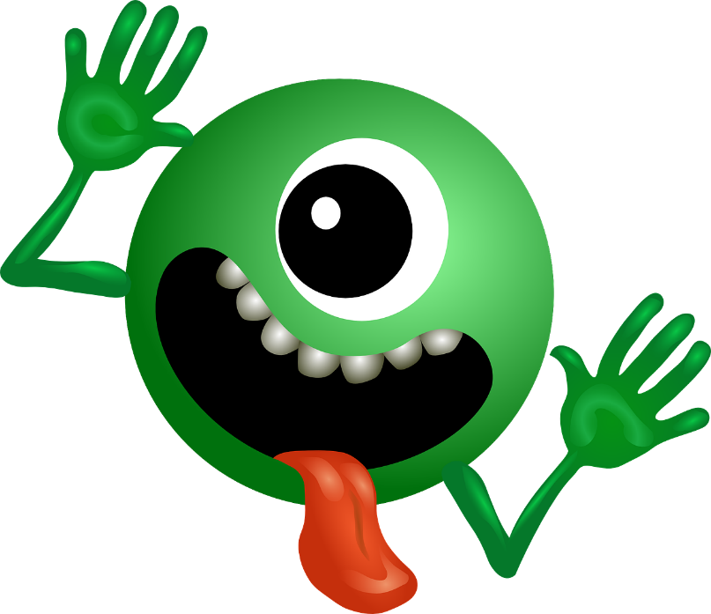
The Lup is really impressed with your progress!
He now wants to test how well you learned the language.
In the following section you will get to see either a singular or a plural form of the word.
You then have to write down the corresponding plural or singular.
Press SPACE when you are ready.

