Slide 1
Machine Learning
Soumia Chandran M
Notes:
This template can be used as a starter file for presenting training materials in a group setting.
Sections
Right-click on a slide to add sections. Sections can help to organize your slides or facilitate collaboration between multiple authors.
Notes
Use the Notes section for delivery notes or to provide additional details for the audience. View these notes in Presentation View during your presentation.
Keep in mind the font size (important for accessibility, visibility, videotaping, and online production)
Coordinated colors
Pay particular attention to the graphs, charts, and text boxes.
Consider that attendees will print in black and white or grayscale. Run a test print to make sure your colors work when printed in pure black and white and grayscale.
Graphics, tables, and graphs
Keep it simple: If possible, use consistent, non-distracting styles and colors.
Label all graphs and tables.
1

Slide 2
Deﬁnitions of machine learning
Arthur Samuel, an early American leader in the ﬁeld of computer gaming and
artiﬁcial intelligence, coined the term “Machine Learning” in 1959 while at IBM.
There is no universally accepted deﬁnition for machine learning.
The following are some of the deﬁnitions.
The ﬁeld of study interested in the development of computer algorithms to
transform data into intelligent action is known as machine learning.
(Brett Lantz, Machine Learning with R)
2. The ﬁeld of study known as machine learning is concerned with the question
of how to construct computer programs that automatically improve
with experience (Tom M Mitchell, Machine Learning).
3. Machine learning is a ﬁeld of computer science that gives computers the
ability to learn without being explicitly programmed (Wikipedia).

Slide 3
Machine Learning
A set of quantitative techniques /algorithms
that makes machine smart
Machine learns from data and use these learnings to predict something without user inerventions
Notes:
Give a brief overview of the presentation. Describe the major focus of the presentation and why it is important.
Introduce each of the major topics.
To provide a road map for the audience, you can repeat this Overview slide throughout the presentation, highlighting the particular topic you will discuss next.
3

Slide 4
Deﬁnition of learning
A computer program is said to learn from experience E
with respect to some class of tasks T and performance
measure P, if its performance at tasks T,as measured by P,
improves with experience E.
Eg:-
Handwriting recognition learning problem
• Task T: Recognizing and classifying handwritten words
within images
• Performance P: Percent of words correctly classiﬁed
• Training experience E: A dataset of handwritten words
with given classiﬁcations

Slide 5
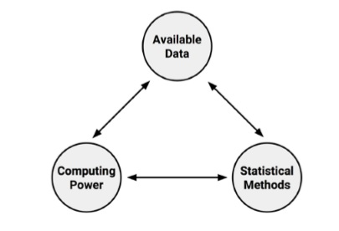
Origins of Machine Learning
Machine learning originated in an environment where ‘available data’,’statistical
Methods’ and ‘computing power’ rapidly and simultaneously evolved
Growth in Data needs Additional Computational Power which needs advanced
statistical methods to analyze large data sets

Slide 6
Data Mining & Machine Learning
Data mining considered to be a sibling of machine learning
Machine learning focus on teaching machines how to use data to solve a problem
Data mining focus on teaching machines to identify patterns that human use to solve a problem
All data mining uses machine learning ,but not all machine learning involves data mining
Notes:
Give a brief overview of the presentation. Describe the major focus of the presentation and why it is important.
Introduce each of the major topics.
To provide a road map for the audience, you can repeat this Overview slide throughout the presentation, highlighting the particular topic you will discuss next.
6

Slide 7
Abuses of Machine Learning
A computer may be more capable than human to find patterns
But it needs human to motivate the analysis and turn the result into meaningful action.
Machines are not good at asking questions ,not knowing what questions to ask.
They are much better at answering when the question is stated in a way that computer can comprehend.
Notes:
Give a brief overview of the presentation. Describe the major focus of the presentation and why it is important.
Introduce each of the major topics.
To provide a road map for the audience, you can repeat this Overview slide throughout the presentation, highlighting the particular topic you will discuss next.
7

Slide 8
Successes of Machine learning
Identification of Spam Messages
Forecasting weather behaviour and long term climate change
Prediction of popular election outcomes
Segmentation of customer behaviour
Optimization of energy use in homes and buildings
etc…
Notes:
Give a brief overview of the presentation. Describe the major focus of the presentation and why it is important.
Introduce each of the major topics.
To provide a road map for the audience, you can repeat this Overview slide throughout the presentation, highlighting the particular topic you will discuss next.
8

Slide 9
limits of Machine learning
Not a substitute for human brain
Little flexibility to extrapolate outside of strict parameters it learned
Knows no common sense
Notes:
Give a brief overview of the presentation. Describe the major focus of the presentation and why it is important.
Introduce each of the major topics.
To provide a road map for the audience, you can repeat this Overview slide throughout the presentation, highlighting the particular topic you will discuss next.
9

Slide 10
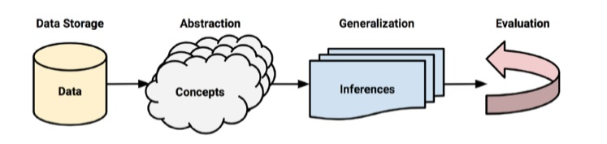
How machines learn
Components of Learning Process:-
Data Storage –utilizes observation,memory and recall to provide a factual basis for further reasoning
Abstraction –Translation of stored data into broader representations and concepts
Generalization –use abstracted data to create knowledge and inferences that drive actions
Evaluation –provides a feedback to make improvements
Notes:
Give a brief overview of the presentation. Describe the major focus of the presentation and why it is important.
Introduce each of the major topics.
To provide a road map for the audience, you can repeat this Overview slide throughout the presentation, highlighting the particular topic you will discuss next.
10

Slide 11
Data Storage
All learning must begin with data
Human and computers use Data storage as a foundation for more advanced reasoning
Human being have Brain
Computers have Hard disk drives ,flash memory and RAM for long term and short term recalls.
Notes:
Give a brief overview of the presentation. Describe the major focus of the presentation and why it is important.
Introduce each of the major topics.
To provide a road map for the audience, you can repeat this Overview slide throughout the presentation, highlighting the particular topic you will discuss next.
11

Slide 12
Abstraction
Assign meaning to raw data.
Computer summarizes raw data using a model - an explicit description of the patterns within the data.
Different types of models are
Mathematical equations
Relational diagrams such as trees and graphs
Logical if/else rules
Groupings of data known as clusters
Model selection is not left upto machine, but learning task and data on hand inform model selection
Observations - > Data - > Model
Notes:
Give a brief overview of the presentation. Describe the major focus of the presentation and why it is important.
Introduce each of the major topics.
To provide a road map for the audience, you can repeat this Overview slide throughout the presentation, highlighting the particular topic you will discuss next.
12

Slide 13
Abstraction
The process of fitting a model to a dataset is called Training
Training transformed raw data into an abstract form that summarizes the information
A learned model does not provide new data , but result in new knowledge
Notes:
Give a brief overview of the presentation. Describe the major focus of the presentation and why it is important.
Introduce each of the major topics.
To provide a road map for the audience, you can repeat this Overview slide throughout the presentation, highlighting the particular topic you will discuss next.
13

Slide 14
Generalization
The process of turning abstracted knowledge into a form that can be utilized for further action
Learner is tasked with limiting the patterns it discovers to only those that will be most relevant to its future tasks
Heuristics are used to find the most useful inferences
Notes:
Give a brief overview of the presentation. Describe the major focus of the presentation and why it is important.
Introduce each of the major topics.
To provide a road map for the audience, you can repeat this Overview slide throughout the presentation, highlighting the particular topic you will discuss next.
14

Slide 15
Generalization
The process of turning abstracted knowledge into a form that can be utilized for further action
Learner is tasked with limiting the patterns it discovers to only those that will be most relevant to its future tasks
Heuristics are used to find the most useful inferences
Heuristics sometimes results in wrong conclusions, then the algorithm is said to have bias.
Notes:
Give a brief overview of the presentation. Describe the major focus of the presentation and why it is important.
Introduce each of the major topics.
To provide a road map for the audience, you can repeat this Overview slide throughout the presentation, highlighting the particular topic you will discuss next.
15

Slide 16
Evaluation
Each learner has weaknesses and no single learning algorithm to rule them all
Final step is evaluate/ measure the learners’s success in spite of its biases and inform additional training if needed.
Models fails to perfectly generalize due to problem of noise.
A model that seems to perform well during training but does poorly during evaluation is said to be overfitted to the training dataset.
Notes:
Give a brief overview of the presentation. Describe the major focus of the presentation and why it is important.
Introduce each of the major topics.
To provide a road map for the audience, you can repeat this Overview slide throughout the presentation, highlighting the particular topic you will discuss next.
16

Slide 17
Machine learning in practice
Data Collection (text file ,spread sheet or database
Data exploration and preparation
Model Training
Model Evaluation
Model Improvement
Notes:
Give a brief overview of the presentation. Describe the major focus of the presentation and why it is important.
Introduce each of the major topics.
To provide a road map for the audience, you can repeat this Overview slide throughout the presentation, highlighting the particular topic you will discuss next.
17

Slide 18
Machine Learning in Practice
1.Data collection :-The data collection step involves gathering the learning
material an algorithm will use to generate actionable knowledge. The data may
have to combine into a single source like a text ﬁle, spreadsheet, or database.
2. Data exploration and preparation:- This step involves learning more about the
data to prepare the same for learning process . It involves
Fixing or cleaning so-called “messy” data,
Eliminating unnecessary data, and
Recoding the data to conform to the learner’s expected inputs.
3. Model training :-When the data has been prepared for analysis, a user is
likely to have an idea of what can be learned from the data. This idea guides
the selection of an appropriate algorithm. The algorithm represents the data in
the form of a model.
4.Model Evaluation:-It is important to evaluate how well the algorithm learns
from its experience. The accuracy of a model is evaluated using a test dataset .
5. Model improvement:- To obtain better performance, we have to improve the
model. This may require the following:
Use more advanced strategies
Switch to a diﬀerent type of model altogether
Supplement your data with additional data
Perform additional preparatory work

Slide 19
Types of Input Data
Unit of Observation- smallest entity with measured properties of interest for a study
Examples – Instances of the unit of observation
Features – Recorded properties /attributes of examples
Notes:
Give a brief overview of the presentation. Describe the major focus of the presentation and why it is important.
Introduce each of the major topics.
To provide a road map for the audience, you can repeat this Overview slide throughout the presentation, highlighting the particular topic you will discuss next.
19

Slide 20
Types of Machine learning Algorithms
Predictive models – used for tasks that involve prediction of one value using other values on the dataset
The process of training a predictive model is known as supervised learning
An often used supervised learning task of predicting which category an example belongs to is known as Classification
Supervised learners can also be used for predicting a numeric value such as income ,test scores ,price etc. To predict it, a form of Numeric prediction fits linear regression models to the input data.
Notes:
Give a brief overview of the presentation. Describe the major focus of the presentation and why it is important.
Introduce each of the major topics.
To provide a road map for the audience, you can repeat this Overview slide throughout the presentation, highlighting the particular topic you will discuss next.
20

Slide 21
Supervisory Learning
A supervised learning algorithm analyzes the training data and produces
an inferred function, which can be used for mapping new examples.
Consider the following data regarding patients entering a clinic. The data
consists of the gender and age of the patients and each patient is labeled as
“healthy” or “sick”.
Based on the below data, when a new patient enters the clinic, can one predict
whether he/she is healthy or sick?
Gender | Age | Label
M | 55 | Sick
M | 67 | Sick
F | 22 | Healthy
F | 48 | Sick
M | 36 | Healthy
F | 65 | Sick

Slide 22
Types of Machine learning Algorithms
Descriptive models – There is no target to learn, but summarize data in new and interesting ways. They are commonly used for Data mining
The process of training a descriptive model is known as unsupervised learning
Descriptive modeling task pattern discovery is used to find useful associations within the data. It is used in market basket analysis.
Descriptive modeling task of dividing a data set into homogeneous groups is called clustering
Notes:
Give a brief overview of the presentation. Describe the major focus of the presentation and why it is important.
Introduce each of the major topics.
To provide a road map for the audience, you can repeat this Overview slide throughout the presentation, highlighting the particular topic you will discuss next.
22

Slide 23
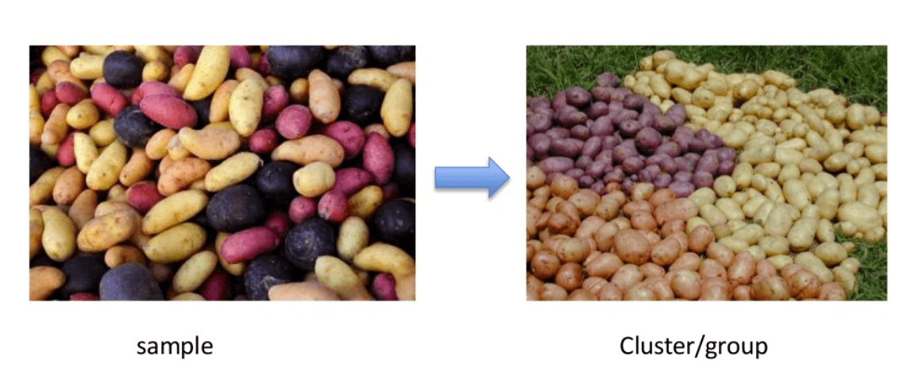
Unsupervisory Learning
Unsupervised learning is a type of machine learning algorithm used to
draw inferences from datasets consisting of input data without labeled
responses.It mainly dealts with unlabelled data.
The most common unsupervised learning method is cluster analysis.
It is used for exploratory data analysis to ﬁnd hidden patterns or grouping in
data.

Slide 24
Types of Machine learning Algorithms
Meta-learners– No specific learning task, focused on learning how to learn effectively
A meta learning algorithm uses results of some learnings to inform additional learning
Reinforcement learning – It is the problem of getting an agent to act in the world so as to maximize its rewards.
A learner is not told what actions to take as in most forms of machine learning, but instead must discover which actions yield the most reward by trying them
Notes:
Give a brief overview of the presentation. Describe the major focus of the presentation and why it is important.
Introduce each of the major topics.
To provide a road map for the audience, you can repeat this Overview slide throughout the presentation, highlighting the particular topic you will discuss next.
24

Slide 25
Types of Machine learning Algorithms
Model | Learning task
Supervised learning
Nearest Neighbour | Classification
Naïve Bayes | Classification
Decision Trees | Classification
Linear Regression | Numeric Prediction
Regression Trees | Numeric Prediction
Neural Networks | Dual Use
Support vector machine | Dual Use
Notes:
Give a brief overview of the presentation. Describe the major focus of the presentation and why it is important.
Introduce each of the major topics.
To provide a road map for the audience, you can repeat this Overview slide throughout the presentation, highlighting the particular topic you will discuss next.
25

Slide 26
Types of Machine learning Algorithms
Model | Learning task
UnSupervised learning
Association Rules | Pattern Detection
K means Clustering | Clustering
Meta Learning
Bagging | Dual Use
Boosting | Dual Use
Random Forests | Dual Use
Notes:
Give a brief overview of the presentation. Describe the major focus of the presentation and why it is important.
Introduce each of the major topics.
To provide a road map for the audience, you can repeat this Overview slide throughout the presentation, highlighting the particular topic you will discuss next.
26

Slide 27
Measuring Central Tendency
Measures of Central Tendency are a class of statistics used to identify a value that falls in the middle of the set of data.
Mean=sum of all values/No.of values
Median is the value that occurs halfway through an ordered list of values
Mode
Notes:
Give a brief overview of the presentation. Describe the major focus of the presentation and why it is important.
Introduce each of the major topics.
To provide a road map for the audience, you can repeat this Overview slide throughout the presentation, highlighting the particular topic you will discuss next.
27

Slide 28
Measuring spread
Mean and median tells us little about whether there exists diversity in the measurements
To measure diversity (how tightly or loosely the values are spaced),the methods are
Five number summary-a set of 5 values roughly depict the spread of feature’s values.
The five values are
Minimum
First Quartile or Q1
Median
Third Quartile or Q3
Maximum
Notes:
Give a brief overview of the presentation. Describe the major focus of the presentation and why it is important.
Introduce each of the major topics.
To provide a road map for the audience, you can repeat this Overview slide throughout the presentation, highlighting the particular topic you will discuss next.
28

Slide 29
Measuring spread-
Numeric data
Range: The span between minimum and maximum is known as range
Quartiles divide a dataset into 4 equal parts
The first and third quartiles-Q1 and Q3 refers to the value below or above which one quarter of values are found
Tertiles(three parts),quintiles (5 parts),deciles (10 parts) and percentiles(100 parts)
InterQuartile Range(IQR)- Difference between Q1 and Q3 (middle 50 % of data found in this region)
Notes:
Give a brief overview of the presentation. Describe the major focus of the presentation and why it is important.
Introduce each of the major topics.
To provide a road map for the audience, you can repeat this Overview slide throughout the presentation, highlighting the particular topic you will discuss next.
29

Slide 30
Measuring spread-
Numeric data
Variance
Standard Deviation
Notes:
Give a brief overview of the presentation. Describe the major focus of the presentation and why it is important.
Introduce each of the major topics.
To provide a road map for the audience, you can repeat this Overview slide throughout the presentation, highlighting the particular topic you will discuss next.
30

Slide 31
Visualizing numeric variables - Boxplot
It can be helpful in diagnosing data problems
A common visualization of five number summary is Box plot or Box-and –Whiskers plot
It depicts the five number summary using lines and dots
The horizontal line forming the box in the middle of each figure represent Q1,Q2 and Q3 while reading from bottom to top.
Median –darkline
Notes:
Give a brief overview of the presentation. Describe the major focus of the presentation and why it is important.
Introduce each of the major topics.
To provide a road map for the audience, you can repeat this Overview slide throughout the presentation, highlighting the particular topic you will discuss next.
31

Slide 32
Visualizing numeric variables - Histogram
It is a way to depict the spread of a numeric variable
It divides the variable’s values into predefined no.of portions or bins that act as containers for values
A histogram is composed of series of bars and heights indicating the count of frequencies of values fall into each of the equal width bins partitioning the values.
Notes:
Give a brief overview of the presentation. Describe the major focus of the presentation and why it is important.
Introduce each of the major topics.
To provide a road map for the audience, you can repeat this Overview slide throughout the presentation, highlighting the particular topic you will discuss next.
32

Slide 33
Understanding Numeric data- Uniform and Normal distribution
A variable’s distribution describes how likely a value falls within the various ranges
If all values are equally likely to occur (the values rolled on a fair six sided die)- the distribution is said to be uniform.
If the values grow less likely to occur as they are farther away from both sides of the center bar, resulting in a bell shaped distribution of data – the distribution is said to be Normal distribution
Notes:
Give a brief overview of the presentation. Describe the major focus of the presentation and why it is important.
Introduce each of the major topics.
To provide a road map for the audience, you can repeat this Overview slide throughout the presentation, highlighting the particular topic you will discuss next.
33

Slide 34
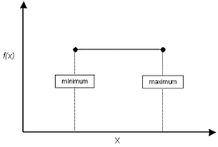
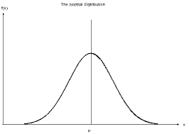
Distributions
Uniform Distribution Normal Distribution
Notes:
Give a brief overview of the presentation. Describe the major focus of the presentation and why it is important.
Introduce each of the major topics.
To provide a road map for the audience, you can repeat this Overview slide throughout the presentation, highlighting the particular topic you will discuss next.
34

Slide 35
Exploring Categorical variables
Categorical data is typically examined using tables rather than summary statistics
A table that presents single categorical variable is known as one-way table
Measuring Central Tendency (Categorical variables)
For categorical data,to measure central tendency,Mode is used.
A variable may have more than one mode.
Variable with single mode is called unimodal and two modes is called bimodal,multiple modes are called multimodal.
Notes:
Give a brief overview of the presentation. Describe the major focus of the presentation and why it is important.
Introduce each of the major topics.
To provide a road map for the audience, you can repeat this Overview slide throughout the presentation, highlighting the particular topic you will discuss next.
35

Slide 36
Visualizing Relationships
Scatterplots :-It visualizes a bivariate relationship
Two way cross tabulations :It is used to find out the relationship between two nominal variables.It is like a two dimensional table,each of the table’s cell indicates values falling into the particular row and column combination.
Notes:
Give a brief overview of the presentation. Describe the major focus of the presentation and why it is important.
Introduce each of the major topics.
To provide a road map for the audience, you can repeat this Overview slide throughout the presentation, highlighting the particular topic you will discuss next.
36

Slide 37
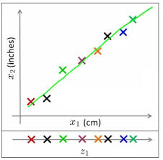
Dimensionality Reduction
The image shows 2 dimensions x1 and x2,measurements of several objects in inches and cm. x1 and x2 will convey similar information and introduce a lot of noise in system, so better use one dimension by converted the dimension of data from 2D (from x1 and x2) to 1D (z1), which has made the data relatively easier to explain.
Notes:
Give a brief overview of the presentation. Describe the major focus of the presentation and why it is important.
Introduce each of the major topics.
To provide a road map for the audience, you can repeat this Overview slide throughout the presentation, highlighting the particular topic you will discuss next.
37

Slide 38
Dimensionality Reduction
Dimension reduction is the process of reducing the number of
variables under consideration by obtaining a smaller set of
principal variables.
Dimensionality reduction may be implemented in two ways.
• Feature selection
In feature selection, we are interested in finding k of the
total of n features that give us the most information
and we discard the other (n − k) dimensions.
• Feature extraction
In feature extraction, we are interested in finding a new set
of k features that are the combination of the original n features.
The best known and most widely used feature extraction
methods are Principal Components Analysis (PCA)
and Linear Discriminant Analysis (LDA)

Slide 39
Dimensionality Reduction
We can reduce n dimensions of data set to k dimensions (k < n) .
These k dimensions can be directly identified (filtered) or
It can be a combination of dimensions (weighted averages of dimensions) or
New dimension(s) that represent existing multiple dimensions.
One of the most common application of this technique is in Image processing
Notes:
Give a brief overview of the presentation. Describe the major focus of the presentation and why it is important.
Introduce each of the major topics.
To provide a road map for the audience, you can repeat this Overview slide throughout the presentation, highlighting the particular topic you will discuss next.
39

Slide 40
Dimensionality Reduction - Advantages
It helps in data compressing and reducing the storage space required
It fastens the time required for performing same computations. Less dimensions leads to less computing,
It takes care of multi-collinearity that improves the model performance. It removes redundant features.
Reducing the dimensions of data to 2D or 3D may allow us to plot and visualize it precisely

Slide 41
Principal component analysis (PCA)
The main idea of this is to reduce the dimensionality of a data set consisting of many variables correlated with each other either heavily or lightly, while retaining the variation present in the dataset, up to the maximum extent.
The same is done by transforming the variables to a new set of variables, which are known as the principal components (or simply, the PCs) and are orthogonal, ordered such that the retention of variation present in the original variables decreases as we move down in the order.

Slide 42
Principal component analysis (PCA)
The principal components are the eigen vectors of a covariance matrix, and hence they are orthogonal.
Principal Component Analysis can supply the user with a lower-dimensional picture, a projection or "shadow" of this object when viewed from its most informative viewpoint.

Slide 43

Principle Component Analysis
Step 1: Normalize the data
First step is to normalize the data that we have so that PCA works properly. This is done by subtracting the respective means from the numbers in the respective column. This produces a dataset whose mean is zero.
Step 2: Calculate the covariance matrix
Since the dataset we took is 2-dimensional, this will result in a 2x2 Covariance matrix. Please note that
Var[X1] = Cov[X1,X1] and Var[X2] = Cov[X2,X2].

Slide 44
Principle Component Analysis
Step 3: Calculate the eigenvalues and eigenvectors
Next step is to calculate the eigenvalues and eigenvectors for the covariance matrix. The same is possible because it is a square matrix. ƛ is an eigenvalue for a matrix A if it is a solution of characteristic equation:det(A -ƛI ) = 0
For each eigenvalue ƛ, a corresponding eigen-vector v, can be found by solving:
(A - ƛI )v = 0

Slide 45
Principle Component Analysis
Step 4: Choosing components and forming a feature vector:
We order the eigenvalues from largest to smallest so that it gives us the components in order or significance.
Here comes the dimensionality reduction part. If we have a dataset with n variables, then we have the corresponding n eigenvalues and eigenvectors.
It turns out that the eigenvector corresponding to the highest eigenvalue is the principal component of the dataset and it is our call as to how many eigenvalues we choose to proceed our analysis with.
To reduce the dimensions, we choose the first p eigenvalues and ignore the rest. We do lose out some information in the process, but if the eigenvalues are small, we do not lose much.

Slide 46
Principle Component Analysis
Next we form a feature vector which is a matrix of vectors, in our case, the eigenvectors. In fact, only those eigenvectors which we want to proceed with.
Feature Vector = (Eig1,Eig2)

Slide 47
Principle Component Analysis
Step 5: Forming Principal Components:
we take the transpose of the feature vector and left-multiply it with the transpose of standardized original dataset.
NewData = FeatureVector^{T x} Standardised Original Data^{T}

Slide 48
Selecting the right features
It enables the machine learning algorithm to train faster.
It reduces the complexity of a model and makes it easier to interpret.
It improves the accuracy of a model if the right subset is chosen.
It reduces overfitting.

Slide 49

Filter Methods
Filter methods are generally used as a preprocessing step.
The selection of features is independent of any machine learning algorithms.
Features are selected on the basis of their scores in various statistical tests for their correlation with the outcome variable..

Slide 50

Filter Methods
Pearson’s Correlation: It is used as a measure for quantifying linear dependence between two continuous variables X and Y. Its value varies from -1 to +1
LDA: Linear discriminant analysis is used to find a linear combination of features that characterizes or separates two or more classes (or levels) of a categorical variable.
ANOVA: ANOVA stands for Analysis of variance. It is similar to LDA except for the fact that it is operated using one or more categorical independent features and one continuous dependent feature.
Chi-Square: It is a is a statistical test applied to the groups of categorical features to evaluate the likelihood of correlation or association between them using their frequency distribution.

Slide 51
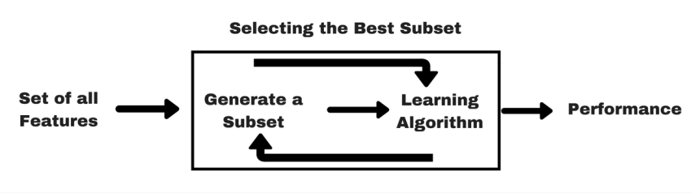
Wrapper methods
In wrapper methods, we try to use a subset of features and train a model using them.
Based on the inferences that we draw from the previous model, we decide to add or remove features from the subset.

Slide 52
Wrapper Methods
Forward Selection: Forward selection is an iterative method in which we start with having no feature in the model. In each iteration, we keep adding the feature which best improves our model till an addition of a new variable does not improve the performance of the model.
Backward Elimination: In backward elimination, we start with all the features and removes the least significant feature at each iteration which improves the performance of the model. We repeat this until no improvement is observed on removal of features.
Recursive Feature elimination: It is a greedy optimization algorithm which aims to find the best performing feature subset. It repeatedly creates models and keeps aside the best or the worst performing feature at each iteration. It constructs the next model with the left features until all the features are exhausted. It then ranks the features based on the order of their elimination.

Slide 53
Difference between Filter and Wrapper methods
The main differences between the filter and wrapper methods for feature selection are:
Filter methods measure the relevance of features by their correlation with dependent variable while wrapper methods measure the usefulness of a subset of feature by actually training a model on it.
Filter methods are much faster compared to wrapper methods as they do not involve training the models. On the other hand, wrapper methods are
computationally very expensive as well.
Filter methods use statistical methods for evaluation of a subset of features
while wrapper methods use cross validation.
Filter methods might fail to find the best subset of features in many occasions but wrapper methods can always provide the best subset of features.
Using the subset of features from the wrapper methods make the model more prone to over fitting as compared to using subset of features from the filter methods.

