Slide 1
MMC 3260 / 5015
Personal Website pt. 2 Requirements

Slide 2
Purpose of the project
Improve your coding and design skills
Create more content for your website
Experiment with using multimedia, using the full capabilities of the web to tell a story
Expand responsive web design skills

Slide 3
Project requirements
Update/improve your website and layout based on feedback from your instructor and classmates
Improve the responsiveness of the website so that it looks good even on mobile devices
Include a section on some topic relevant to your professional interests

Slide 4


New content guidelines
Roughly 2,000 words of content about one subject
Include multimedia to tell a multifaceted story
You can include multimedia from other people, like YouTube videos, but more credit will be given if you create the multimedia yourself

Slide 5
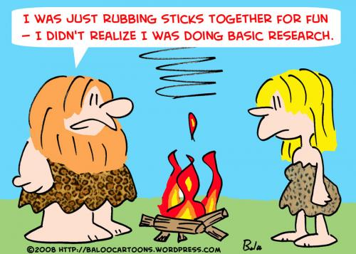
Citation requirements
This project will involve research about your topic of choice
All information you get from other sources must be cited
The citation style you choose is up to you, as long as it’s consistent

Slide 6

Citation requirements
You must also interview at least one (1) expert relevant to the subject
How you reference the interview on your page is up to you

Slide 7
Coding requirements
Use HTML for content and CSS for presentation
Organize your website into folders, same as the first project
Upload your files to your GitHub.io repository

Slide 8

Domain name
Link your website to a domain name
Dave will show you in the lab videos how to do this

Slide 9
Image guidelines
Individual images can be no more than 200 kb in size, and the images on your page cannot total more than 1 mb (1024 kb)
Images placed in an “images” or “img” folder

Slide 10
DUE DATE
Project is due Tuesday, December 3 at 11:59 p.m.
Submit via GitHub
We should be able to go to “yourname.com” and pull up the files you have uploaded to GitHub

Slide 11
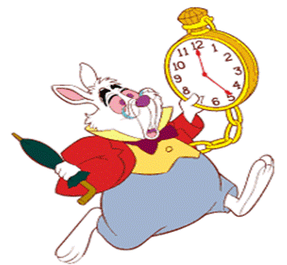
Late work
For each day, or partial day, that your project is late, you will be deducted 10% from your final grade

Slide 12

Grading
Expectations for grading will be higher than with the first website
Due to the short turnaround before grades are due, you likely won’t get detailed feedback unless you request it

Slide 13
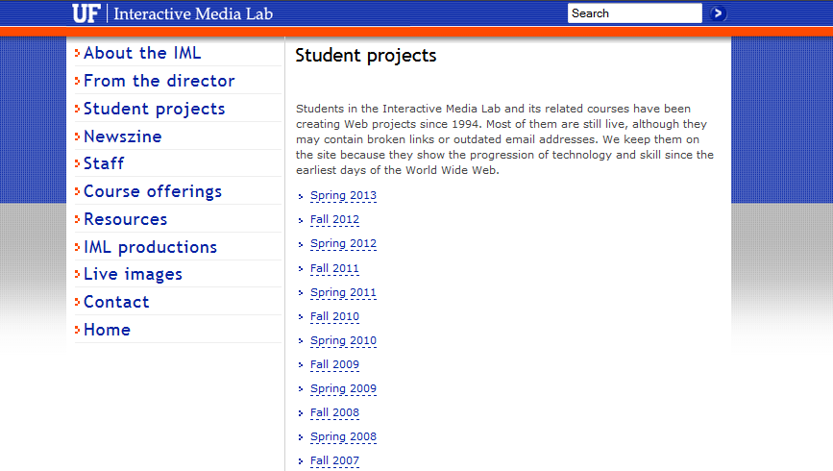
Previous projects
http://iml.jou.ufl.edu/projects/

