Slide 1
World Religions: Similarity or Difference?
"No religion is an island.”
Abraham Heschel
Jewish Philosopher
"He who knows one, knows none."
Max Müller, German philologist

Slide 2
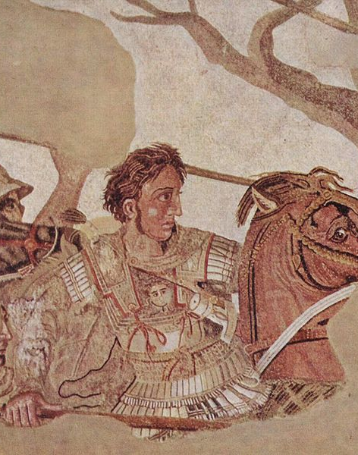
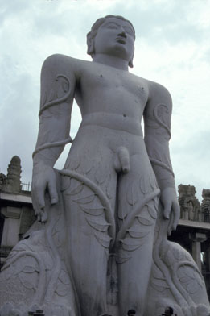
An Ancient Encounter
“I am conquering the World”
“I am experiencing Nothingness”

Slide 3
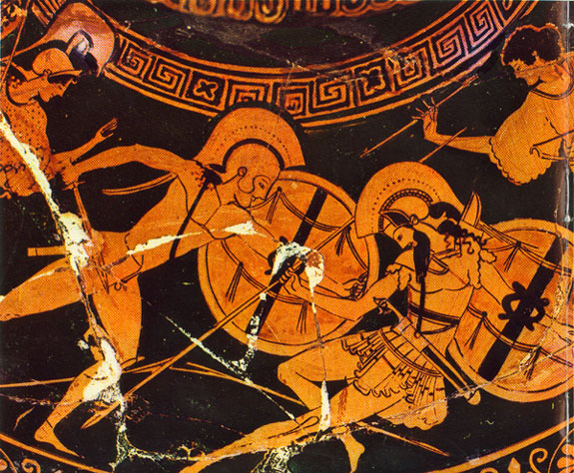
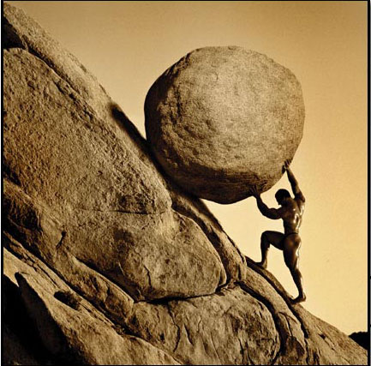
Alexander’s “world”
A life lived “excellently”
Achilles vs. Sisyphus
NO! to monotony, mediocrity, meaninglessness
YES! To exhilaration, being spectacular, winning
You only cross the river once.

Slide 4
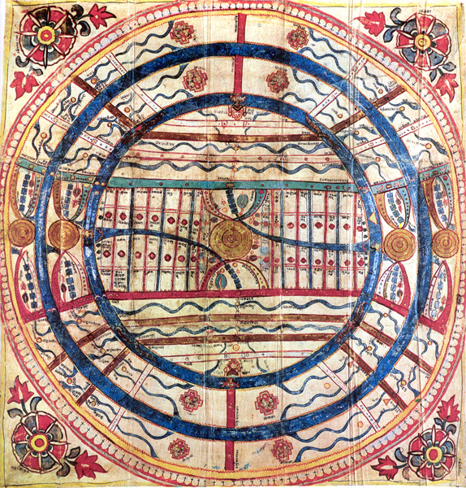
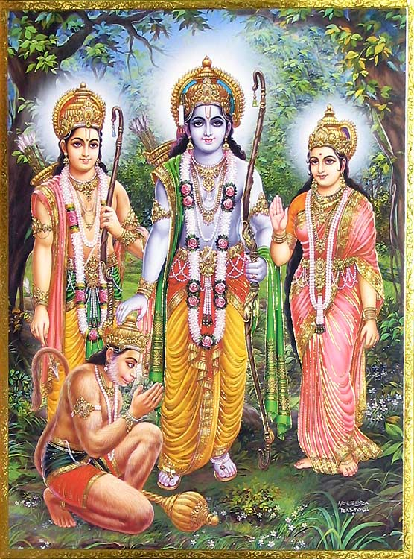
The Gymnosophist’s “world”
Reconciliation to the infinite
Bharat, Ram and Krisna
In the canvas of infinity, we are insignificant.
Nothing lasts forever, all comes to an end, and returns.
You may cross the river again and again.

Slide 5
What do the stories tell us?
They each have heroes, an example
They each have view of the world, a ‘problem’
They each have a view of an ‘end’, a ‘solution’ or goal
They each have a way to live, to be, in the world

Slide 6
What do the stories tell us?
They each have heroes, an example
They each have view of the world, a ‘problem’
They each have a view of an ‘end’, a ‘solution’ or goal
They each have a way to live, to be, in the world
Religious Language
Life & Death
Ethics & Morality
Pluralism & Diversity

Slide 7
Same God?
"The Koran or the Zend-Avesta or the Bible is as much a sacred book as the Bhagavad-Gita…. Ahuramazda, Isvara, Allah, Jehovah are different names for one God.
- Swami Sivananda:
Belief in one God is the cornerstone of all religions.
- Mohandas Gandhi

Slide 8
The “Golden Rule” The essential message of all religions is very much the same. - Dalai Lama
“Do not do to others what you would not like them to do to you.”
Confucius
“That which is hateful to you, do not do to your neighbor. That is the Torah. The rest is commentary. Go and study it.”
- Rabbi Hillel, 1st c. C.E.
Scripture “teaches nothing but charity, and we must not leave an interpretation of scripture until we have found a compassionate interpretation of it.”
Augustine of Hippo

Slide 9
Similarities as “family resemblance”
Allow us to discover bridges for collaboration and shared work.
Tendencies towards belief or behavior
Rituals
Stories about beginning of life and death
Techniques of ecstasy and devotion
Organization into institutions or gathering into sacred places
Instructions about behavior.

Slide 10
Every Religion articulates:
A Problem
A Solution (which is also a goal)
A Technique (for moving from problem to solution)
An Exemplar

Slide 11
Different Problems, Different Solutions: Buddhism
A Problem
A Solution (which is also a goal)
A Technique (for moving from problem to solution)
An Exemplar
Suffering
Nirvana
Noble Eightfold Path
Arhats, Bodhisattas, or Iamas

Slide 12
Different Problems, Different Solutions: Judaism
A Problem
A Solution (which is also a goal)
A Technique (for moving from problem to solution)
An Exemplar
Exile
Return to God and home
The Law, Torah
Abraham, Isaac, Jacob

Slide 13
Different Problems, Different Solutions: Others?
A Problem
A Solution (which is also a goal)
A Technique (for moving from problem to solution)
An Exemplar
Christianity
Islam
Confucianism
Hinduism
Daoism
Yaruba
Athesism

Slide 14
Different Problems, Different Solutions: Islam
A Problem
A Solution (which is also a goal)
A Technique (for moving from problem to solution)
An Exemplar
Pride
Submission
Five Pillars
Muhammed

Slide 15
Different Problems, Different Solutions: Christianity
A Problem
A Solution (which is also a goal)
A Technique (for moving from problem to solution)
An Exemplar
Sin
Salvation
Faith and Good Works
Saints and the Faithful

Slide 16
Difference:
"No religion is an island.”
Abraham Heschel
Jewish Philosopher
"He who knows one, knows none."
Max Müller, German philologist
Differences are an opportunity for learning about the self and the ‘other.’

