Slide 1
Drone-to-Satellite Image Retrieval using DualResNet
Group 2
Ahmad Sidani, Maria Al Hussien, Mariah Sandakli

Slide 2
Midterm Deliverable Summary
Model Architecture Modification:
Replaced the original EVA backbone with a DualResNet architecture.
Integrated dual-branch processing for satellite and drone views.
Training:
Trained the modified DualResNet on a subset of the dataset.
Saved the trained model weights in a .pth file.
Evaluation:
Evaluated the trained model on the provided test set.
Metrics Achieved:
Recall@1: 3.35%
Recall@5: 12.00%
mAP: 10.04%

Slide 3
Autotuning Hyperparameters
Defined a grid of hyperparameters: Learning Rates = [1e-3, 1e-4], Weight Decays = [0, 1e-5], Dropout Rates = [0.0, 0.3].
Used a subset of the training dataset (100 classes; 50 drone images per class).
Loaded the DualResNet model and froze the backbone weights to focus tuning on classifier heads.
Applied data augmentation: random flip, rotation, and color jitter for better generalization.
Modified the classifier layers to include dropout (variable based on the tested config).
For each hyperparameter combination:
Trained the model for 2 epochs.
Evaluated classification accuracy on the same subset using average predictions from both branches.
Stored accuracy along with the tested configuration.
Selected the best configuration based on the highest validation accuracy:
Lr= 0.01, weight decay = 0, dropout = 0.3 after achieving accuracy = 41%

Slide 4
Fine Tuning DualResNet model
1. Setup & Configuration
Load pretrained model (best_model.pth)
Define fine-tuning config obtained from autotuning : lr = 0.001, dropout = 0. epochs = 15, batch size = 8
2. Data Preparation
Use paired satellite & drone images (PairedU1652Dataset).
Images were resized and saved to 224x224
Apply transforms: Flip, rotation, color jitter, Normalize (ImageNet stats)
3. Model Modification
Load DualResNet(num_classes=100)
Freeze both backbones
Replace classifiers with: Dropout(p=0.3) → Linear(512 → 100)

Slide 5
Fine Tuning DualResNet model
4. Training
Use CrossEntropyLoss
Optimizer: Adam (only classifier params)
Train both branches:
Compute loss from both outputs
Average loss → backpropagation
5. Evaluation & Saving
Track average accuracy across branches
Save best model if accuracy improves in finetuned_best.pth with best achieved accuracy = 82.22%

Slide 6
Evaluate Fine Tuned Model
Model Setup
Load the fine-tuned DualResNet model where only classifier layers are active (backbones already trained).
Data Preparation
Two test folders:
gallery_satellite (retrieval base)
query_drone (query set)
Apply resize + normalization transforms.
Feature Extraction
Extract normalized features:
Satellite → view=1
Drone → view=2
Store features + labels for comparison.

Slide 7
Evaluate Fine Tuned Model
Matching & Evaluation
For each drone query:
Compute cosine similarity with all satellite features.
Rank gallery images.
Compute:
Average Precision (AP)
CMC Curve (Recall@1, Recall@5, ...)
Final Output
Recall@1 = 3.50%
Recall@5 = 13.63%
mAP = 10.64%

Slide 8
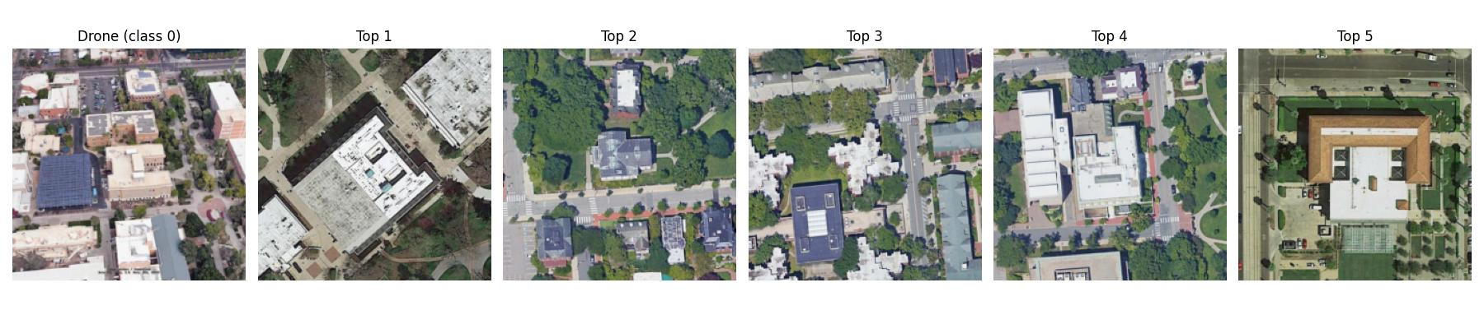
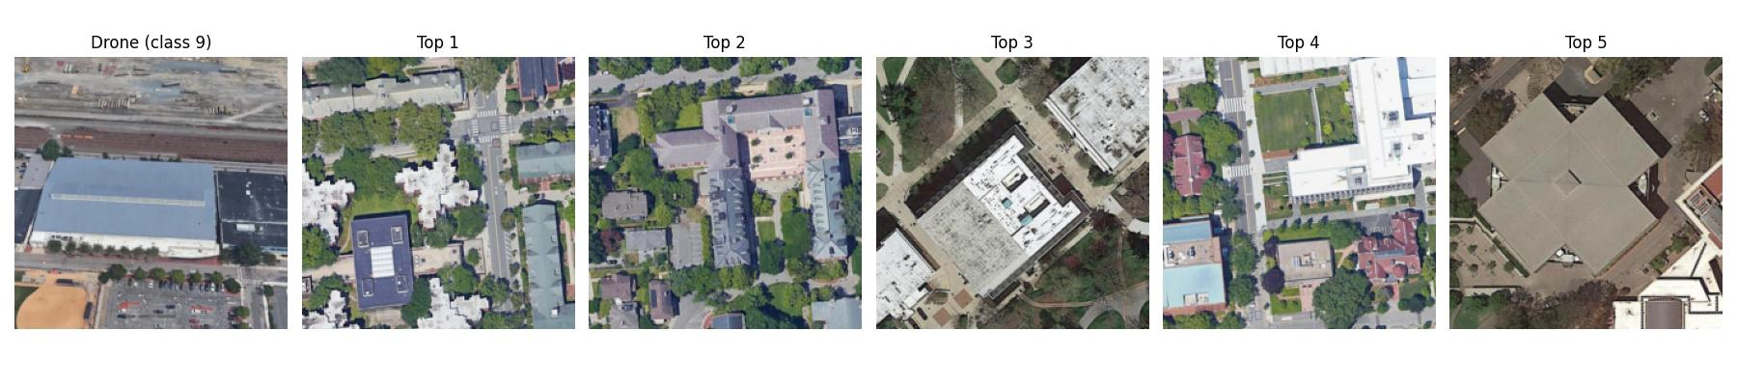
Visualization

Slide 9
Improving Drone-to-Satellite Retrieval with Averaged Query Embeddings
1- Fusion
Feature Extraction
Use the pretrained DualResNet model to extract feature embeddings separately for:
Gallery satellite images (view=1).
Drone query images (view=2).
Normalize the extracted features to unit vectors.
Multi-Query Fusion
Group all query features by their class labels.
For each class, compute the average of all query features belonging to that class.
This produces one fused feature vector per class, reducing noise and redundancy.
Performance Metrics
Recall@1 = 4.00%
Recall @5 = 14.00%
mAP = 11.10%

Slide 10
Improving Drone-to-Satellite Retrieval with Averaged Query Embeddings
2- Fusion & Filtering:
Identify good matches: gallery images with the same label as the query image.
Identify junk matches: gallery images labeled as irrelevant or noise (e.g., label = -1).
Remove junk images from the ranked retrieval list before evaluation.
Use only the filtered list to compute evaluation metrics like mAP and CMC.
This ensures the evaluation focuses solely on relevant (good) images, avoiding unfair penalties.
Performance Metrics
Recall@1 = 13.93 %
Recall @5 = 33.46 %
mAP = 24.38 %

Slide 11
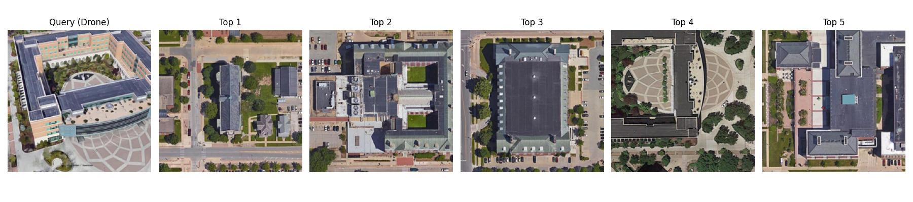
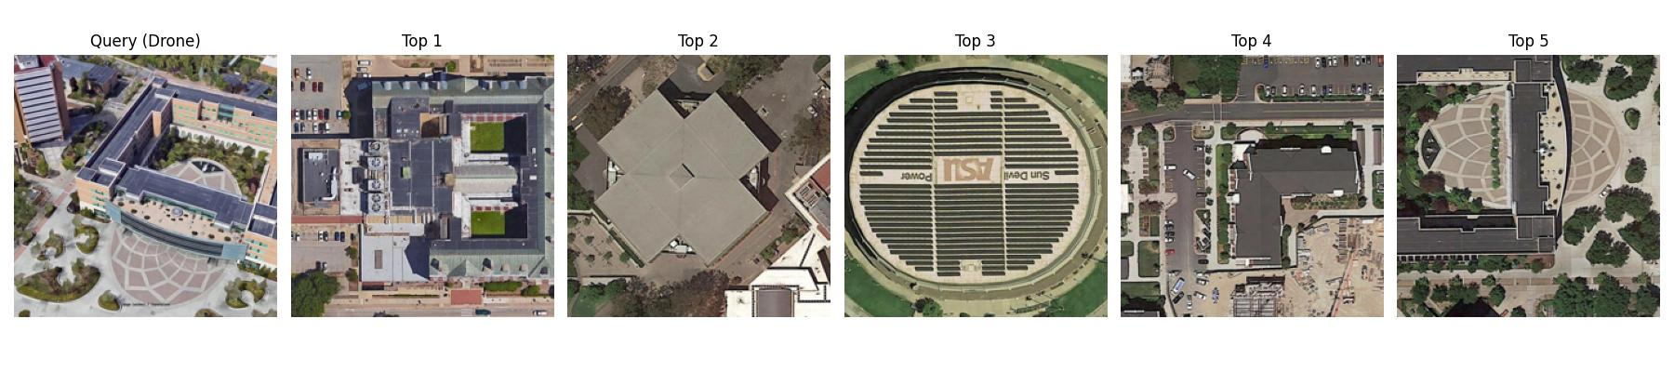
Visualization

Slide 12
Improving Drone-to-Satellite Retrieval with Averaged Query Embeddings
3- Re-ranking
For each query image, find its nearest neighbors from the gallery using initial distances.
Identify gallery images that share similar neighbors with the query (common local neighborhood).
Re-order the gallery list to prioritize images that belong to the same neighborhood group as the query.
This re-ranking boosts accuracy by focusing on groups of mutually similar images rather than isolated matches.
Performance Metrics
Recall@1 = 0.02%
Recall @5 = 4.78%
mAP = 5.68%

Slide 13
Improving Drone-to-Satellite Retrieval with Averaged Query Embeddings
4- Whitening
Model extracts raw features from images (query and gallery).
Compute whitening parameters (mean and projection matrix) from gallery features.
Subtract mean from both query and gallery features to center them.
Apply projection matrix to decorrelate and scale features (whitening).
Normalize the whitened features to unit length.
Use these processed features to compute similarity scores (e.g., cosine similarity or Euclidean distance) for evaluation.
Performance Metrics
Recall@1 = 1.5%
Recall @5 = 4.78%
mAP = 5.68%

Slide 14
Improving Drone-to-Satellite Retrieval with Averaged Query Embeddings
5- Test Time Augmentation
Extract features from the original image and its horizontal flip.
Average the two feature vectors to get a more stable representation.
Normalize the combined feature vector for consistency across samples.
Fusion: Combine features from two different views by concatenating their feature vectors to create richer representations.
Filtering: During evaluation, ignore irrelevant gallery images labeled as “junk” to focus only on meaningful matches for accurate metric calculation.
Performance Metrics
Recall@1 = 15.22%
Recall @5 = 34.76%
mAP = 25.80%

Slide 15
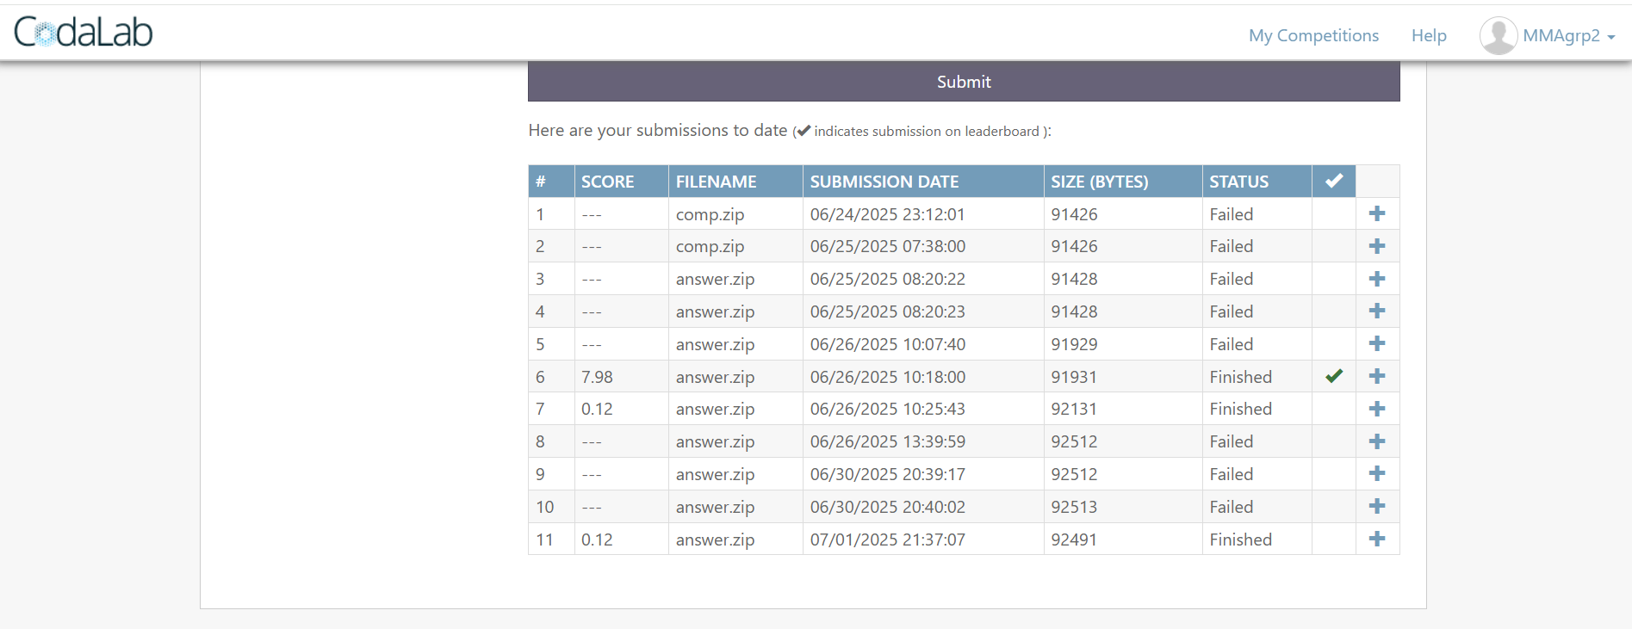
Codalab Challenge

Slide 16
Codalab on Fine Tuned Model
The pretrained DualResNet model is loaded, set to evaluation mode, and moved to the appropriate device (CPU or GPU).
Images are preprocessed by resizing, converting to tensors, and normalizing using standard ImageNet statistics.
Each image is read, converted to RGB, preprocessed, and passed through the two separate branches of the model to extract features from both views.
The features from both views are concatenated and then normalized to form a single fused feature vector.
Features for all gallery images are extracted in a loop, with invalid images skipped, and stored alongside their filenames.
Similarly, features for all query images are extracted, fused, and stored, skipping any images that cause errors.
A cosine similarity matrix is computed between all query features and gallery features to measure their similarity.
For each query image, the top 10 most similar gallery images are identified and written to an output file with their filenames.

