Slide 1
INFORMATION KIT
No drought declarations needed – help is always available
November 2025

Slide 2


About this kit
Drought affects us all—and supporting rural communities is a shared responsibility. The Australian Government is working with banks, through the Australian Banking Association, to ensure farmers and agribusiness are informed and supported during times of drought.
This digital toolkit has been developed to help farmers and agribusinesses understand that drought declarations are no longer made by the Australian Government—and are not required to access support. ABA member banks strongly encourage customers experiencing financial difficulty to reach out early and access available support services. Timely engagement can make a real difference.
All content in this kit is freely available to share across websites, newsletters, and social media platforms. We encourage you to use and distribute this information to help keep your community informed and resilient.
Please click below to navigate to your relevant section.
Website & newsletter content
Social media content

Slide 3
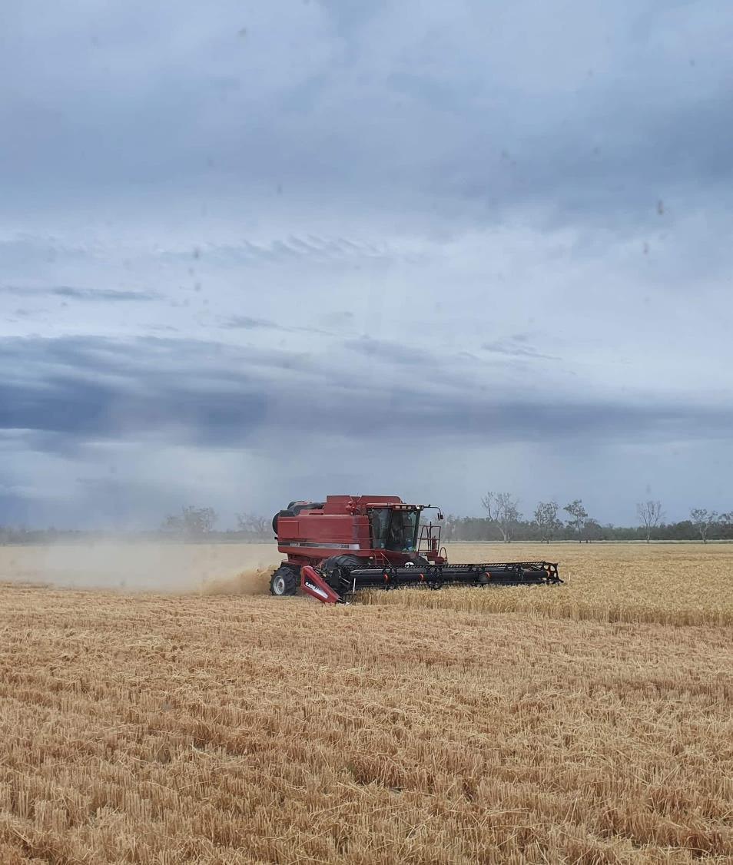
Website & newsletter content

Slide 4

Newsletter content
Drought Support: What You Need to Know
Drought support is available—without the need for a formal drought declaration. The Australian Government no longer makes drought declarations, instead providing ongoing access to a wide range of support programs to help prepare for, manage through, and recover from drought.
In partnership with the Australian Banking Association, the Australian Government is working to ensure farmers and agribusinesses are informed and ready.
If you're experiencing financial pressure, contact your bank early—help is there when you need it.
🔗 drought.gov.au – Learn about Australian Government drought policy and support 🔗 ausbanking.org.au/financial-assistance-hub – See how lenders can help
No drought declarations needed to access support
The Australian Government no longer makes formal drought declarations. Instead, support is provided based on individual needs and circumstances—meaning help is always available to assist farmers and agribusinesses—whether they are preparing for, managing through or recovering from drought.
The Australian Government and Australian Banking Association are working together because banks can play a vital role in supporting Aussie farmers experiencing hardship. If you're experiencing financial stress, don’t wait—contact your bank early. They have dedicated teams ready to talk through your options and help find the right solution for your situation.
This approach reflects over 40 years of learnings and feedback. The Australian Government now focuses on building resilience, preparedness, and financial self-reliance through a range of national programs—available whenever you need them.
If you're experiencing financial pressure, contact your bank early—help is there when you need it.
🔗 drought.gov.au – To learn about Australian Government drought policy and support 🔗 ausbanking.org.au/financial-assistance-hub – To see how lenders can help

Slide 5

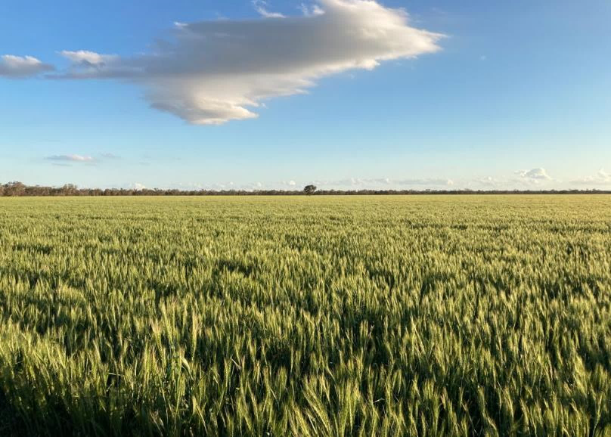
Website content
No drought declarations needed, support is always available
You don’t need a drought declaration to get support from your bank or to access Australian Government programs.
The Australian Government no longer makes formal drought declarations. Instead, a range of support options are available for customers experiencing hardship—to help farmers and agribusinesses prepare for, manage through, and recover from drought.
Banks can help too. If you're a farmer or agribusiness feeling financial pressure, contact your lender early. They have dedicated teams ready to help.
🔗 drought.gov.au – Learn about Australian Government drought support 🔗 ausbanking.org.au/financial-assistance-hub – See how lenders can help
Support is always available—no drought declarations needed.

Slide 6
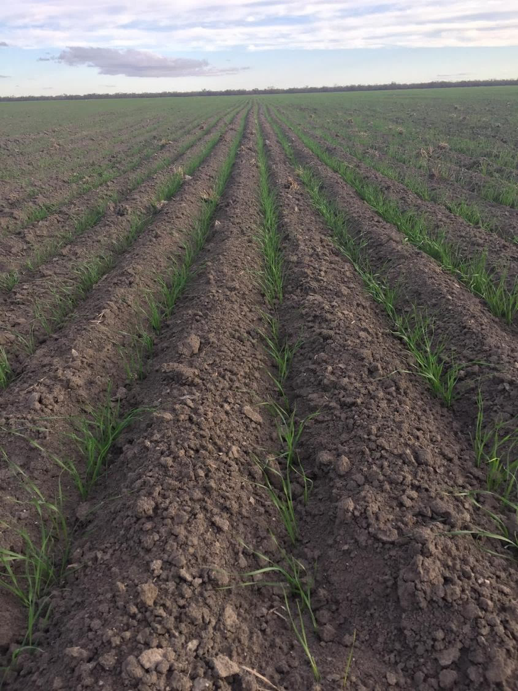
Social media content

Slide 7


LinkedIn & Facebook
No drought declaration needed to get support
The Australian Government no longer makes drought declarations with support always available to farmers and agribusinesses through government programs and their bank.
The Australian Government and the Australian Banking Association are working together to ensure farmers, agribusinesses and rural communities are informed and supported during tough times.
If you're experiencing financial pressure, contact your lender early—help is there when you need it.
🔗 drought.gov.au 🔗 ausbanking.org.au/financial-assistance-hub
#DroughtSupport #RuralAustralia #FinancialHelp #NoDeclarationNeeded #WorkingTogether
You don’t need a drought declaration to get help.
The Australian Government no longer makes formal drought declarations. Instead, support is always available—through government programs and financial institutions working to help farmers, agribusinesses and rural communities prepare for, manage through, and recover from drought.
Banks have dedicated teams ready to support customers doing it tough. If you're feeling financial pressure, reach out early.
✅ No declaration needed ✅ Help is available ✅ We're working together
🔗 drought.gov.au 🔗 ausbanking.org.au/financial-assistance-hub
#DroughtSupport #FarmFinance #AustralianAgriculture #NoDeclarationNeeded #CommunityResilience

Slide 8

X/Twitter
The Australian Government no longer makes drought declarations. But support is always available.
Farmers and agribusinesses impacted by drought can access support from the Australian Government and banks—no declarations needed.
🔗 drought.gov.au 🔗 ausbanking.org.au/financial-assistance-hub
#DroughtSupport #AusAg #NoDeclarationNeeded
You don’t need a drought declaration to get help.
The Australian Government now provides support based on need—not declarations.
@ausbanking and lenders across Australia are part of the solution.
Reach out early. Support is available.
#NoDeclarationNeeded #RuralSupport #AusAg

Slide 9

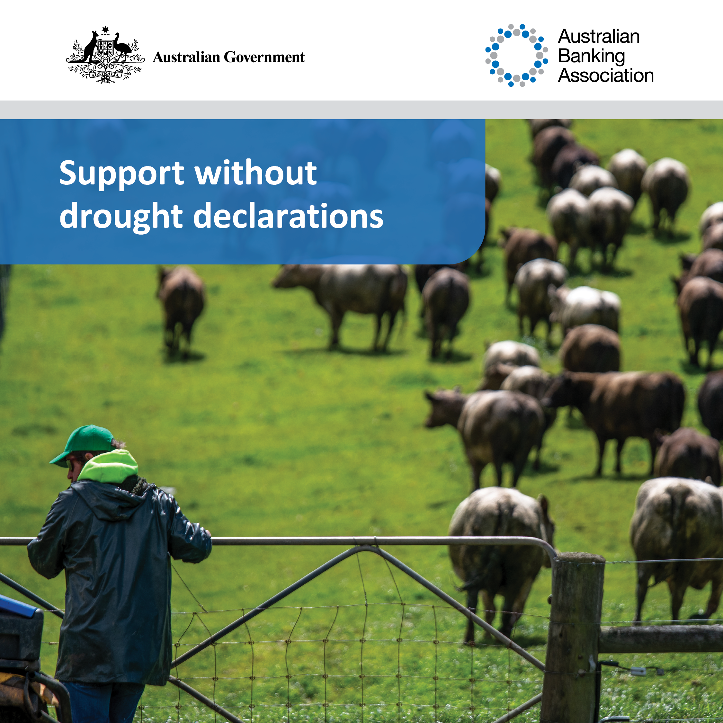
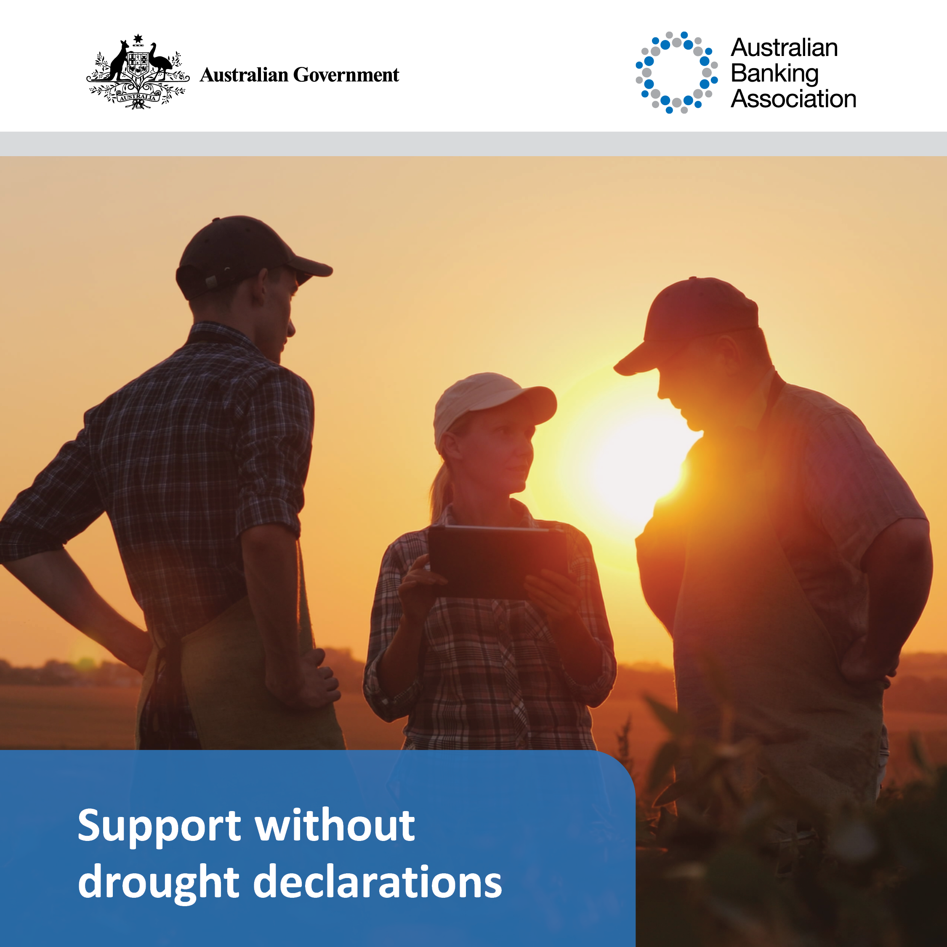
Images for use with social media

Slide 10
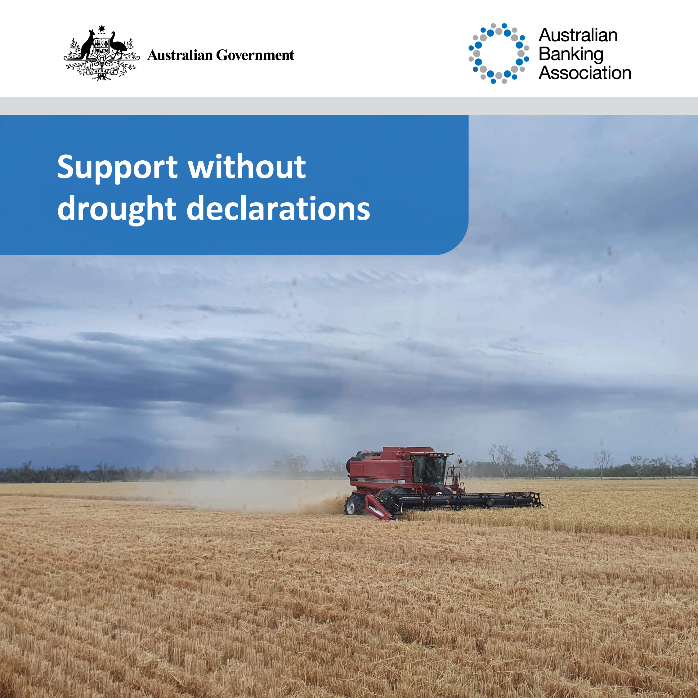
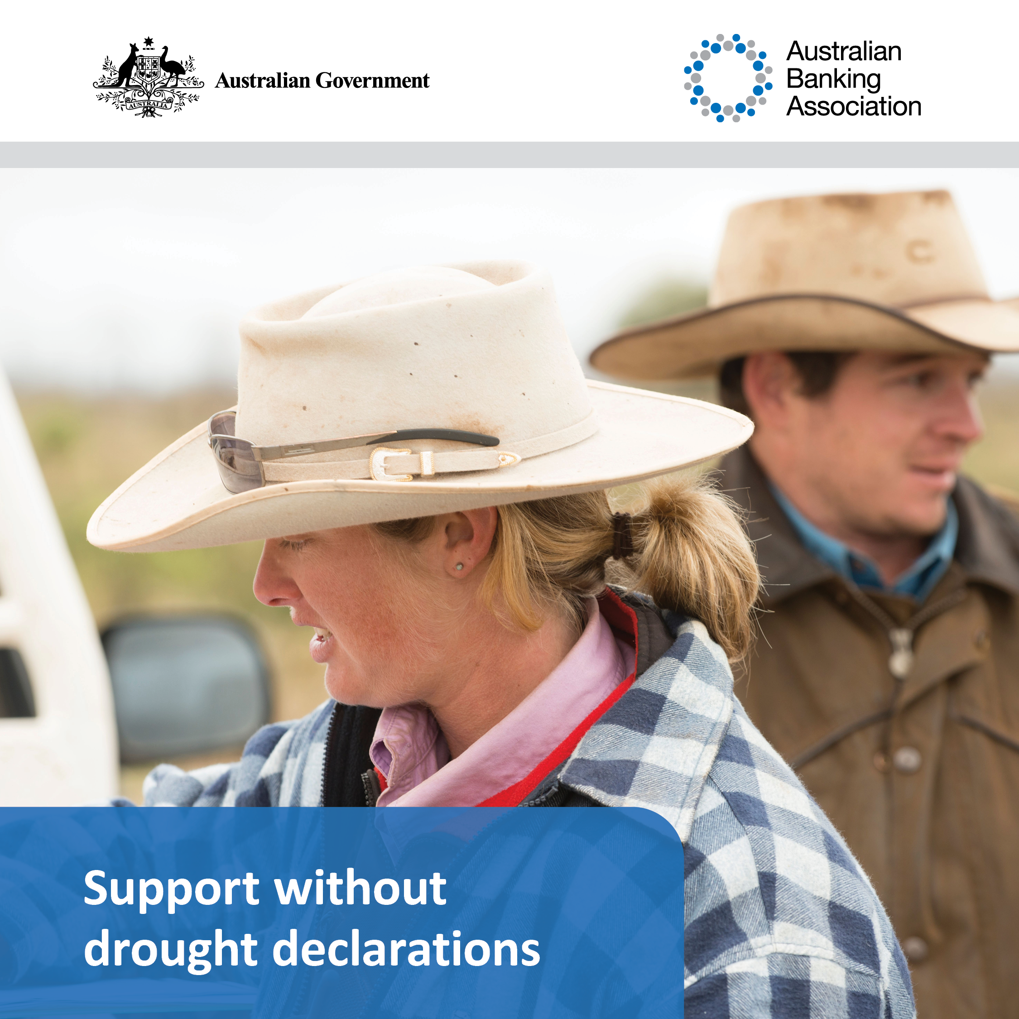
Images for use with social media

