Slide 1




Industry Information Session
2025-26 BMSB Seasonal Measures
01 September 2025
Candice Somerville
Assistant Director | Hitchhiker Pests Policy
Notes:
Welcome everyone to the 2025–26 BMSB Season Update. My name is ………. Today we’ll walk through upcoming BMSB season and the key updates in comparison from last season.

Slide 2

Agenda
Acknowledgement of country
2024-25 BMSB season review
Measures for the upcoming BMSB season
Questions
Target Goods, Countries and Dates
Containerised vs Break Bulk
BMSB Treatments
Safeguarding Scheme
NUFT and 120 hours
Verification Inspections
Sealing Declarations
In-transit & Rolled Policies
Emerging Risk Countries
UPEs and Concessional Tariff 99
Management of LCL/FAK Containers
ICS Reporting
Notes:
'I'd like to begin by acknowledging the Traditional Custodians and Owners of the land and/or water on which we meet today. I'd also like to acknowledge their Elders - past and present, and any other Aboriginal or Torres Strait Islander peoples who may be present here today.’
Today we’ll walk through the topics listed on this screen. If you have questions, please use the Q&A button at the top right of your screen. For complex or scenario-specific queries, howeverwe do ask that you email us directly so we can provide detailed responses and follow-up support.
For any questions related to treatment provider approvals, suspensions, or treatment procedures, please email: offshoretreatments@aff.gov.au.

Slide 3





2024-25 BMSB Season Review
BMSB Detections
 |  | 2023-24 1 Sept – 19 June | 2024-25 1 Sept – 18 June
 | Condition | Number of Detections
Biosecurity Intervention Point | Alive | 21 | 12
 | Dead | 151 | 164
Post Biosecurity | Alive | 8 | 37
 | Dead | 7 | 6
Total |  | 187 | 219
YSSB Detections
 |  | 2024-25 1 Sept – 18 June
 | Condition | Number of Detections
Biosecurity Intervention Point | Alive | 24
 | Dead | 97
Post Biosecurity | Alive | 2
 | Dead | 0
Total |  | 123
46 AIMS entries
with BMSB
detections.
5,340 BMSB entries lodged through AEPCOMM.
66,396 Whitelisted consignments
treated offshore.
313 SPIs performed on Roll-On Roll-Off vessels.
88,690 Total entries referred into AIMs
for BMSB.
2,859 consignments with a BMSB profile directed for inspection.
232 Registered
AusTreat treatment providers.
104 Consignments directed for export for arriving non-compliant.
Notes:
Looking at last season’s data, we saw an increase in total BMSB detections, particularly post-biosecurity. While we haven’t identified a specific factor or pathway responsible for this rise, these insights have helped shape our approach for the coming season.
We’ve also included data on Yellow Spotted Stink Bug (YSSB) for the first time. Although there are currently no plans to target YSSB in the same way as BMSB, we’re closely monitoring developments in this area.
This data reinforces the importance of maintaining strong biosecurity measures and adapting our strategies based on emerging trends.

Slide 4
2025-26 BMSB Seasonal Measures
Measures apply to goods shipped between 1 September and 30 April (inclusive) as sea cargo. Any target high risk or target risk goods manufactured in, or shipped from a target risk country are subject to the BMSB seasonal measures:
Target high risk goods – mandatory treatment
Target risk goods – subject to random inspection
Any vessel that berths at, loads or tranships goods from these countries are also subject to heightened vessel surveillance.
Japan and Republic of Korea have been added to the emerging risk country list along with the United Kingdom and China.
Airfreight from USA and China will now be subject to random verification inspections.
Notes:
Seasonal measures apply to sea cargo shipped between 1 Sept and 30 April. Target high risk goods require mandatory treatment. Japan, Korea, UK, and China are now emerging risk countries. We are also looking at Airfreight from USA and China which will now be subject to random inspection only, mandatory treatment for airfreight will not be required.

Slide 5









































2025-26 BMSB Target Risk Countries
USA
Belgium
Germany
Luxembourg
Romania
Turkey
Canada
Bosnia and Herzegovina
Greece
Moldova, Republic of
Russia
Ukraine
Albania
Bulgaria
Hungary
Montenegro
Serbia
Uzbekistan
Andorra
Croatia
Italy
Netherlands
Slovakia
Armenia
Czechia
Kazakhstan
North Macedonia
Slovenia
Austria
France
Kosovo
Poland
Spain
Azerbaijan
Georgia
Liechtenstein
Portugal
Switzerland
Heightened vessel surveillance only
Japan
China
Republic of Korea
Notes:
The full list of target risk countries has not changed from the 2024-25 season. Goods from these countries are subject to BMSB measures. Note the addition of Japan, China, and Korea under heightened vessel surveillance.

Slide 6
Containerised vs Break Bulk
Break Bulk
Includes all flat rack and open top containers.
All target high risk goods shipped as break bulk must be treated offshore.
No allowances will be made for untreated break bulk and goods will be directed for export.
Must be shipped on board within 120 hours of the completion of treatment (if treated in a target risk country prior to 1 December).
FCL containers (inc. SOCs) that have been modified, such as those used to house in-built power generators, portable workshops etc., are considered break bulk.
Containerised
Refers to sealed six hard sided containers - general purpose/dry box.
Refrigerated containers (operating or non-operating) fall into this category and are subject to the measures.
Has the option for onshore treatment.
Must be sealed within 120 hours of treatment completion (if treated prior to 1 December in a target risk country).
Hard top open tops (ISO22U6/ISO22UP, ISO42U6/ISO42UP and ISO45U6/ISO45UP) are deemed to be a sealed six hard sided container.
Notes:
Break bulk which includes flat rack and open top containers and must be treated offshore. Containerised goods can be treated onshore but must meet sealing requirements. Modified containers are treated as break bulk.

Slide 7
BMSB Approved Treatments
Offshore Treatment Providers
Four approved BMSB treatment types BMSB:
All treatment providers in target risk countries that intend to conduct BMSB treatments must register under AusTreat.
Treatment providers in non-target risk countries that intend to conduct BMSB treatments are encouraged to register under AusTreat however, it is not mandatory.
All queries relating to offshore BMSB treatment requirements, methodologies and provider registrations and approvals to be directed to offshoretreatments@aff.gov.au.
Onshore Treatment Providers
Three approved arrangement (AA) classes support onshore treatment providers to manage BMSB:
12.1 - Methyl Bromide fumigation
12.2 - Sulfuryl Fluoride fumigation
12.3 - Heat treatment
Class 4.7 AA site:
Class 4.7 allows a container unpack within a secure environment to enable effective treatment of the goods.
Requests must be sent by the treatment provider to the onshore treatments team via email (treatments@aff.gov.au).
To reduce delays at the border, the department recommends that industry treat offshore or pack containers to allow effective onshore treatment.
Methyl Bromide
Sulfuryl Fluoride
Ethyl Formate
Heat treatment
Notes:
Methyl Bromide, Sulfuryl Fluoride, and Heat Treatment are approved for both onshore and offshore use. In addition to these, this season we’ve approved Ethyl Formate as a new treatment option for BMSB—but only when performed offshore. Onshore use of Ethyl Formate is anticipated for the 2026–27 season, pending further policy development.
All offshore treatment providers must be registered with the department and listed as approved on the departments list of treatment providers for the treatment to be considered acceptable, and onshore treatments must occur at AA holding a AA class 4.7. For any questions, please refer to the contact details provided on the slide.

Slide 8
BMSB Safeguarding Scheme
The Safeguarding Arrangements Scheme (the scheme) offers an alternative clearance pathway for BMSB targeted goods shipped in a sealed six hard sided container from risk countries during the BMSB risk season, 1 September to 30 April. Safeguarding Arrangement applications will be open between 31 July 2025 and 30 January 2026.
To uphold the standard and effectiveness of the scheme, the department has introduced several mandatory and important changes for the 2025-26 BMSB (Brown Marmorated Stink Bug) season.
Key updates include a revised application form, and the introduction of the mandatory use of the Mitigation and Contingency Plan templates.
Each consignment must be accompanied by a completed safeguarding declaration covering all safeguarded goods within the consignment.
All entries containing safeguarded goods, will be directed for a document assessment at a 100% intervention rate.
Use of AEPCOMM to clear safeguarded goods is not permitted.
These changes will provide the department with a more in depth understanding and assurance when determining if the supply chain has the robust measures in place to prevent their goods from being exposed to and contaminated with BMSB and other exotic pests.
Notes:
The Safeguarding Scheme offers an alternative clearance pathway. New requirements include mandatory templates and declarations. AEPCOMM cannot be used for safeguarded goods.

Slide 9
BMSB NUFT and 120 hour window
BMSB NUFT
Goods that can meet all the following criteria will not be subject to mandatory BMSB treatment:
The goods were manufactured on or after 1 December? (manufacture must start from 1 December of the current BMSB risk season).
The goods are classified under the following tariff chapters only: 82, 84, 85, 86, 87, 88 and 89?
Evidence can be provided in the form of a BMSB NUFT (new, unused and not field tested) manufacturers declaration that the goods were manufactured on or after 1 December?
NUFT declarations must state the manufacture start date - refurbishments are ineligible.
NUFT declarations can be used for FCL, LCL/FAK and break bulk (including open top and flat racks).
120 hour post treatment window
Goods treated in a target risk country are subject to the 120 hour post treatment window when treated prior to 1 December
Containerised goods must be sealed in the container.
Break bulk goods (incl. open top, flat rack and modified containers) must be shipped on board the vessel.
The ‘shipped on board’ date is considered the date listed as shipped or laden on board as per the ocean bill of lading. Original “ETDs” and “Gate in” dates and times are not acceptable.
The 120 hours does NOT apply to:
Goods treated in non-target risk countries.
Good treated after 1 December.
120 hour transhipment window
Breakbulk goods that tranship in a target risk country prior to 1 December, are subject to the 120 hour window. Does not apply to sealed containers.
Notes:
Goods treated before 1 Dec in target risk countries must meet the 120-hour window. Goods are only exempt from the meeting the 120 hours post window treatment in instances where the treatment occurs on or after 1 Dec OR if the goods are treated in a non target risk country.
NUFT declarations exempt certain goods from treatment if manufactured after 1 Dec and meet specific tariff codes.

Slide 10
Verification Inspections
Random verification inspections for sea cargo
All goods sent for random verification inspection must be conducted at a 1.1, 1.3, 2.1 or 2.2 AA (where approved) in a metropolitan location. The container will be permitted to be dehired prior to inspection.
For entries with multiple containers, containers not selected for inspection will be permitted to be delivered and deconsolidated.
The department may permit inspections at a non-approved AA location / importers premises where containers can be unpacked with the appropriate equipment if required. For approval, please contact the Inspections Group in the corresponding regional office on 1800 900 090.
Inspections conducted at a non-approved AA location or importers premises, will be required to be completed as seals intact inspections under Biosecurity supervision.
Random verification inspections for airfreight
Random inspections will apply to target high risk goods shipped as airfreight from United States of America and China between 1 September to 30 April (inclusive). BMSB treatment of these goods will not be required.
Notes:
Random inspections apply to sea and air cargo. Sea cargo inspections must occur at approved sites. And again, airfreight from USA and China will be inspected randomly but not subject to mandatory treatment.

Slide 11
BMSB sealing declarations
Sealing declarations will be accepted by the department to verify:
goods have been sealed in a six hard sided container in a target risk country prior to 1 September,
goods have been sealed in a six hard sided container in a non-target risk country prior to being shipped from a target risk port at any time within the BMSB season, or
goods have been treated and sealed in a six hard sided container within the 120-hour post treatment window.
Sealing declarations must be completed by the exporter/freight forwarder/shipping company at the port of origin. Australian based importers/brokers cannot sign off on these declarations, and they will not be accepted by the department.
Sealing declarations cannot be used for open top, flat rack or modified containers.
Notes:
Sealing declarations verify compliance with treatment and sealing timelines must be completed at the port of origin and are not valid for break bulk, FR or OT or modified containers.

Slide 12
In-Transit Policy
In-Transit Policy
Break bulk (including flat rack and open top containers) that were shipped on board on or prior to the relevant treatment provider being placed under review or suspended, or that have shipped on board a vessel within 120 hours after the suspension (goods in-transit to Australia at the time of status change), will be permitted to discharge/unload on arrival only if there is an approved risk management plan (RMP) in place. This (RMP) will be in the form of an approved ‘In-Transit Application’.
As part of the application requirements, the completed form must include:
A copy of the original treatment certificate.
A copy of the Bill of Lading that includes a shipped on board date.
Written evidence from the entity engaged to perform the tarping, confirming the tarping will be performed within 24 hours of discharge.
Written evidence from the wharf operator, confirming access will be provided to the 3rd party to allow tarping to be performed within 24 hours of discharge.
Written evidence from the entity (AA class 4.6) engaged to perform the treatment, confirming the treatment will be performed within 24 hours of the tarping being verified by a DAFF officer prior to movement to the nominated AA.
Notes:
Goods in transit during provider suspension may be discharged if an approved risk management plan is in place. Specific documentation and timelines are required. This season we have introduced a standardised application form to streamline the application process – this application form can be downloaded from our webpage.

Slide 13
Rolled Goods Policy
In-Transit Policy
There are provisions in the measures that enable break bulk (including open top and flat rack containers) to be retreated onshore within 48 hours of arrival if they have exceeded the 120 hour post treatment window by less than 48 hours (making total post treatment window time 168 hours) due to being delayed in the load port by the shipping line. This will now be managed via a ‘Rolled Goods Application’.
As part of the application requirements, the completed form must include:
A copy of the original treatment certificate.
A copy of the original booking that includes the intended shipping date.
Evidence from the shipping line that the goods were rolled to another booking.
Evidence of the rebooked voyage and actual shipped on board date.
Written evidence from the entity engaged to perform the tarping, confirming the tarping will be performed within 24 hours of discharge.
Written evidence from the wharf operator, confirming access will be provided to the 3rd party to allow tarping to be performed within 24 hours of discharge.
Written evidence from the entity (AA class 4.6) engaged to perform the treatment, confirming the treatment will be performed within 24 hours of the tarping being verified by a DAFF officer prior to movement to the nominated AA.
Notes:
Goods delayed at the port due to the shipping line may be eligible for onshore retreatment if the delay is no more than 48 hours—meaning the shipped-on-board date is within 168 hours of treatment completion.
This season, we’ve introduced a standardised application form to streamline the process. The form is available for download from our webpage.
For both In-Transit and Rolled Goods applications, we strongly encourage importers or brokers to apply for retreatment as early as possible and prior to arrival. This helps ensure eligible consignments receive timely approval and directions, reducing container dwell time at the wharf and efficiently managing BMSB risk.

Slide 14

Emerging Risk Countries
The department has recognised the United Kingdom, China, Japan and the Republic of Korea as an emerging risk country only, therefore target high risk goods (with the addition of chapters 39, 94 and 95) that are manufactured in and shipped from these countries, will be subject to random inspections only.
BMSB fumigation for these goods will not be required.
However, if the goods were manufactured in a target risk country, then shipped to the emerging risk country for export, they will be subject to BMSB seasonal measures including mandatory treatment if they were shipped within season.
Emerging risk only - Treatment not required
United Kingdom
Japan
China
Republic of Korea
Notes:
Goods from UK, China, Japan, and Korea are subject to random inspections only. However, if manufactured in a target risk country and shipped via an emerging risk country, full measures apply.

Slide 15
UPEs and Concessional Tariff 99
Unaccompanied Personal Effects (UPEs)
Household goods and personal effects imported as unaccompanied personal effects (UPEs), and that are categorised as target high risk goods will not be subject to mandatory treatment requirements if they are imported as UPEs under the B534 form. However, goods that are required to be reported under a Full Import Declaration (FID), for example motor vehicles and motorbikes or goods not meeting UPE clearance requirements, will require mandatory BMSB treatment either offshore or onshore (if permitted).
Describing the goods as UPEs in the description is not enough to deem these goods out of scope for BMSB, neither is providing the B534 that was lodged for the goods; they must be approved by ABF to be reported under the concessional tariff chapter 99. If ABF have not approved chapter 99 to be utilised for the whole consignment on a B534 form and the goods are reported individually on a FID, then for the purposes of BMSB they are not considered UPEs and are subject to the same BMSB seasonal measures including mandatory treatment as all other imports.
Note: This exemption is only for UPEs that meet the above criteria and is not applicable to any other goods reported under concessional tariff 99 (e.g., goods for diplomatic / government / military use etc).
Carnets and diplomatic goods are not exempt from BMSB seasonal measures.
Notes:
UPEs under B534 and approved for tariff 99 are exempt from treatment. Goods reported under FID or not where the B354 is not endorsed/approved by ABF must comply with BMSB measures. Diplomatic goods are also not exempt.

Slide 16
Management of LCL/FAK Containers
Less than Container Load (LCL) and Freight All Kinds (FAK) containers with target high risk goods that are shipped from target risk countries between 1 September and 30 April (inclusive) are managed at the container level for BMSB risk prior to deconsolidation.
All LCL/FAK containers with a Seasonal Pest hold (SP HOLD) in ICS are required to have a Master Consolidator (MC) declaration submitted declaring the BMSB risk status of the container via the MC online portal.
All MCs must register their company as a MC and identify individual users via a unique email address on the MC registration form. Each individual submitting declarations is required to have their own User ID and login.
For all questions and information related directly to BMSB LCL / FAK declarations, assessments, directions and / or MC declaration lodgements, email BMSB Processing Team on BMSBprocessing@aff.gov.au. Hitchhiker Pests Policy will not action any emails relating to MC declaration submissions or the assessment/release of associated containers and/or AIMs entries.
Authenticator Issues
Users that have previously registered, however, have changed phones or phone numbers, may have difficulties logging into the portal with their authenticator code. In these instances, please email HPP@aff.gov.au to get a reset of your login.
Notes:
LCL/FAK containers are managed at the container level. MC declarations must be submitted via the online portal. Authenticator issues can be resolved by contacting HPP

Slide 17
ICS Reporting
Amending the cargo type from LCL to FCL
Once a cargo type is declared as an LCL in the Integrated Cargo System (ICS), a Seasonal Pest Hold (SPHOLD) will be systematically applied. This hold will remain on the container even after an amendment has been made to the cargo type. If you originally declared your container as an LCL and then amend the cargo type to a FCL / FCX, please contact BMSBprocessing@aff.gov.au with evidence of the correct container type (i.e., BOL), to have the SPHOLD lifted.
ICS amendments & late reporting
It is important to ensure all reporting has been done prior to unpack, as all goods will be profiled as they are reported and an SPHOLD can be triggered at any time during the reporting if the goods are subject to measures.
Note: Amendments will cause the cargo to run through the profiles again which may result in containers out of scope having holds applied after they have been unpacked and delivered. If this is the case, please email BMSBprocessing@aff.gov.au, and they will be able to evaluate the container and lift the hold if required.
Notes:
Amending cargo type in ICS can trigger holds. To reduce delays please ensure accurate reporting before unpacking. Contact BMSBprocessing for hold removals or reporting issues.

Slide 18
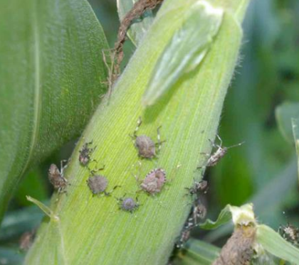
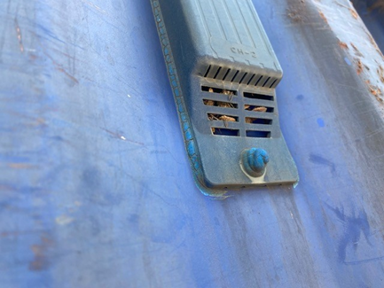
Industry’s role in Biosecurity
See. Secure. Report
Working with offshore suppliers to manage not just BMSB risk, but all pest risks.
Stay updated on the BMSB seasonal measures by visiting the following webpages www.agriculture.gov.au/bmsb.
Subscribe to our Import Industry Advice Notices to get updates on changes to import requirements, including updates on Brown marmorated stink bug seasonal measures https://subscribe.agriculture.gov.au/subscribe.
Recommend watching webinar: Managing the risk of a serious hitchhiker pest.
https://www.agriculture.gov.au/biosecurity/australia/public-awareness/webinar-series
Notes:
Industry plays a vital role in biosecurity. Stay informed via our website and subscribe to updates.

Slide 19
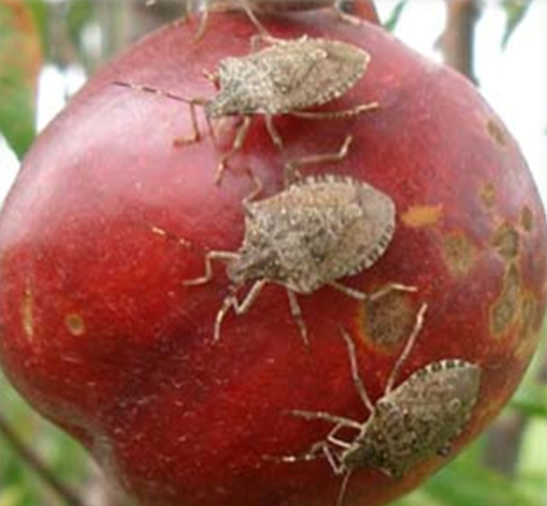


Summary
Key changes
The addition of Japan and the Republic of Korea to the emerging risk country list.
Airfreight from the USA and China will now be subject to random verification inspections.
Changes in the management of In-Transit and Rolled goods via a dedicated form.
Changes to the Safeguarding Scheme evidence requirements.
Questions:
Policy for Hitchhiker Pests: hpp@aff.gov.au
Safeguarding: safeguarding@aff.gov.au
BMSB Treatments (including registration and approval of offshore treatment providers): offshoretreatments@aff.gov.au
Notes:
Recapping on the key changes include new emerging risk countries, airfreight inspections, and updated safeguarding and rolled/transit policies. Contact details are provided for further queries.

