Slide 1


MANAGEMENT OF LCL / FAK CONTAINERS
15 August 2023

Slide 2
Agenda
Acknowledgement of country
When to lodge an MC declaration
How to register as an MC
How to access the new portal
Types of MC declarations
Nil Risk
Treated Onshore
Treated Offshore
Partially Treated Offshore
Unknown Risk
Common Holds and ICS messages
SPHOLD
COND REL
SPREF
GAS
Common scenarios and solutions
Change of SCR type from LCL to FCL / FCX
SP Hold still present after lodgement
Changing a declaration type
FIXLOC directions
Department contacts
Questions

Slide 3
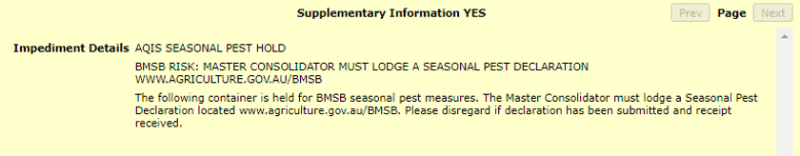
When to lodge an MC declaration
LCL / FAK containers are managed for BMSB risk at the container level. This includes LCL consignments that are manufactured in and / or shipped from a target risk country, between 1 September and 30 April (inclusive).
If your LCL / FAK container is subject to the measures when the cargo report is lodged, it will be referred for a Seasonal Pest hold (SPHOLD), and the cargo reporter will receive a message that an MC declaration is required to be submitted – see below. If you believe your cargo is not subject to the measures, a Nil Risk MC declaration will still be required to lift the hold.
Note: You will need to provide appropriate documentation that verifies your container is out of scope.
Important: If your LCL / FAK container does not have an SPHOLD at the container level and you do not receive this message in the ICS, DO NOT SUBMIT AN MC DECLARATION – your LCL / FAK container is not subject to BMSB seasonal measures and does not require a declaration to be lodged for clearance.

Slide 4
How to register as an MC
Master Consolidators intending to provide declarations about LCL / FAK containers to the department must register their company as a Master Consolidator and identify individual users via a unique email address on the Master Consolidator Registration form.
Each user who intends to submit MC declarations, is required to register as a User under the MC ID for their company. Each individual submitting declarations is required to have their own User ID and login. Sharing of User ID’s will be recorded as a non-compliance for the Master Consolidator and may result in increased intervention of LCL / FAK containers.
Once registered, the department will provide users with an email containing your MC ID, a temporary password, and a link to the online declaration form to set your own password. You must use your own unique login to lodge a MC declaration.
Registration Forms can be found here:
https://www.agriculture.gov.au/biosecurity-trade/import/before/brown-marmorated- stink-bugs/lclcontainers#master-consolidator-registrations
Completed Master Consolidator registration forms are to be sent to SPP@aff.gov.au.

Slide 5
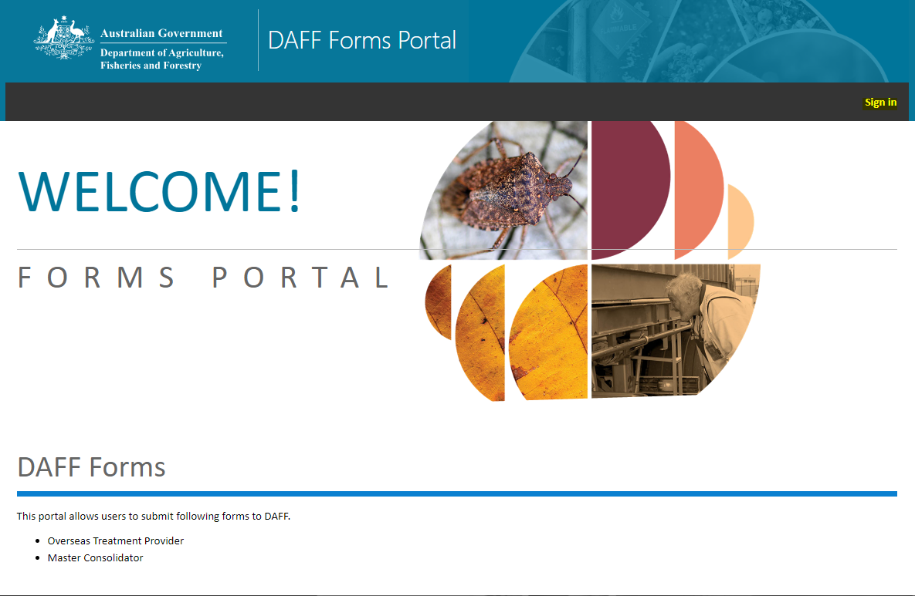
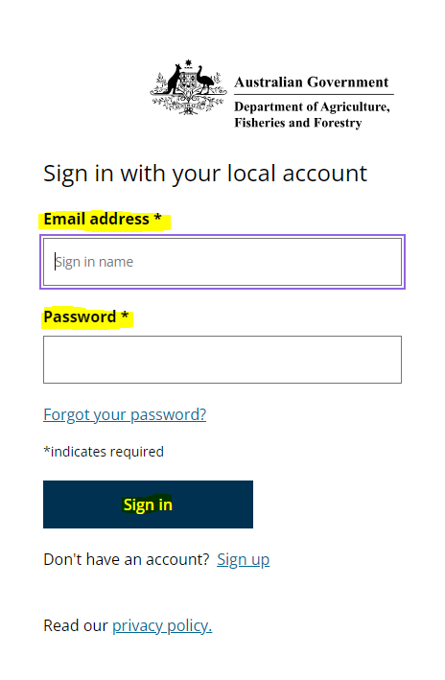
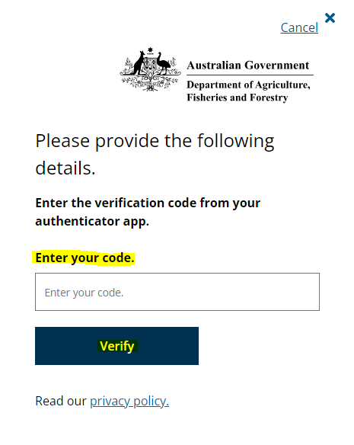
How to access the new portal
Once you have registered and have received your MC ID, log on to the departmental portal using your registered username, password and two factor authenticator code.
The Master Consolidator Declaration form can be accessed through the department portal via https://portal-forms.agriculture.gov.au
Detailed instructions on how to login and lodge a Master Consolidator Declaration Form and troubleshooting information is available at: https://www.agriculture.gov.au/sites/default/files/documents/master-consolidator-user-guide.pdf.

Slide 6
Types of MC declarations
There are five risk status types that can be declared:
Treated offshore - the entire container with target high risk goods has been treated offshore, or
Partially treated - all the target high risk goods inside the container have been treated offshore, or
Treatment onshore - the entire container is nominated for onshore treatment, or
Nil risk - the entire container does not have any target high risk goods inside, or
Unknown risk - the contents of the container are unknown and nominated to be held at an
approved arrangement (AA) site pending further information to be provided.
Important: You must ensure that details entered for the ‘Vessel Id’ and ‘Voyage Number’ match exactly what has been declared in ICS on the sea cargo report. If this information does not match, the system cannot release the hold on your container.

Slide 7
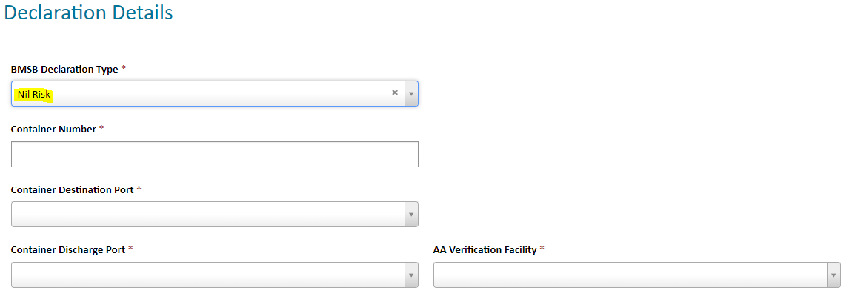
Nil Risk
All goods within the container are Nil risk and do not meet any of the criteria outlined in the BMSB seasonal measures by the department. This also includes containers that have been shipped out of season but have still been flagged whilst the BMSB profiles are active in ICS.
DO NOT use this option unless everything within the container is out of scope for BMSB seasonal measures. If there are target high risk goods within the container that have been treated and the balance is Nil risk, you will have to use the “Partially Treated” option as the “Nil Risk” option is not the correct declaration type to lodge for this scenario and may result in a non-compliance being issued.

Slide 8
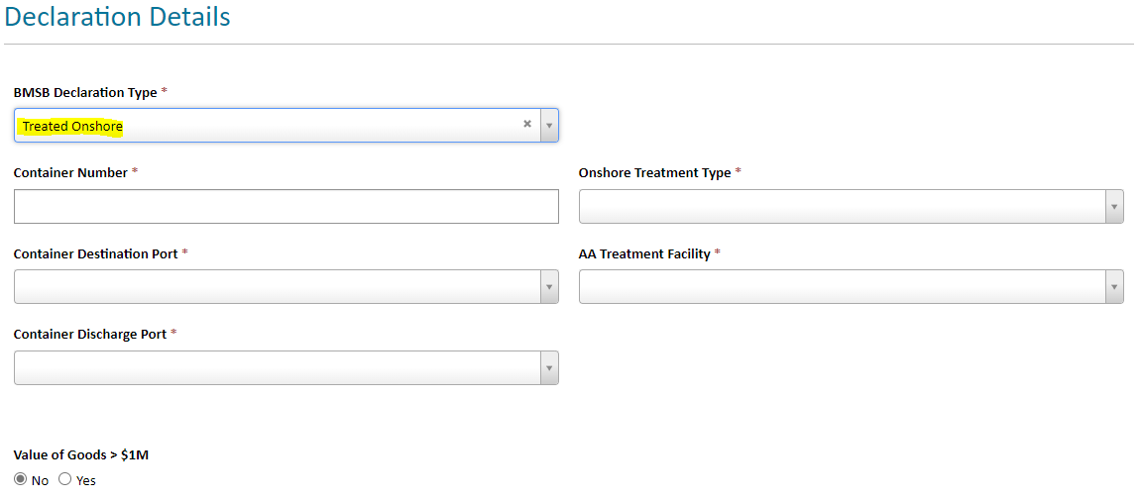
Treated Onshore
Not all target high risk goods OR nil goods have been treated offshore and whole container will need to be treated onshore to mitigate the BMSB risk. It is the Master Consolidators responsibility to clear treatment of goods with all relevant importers / brokers, as this decision lies solely with the Master Consolidator. If any goods within the container cannot be treated for any reason, export will be the only option available. Deconsolidation for part treatment is not permitted, if the whole container cannot be treated onshore, the container will be directed for export.

Slide 9
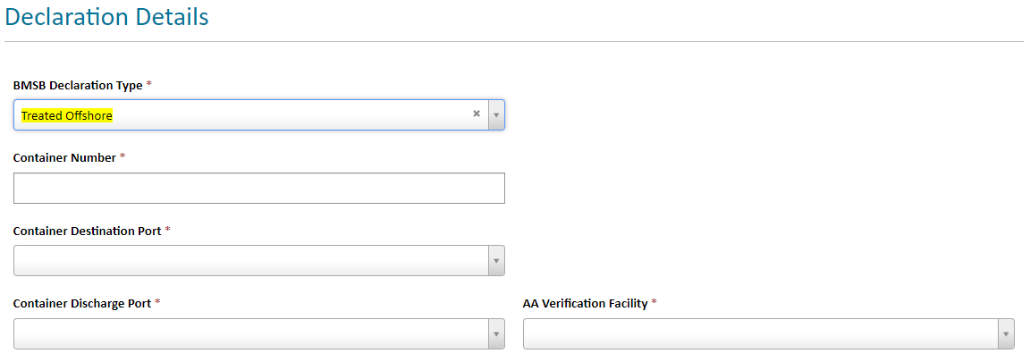
Treated Offshore
All goods within the container can be treated on the one certificate as an FCL, or across multiple certificates as LCLs, but ALL goods must have been treated offshore, not just the target high risk goods.
If ALL goods have not been treated, and only the target high risk goods have been treated, please select the “Partially Treated” declaration type, as the “Treated Offshore” option is not the correct declaration type to lodge for this scenario and may result in a non-compliance being issued.
Important: The container and seal for all goods and package quantities must be linked to the relevant treatment certificate(s) via an acceptable consignment link, failure to do so will result in the whole container requiring onshore treatment or export.

Slide 10
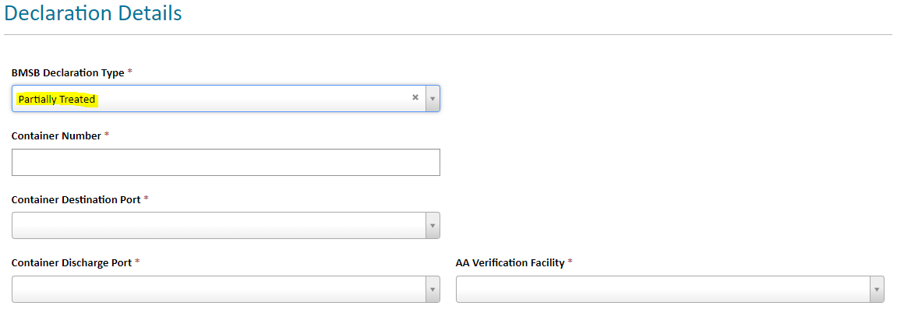
Partially Treated Offshore
Only part of the container has been treated i.e. All target high risk goods within the container. These goods can be treated on the one certificate as consolidated cargo, or across multiple certificates as LCL’s, but ALL target high risk goods must have been treated offshore.
If all target high risk goods have not been treated offshore, then please use the “Treated Onshore” as the “Partial Treatment” option is not the correct declaration type to lodge for this scenario and may result in a non-compliance being issued.
Important: The container and seal for all goods and package quantities must be linked to the relevant treatment certificate(s) via an acceptable consignment link, failure to do so will result in the whole container requiring onshore treatment or export.

Slide 11
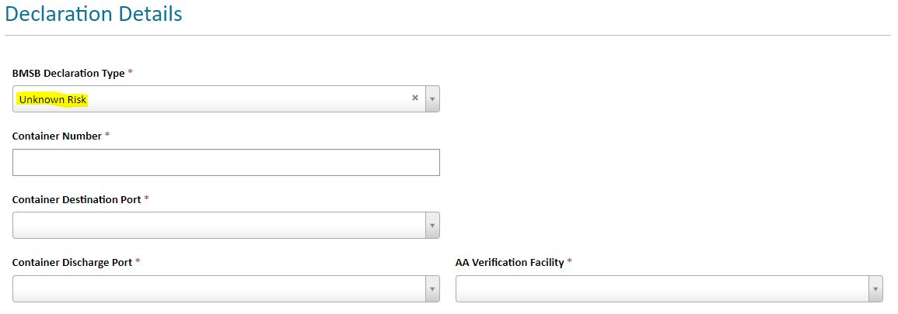
Unknown Risk
Any declaration lodged as Unknown will be subject to a Full Import Declaration (FID) assessment. Additional information will need to be sent to BMSBprocessing@aff.gov.au once the contents and risk has been identified, including but not limited to a manifest and bill of lading. The Master Consolidator is required to follow up on all containers lodged under this option and provide relevant information once all FID’s have been lodged in ICS.
Important: If there is no contact or declaration made by the relevant Master Consolidator for the container after 35 business days, the container will be directed for export.

Slide 12
Common Holds and ICS messages
There are many different hold types within the ICS. The only hold for BMSB relating to LCL / FAK containers is:
SPHOLDM – Seasonal Pest Hold
Common holds and/or messages mistaken for BMSB holds are:
CONDREL – Conditional Release (pending department intervention on noted entry)
SPREF – Seasonal Pest Referral
GAS – Aqis Gas Hold
HELD – Consolidated Status with no impediment details
CHAINED UNDERBOND – Underbond movement not approved due to chaining
Important: All LCL/FAK containers subject to BMSB Seasonal Measures will be held at the container level on the wharf with an AQIS SEASONAL PEST HOLD (SPHOLDM) until an MC declaration has been lodged. Individual House Bills (HBOLs) will not be held by BMSB holds they only apply at the container level.

Slide 13
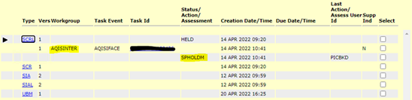
SPHOLDM
If you have a AQIS SEASONAL PEST HOLD (SPHOLDM) and you receive a message in ICS directing you to lodge an MC declaration, you will not be able to move your container until a declaration has been completed. There is no way to have this hold lifted without a MC declaration.
Important: If you have lodged an MC declaration and ICS is still showing this message, please check that your declaration has the correct vessel, voyage and container information as what has been declared in the ICS.

Slide 14
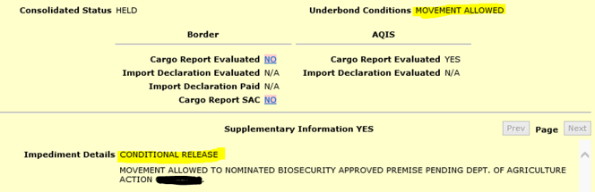
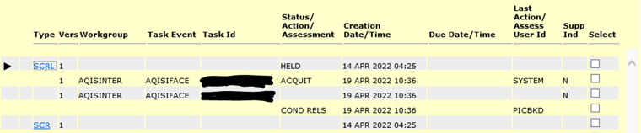
CONDREL
If your FCL is showing a CONDITIONAL RELEASE message, your container is subject to department intervention outlined in the noted entry. Your conditional release will clear once you have completed all onshore interventions and receive a final release.
Important: Your consolidated status will remain HELD until your container has been assessed and cleared from both DAFF and ABF requirements.

Slide 15
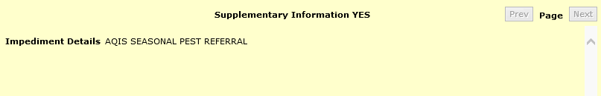
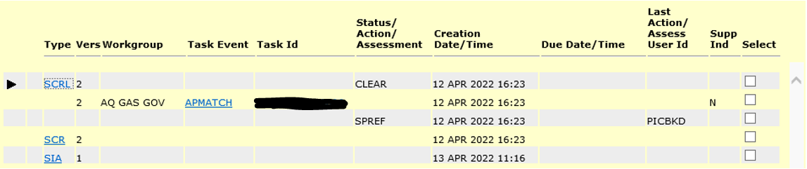
SFREF
If your House Bill (HBOL) is showing an AQIS SEASONAL PEST REFERRAL (SPREF) message, this is NOT a hold. It is a system reference recognising that the goods on this HBOL has been profiled for BMSB and applied a SPHOLD at the container level. The AQIS SEASONAL PEST REFERRAL message will remain on the status summary review screen. Do not contact the department requesting that the SPREF be lifted, it cannot be lifted as it is not a hold.
Important: If your container is showing as HELD, please check ICS to ensure that there are no other
ABF or AQIS holds as this is usually what is holding your HBOL if your container has a CONDCLEAR
or SUBUBMOV.

Slide 16
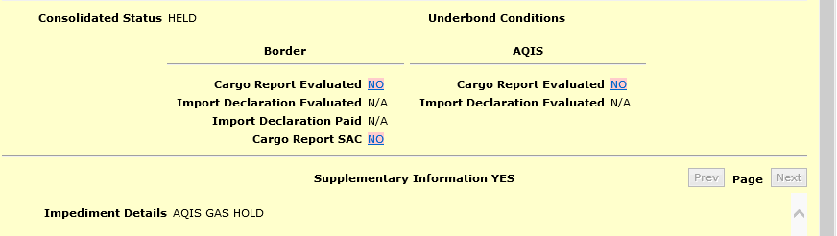
GAS HOLD
If your FCL is showing a AQIS GAS HOLD message, your container is subject to Giant African Snail measures, this is not BMSB related. These holds cannot be lifted by the BMSB Processing Team, and your container will be held until the risk has been investigated and / or mitigated by the Container NCC team (containerncc@aff.gov.au).
Important: Hitchhiker Pests Policy (HPP) and the BMSB Processing team cannot action these holds, they are not BMSB related.

Slide 17
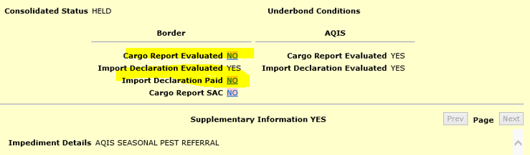
HELD
If your FCL or HBOL is showing a consolidated status of HELD, with no underbond conditions or impediment details in the supplementary information (AQIS SEASONAL PEST REFERRAL is only a system message, it is not an impediment), it is usually being held by ABF.
Please check that the cargo report has been evaluated and / or the import declaration has been paid as these will hold your container on the ABF side. DAFF cannot action these holds.
Important: An AQIS SEASONAL PEST REFERRAL is not a hold or an impediment. It will not impede the movement of your container. If you have made payment and ICS has not updated your status from HELD, ABF may need to do a recalc on the system.

Slide 18
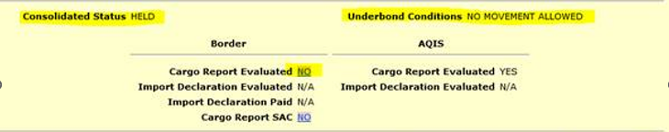
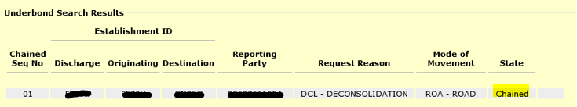
CHAINED UNDERBOND
If your FCL is showing a consolidated status of HELD and / or your Underbond Conditions show NO MOVEMENT ALLOWED, your underbond may be chained.
If the state of your underbond is CHAINED, you will need to contact ABF regarding your underbond application as DAFF cannot action underbond movements or approvals.

Slide 19
Common scenarios and solutions
The scenarios below answer the most frequently asked questions regarding the importation of goods during the BMSB risk season:
Change of SCR type from LCL to FCL/FCX
Changes to BMSB treatment rates to include timber
FIXLOC Directions
My container is still held in ICS after declaration lodgement

Slide 20
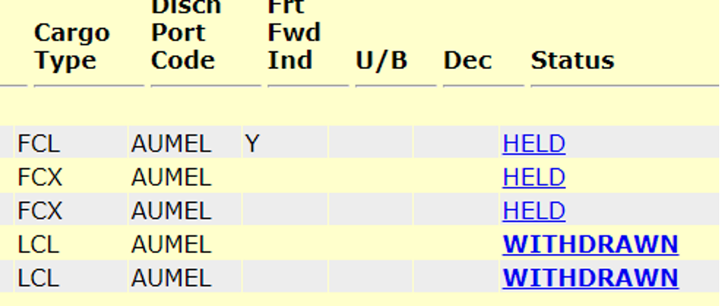
Change of SCR type from LCL to FCL/FCX
Once a cargo type is reported in ICS as an LCL and referred for BMSB, an SPHOLD will be placed on the container. If the cargo type is amended to an FCL / FCX, the SPHOLD will remain at the container level even after the LCL report has been withdrawn. The system will not automatically lift the hold. If this occurs, please email BMSBprocessing@aff.gov.au with your OBOL verifying the FCL cargo type, to have the hold lifted.
Important: ICS cannot automatically lift this hold once it has been applied. You must contact the BMSB processing team to have your container released.

Slide 21
Changes to BMSB treatment rates to include timber
Occasionally goods being imported will require onshore treatment for BMSB and treatment to address commodity concerns like timber. If this is the case, once you have lodged your declaration you will have to contact BMSBprocessing@aff.gov.au to amend the automated direction as this cannot be done via the portal.
It is important that the rate gets changed to meet the higher requirements of the timber concern otherwise your goods will be subject to a second treatment as the BMSB rate does not meet the timber requirements.

Slide 22
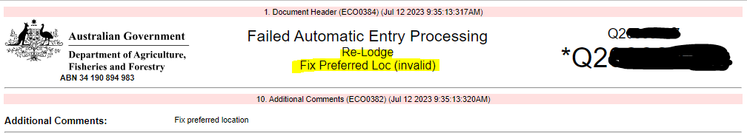
FIXLOC Directions
If you receive a FIXLOC direction for your container via AIMS, you will need to contact BMSBprocessing@aff.gov.au with the location you have nominated, and the entry number associated.
This usually occurs when the selected approved arrangement in the declaration does not have the direction required active for their location.
You may need to change your AA nomination to one that has been approved to carry out the required onshore intervention. This cannot be fixed via the online portal or by lodging amended or additional declarations.
Important: Do not continue to lodge declarations and / or amendments via the online portal to change / fix the location, this can only be amended manually by the BMSB Processing team.

Slide 23
Container is still held in ICS after MC declaration lodgement
If you have lodged your declaration, please wait up to an hour for messaging to update in ICS. If you have waited and the hold still has not been lifted, please log back into the MC portal and review your declaration. In most cases, a hold not lifting is due to the Vessel ID and/or the Voyage ID not matching what has been reported in ICS on the Sea Cargo Report for the container.
If this is the case, please see the ‘what happens if I’ve made a mistake’ section of the Master Consolidator User Guide. If the details in your lodgement are correct and your container is still held, please contact BMSBprocessing@aff.gov.au to investigate further.
Important: The BMSB Processing team is the only team that can advise and /or have this SPHOLD lifted.

Slide 24
Department contacts
Hitchhiker Pests Policy: SPP@aff.gov.au For questions and information related directly to BMSB Seasonal Measures that cannot be answered by visiting the website. Submission of MC registration form.
BMSB Processing Team: BMSBprocessing@aff.gov.au For questions and information related directly to BMSB LCL / FAK assessment and directions and / or MC declaration lodgement only.
BMSB treatments: BMSBtreatments@aff.gov.au Questions and information related directly to offshore BMSB treatments and treatment providers, including treatment certificates.
Treatments: treatments@aff.gov.au Requests for 4.7 secure unpack directions only and enquiries regarding finalisation of onshore BMSB treatment directions.
Import Assessments: ImportAssessment@aff.gov.au Any assessment or direction queries relating to imports including FIDs lodged via COLs, UPEs and Carnets.

Slide 25
Questions

