Slide 1
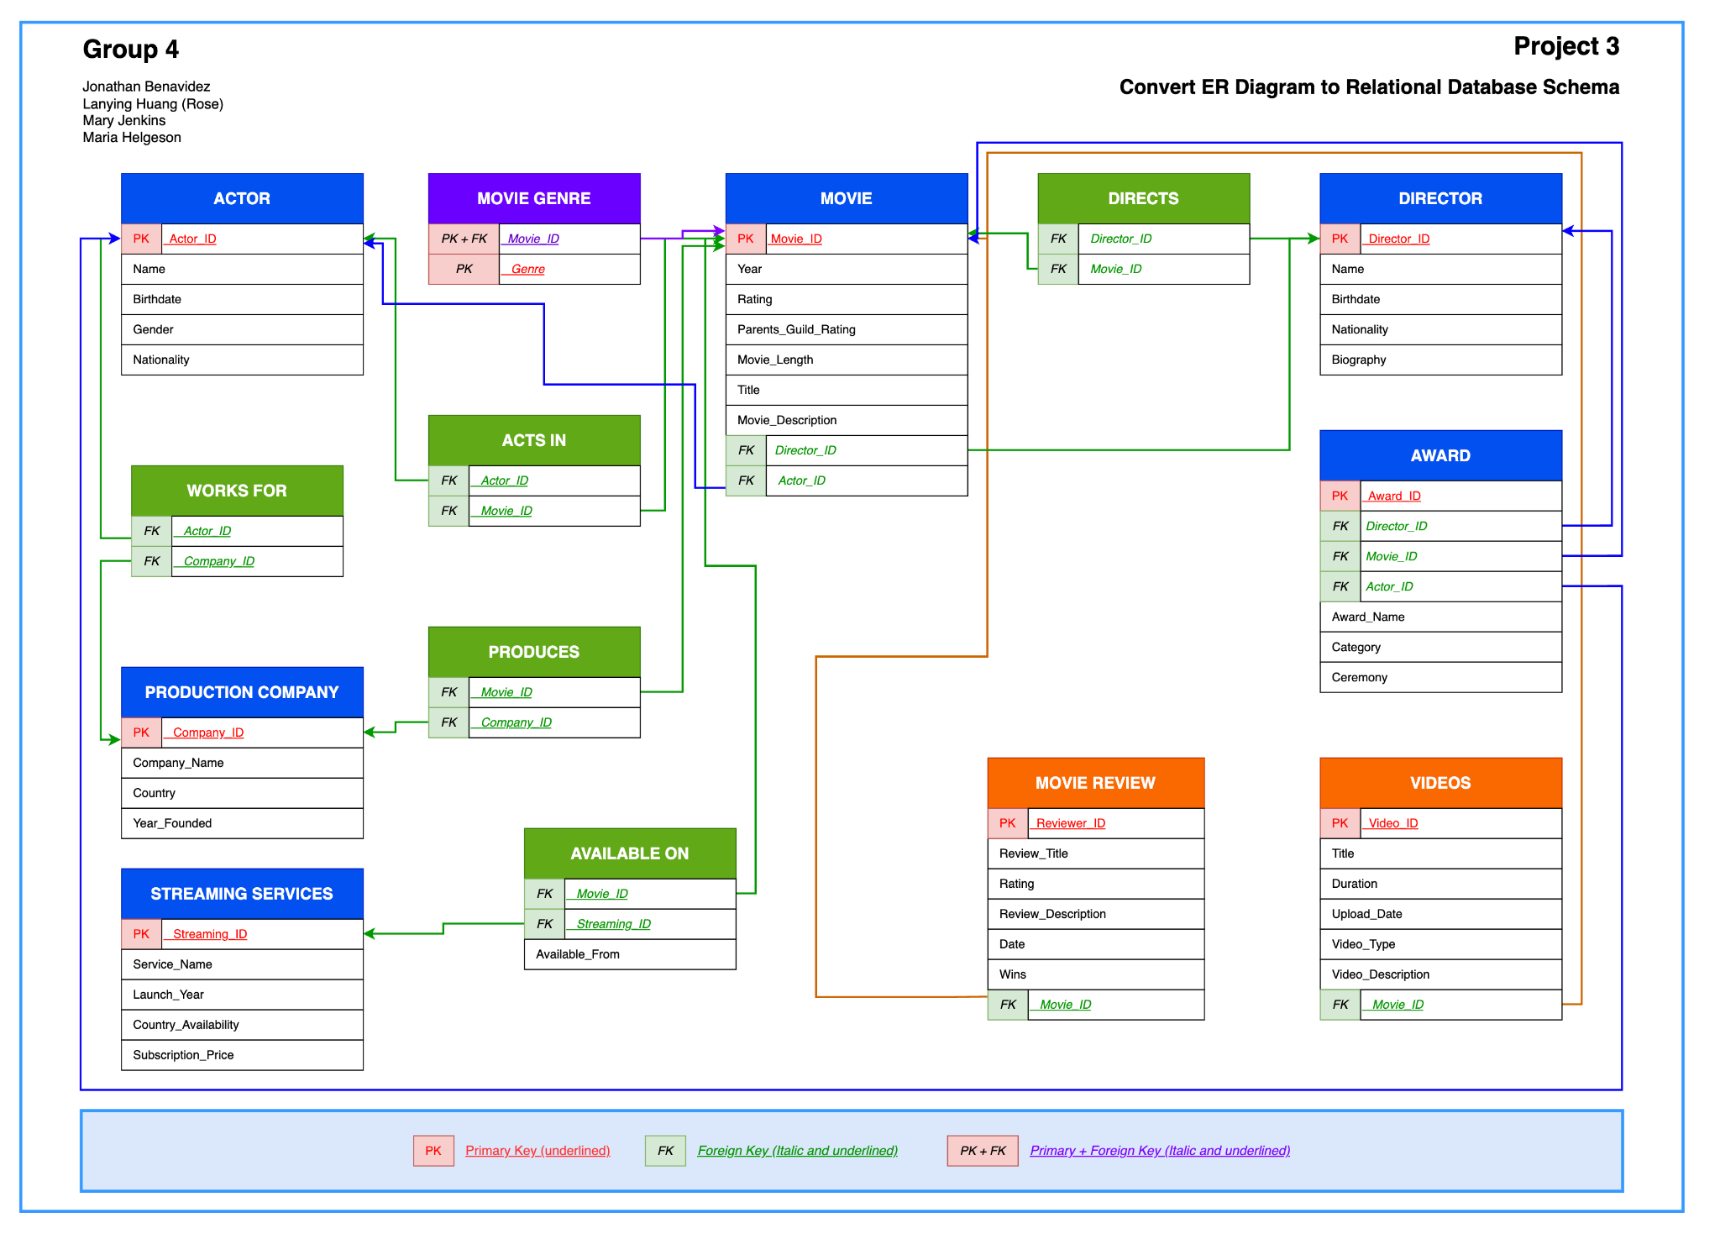
CS4420 Intro to Database Systems Final Project
Movie Database
Group 4
• Jonathan Benavidez
• Lanying Huang (Rose)
• Mary Jenkins
• Maria Helgeson
Final presentation: database design, data loading, and meaningful Oracle DML queries
1
Notes:
Good morning/afternoon. This presentation is for Group 4's CS4420 Database Systems final project. Our project is a movie database. We designed the database, converted it into a relational schema, implemented it in Oracle, loaded sample data, and tested it with meaningful SQL queries. In this presentation, we will briefly introduce the project, explain the schema, summarize the data loaded into Oracle, and then show three interesting queries with their results.

Slide 2
Final Project Overview
Group 4 Movie Database
Project Purpose & Scope
Purpose
Project dataset
Create a working Oracle database from a movie-focused ER design.
Load data into every table and verify the final state with SELECT statements.
Use Oracle DML to design meaningful queries that test the relationships.
12
movies loaded
14
database tables
10
required queries
The final report documents the ER diagram, relational schema, Oracle DDL, data loading script, table verification screenshots, and Query 1 through Query 10 with result screenshots.
2
Notes:
The purpose of our project was to take the database design process from the conceptual stage all the way to actual implementation in Oracle. We started with a movie database idea, created the ER diagram, converted it to a relational schema, and created the tables using Oracle DDL. For the final part, we loaded 12 movies and their related information. This includes actors, directors, genres, production companies, streaming services, awards, reviews, and videos. We also wrote the 10 required queries, including joins, set operations, and aggregate queries.

Slide 3
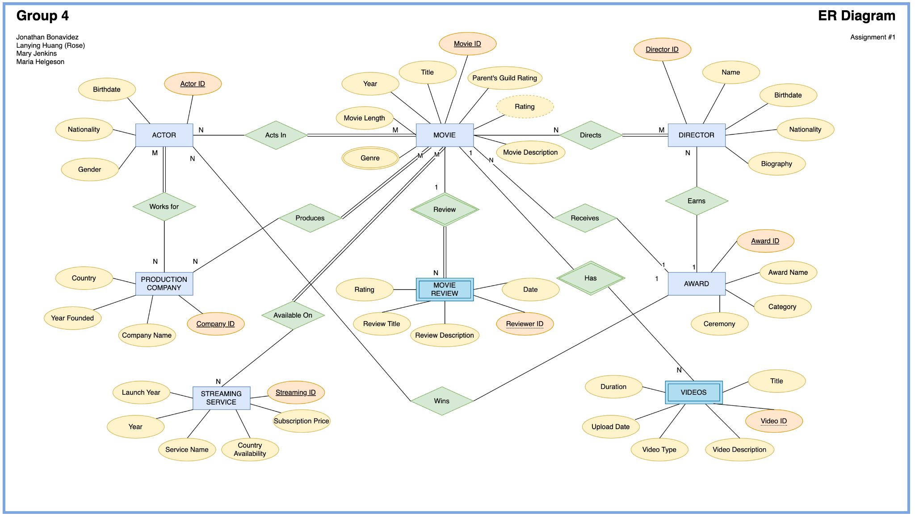
Database Design
Group 4 Movie Database
Final ER Diagram
The ER diagram models movies and related entities such as actors, directors, awards, reviews, videos, production companies, and streaming services.
3
Notes:
This slide shows our final ER diagram. The main entity in the center is Movie. Around Movie, we have related entities such as Actor, Director, Production Company, Streaming Service, Movie Review, Award, and Videos. The diagram helped us identify which objects needed their own tables and which relationships needed bridge tables. For example, actors can act in movies, production companies can produce movies, and movies can be available on streaming services. This design became the foundation for our relational schema.

Slide 4
Database Design
Group 4 Movie Database
Final Relational Schema Diagram
4
Notes:
After completing the ER diagram, we converted it into a relational schema. This slide shows the final relational schema diagram. The blue tables are main entity tables, such as Actor, Movie, Director, Production Company, and Streaming Services. The green tables are relationship tables, such as Acts In, Works For, Produces, Available On, and Directs. Each table has a primary key, and foreign keys are used to connect related tables. This structure allows Oracle to enforce referential integrity between the tables.

Slide 5
DDL and Constraints
Group 4 Movie Database
Oracle Implementation
Tables created in Oracle
Database rules implemented
Main tables: ACTOR, DIRECTOR, MOVIE, PRODUCTION_COMPANY, STREAMING_SERVICES
Relationship tables: ACTS_IN, WORKS_FOR, PRODUCES, AVAILABLE_ON, DIRECTS
Supporting tables: MOVIE_GENRE, AWARD, MOVIE_REVIEW, VIDEOS
Primary keys uniquely identify each record.
Foreign keys connect related tables.
NOT NULL rules protect required fields, such as names and titles.
Example SQL structure
CREATE TABLE movie ( movie_id NUMBER, title VARCHAR2(150) NOT NULL, director_id NUMBER, actor_id NUMBER, CONSTRAINT pk_movie PRIMARY KEY (movie_id), CONSTRAINT fk_movie_director FOREIGN KEY (director_id) REFERENCES director(director_id) );
5
Notes:
For the Oracle implementation, we used DDL statements to create the database tables. The project includes main entity tables, relationship tables, and supporting tables. The main tables store the core information, such as movies, actors, directors, companies, and streaming services. The relationship tables connect records between entities. For example, Available On connects movies to streaming services, and Produces connects movies to production companies. Primary keys and foreign keys are important because they help protect the database from invalid relationships.

Slide 6
Part 1: Loading Data
Group 4 Movie Database
Data Loaded Into Oracle
We loaded 12 movies and all related information into Oracle.
12 Movies
12 Actors
12 Directors
6 Streaming services
24 Genres
24 Reviews
24 Videos
Verification method
After running the INSERT statements and COMMIT, each table was verified using SELECT * FROM table_name.
SELECT * FROM each table
6
Notes:
For Part 1, we loaded a complete sample dataset into Oracle. The data includes 12 movies, 12 actors, 12 directors, 6 streaming services, 24 movie genre rows, 24 reviews, and 24 videos. We also loaded relationship records in tables like Acts In, Produces, Available On, Directs, Works For, and Award. After the data was loaded, we ran SELECT star FROM each table to verify that the final state of the database was correct. Screenshots of those results are included in the final report.

Slide 7
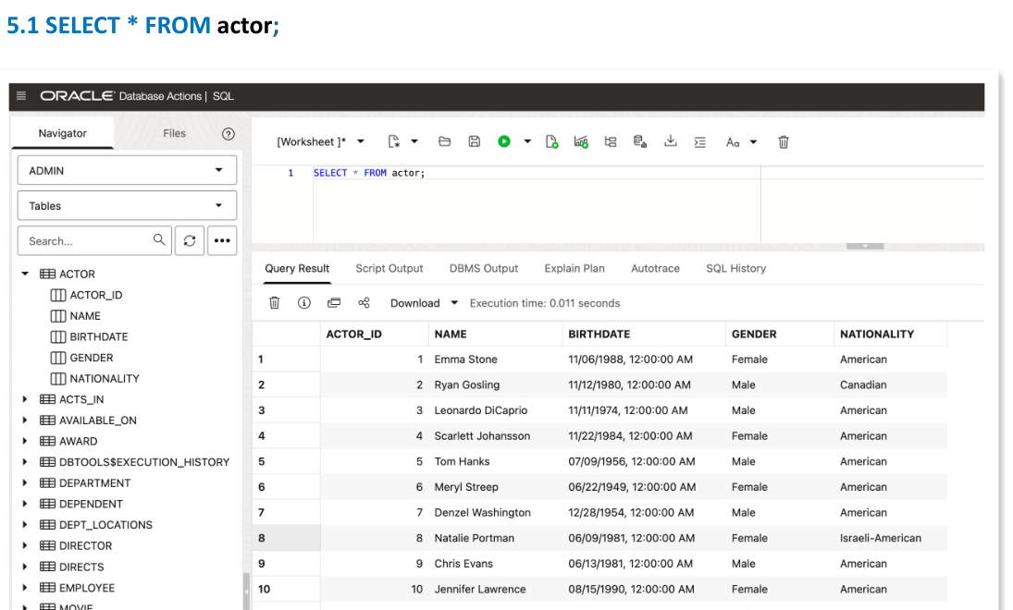
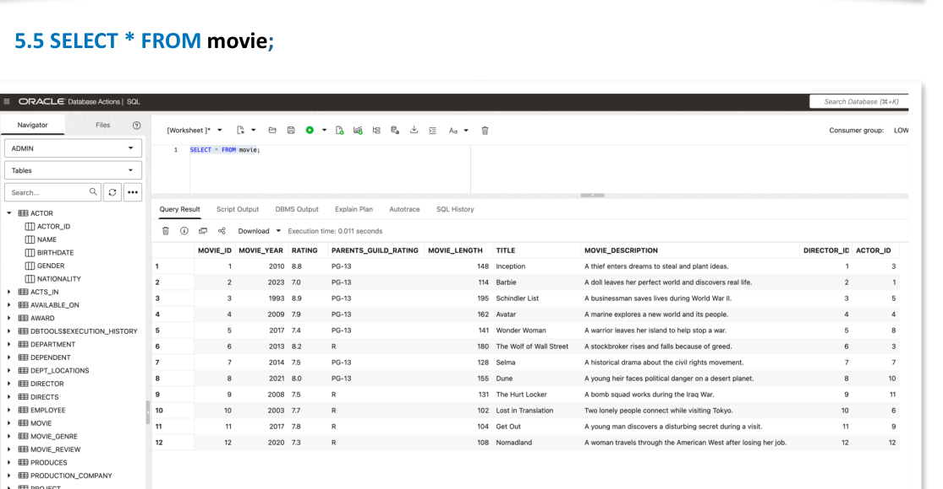
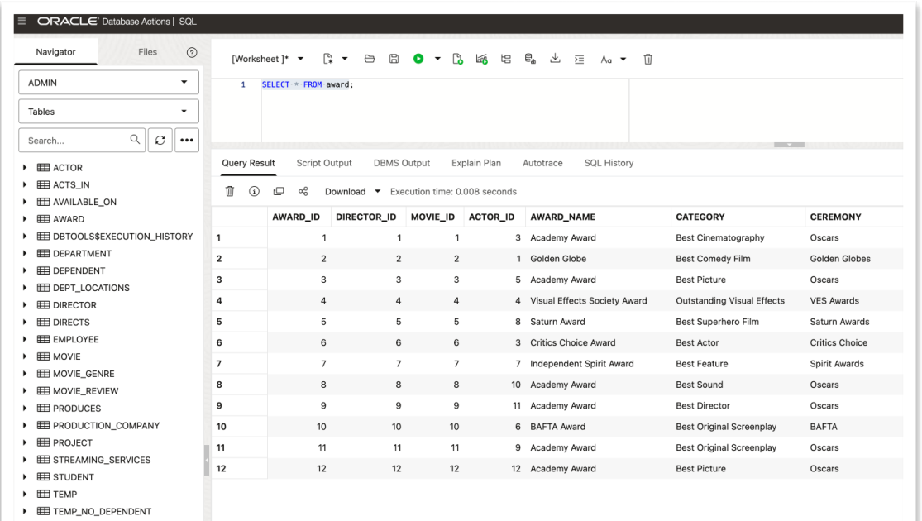
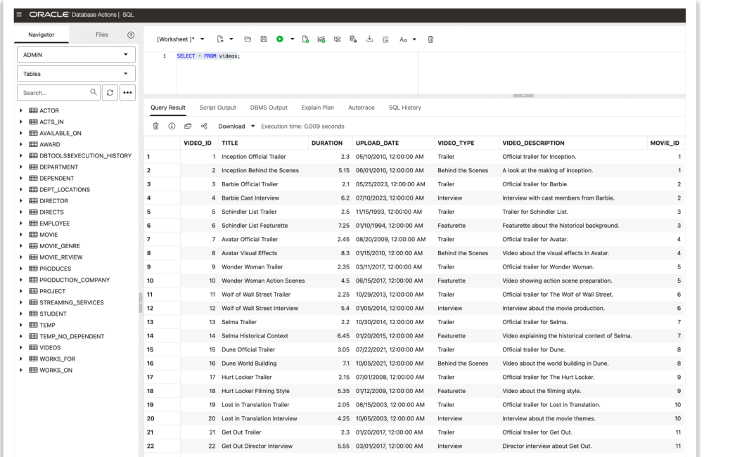
Part 1: SELECT Screenshots
Group 4 Movie Database
Final Table Verification
Sample verification screenshots from Oracle Database Actions
7
Notes:
This slide shows examples of the verification screenshots. The report includes SELECT results for each table. For example, we verified the Actor table, the Movie table, the Streaming Services table, Available On, Award, Movie Review, Videos, and the relationship tables. This step is important because it proves that the data was loaded successfully and that the tables contain usable records for the queries.

Slide 8
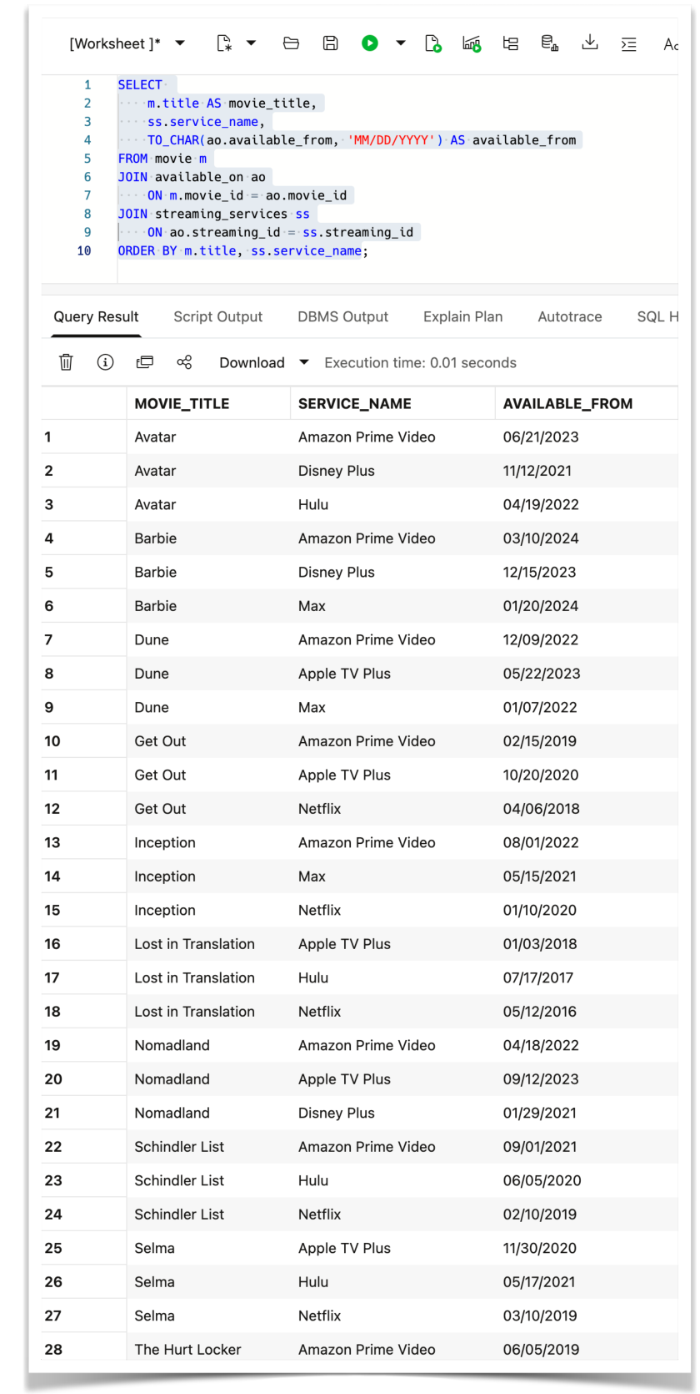
Part 2: Oracle DML
Group 4 Movie Database
Interesting Query 1: Streaming Availability
Query 5 joins MOVIE, AVAILABLE_ON, and STREAMING_SERVICES.
Shows each movie with the streaming service where it is available.
Includes the date when the movie became available.
Demonstrates a three-table join.
8
Notes:
The first query we selected for the presentation is Query 5. This query joins three tables: Movie, Available On, and Streaming Services. The purpose is to show each movie, the service where it is available, and the available-from date. This is a useful query because users could use it to find where a movie can be watched. It also shows why the Available On relationship table is important, because one movie can be available on several different streaming services.

Slide 9
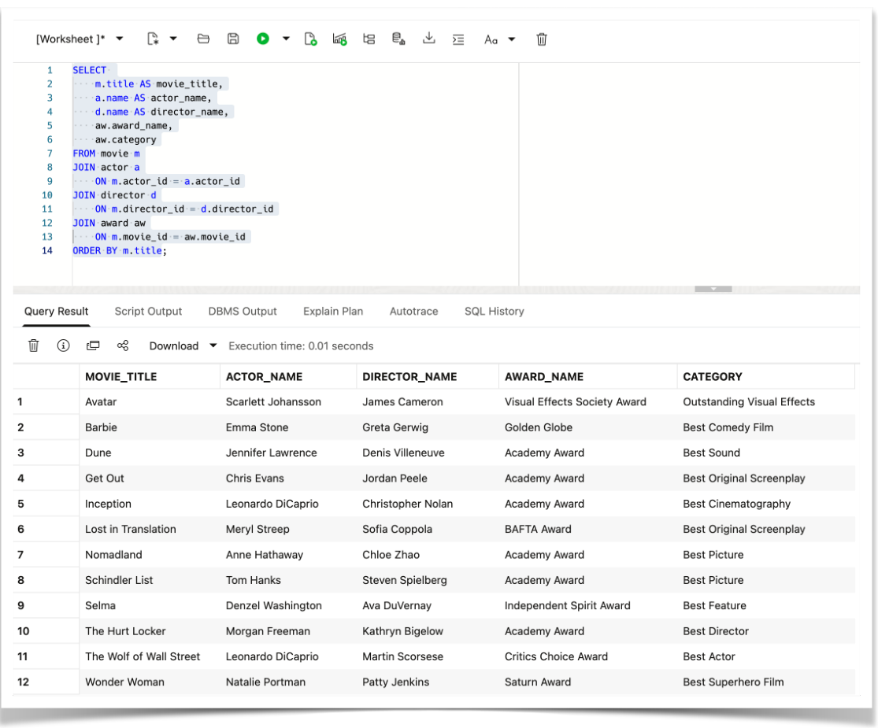
Part 2: Oracle DML
Group 4 Movie Database
Interesting Query 2: Movie, Actor, Director & Award
Query 6 joins MOVIE, ACTOR, DIRECTOR, and AWARD.
Connects movie titles to actors and directors.
Adds award information for each movie.
Demonstrates a four-table join.
9
Notes:
The second query is Query 6, which is the required four-table join. It joins Movie, Actor, Director, and Award. The result shows the movie title, actor name, director name, award name, and award category. This query is meaningful because it brings together several important parts of the database into one result. It also proves that the foreign key connections between movies, actors, directors, and awards are working correctly.

Slide 10
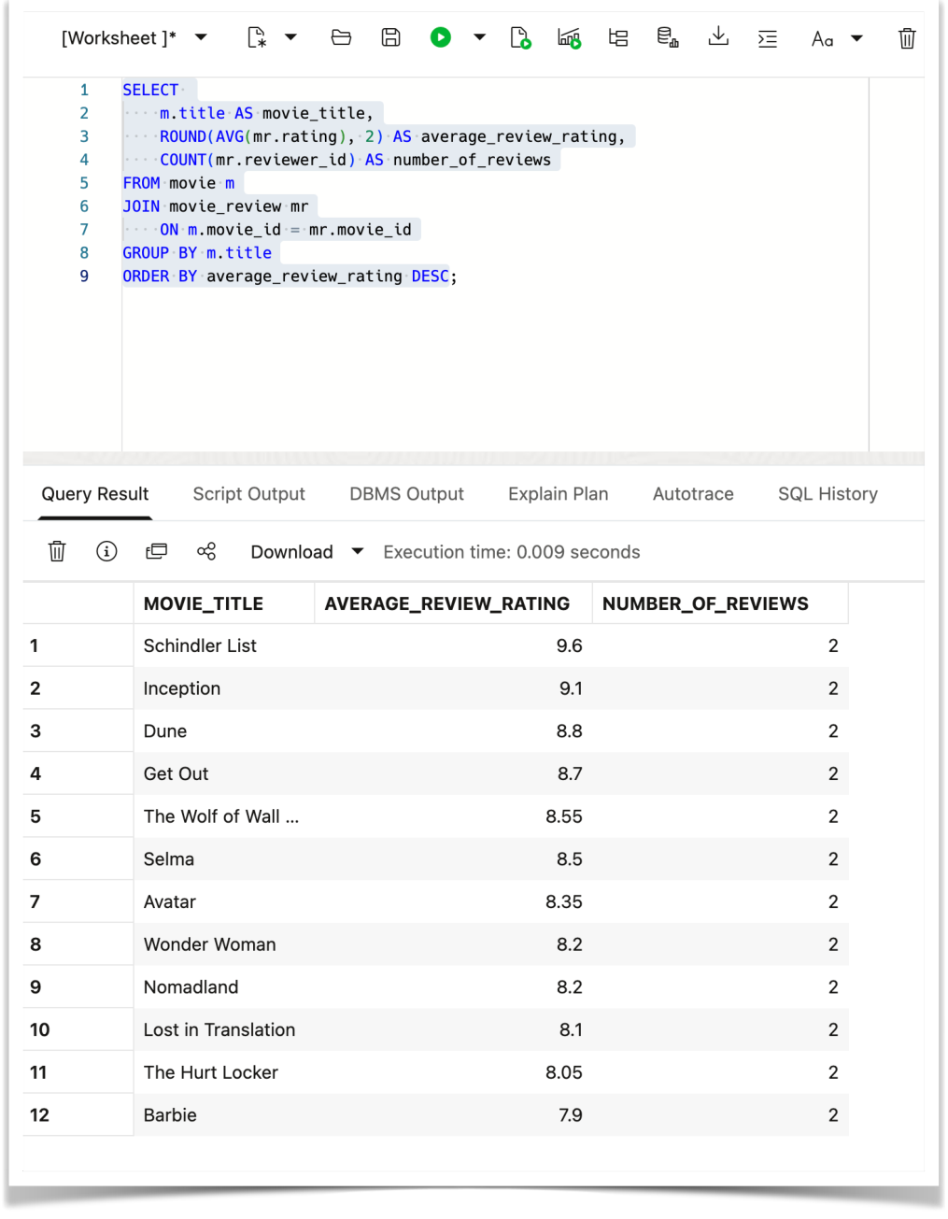
Part 2: Oracle DML
Group 4 Movie Database
Interesting Query 3: Average Review Rating
Query 10 uses aggregate and grouping operations.
Calculates the average review rating for each movie.
Counts the number of reviews per movie.
Uses AVG, COUNT, ROUND, and GROUP BY.
10
Notes:
The third query is Query 10. This query uses aggregate and grouping operations. It calculates the average review rating for each movie and counts how many reviews each movie has. We used AVG to calculate the average, COUNT to count the reviews, ROUND to format the average rating, and GROUP BY to group the results by movie title. This query is useful because it summarizes review data instead of simply listing individual records.

Slide 11
Conclusion
Group 4 Movie Database
Project Results
Final project accomplishments
Completed a final ER diagram and relational schema diagram.
Implemented the database in Oracle using DDL.
Loaded and verified records across all tables.
Created 10 required Oracle queries with screenshots.
Selected three strong queries for the video presentation.
Video link
https://www.youtube.com/watch?v=RKsHJEXOhP
11
Notes:
In conclusion, our group completed the full database project process. We created the ER diagram, converted it into a relational schema, implemented the tables in Oracle, loaded the data, and verified the final state of each table. We also wrote the 10 required queries, including one-table queries, two-table joins, three-table joins, a four-table join, set operations, and aggregate grouping queries. Overall, the project shows that our movie database design works correctly and can be used to retrieve meaningful information from Oracle. Thank you.

