Slide 1
DATA WRANGLING
This code I Made in Jupyter Notebook and here is the input. The following slides will include what the data shows after being cleaned and made into different graphs for visualization..
The code will also be included..

Slide 2
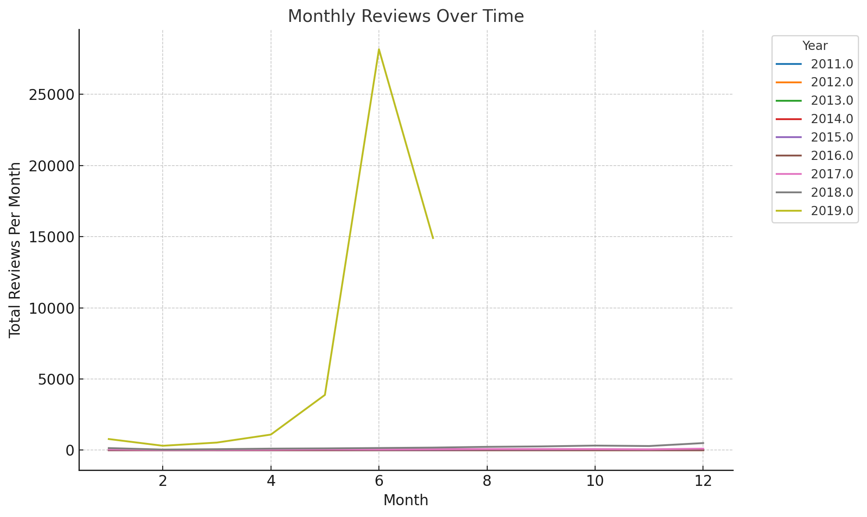
This is the time frame and data of how many reviews per months

Slide 3
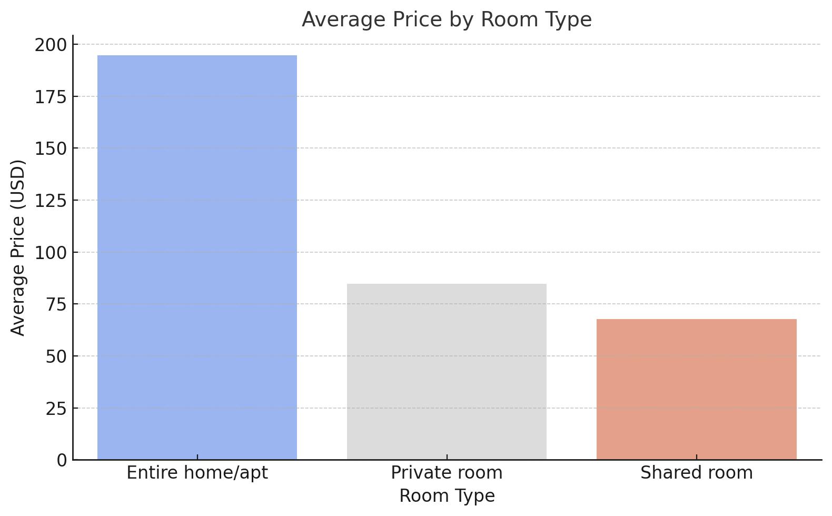
Here is a graph including the prices averaging per room and type of room.

Slide 4
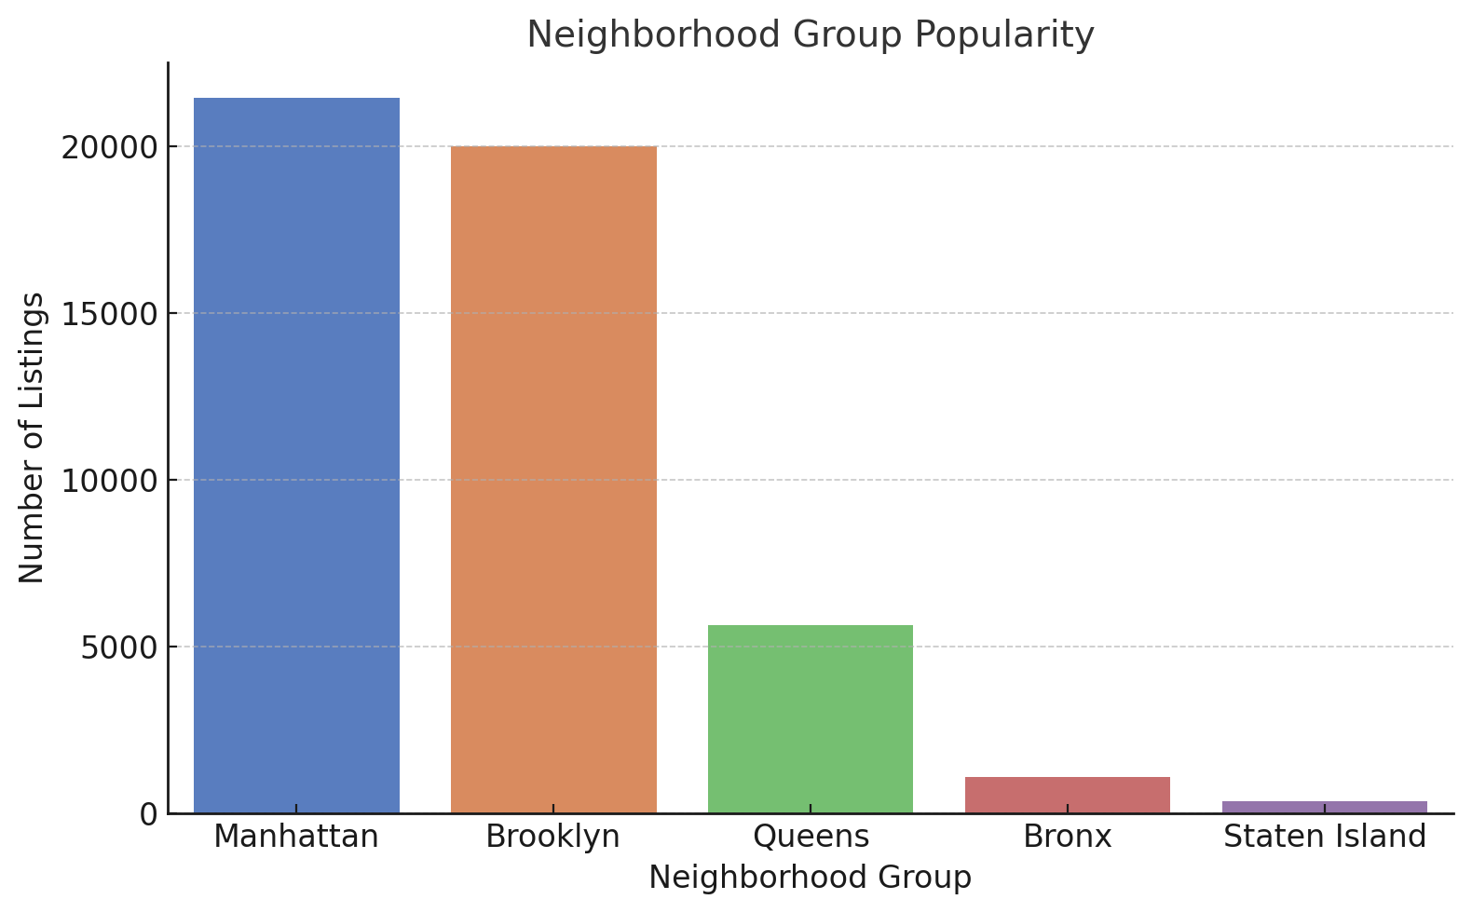
Popularity!! The amount of listings and what was more preferred directly by location.

Slide 5
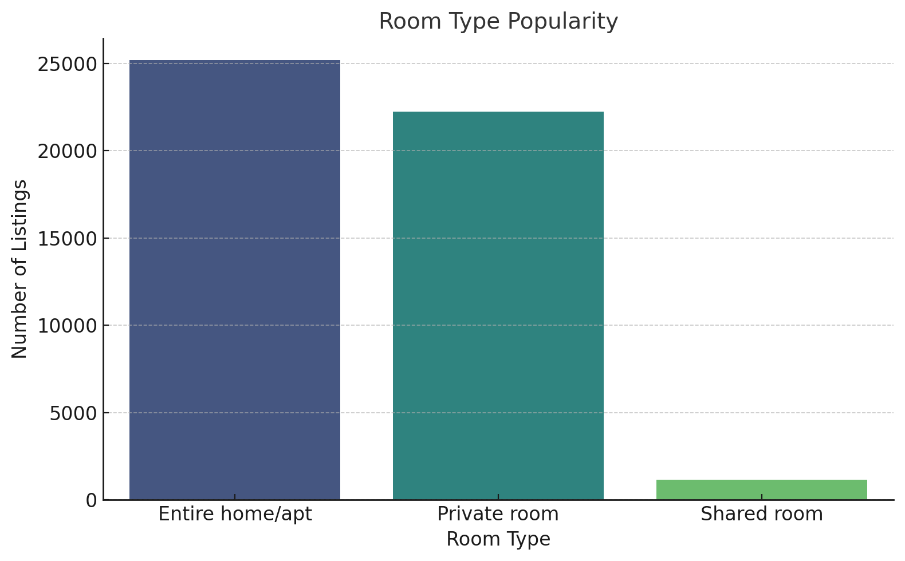
Type of room directly effects the popularity of the listing.

Slide 6
Jupyter code in the next few slides.
import pandas as pd
import matplotlib.pyplot as plt
import seaborn as sns
# Load the dataset
file_path = 'AB_NYC_2019.csv' # Replace with the actual file path
data = pd.read_csv(file_path)
# Data Cleaning
data_cleaned = data.dropna(subset=['name', 'host_name'])
data_cleaned['reviews_per_month'] = data_cleaned['reviews_per_month'].fillna(0)
data_cleaned['last_review'] = pd.to_datetime(data_cleaned['last_review'], errors='coerce')
data_cleaned = data_cleaned.drop_duplicates()
data_cleaned = data_cleaned[(data_cleaned['price'] > 0) & (data_cleaned['price'] <= 1000)]
data_cleaned = data_cleaned[data_cleaned['minimum_nights'] <= 365]

Slide 7
# getting rid of unneeded data
data_cleaned['last_review_year'] = data_cleaned['last_review'].dt.year
data_cleaned['last_review_month'] = data_cleaned['last_review'].dt.month
# Aggregations for Visualization
room_type_popularity = data_cleaned['room_type'].value_counts()
neighbourhood_group_popularity = data_cleaned['neighbourhood_group'].value_counts()
price_by_room_type = data_cleaned.groupby('room_type')['price'].mean()
monthly_reviews = data_cleaned.groupby(['last_review_year', 'last_review_month'])['reviews_per_month'].sum().reset_index()

Slide 8
# Generate and Save Graphs
# Room Type Popularity
plt.figure(figsize=(8, 5))
sns.barplot(x=room_type_popularity.index, y=room_type_popularity.values, palette="viridis")
plt.title("Room Type Popularity", fontsize=14)
plt.xlabel("Room Type", fontsize=12)
plt.ylabel("Number of Listings", fontsize=12)
plt.savefig('room_type_popularity.png')
plt.close()

Slide 9
# Neighborhood Group Popularity
plt.figure(figsize=(8, 5))
sns.barplot(x=neighbourhood_group_popularity.index, y=neighbourhood_group_popularity.values, palette="muted")
plt.title("Neighborhood Group Popularity", fontsize=14)
plt.xlabel("Neighborhood Group", fontsize=12)
plt.ylabel("Number of Listings", fontsize=12)
plt.savefig('neighbourhood_group_popularity.png')
plt.close()

Slide 10
# Price by Room Type
plt.figure(figsize=(8, 5))
sns.barplot(x=price_by_room_type.index, y=price_by_room_type.values, palette="coolwarm")
plt.title("Average Price by Room Type", fontsize=14)
plt.xlabel("Room Type", fontsize=12)
plt.ylabel("Average Price (USD)", fontsize=12)
plt.savefig('price_by_room_type.png')
plt.close()

Slide 11
# Monthly Reviews Trend
plt.figure(figsize=(10, 6))
sns.lineplot(data=monthly_reviews, x='last_review_month', y='reviews_per_month', hue='last_review_year', palette="tab10")
plt.title("Monthly Reviews Over Time", fontsize=14)
plt.xlabel("Month", fontsize=12)
plt.ylabel("Total Reviews Per Month", fontsize=12)
plt.legend(title="Year", bbox_to_anchor=(1.05, 1), loc='upper left')
plt.savefig('monthly_reviews_trend.png')
plt.close()
print("Graphs saved as 'room_type_popularity.png', 'neighbourhood_group_popularity.png', 'price_by_room_type.png', and 'monthly_reviews_trend.png'.")

