Slide 1

British Airways Forage Task 2: Key Model Results and Insights for Predicting Customer Booking Behavior
By: Mariah Noelle Cornelio

Slide 2
Background and Task Overview
Problem context
  Customers can now book flights online and have access to details such as seat, baggage, and meal preferences. Predicting booking completion helps BA proactively target high-intent customers
Approach
  3 models will be tested and compared: Logistic Regression, Random Forest, and XGBoost
Metric prioritization
  Recall (captures booking customers) > F1 (balances false positives/negatives) > ROC-AUC (overall predictive power)
    Accuracy and precision are considered secondary due to class imbalance in booking_complete target variable

Slide 3
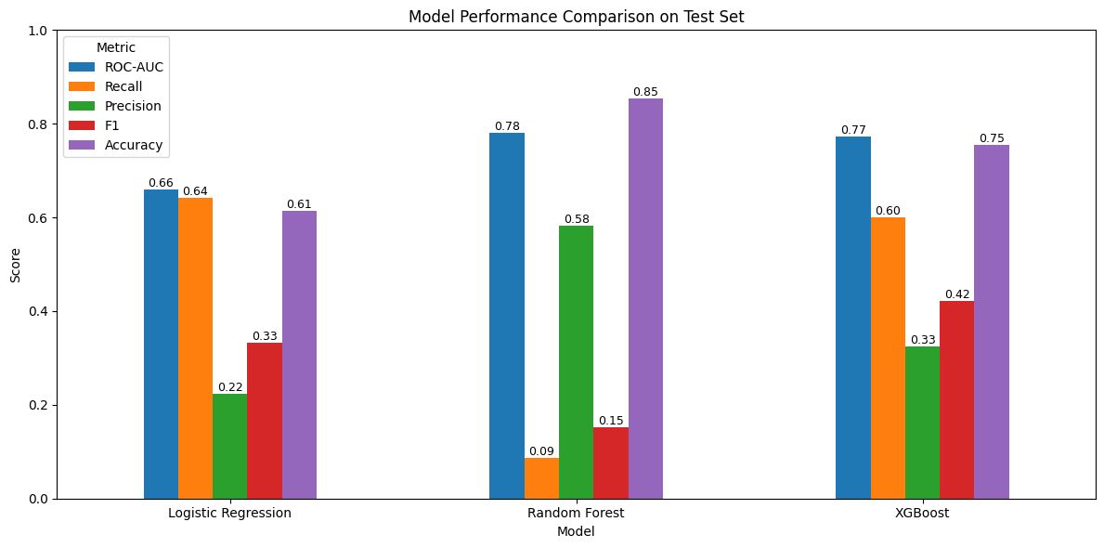
Model Comparison (booking_complete = 1)
  Figure 1. Bar chart comparing ROC-AUC, Recall, F1, Precision, Accuracy for all three models
  Best performing model: XGBoost
  Chosen due to high and balanced ROC-AUC, recall, and F1 scores that indicate strong predictive power

Slide 4
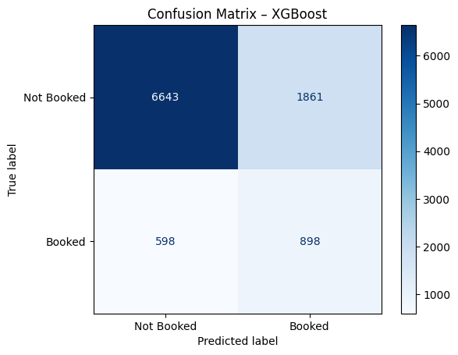
XGBoost Classification Report & Confusion Matrix
  Table 1. XGBoost metric classification report
XGBoost Classification Report
 | Precision | Recall | F1
0 (Not Booked) | 0.92 | 0.78 | 0.84
1 (Booked) | 0.33 | 0.60 | 0.42
Accuracy |  |  | 0.75
Macro Avg | 0.62 | 0.69 | 0.63
  True positives are high, capturing most booking customers
  False negatives low, few missed opportunities
  Figure 2. XGBoost confusion matrix

Slide 5
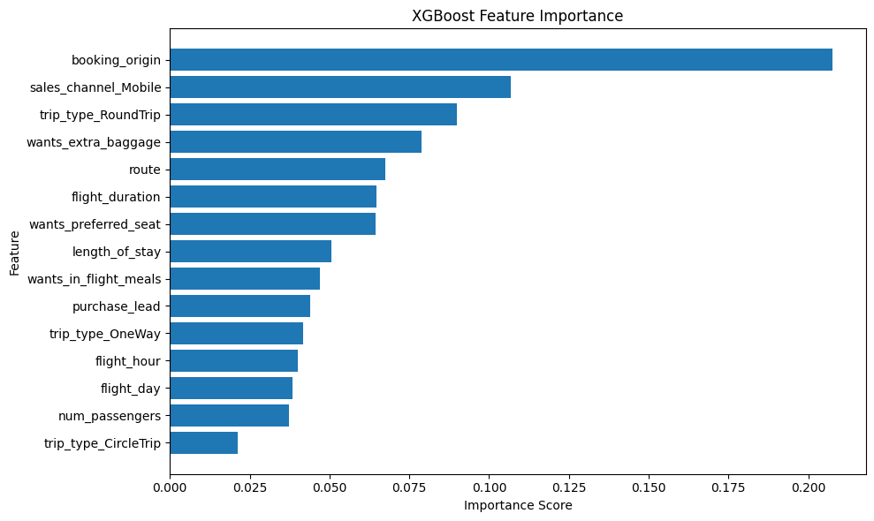
XGBoost Feature Importance
  Figure 3. Feature importance of XGBoost model using gain-based importance
  The feature importance plot shows that booking origin, someone purchasing a ticket on their mobile device, round trip flights, customers who want extra baggage, and the route contribute most strongly to the model’s predictive power.

Slide 6
Key Insights and Conclusion
The model shows that booking behavior and travel structure such as booking origin, mobile usage, trip type, and route are stronger predictors of booking completion than ancillary preferences alone. This suggests that British Airways can more effectively drive conversions by targeting customers earlier in their booking journey based on behavioral and geographic signals.
Customers booking via mobile and planning round-trip flights are more likely to complete bookings, indicating that mobile-optimized offers and targeted promotions for return travel may increase conversion rates
Booking origin and route emerge as key predictors, suggesting that localized marketing campaigns and route-specific pricing strategies could be particularly effective
While preferences such as extra baggage contribute less individually, they still provide incremental value and can be used to refine personalized offers once high-intent customers are identified
These findings support a proactive, data-driven acquisition strategy where British Airways prioritizes high-intent customers early, rather than relying on reactive booking behavior at the airport or late in the customer journey.

