Slide 1

Announcement Text Learning
Grade X
Industrial Automation Engineering
September 3, 2026

Slide 2

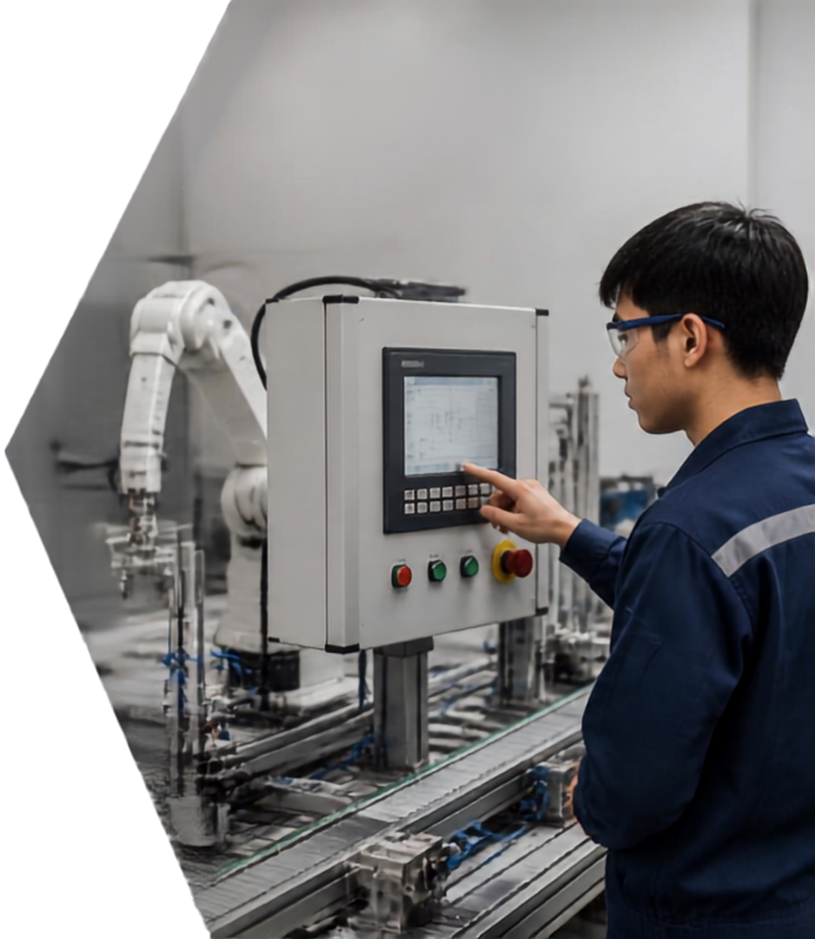


INDUSTRIAL AUTOMATION LABORATORY
WARM-UP
WHAT’S HAPPENING?
What is this announcement about?
Where does it happen?
Why is it important?
Who should know this?

Slide 3





PURPOSE AND STRUCTURE
OF AN ANNOUNCEMENT
STRUCTURE
PURPOSE
to inform clearly and briefly
TITLE
CONTENT
CLOSING
WHAT
WHO
WHEN
WHERE
WHY
is it about
is involved
does it happen
does it take place
is it important

Slide 4

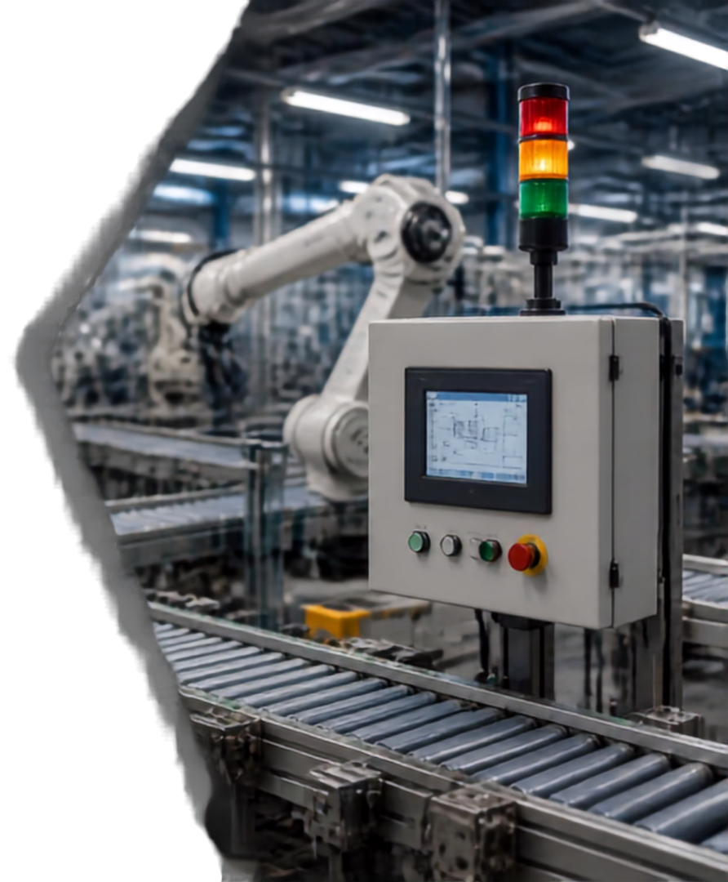






Important
Information
Find the key details in every announcement.
What
the activity or event
Who
the people involved
When
the time it happens
Where
the place it takes place
Why
the reason it matters

Slide 5

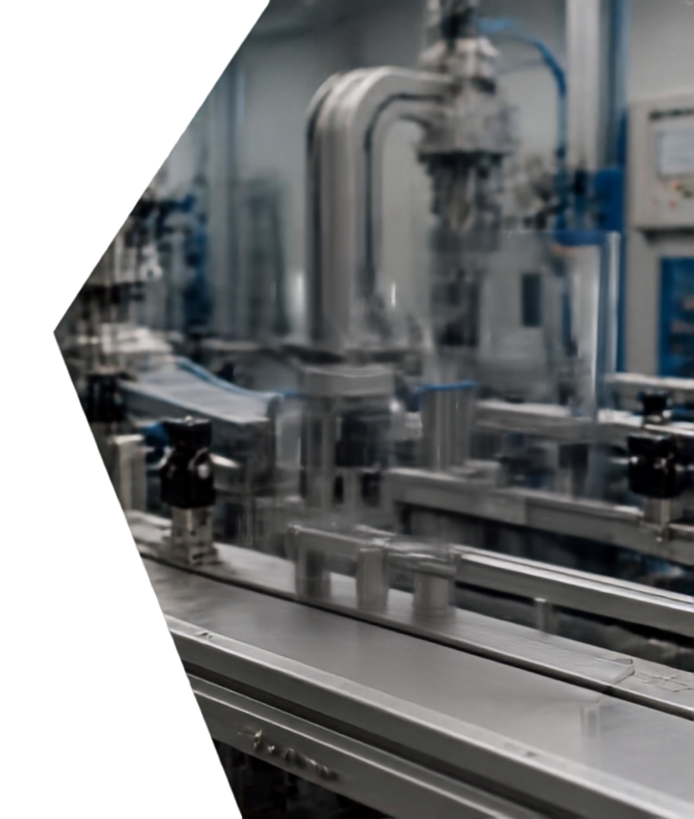






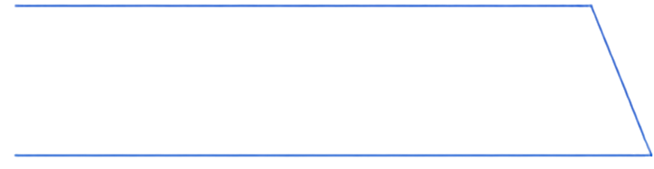



LANGUAGE FEATURES
IN AN ANNOUNCEMENT
NOTICE
01
SIMPLE PRESENT TENSE
States facts clearly and directly.
The lab is closed.
MAINTENANCE IN PROGRESS
02
IMPERATIVE SENTENCES
Gives instructions or requests.
LABORATORY CLOSED ON WEDNESDAY
Please do not enter.
03
TIME AND PLACE EXPRESSIONS
Tells when and where it happens.
on Wednesday, in the lab.

Slide 6
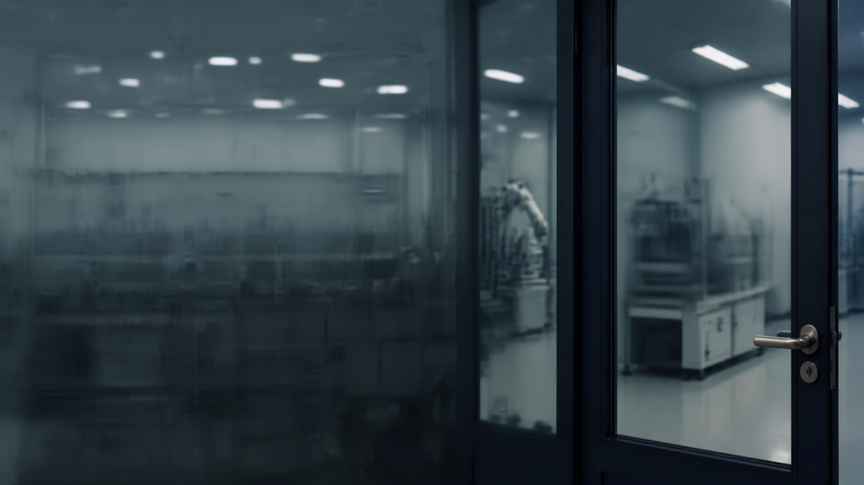




toi laboratory
announcement
Attention, Class X TOI students.
The Automation Laboratory will be closed on Wednesday, September 9, 2026, from 10 a.m. to 12 p.m.
Due to equipment maintenance.
Please do not enter during this time.
Thank you.

Slide 7





AI ANNOUNCEMENT
CHECKER
01
02
03
04
Use AI to check grammar and information.
Compare AI suggestions with the original text.
Discuss and correct errors with your partner.
Use AI as a learning tool, not a shortcut.

Slide 8

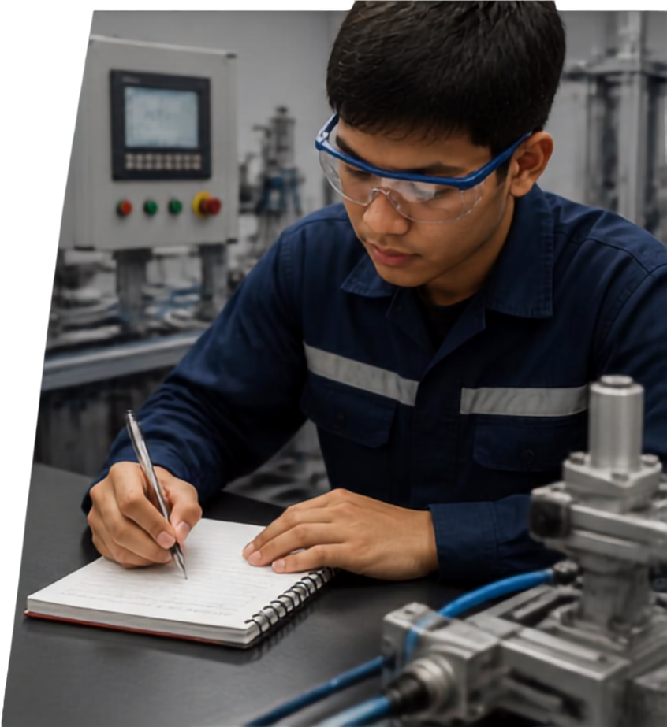

CREATING YOUR OWN ANNOUNCEMENT
01
Write a 50-70 word announcement
02
Choose one situation from our lab
03
Include what, who, when, where, why
04
Use clear language and imperative
05
Prepare to present your announcement

Slide 9


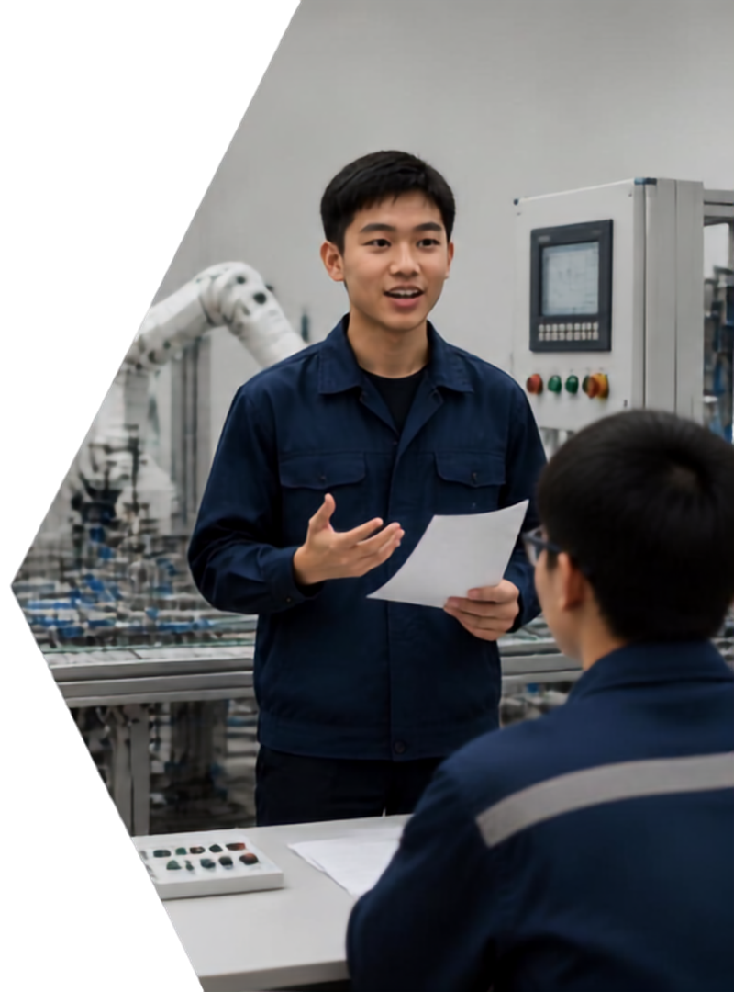



PRESENTATION,
FEEDBACK, AND SUMMARY
Share, reflect, and learn together.
01
PRESENT TO CLASS
Deliver your announcement clearly.
02
PEER FEEDBACK
Give two stars and one suggestion.
SUMMARIZE LEARNING
03
Review purpose, structure, language, AI use, and communication.

Slide 10



Reflection and Follow-Up Task
REFLECT ON TODAY
Safety Announcement
3 things learned
2 new words
1 question
Work safely. Think clearly. Communicate always.
Stay alert
Stay safe
Stay productive
THINK ABOUT THIS
How do announcements help
safe, clear communication in industry?
YOUR NEXT STEP
Prepare a digital announcement poster for the lab.

