Slide 1
Smart Charging Stations: ARIMA Predictions and K-Means Clustering for Efficient Electric Vehicle Charging Networks
Presented by
Maria Joseph Kodiganti
UG Student
Dept. of Electrical and Electronics Engg
Velagapudi Ramakrishna Siddhartha Engineering College, Vijayawada, Andhra Pradesh
Under the Guidance of
Dr. J.RAMESH M.Tech., Ph.D
Associate Professor
Dept. of Electrical and Electronics Engg
Velagapudi Ramakrishna Siddhartha Engineering College, Vijayawada,
Andhra Pradesh
2024 International Conference on Computer Communication and Informatics (ICCCI-2024), Jan. 29-31, 2024, Coimbatore, INDIA

Slide 2
INTRODUCTION
Overview of Electric Vehicle (EV) Landscape:
Rapid growth in Electric Cars (EVs) adoption.
Shift towards cleaner and sustainable transportation.
Challenges in Existing Charging Infrastructure:
Inadequacy of current charging systems.
Struggling to meet the rising demand for EV charging.
Purpose of the Study:
Address the evolving needs of EV users.
Optimize charging infrastructure for efficiency.
Emphasize eco-friendly and sustainable charging solutions.
2024 International Conference on Computer Communication and Informatics (ICCCI-2024), Jan. 29-31, 2024, Coimbatore, INDIA

Slide 3
OBJECTIVES
Utilize Past EV Data for Predictions:
Leverage historical data on electric vehicle (EV) usage to gain insights into past trends.
Employ advanced data analysis techniques to extract meaningful patterns and information.
Implement ARIMA Models and K-Means Clustering:
Apply Auto-Regressive Integrated Moving Average (ARIMA) models to accurately predict future EV adoption rates.
Utilize K-Means Clustering to identify optimal locations for charging stations based on EV usage patterns.
Design an Eco-Friendly Charging System:
Develop strategies for creating an environmentally conscious charging infrastructure.
Explore the integration of renewable energy sources, such as solar power, into the charging stations.
Key Points:
Uncover valuable insights from historical EV data.
Employ ARIMA models for precise future predictions.
Use K-Means Clustering to strategically position charging stations.
Promote the development of a sustainable and eco-friendly charging system.
2024 International Conference on Computer Communication and Informatics (ICCCI-2024), Jan. 29-31, 2024, Coimbatore, INDIA

Slide 4
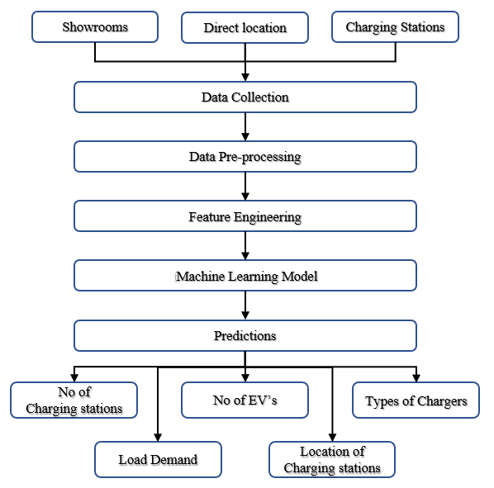
Block Diagram
Figure 1. Block diagram of the Proposed method
2024 International Conference on Computer Communication and Informatics (ICCCI-2024), Jan. 29-31, 2024, Coimbatore, INDIA

Slide 5
METHODOLOGY
Data Collection:
Counting the number of electric cars (EVs) in specific locations.
Suitable for smaller areas or groups with achievable data collection efforts.
Gathering information from charging spots to understand power usage patterns.
Considerations for locations not covered by public charging spots.
Data Pre-Processing:
Ensuring the cleanliness of electric vehicle (EV) data.
Eliminating duplicate information and filling in missing data with accurate predictions.
Verification of data integrity for meaningful analysis.
Feature Engineering:
Identifying crucial information in the dataset.
Simplifying data for ease of analysis and pattern recognition.
Facilitating better predictions and planning for the future of electric vehicles.
Machine Learning Model (ARIMA):
Utilizing Auto-Regressive Integrated Moving Average (ARIMA) models for time series forecasting.
Assessing past EV data to recognize patterns and trends.
Providing a predictive tool for estimating future EV adoption and charging demand.
2024 International Conference on Computer Communication and Informatics (ICCCI-2024), Jan. 29-31, 2024, Coimbatore, INDIA

Slide 6
Block Diagram of Proposed Method
K-Means Clustering:
Grouping EV-related data using K-Means Clustering.
Identifying optimal locations for charging stations based on usage patterns.
Enhancing strategic placement to meet diverse charging demands.
Predictions:
Generating predictions based on ARIMA models.
Offering insights into the expected growth of electric cars.
Aiding in the planning of charging stations, charger types, and infrastructure to meet future demand.
Key Points:
Detailed breakdown of the methodology used in the study.
Importance of accurate data collection and pre-processing.
Significance of feature engineering in enhancing dataset usability.
Application of ARIMA models and K-Means Clustering for comprehensive predictions.
2024 International Conference on Computer Communication and Informatics (ICCCI-2024), Jan. 29-31, 2024, Coimbatore, INDIA

Slide 7
DATASETS
EV Usage and Development:
Overview of the data showcasing the use and development of Electric Vehicles (EVs) from 2020 to 2023.
Charging Stations and EV Connections:
Details about different types of charging stations (quick, normal, slow) and their distribution.
Geographic visualization of EV locations, showing the connections between 230 electric vehicles.
Importance of the Data:
Understanding the states' contribution to EV adoption.
Analyzing the distribution of charging stations and their types.
Providing insights into the geographic locations of EVs for better infrastructure planning.
Key Points:
Utilization of real-world data for accurate predictions.
Visualization of EV counts and locations for comprehensive analysis.
Foundation for predicting EV adoption trends and planning charging infrastructure.
2024 International Conference on Computer Communication and Informatics (ICCCI-2024), Jan. 29-31, 2024, Coimbatore, INDIA

Slide 8
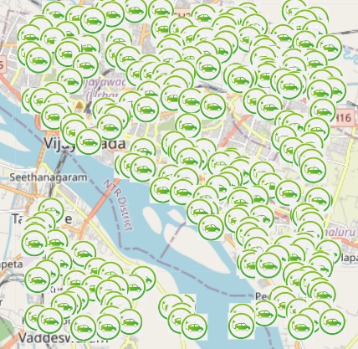
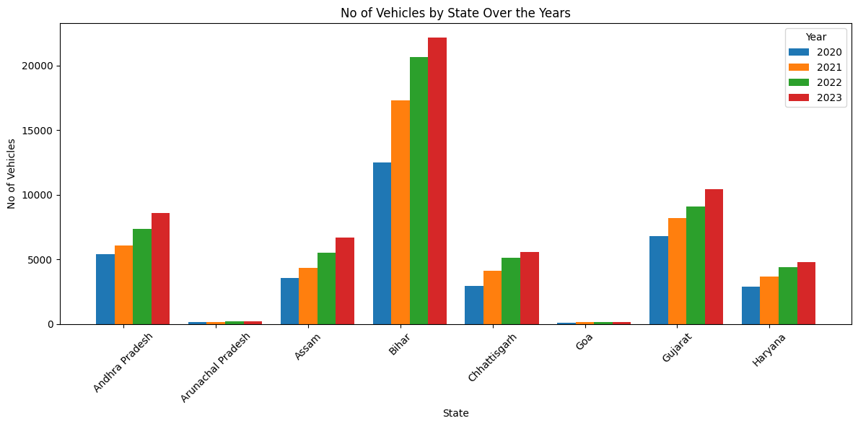
Contd...
Figure 2. Visualization of EV’s count to States in Different years
Figure 3. Geographic visualization of EV locations
2024 International Conference on Computer Communication and Informatics (ICCCI-2024), Jan. 29-31, 2024, Coimbatore, INDIA

Slide 9
ARIMA PREDICTIONS
Data Analysis:
ARIMA starts by analyzing historical EV data, studying patterns and trends in EV adoption over time. This step involves scrutinizing usage variations, potential trends, and fluctuations in EV adoption data.
Pattern Identification:
The model then identifies patterns in EV adoption, such as seasonality, cyclic behavior, and underlying trends. This recognition is crucial for understanding the recurring factors influencing EV adoption.
Model Construction:
ARIMA constructs a model by combining Auto-Regressive (AR), Integrated (I), and Moving Average (MA) components. This construction is tailored to the specific characteristics of EV adoption, utilizing past usage patterns to inform the model.
Forecasting:
With the constructed model, ARIMA predicts future EV adoption values based on the identified patterns and historical data. The forecasting process accounts for the complexities and nuances of EV adoption dynamics, providing valuable insights for planning and decision-making.
2024 International Conference on Computer Communication and Informatics (ICCCI-2024), Jan. 29-31, 2024, Coimbatore, INDIA

Slide 10
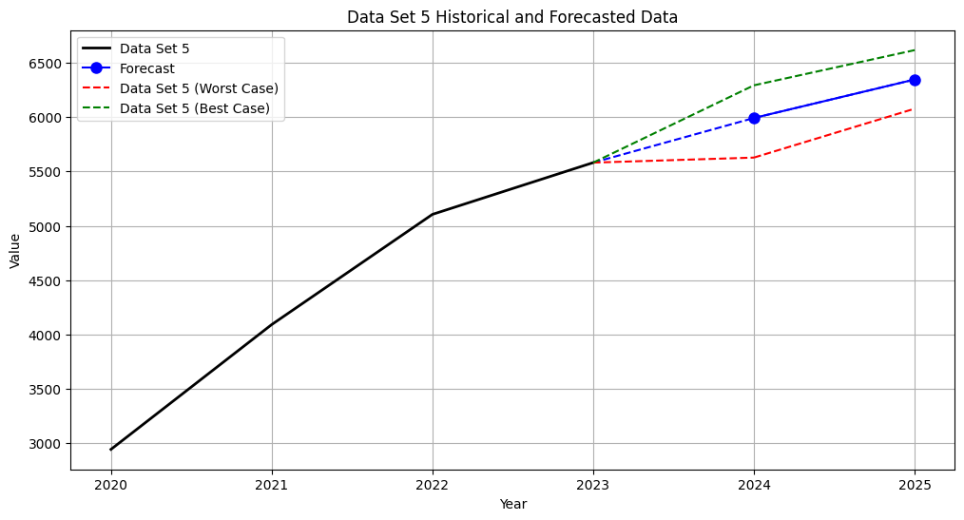
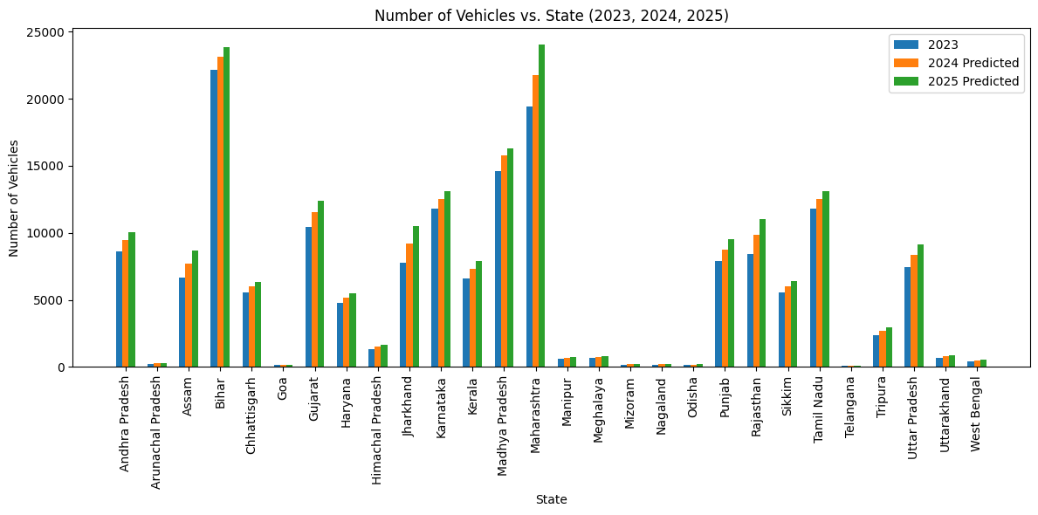
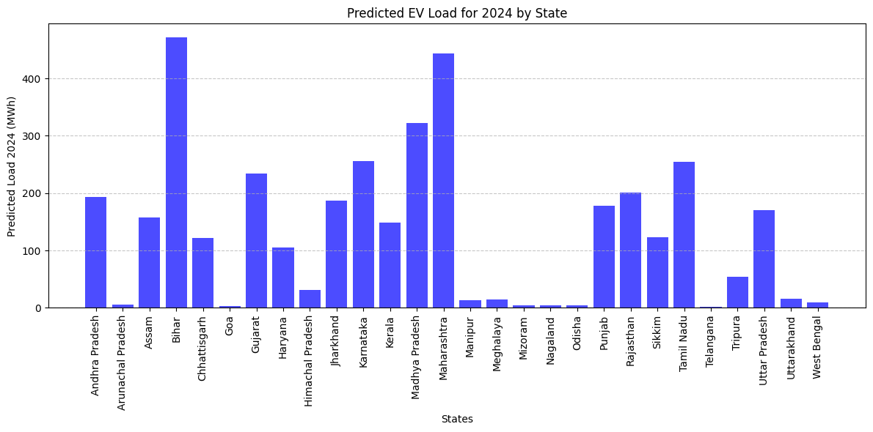
Contd..
Figure 4. Arima Predictions of a state
Figure 5. Arima Predictions for each state
Figure 6. Forecasted Load for 2024
2024 International Conference on Computer Communication and Informatics (ICCCI-2024), Jan. 29-31, 2024, Coimbatore, INDIA

Slide 11
K-MEANS CLUSTERING
Data Grouping:
K-Means Clustering initially groups data points into clusters based on their similarity. In the context of EV charging stations, this involves categorizing stations with similar features or usage patterns into distinct groups.
Cluster Centres:
The algorithm identifies central points known as centroids for each cluster. These centroids represent the mean position of the data points within the cluster.
Grouping Similar Items:
Data points are then assigned to clusters based on their proximity to the centroid. Items with similar characteristics or attributes end up in the same cluster, facilitating effective grouping.
Optimal Cluster Number:
K-Means aims to find the optimal number of clusters that maximizes homogeneity within clusters and heterogeneity between them. This optimization is crucial for ensuring that each cluster captures distinct patterns in the data.
Example:
Applying K-Means to EV charging stations involves clustering them based on factors like daily usage patterns, geographical location, and charging demand. Stations within the same cluster share similar characteristics, aiding in optimal resource allocation and strategic infrastructure planning.
2024 International Conference on Computer Communication and Informatics (ICCCI-2024), Jan. 29-31, 2024, Coimbatore, INDIA

Slide 12
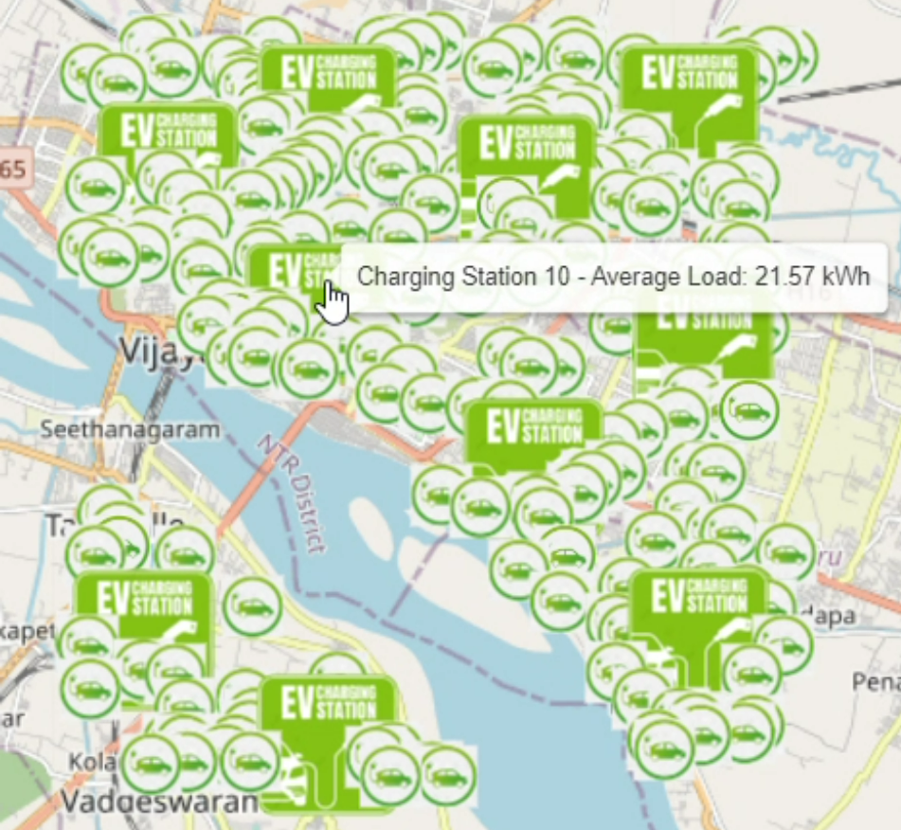
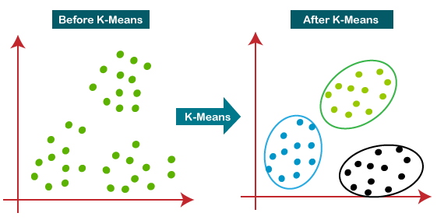
Contd…
Figure 7. Visualization of K-means Clustering Process
Figure 8. EV and Charging Station Locations with Load Averages
2024 International Conference on Computer Communication and Informatics (ICCCI-2024), Jan. 29-31, 2024, Coimbatore, INDIA

Slide 13
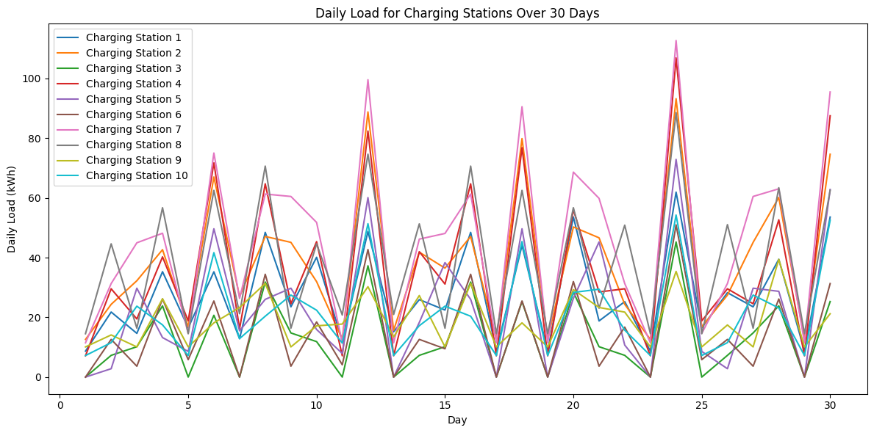
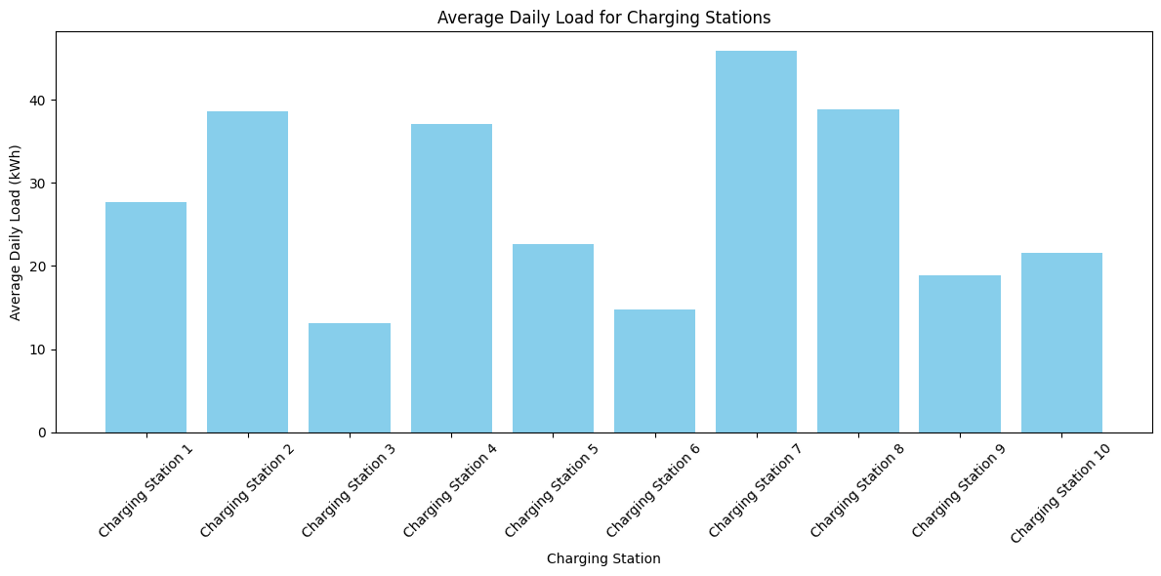
DAILY LOAD ANALYSIS
Charging Station Usage Patterns:
Incorporating insights from the daily load analysis, the presentation highlights usage patterns observed in EV charging stations. Utilizing data from the study, it delves into specific trends, peak charging times, and variations in demand.
Optimizing Charging Infrastructure:
The analysis not only serves to understand user behavior but also plays a pivotal role in optimizing charging infrastructure. Identifying peak load times and areas with higher demand, provides valuable input for the strategic placement of charging stations and efficient resource allocation.
Figure 9. Daily Load analysis of each Charging Station
Figure 10. Average Load of Each Charging Station
2024 International Conference on Computer Communication and Informatics (ICCCI-2024), Jan. 29-31, 2024, Coimbatore, INDIA

Slide 14
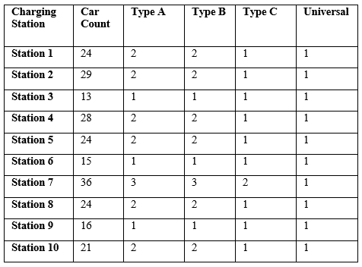
ADVANTAGES AND DISADVANTAGES
Introduction to Recommendations:
This slide presents the recommended distribution of charger types based on load requirements derived from the study."
Utilizing a combination of data analysis and load patterns, the presentation suggests an optimal mix of charger types for different locations.
Table: Charger Type Distribution
Create a table with the specified details (Types of chargers Type A, Type B, Type C ).
Highlight the percentages for each charger type.
Visual Representation:
Bar graph beside the table, Emphasizes the proportional distribution of charger types.
Figure 11. Charger-type distribution in EV charging stations
2024 International Conference on Computer Communication and Informatics (ICCCI-2024), Jan. 29-31, 2024, Coimbatore, INDIA

Slide 15
CONCLUSION
Summarize Key Findings:
Our study leveraged ARIMA predictions and K-Means clustering to gain valuable insights into EV adoption patterns.
ARIMA models provided accurate predictions for EV adoption in 2024 and 2025.
K-Means clustering facilitated data-driven charger type recommendations and optimized charging station locations.
Implications:
Accurate predictions from ARIMA models contribute to informed decision-making in EV infrastructure planning.
K-Means clustering optimizes both charger type distribution and strategic charging station locations, enhancing resource allocation for diverse regions.
Reiteration of Importance:
Efficient charging infrastructure is pivotal for accommodating the surge in EV adoption."
Our findings underscore the significance of data-driven approaches in meeting the unique demands of different regions, including optimal charging station placement.
2024 International Conference on Computer Communication and Informatics (ICCCI-2024), Jan. 29-31, 2024, Coimbatore, INDIA

Slide 16
REFERENCES
S. Deb, "Machine Learning for Solving Charging Infrastructure Planning: A Comprehensive Review," 2021 5th International Conference on Smart Grid and Smart Cities (ICSGSC), Tokyo, Japan, 2021, pp. 16-22, doi: 10.1109/ICSGSC52434.2021.9490407.
H. M. Abdullah, A. Gastli and L. Ben-Brahim, "Reinforcement Learning Based EV Charging Management Systems–A Review," in IEEE Access, vol. 9, pp. 41506-41531, 2021, doi: 10.1109/ACCESS.2021.3064354.
E. ElGhanam, M. Hassan and A. Osman, "Machine Learning-Based Electric Vehicle Charging Demand Prediction Using Origin-Destination Data: A UAE Case Study," 2022 5th International Conference on Communications, Signal Processing, and their Applications (ICCSPA), Cairo, Egypt, 2022, pp. 1-6, doi: 10.1109/ICCSPA55860.2022.10019107.
A. Hafeez, R. Alammari and A. Iqbal, "Utilization of EV Charging Station in Demand Side Management Using Deep Learning Method," in IEEE Access, vol. 11, pp. 8747-8760, 2023, doi: 10.1109/ACCESS.2023.3238667.
Q. Xing et al., "Charging Demand Forecasting Model for Electric Vehicles Based on Online Ride-Hailing Trip Data," in IEEE Access, vol. 7, pp. 137390-137409, 2019, doi: 10.1109/ACCESS.2019.2940597.
Y. Liang, Z. Ding, T. Ding, and W. -J. Lee, "Mobility-Aware Charging Scheduling for Shared On-Demand Electric Vehicle Fleet Using Deep Reinforcement Learning," in IEEE Transactions on Smart Grid, vol. 12, no. 2, pp. 1380-1393, March 2021, doi: 10.1109/TSG.2020.3025082.
2024 International Conference on Computer Communication and Informatics (ICCCI-2024), Jan. 29-31, 2024, Coimbatore, INDIA

Slide 17
S. Wang, S. Bi and Y. A. Zhang, "Reinforcement Learning for Real-Time Pricing and Scheduling Control in EV Charging Stations," in IEEE Transactions on Industrial Informatics, vol. 17, no. 2, pp. 849-859, Feb. 2021, doi: 10.1109/TII.2019.2950809.
Kim, Y, Kim, S, "Forecasting Charging Demand of Electric Vehicles Using Time-Series Models, Energies, vol. 14, no. 5, 1487, Mar. 2021, doi.org/10.3390/en14051487.
M. Majidpour, C. Qiu, P. Chu, R. Gadh and H. R. Pota, "Fast Prediction for Sparse Time Series: Demand Forecast of EV Charging Stations for Cell Phone Applications," in IEEE Transactions on Industrial Informatics, vol. 11, no. 1, pp. 242-250, Feb. 2015, doi: 10.1109/TII.2014.2374993.
S. Matrone, E. G. C. Ogliari, A. Nespoli, G. Gruosso and A. Gandelli, "Electric Vehicles Charging Sessions Classification Technique for Optimized Battery Charge Based on Machine Learning," in IEEE Access, vol. 11, pp. 52444-52451, 2023, doi: 10.1109/ACCESS.2023.3279715.
M. Kovačević and M. Vašak, "Aggregated Representation of Electric Vehicles Population on Charging Points for Demand Response Scheduling," in IEEE Transactions on Intelligent Transportation Systems, vol. 24, no. 10, pp. 10869-10880, Oct. 2023, doi: 10.1109/TITS.2023.3286012.
Muhammad Ahsan Zamee, Dongjun Han, and Dongjun, " Self-supervised online learning algorithm for electric vehicle charging station demand and event prediction,” in Journal of Energy Storage, vol71, pp.108189, Nov 2023, doi.org/10.1016/j.est.2023.108189
2024 International Conference on Computer Communication and Informatics (ICCCI-2024), Jan. 29-31, 2024, Coimbatore, INDIA

Slide 18
THANK YOU

