Slide 1




Paper ID: 1655 Title: Weather-Adaptive Power Factor Management A Machine Learning Approach Authors: Maria Joseph Arun Showry Kodiganti, Ramesh Jayaraman, Dhoohitha Narahari, Venkata Naga Hanumanth Thopuri Organization: Velagapudi Ramakrishna Siddhartha Engineering College

Slide 2
Outline
1. Introduction
2. Background/Related Work
3. Research Objectives
4. Methodology/Block Diagram
5. Results
6. Discussion
7. Conclusions
8. Future Work
9. Q&A

Slide 3
INTRODUCTION
Importance of Power Factor:
Real power (P) is the actual work power in watts, while apparent power (S) is the sum of real and reactive power. Power factor influences system efficiency, costs, equipment performance, and overall energy efficiency. Low power factor conditions result in penalties, waste, fines, and environmental impacts.
Challenges in Power Factor Management:
Power factor affected by weather and load variations, leading to suboptimal conditions. Varied consumption patterns due to weather changes make a single policy ineffective. Financial penalties and inefficient energy use are consequences of suboptimal power factors.
Research Motivation and Need for Adaptation:
Investigate how weather conditions influence power factors, Power factors are not static; they fluctuate based on real-time weather variations. Recognizing the need for a system that dynamically adjusts to changing conditions. The significance of incorporating machine learning for real-time adaptation.

Slide 4
BACKGROUND/RELATEDWORK
Power Factor Significance:
Essential for optimizing electrical system efficiency. Inefficient power factors lead to penalties, losses, and environmental impacts.
Correction Approaches:
Traditional methods like capacitor banks explored (M. Callies et.al [1], M. S. Rahman et.al [2]).
Machine Learning in Power System:
A. Alkhalifah and M. Khalid [3] emphasize power factor correction's importance. Our research integrates machine learning into power factor correction, considering weather dynamics.
Automated Power Factor Improvement:
R. S. Jagzap et.al [4] introduced automated improvement. Our study builds upon these approaches with a focus on weather-adaptive solutions.
Unique Contribution:
Incorporates weather parameters into correction model. Introduces machine learning for dynamic capacitor adjustments based on real-time weather conditions.

Slide 5
Research Objectives
Investigate and comprehend the impact of varying weather conditions on power factors in electrical systems.
Devise an intelligent and automated system that can dynamically adjust capacitors in real time based on weather data.
Implement machine learning methodologies, including logistic regression, SVM, decision trees, and random forest models, to analyse and predict power factors.
Attain a high precision level, particularly 93%, by applying supervised learning models.
Strengthen the reliability of the models through cross-validation, achieving an accuracy level of more than 99.7%.
Develop a solution that optimizes power factors by adjusting capacitors based on real-time weather data.
Introduce an intelligent approach to resolving power factor problems, aiming to enhance efficiency and avoid financial penalties.

Slide 6
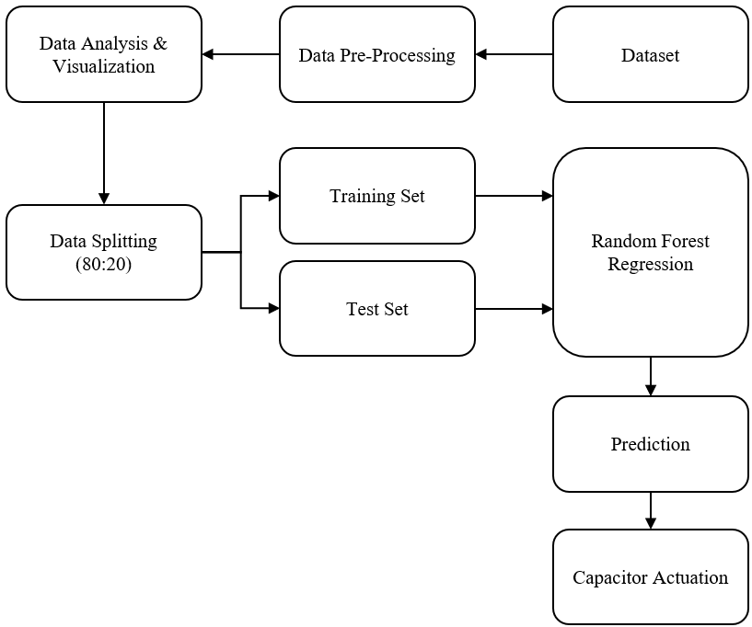
Block Diagram
Fig 1. Block Diagram

Slide 7
Methodology
A. Dataset Description:
ZigBee Wireless Sensor and Energy Consumption Dataset. Covers a 4.5-month duration. Monitors house conditions at 10-minute intervals via the ZigBee network. Enriched with integrated weather information from Chievres Airport, Belgium.
B. Dataset Preparation:
Imputation or removal of cases with null values to ensure dataset completeness and accuracy.
Box plot analysis to identify gaps, outliers, and sudden changes in the dataset.
C. Dataset Exploration:
Illustrate the distribution of key parameters such as active power, reactive power, room temperature, and humidity.
Matrix representation of data variation across days and months, particularly focusing on mean reactive power values.

Slide 8
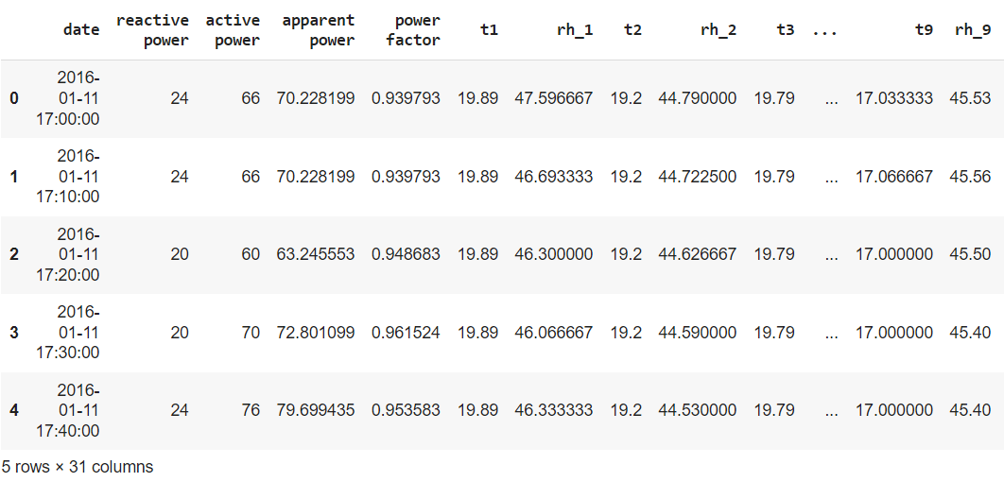
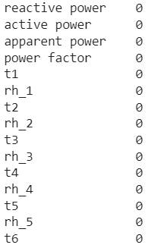
Contd..
Fig 2. Energy Consumption Dataset.
Fig 3. Elimination of Null Values for Enhanced Dataset Integrity.

Slide 9
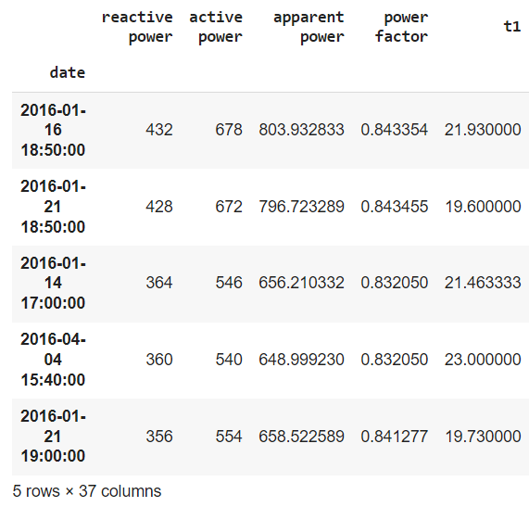
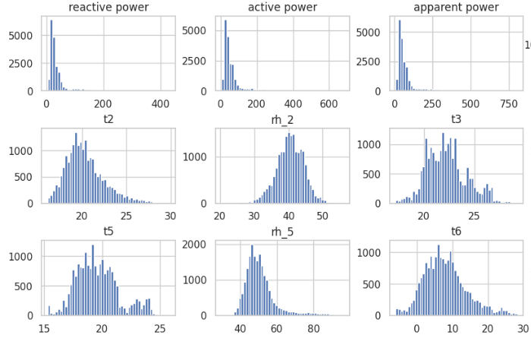
Contd..
Fig 4. Identification of Discontinuities
Fig 5. Histograms illustrating parameter distributions in the dataset.

Slide 10
Contd..
D. Data Splitting:
Utilization of the train_test_split function to divide the dataset into training (80%) and testing (20%) sets.
E. Random Forest Algorithm:
Application of Random Forest, a powerful algorithm for predicting continuous variables with numerical values.
Recursive procedure for tree building with nodes split on features leading to maximum reduction in variance.
Ensuring model reliability through cross-validation, providing insights into feature importance.
Key Focus:
Utilizing machine learning techniques to predict and optimize power factors based on real-time weather data.
Determining the optimal capacitance values required for maintaining power factors under different weather conditions.

Slide 11
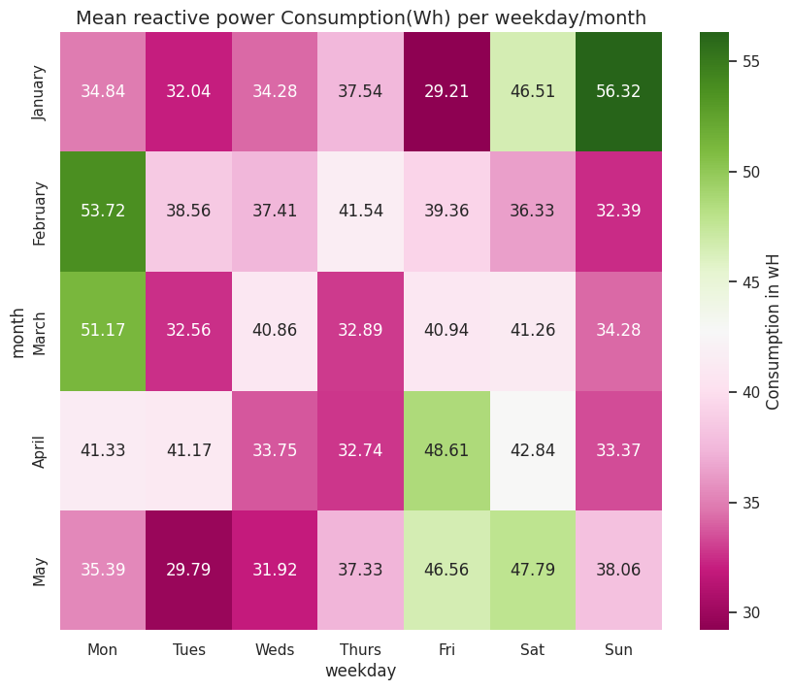
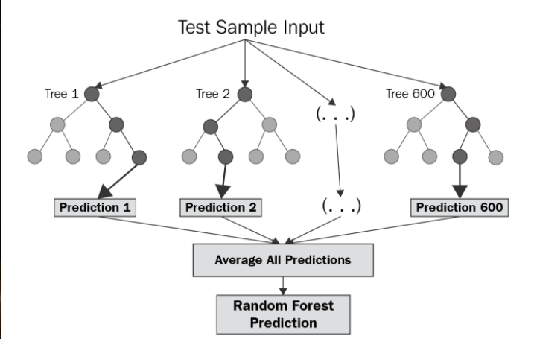
Contd..
Fig 6. Matrix Representation of data variation across days and months.
Fig 7. Random forest workflow

Slide 12
Results
Logistic Regression, SVM, Decision Trees, and Random Forest. Among the evaluated models, Random Forest stands out with an astonishingly high accuracy of 93%.
Post-cross-validation, model accuracies improved slightly:
Linear Model: 99.59%, SVR Model: 98.60%, Decision Tree and Random Forest: 100%
The proposed solution adjusts capacitors in real-time based on weather data. Aimed at optimizing power factors as precisely as possible.
Visual representation of Random Forest predictions for active and reactive power. Blue line: Target values, Red dashed line: Predictions.
Additional reactive power needed to maintain a unity power factor calculated for all runs in the dataset.
An optimization process derived an optimal set of capacitor values: [1.0, 1.5, 2.0, 3.0, 4.3, 4.7, 5.6, 6.2, 6.8, 7.5, 8.2, 9.1].
The resulting capacitors are well-suited for the system's reactive power needs, contributing to balanced distribution and optimal real-to-apparent power ratios.

Slide 13
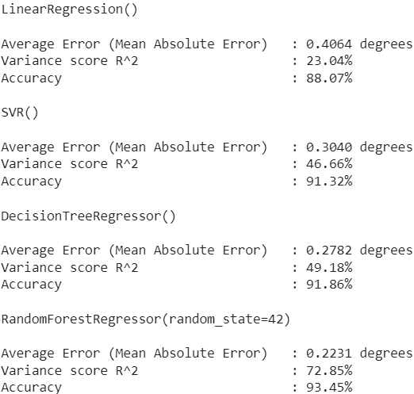
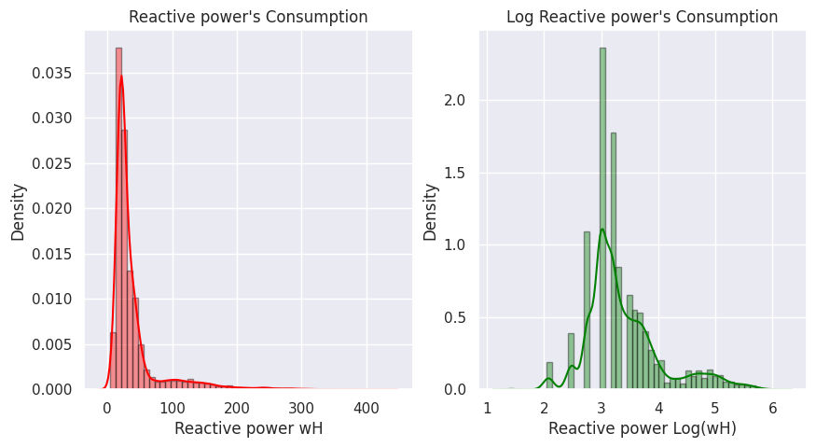
Results
Fig 8. Log Reactive Power
Fig 9. Regression Models Comparison

Slide 14
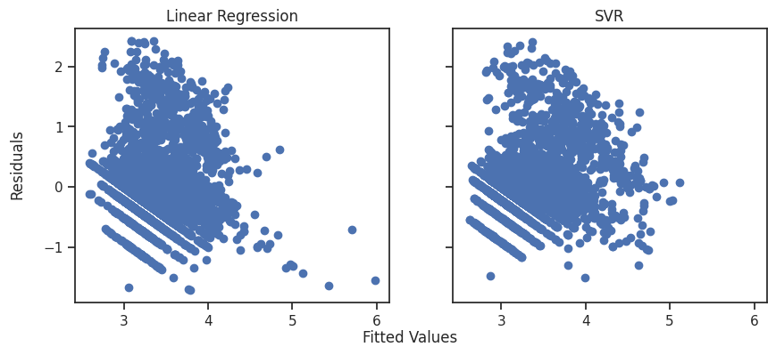
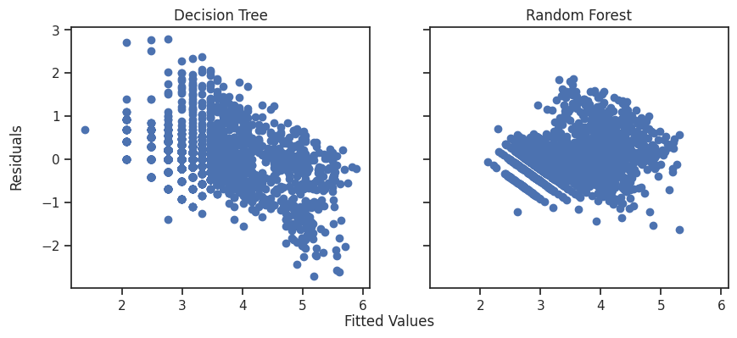
Results
Fig 10. LR vs. SVM — Fitting values and residuals comparison.
Fig 11. DT vs. RF — Fitting values and residuals comparison.

Slide 15
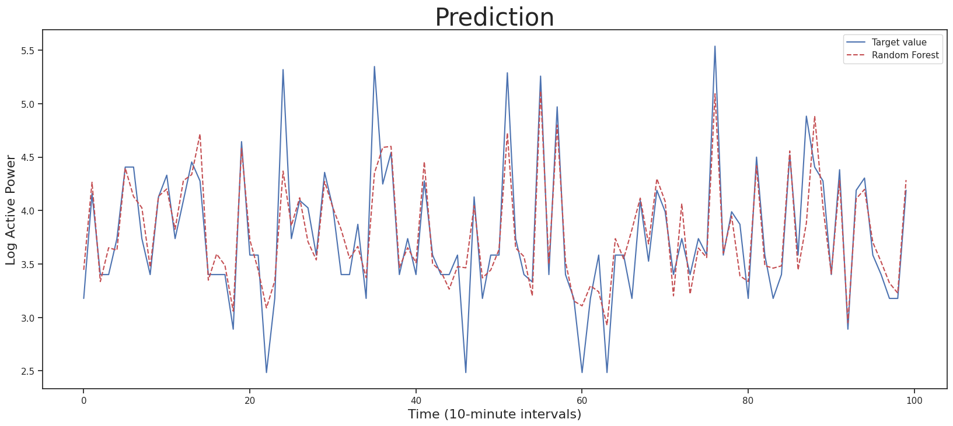
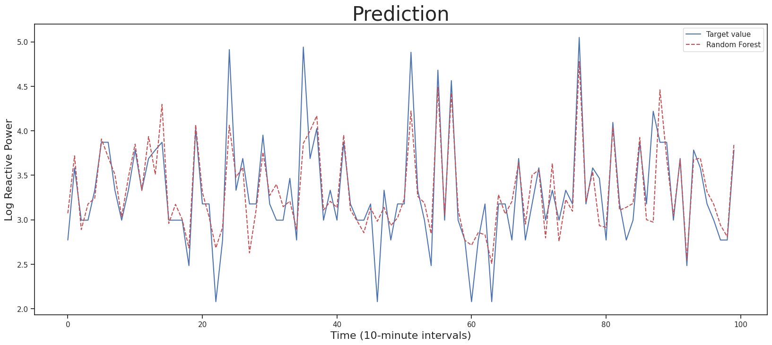
Results
Fig 12. Random Forest Active Power Predictions
.
Fig 13. Random forest reactive power Predictions
.

Slide 16
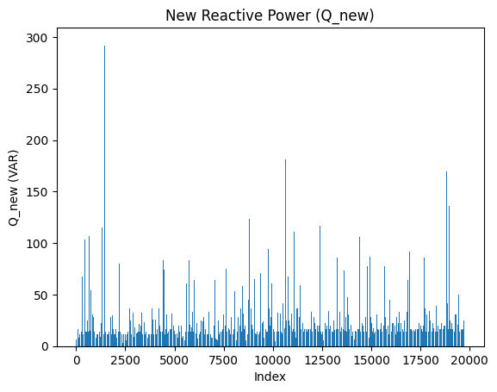
Results
Table of Capacitor Combinations and Times Repeated
S.No | Target Reactance Value | Combination | Times Repeated
1 | 13.9 | (3.0, 4.7, 6.2) | 3995
2 | 16.6 | (7.5, 9.1) | 2663
3 | 11.1 | (2.0, 9.1) | 1814
4 | 19.4 | (4.7, 5.6, 9.1) | 1093
5 | 22.2 | (5.6, 7.5, 9.1) | 876
6 | 25.0 | (1.5, 6.2, 8.2, 9.1) | 684
7 | 8.3 | (1.5, 6.8) | 658
8 | 27.8 | (1.0, 4.3, 6.8, 7.5, 8.2) | 454
9 | 30.6 | (1.0, 6.2, 6.8, 7.5, 9.1) | 326
Fig 14. Additional Reactive Power Need to be Injected

Slide 17
Discussion
Weather-Informed Power Factor Management:
The study successfully demonstrated the influence of weather conditions on power factors. The need for adaptive systems to address dynamic variations in power consumption.
Machine Learning Efficiency:
The machine learning models (Random Forest, SVM, Decision Trees) showcased high precision (93%) in predicting power factor changes. Cross-validation reinforced model reliability, surpassing 99.7% accuracy.
Dynamic Capacitor Control Implementation:
The proposed system, employing dynamic capacitor control based on real-time weather data, optimized power factors effectively. Significantly contributed to resolving power factor issues, enhancing efficiency, and mitigating financial penalties.

Slide 18
Future Work
Advanced Weather Models:
Explore sophisticated weather models for precise power factor predictions. Incorporate additional meteorological parameters for a comprehensive understanding.
Dynamic Capacitor Control:
Refine the system for more precise capacitor adjustments. Investigate adaptive algorithms for autonomous optimization.
IoT Integration:
Integrate IoT devices and sensors for real-time data collection. Enhance system responsiveness through IoT capabilities.

Slide 19
References
M. Callies, R. Ulmer, J. McHugh and Z. Reed, "Case Studies: New Options for Power Factor Correction," 2022 IEEE Rural Electric Power Conference (REPC), Savannah, GA, USA, 2022, pp. 60-64, doi: 10.1109/REPEC55671.2022.00018.
M. S. Rahman, A. Memy, M. A. Mahmud and S. Siddique, "Automatic Power Factor Measurement And Improvement Using Capacitor Bank," 2022 IEEE International Power and Renewable Energy Conference (IPRECON), Kollam, India, 2022, pp. 1-6, doi: 10.1109/IPRECON55716.2022.10059553.
A. Alkhalifah and M. Khalid, "Power Quality in Electrical Network – A Practical Case," 2022 5th International Conference on Power Electronics and their Applications (ICPEA), Hail, Saudi Arabia, 2022, pp. 1-6, doi: 10.1109/ICPEA51060.2022.9791168.
R. S. Jagzap, K. N. Adhav, M. R. Raktate, S. S. Gadekar, P. V. Thokal and D. B. Pardeshi, "Automatic Power Factor Improvement Using Microcontroller," 2023 2nd International Conference on Edge Computing and Applications (ICECAA), Namakkal, India, 2023, pp. 1450-1454, doi: 10.1109/ICECAA58104.2023.10212284.
L. E. Aciu and A. Dănilă, "An Analysis of the Power Factor Compensation Within the Power Grid of an Industrial Plant by Means of Supervised Learning Methods," 2023 International Conference on Electromechanical and Energy Systems (SIELMEN), Craiova, Romania, 2023, pp. 1-6, doi: 10.1109/SIELMEN59038.2023.10290754.

Slide 20
Thank You

