Slide 1
Day RIT Data Science Seminar: Day 2
Mateo Sokac

Slide 2
Let’s remind ourselves: Day 1
Before we finished you wrote
install.packages(“tidyverse”)
install.packages(“ggpubr”)
If you did not, do it now…
Reminder
https://github.com/mxs3203/RIT_DataScience_Seminar
Google Git hub mxs3203

Slide 3
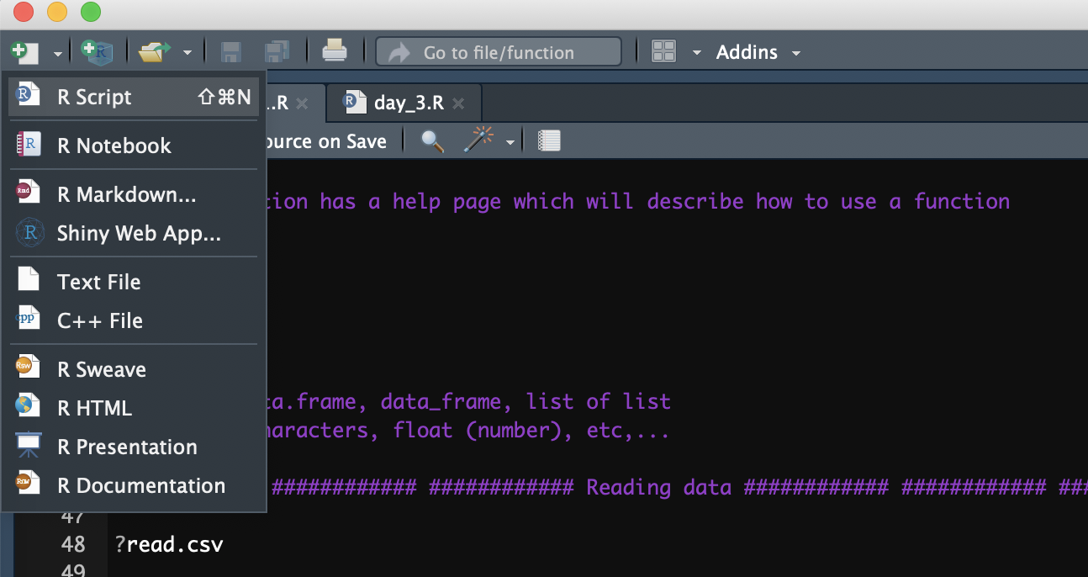
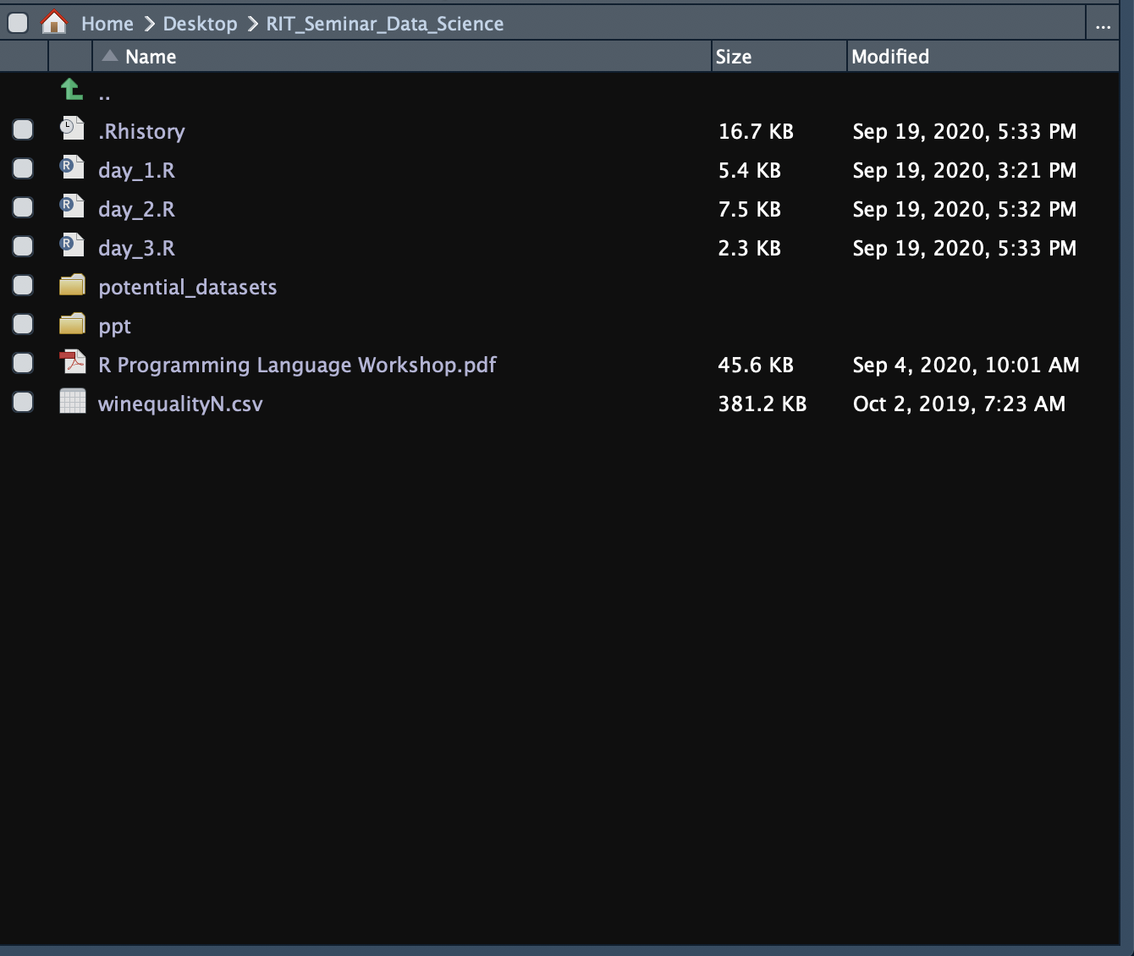
Let’s remind ourselves: Day 1
Making new empty file
Check if you are in correct directory in RStudio

Slide 4
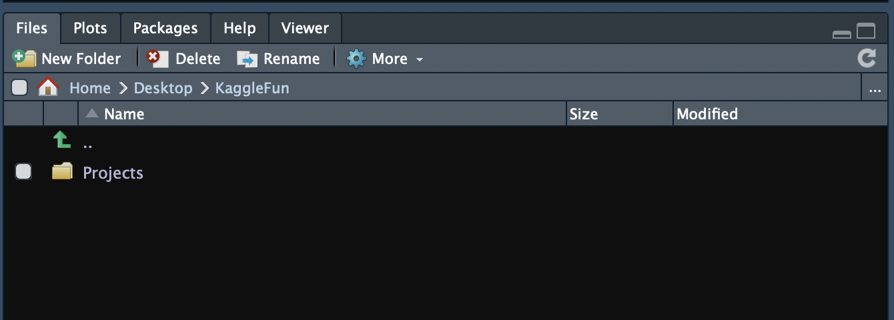
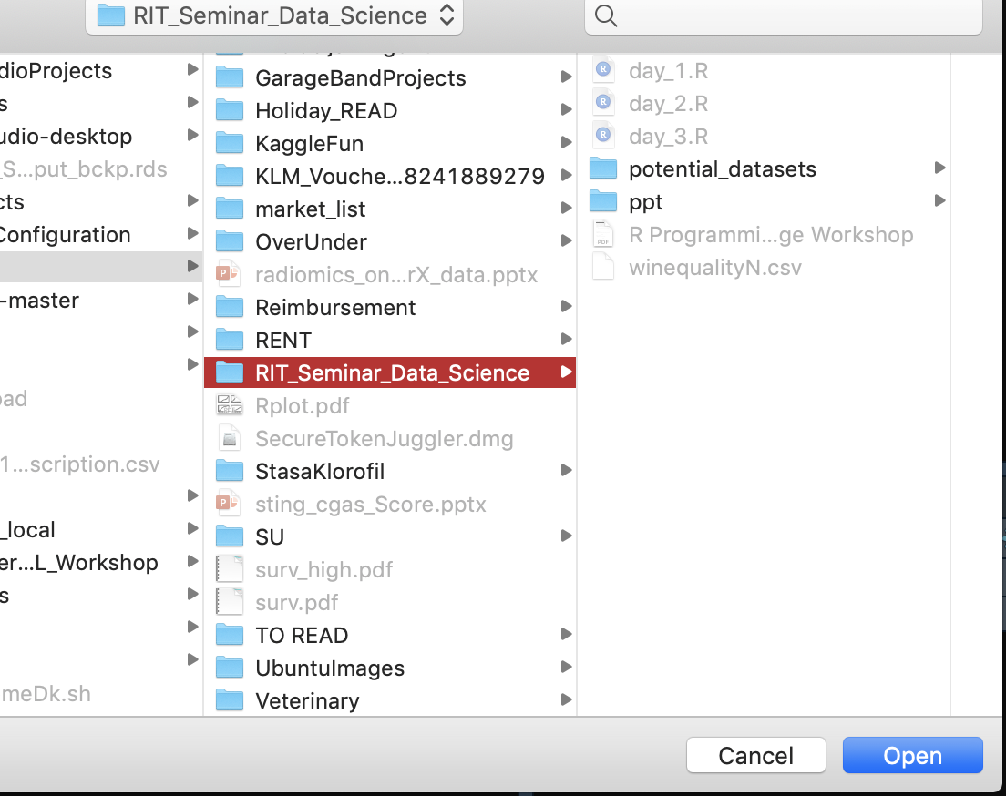
Let’s remind ourselves: Day 1
If you are not in correct directory then set it up by clicking … and finding your directory and pressing open

Slide 5
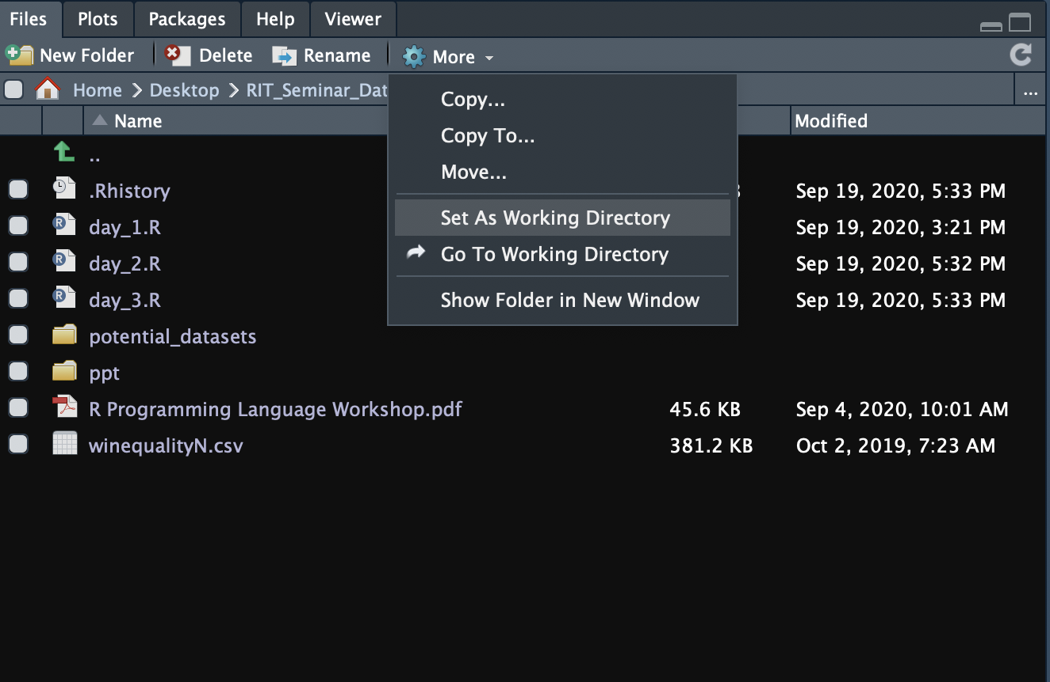
Let’s remind ourselves: Day 1
Set your working directory to that current folder by clicking on More and then on Set As Working Directory
Now you are ready to read CSV file from that directory…

Slide 6
Let’s remind ourselves: Day 1
How to run code?
Go to the line of code which you want to execute and press
Mac: CMD + Enter
Windows : CTRL + Enter
How to read a data?
data = read.csv(“file.csv”)
If something is wrong with reading the data…
Check how are columns separated!
Load data with alternative separator, let’s say ;
data = read.csv(“file.csv”, sep = “;”)
If your column names are not visible
data = read.csv(”file.csv”, header = TRUE)

Slide 7
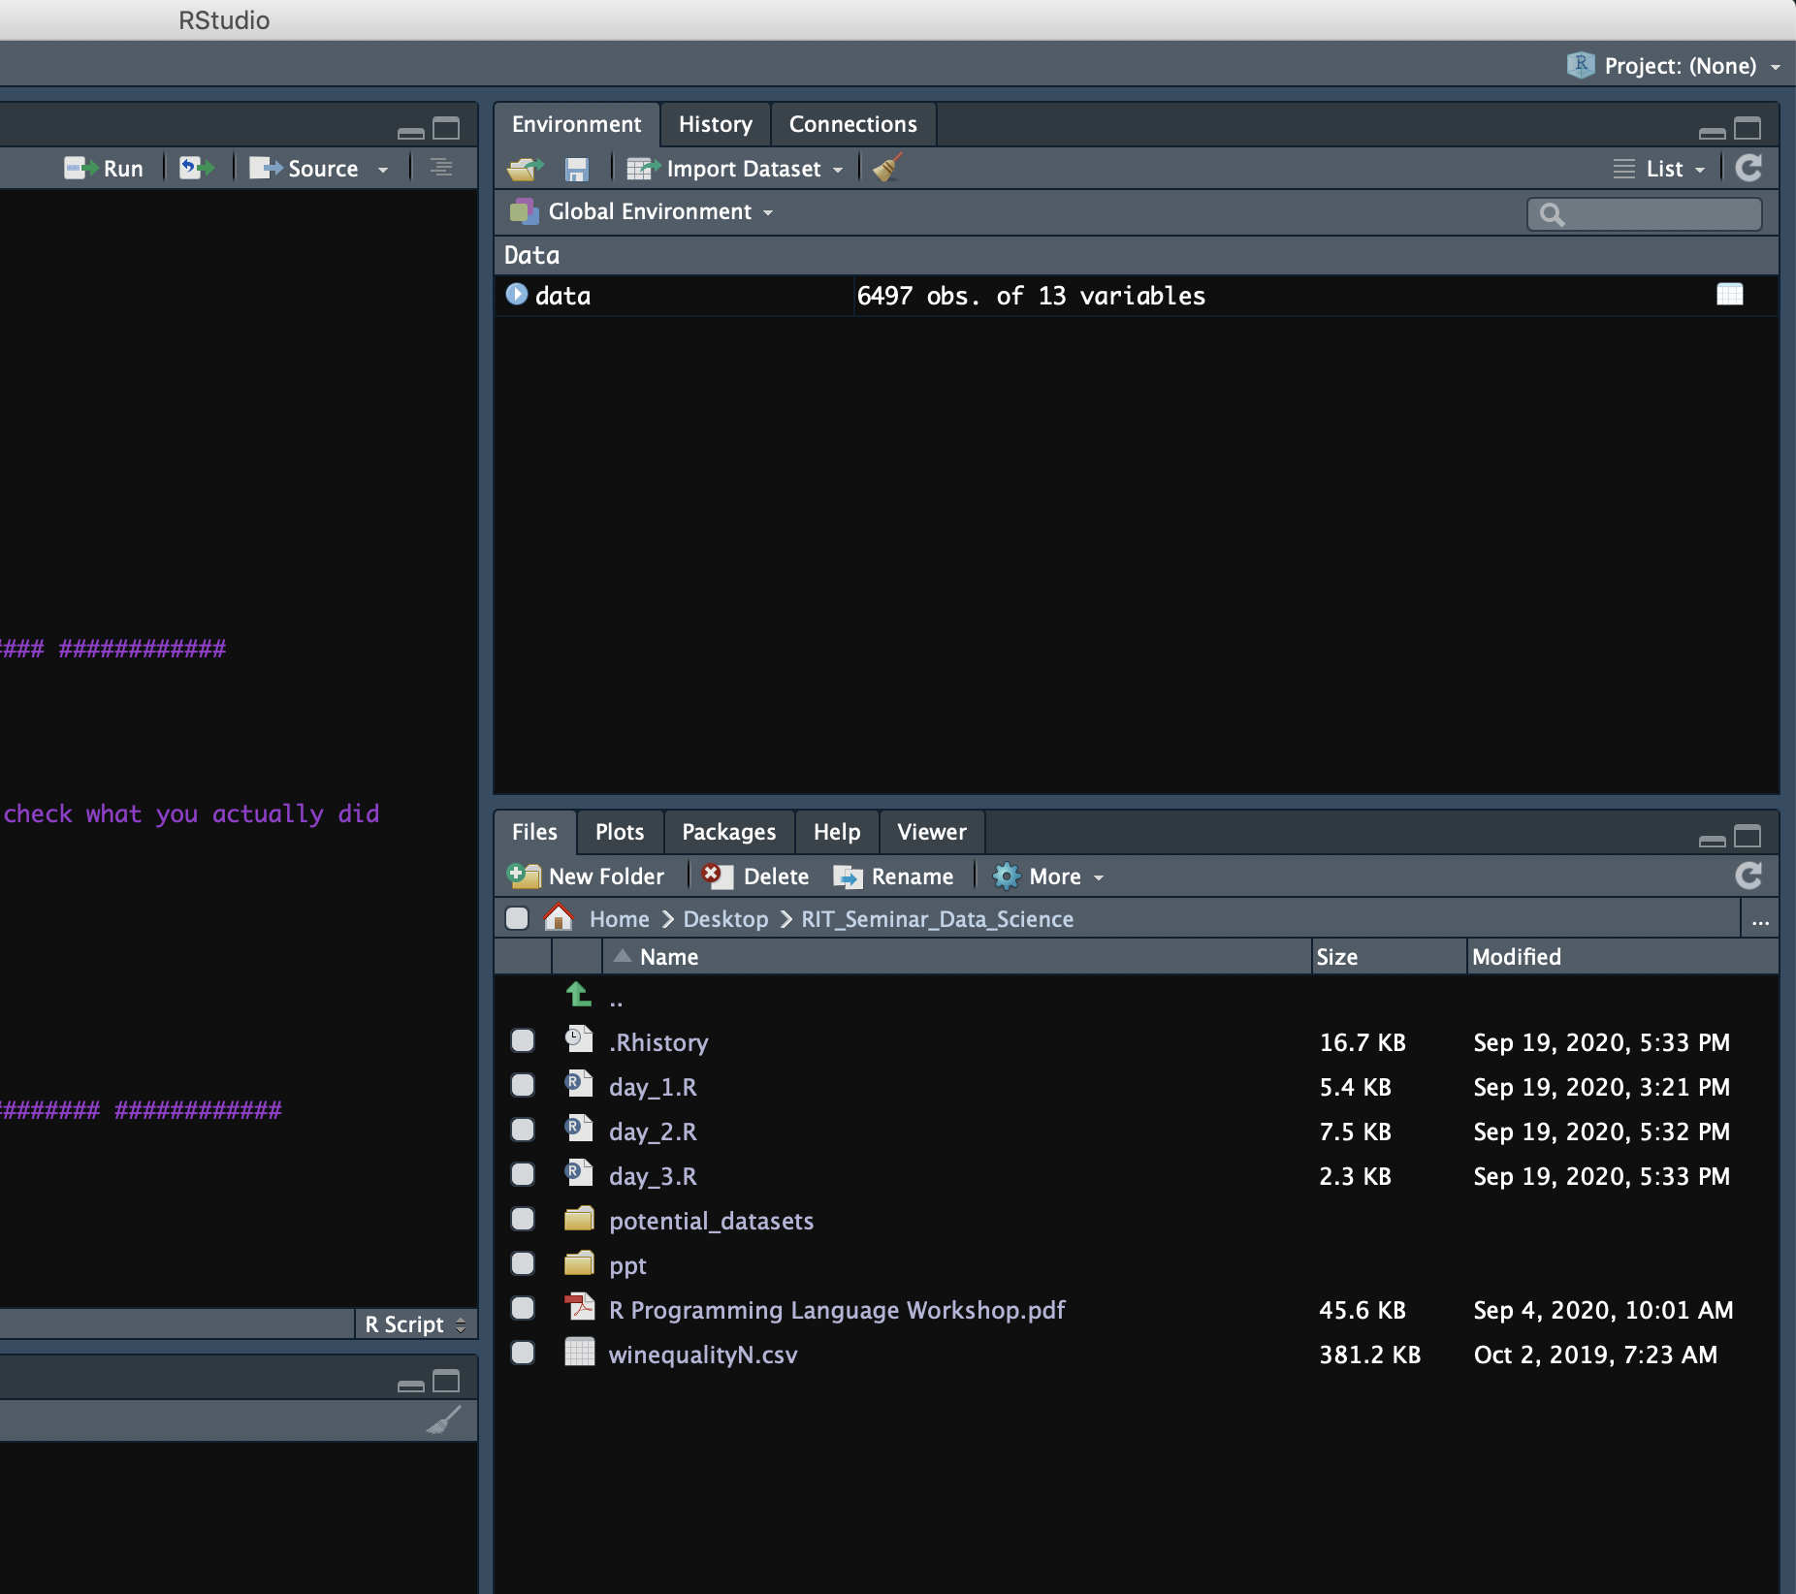
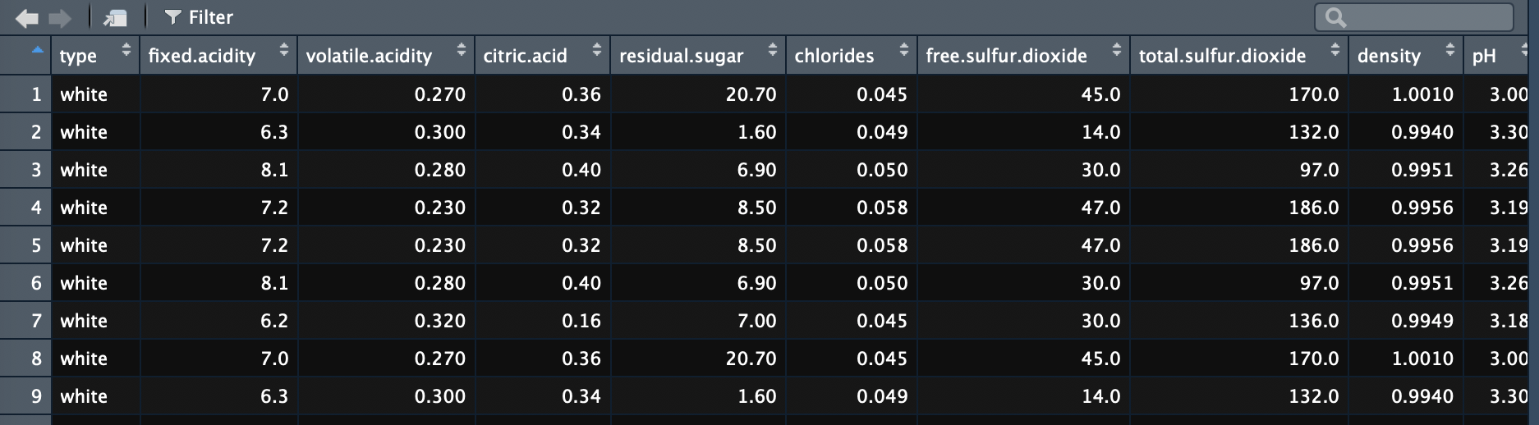
Let’s remind ourselves: Day 1
Once you read data and store it into variable (let’s say data) you should be able to see it in your environment
Check if columns numbers and row numbers are correct
Click on it in Global Environment to open it and check how it looks

Slide 8
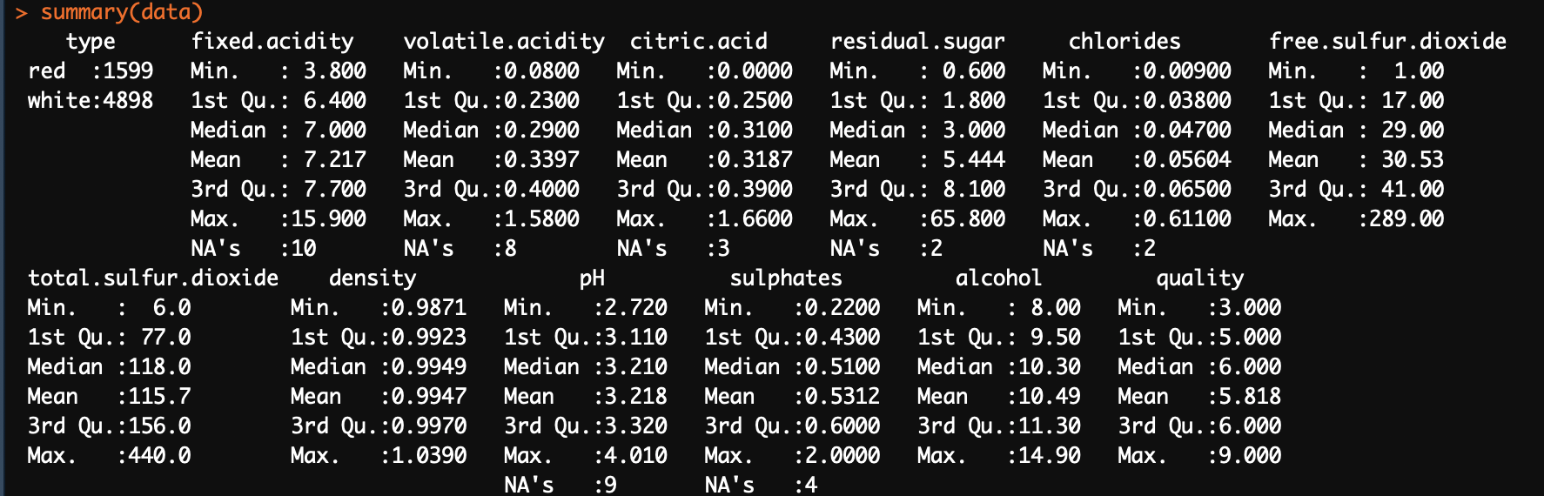
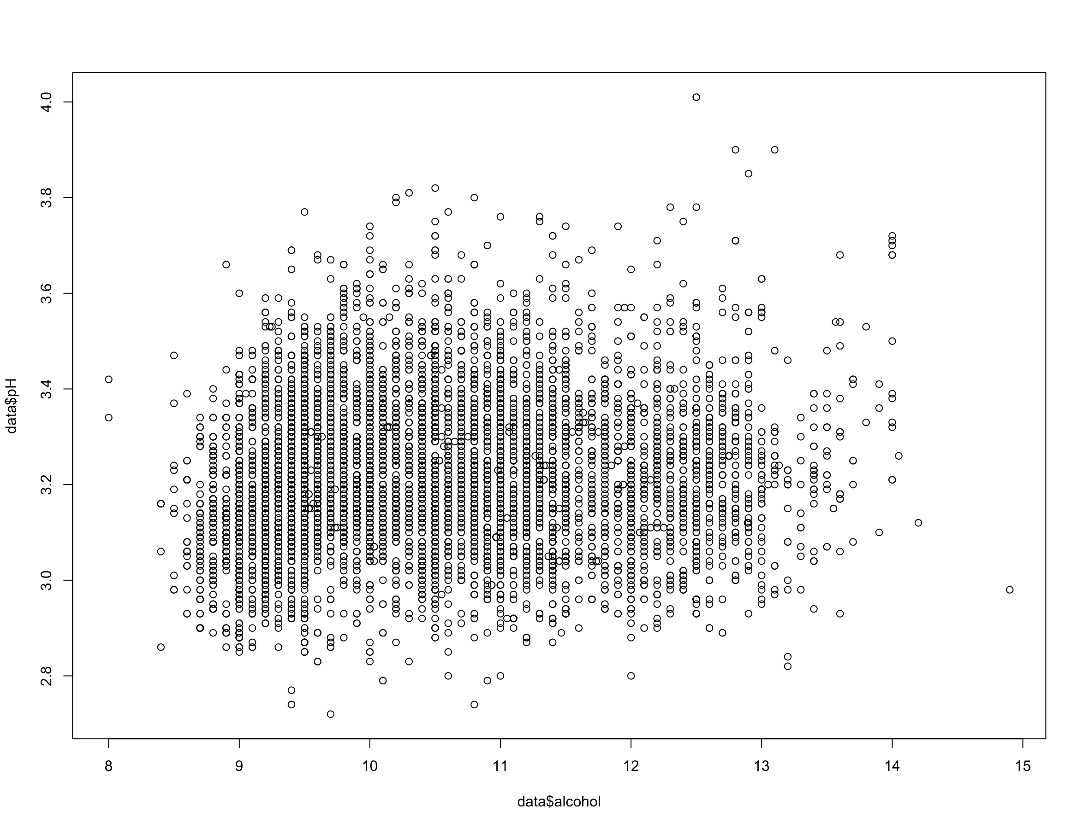
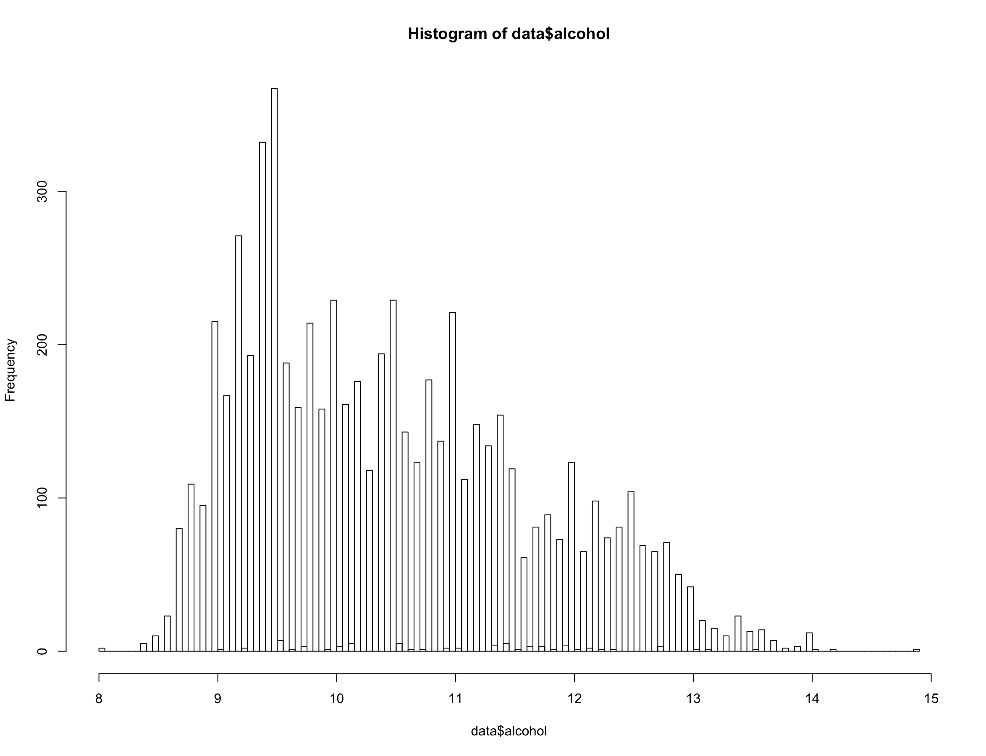
Let’s remind ourselves: Day 1
Let’s check basic statistics of our data
We write…
summary(data)
CMD + Enter
We made basic plots:
Histogram by typing
hist(data$alcohol)
Scatter plot by typing
plot(data$alcohol, data$pH)

Slide 9
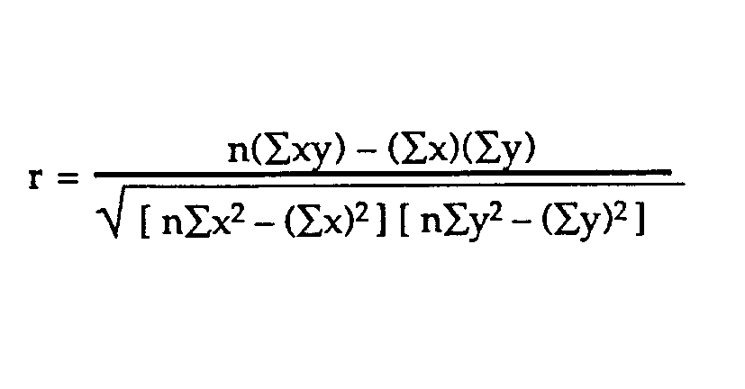
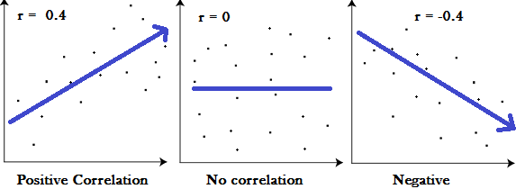
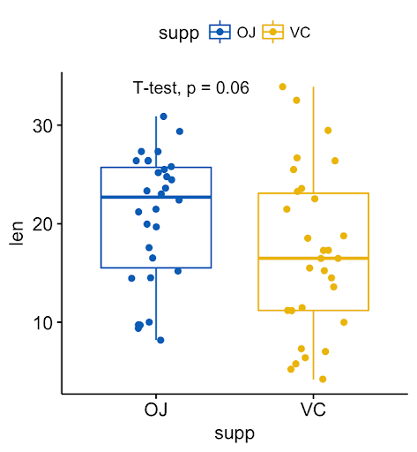
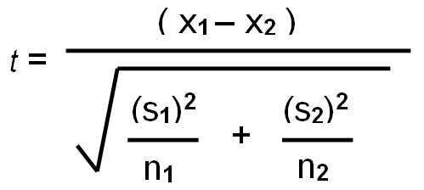
Statistical tests
Comparing two numeric variables
Correlation test
Pearson or Spearman
Comparing two groups (difference in mean)
T-test
P value
evidence against a null hypothesis
< 0.05 = significant
>= 0.05 = not significant

Slide 10
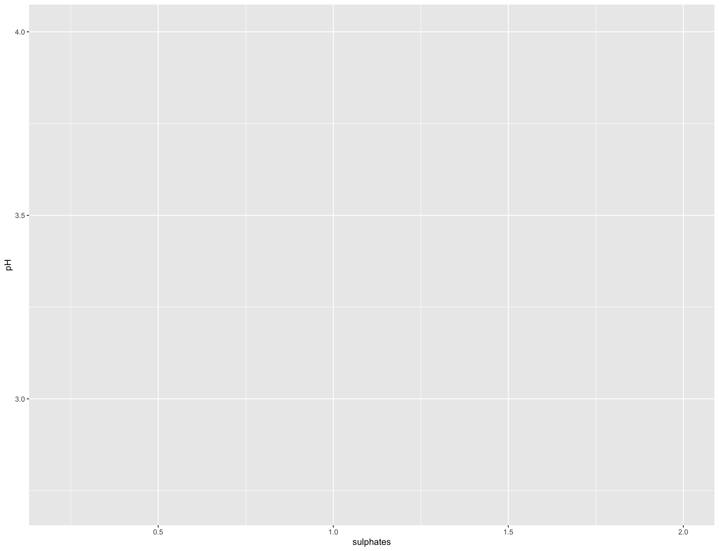
Day 2: Nicer plots using Tidyverse and ggpubr library
You have to load packages by writing…
library(tidyverse)
library(ggpubr)
Before we start small introduction about new “fancy” plots (ggplot)
Layered structure
ggplot(data = data, aes(x = sulphates , y = pH))

Slide 11
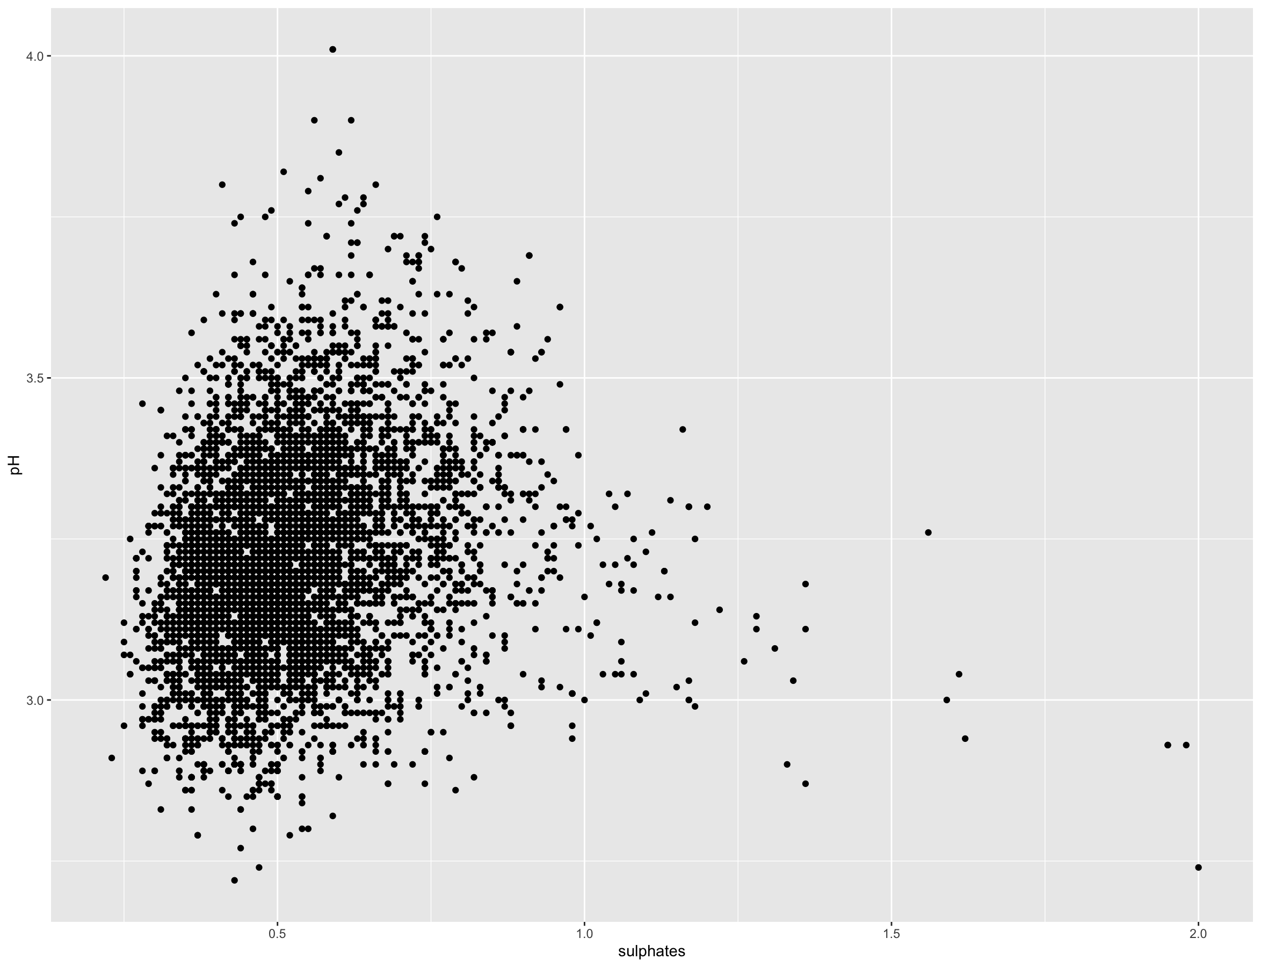
Day 2: Nicer plots using Tidyverse and ggpubr library
You have to load packages by writing…
library(tidyverse)
library(ggpubr)
Before we start small introduction about new “fancy” plots (ggplot)
Layered structure
ggplot(data = data, aes(x = sulphates , y = pH)) +
geom_point()

Slide 12
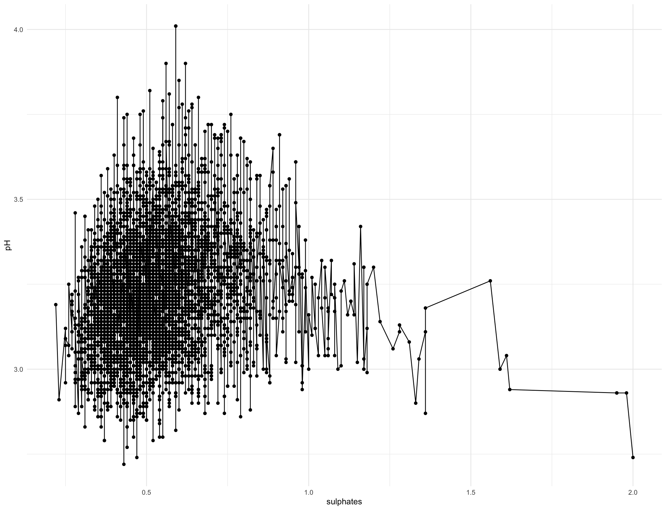
Day 2: Nicer plots using Tidyverse and ggpubr library
You have to load packages by writing…
library(tidyverse)
library(ggpubr)
Before we start small introduction about new “fancy” plots (ggplot)
Layered structure
ggplot(data = data, aes(x = sulphates , y = pH)) +
geom_point() +
geom_line()
…You can continue adding layers…

Slide 13
Let’s do that in code…

