Slide 1
Day RIT Data Science Seminar: Day 3
Mateo Sokac

Slide 2
We start by downloading the github folder
https://github.com/mxs3203/RIT_DataScience_Seminar
***Copy to zoom chat
You can download the folder on this link
I wrote some starter code so we can focus on new topics
It is just loading the data and comments

Slide 3
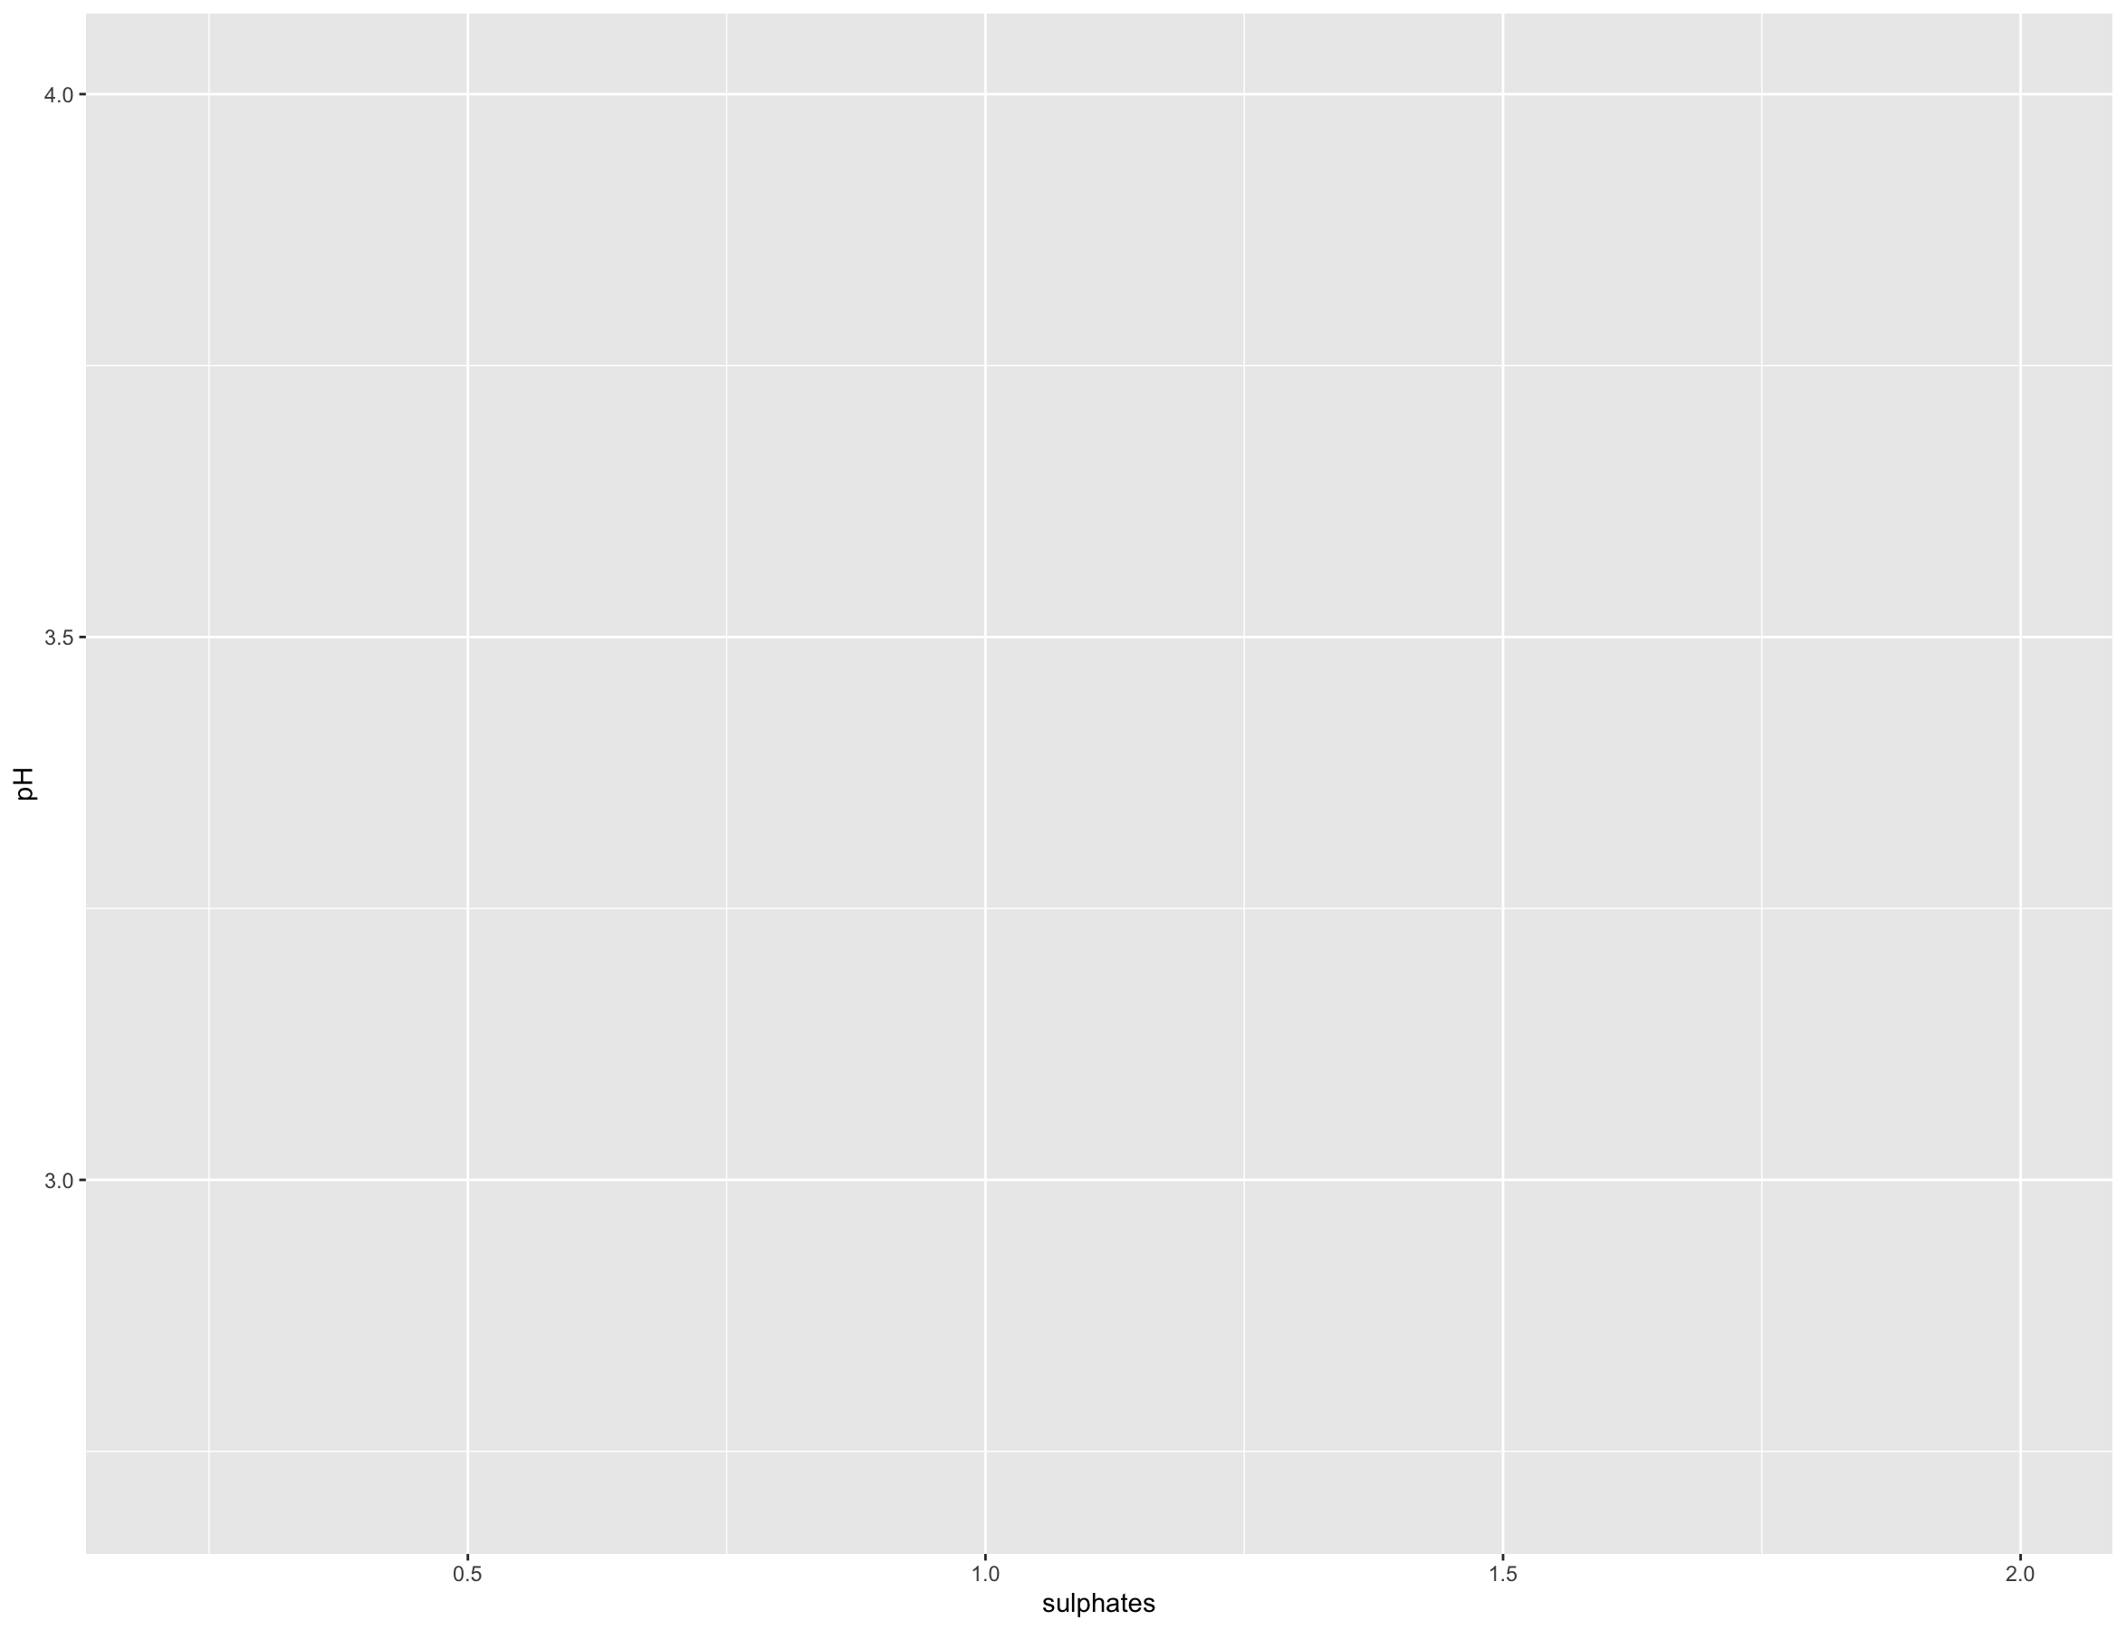
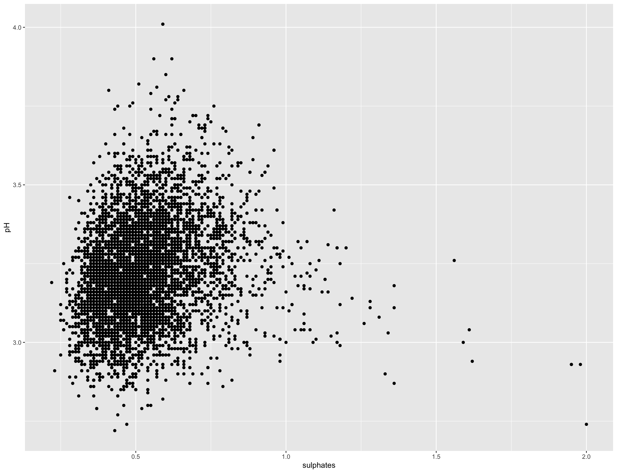
Reminder from last time
We used tidyverse library to make ggplots
Ggplot
Works in layered structure
ggplot(data = data, aes(x = sulphates , y = pH))
ggplot(data = data, aes(x = sulphates , y = pH)) + geom_point()

Slide 4
Reminder from last time
We use plots to understand the data and know what to expect from it
We want to predict future temperature
Therefore, we want to find parameters which are correlated with temperature
Correlation IS NOT the same as linear regression
Both describe relationship between two variables but it is not the same
For this purpose we are going naively to rely on correlation

Slide 5
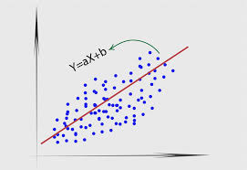
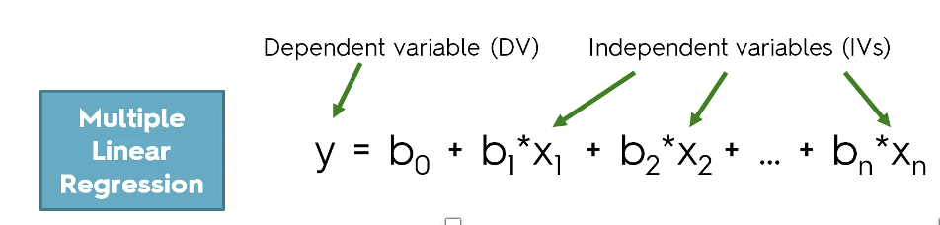
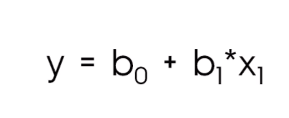
Learning from data
First step into Machine learning area
We have observation and we want to learn from it
Basic linear regression
Simplest model to use
Can have multiple parameters not only one
We want to predict future temperature based on X1, X2,X3 (CO2, CH4, etc,…)

Slide 6
Learning from data
How to know your model is good?
Train – Test split
Make a model using 80% of your data
Test your model on 20% of your data model never saw
I will use write those functions for you so you do not spend time figuring out how to write it in R
Model can “memorize” training data which is not good because it has to be robust and you should be able to apply it on unknown data
The purpose is to understand why

Slide 7
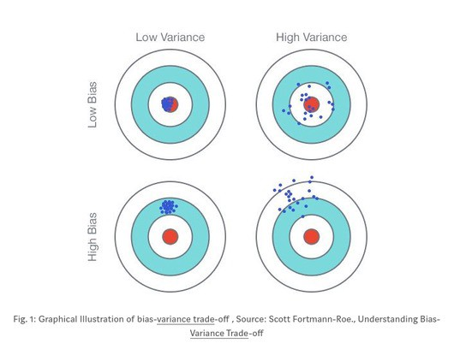
Learning from data:
Why do we care about what parameters we want to include?
Variance
We are not accurate enough
Bias
We are thinking (biased towards) some conclusion which is not actually correct

Slide 8
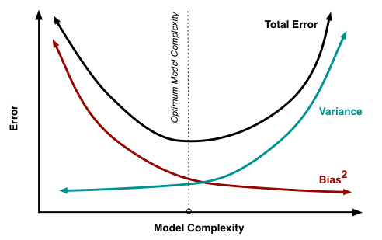
Learning from data:
Why do we care about what parameters we want to include?
More parameters = Complex model
Less parameters = Simple model

Slide 9
Learning from data
Example:
We included 5 parameters in our model
Let’s say that is a complex model because you have to explain to someone that your model considers 5 parameters to predict 1
We included more info from different parameters therefore we are not biased
But that information can also be noise or useless information therefore we have high variance
We included 1 parameter in our model
It is a simplest model
We included only one parameter therefore we are biased towards that parameter and we are ignoring everything else
1 parameter has less noise then 5 parameters therefore we have low variance

Slide 10

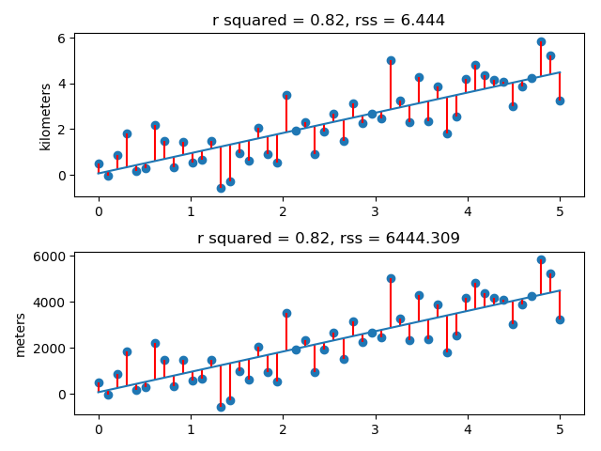
How I linear model is good?
RSS (Residual Sum of Squares)
A line is your model
You sum up all distances between model and observed data
Depends on units of data
See example on the right

Slide 11
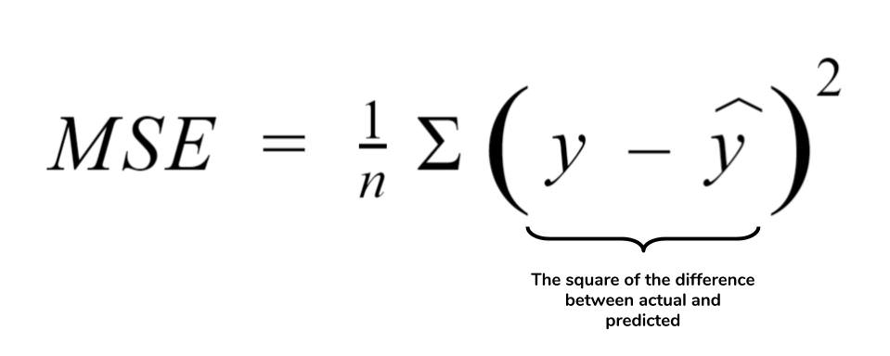
How I linear model is good?
MSE (Mean squared error )
RSS/N
A line is your model
You sum up all distances between model and observed data
MSE = RSS Normalized by number of observations

Slide 12
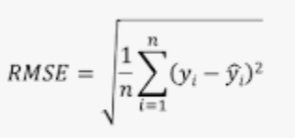
How I linear model is good?
RMSE (Root Mean squared error )
sqrt(MSE)
A line is your model
You sum up all distances between model and observed data
RMSE
is a measure of how spread out these residuals are. In other words, it tells you how concentrated the data is around the line of best fit.
R squared
Proportion of variance explained by your model
Can be interpreted as percentage how well the model fit your data

Slide 13
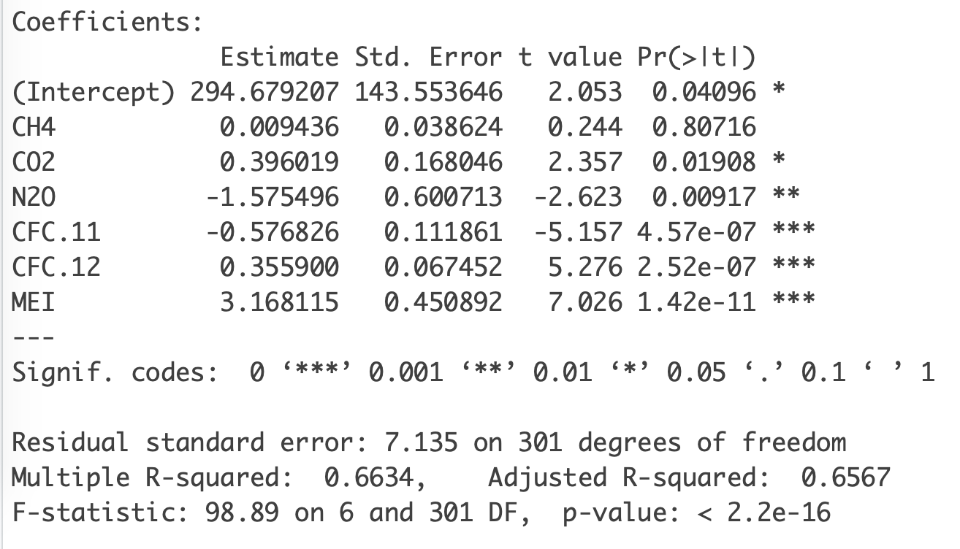
Which parameter is useful?
Do correlation analysis with all possibilities
Make a model summary and observe P-value under F-statistics
Look how R^2 is changing
Try different combinations of parameters and observe the change

Slide 14
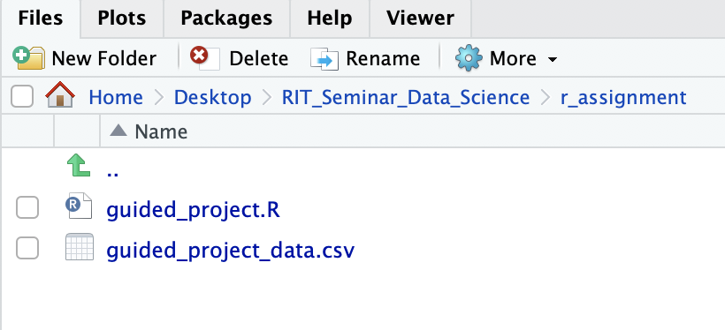
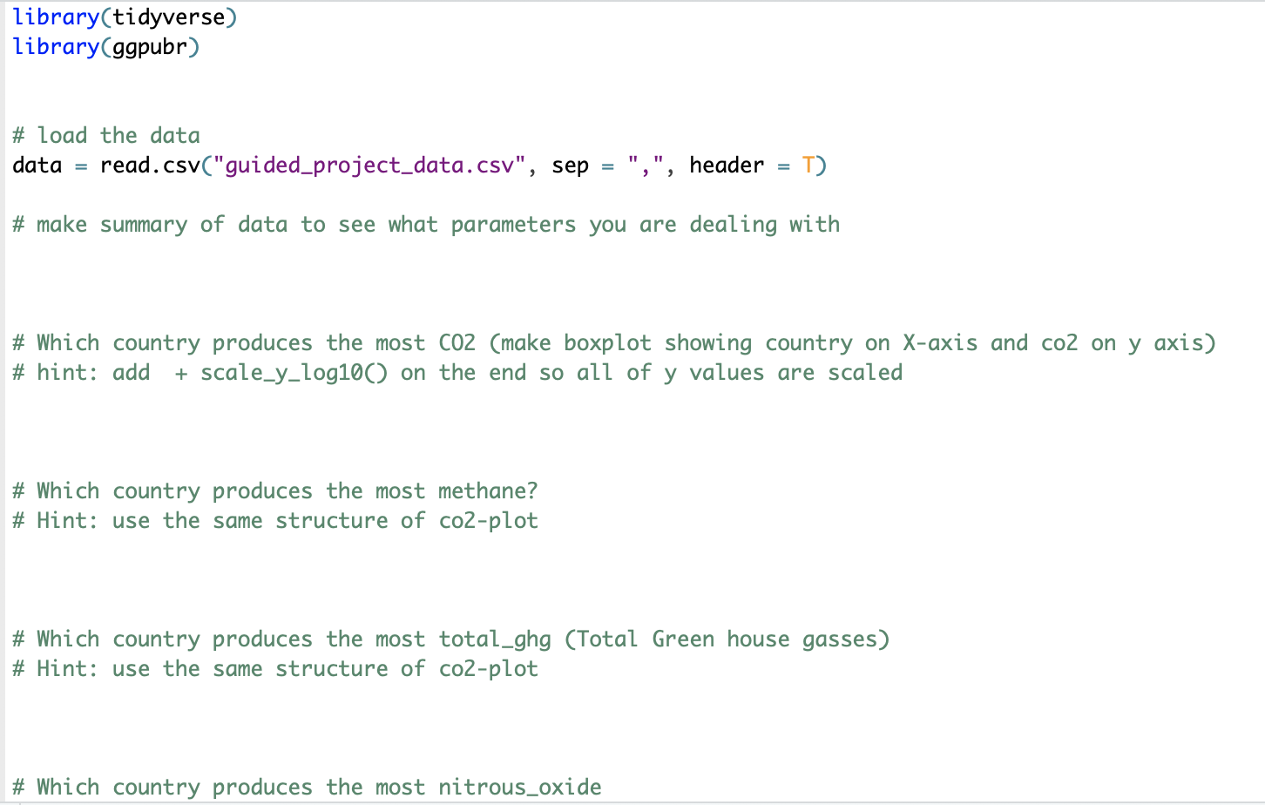
Assignment: Guided Project
In github there is new folder called r_assignments
Contains script and data
Script has comments what to do

Slide 15
Let’s try this in R

