Slide 1
RIT Data Science in R - workshop
Mateo Sokac

Slide 2
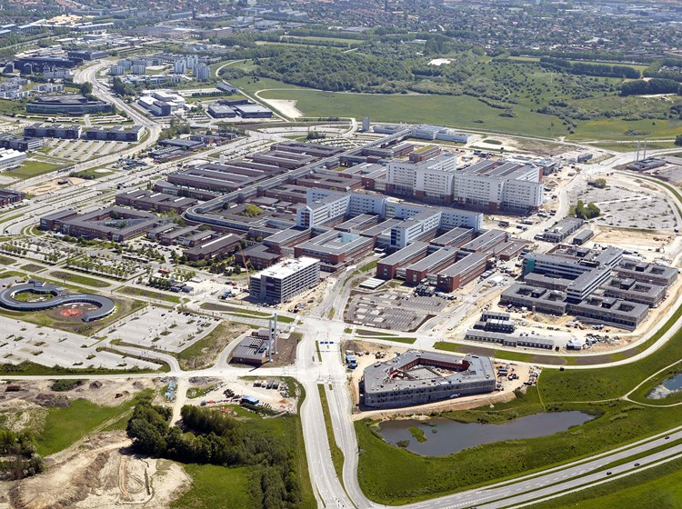
Short intro about me
Bachelor degree in Zagreb, RIT
MSc in Bioinformatics in Aarhus, Denmark
PhD Student Molecular Medicine, Aarhus Denmark
Cancer Evolution
Work as Data Scientist
Machine learning
Artificial Intelligence application in medicine
Mathematical modelling
mateo.sokac@clin.au.dk or mxs3203@g.rit.edu

Slide 3
If someone did not install R and Rstudio
Download R for Windows
https://cran.r-project.org/bin/windows/base/
Download R for Mac OS
https://cran.r-project.org/bin/macosx/
Download Rstudio
https://rstudio.com/products/rstudio/download/#download

Slide 4
What is R?
R is simple programming language for performing statistical analysis
Rstudio is “writer” where you write and visualize your R code
“Writer” also know as IDE = integrated development environment
You can use R and R console without Rstudio but it is not nice
Once you install R and Rstudio you can start coding in Rstudio

Slide 5
Day 1: R programming
Used in science and industry a lot
Easy to understand and apply
A lot of functionalities are implemented for you
Use google but understand what happened
Do not install some fancy library for this purpose

Slide 6
What is workshop about?
Learning how to use R in Rstudio
Able to perform basic analysis and plotting
Understand concepts of data science
Analyse your data for seminars for prof. Puskaric course
Write a small report based on your results
Details with prof. Puskaric

Slide 7
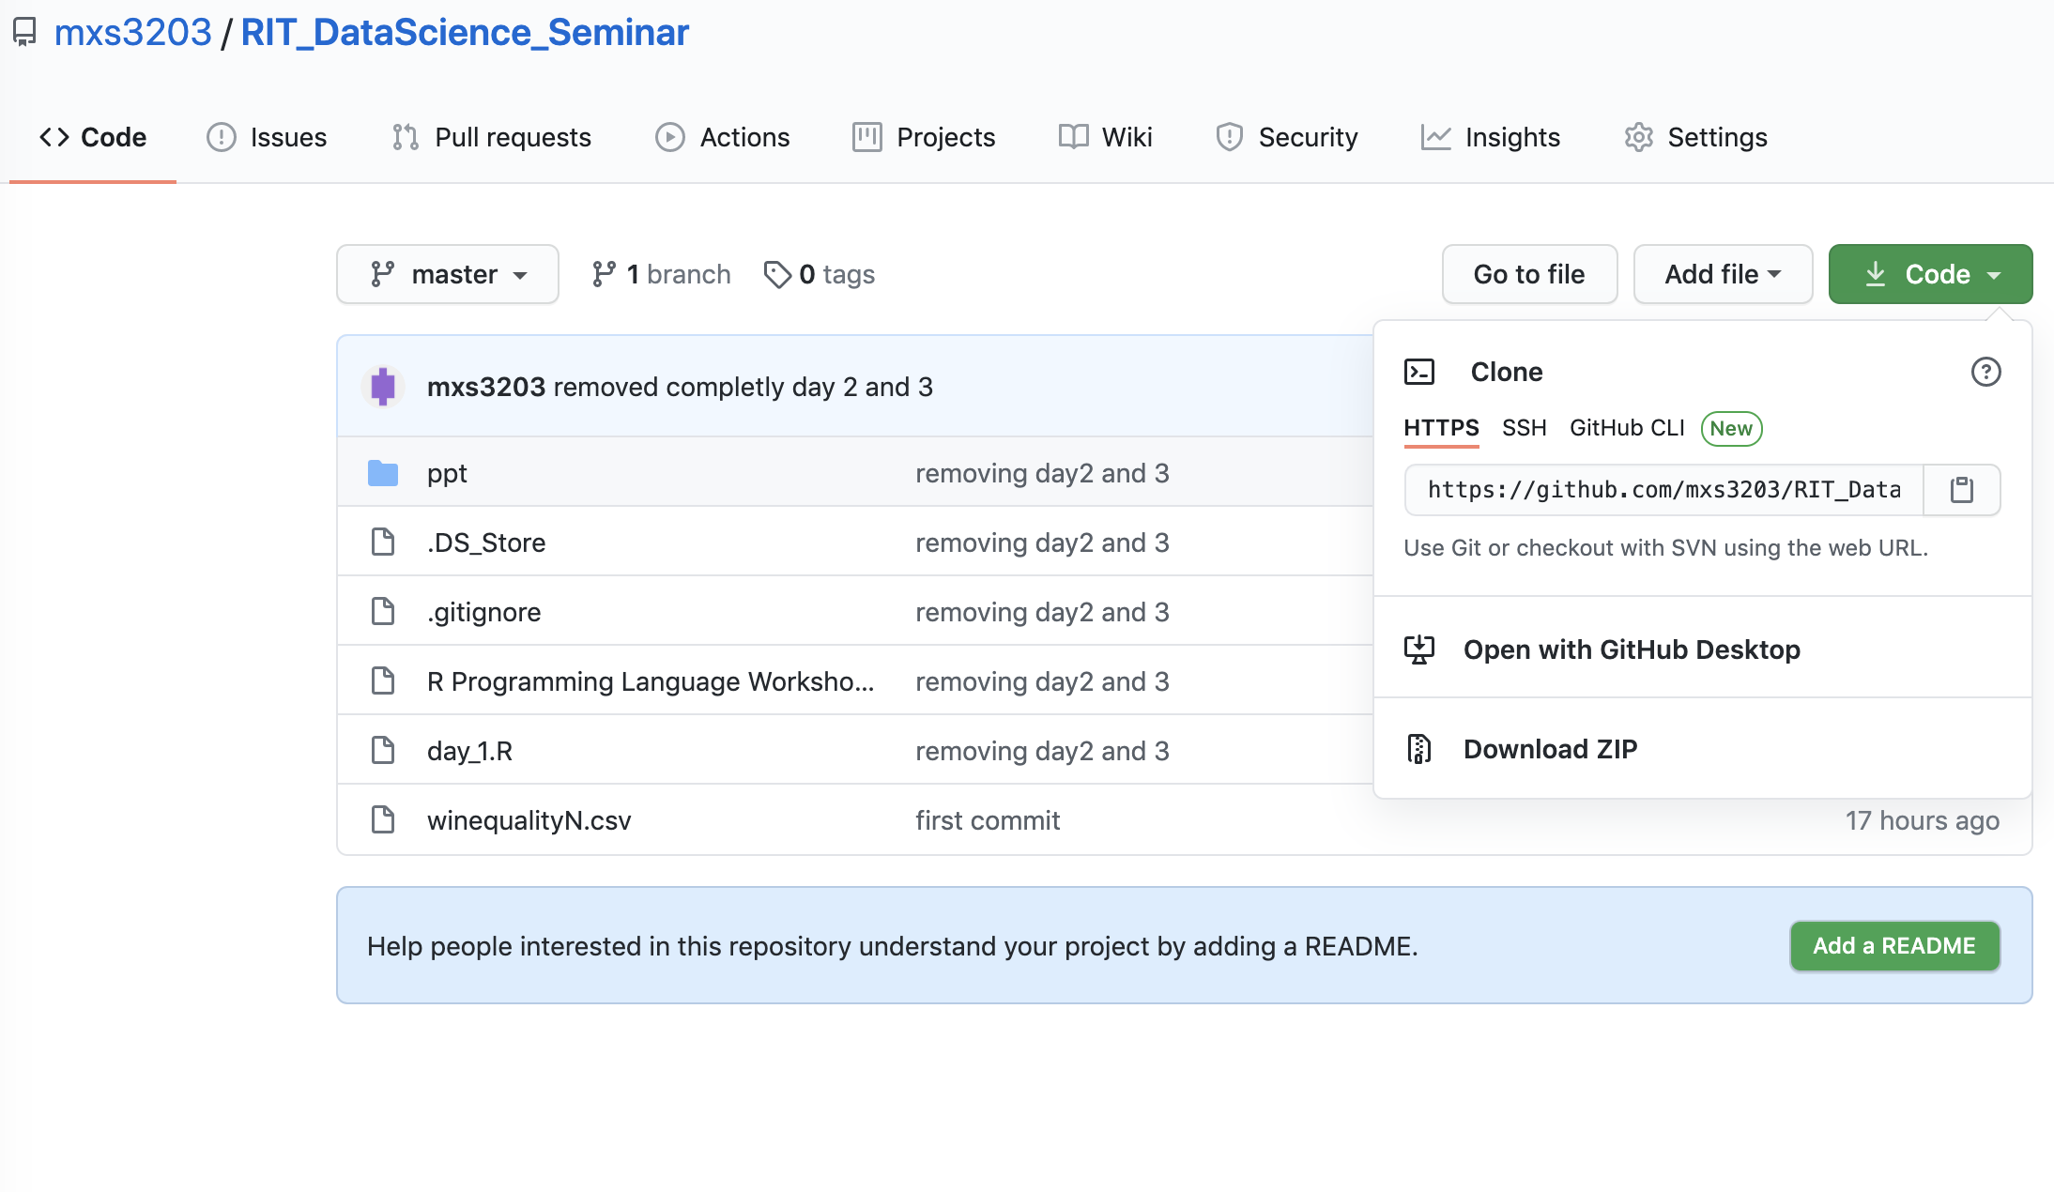
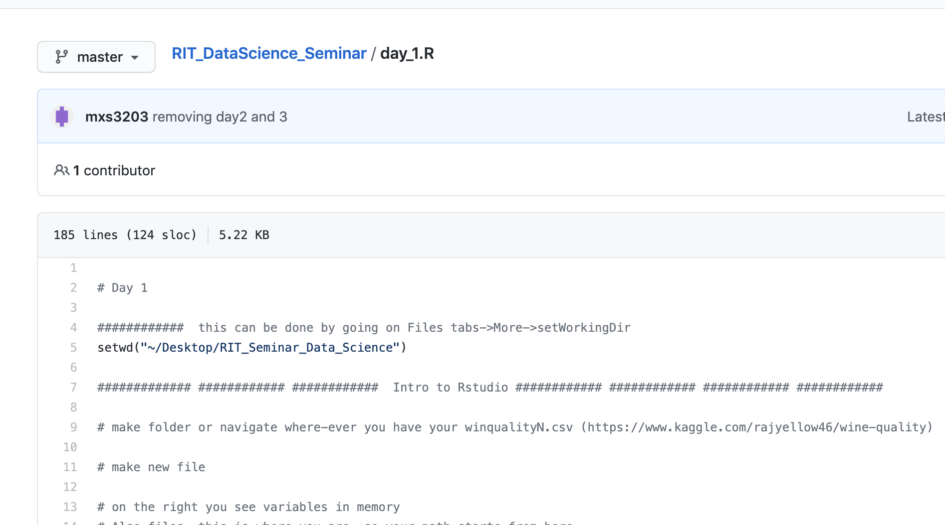
Sharing slides and code with you
https://github.com/mxs3203/RIT_DataScience_Seminar
If you are not familiar with GIT just go to download ZIP and download everything
Or open a file and copy paste part of code you want

Slide 8
Workshop
Day 0
You installed R and Rstudio
Download Wine dataset
Day 1
R syntax, how to load data, Rstudio
How to make basic plots and interpret them
Install tidyverse package for Day 2
Day 2
You worked on your own data using knowledge from day 1
Making nicer plots and interpreting results
Day 3
Mathematical modelling using simple linear regression
Try to predict numerical outcome from your data (temperature, co2, etc)

Slide 9
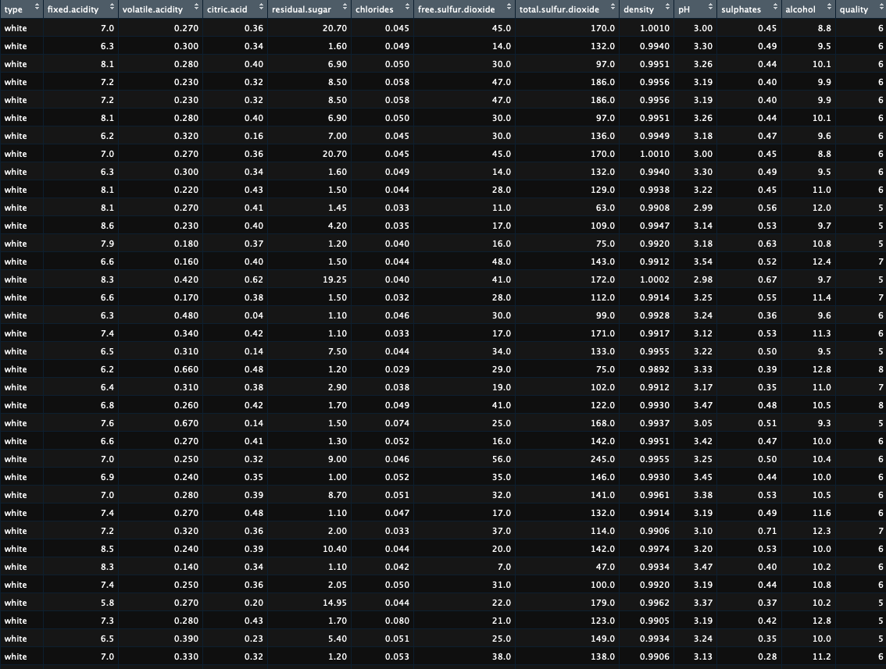
Day 1:
Wine dataset introduction
Most of the parameters are numeric
Type = categorical
School-example dataset
Data is tidy
For purpose of this seminar we are going to pretend we are interested in how are other parameters affecting alcohol and can we predict alcohol from params we have
You have similar scenario because you want to make a model predicting numeric value (CO2, Temp, etc…)

Slide 10
Let’s continue in RStudio

