Slide 1
NYPD Crime Project
Mason Plikerd, Maria Kabeer, Alberto Medina

Slide 2
NYPD Arrest Data
Dataset is every arrest from January 1st, 2024 to April 22, 2024 (Done quarterly)
There are 43 unique crimes that are listed with 63,621 entries
Used for the public to look into police activity within New York
Categories: Type of crime, borough of arrest, Age(group), Race, Location
Top Five crimes: Assault 3, Larceny, Felony Assault, Dangerous Drugs, Miscellaneous Penal Law

Slide 3
Question and Focus
What is the race distribution within the dataset?
What are the common crimes committing among the age groups?
Which gender commits more crimes?
What are the most common offenses committed by sex?
What are the most common offenses committed by geographical location within NYC?

Slide 4
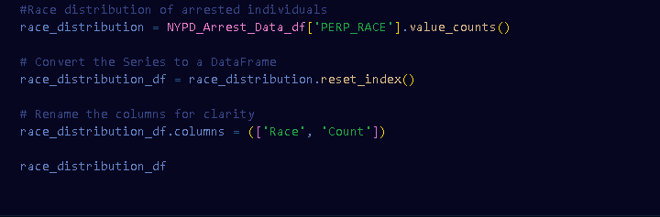
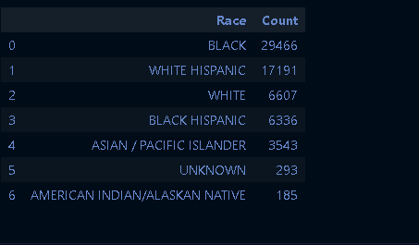
Race Distribution of arrested individuals

Slide 5
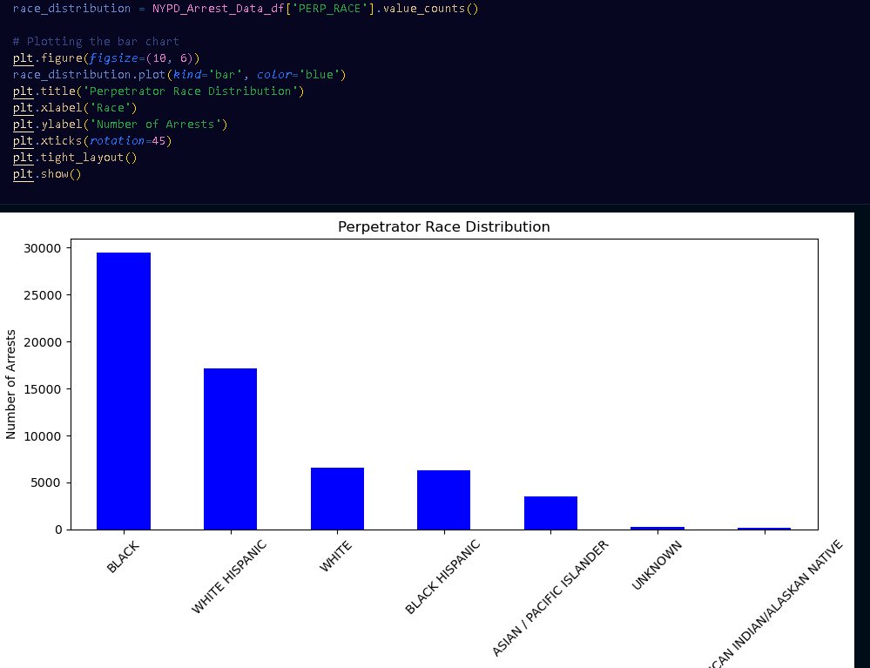

Slide 6
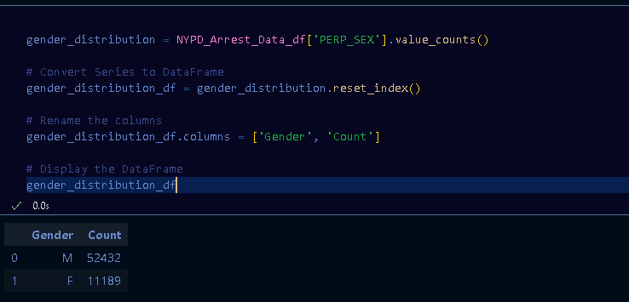
Gender distribution

Slide 7
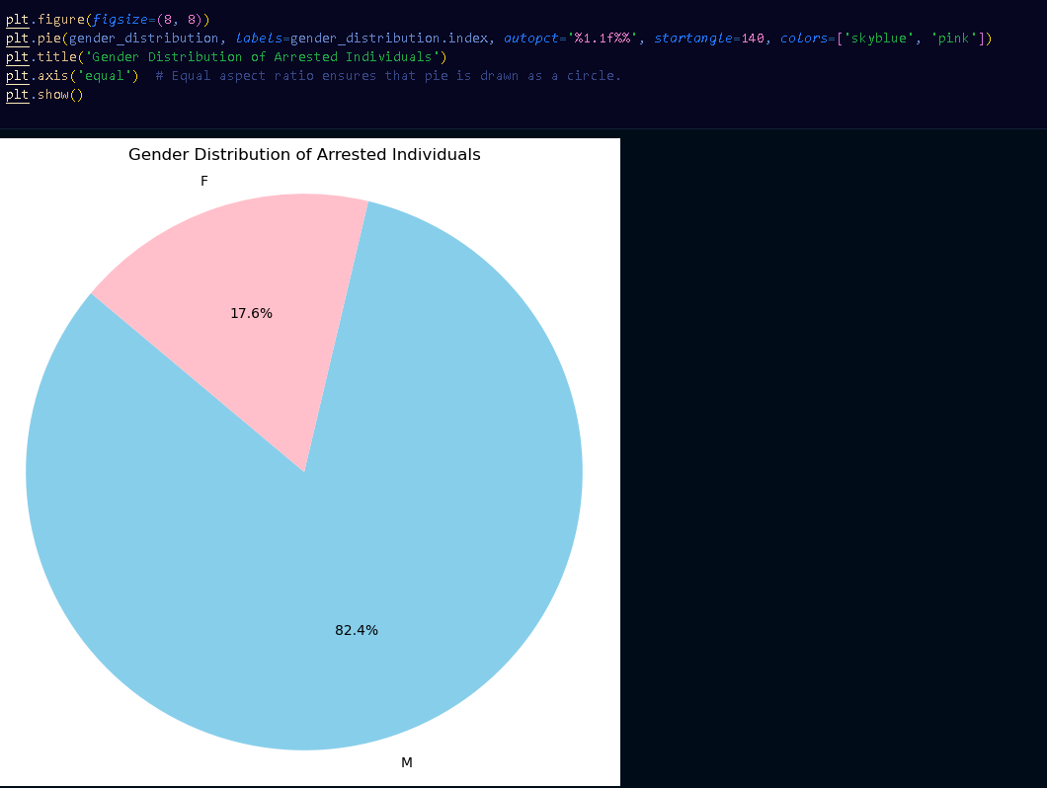
Gender Distribution of Arrested Individuals

Slide 8
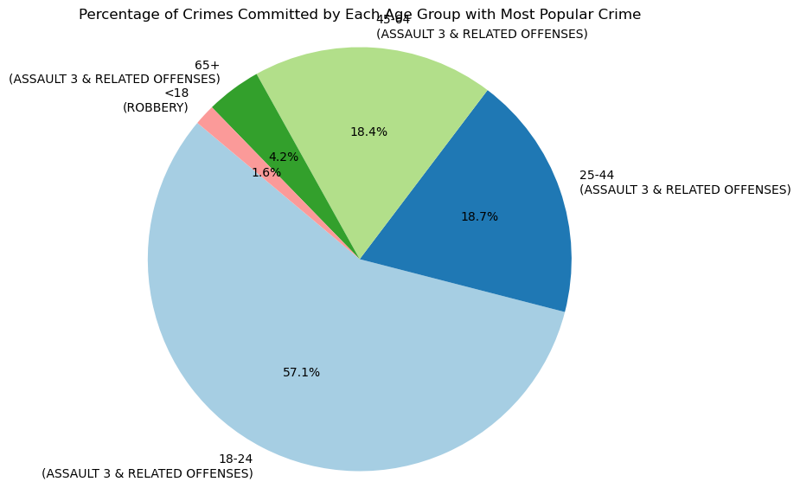
NYC Age Group Ranges
<18
18-24
25-44
44-64
>65
According to the data, the least active are the children, but the most active age group in committing crimes are 18-24 year olds, with more than half the data entries. The second being the age group being the next largest and so on, but the least recorded is under 18 .

Slide 9
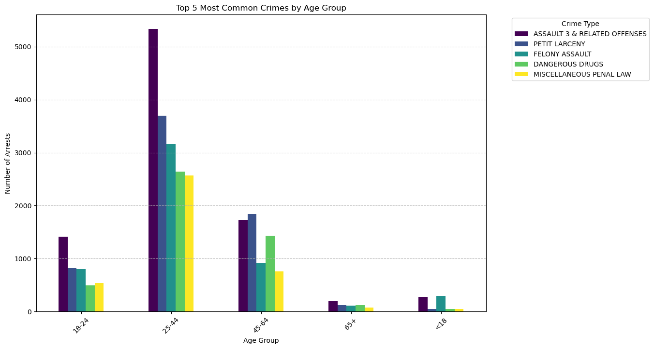
Age Group
This graph shows the top 5 crimes committed in the whole data set and how many occurrences they have for each age group
Assault 3 is present in every age group and is at the top of every age group

Slide 10
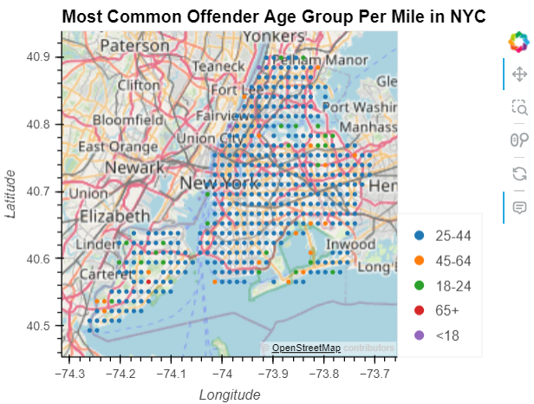
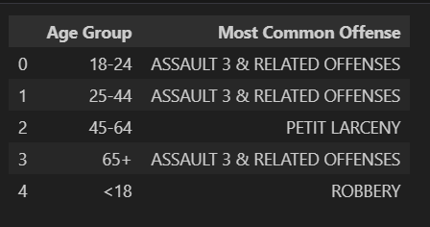
Location vs. Age Group Analysis

Slide 11
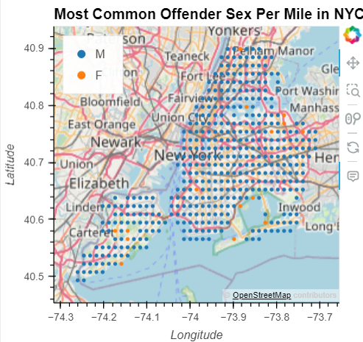

Location vs. Sex Analysis

Slide 12
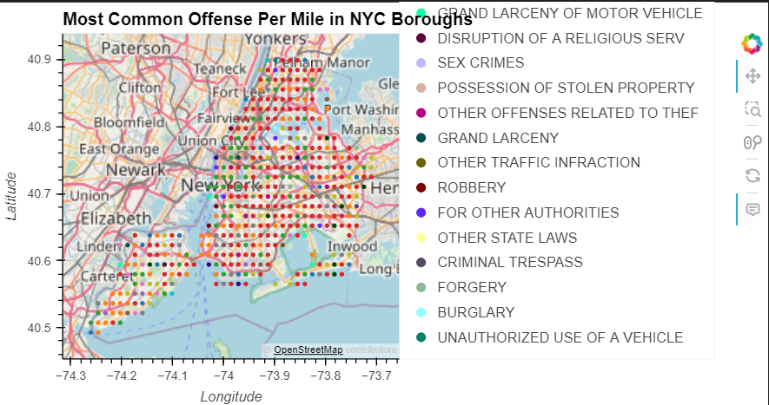
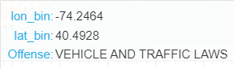
Location vs. Offense Analysis

Slide 13
Summary
For age groups there are a few common trends that are able to be seen. Senior Citizens and Children are the least represented in the data and by a significant number, while the mass majority of the data resides in the age groups of 18-24 and 25-44.
The race distribution of arrested individuals in the NYPD dataset is represented by a bar chart, revealing the frequency of arrests across different racial groups. The gender distribution of the arrested individuals is illustrated through a pie chart, indicating the proportion of male and female arrestees.
The geographical mapping of committed offenses allows for further in-depth research. For the majority of NYC, the 25-44 age group is committing the most offenses. For the majority of NYC, males are committing the most offenses. Finally, Assault 3 & Related Offenses is the most common offense in Manhattan, The Bronx, Brooklyn, and Queens while Vehicle & Traffic Laws is the most common offense in Staten Island.

