Slide 1

Body Motion
Alex Mariakakis
University of Toronto
Department of Computer Science

Slide 2
Why Study Human Body Motion?
Domain | Purpose
Physical Injury Rehabilitation | Ensure that the correct muscles are being targeted during therapy
Sports Performance | Identify areas for improvement, technique optimization, and injury risk reduction
Aging | Track deterioration of range-of-motion, balance, and overall coordination
Neurological Disorders | Detect external indicators of abnormalities in the nervous system

Slide 3
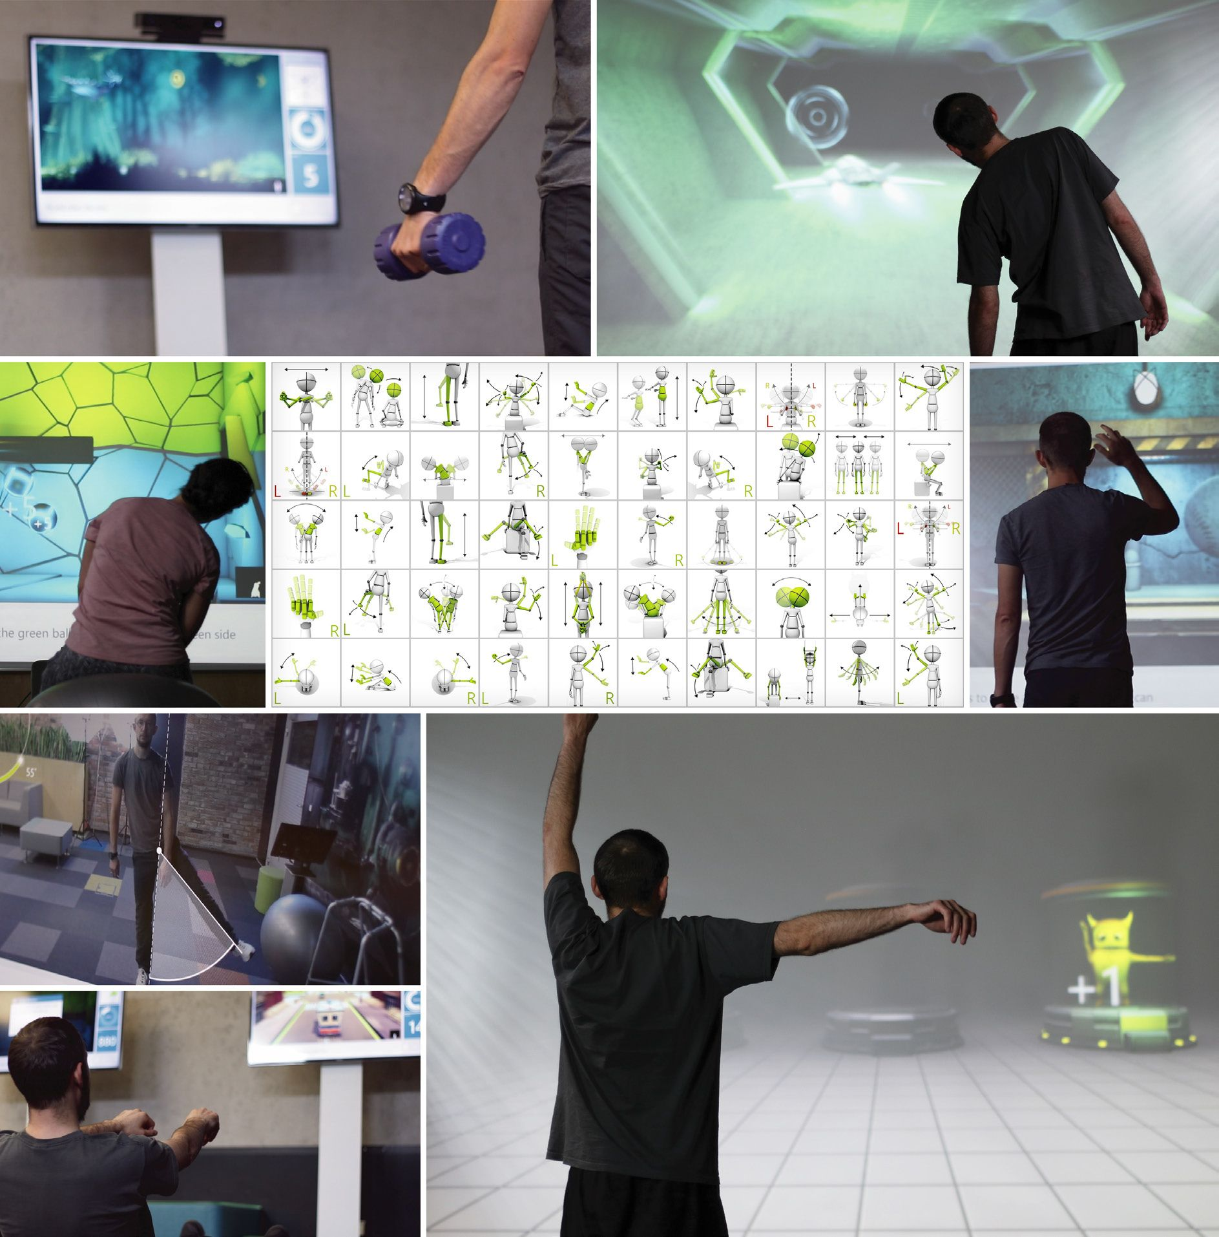
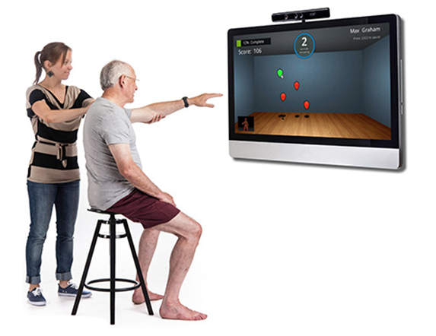
Cameras
Pros
Cons
Body- and hand-pose tracking are well-studied in computer vision
Compromises privacy in public and passive settings
Dependent on field of view

Slide 4
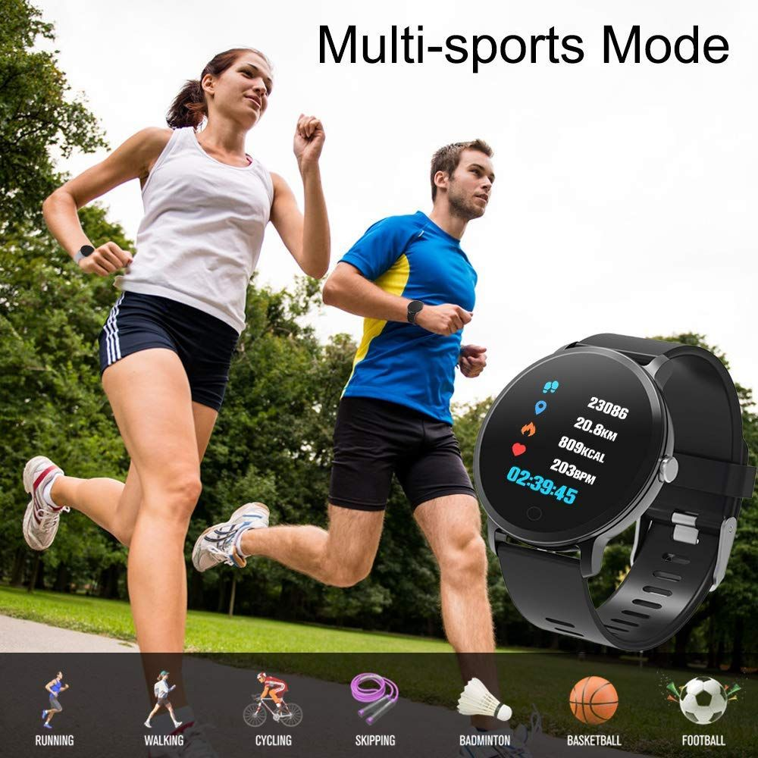
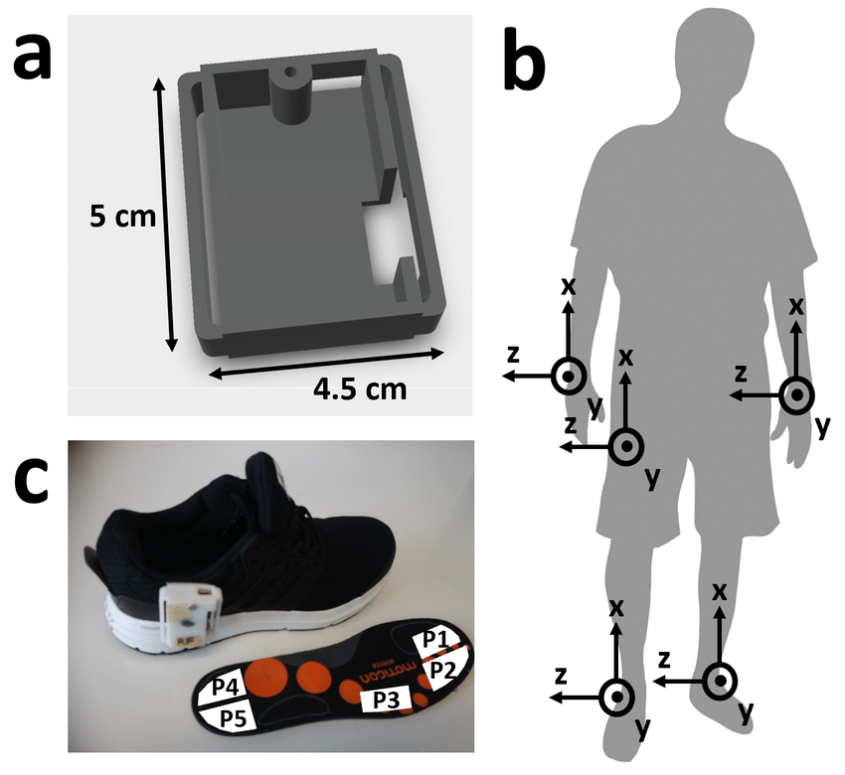
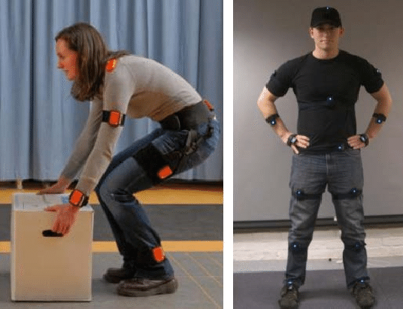
Inertial Measurement Units (IMUs)
Includes multiple signals:
Accelerometer (linear motion)
Gyroscope (rotational motion)
Magnetometer (orientation), sometimes
Pros
Cons
Does not contain protected health information
Completely portable
Accuracy depends on sensor placement (e.g., step counting from pocket versus watch)

Slide 5
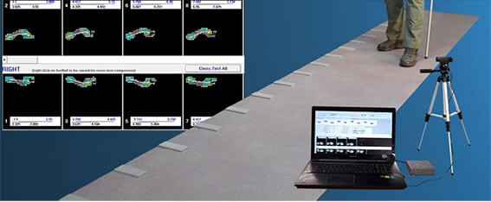
Pressure-Sensitive Mats
Pros
Cons
Specifically designed for gait analysis
Simplifies measurements like stride length and gait speed
Only designed for gait analysis
Fixed location
Expensive

Slide 6
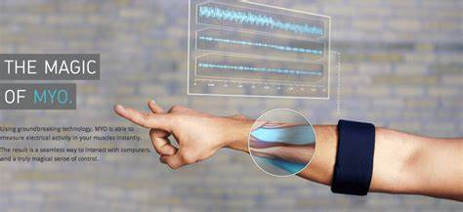
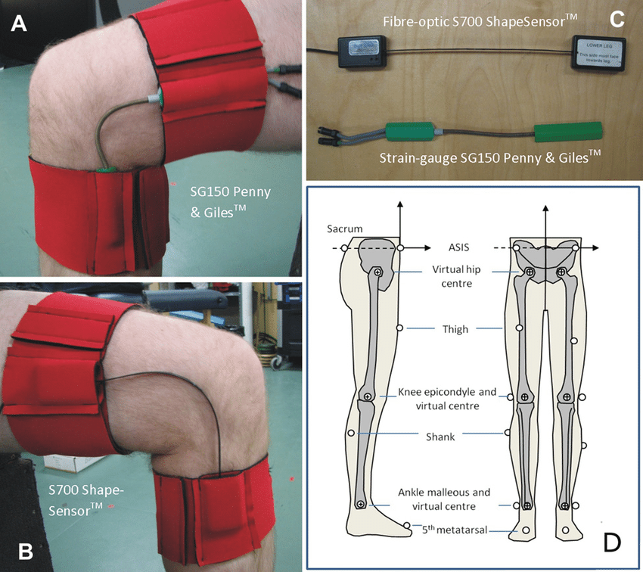
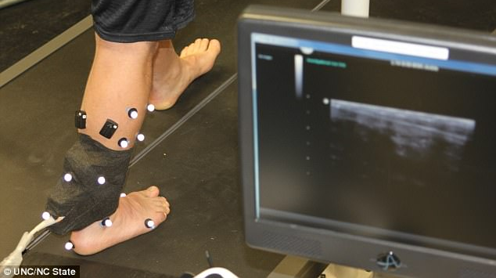
Other Sensors
Electromyography (electrical activity in muscles)
Goniometers / Strain gauges (flexion of joints)
Motion Capture System (precise marker tracking)

Slide 7
Resources
Gait Analysis: An Introduction (Whittle ‘91)

