Slide 1

Sleep
Alex Mariakakis
University of Toronto
Department of Computer Science

Slide 2
Why Is Sleep Important?
Sleep touches on multiple facets of our overall health
Encourages muscle repair
Supports hormone regulation and metabolism
Helps with formation of long-term memories
Lesser demands on circulatory and respiratory systems
Adults are recommended to sleep at least 7 hours each night

Slide 3

How Do We Know When Someone Is Sleeping?
Slower brain activity … for the most part
Slow and steady breathing
Slower heart rate
Snoring
Lack of body movement
In a dark and quiet room
Evening or nighttime
Lying down in bed

Slide 4
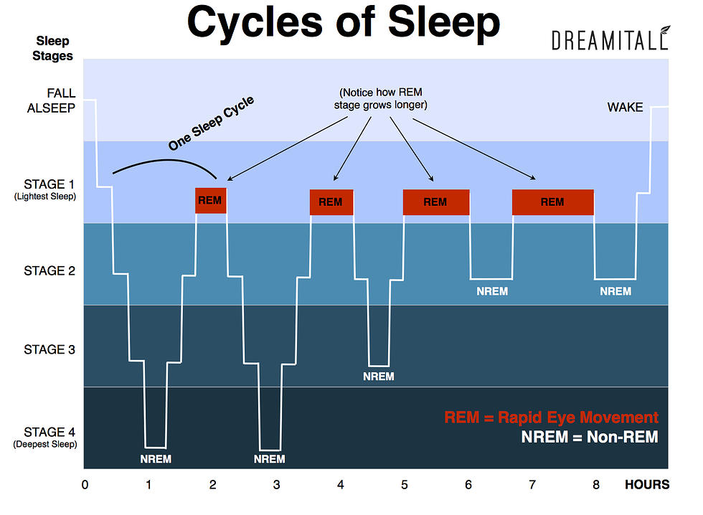
What Are Some Important Features of Sleep?
Time in bed
Total sleep duration
% of REM sleep
# of body movements
# of noise events
Breathing rate
# of airflow stoppages

Slide 5
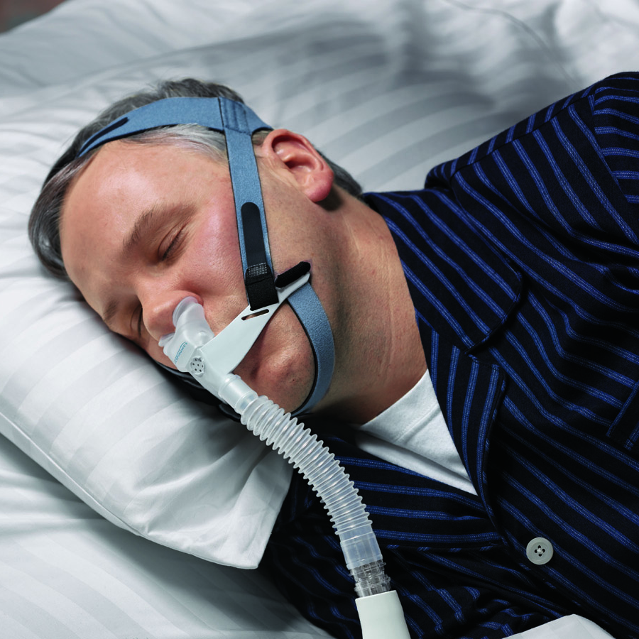
What Can Go Wrong With Sleep?
Insomnia: Trouble falling or remaining asleep
Apnea: Breathing disruptions
Hypopnea: Shallow breathing
Obstructive apnea: Airway blockage
Central sleep apnea: Breath holding
Restless leg syndrome: Tingling sensation that causes the urge to move the legs
Continuous positive airway pressure (CPAP) machine for helping control breathing

Slide 6
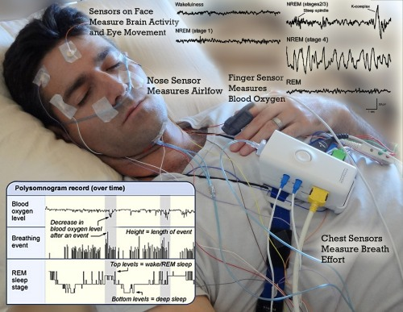
How Can We Monitor Sleep?
The gold standard is polysomnography (PSG)
PSG entails monitoring physiology during sleep
Typically done in a sleep clinic
Typically requires significant instrumentation
Measures signals ranging from breathing rate to brain activity

Slide 7
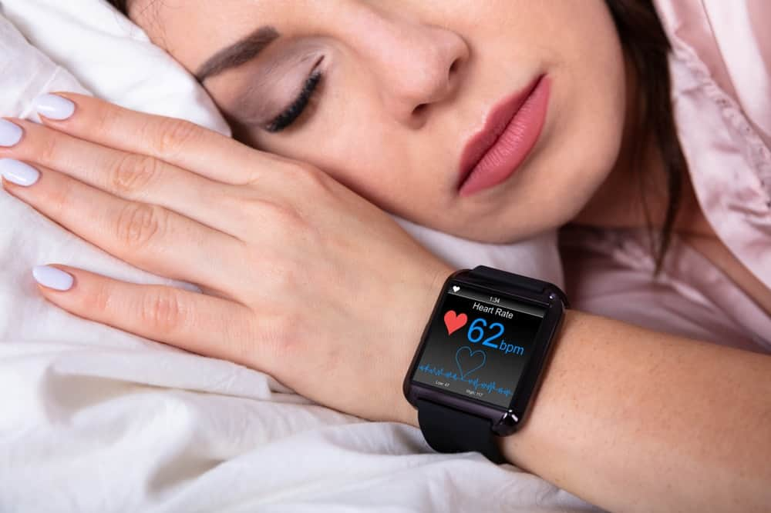
How Can We Monitor Sleep?
Smartwatches and other wearables can monitor heart rate, motion, and even respiration rate
These signals can be more reliable during sleep since the devices remain still through the night

Slide 8
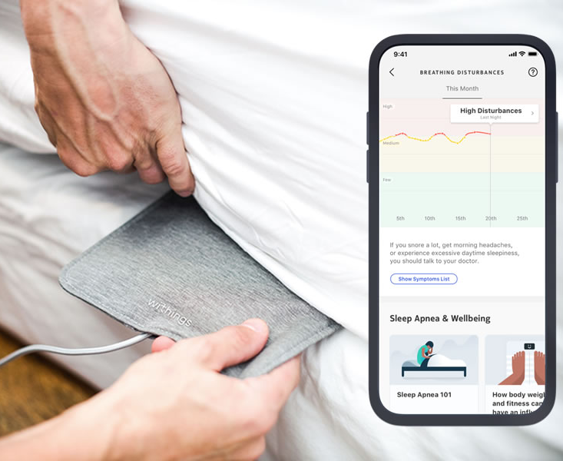
How Do We Know That Someone Is Sleeping?
Mattress sensors detect breathing rate (and even heart rate, purportedly) via pressure sensing
Piezoelectric
Capacitive
Conductive fabric
Pressure on its own measures time in bed, so extra processing is needed to identify actual sleep time

Slide 9
Resources
Sleep Disorders (Sleep Foundation ‘22)
Technical Review of Polysomnography (Vaughn and Giallanza ‘08)

