Slide 1

Influenza-Like Illnesses
Alex Mariakakis
University of Toronto
Department of Computer Science

Slide 2
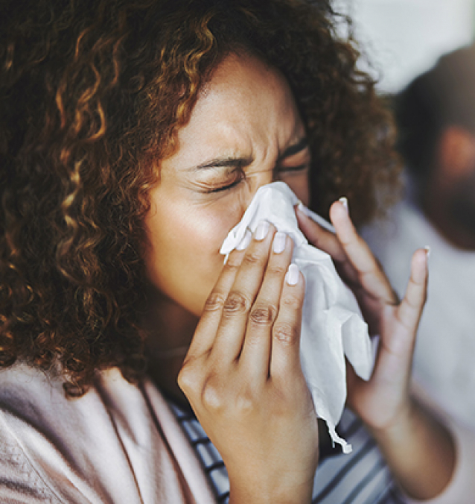
What Is An Influenza-Like Illness (ILI)?
Influenza (i.e., the “flu”) is an infectious disease specifically caused by influenza viruses
ILIs have similar symptoms as influenza
Examples of ILIs include …
Common cold
COVID-19
Pneumonia

Slide 3
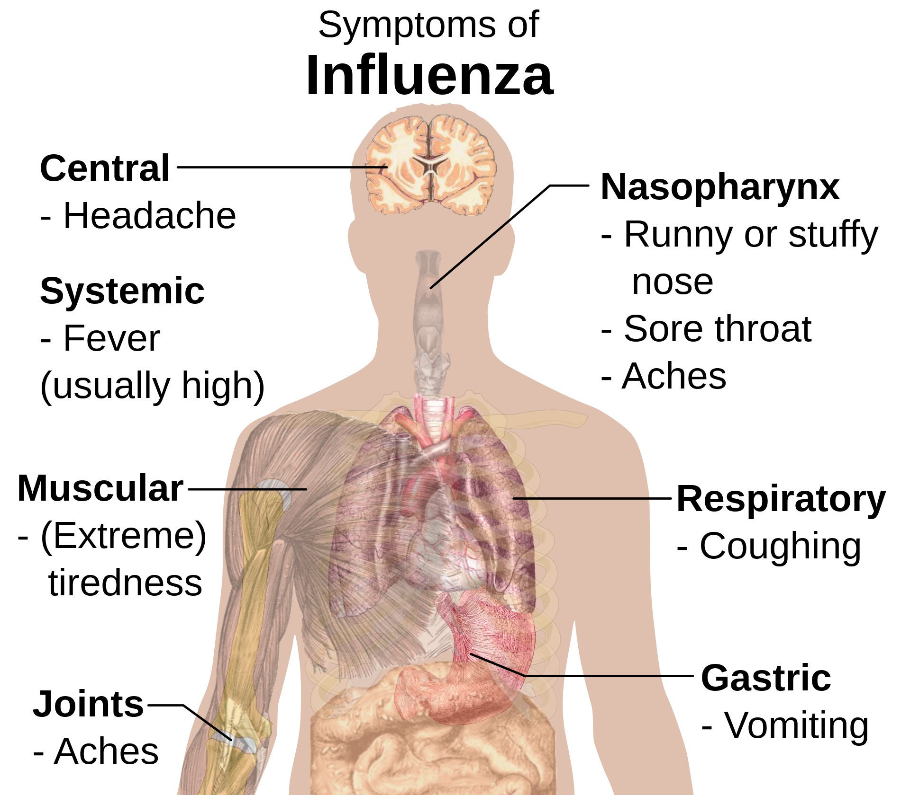
What Are The Symptoms of ILIs?
The WHO defines an illness as an ILI if the patient has …
Has a fever greater than or equal to 38 °C
Has a cough that began in the last 10 days

Slide 4
Why Talk About ILIs Instead of Influenza?
Mobile health tools generally aren’t “detecting influenza”; they’re “detecting symptoms of influenza”
Having influenza may lead to a high probability of fever and cough, but having a fever and cough may not mean a person has influenza
The same holds true for many other mobile health tools
Fatigue could imply insomnia, depression, etc.
Breathlessness could imply COPD, asthma, etc.

Slide 5
How Can We Detect ILI Symptoms?
Symptom | Mobile Health Measurement Techniques
Coughing | Personal, portable microphones on smartphones and smartwatches Personal, static microphones in home smartspeakers Public, static microphones in waiting rooms
Fever | Personal thermistors on smartwatches and smart rings (note: peripheral body temperature ≠ core body temperature) Public thermal cameras and handheld infrared thermometers (e.g., “temperature guns”)
Fatigue | Personal sleep tracking on smartwatches and smart rings

Slide 6
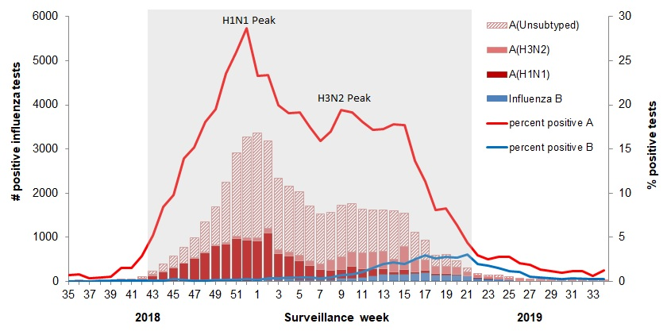
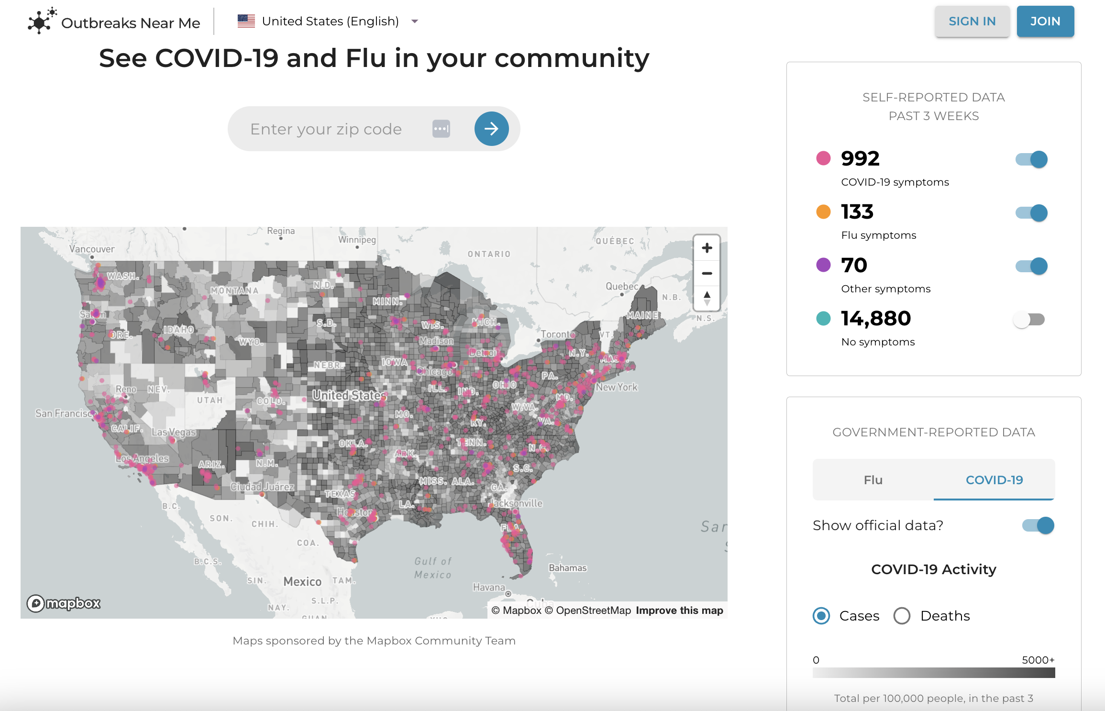
Public Health Surveillance
Time and location can provide important context for population-level surveillance, helping agencies target interventions
FluWatch by Health Canada
Outbreaks Near Me by Boston Children’s Hospital

Slide 7
Resources
Overview of Influenza Monitoring in Canada (Health Canada)
Outbreaks Near Me (Boston Children’s Hospital)

