Slide 1
Neural Data Science-- Clustering
Neurons in High Dimensions
Maria Kesa
AstraZeneca Interview, June 9, 2020

Slide 2


1. Agenda
New recording technologies may transform neuroscience.
Simultaneous calcium imaging recordings from 19,000 neurons in mouse V1 and simultaneous behavioral videos
Cool new algorithm for analyzing this data (it’s fast too!)
From algorithm to insights

Slide 3
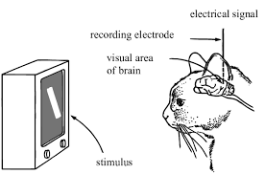
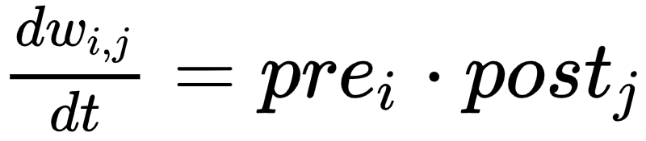
History-- Neuroscience Classics
Hubel and Wiesel,
1960’s and 1970’s
Hebb,
1940’s and 1950’s

Slide 4
The experiment
The mice were viewing sparse noise stimuli without an explicit task or reward. Recordings were made in primary visual cortex.
Along with neural recordings, the movie of the mouse snout was recorded.
Data freely available online (google Stringer Figshare).

Slide 5
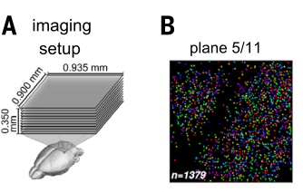
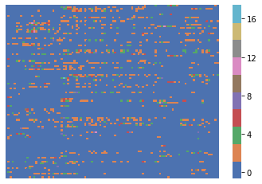
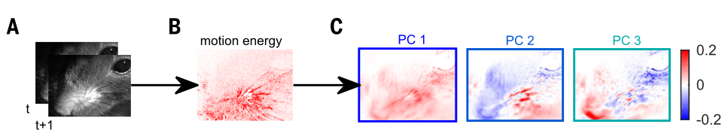
Preprocessing of raw data
The data was recorded at 2.5 Hz (one time point is 400 ms).
Fluorescence movie was processed using the suite2p library.
We used deconvoloved data (OASIS) for our analyses.
Deconvolution infers time-localized and noisy estimates of the calcium influx of the cells which is an indirect proxy for action potential firing (Stringer, Pachitariu, 2018).
We used 500 motion energy principal components from the snout movie as behavioral data.

Slide 6
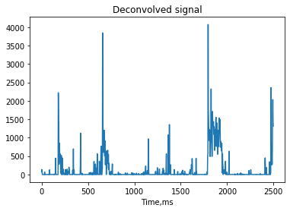
What does the data look like?

Slide 7
Ensemble Pursuit-- A clustering algorithm where a neuron can belong to multiple clusters
EP learns clusters of cells that tend to co-activate, e.g. form ensembles.
https://github.com/MouseLand/EnsemblePursuit
!pip install EnsemblePursuit
ep=EnsemblePursuit(n_components=100,lam=0.01,n_kmeans=100)
model=ep.fit(data)
V=model.components_
U=model.weights
Extracts 100 components of co-activating cells from 19,000 neurons x10,000 time points data in 4 minutes

Slide 8

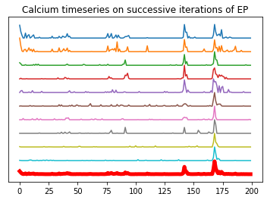
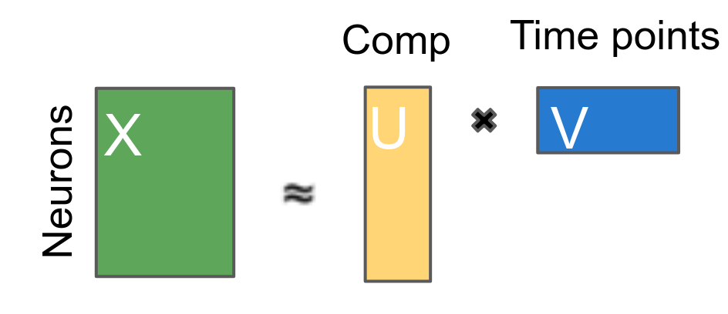
Ensemble Pursuit Algorithm
NP-Hard!
Greedy approximation!
Pick lambda through supervised (KNN) cross-validation!

Slide 9
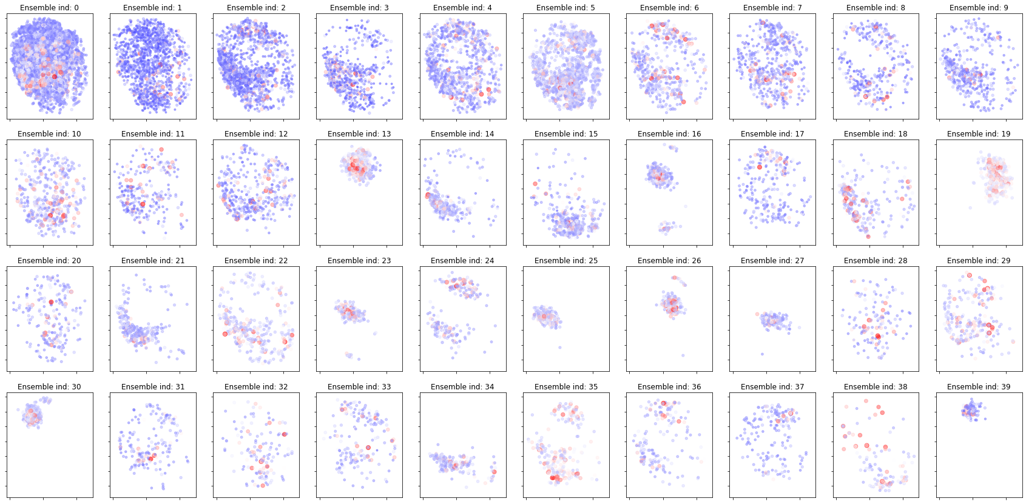
Cells in clusters

Slide 10
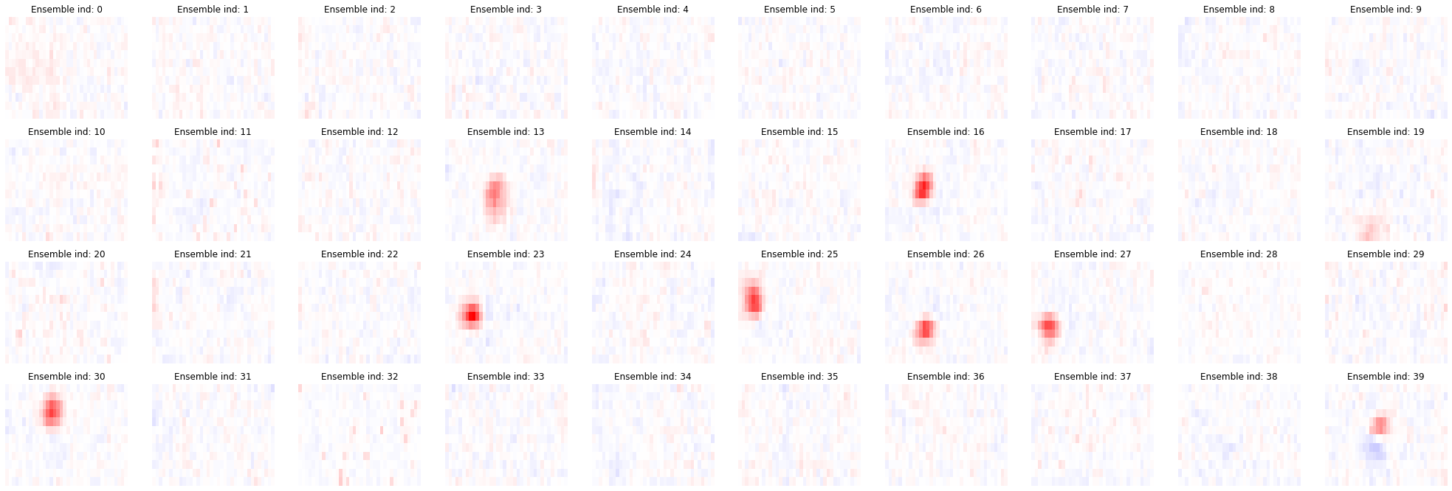
Ensemble receptive fields

Slide 11
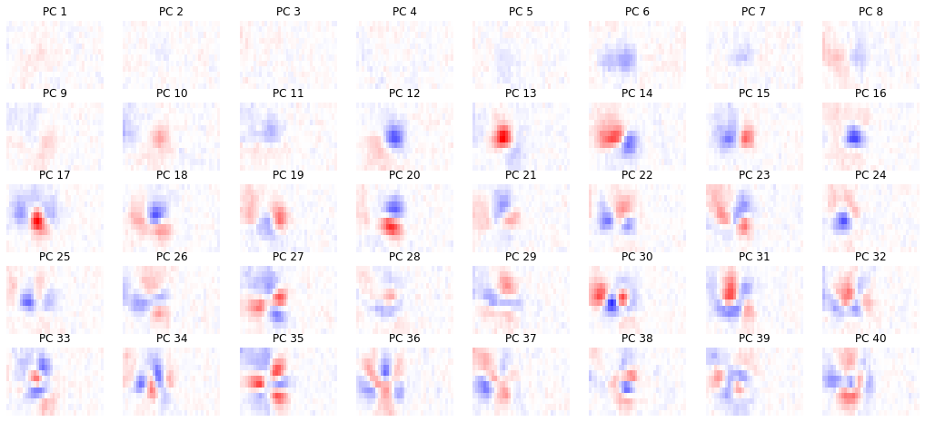
PCA receptive fields

Slide 12
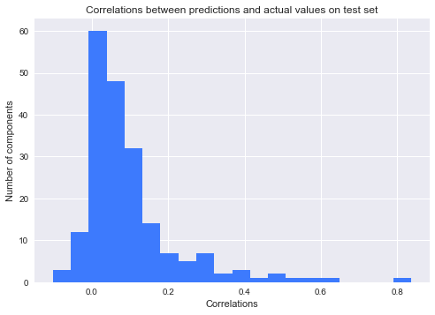
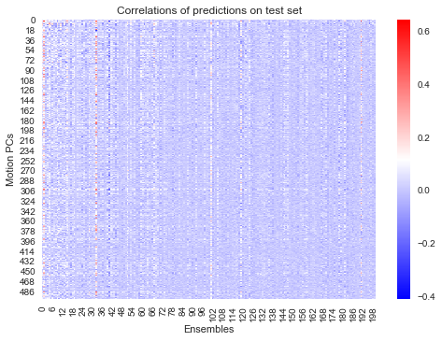
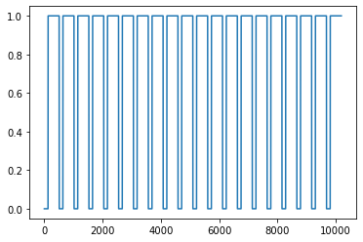
Signatures of sensorimotor integration

Slide 13
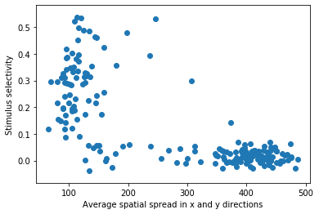
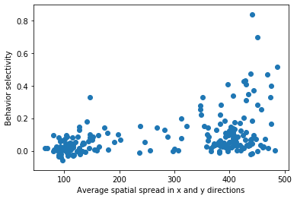
‘Behavior’ ensembles are spatially spread out, ‘Stimulus’ ensembles are localized

Slide 14
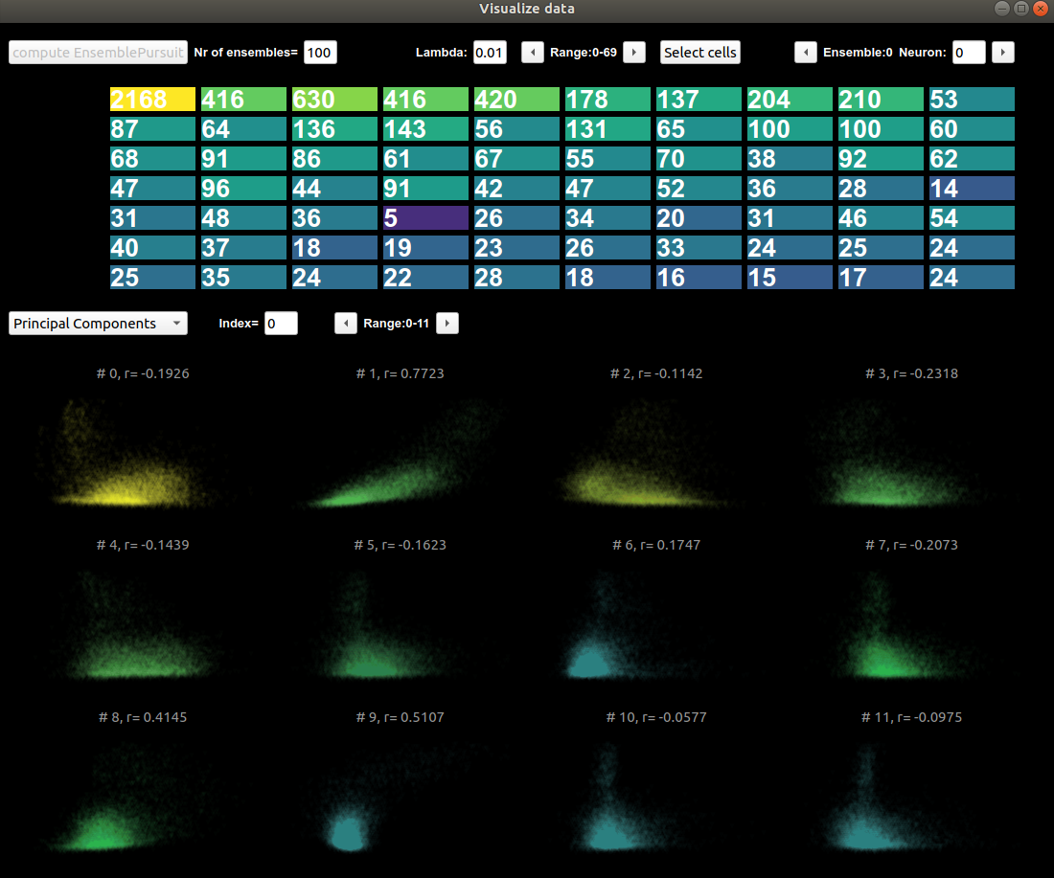

Slide 15
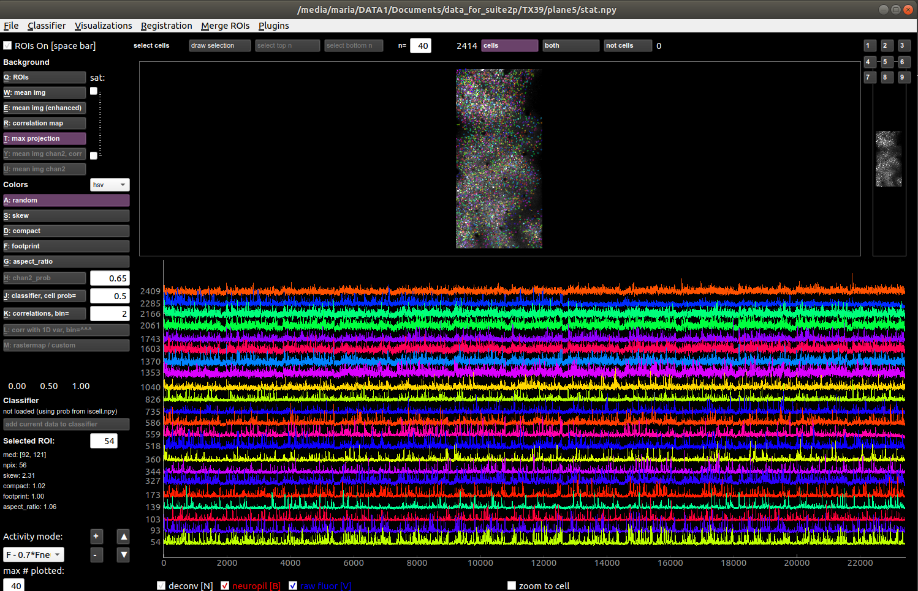

Slide 16
Acknowledgments!
Marius Pachitariu, Howard Hughes Medical Institute, Janelia
Carsen Stringer, Howard Hughes Medical Institute, Janelia

Slide 17
