Slide 1
Data Visualization in R
download from github.com/rjake/data-viz-talk Jake Riley

Slide 2
Today’s talk
Intro
What is ggplot
Tips & Tricks
Best Practices
Try it out

Slide 3
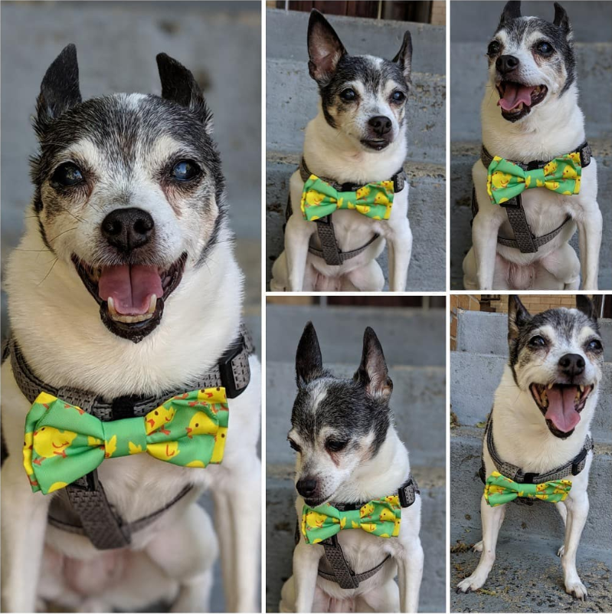



An intro
Jake Riley
Clinical Data Analyst at CHOP
Avid package developer
#dogdad
@yake_84

Slide 4
Before we get started
this talk is aimed at intermediate ggplot2 users
everything is within the tidyverse framework & R for Data Science (R4DS)
the pipe %>% is used in many places and allows us to create a sequence of manipulations
iris %>% head(20) head(iris, 20)
the + used with ggplot() is another type of pipe
you can pipe from a dplyr sequence into a ggplot() sequence

Slide 5
What is ggplot?
grammar of graphics
just like every sentence has a subject, verb, and noun, every chart has a
coordinate system (cartesian, polar)
geometry (bar, point, boxplot)
aesthetics (x, y, fill, alpha)
the hope is that we will invent new types of charts

Slide 6
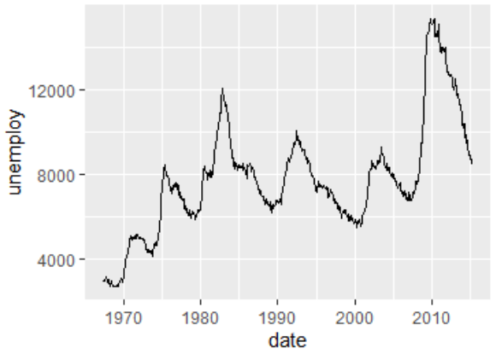
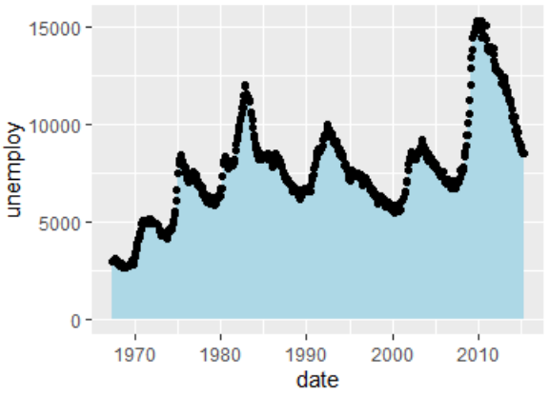
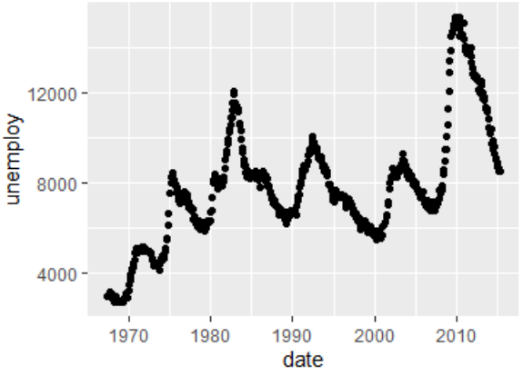
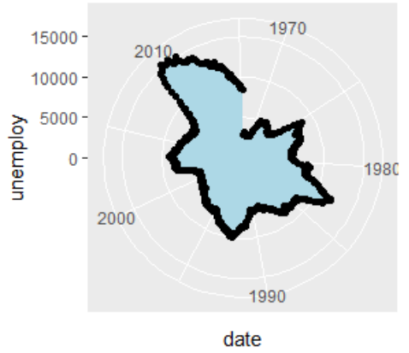
library(tidyverse) econ <- ggplot(economics, aes(date, unemploy))
econ + geom_line()
econ + geom_point()
econ + geom_area(fill = "lightblue") + geom_point()
econ + geom_area(fill = "lightblue") + geom_point() + coord_polar()

Slide 7
Demystifying aes()
aes() = aesthetics
dynamic, data driven variables go inside the aes()
constant, static values go outside
the first 2 arguments of aes() are x and y and I will mostly omit naming these
geom_point(aes(color = class, size = n), ...)
geom_point(aes(...), color = "blue", size = 2)

Slide 8
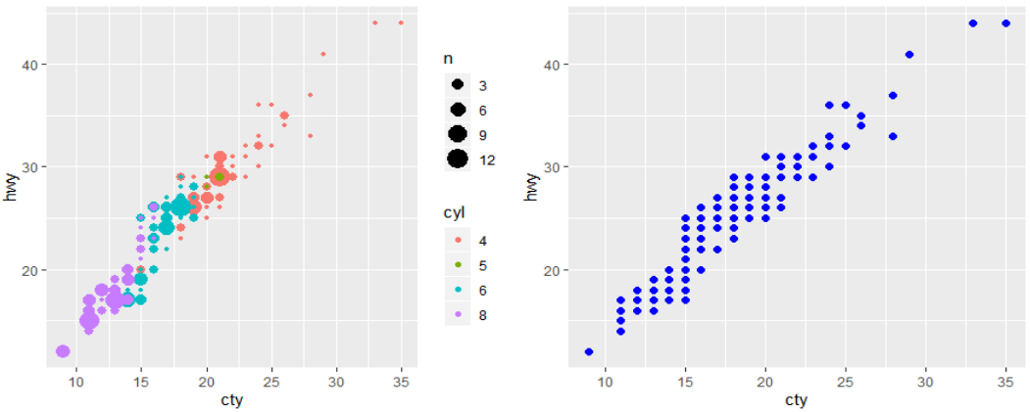
Note the difference
geom_point(aes(color = class, size = n), ...)
geom_point(aes(...), color = "blue", size = 2)

Slide 9
Tips & Tricks

Slide 10
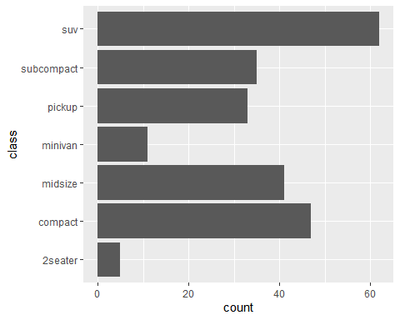
Descending bar charts
The number one things I get asked is how to make a barchart go in descending order.
ggplot(mpg, aes(y = class)) + geom_bar()

Slide 11
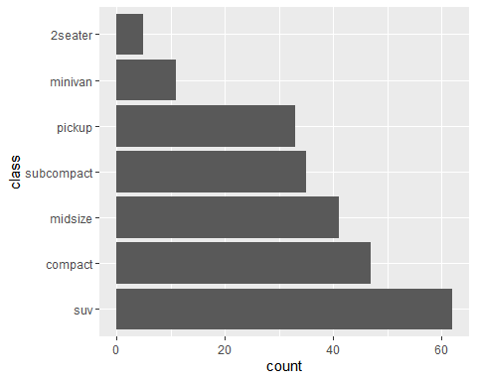
Arrange by volume: fct_infreq()
mpg %>% mutate(class = fct_infreq(class)) %>% ggplot(aes(y = class)) + geom_bar()

Slide 12
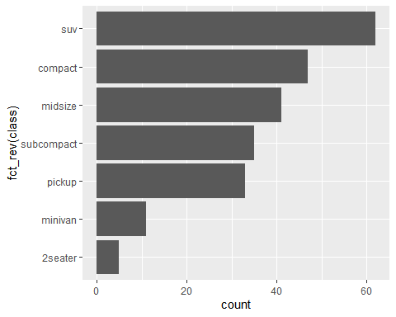
Arrange in descending order: fct_rev()
mpg %>% mutate(class = fct_infreq(class)) %>% ggplot(aes(y = fct_rev(class))) + geom_bar()

Slide 13
Aggregated data: fct_reorder()
mpg %>% count(class) %>% mutate(class = fct_reorder(class, n, sum))
## # A tibble: 7 x 2 ## class n ## <fct> <int> ## 1 2seater 5 ## 2 compact 47 ## 3 midsize 41 ## 4 minivan 11 ## 5 pickup 33 ## 6 subcompact 35 ## 7 suv 62

Slide 14

Aggregated data: geom_col()
mpg %>% count(class) %>% mutate(class = fct_reorder(class, n, sum)) %>% ggplot(aes(n, class)) + geom_col()

Slide 15
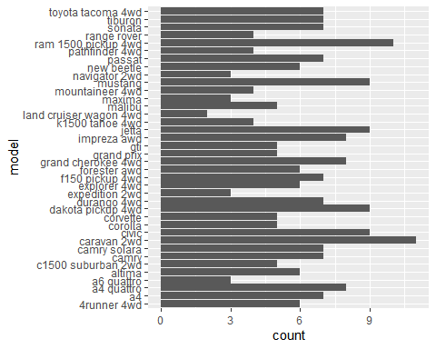
Too many bars
ggplot(mpg, aes(y = model)) + geom_bar()

Slide 16
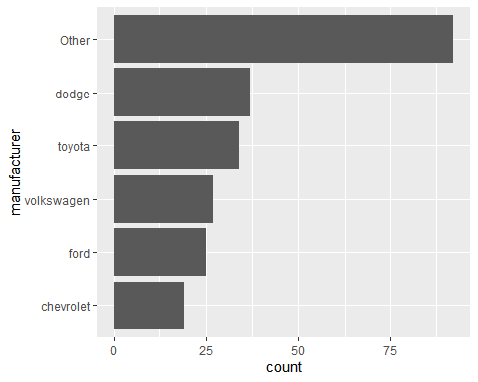
Too many bars: fct_lump()
mpg %>% mutate( manufacturer = fct_lump(manufacturer, 5) %>% fct_infreq() %>% fct_rev() ) %>% ggplot(aes(y = manufacturer)) + geom_bar()

Slide 17
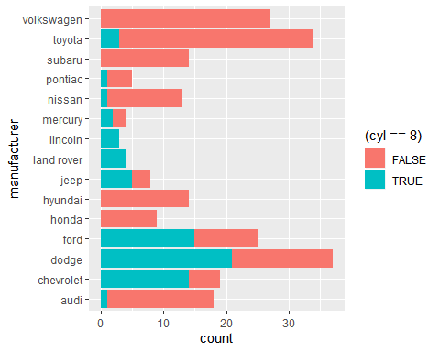
Sorting by fill
ggplot(mpg, aes(y = manufacturer, fill = (cyl == 8))) + geom_bar()

Slide 18
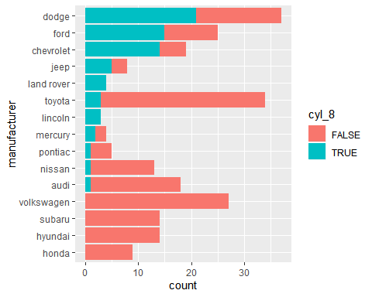
Sorting by fill
mpg %>% mutate( cyl_8 = (cyl == 8), manufacturer = fct_reorder(manufacturer, cyl_8, sum) ) %>% ggplot(aes(manufacturer, fill = cyl_8)) + geom_bar() + coord_flip()

Slide 19
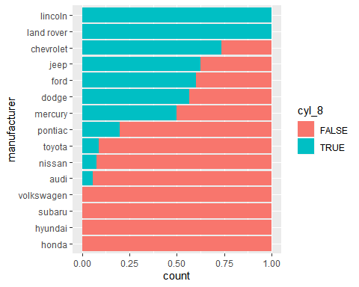
Sorting by fill (percent)
mpg %>% mutate( cyl_8 = (cyl == 8), manufacturer = fct_reorder(manufacturer, cyl_8, mean) ) %>% ggplot(aes(y = manufacturer, fill = cyl_8)) + geom_bar(position = "fill")

Slide 20
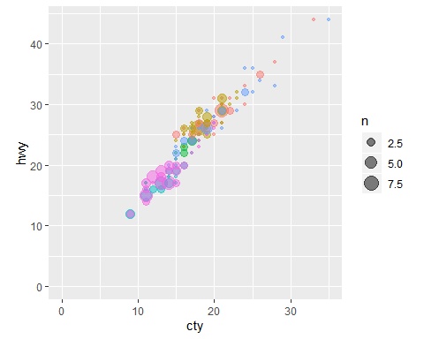
facet_grid() vs facet_wrap()
p <- mpg %>% filter(class != "2seater", cyl != 5) %>% ggplot(aes(cty, hwy, color = class)) + geom_count(alpha = 0.5) + lims(x = c(0, NA), y = c(0, NA)) + # can also use xlim() or scale_x_continuous guides(color = FALSE) + theme(aspect.ratio = 1)

Slide 21
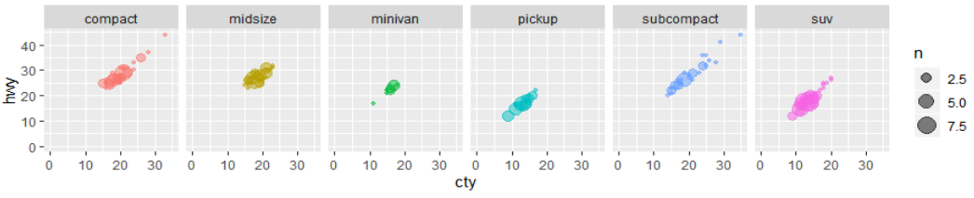
facet_grid(): new syntax
# this is the new syntax, replaces `facet_grid(~class)` p + facet_grid(cols = vars(class))

Slide 22
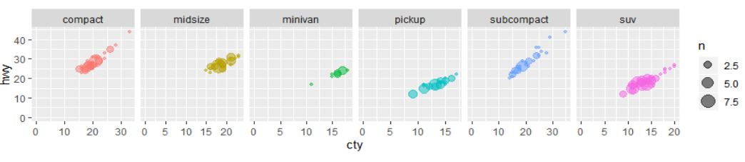
facets: scales
# scales allows the x & y to vary # also "free_x", "free_y" p + facet_grid(cols = vars(class), scales = "free")

Slide 23
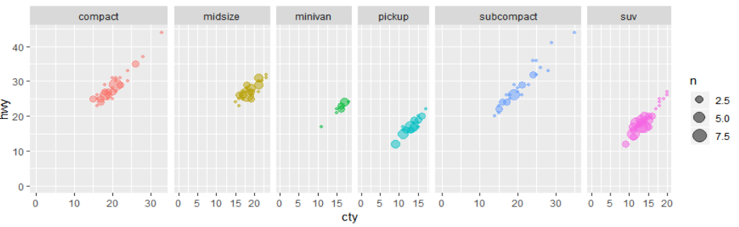
facets: scales & space
p + facet_grid(cols = vars(class), scales = "free", space = "free")

Slide 24
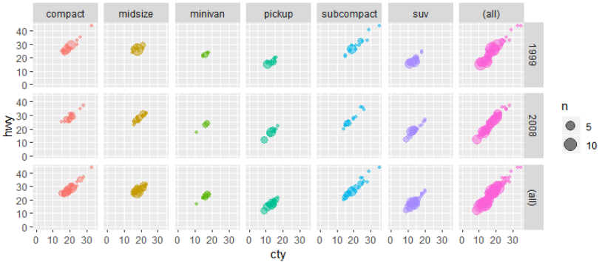
facets: margins
p + facet_grid(rows = vars(year), cols = vars(class), margins = TRUE)

Slide 25
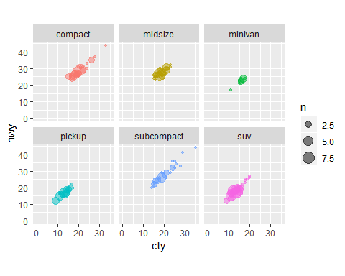
facet_wrap: # of columns/rows
# also nrow p + facet_wrap(~class, ncol = 3)

Slide 26
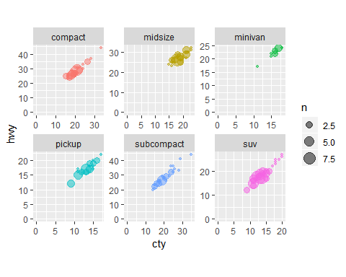
facet_wrap: scales
# space does not work with facet_wrap() p + facet_wrap(~class, ncol = 3, scales = "free")

Slide 27
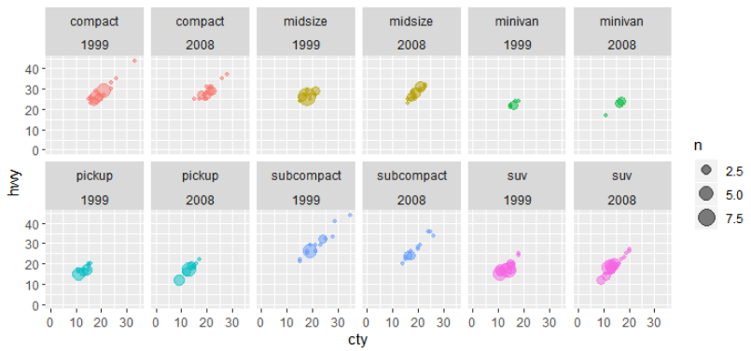
facets: (a + b)
# also works with facet_grid p + facet_wrap(~class + year, nrow = 2)

Slide 28
scale_*_identity()
Sometimes I want to have better control over colors & sizes.
Here, I am hard coding the colors
df <- mpg %>% mutate(category = case_when( cty < 14 ~ "coral", cty > 19 ~ "turquoise", TRUE ~ "grey40" ) )

Slide 29
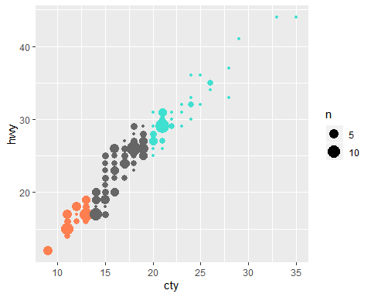
scale_color_identity()
ggplot(df, aes(cty, hwy, color = category)) + geom_count() + scale_color_identity()

Slide 30
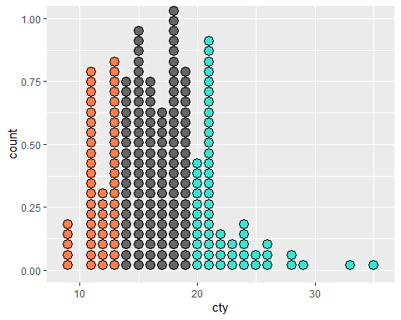
scale_fill_identity()
ggplot(df, aes(cty, fill = category)) + geom_dotplot() + scale_fill_identity()

Slide 31
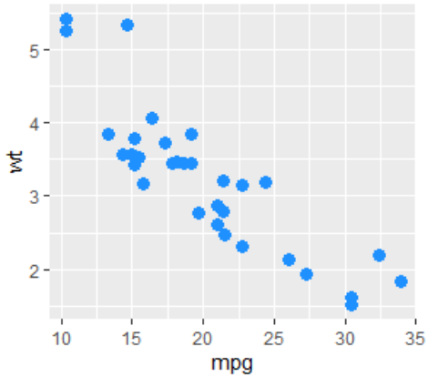
Default colors
update_geom_defaults( "point", list(color = "dodgerblue", size = 3) )
ggplot(mtcars, aes(mpg, wt)) + geom_point()

Slide 32
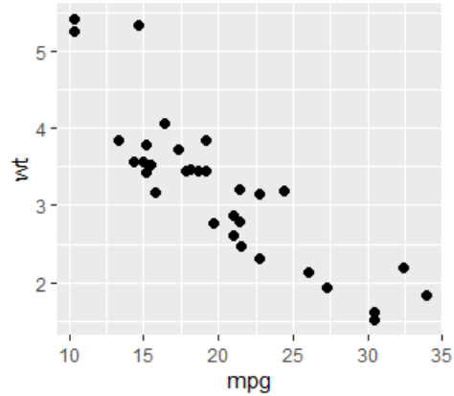
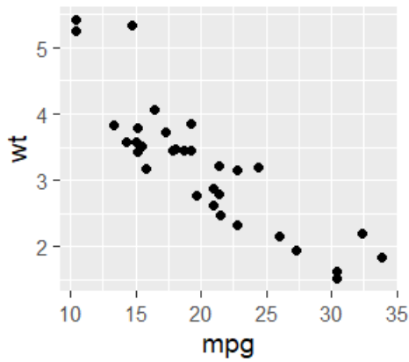
Base font size
ggplot(mtcars, aes(mpg, wt)) + geom_point()
ggplot(mtcars, aes(mpg, wt)) + geom_point() + theme_gray(base_size = 14)

Slide 33
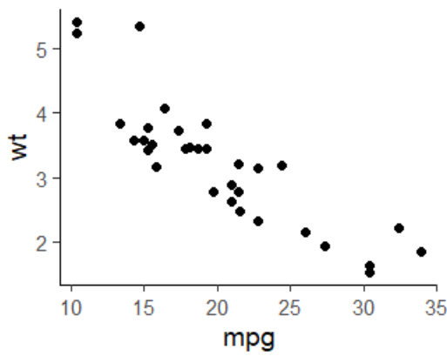
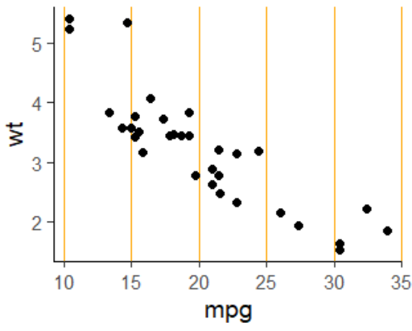
Default theme
# will apply to all future charts
theme_set(theme_classic(base_size = 14))
ggplot(mtcars, aes(mpg, wt)) +
geom_point()
# can update with theme()
ggplot(mtcars, aes(mpg, wt)) +
geom_point() +
theme( panel.grid.major.x = element_line(color = "orange") )
# can revert back using this code
theme_set(theme_gray())

Slide 34
Best practices

Slide 35
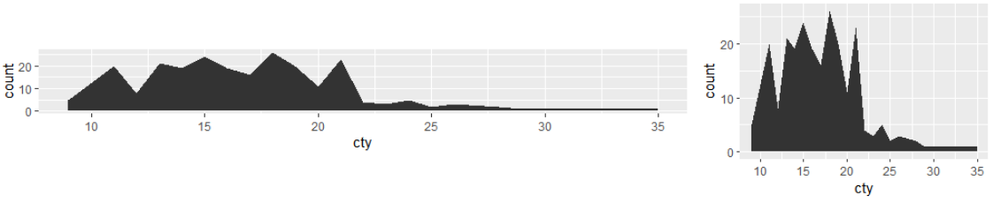
The golden ratio 1:1.6
Try to give your charts the proportion of a credit card
Also look this up
p <- ggplot(mpg, aes(cty)) + geom_bar() p + coord_fixed(1/10) p + theme(aspect.ratio = 1/1.6) # ratio depends on the units

Slide 36
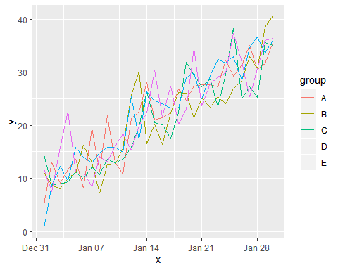
Dealing with spaghetti charts
This is one of the most common questions:
change for multiple categories over time
This often results in a chart like the one here. It is hard to read but there are some ways you can help your audience
ggplot(df, aes(x, y, color = group)) + geom_line()

Slide 37
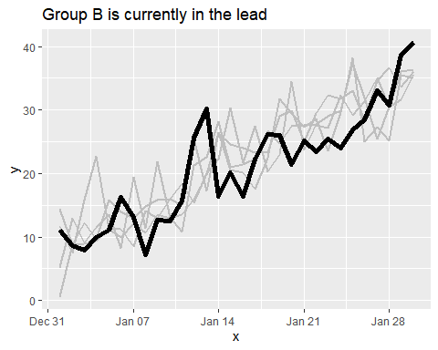
Highlight the focus & use an informative title
ggplot(df, aes(x, y, group = group)) + geom_line(data = filter(df, group != "B"), color = "grey", size = 1) + geom_line(data = filter(df, group == "B"), color = "black", size = 2) + labs(title = "Group B is currently in the lead")

Slide 38
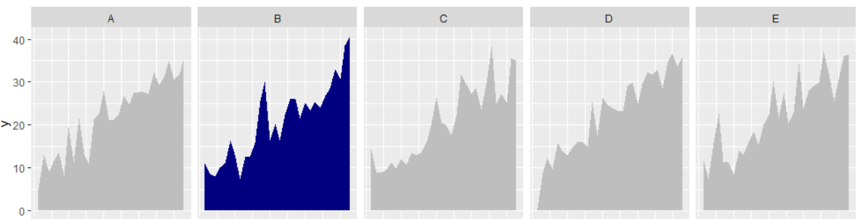
Use facets
ggplot(df, aes(x, y, fill = (group == "B")) + geom_area() + facet_grid(cols = vars(group)) +

Slide 39
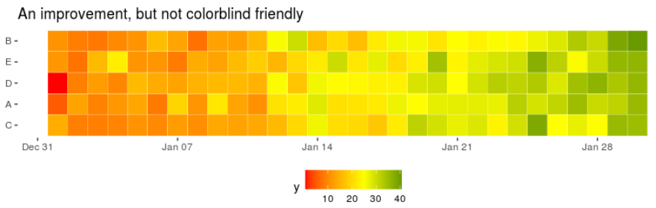
Try a heatmap but beware
ggplot(df, aes(x, fct_reorder(group, y, last), fill = y)) + geom_tile(color = "white") + scale_fill_gradient2( low = "red", mid = "yellow", high = "darkgreen", midpoint = 25 ) + my_theme + labs(title = "An improvement, but not colorblind friendly"

Slide 40
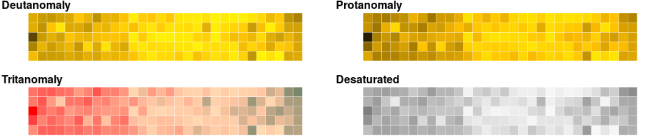
#remotes::install_github("clauswilke/colorblindr")
colorblindr::cvd_grid(h + theme_void())

Slide 41
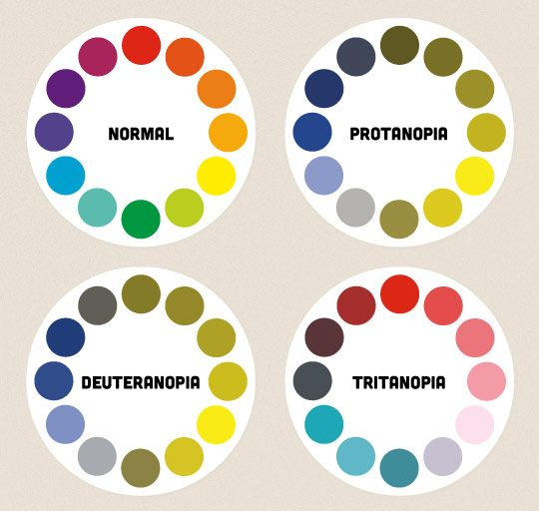
Blue & Orange

Slide 42
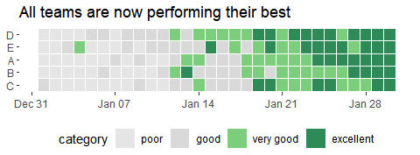
Not every point needs a color
ggplot(df, aes(x, fct_reorder(group, y), fill = category)) + geom_tile(color = "white", size = 0.1) + scale_fill_manual( values = c("grey90", "grey85", "palegreen3", "seagreen4"), labels = c("poor", "good", "very good", "excellent") ) + my_theme + labs(title = "All teams are now performing their best")
You can see this in the
code sample: category = factor(ntile(y, 4))

Slide 43
Take care when cropping data
The usual methods to “zoom in” can yield unexpected results when stat_*() geoms are used.
For example, geom_boxplot() calls stat_boxplot()
filters out data outside the coordinates before doing the stats
the boxplot will keep readjusting the quartiles

Slide 44
Use coord_cartesian() to zoom in
Use coord_cartesian() instead of ylim() or scale_*_continuous()
on summary stats # find_limits() is a custom function bind_rows( find_limits(p), find_limits(p + ylim(0, 12000)), find_limits(p + scale_y_continuous(limits = c(0, 12000))), find_limits(p + coord_cartesian(ylim = c(0, 12000))) ) ## lower middle upper ## 950 2401 5324 ## 911 2161 4679 ## 911 2161 4679 ## 950 2401 5324

Slide 45
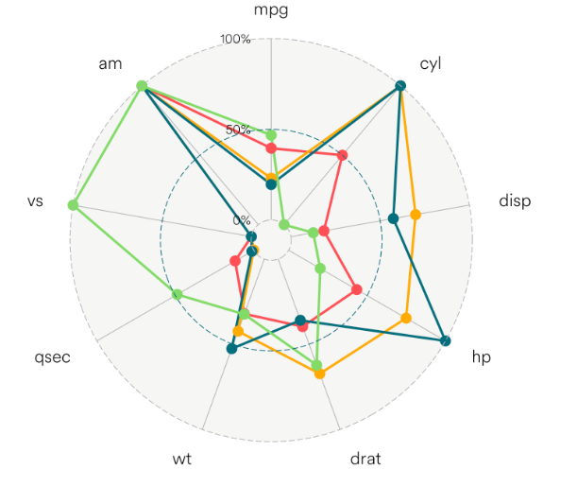
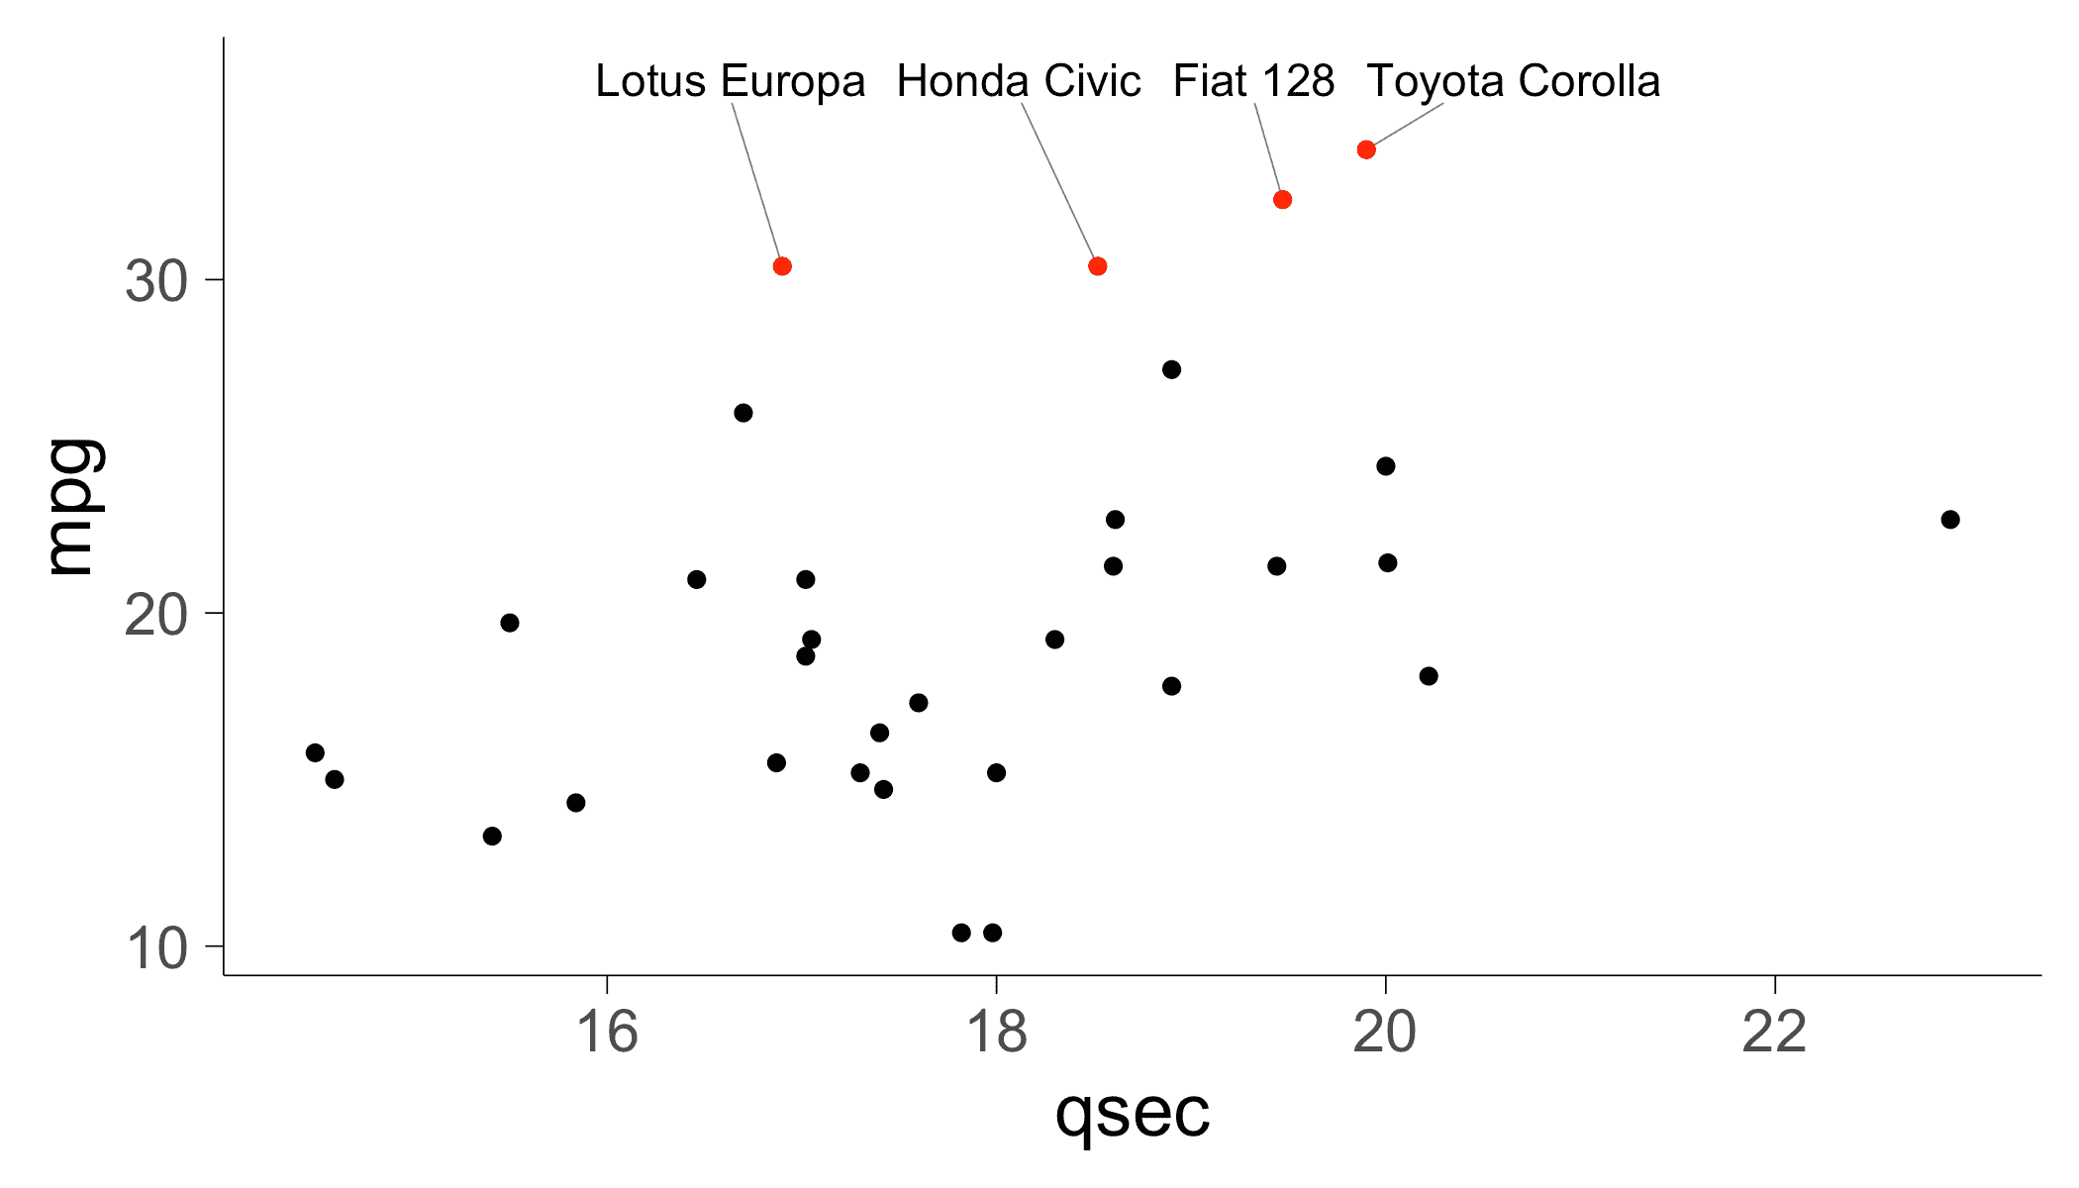
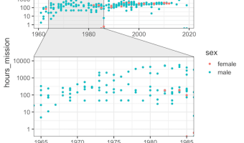
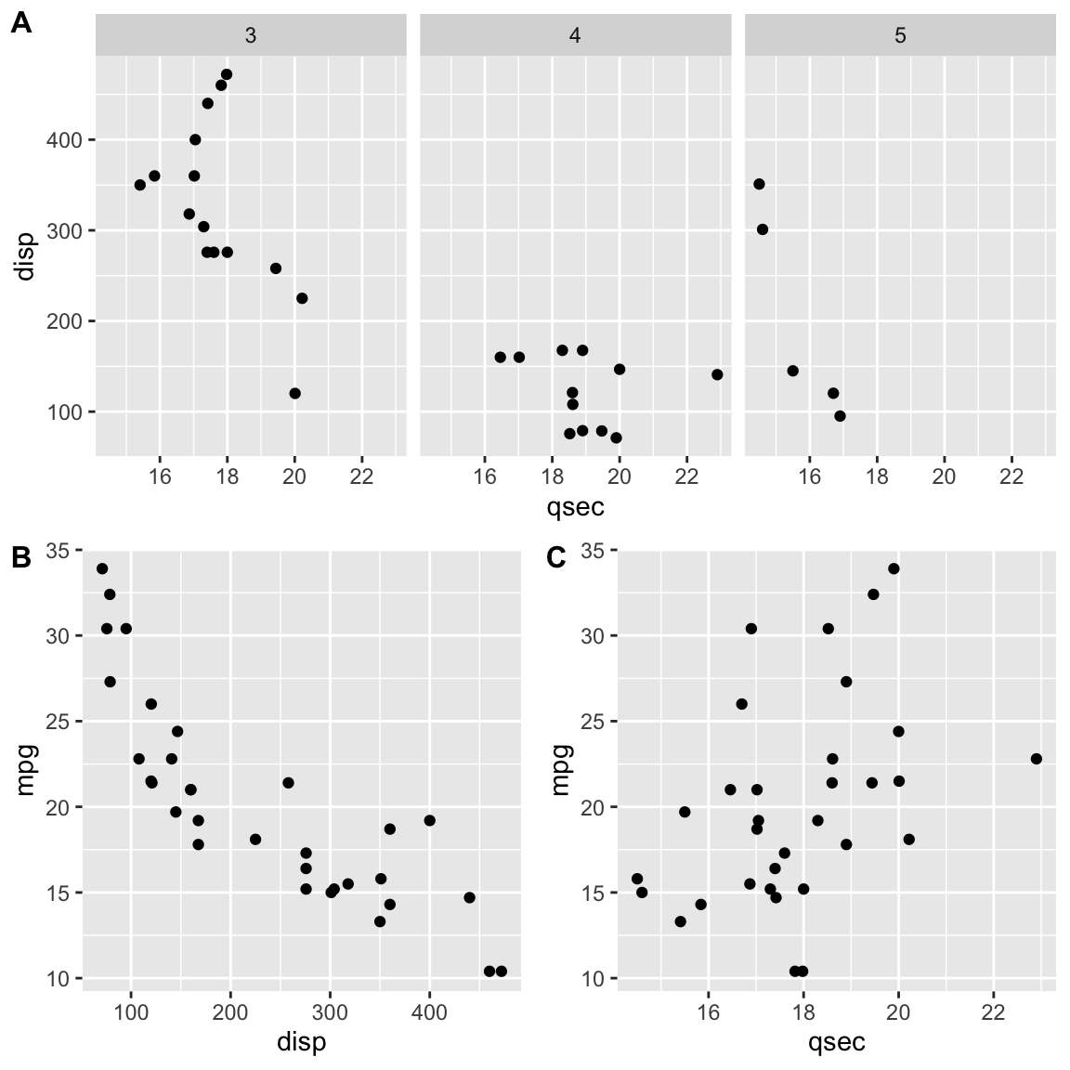
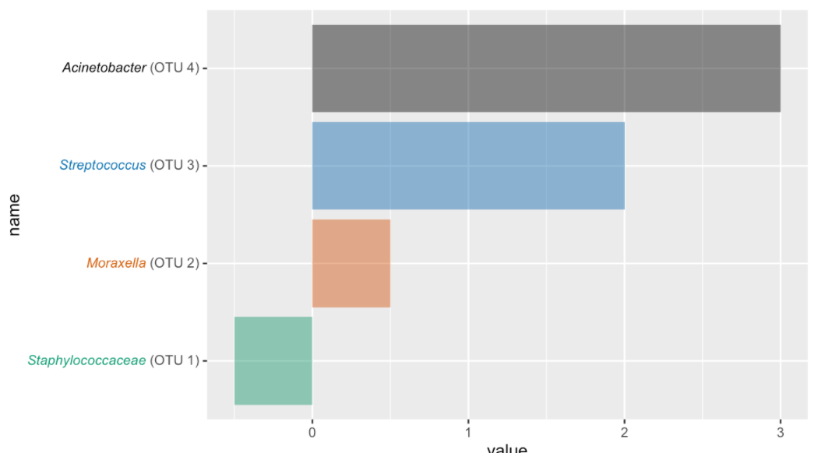
Extensions
ggradar - spider/radar plots
gganimate
ggrepel
ggforce
cowplot
ggtext

Slide 46
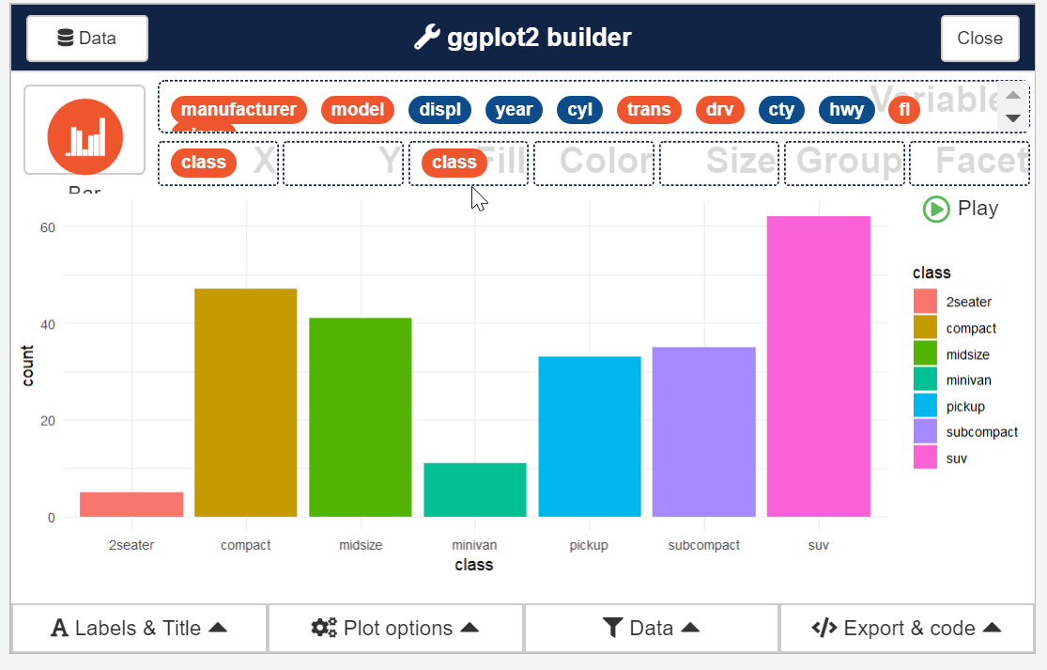
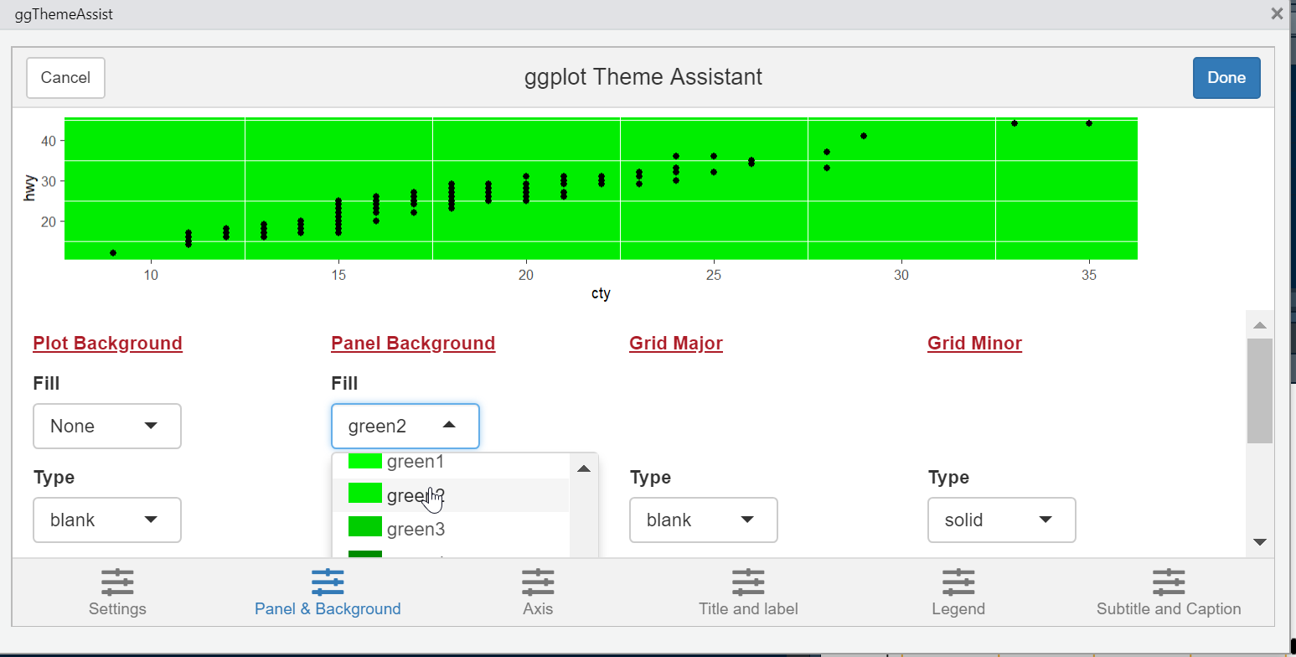
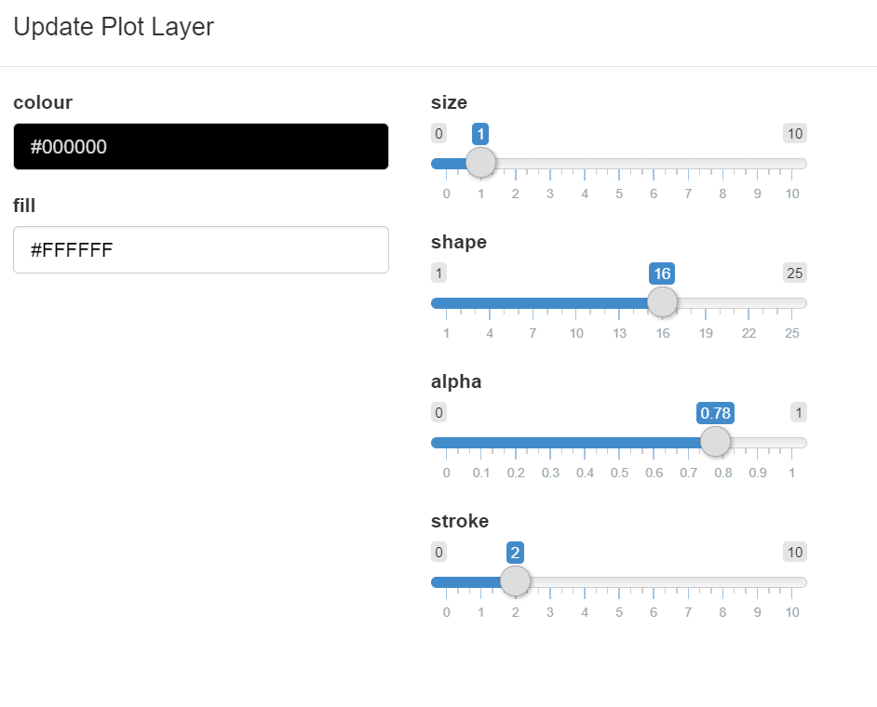
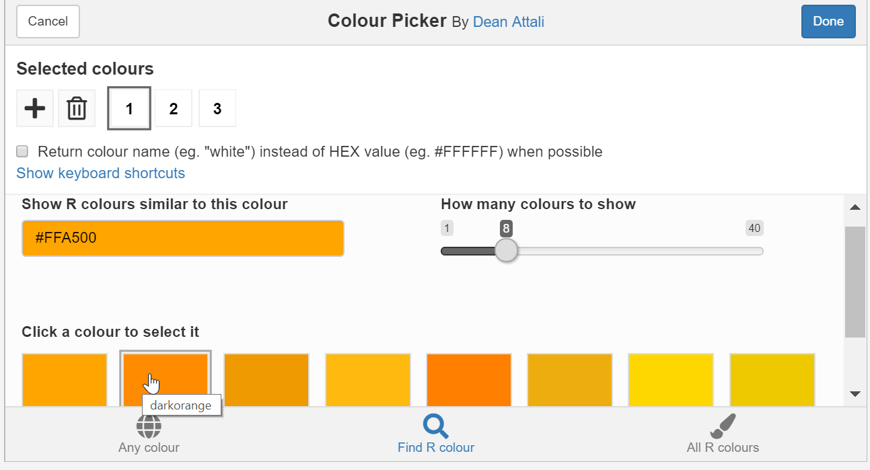
addinslist
addinslist::addinslistAddin() p <- ggplot(mpg, aes(cty, hwy)) + geom_point()
# esquisse esquisse:::esquisser() esquisse:::esquisser(mpg) # others ggThemeAssist::ggThemeAssistGadget(p) ggedit::ggedit(p) colourpicker::colourPicker()

Slide 47
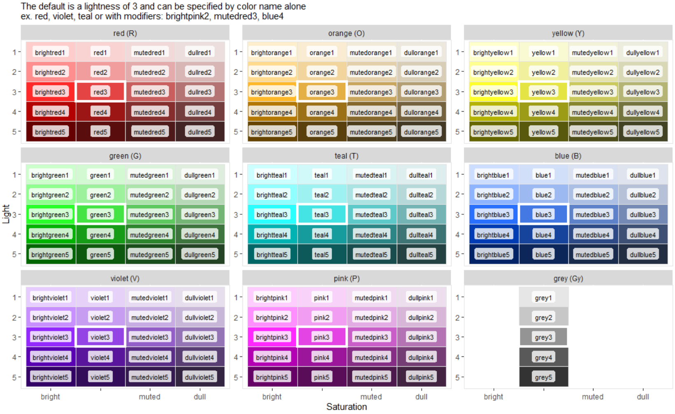
simplecolors
https://rjake.github.io/simplecolors/articles/intro.html # devtools::install_github("rjake/simplecolors")
library(simplecolors) show_colors(labels = TRUE)

Slide 48
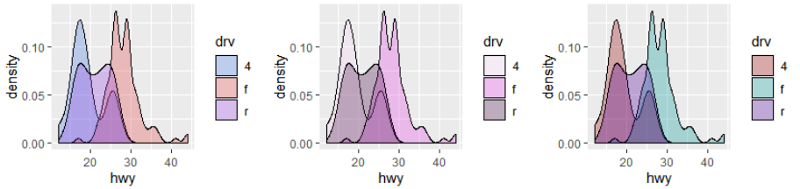
simplecolors
Three main functions: sc() sc_across() sc_*() p <- ggplot(mpg, aes(hwy, fill = drv)) + geom_density(alpha = 0.3) p + scale_fill_manual(values = sc("blue3", "red3", "violet3")) p + scale_fill_manual(values = sc_pink(light = c(1,3,5))) p + scale_fill_manual(values = sc_across("RTV", light = 4, sat = "bright"))

Slide 49
Appendix

Slide 50
R4DS
R for Data Science is a book all about the tidyverse. It is less “data science-y” and more about data manipulation and visualization. It is free online here as well as available for sale.

Slide 51
Stackoverflow
try datapasta for a minimal reprex
include images rather than links
incorporate styler

Slide 52


Cheatsheets
https://rstudio.com/resources/cheatsheets/
ggplot2
forcats

