Slide 1
Introduction to Data Visualisation in R
Maria Korochkina, PhD
https://mariakna.github.io/

Slide 2
«The purpose of visualisation is insight, not pictures»
Ben Schneiderman

Slide 3
Key things to consider
What’s my message?
  What is the main story or insight that you want to communicate?
What does my audience need to understand it?
  Consider their background, expectations, and how much context they need
What information do I need to show that message?
  Choose data and visuals that directly support your point
Did I include everything essential — and only that?
  Keep the focus on what matters, and remove clutter or irrelevant details
Am I being transparent and truthful?
  Make sure scales, colours, and design choices reflect the data accurately
Could my visualisation mislead or confuse?
  Check for distortions & missing context that might create the wrong impression

Slide 4
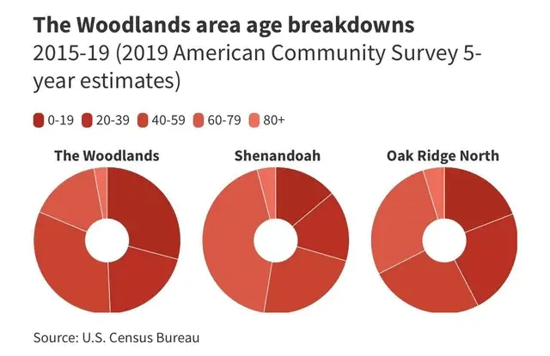
Colour – can you see the differences?
Image: https://www.tempo.io/blog/good-and-bad-data-visualization

Slide 5
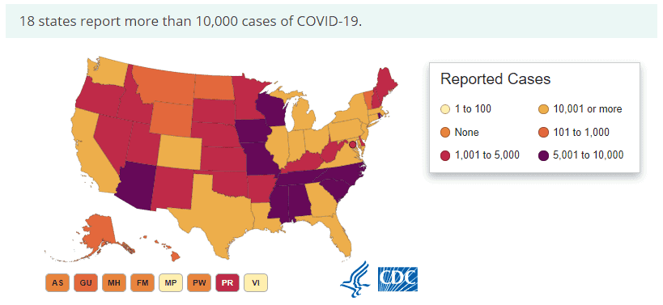
Colour – is the pallette intuitive?
Image: https://www.tempo.io/blog/good-and-bad-data-visualization

Slide 6
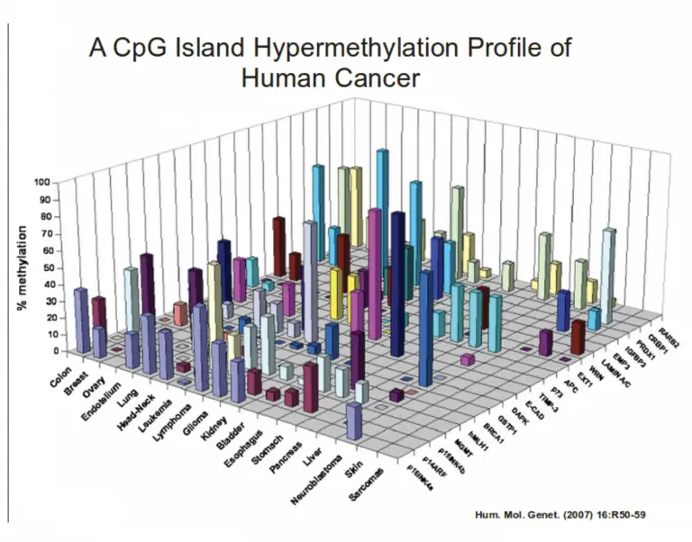
Colour – is it meaningful?
Image: https://www.tempo.io/blog/good-and-bad-data-visualization

Slide 7
Does it need to be so complex?
Image: https://www.tempo.io/blog/good-and-bad-data-visualization

Slide 8
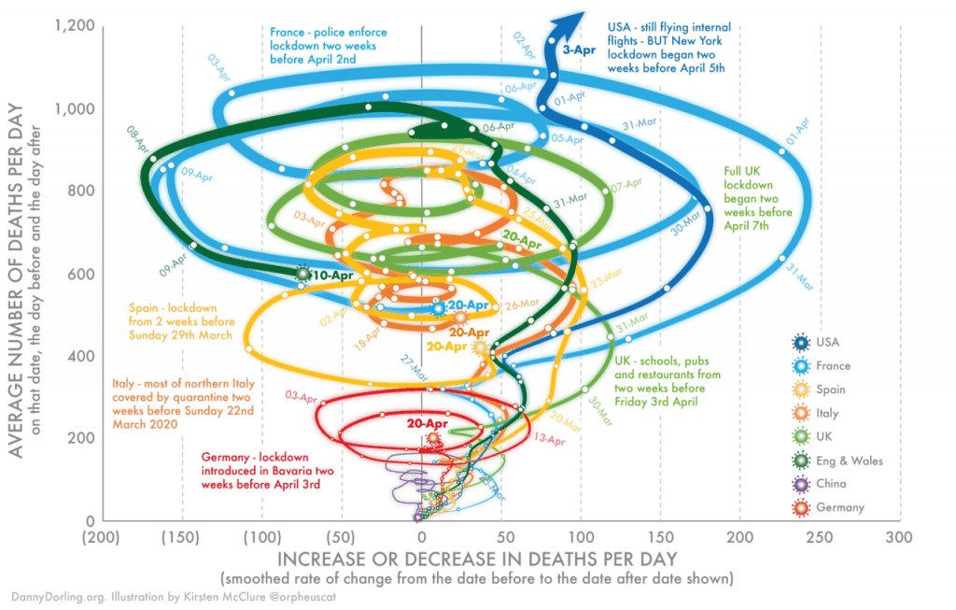
Seriously, does it?..
Image: https://www.tempo.io/blog/good-and-bad-data-visualization

Slide 9
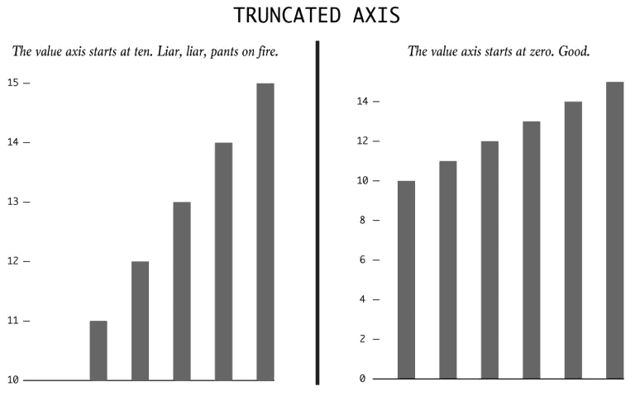
Are you misleading me on purpose?
Image: https://www.tempo.io/blog/good-and-bad-data-visualization

Slide 10
Are you misleading me on purpose?
Image: https://www.tempo.io/blog/good-and-bad-data-visualization

Slide 11
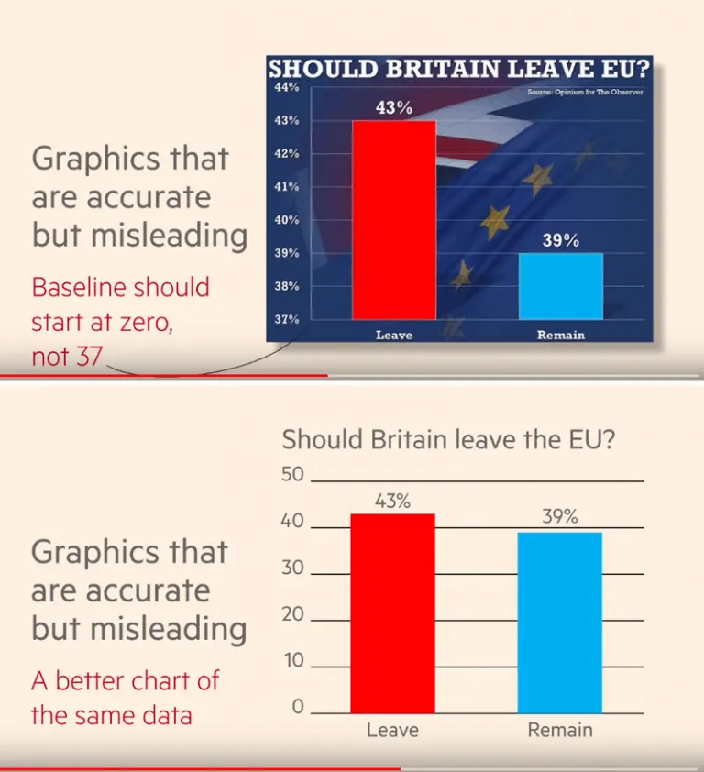
Are you misleading me on purpose?
Image: https://www.tempo.io/blog/good-and-bad-data-visualization

Slide 12
Are you misleading me on purpose?
Image: https://www.tempo.io/blog/good-and-bad-data-visualization

Slide 13
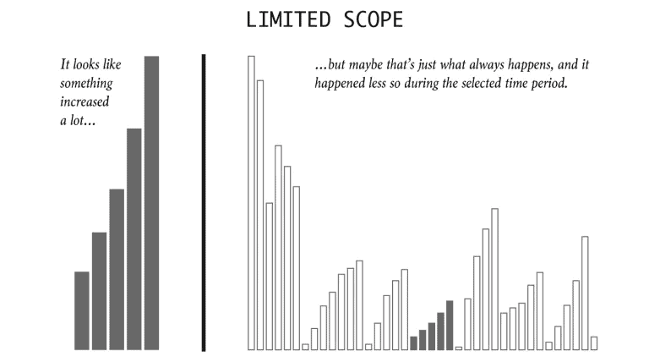
Are you misleading me on purpose?
Image: https://www.tempo.io/blog/good-and-bad-data-visualization

Slide 14
Are you misleading me on purpose?
Image: https://www.tempo.io/blog/good-and-bad-data-visualization

Slide 15
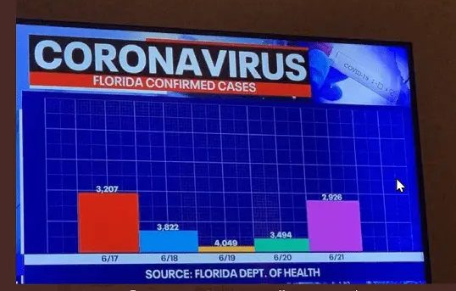
Wait…what?
Image: https://www.tempo.io/blog/good-and-bad-data-visualization

Slide 16
Materials
https://github.com/mariakna/SEDarc2025_Intro_to_Data_Vis_in_R/tree/main

Slide 17
Thank you!
https://mariakna.github.io/

