Slide 1
Introduction to Quantitative Analysis in R
Maria Korochkina, PhD
https://mariakna.github.io/

Slide 2
What’s quantitative analysis?
A research approach that relies on numerical data, mathematical models, and statistical techniques to describe, explain, or predict phenomena
Focuses on measurable data
Relies on datasets stored in spreadsheets & databases
Aims to minimise bias by using data-driven evidence
Applies statistical tools to understand data & make predictions

Slide 3

Why R?
The gold standard for statistical analysis,
built by statisticians for statisticians
Image: https://www.r-project.org/
Notes:
Although we could use a spreadsheet in Microsoft Excel or Google sheets to analyze our data, these tools are limited in their flexibility and accessibility. Critically, they also are difficult to share steps which explore and change the raw data, which is key to “reproducible” research.
Therefore, this lesson will teach you how to begin exploring your data using R and RStudio. The R program is available for Windows, Mac, and Linux operating systems, and is a freely-available where you downloaded it above. To run R, all you need is the R program.
To make using R easier, we will use the program RStudio, which we also downloaded above. RStudio is a free, open-source, Integrated Development Environment (IDE). It provides a built-in editor, works on all platforms (including on servers) and provides many advantages such as integration with version control and project management.

Slide 4
Installation & set up
Install R
Instructions: https://www.r-project.org/, https://posit.co/download/rstudio-desktop/
Install RStudio
Instructions: https://posit.co/download/rstudio-desktop/
Since 2022, the company developing RStudio has been called Posit (formerly RStudio Inc.)
Notes:
plots/files/help

Slide 5
Materials
https://github.com/mariakna/SEDarc2025_Intro_to_Quant_Analysis_in_R

Slide 6
Thank you!
https://mariakna.github.io/

Slide 7
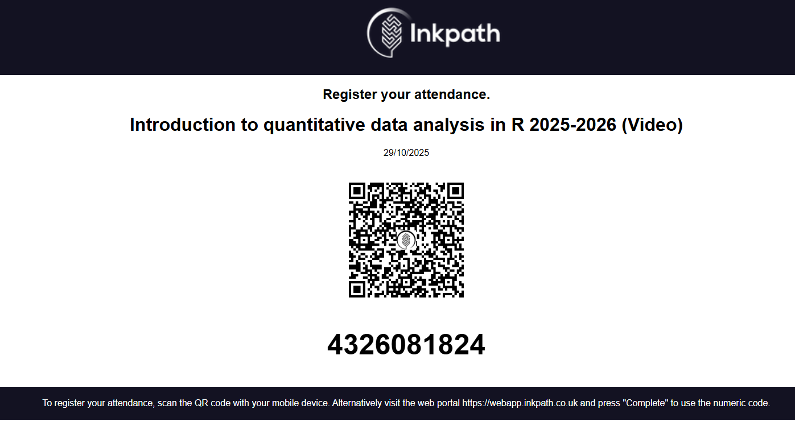

Slide 8
