Slide 1
Making your research transparent and reproducible
Maria Korochkina, PhD
https://mariakna.github.io/

Slide 2
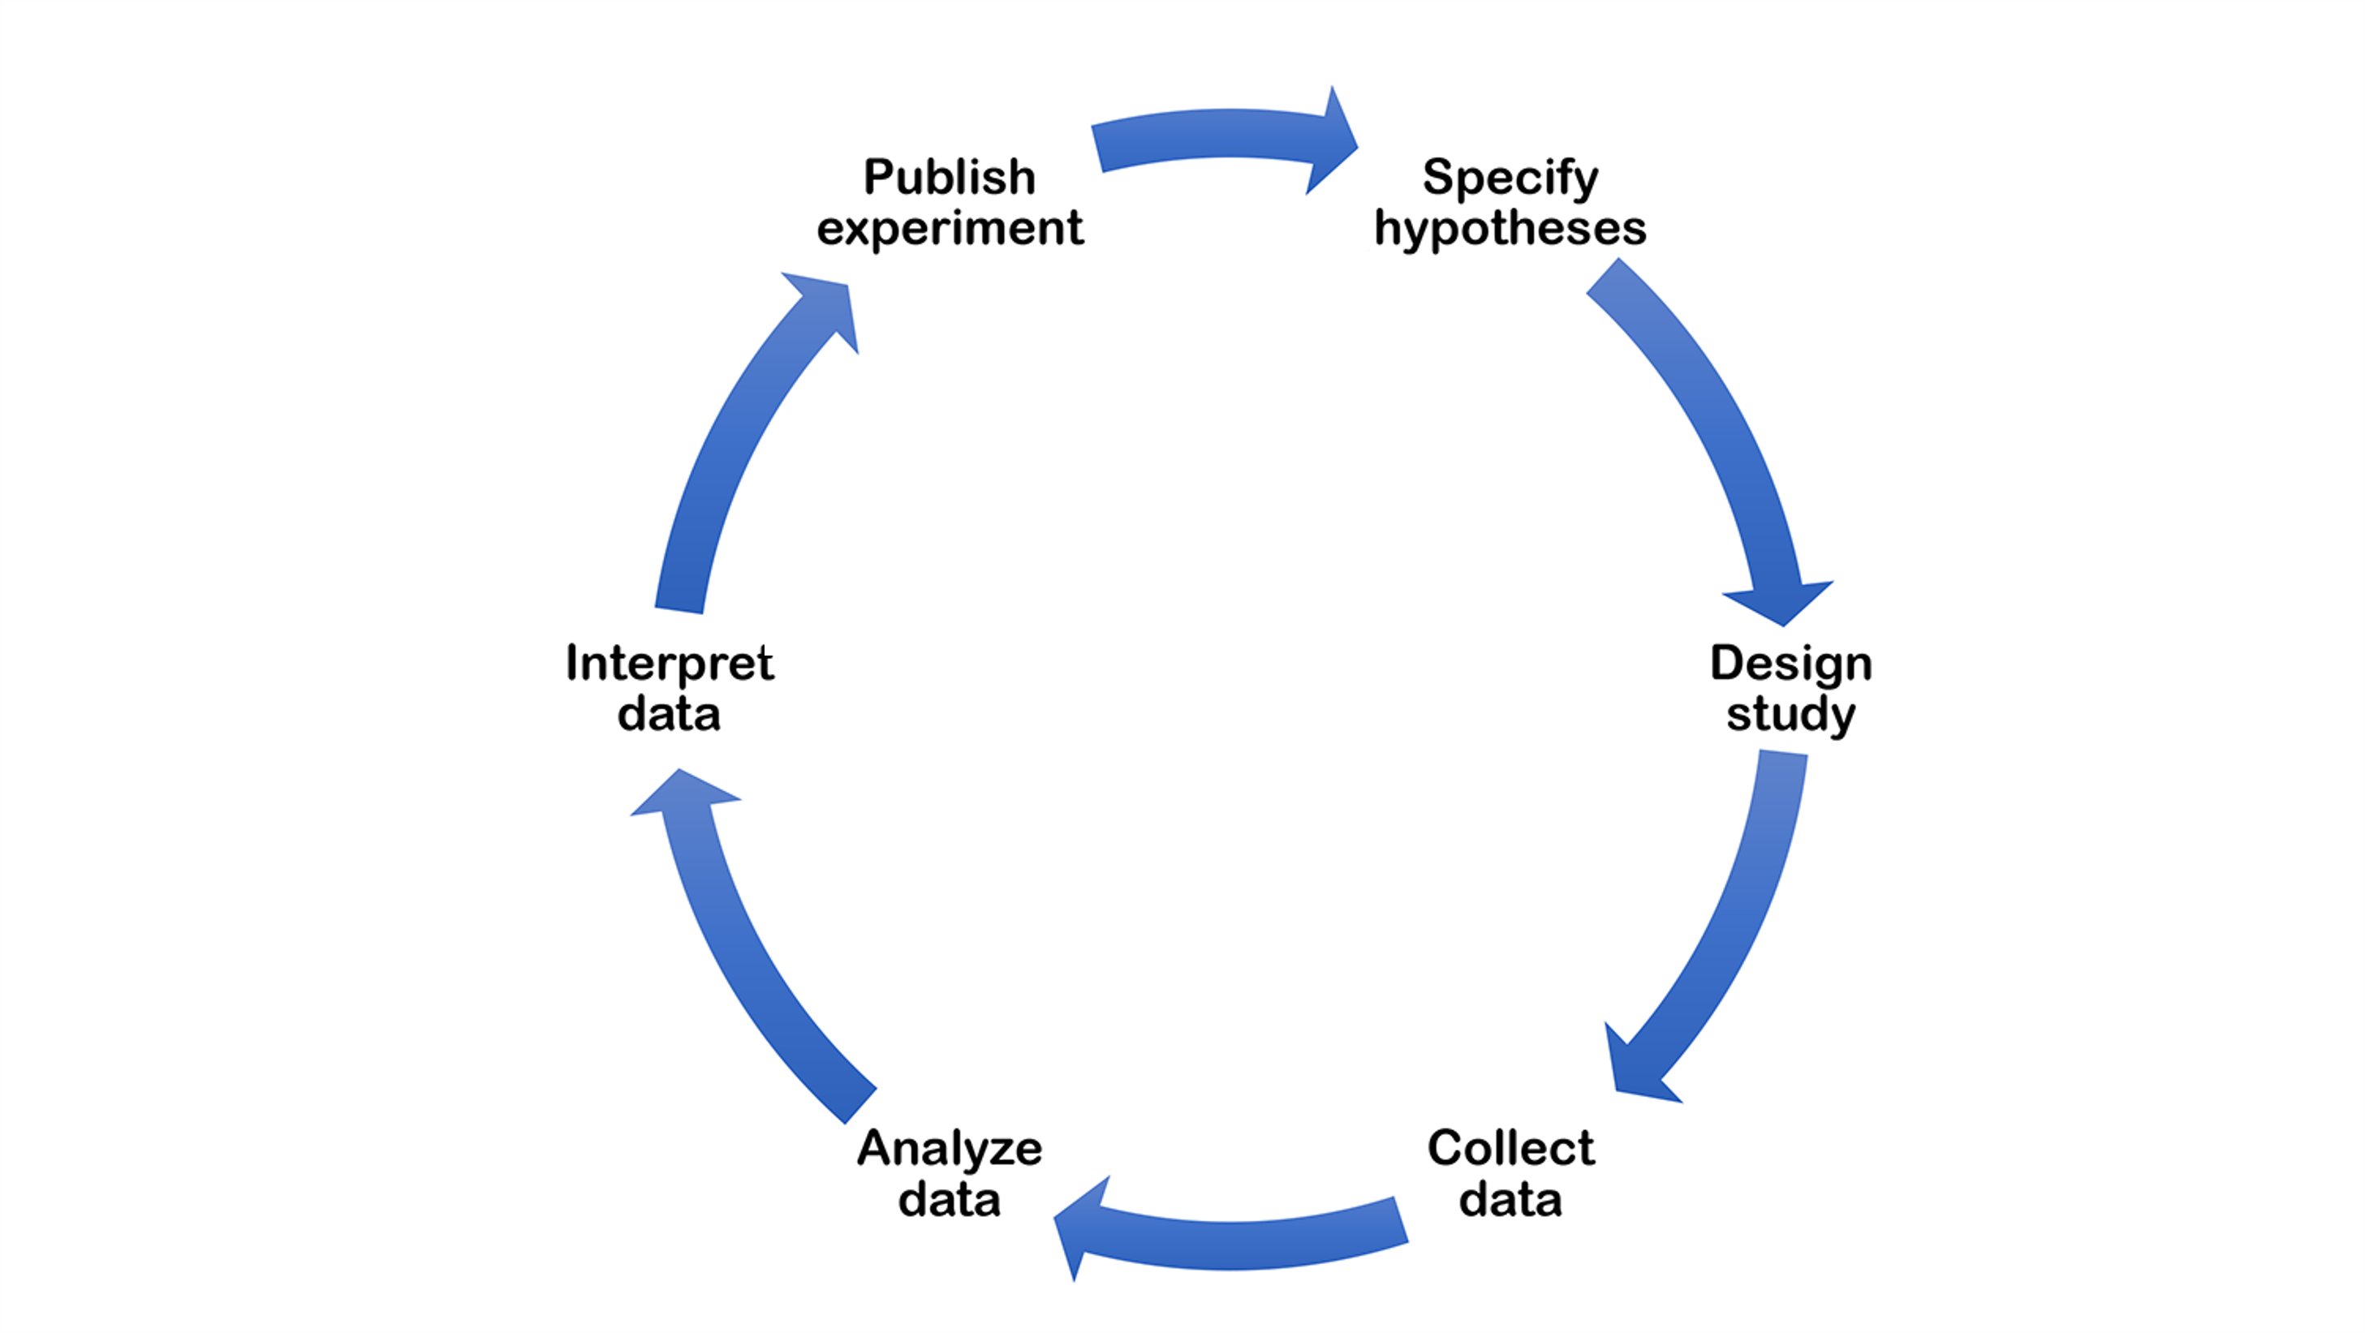
Typical research cycle
Image: https://www.cos.io/initiatives/registered-reports

Slide 3
Typical research cycle
Image: https://www.cos.io/initiatives/registered-reports

Slide 4
Typical research cycle
Image: https://www.cos.io/initiatives/registered-reports

Slide 5
Typical research cycle
Image: https://www.cos.io/initiatives/registered-reports

Slide 6
Typical research cycle
Image: https://www.cos.io/initiatives/registered-reports

Slide 7
Typical research cycle
Image: https://www.cos.io/initiatives/registered-reports

Slide 8
Typical research cycle
Image: https://www.cos.io/initiatives/registered-reports

Slide 9
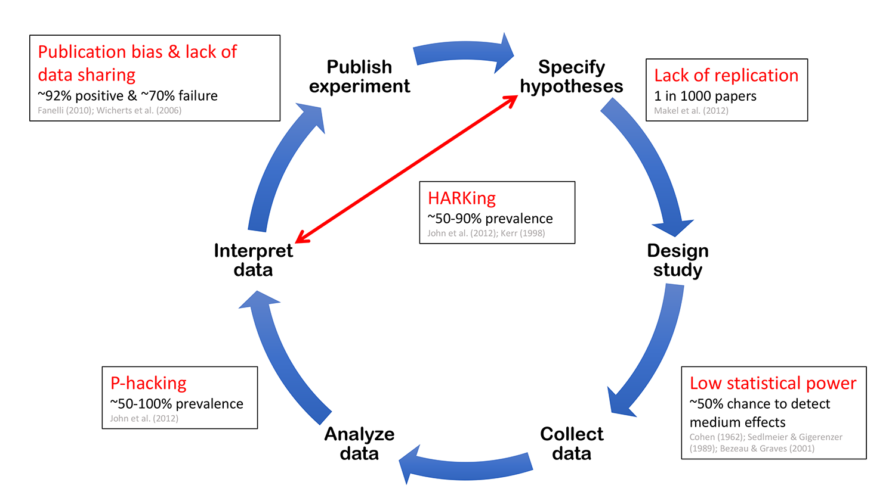
Short-circuited by questionable practices
Image: https://www.cos.io/initiatives/registered-reports

Slide 10
Short-circuited by questionable practices
Image: https://www.cos.io/initiatives/registered-reports
Notes:
Lack of replication impedes the elimination of false discoveries and weakens the evidence base underpinning theory

Slide 11
Short-circuited by questionable practices
Image: https://www.cos.io/initiatives/registered-reports
Notes:
Low statistical power increases the chances of missing true discoveries and reduces the likelihood that obtained positive effects are real.

Slide 12
Short-circuited by questionable practices
Image: https://www.cos.io/initiatives/registered-reports
Notes:
Exploiting researcher degrees of freedom (p-hacking) manifests in two general forms: collecting data until analyses return statistically significant effects, and selectively reporting analyses that reveal desirable outcomes.

Slide 13
Short-circuited by questionable practices
Image: https://www.cos.io/initiatives/registered-reports
Notes:
HARKing, or hypothesizing after results are known, involves generating a hypothesis from the data and then presenting it as a priori.

Slide 14
Short-circuited by questionable practices
Image: https://www.cos.io/initiatives/registered-reports
Notes:
Publication bias occurs when journals reject manuscripts on the basis that they report negative or undesirable findings. Finally, lack of data sharing prevents detailed meta-analysis and hinders the detection of data fabrication.

Slide 15
Research is transparent
when all stages of the research process — including hypotheses, methods, design, data, analysis, and conclusions — are reported comprehensively and openly.
Research is reproducible
when other researchers perform the same analysis on the same dataset and consistently obtain the same findings.
Research must be transparent and reproducible to make scientific findings trustworthy and reliable, and to allow science to correct and improve itself over time.

Slide 16
Typical research cycle
Image: https://www.cos.io/initiatives/registered-reports

Slide 17
Typical research cycle
Report, store, share
Image: https://www.cos.io/initiatives/registered-reports

Slide 18
Typical research cycle
Report, store, share
Image: https://www.cos.io/initiatives/registered-reports

Slide 19

Typical research cycle
Report, store, share
Plan
What are your research questions? How will your study address them?
Method;
Sample size
Data collection, preprocessing, analysis, management post analysis
Image: https://www.cos.io/initiatives/registered-reports

Slide 20
Typical research cycle
Report, store, share
Plan
What are your research questions? How will your study address them?
Method;
Sample size
Data collection, preprocessing, analysis, management post analysis
Image: https://www.cos.io/initiatives/registered-reports

Slide 21
Typical research cycle
Report, store, share
Plan
What are your research questions? How will your study address them?
Method;
Sample size
Data collection, preprocessing, analysis, management post analysis
Image: https://www.cos.io/initiatives/registered-reports

Slide 22

Typical research cycle
Report, store, share
Plan
What are your research questions? How will your study address them?
Method;
Sample size
Data collection, preprocessing, analysis, management post analysis
Project management
Infrastructure
Backup / version control
Code quality & documentation
Data archiving
Report writing
Image: https://www.cos.io/initiatives/registered-reports

Slide 23
Typical research cycle
Report, store, share
Plan
What are your research questions? How will your study address them?
Method;
Sample size
Data collection, preprocessing, analysis, management post analysis
Project management
Infrastructure
Backup / version control
Code quality & documentation
Data archiving
Report writing
Image: https://www.cos.io/initiatives/registered-reports

Slide 24
Planning your research
Decisions to make and how to hold yourself accountable

Slide 25

Key decisions to make
What is the study about & what are your hypotheses?
What are your dependent variables & how will they be measured?
What conditions will the participants be assigned to?
Which analyses are you planning to conduct?
Will there be any data exclusions? Why?
What sample size are you aiming for?
Make these decisions before data collection & document them
It is good practice to make your research plans publicly available

Slide 26
Registering your research plans
Pre-registration and registered reports

Slide 27

«All too often, we find ourselves unable to predict what will happen; yet after the fact we explain what did happen with a great deal of confidence. This “ability” to explain that which we cannot predict, even in the absence of any additional information, represents an important, though subtle, flaw in our reasoning. It leads us to believe that there is a less uncertain world than there actually is.... »

Slide 28
Pre-registeration
Create a permanent record of your study plans before you look at the data
Store this plan in a date-stamped, uneditable file in a secure online archive
Allow others to access & evaluate this pre-registered plan
↓
The purpose is to make clear what you set out to do (confirmation) &
what was discovered along the way (exploration)
Notes:
https://www.pnas.org/doi/10.1073/pnas.1708274114

Slide 29
What shall I pre-register?
What is the study about & what are your hypotheses?
What are your dependent variables & how will they be measured?
What conditions will the participants be assigned to?
Which analyses are you planning to conduct?
Will there be any data exclusions? Why?
What sample size are you aiming for?
Remember that you should make these decisions before running your study anyway,
pre-registration simply documents them!

Slide 30
How detailed should it be?
Take the perspective of your future audience!
What would you need to know to understand a study’s rationale, methods, & analysis?
Remember that your reader may not be an expert in the field
Don’t go overboard: pre-reg will accompany your paper & code, not replace them
Only pre-register things you are sure about
If unsure now, explain how & when the decision will be made

Slide 31





Where shall I pre-register?
AsPredicted: http://aspredicted.org/
9 questions about the research design & analyses
Can do a mock pre-registration that will self-destroy after 24h
Open Science Framework: https://osf.io/
Many templates available but can be open-ended
Templates for both quantitative & qualitative studies
Clinical trials
https://www.isrctn.com/ OR https://clinicaltrials.gov/
Detailed guidelines available
Remains private (embargoed) for as long as needed
View-only links & anonymous versions for reviewers

Slide 32
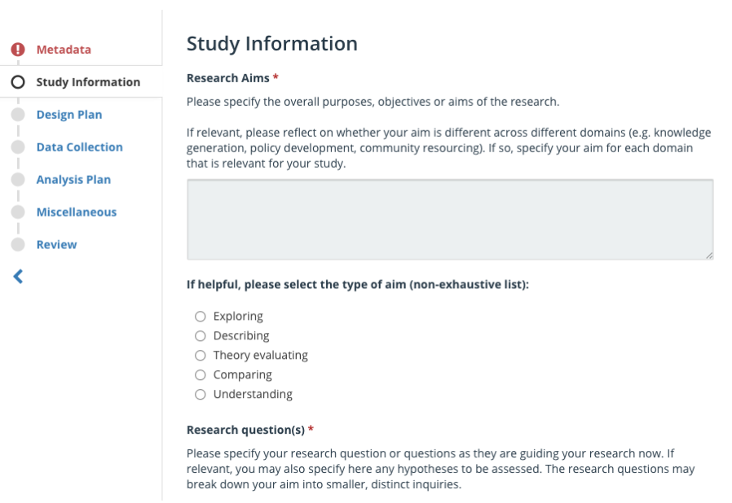
Quantitatve vs. Qualitative research
Qualitative research is often conceived as essentially inductive
For this reason, pre-reg is sometimes perceived as useless and impossible to perform
However, inductive research does not start from a theoretical void
Pre-reg is a commitment device as well as a tool for transparent communication of the research process
https://www.cos.io/blog/qualitative-preregistration

Slide 33
When shall I pre-register?
Pre-register before you have seen – and, ideally, collected – the data!
Include a statement describing the degree to which data exist
Need to change things?
Create a new pre-reg in the same OSF project
Update the original: https://help.osf.io/article/382-updating-registrations
Keep as is but document & justify changes in the paper
What if I deviate?
Discovered a “better” analysis? Just label it as exploratory!
Ineffective to stick to an outdated plan? Made a mistake? Just state that!
Pre-registration is a plan, not a prison!
https://www.cos.io/blog/preregistration-plan-not-prison

Slide 34
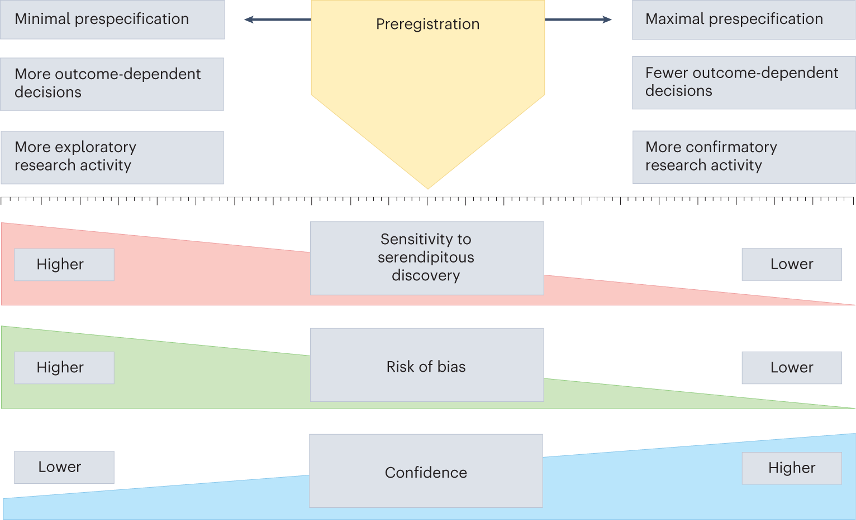
Why bother?
Image: https://www.nature.com/articles/s41562-022-01497-2

Slide 35
Why bother?
Image: https://www.nature.com/articles/s41562-022-01497-2

Slide 36
Why bother?
Image: https://www.nature.com/articles/s41562-022-01497-2

Slide 37
Why bother?
Image: https://www.nature.com/articles/s41562-022-01497-2

Slide 38
Why bother?
Image: https://www.nature.com/articles/s41562-022-01497-2

Slide 39
But seriously, why?
Pre-register for selfish reasons, not to please reviewers
Promotes critical evaluation of your own ideas
Reduces analysis-related anxiety & time spent on analysis
Prevents you from being taken hostage by your own data
The core of Methods & Results written up in advance
Helps against publication bias
Make use of available resources, e.g., https://www.cos.io/initiatives/prereg
The more you do it, the easier it gets!

Slide 40

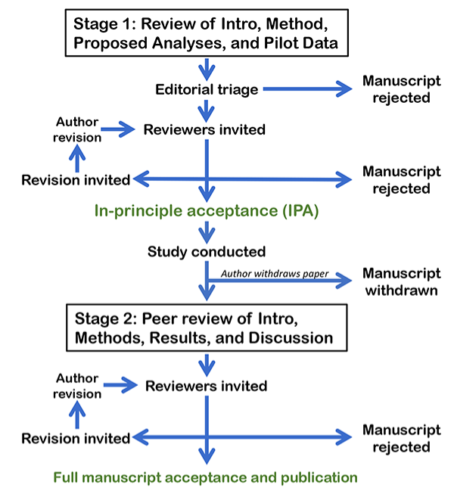
Registered report
Image: https://www.cos.io/initiatives/registered-reports

Slide 41
Registered report
Image: https://www.cos.io/initiatives/registered-reports

Slide 42
Registered report
Image: https://www.cos.io/initiatives/registered-reports

Slide 43
Registered report
Image: https://www.cos.io/initiatives/registered-reports

Slide 44
Registered report
Image: https://www.cos.io/initiatives/registered-reports

Slide 45
Registered report
Image: https://www.cos.io/initiatives/registered-reports

Slide 46
Registered report
Image: https://www.cos.io/initiatives/registered-reports

Slide 47
Registered report
Image: https://www.cos.io/initiatives/registered-reports

Slide 48
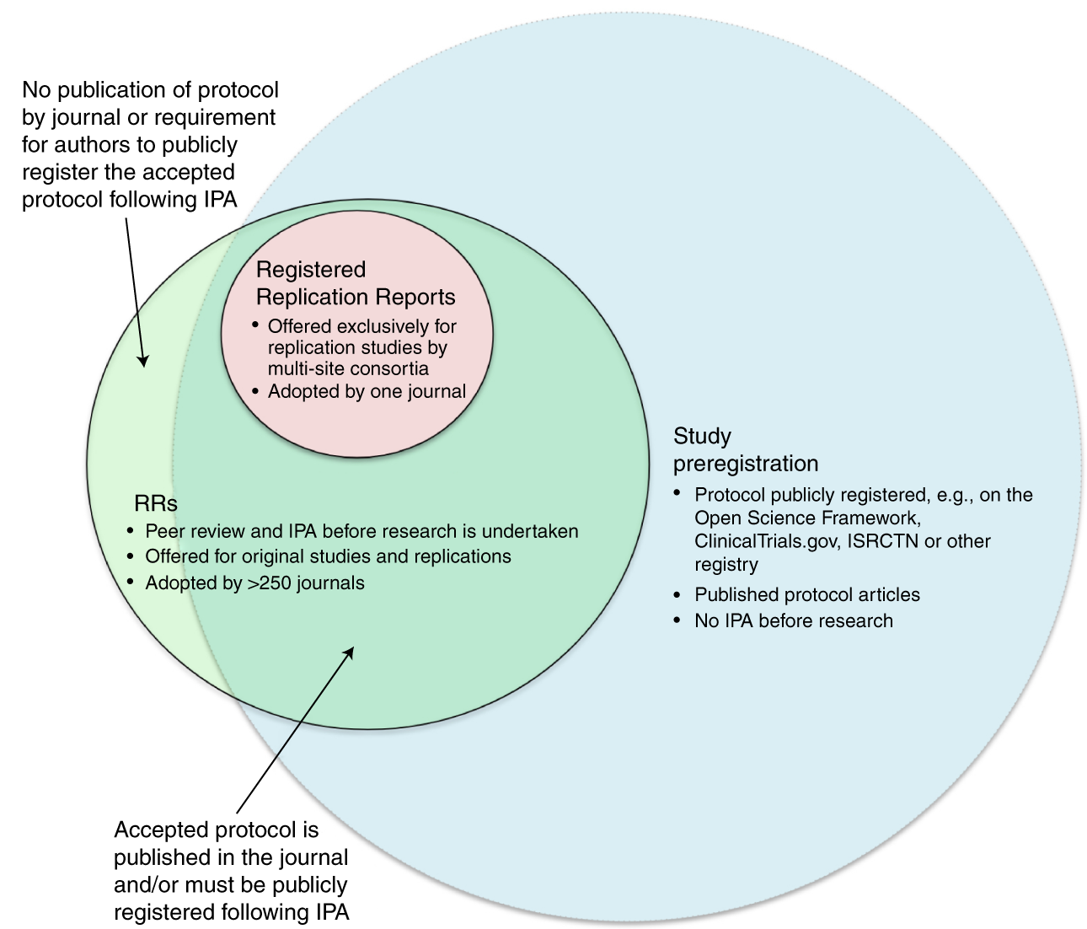
Registered report vs.
pre-registration
Image: https://www.nature.com/articles/s41562-021-01193-7

Slide 49
Registered report vs.
pre-registration
Image: https://www.nature.com/articles/s41562-021-01193-7

Slide 50
Registered report vs.
pre-registration
Image: https://www.nature.com/articles/s41562-021-01193-7

Slide 51
Registered report vs.
pre-registration
Image: https://www.nature.com/articles/s41562-021-01193-7

Slide 52
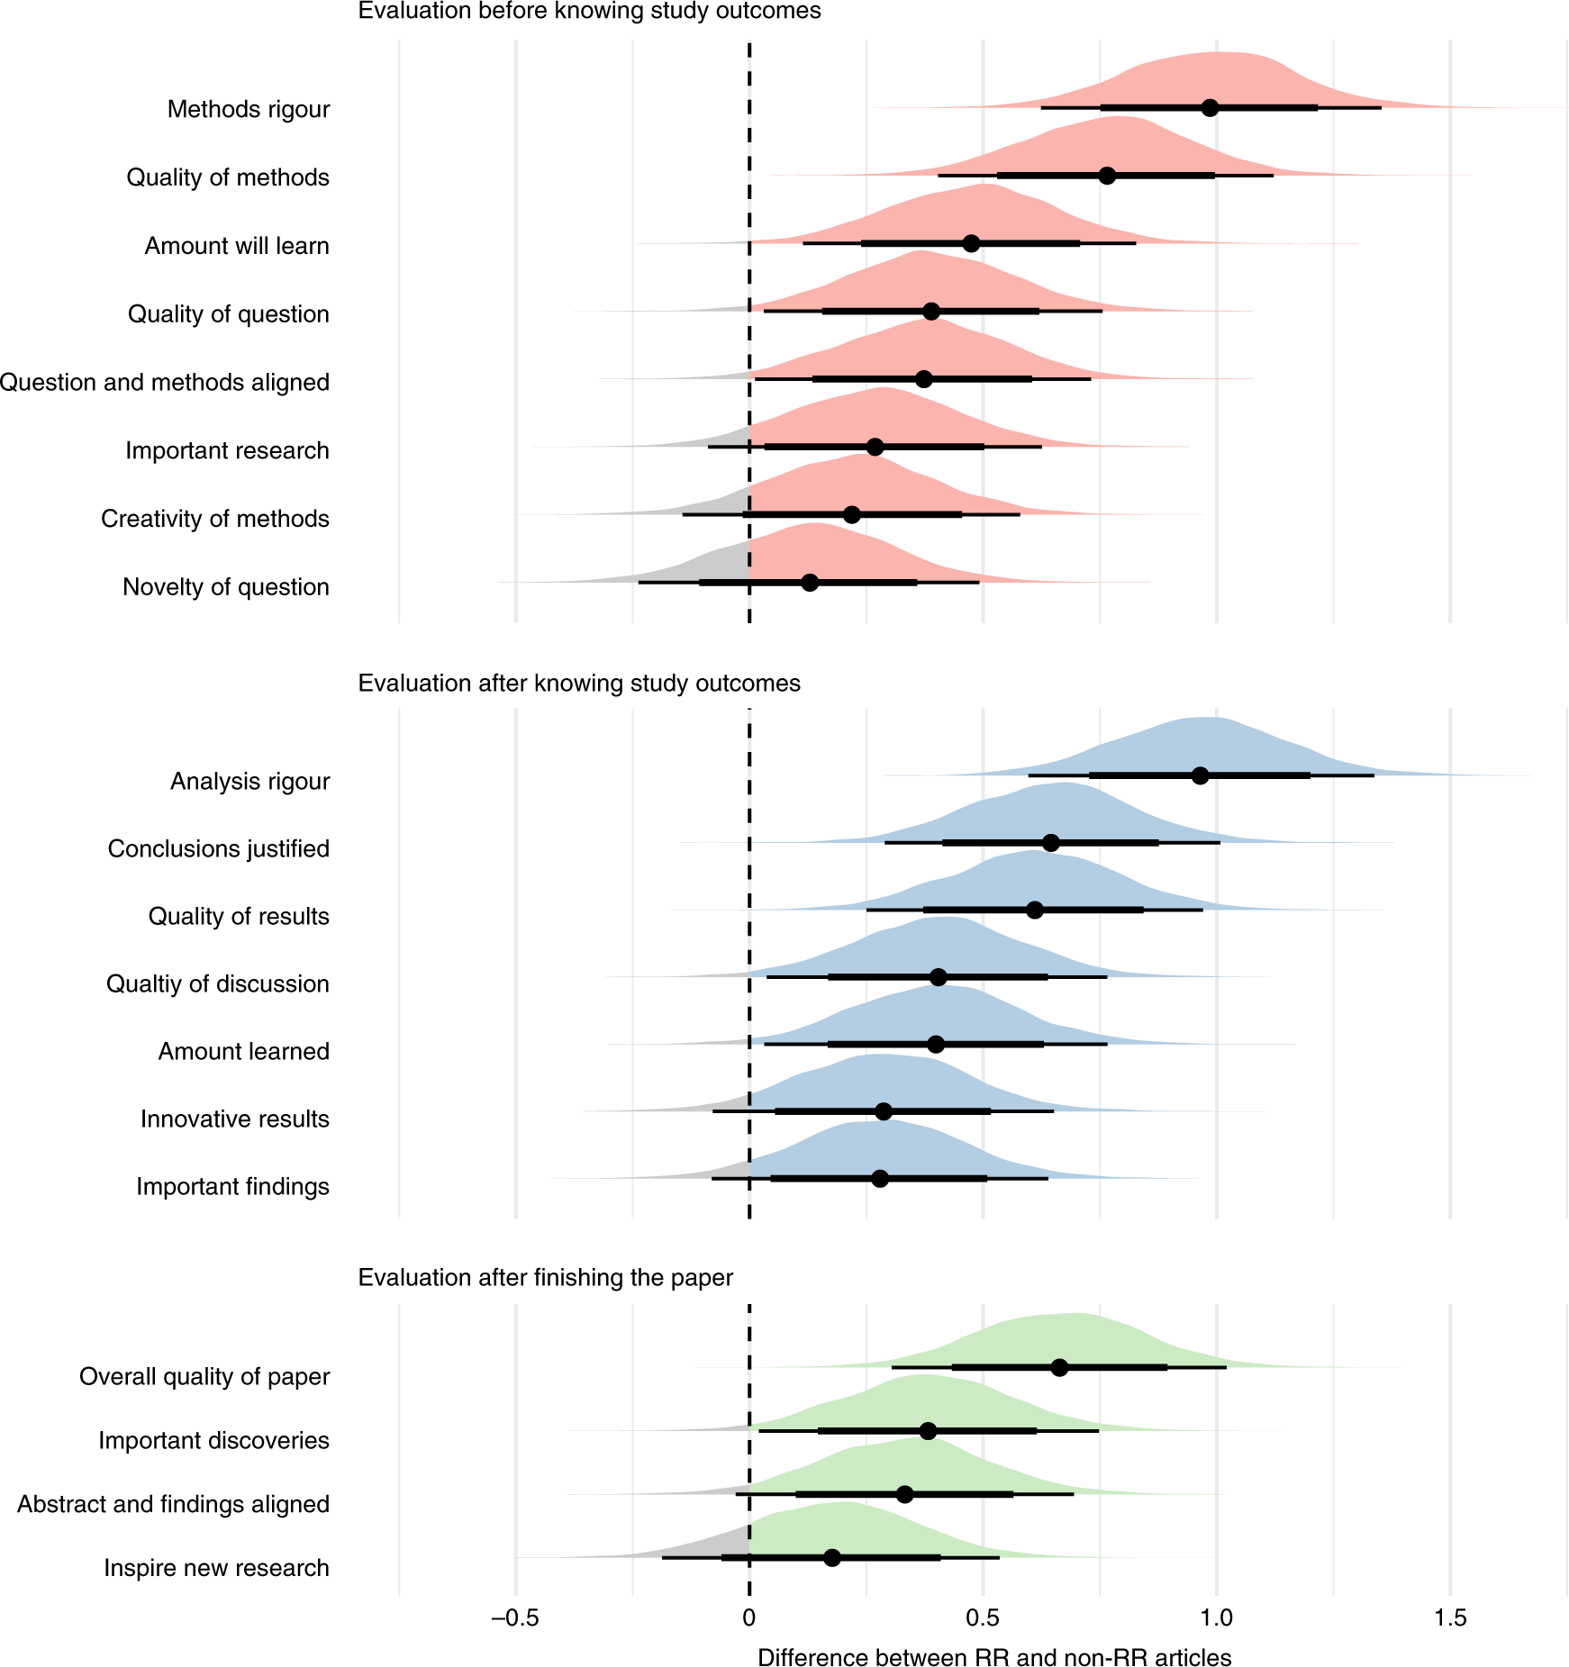
Research quality of RRs vs. the standard publishing model
Image: https://www.nature.com/articles/s41562-021-01142-4

Slide 53
Research quality of RRs vs. the standard publishing model
Image: https://www.nature.com/articles/s41562-021-01142-4

Slide 54
Research quality of RRs vs. the standard publishing model
Image: https://www.nature.com/articles/s41562-021-01142-4

Slide 55
Research quality of RRs vs. the standard publishing model
Image: https://www.nature.com/articles/s41562-021-01142-4

Slide 56
Research quality of RRs vs. the standard publishing model
Image: https://www.nature.com/articles/s41562-021-01142-4

Slide 57
Research quality of RRs vs. the standard publishing model
Image: https://www.nature.com/articles/s41562-021-01142-4

Slide 58
Research quality of RRs vs. the standard publishing model
Image: https://www.nature.com/articles/s41562-021-01142-4

Slide 59
Typical research cycle
Report, store, share
Plan
What are your research questions? How will your study address them?
Method;
Sample size
Data collection, preprocessing, analysis, management post analysis
Project management
Infrastructure
Backup / version control
Code quality & documentation
Data archiving
Report writing
Image: https://www.cos.io/initiatives/registered-reports

Slide 60
Typical research cycle
Report, store, share
Plan
What are your research questions? How will your study address them?
Method;
Sample size
Data collection, preprocessing, analysis, management post analysis
Project management
Infrastructure
Backup / version control
Code quality & documentation
Data archiving
Report writing
Image: https://www.cos.io/initiatives/registered-reports

Slide 61
Project management
A workflow for transparent, reproducible research

Slide 62
Workflow in a broad sense
Transparent and reproducible research requires organising your project and workflow so that both you and your collaborators — now and in the future — can easily navigate files and track progress.
With the right infrastructure in place from the start, sharing materials, data, and code once your research is completed becomes quick and easy!
Folder structure
Robust backup / version control system
Code quality
Documentation

Slide 63
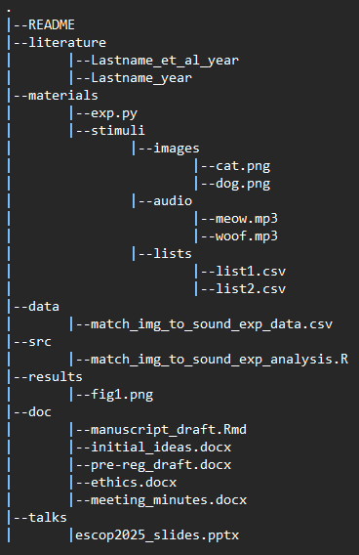
Folder structure
Read-only (RO)
not edited
Human-writeable (HW)
edited by the researcher only
Project-generated (PG)
generated when running the code; these folders can be deleted or emptied and will be completely reconstituted as the project is run

Slide 64
Folder structure
Read-only (RO)
not edited
Human-writeable (HW)
edited by the researcher only
Project-generated (PG)
generated when running the code; these folders can be deleted or emptied and will be completely reconstituted as the project is run
RO

Slide 65
Folder structure
Read-only (RO)
not edited
Human-writeable (HW)
edited by the researcher only
Project-generated (PG)
generated when running the code; these folders can be deleted or emptied and will be completely reconstituted as the project is run
HW

Slide 66
Folder structure
Read-only (RO)
not edited
Human-writeable (HW)
edited by the researcher only
Project-generated (PG)
generated when running the code; these folders can be deleted or emptied and will be completely reconstituted as the project is run
PG

Slide 67
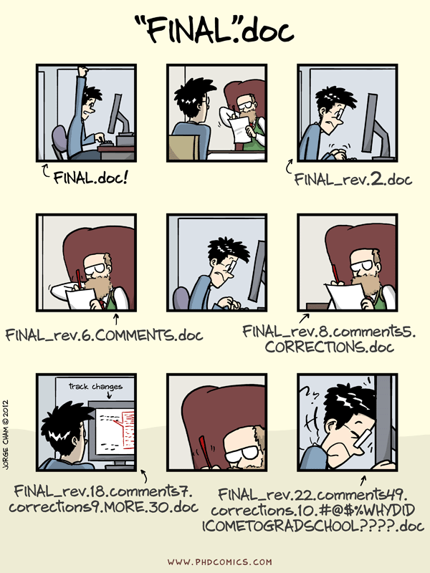
Version control
A tool that keeps track of changes by creating different versions of files
Records your progress and allows you to play back every change of needed
Allows many people to work in parallel
Image: https://phdcomics.com/comics/archive.php?comicid=1531

Slide 68
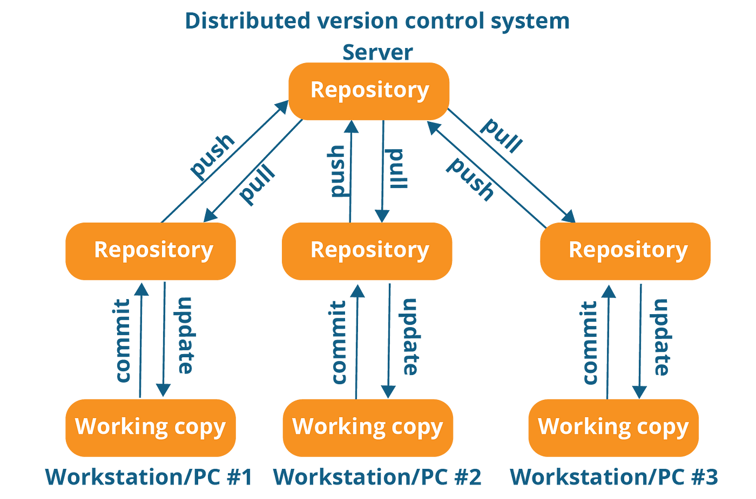
Git & GitHub
Git is a distributed version control system
Make your changes visible to others:
You commit
You push
They pull
They update
GitHub is the most popular platform for working with Git
Image: https://medium.com/@irohulk77/version-control-system-cdc05c0ee261
Notes:
Git is now the standard for version control

Slide 69
Git & GitHub
Git is a distributed version control system
Make your changes visible to others:
You commit
You push
They pull
They update
GitHub is the most popular platform for working with Git
Image: https://medium.com/@irohulk77/version-control-system-cdc05c0ee261

Slide 70
Git & GitHub
Git is a distributed version control system
Make your changes visible to others:
You commit
You push
They pull
They update
GitHub is the most popular platform for working with Git
Image: https://medium.com/@irohulk77/version-control-system-cdc05c0ee261

Slide 71
Git & GitHub
Git is a distributed version control system
Make your changes visible to others:
You commit
You push
They pull
They update
GitHub is the most popular platform for working with Git
Image: https://medium.com/@irohulk77/version-control-system-cdc05c0ee261

Slide 72
Git & GitHub
Git is a distributed version control system
Make your changes visible to others:
You commit
You push
They pull
They update
GitHub is the most popular platform for working with Git
Image: https://medium.com/@irohulk77/version-control-system-cdc05c0ee261

Slide 73
Git & GitHub
Git is a distributed version control system
Make your changes visible to others:
You commit
You push
They pull
They update
GitHub is the most popular platform for working with Git
Image: https://medium.com/@irohulk77/version-control-system-cdc05c0ee261

Slide 74
Git & GitHub
Git is a distributed version control system
Make your changes visible to others:
You commit
You push
They pull
They update
GitHub is the most popular platform for working with Git
Image: https://medium.com/@irohulk77/version-control-system-cdc05c0ee261

Slide 75
Git & GitHub
Git is a distributed version control system
Make your changes visible to others:
You commit
You push
They pull
They update
GitHub is the most popular platform for working with Git
Image: https://medium.com/@irohulk77/version-control-system-cdc05c0ee261

Slide 76

Git & GitHub
Git is a distributed version control system
Make your changes visible to others:
You commit
You push
They pull
They update
GitHub is the most popular platform for working with Git
Image: https://medium.com/@irohulk77/version-control-system-cdc05c0ee261

Slide 77
A basic set up: Using a template
Git
On Windows: should be installed on your computer as part of your Bash install
On MacOS/Linux: should be installed, but if not, follow https://carpentries.github.io/workshop-template/install_instructions/#git
Create a GitHub account at https://github.com/
Use a template to set up a simple project
https://github.com/UtrechtUniversity/simple-r-project if using R
https://github.com/UtrechtUniversity/simple-python-template/ if using Python

Slide 78
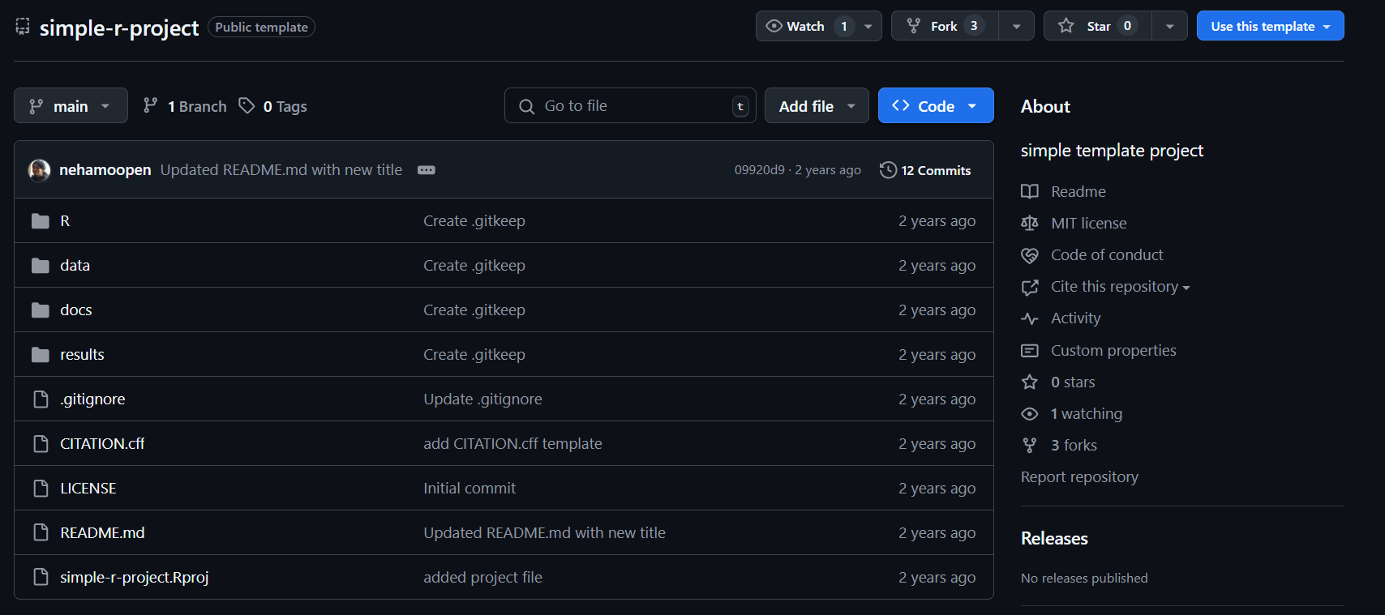
A basic set up: demo #1

Slide 79
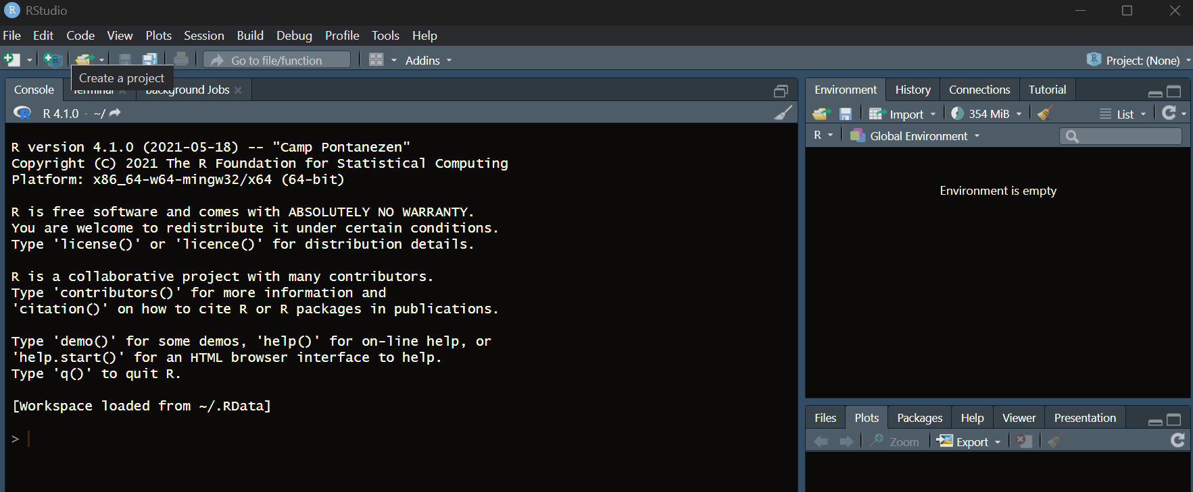
A basic set up: demo #2
Notes:
From here on, move to R

Slide 80
Code quality
The 3 R’s of good code
Readable
Easy for others (and your future self) to understand and follow
Reusable
Can be adapted or repurposed across different contexts or projects
Robust
Can handle errors and continue to function reliably

Slide 81
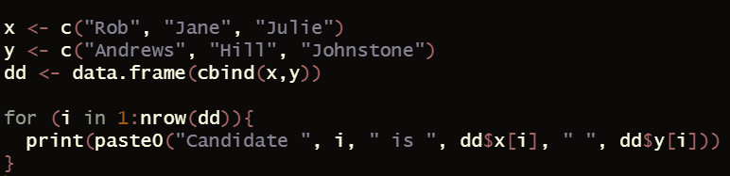
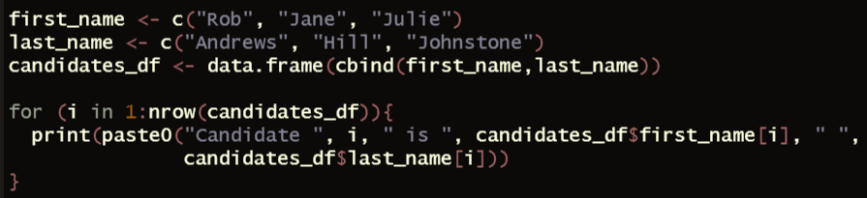
Readability: Variable names

Slide 82
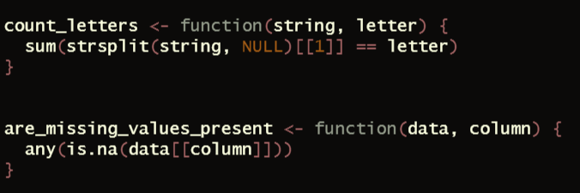
Readability: Function names

Slide 83
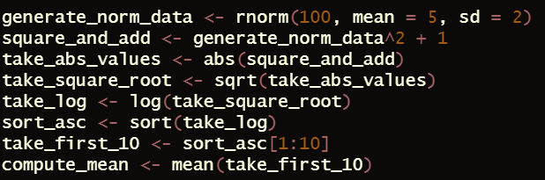

Readability: be careful with one-liners

Slide 84

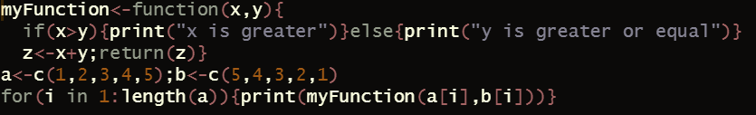
Readability: Style
Be consistent
Follow conventions
https://style.tidyverse.org/
https://peps.python.org/pep-0008/

Slide 85
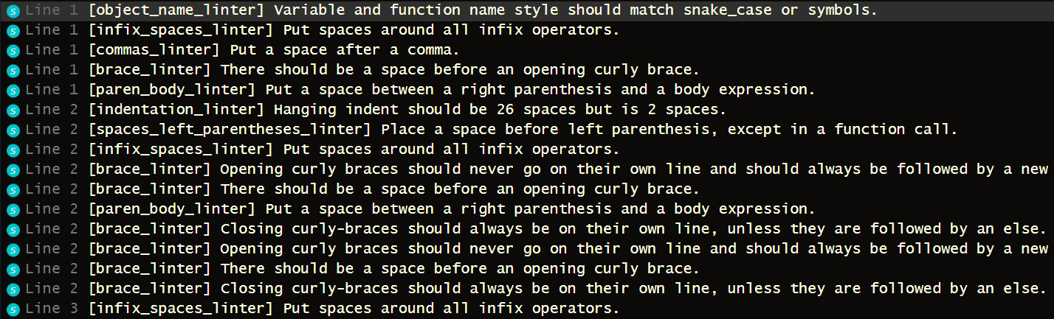
Readability: Style
Use linters/formatters
R: lintr, formatR, styler
Python: ruff, pylint, black

Slide 86
Reusability
Keep data & code separate
Hardcode only those variables that won’t change
Automate repetitive or manual tasks whenever possible & don’t invent the wheel
Avoid repetition
One thing at a time
One function for one process
One script for one purpose
Think in units!

Slide 87
Robustness
Make assumptions and expectations explicit (e.g. in a README file)
Will the code work on a different computer?
Relative, not absolute paths!
Will the code work if using a different version of a given package?
Will the function work if the input vector is a different length?
Produce errors when expectations are not met
Error management
What should happen if assumptions aren’t met?
Log the error to allow the user to troubleshoot
Abort the run

Slide 88
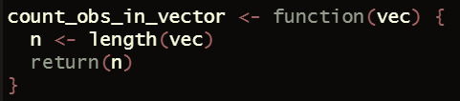
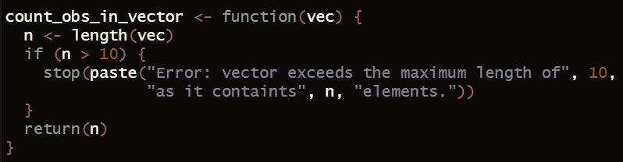
Robustness: Produce errors

Slide 89
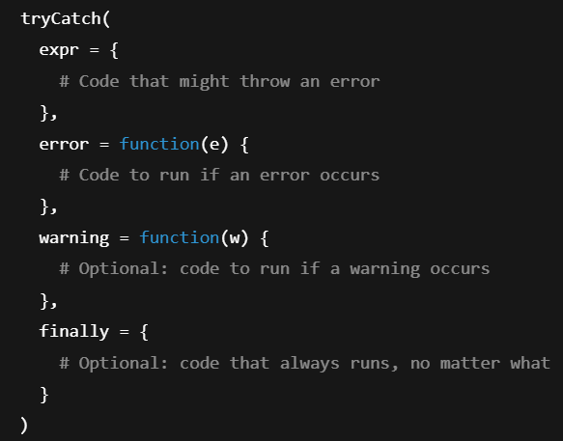
Robustness: error management

Slide 90
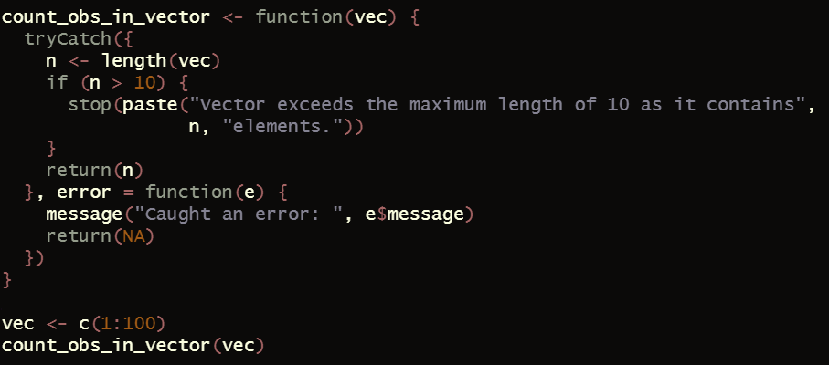
Robustness: error management

Slide 91
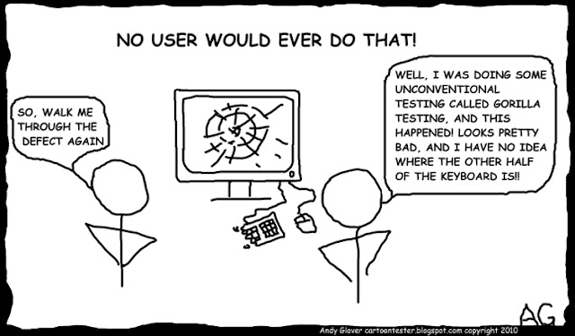
Expect the worst & test your code
Image: https://cartoontester.blogspot.com/2011/01/no-user-would-ever-do-that.html

Slide 92
Code documentation
You want your code to be…
easy for your future self to understand
easy for others to follow
README
General info: what the code does, what is needed for it to run (e.g., installation instructions), what does the user need to keep in mind when using the code (e.g., that certain parts may take a long time to run)
Comments
Repeat in natural language what your code does if it’s not intuitive
If it’s a function, consider adding a docstring (https://cran.r-project.org/web/packages/docstring/vignettes/docstring_intro.html)

Slide 93
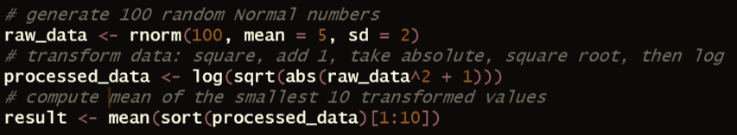
Code documentation: Comments
Source: https://github.com/tidyverse/dplyr

Slide 94
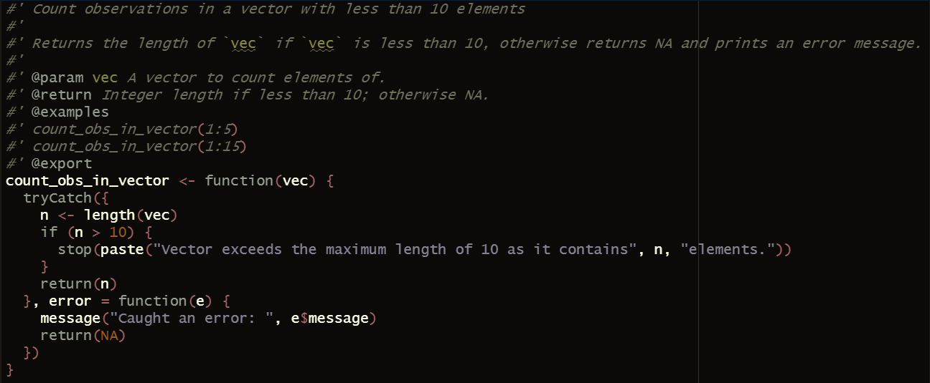
Code documentation: Docstrings

Slide 95
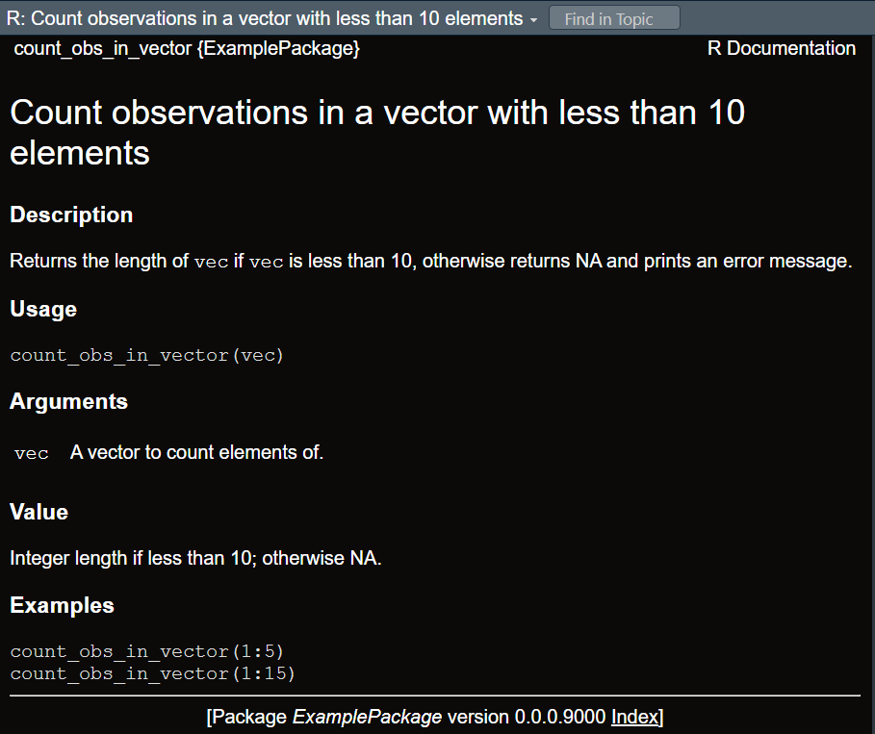
Code documentation: Docstrings

Slide 96
Last but not least...
You now have a project...
With an accessible structure
With readable, reusable, and robust code
Properly documented
Under version control
With a landing site on GitHub
Is that it?
Almost!
You have declared dependencies in the README file
You may want to consider packaging them (e.g., renv in R; uv in Python)
Notes:
Now short demo

Slide 97

Data archiving
Anonymised
Include both raw and pre-processed versions
Add persistent links or identifiers (e.g., DOI)
Follow code principles: Readable, Reusable, Robust
Use self-explanatory, consistent column names (e.g., no spaces or special characters)
Provide documentation (README with column details, units, data preprocessing steps)
Use accessible file extensions (e.g., CSV), avoid proprietary formats, handle encoding, follow conventions (e.g. NA for missing data)
Choose format wisely
Humans prefer wide, computers prefer long
Notes:
Now short demo

Slide 98
Wide vs. long format
SubjectID | WM_score | Sleep_score | Depression_score
1 | 88 | 14 | 10
2 | 91 | 16 | 15
3 | 30 | 20 | 87
4 | 56 | 17 | 60
Notes:
Now short demo

Slide 99
Wide vs. long format
SubjectID | WM_score | Sleep_score | Depression_score
1 | 88 | 14 | 10
2 | 91 | 16 | 15
3 | 30 | 20 | 87
4 | 56 | 17 | 60
Notes:
Now short demo

Slide 100
Wide vs. long format
SubjectID | WM_score | Sleep_score | Depression_score
1 | 88 | 14 | 10
2 | 91 | 16 | 15
3 | 30 | 20 | 87
4 | 56 | 17 | 60
Notes:
Now short demo

Slide 101
Wide vs. long format
SubjectID | WM_score | Sleep_score | Depression_score
1 | 88 | 14 | 10
2 | 91 | 16 | 15
3 | 30 | 20 | 87
4 | 56 | 17 | 60
Notes:
Now short demo

Slide 102
Wide vs. long format
SubjectID | WM_score | Sleep_score | Depression_score
1 | 88 | 14 | 10
2 | 91 | 16 | 15
3 | 30 | 20 | 87
4 | 56 | 17 | 60
Notes:
Now short demo

Slide 103
Wide vs. long format
SubjectID | WM_score | Sleep_score | Depression_score
1 | 88 | 14 | 10
2 | 91 | 16 | 15
3 | 30 | 20 | 87
4 | 56 | 17 | 60
Notes:
Now short demo

Slide 104
Wide vs. long format
SubjectID | WM_score | Sleep_score | Depression_score
1 | 88 | 14 | 10
2 | 91 | 16 | 15
3 | 30 | 20 | 87
4 | 56 | 17 | 60
Repeated measures in separate columns / stacked in one column
More than one observation per row
More columns, fewer rows / Fewer columns, more rows
Easy to read manually / Easy to analyse
Notes:
Now short demo

Slide 105
Wide vs. long format
SubjectID | Test | Score
1 | WM | 88
1 | Sleep | 14
1 | Depression | 10
2 | WM | 91
2 | Sleep | 16
2 | Depression | 15
3 | WM | 30
3 | Sleep | 20
3 | Depression | 87
4 | WM | 56
4 | Sleep | 17
4 | Depression | 60
SubjectID | WM_score | Sleep_score | Depression_score
1 | 88 | 14 | 10
2 | 91 | 16 | 15
3 | 30 | 20 | 87
4 | 56 | 17 | 60
Notes:
Now short demo

Slide 106
Wide vs. long format
SubjectID | Test | Score
1 | WM | 88
1 | Sleep | 14
1 | Depression | 10
2 | WM | 91
2 | Sleep | 16
2 | Depression | 15
3 | WM | 30
3 | Sleep | 20
3 | Depression | 87
4 | WM | 56
4 | Sleep | 17
4 | Depression | 60
SubjectID | WM_score | Sleep_score | Depression_score
1 | 88 | 14 | 10
2 | 91 | 16 | 15
3 | 30 | 20 | 87
4 | 56 | 17 | 60
Notes:
Now short demo

Slide 107
Wide vs. long format
SubjectID | Test | Score
1 | WM | 88
1 | Sleep | 14
1 | Depression | 10
2 | WM | 91
2 | Sleep | 16
2 | Depression | 15
3 | WM | 30
3 | Sleep | 20
3 | Depression | 87
4 | WM | 56
4 | Sleep | 17
4 | Depression | 60
SubjectID | WM_score | Sleep_score | Depression_score
1 | 88 | 14 | 10
2 | 91 | 16 | 15
3 | 30 | 20 | 87
4 | 56 | 17 | 60
Notes:
Now short demo

Slide 108
Wide vs. long format
SubjectID | Test | Score
1 | WM | 88
1 | Sleep | 14
1 | Depression | 10
2 | WM | 91
2 | Sleep | 16
2 | Depression | 15
3 | WM | 30
3 | Sleep | 20
3 | Depression | 87
4 | WM | 56
4 | Sleep | 17
4 | Depression | 60
SubjectID | WM_score | Sleep_score | Depression_score
1 | 88 | 14 | 10
2 | 91 | 16 | 15
3 | 30 | 20 | 87
4 | 56 | 17 | 60
Notes:
Now short demo

Slide 109
Wide vs. long format
SubjectID | Test | Score
1 | WM | 88
1 | Sleep | 14
1 | Depression | 10
2 | WM | 91
2 | Sleep | 16
2 | Depression | 15
3 | WM | 30
3 | Sleep | 20
3 | Depression | 87
4 | WM | 56
4 | Sleep | 17
4 | Depression | 60
SubjectID | WM_score | Sleep_score | Depression_score
1 | 88 | 14 | 10
2 | 91 | 16 | 15
3 | 30 | 20 | 87
4 | 56 | 17 | 60
Notes:
Now short demo

Slide 110
Wide vs. long format
SubjectID | Test | Score
1 | WM | 88
1 | Sleep | 14
1 | Depression | 10
2 | WM | 91
2 | Sleep | 16
2 | Depression | 15
3 | WM | 30
3 | Sleep | 20
3 | Depression | 87
4 | WM | 56
4 | Sleep | 17
4 | Depression | 60
SubjectID | WM_score | Sleep_score | Depression_score
1 | 88 | 14 | 10
2 | 91 | 16 | 15
3 | 30 | 20 | 87
4 | 56 | 17 | 60
Repeated measures in separate columns / stacked in one column
More than one observation per row
More columns, fewer rows / Fewer columns, more rows
Easy to read manually / Easy to analyse
Notes:
Now short demo

Slide 111
Wide vs. long format
SubjectID | Test | Score
1 | WM | 88
1 | Sleep | 14
1 | Depression | 10
2 | WM | 91
2 | Sleep | 16
2 | Depression | 15
3 | WM | 30
3 | Sleep | 20
3 | Depression | 87
4 | WM | 56
4 | Sleep | 17
4 | Depression | 60
SubjectID | WM_score | Sleep_score | Depression_score
1 | 88 | 14 | 10
2 | 91 | 16 | 15
3 | 30 | 20 | 87
4 | 56 | 17 | 60
Repeated measures in separate columns / stacked in one column
More than one observation per row
More columns, fewer rows / Fewer columns, more rows
Easy to read manually / Easy to analyse
Notes:
Now short demo

Slide 112
Wide vs. long format
SubjectID | Test | Score
1 | WM | 88
1 | Sleep | 14
1 | Depression | 10
2 | WM | 91
2 | Sleep | 16
2 | Depression | 15
3 | WM | 30
3 | Sleep | 20
3 | Depression | 87
4 | WM | 56
4 | Sleep | 17
4 | Depression | 60
SubjectID | WM_score | Sleep_score | Depression_score
1 | 88 | 14 | 10
2 | 91 | 16 | 15
3 | 30 | 20 | 87
4 | 56 | 17 | 60
Repeated measures in separate columns / stacked in one column
More than one observation per row
More columns, fewer rows / Fewer columns, more rows
Easy to read manually / Easy to analyse
Notes:
Now short demo

Slide 113
Wide vs. long format
SubjectID | Test | Score
1 | WM | 88
1 | Sleep | 14
1 | Depression | 10
2 | WM | 91
2 | Sleep | 16
2 | Depression | 15
3 | WM | 30
3 | Sleep | 20
3 | Depression | 87
4 | WM | 56
4 | Sleep | 17
4 | Depression | 60
SubjectID | WM_score | Sleep_score | Depression_score
1 | 88 | 14 | 10
2 | 91 | 16 | 15
3 | 30 | 20 | 87
4 | 56 | 17 | 60
Repeated measures in separate columns / stacked in one column
More than one / Only one observation per row
More columns, fewer rows / Fewer columns, more rows
Easy to read manually / Easy to analyse
Notes:
Now short demo

Slide 114
Wide vs. long format
SubjectID | Test | Score
1 | WM | 88
1 | Sleep | 14
1 | Depression | 10
2 | WM | 91
2 | Sleep | 16
2 | Depression | 15
3 | WM | 30
3 | Sleep | 20
3 | Depression | 87
4 | WM | 56
4 | Sleep | 17
4 | Depression | 60
SubjectID | WM_score | Sleep_score | Depression_score
1 | 88 | 14 | 10
2 | 91 | 16 | 15
3 | 30 | 20 | 87
4 | 56 | 17 | 60
Repeated measures in separate columns / stacked in one column
More than one / Only one observation per row
More columns, fewer rows / Fewer columns, more rows
Easy to read manually / Easy to analyse
Notes:
Now short demo

Slide 115
Wide vs. long format
SubjectID | Test | Score
1 | WM | 88
1 | Sleep | 14
1 | Depression | 10
2 | WM | 91
2 | Sleep | 16
2 | Depression | 15
3 | WM | 30
3 | Sleep | 20
3 | Depression | 87
4 | WM | 56
4 | Sleep | 17
4 | Depression | 60
SubjectID | WM_score | Sleep_score | Depression_score
1 | 88 | 14 | 10
2 | 91 | 16 | 15
3 | 30 | 20 | 87
4 | 56 | 17 | 60
Repeated measures in separate columns / stacked in one column
More than one / Only one observation per row
More columns, fewer rows / Fewer columns, more rows
Easy to read manually / Easy to analyse
Notes:
Now short demo

Slide 116
Wide vs. long format
SubjectID | Test | Score
1 | WM | 88
1 | Sleep | 14
1 | Depression | 10
2 | WM | 91
2 | Sleep | 16
2 | Depression | 15
3 | WM | 30
3 | Sleep | 20
3 | Depression | 87
4 | WM | 56
4 | Sleep | 17
4 | Depression | 60
SubjectID | WM_score | Sleep_score | Depression_score
1 | 88 | 14 | 10
2 | 91 | 16 | 15
3 | 30 | 20 | 87
4 | 56 | 17 | 60
Repeated measures in separate columns / stacked in one column
More than one / Only one observation per row
More columns, fewer rows / Fewer columns, more rows
Easy to read manually
Notes:
Now short demo

Slide 117
Wide vs. long format
SubjectID | Test | Score
1 | WM | 88
1 | Sleep | 14
1 | Depression | 10
2 | WM | 91
2 | Sleep | 16
2 | Depression | 15
3 | WM | 30
3 | Sleep | 20
3 | Depression | 87
4 | WM | 56
4 | Sleep | 17
4 | Depression | 60
SubjectID | WM_score | Sleep_score | Depression_score
1 | 88 | 14 | 10
2 | 91 | 16 | 15
3 | 30 | 20 | 87
4 | 56 | 17 | 60
Repeated measures in separate columns / stacked in one column
More than one / Only one observation per row
More columns, fewer rows / Fewer columns, more rows
Easy to read manually / Easy to analyse
Notes:
Now short demo

Slide 118
Writing a report
Microsoft Word & PowerPoint
Difficult to avoid as still required by publishers and supervisors
Google Doc
Excellent for real-time collaboration & track changes
Intuitive to use and share
LaTeX
Ideal for academic (articles, theses) & technical writing
Professional typesetting, esp. for complex formatting
Style & content are separate
Version-control friendly
Easy collaboration through Overleaf
However, steep learning curve & not ideal for quick, informal documents

Slide 119
Writing a report
R Markdown
Uses the same TeX engine as LaTeX when rendering to PDF
Combines text, code, and output in a single, integrated document
Automatically updates results if data or analysis changes
Supports multiple output formats, including PDF, Word, and HTML
Works well with Git for version control and collaboration

Slide 120
Summing up
Report, store, share
Plan
What are your research questions? How will your study address them?
Method;
Sample size
Data collection, preprocessing, analysis, management post analysis
Project management
Infrastructure
Backup / version control
Code quality & documentation
Data archiving
Report writing

Slide 121
Summing up
Report, store, share
Plan
What are your research questions? How will your study address them?
Method;
Sample size
Data collection, preprocessing, analysis, management post analysis
Project management
Infrastructure
Backup / version control
Code quality & documentation
Data archiving
Report writing

Slide 122
Summing up
Report, store, share
Plan
What are your research questions? How will your study address them?
Method;
Sample size
Data collection, preprocessing, analysis, management post analysis
Project management
Infrastructure
Backup / version control
Code quality & documentation
Data archiving
Report writing

Slide 123
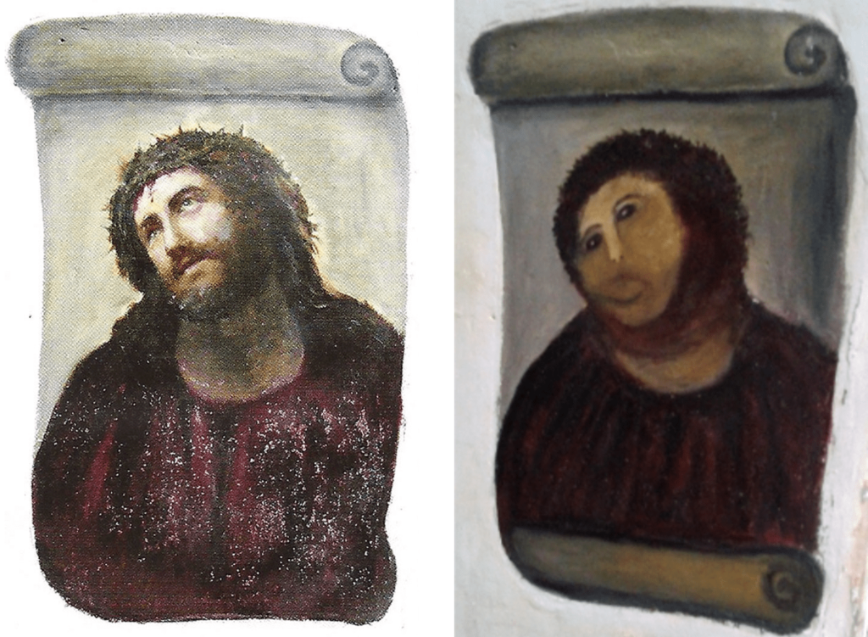

Slide 125
Materials
https://github.com/mariakna/SEDarc2026_Making_Your_Research_Transparent_and_Reproducible.git

Slide 126
Thank you!
https://mariakna.github.io/

