Slide 1
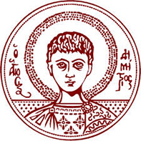
Synchronization of Fireflies
INTER-FACULTY MASTER PROGRAM «COMPLEX SYSTEMS AND NETWORKS»
Supervisor: Antoniou Ioannis
Georgoulis Filippos
Kofterou Maria
Foudouli Anastasia

Slide 2
Contents
Buck’s Experiments on Fireflies
Fireflies as a Coupled-Oscillator Model
Kuramoto Model
Perskin Model
Mirollo and Strogatz Model
Ermentrout Model
Small-world Synchronization
Simulations in Python

Slide 3
Fireflies’ Synchronization
More than 2000 species worldwide
Variety of frequencies, cycle ranges and flashing behavior
Different kinds of synchrony among the species
Synchronization: The tendency, in some species, to synchronize their flashings when formed in groups
Only the males tend to synchronize
Biological interpretation :
1)Mating goals; males flash in unison to draw females’ attention.
2) Flashing is a code of communication, similar to Mors signal.

Slide 4
Fireflies’ Synchronization
No apparent leader
No global communications; each firefly has a limited receptor radius for flashing signals (1 mtr max)
They keep up to 0.3 mtr distance
Nearly 360° vision field
Thousands of insects can be involved
Random movement of each insect within the group speeds up global synchronization

Slide 5
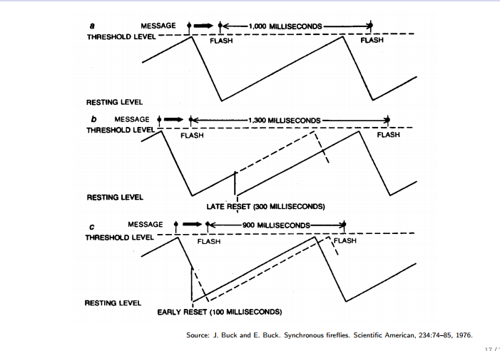
Buck’s Experiments (1966-1990)
First conception of fireflies’ flashing synchronization as a coupled-oscillator synchronization model
Firefly acts as intrinsic oscillator ⇒
Flashes at characteristic frequency ⇒
Coupling via perception of neighbors flashing⇒ Global Synchronization

Slide 6
Buck’s Experiments (1966-1990)
Laboratory Experiments on isolated insect P.Cribellata:
-free range flash cycle of 965 ms ± 90 ms
-40 ms random flashes injected at random intervals
-21 pulses at a time.
Results:
-Signal ≡ firefly’s spontaneous flash⇒ No effect
-Signal ≡ (100ms, 800ms) after the flash⇒ Delay; Next flash after aprx. 1sec
- Signal ≡ 800ms+ after the flash and before next flash ⇒ Acceleration ; Next flash up to 200ms early!
*In all cases the flashes were ,after signal’s effect, about 1 second apart ⇒
frequencies remained stable, phases changed.

Slide 7
Types of Synchronization
3 Levels of Synchronization:
-Frequency Locking; constant freq difference
-Phase Locking ;constant phase difference
-Synchronization; fire in unison
3 Types of Synchronization:
-Phase Advance Synchrony
-Phase Delay Synchrony
-Perfect Synchrony; zero phase lag

Slide 8
Coupled-Oscillators’
The key concept behind the phenomenon of spontaneous adaption in the same frequency of a huge number of oscillators that form a system
Unaffected by the different individual natural frequencies
Examples in nature: bird flying patterns, menstrual periods, heart’s pacemaker cells, crickets that chirp in unison, and microwave oscillators, finger tapping , fireflies flashing
Wiener (1958) : He tried to derive a mathematical formula from the phenomenon using Fourier integrals to approach it.
Winfree (1967): Made simplifications ;weak coupling and nearly identical oscillators
Stimulations in a firefly machine;
- 71 electrically-coupled neon oscillators
- narrow distribution of natural frequencies
*When oscillators were coupled equally to one another through a common resistor, synchronization never occurred.

Slide 9
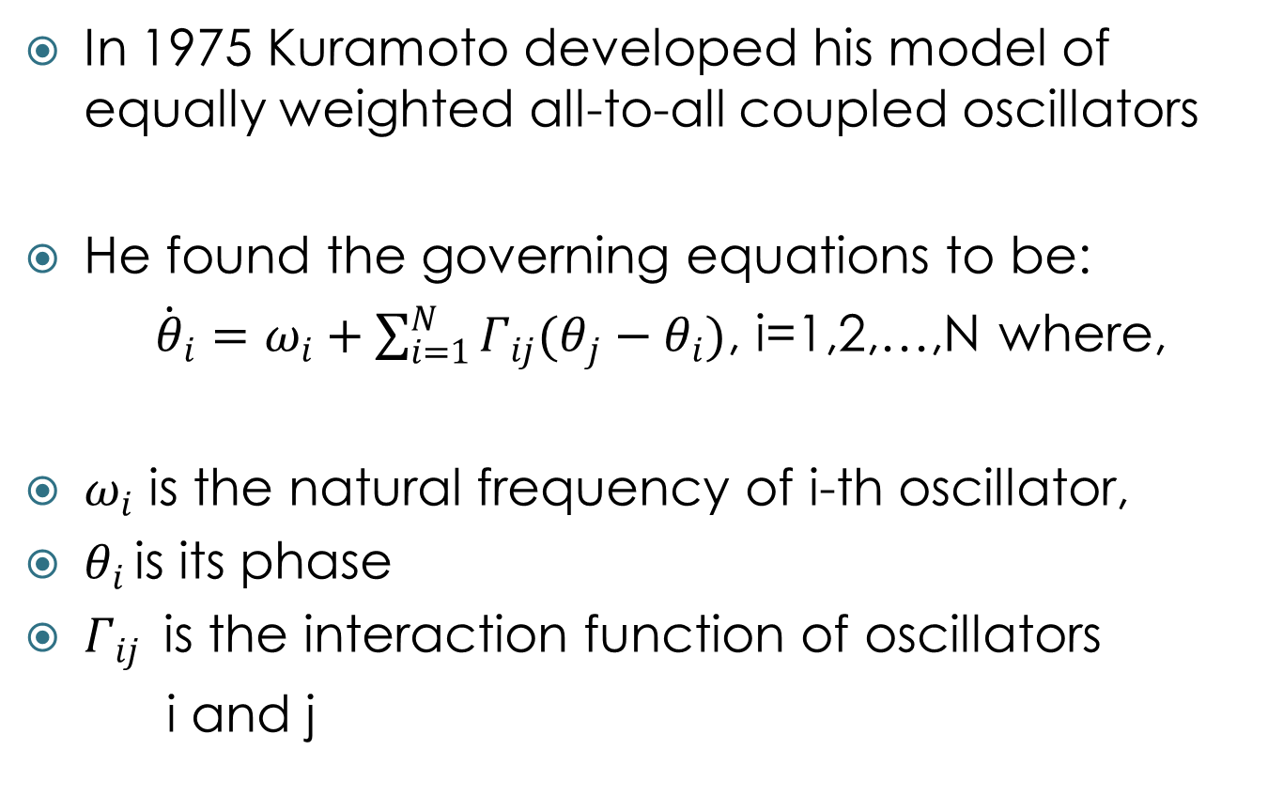
Kuramoto model
In 1975 Kuramoto developed his model of equally weighted all-to-all coupled oscillators
He found the governing equations to be:
${\dot{θ}}_{i}=ω_{i}+\sum_{i=1}^{N}{Γ_{ij}(θ_{j}−θ_{i})}$, i=1,2,…,N where,
$ω_{i}$ is the natural frequency of i-th oscillator,
$θ_{i }$is its phase
$Γ_{ij }$ is the interaction function of oscillators
i and j

Slide 10
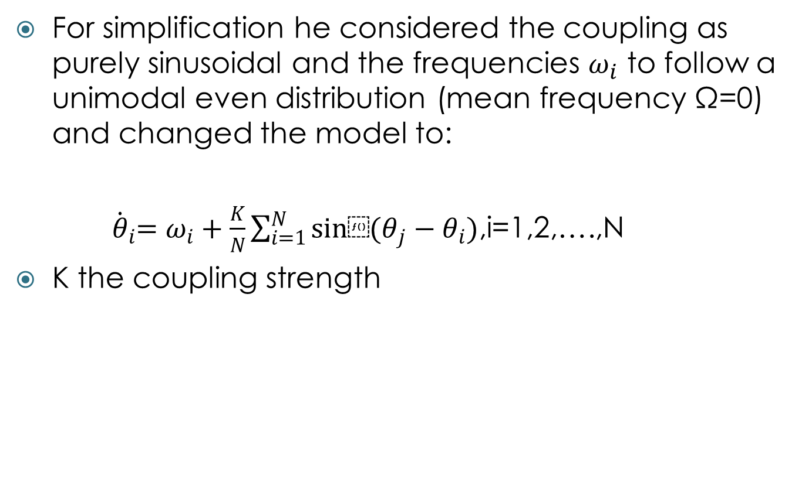
Kuramoto model
For simplification he considered the coupling as purely sinusoidal and the frequencies $ω_{i}$ to follow a unimodal even distribution (mean frequency Ω=0) and changed the model to:
${ \dot{θ}}_{i}=ω_{i}+\frac{K}{N}\sum_{i=1}^{N}{sin⁡(θ_{j}−θ_{i})}$,i=1,2,….,N
K the coupling strength

Slide 11
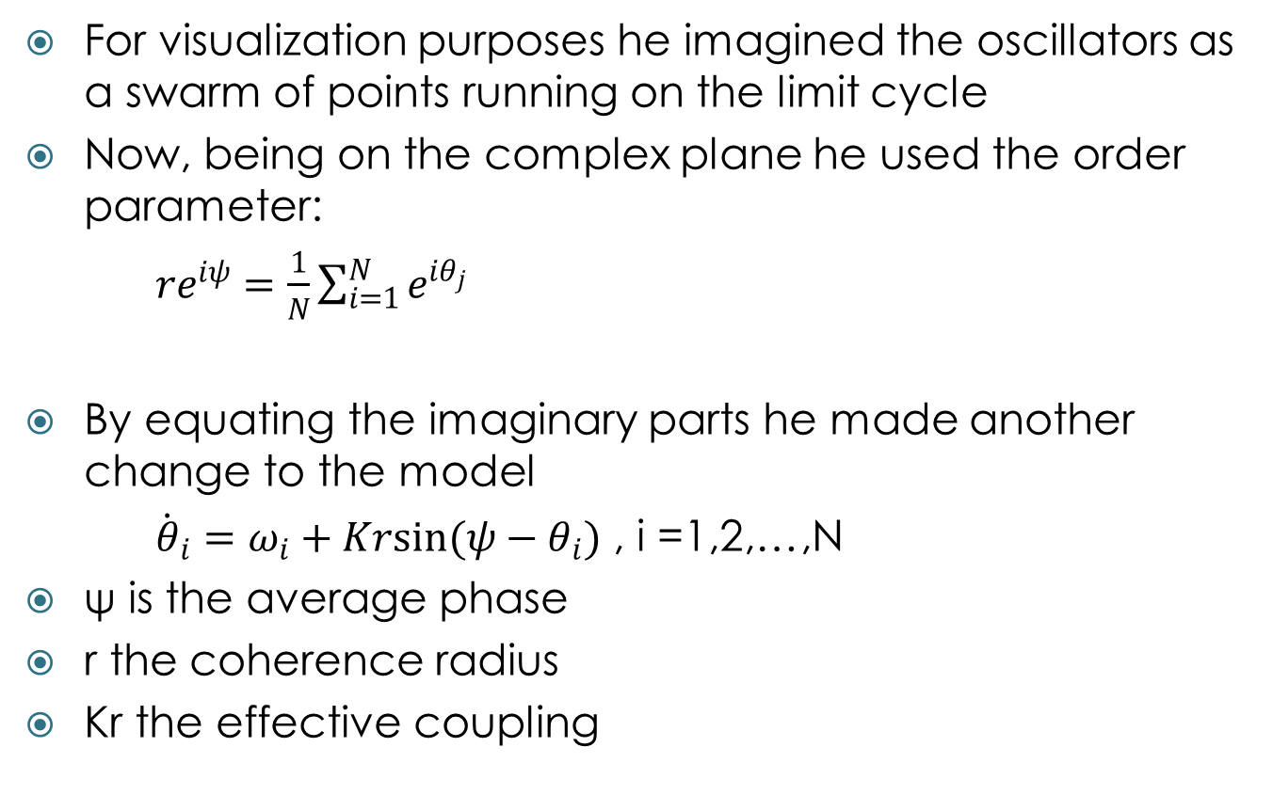
Kuramoto model
For visualization purposes he imagined the oscillators as a swarm of points running on the limit cycle
Now, being on the complex plane he used the order parameter:
${re}^{iψ}=\frac{1}{N}\sum_{i=1}^{N}{e^{iθ_{j}}}$
By equating the imaginary parts he made another change to the model
${\dot{θ}}_{i}=ω_{i}+Krsin(ψ−θ_{i})$ , i =1,2,…,N
ψ is the average phase
r the coherence radius
Kr the effective coupling

Slide 12
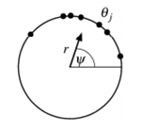
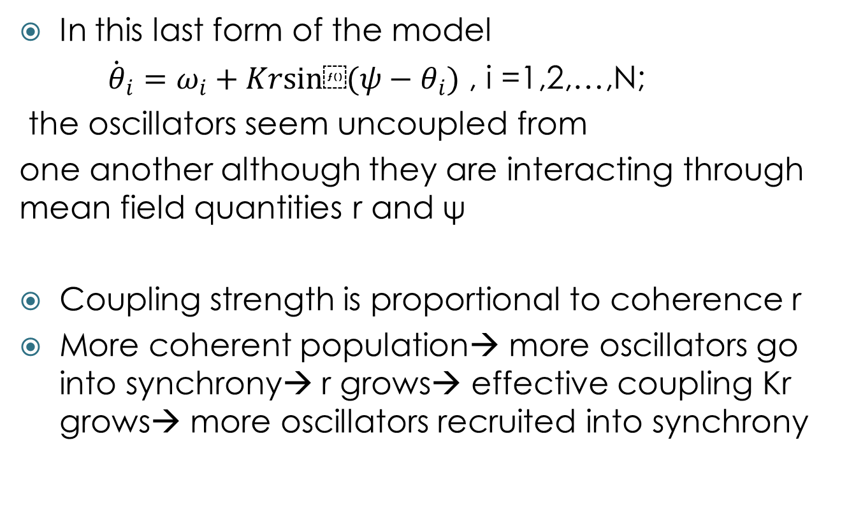
Kuramoto model
In this last form of the model
${\dot{θ}}_{i}=ω_{i}+Krsin⁡(ψ−θ_{i})$ , i =1,2,…,N;
the oscillators seem uncoupled from
one another although they are interacting through mean field quantities r and ψ
Coupling strength is proportional to coherence r
More coherent population→ more oscillators go into synchrony→ r grows→ effective coupling Kr grows→ more oscillators recruited into synchrony

Slide 13
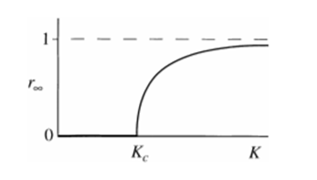
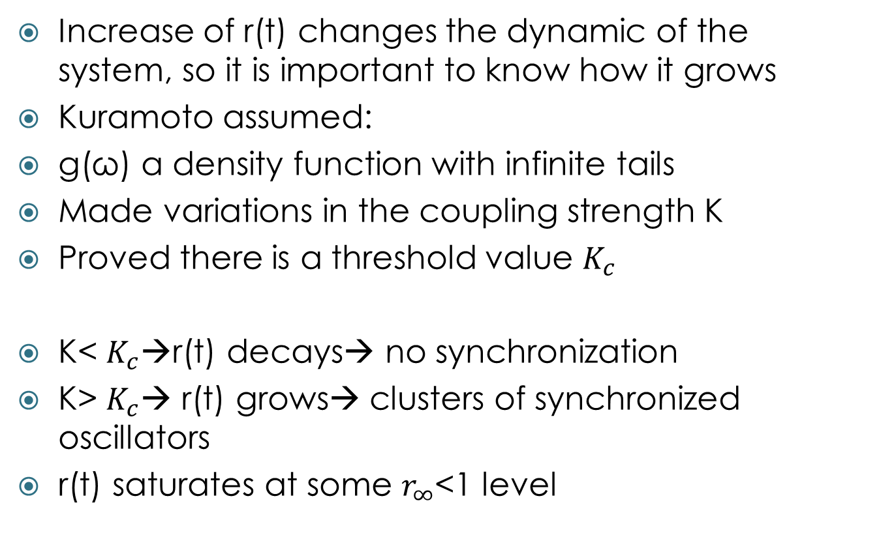
Kuramoto model
Increase of r(t) changes the dynamic of the system, so it is important to know how it grows
Kuramoto assumed:
g(ω) a density function with infinite tails
Made variations in the coupling strength K
Proved there is a threshold value $K_{c}$
K< $K_{c}$→r(t) decays→ no synchronization
K> $K_{c}$→ r(t) grows→ clusters of synchronized oscillators
r(t) saturates at some $r_{∞}$<1 level

Slide 14
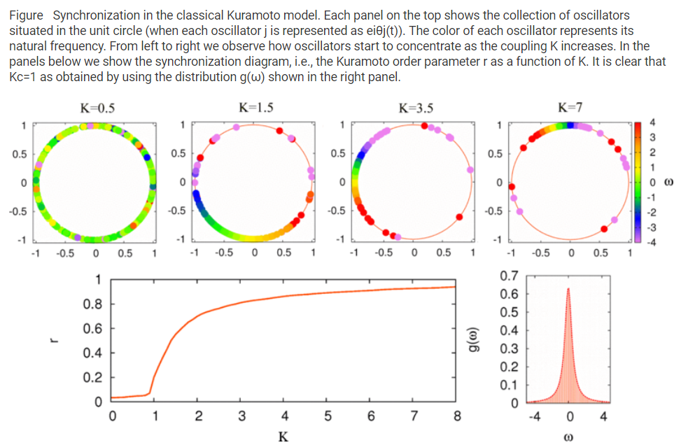
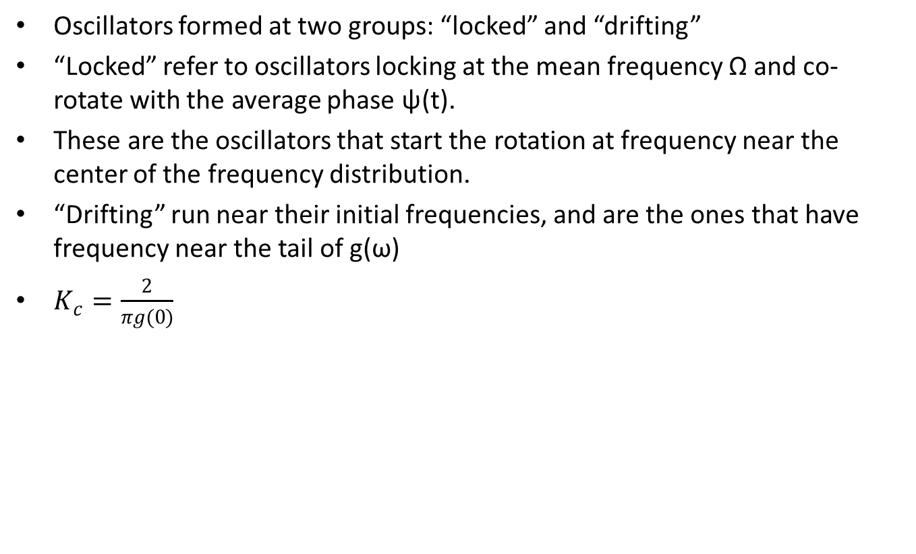
Kuramoto model

Slide 15

Kuramoto Model

Slide 16
Peskin Model (1975)
N “integrate-and-fire” oscillators
A voltage-like state variable x was attributed to each one of the N oscillators:
S:constant, γ: dissipation factor
When it fires x=1 and immediately jumps back to 0
Interaction model: simple pulse coupling; when an oscillator fires, all the other oscillators in the system are pulled up by ε or pulled right to firing state, whichever is closer

Slide 17
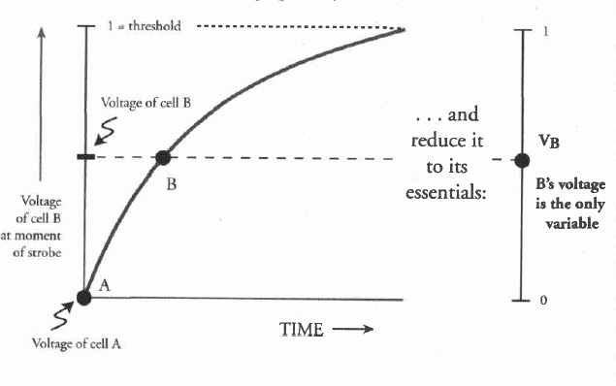
Mirollo and Strogatz Proof
1) Consider and list all possible conditions of the system
2) Plot Phase Respond Curve (PRC) of the system; the curve of the voltaglike state xi for all oscillators and their phases
3) Consider bad and good points.
4) Focus on Terrible points. Prove topologically that they occupy zero area and the proof is done.

Slide 18
Mirollo and Strogatz Model
State function of the i-th oscillator:
where:
phase variable with the properties:
i) , T : the cycle period
ii) just fired so f(0)=0
iii) time of firing so f(1)=1
is smooth, monotonic increasing (f’>0) and concave down (f’’<0)
Since f is monotonic, g is defined as g(x)=φ, so that and g is also smooth, monotonic increasing (g’>0) and concave up (g’’>0).

Slide 19
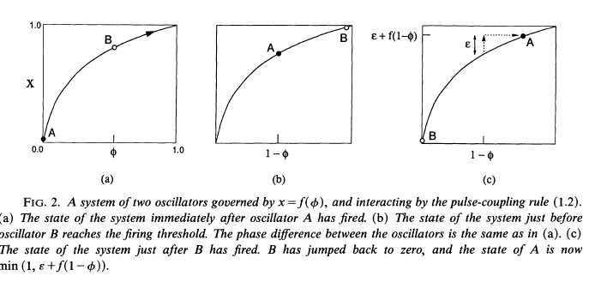
Mirollo and Strogatz Model
The system is studied after one oscillator had just fired and x returned to zero (so did φ).
The state of the system S is characterized by all φ, for all n<N independed oscillator or group:
Conventions:
1)All-to-all connection
2)Identical oscillators ≡ identical dynamics and frequencies

Slide 20
Mirollo and Strogatz Model
Firing Map h(φ): transforms to a phase vector after the firing
Firing happens after
i-th oscillator’s new phase:
Phases right before the firing:
Phases right after the firing:
Therefore,
*S:the domain of h

Slide 21
Mirollo and Strogatz Model
Absorption : The fire of one oscillator causes the other one to fire immediately, as it is closer to reach threshold so it jumps straight to 1, thereby from so on the two oscillators share the shame φ and act as one.
That is: ,ε is the strenght of the pulse
1) The domain of h is not S but
2) The strength of the group’s pulse =the sum of its oscillator’s strengths
A group is considered a single oscillator with enhanced strength
Synchronization occurs when S is a single unit set.

Slide 22
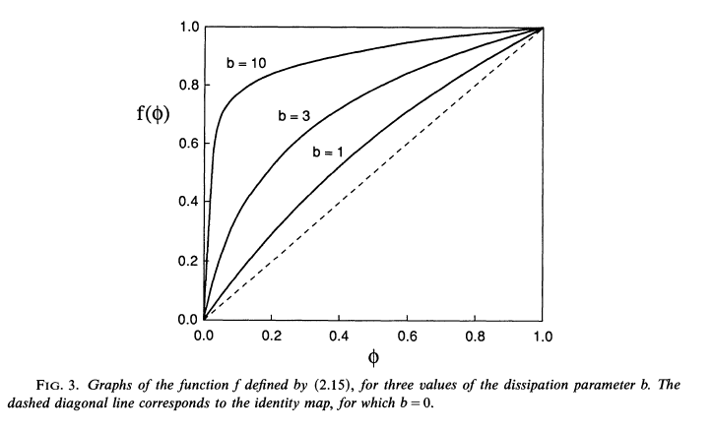
Example: A Simplified Model-Applied in Ad Hoc Networks
When coupled, an oscillator is a receptor of neighbor pulses.
The reception of such a pulse will instantly increase its phase by an amount based on its current value:
That causes it to fire earlier.
Simplified model could be:
Where, and
b:the dissipation factor
ε: the coupling strength
Time of synchronization: Inversely proportional to b*ε

Slide 23
Mirollo and Strogatz Model
Drawbacks:
The assumption that all oscillators have the same frequency doesn’t stand in reality
The convention of a global connection in the system, that is an all-to-all pulsing reception model
The faster one setting the pace and nonnegative interactions (delays) occurring in the system. Some species submit to it and others are not
No chain reactions are allowed
The pulse’s strength of a group is calculated as the sum of its oscillators’ pulses

Slide 24
Ermentrout Model (1991)
Model based on perfect synchronization in P.malaccae
This model is based on the insect’s PRC
The intrinsic frequency of the oscillator is allowed to slowly adapt
This models adapts frequencies, not phases
Zero lag phase entrainment (perfect synchronization) will be achieved
Idea: the phase shift between stimulus and oscillator becomes fixed and its size remains small as the limits of entrainment are reached
Firefly tree

Slide 25
Ermentrout Model (1991)
Each insect has an unique intrinsic frequency
There is a range of frequencies that enable synchrony same for all of them
The form of the j-th periodically forced oscillator, a firefly on the tree:
a time-depended variable frequency and

Slide 26
Ermentrout Model (1991)
Where,
:the intrinsic frequency of j-th oscillator
:the phase of an oscillator after a stimulus
ε :the rate at which the oscillators returns to its previous frequency
:the strength of the pulse from k-th oscillator observed by j-th oscillator
G measures the effect of the pulse (stimulus) on the intrinsic frequency ( representing the PRC)
** It is proven that G can be no independent of ω in order for the model to be adaptional

Slide 27
Ermentrout Model (1991)
All the functions are periodic with period 1
Basic idea of frequency adaption:
i) when no stimulus is applied
ii) if the pulse comes late in j-th oscillator’s cycle
iii) if the pulse comes early in j-th oscillator’s cycle
“The final frequency is not the same as the intrinsic frequency of any oscillator: the faster insect slows down and the slowest speeds up”

Slide 28
Ermentrout Model (1991)
PRC is formed as:
Where,
:the phase after the stimulus
:periodic functions with the properties:
1)
2) and
3) and
φ: the phase shift in the cycle

Slide 29
Ermentrout Model (1991)
And an ideal choice for these functions should satisfy the following model’s behavior:
For each oscillator of the system if:
:the frequency between n-th and (n+1)-th impulses ***h(ε, , )
Τ:the forcing period
:the phase after n-th stimulus
1:1 locking is achieved ⬄ ⬄ ⬄
and φ satisfies:

Slide 30
Ermentrout Model (1991)
By choosing appropriately , synchronization with zero phase lag in a model that supports large differences in frequencies can be reached.
In further analysis of this model it is proved that locking can occur for:
There appear to be no models that give a zero phase difference for a rage of frequency away from intrinsic frequency of the oscillator

Slide 31
A simplified model
The insect responds to all nearby insects in precisely the same way and their response does not vary once the nearby oscillator exceeds the range Smax
For ε sufficiently small, it is proved that the phase shift between oscillators is O(ε) and all oscillators tend to a locked frequency, Ω
The result is that all oscillators synchronize to a frequency which is the mean of all the individual oscillators and the phase difference is of order ε, Ο(ε)

Slide 32
Ermentrout Model (1991)
Ermetrout’s model comes closer to a realistic biological system
The equations that describe this mechanism bear great resemblance to those used for the description of an interconnected neural network
Indeed it each firefly is controlled by an endogenous neural oscillator, a pacemaker
This model represents a form of learning, learning how to synchronize
Fireflies’ neural oscillators interact neurally through the visual system (flash)
The only significant difference between the firefly system and an oscillatory neural network is in the time scale (milliseconds /seconds) and the space scale (microns /meters).

Slide 33
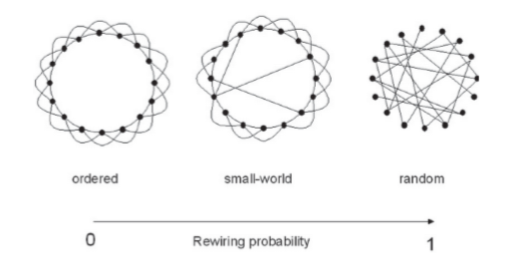
Small-world Synchronization
A small world network is a network that has:
Small distances between nodes, proportionate to the logarithm of number of nodes N
High clustering coefficient → “ordered” network
How can we create one?
Create a small world from an extremely ordered network (rewiring, Strogatz, 2012)
Transformation of symmetry, yet part of the structure intact

Slide 34
Small-world Synchronization
How can we build a network from fireflies (in our case self-sustained oscillators)?
Each node in the network is an oscillator
Link is considered as interaction
One example, the Kuramoto model (mutually coupled oscillators, sine-wave interactions)
If structure is a ring, each oscillator coupled to a fixed number of neighbors on either side → hard to achieve synchrony or cluster of synchronization
Change 2% of connections by rewiring → enharitence synchrony
Notes:
Watts & Strogatz, 1998

Slide 35
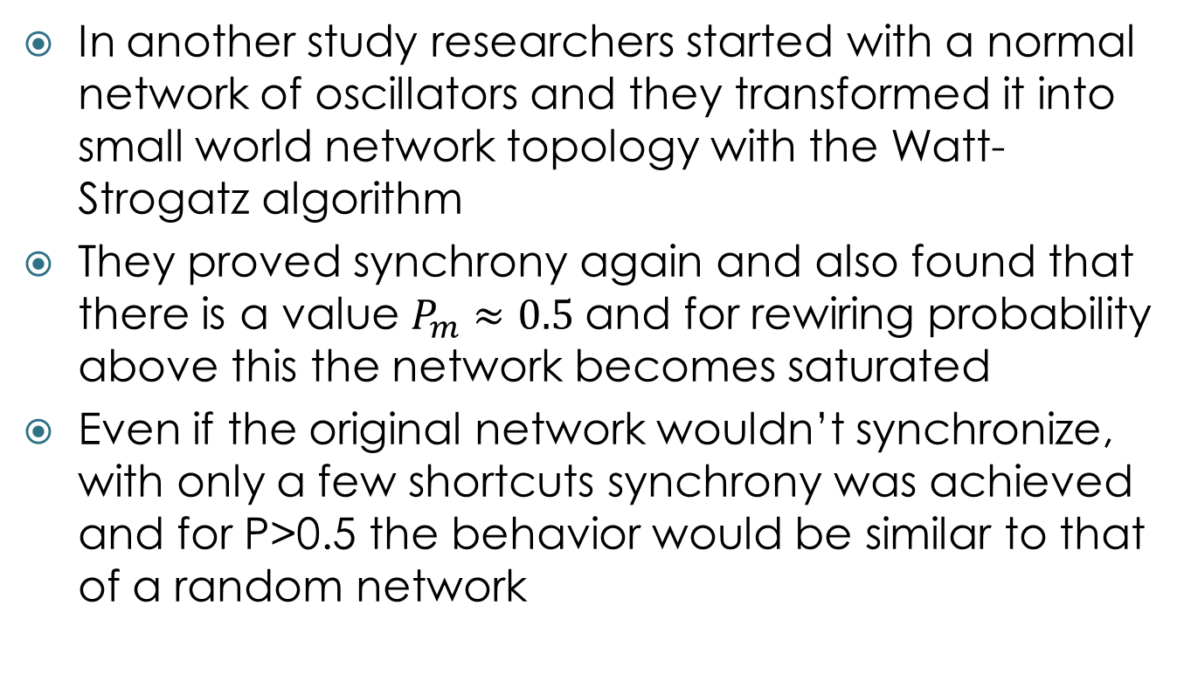
Small world synchronization
In another study researchers started with a normal network of oscillators and they transformed it into small world network topology with the Watt-Strogatz algorithm
They proved synchrony again and also found that there is a value $P_{m}≈0.5$and for rewiring probability above this the network becomes saturated
Even if the original network wouldn’t synchronize, with only a few shortcuts synchrony was achieved and for P>0.5 the behavior would be similar to that of a random network
Notes:
Hong, Choi, & Beom Jun Kim, 2008

Slide 36
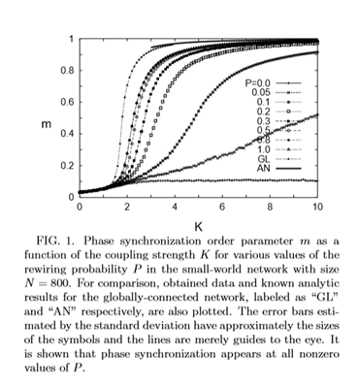
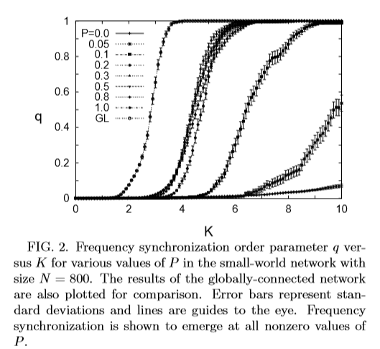
Small world synchronization
Phase-sync Frequency-sync

Slide 37
Small world synchronization
A third study proved that in coupled oscillators with phase lag with small world topology the synchronous state is stable
The initial network was a normal network which was transformed into a small world by Newman-Watt algorithm
By adding perturbations in the synchronous state they proved that the synchronized state of phases remains stable regardless of the topology and the probabilities
Notes:
Li, Xu, Liao, & Yu, 2004

Slide 38
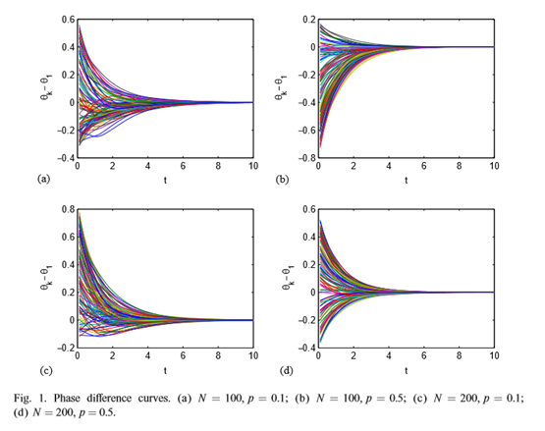
Small world synchronization

Slide 39
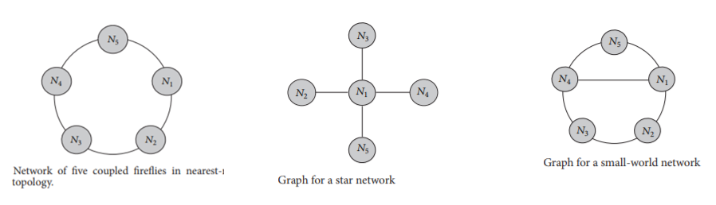
Small world synchronization
Another study investigated synchronization in systems of fireflies
Discrete time dynamic systems are utilized in contrast to previous models
Three different topologies tested, however only in a network of 5 nodes
Nearest Neighbor
Star
Small world
Notes:
Arellano-Delgado, Cruz-Hernández, López Gutiérrez, & Posadas-Castillo, 2015

Slide 40
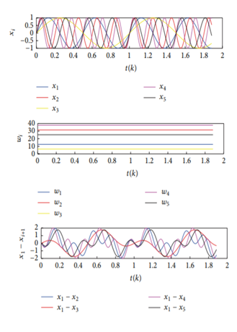
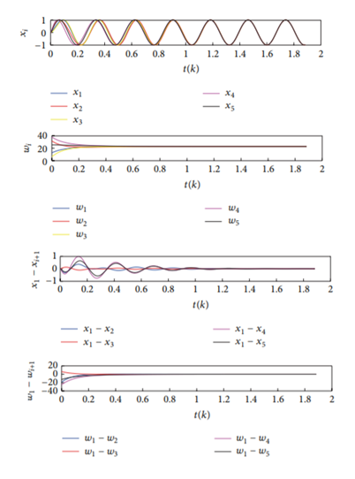
Small world synchronization
They proved both phase and frequency synchronization in all cases, when there was sufficient coupling strength
The case of small-world topology was able to synchronize in a smaller value of coupling strength.

Slide 41
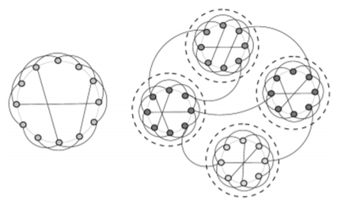
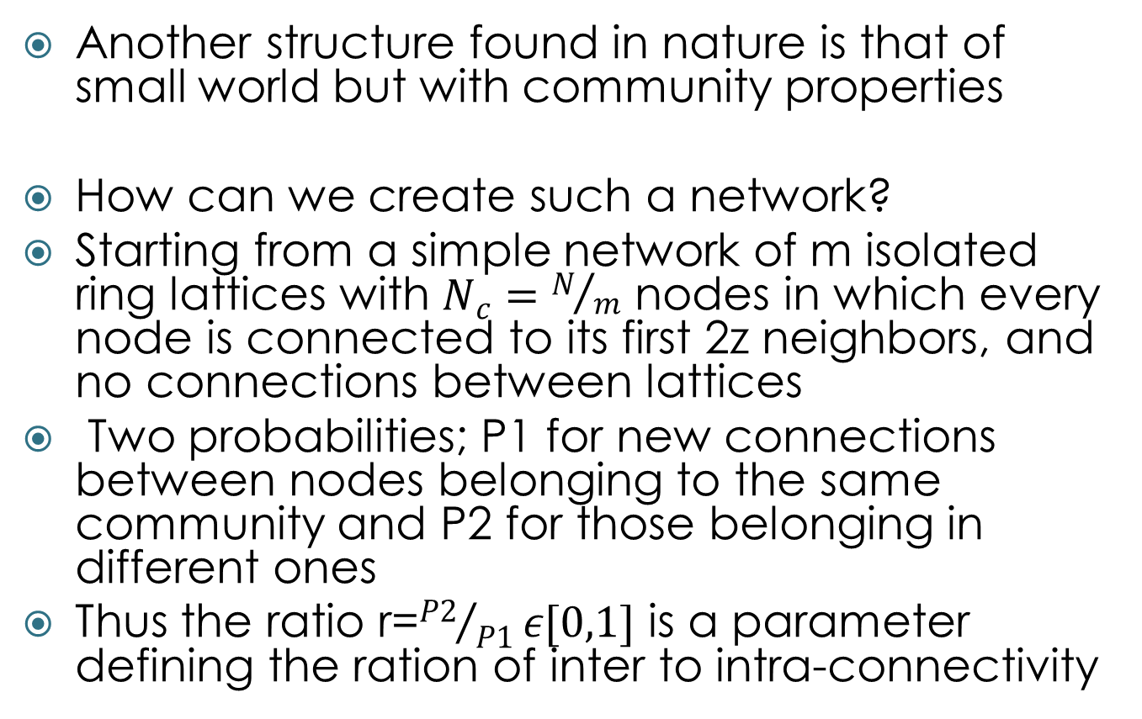
Small world synchronization
Another structure found in nature is that of small world but with community properties
How can we create such a network?
Starting from a simple network of m isolated ring lattices with $N_{c}=N/m$ nodes in which every node is connected to its first 2z neighbors, and no connections between lattices
Two probabilities; P1 for new connections between nodes belonging to the same community and P2 for those belonging in different ones
Thus the ratio r=${P2}/{P1}ε[0,1]$ is a parameter defining the ration of inter to intra-connectivity
Notes:
Xiao-Hua, Li-Cheng, Jian-she, 2009

Slide 42
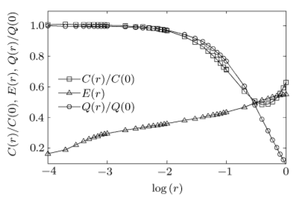
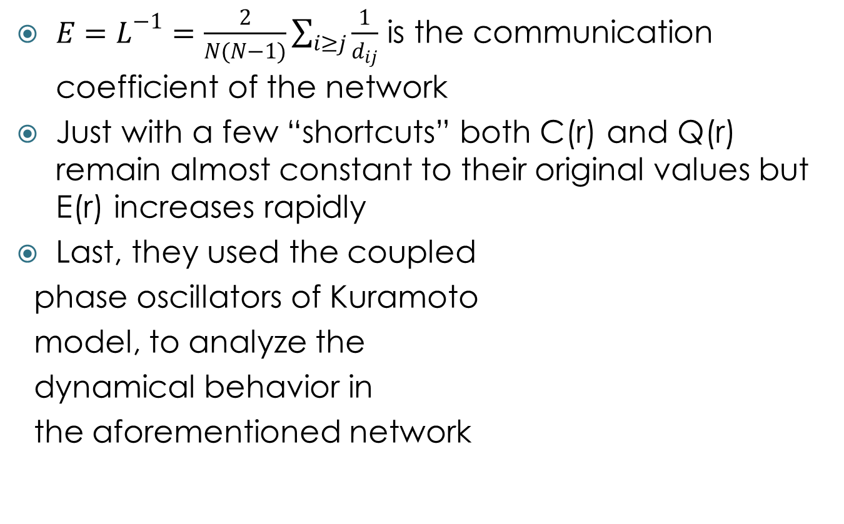
Small world synchronization
$E=L^{−1}=\frac{2}{N(N−1)}\sum_{i≥j}{\frac{1}{d_{ij}}}$ is the communication coefficient of the network
Just with a few “shortcuts” both C(r) and Q(r) remain almost constant to their original values but E(r) increases rapidly
Last, they used the coupled
phase oscillators of Kuramoto
model, to analyze the
dynamical behavior in
the aforementioned network

Slide 43
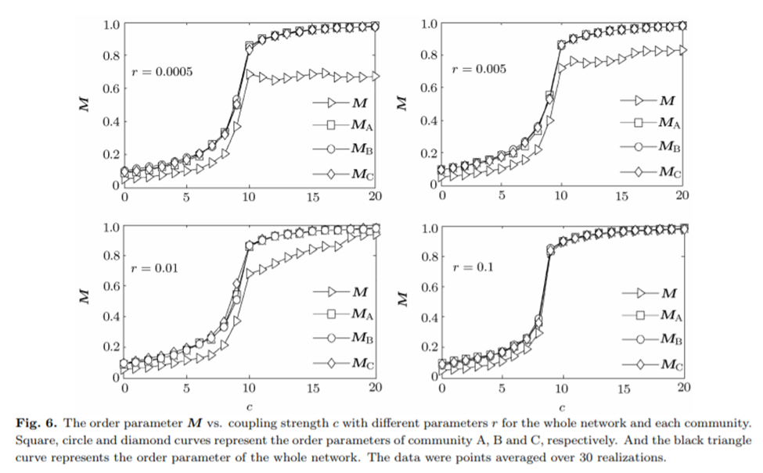
Small world synchronization
They proved that different values of r played a significant role in the synchronization of the network
For r>0.01 the network would synchronize
For r<0.01 there was an obnormal area
Even if the individual communities would synchronize when there were no shortcuts
With very few intra-community shortcuts input signals contained by these edges disturbed the synchronization process of these communities

Slide 44
Small world synchronization
However, all indications so far that small world property enhances synchronization in a network are based on simulation experiments
No solid mathematical that the addition of random shortcuts will lead to the synchronization of networks of coupled dynamical systems
Baharona and Pecora provided numerical and analytical quantification of how the small world scheme improved synchronization, when compared to standard deterministic graphs and even to fully random ones
They concluded that there is no guarantee that the small-world property will endure networks’ synchronization
That is because the synchronization threshold lies within the boundaries, but is linked to the end of the small-world region and not its onset
Notes:
Baharona, Pecora 2002

Slide 45
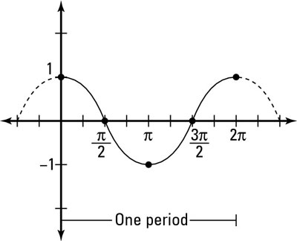
Visualisation
In every model fireflies are given a random number φ which is the range of time between two firings.
If we assume that fireflies have a cosine function for firing then φ may be the T period.
lighting
T ≈ φ

Slide 46
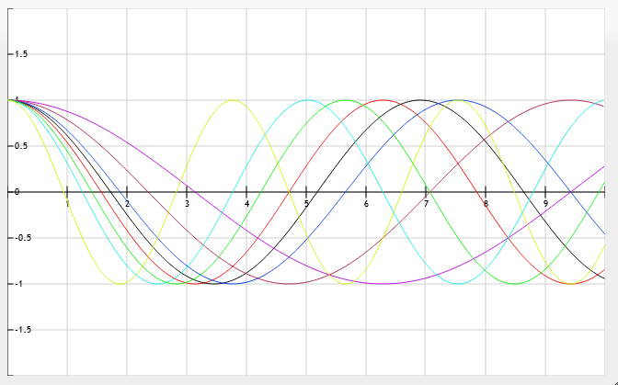
Visualisation
The synchronization of fireflies suppose to start just after they fired all together.
Every time a firefly is firing she holds until the last firing of the group.
Then every firefly change its period on a way which depends on the model we visualize.

Slide 47
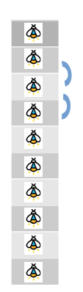
1st model
Fireflies (oscillators) placed in a straight line
k nearest neighbor coupling
They all start in a non firing state.
A random value φ, within a preselected range, is distributed in each one of them, corresponding to the time they remain dark.
The model adapts to the fastest firefly’s rhythm.
First step : just after they fired all together till the flash of the last one (slower one, with higher φ)
n-th step: the time after the flashing of the (n-1)th state slowest firefly, till the flashing of the slowest firefly in the n-th period.
User choices: range of initial phases, the number of fireflies , k of nearest neighbors

Slide 48
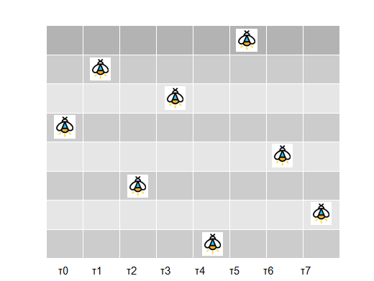
1st model

Slide 49
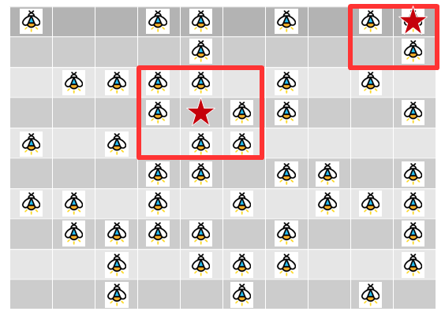
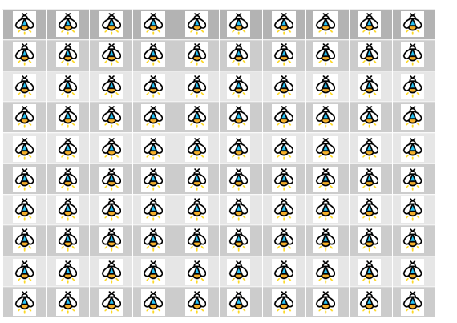
2nd model
Same adaption rule as the 1st model
Fireflies placed in a matrix
k nearest neighbors coupling
flashing fireflies (attributed with the value 1) are presented in yellow color and the others (attributed with 0) in black.
Second trial: Movement added to the model
Represented by randomly change oscillator’s position in the matrix in every step.
Result: Impressive reduction in the number of required steps of synchronization

Slide 50
3rd model
N fireflies placed in a matrix
K nearest neighbor coupling
Adaption rule: Each oscillator in each step of synchronization adapts to rounded mean frequency of its neighbors, itself included
In this model phase locking synchronization is achieved
If we apply random movement in this model a global perfect synchronization is achieved
Movement in the model leads to a reduction in the number of steps required for synchronization

Slide 51
4rth model
N fireflies placed in a matrix
K nearest neighbor coupling
Adaption rule: The Mirollo and Strogatz model is partially stimulated;
Each oscillators receives a pulse ε=0.1φ, from its fastest neighbor.
For groups of fireflies firing in unison in the fastest pace, the sum of their pulses is considered as the pulse of the group.
φ’ = φ – no of fastest neighbors* 0.1 *φ.
Perfect synchronization is reached
Convention: φ_{max} - φ_{min} < 0.5 is considered insignificant an synchronization is considered reached.

Slide 52
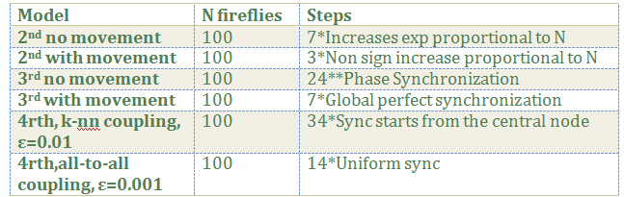
Comparison
Default range: 100-300
K in k-nn coupling=1

Slide 53
Bibliography
Arellano-Delgado, A., Cruz-Hernández, C., López Gutiérrez, R. M., & Posadas-Castillo, C. (2015). Outer Synchronization of Simple Firefly Discrete Models in Coupled Networks. Mathematical Problems in Engineering, 2015. http://doi.org/10.1155/2015/895379
Barahona, M., Barahona, M., & Pecora, L. M. (2002). Synchronization in small-world systems. Physical Review Letters, 89(5), 054101/1-054101/4. http://doi.org/10.1103/PhysRevLett.89.054101
Buck, J. (1988). Synchronous rhythmic flashing of fireflies. II. Quarterly Review of Biology, 63(3), 265–289. http://doi.org/10.1086/415929
Buck, J., & Buck, E. (1966). Biology of synchronous flashing of fireflies. Nature, 211(5049), 562–564. http://doi.org/10.1038/211562a0
Buck, J., Buck, E., Case, J. F., & Hanson, F. E. (1981). Control of flashing in fireflies - V. Pacemaker synchronization in Pteroptyx cribellata. Journal of Comparative Physiology □ A, 144(3), 287–298. http://doi.org/10.1007/BF00612560
Ermentrout, B. (1991a). An adaptive model for synchrony in the firefly Pteroptyx malaccae. Journal of Mathematical Biology, 29(6), 571–585. http://doi.org/10.1007/BF00164052
Ermentrout, B. (1991b). Pteroptyx malaccae, 571–585.
Hermoso De Mendoza, I., Pachón, L. A., Gómez-Gardeñes, J., & Zueco, D. (2014). Synchronization in a semiclassical Kuramoto model. Physical Review E - Statistical, Nonlinear, and Soft Matter Physics, 90(5). http://doi.org/10.1103/PhysRevE.90.052904

Slide 54
Bibliography
Hong, H., Choi, M. Y., & Beom Jun Kim. (2008). Synchronization in small-world networks. Chaos, 18(3). http://doi.org/10.1063/1.2939136
John, & Buck, E. (1976). Synchronous Fireflies. Scientific American, 234(5), 74–85. http://doi.org/10.1038/scientificamerican0576-74
Li, C., Xu, H., Liao, X., & Yu, J. (2004). Synchronization in small-world oscillator networks with coupling delays. Physica A: Statistical Mechanics and Its Applications, 335(3–4), 359–364. http://doi.org/10.1016/j.physa.2003.12.037
Mirollo, R. E., Strogatz, S. H., Journal, S., & Dec, N. (2007). Synchronization of Pulse-Coupled Biological Oscillators, 50(6), 1645–1662.
Strogatz, S. H. (2000). From Kuramoto to Crawford : exploring the onset of synchronization in populations of coupled oscillators, 143, 1–20.
Strogatz, S. H. (2012). Sync: How Order Emerges from Chaos In the Universe, Nature, and Daily Life. Hachette Books. Retrieved from https://books.google.gr/books?id=ZQeZAAAAQBAJ
Tyrrell, A., Auer, G., & Bettstetter, C. (2006). Firefly Synchronization in Ad Hoc Networks.
WANG, X. F., & CHEN, G. (2002). Synchronization in Small-World Dynamical Networks. International Journal of Bifurcation and Chaos, 12(1), 187–192. http://doi.org/10.1142/S0218127402004292
Watts, D. J. J., & Strogatz, S. H. H. (1998). Collective dynamics of “small-world” networks. Nature, 393(6684), 440–442. http://doi.org/10.1038/30918
Zhou, T., Zhao, M., Chen, G., Yan, G., & Wang, B.-H. (2007). Phase synchronization on scale-free networks with community structure. Physics Letters A, 368(6), 431–434. http://doi.org/10.1016/j.physleta.2007.04.083
Hanson F.E. (1982). Pacemaker control of rhythmic fireflies . In: Carpenter, D. (ed.) Cellular Pacemakers Vol.2 ,pp 81-100, New York
Norbert Wiener (1958). Nonlinear Problems in Random Theory, pp. 142. ISBN 0-262-73012-X. Cambridge, Massachusetts, USA: The MIT Press

