Slide 1
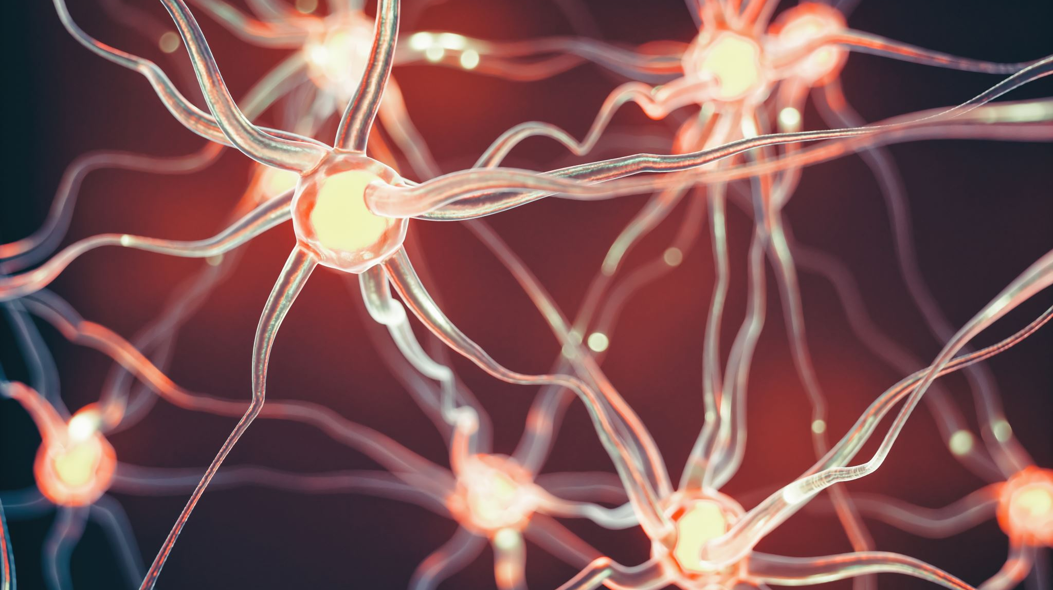
Spiking Neural Network (SNN) simulation
December 15, 2023

Slide 2

Tutorials
Introduction to NEST Simulator basic functions
Focus on connectivity and synapse models
Short-term synaptic plasticity
Brunel Network simulation

Slide 3


NEST simulator
Computational neuroscience tool to model large neural networks of point neurons.
The models describe single neuron and synapse behavior and their connections.
Different mechanisms of plasticity can be used to investigate artificial learning and help to shed light on the fundamental principles of how the brain works.

Slide 4
Using NEST on EBRAINS platform
Create an accont on EBRAINS
Sign in
Open Ebrains Lab
Enter in drive/My Libraries/La mia Libreria
Copy the tutorial repository nest_intro
Open tutorial notebooks
Select the kernel EBRAINS-23.06

Slide 5
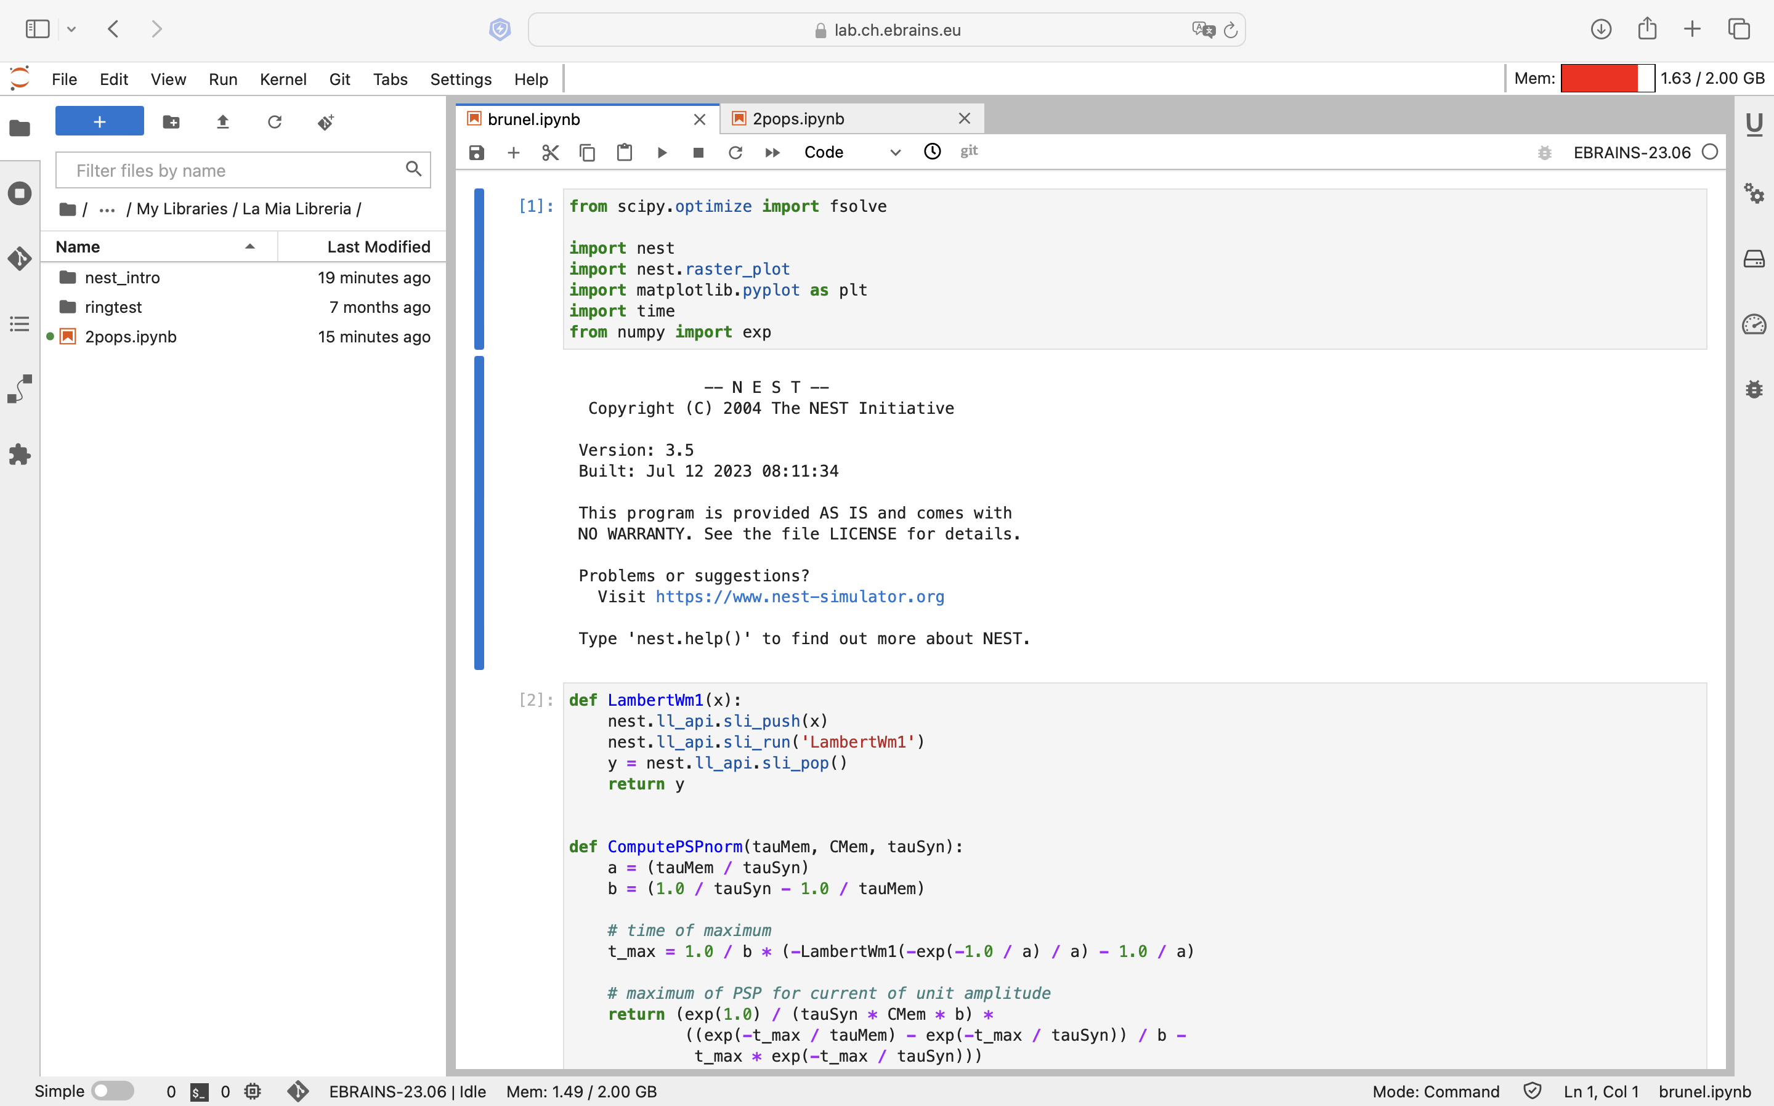

Slide 6
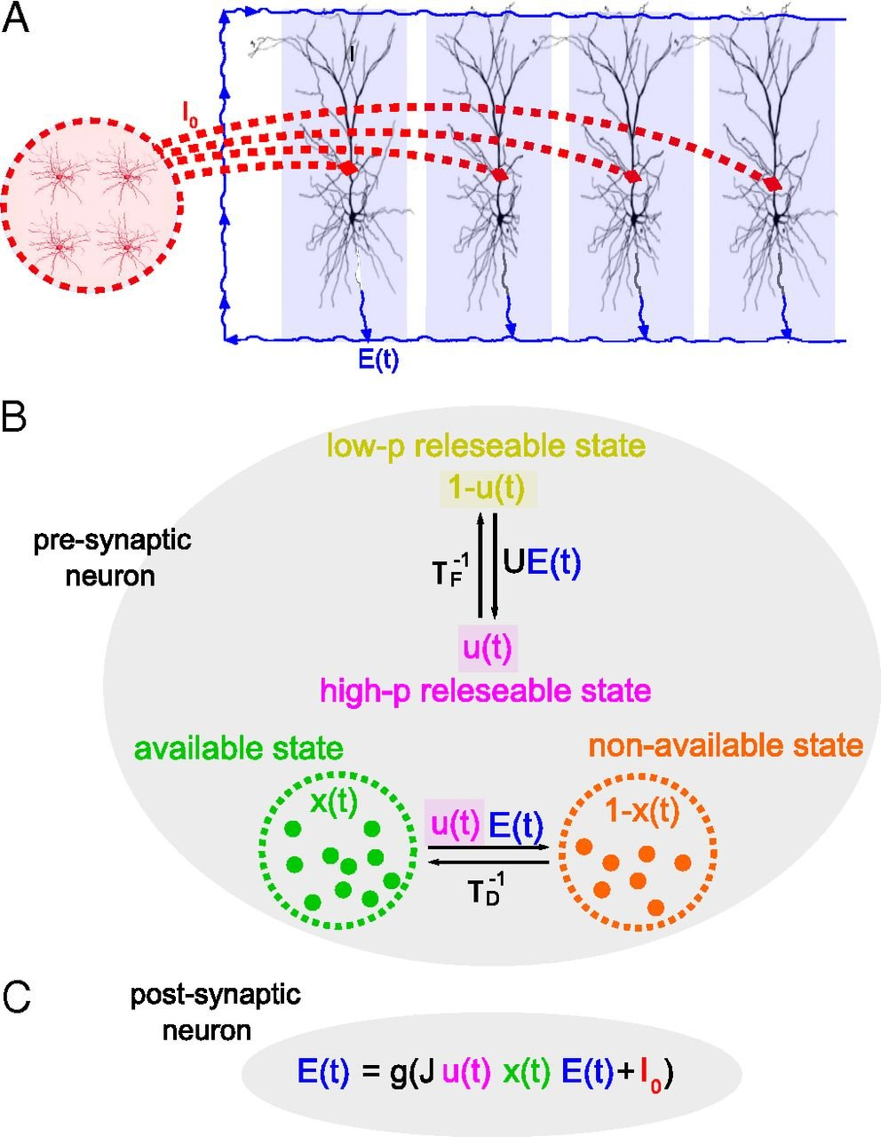
Short-term synaptic plasticity
Tsodyks & Markram model:
STD effect: variable x (0≤x≤1) → fraction of resources that remain available after neurotransmitter depletion.
STF effect: variable u → fraction of available resources ready for use (release probability).

Slide 7
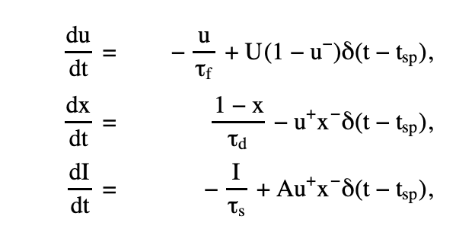
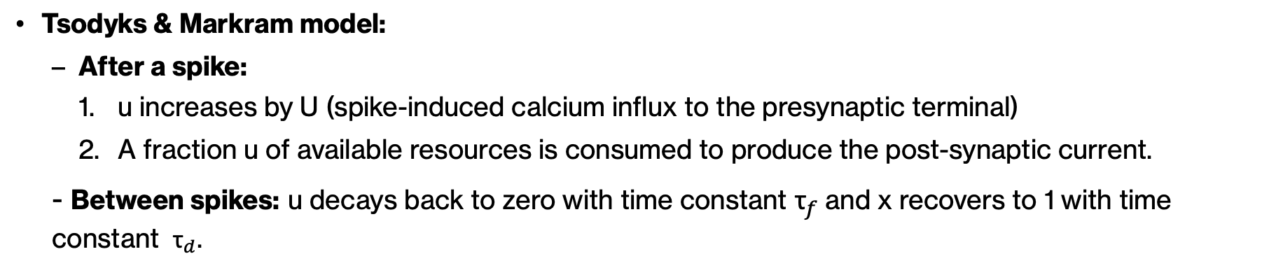
Short-term synaptic plasticity
Tsodyks & Markram model:
After a spike:
u increases by U (spike-induced calcium influx to the presynaptic terminal)
A fraction u of available resources is consumed to produce the post-synaptic current.
- Between spikes: u decays back to zero with time constant ${\text{τ}}_{f}$and x recovers to 1 with time constant ${\text{τ}}_{d}$.

Slide 8
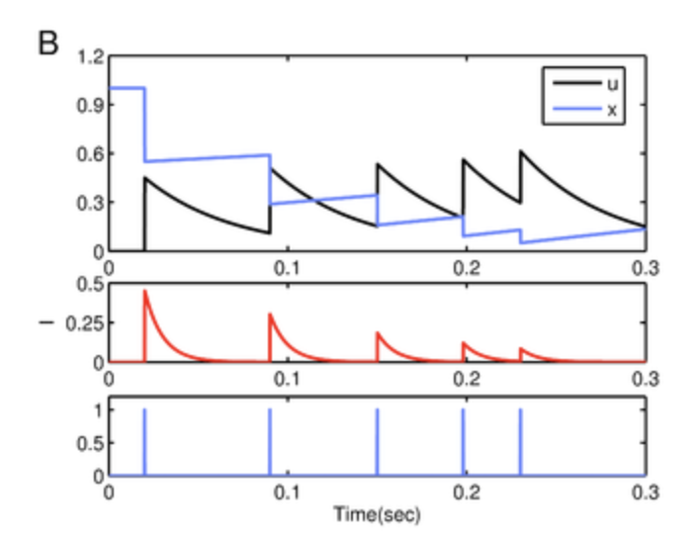
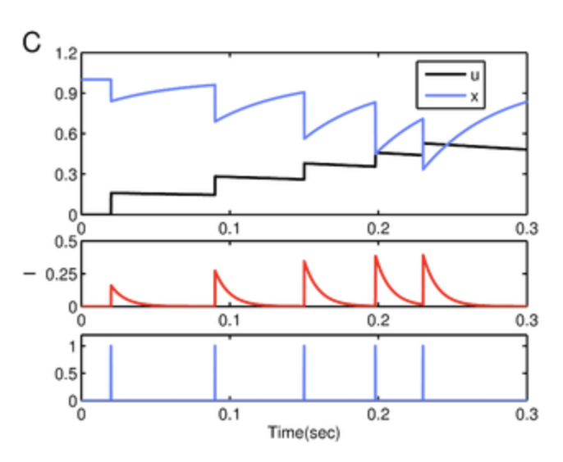
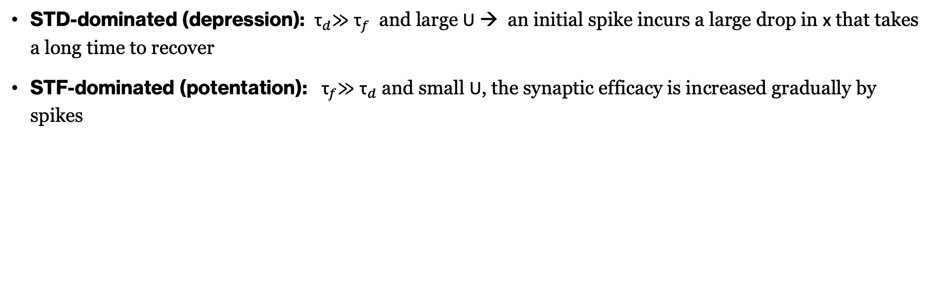
Short-term synaptic plasticity
STD-dominated (depression): ${\text{τ}}_{d}$≫ ${\text{τ}}_{f}$ and large U → an initial spike incurs a large drop in x that takes a long time to recover
STF-dominated (potentation): ${\text{τ}}_{f}$≫ ${\text{τ}}_{d}$and small U, the synaptic efficacy is increased gradually by spikes

Slide 9
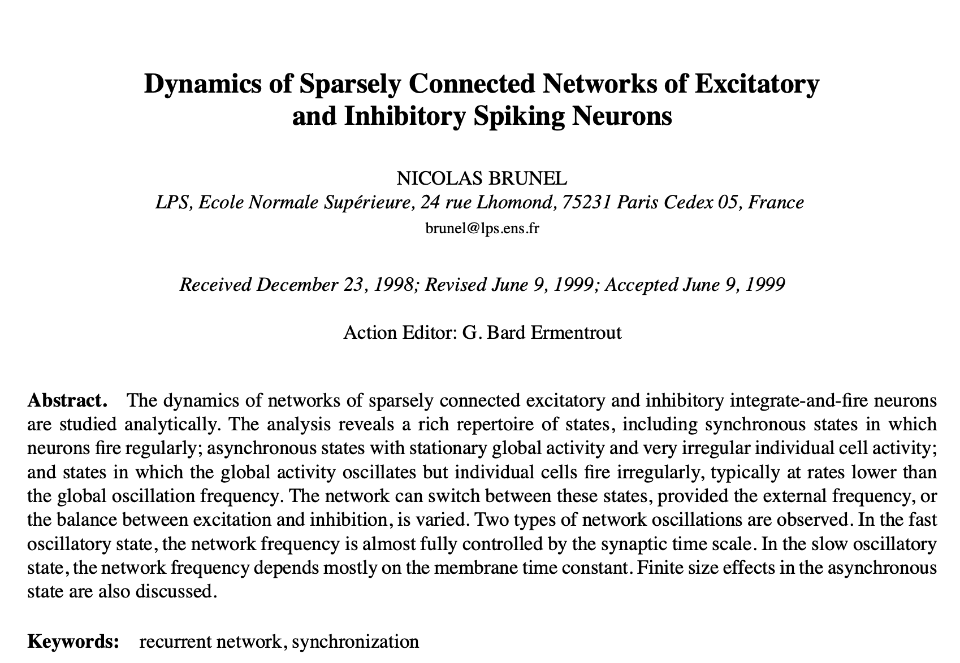
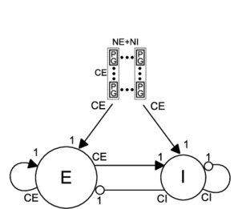
Practical example – Brunel network: a sparsely connected recurrent network
Recurrency

Slide 10
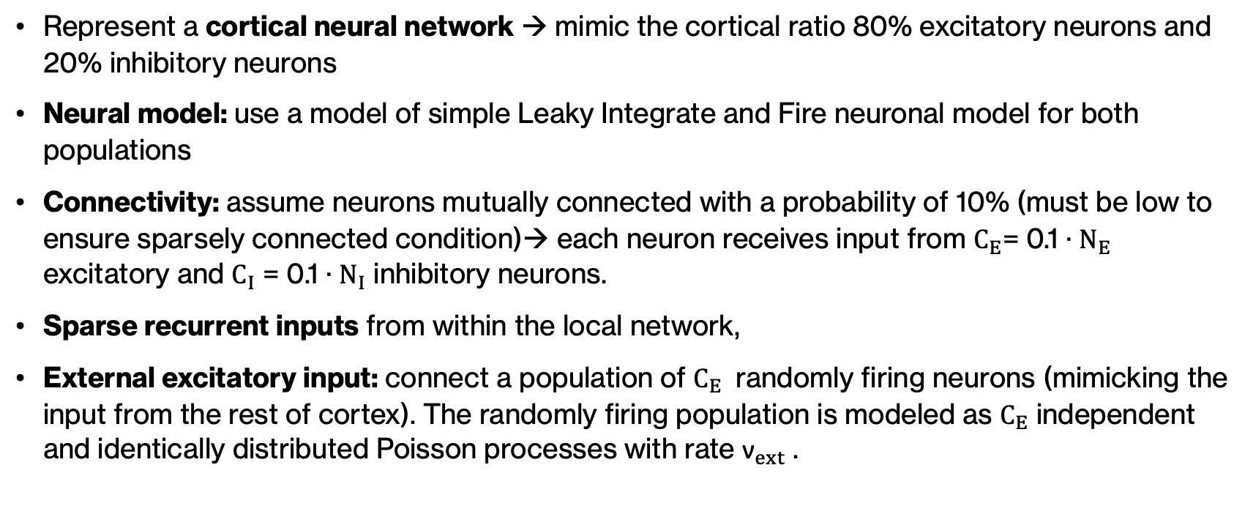
Brunel network - model
Represent a cortical neural network → mimic the cortical ratio 80% excitatory neurons and 20% inhibitory neurons
Neural model: use a model of simple Leaky Integrate and Fire neuronal model for both populations
Connectivity: assume neurons mutually connected with a probability of 10% (must be low to ensure sparsely connected condition)→ each neuron receives input from $C_{E}$= 0.1 · $N_{E}$ excitatory and $C_{I}$ = 0.1 · $N_{I}$ inhibitory neurons.
Sparse recurrent inputs from within the local network,
External excitatory input: connect a population of $C_{E}$ randomly firing neurons (mimicking the input from the rest of cortex). The randomly firing population is modeled as $C_{E}$ independent and identically distributed Poisson processes with rate ${\text{ν}}_{ext}$ .

Slide 11
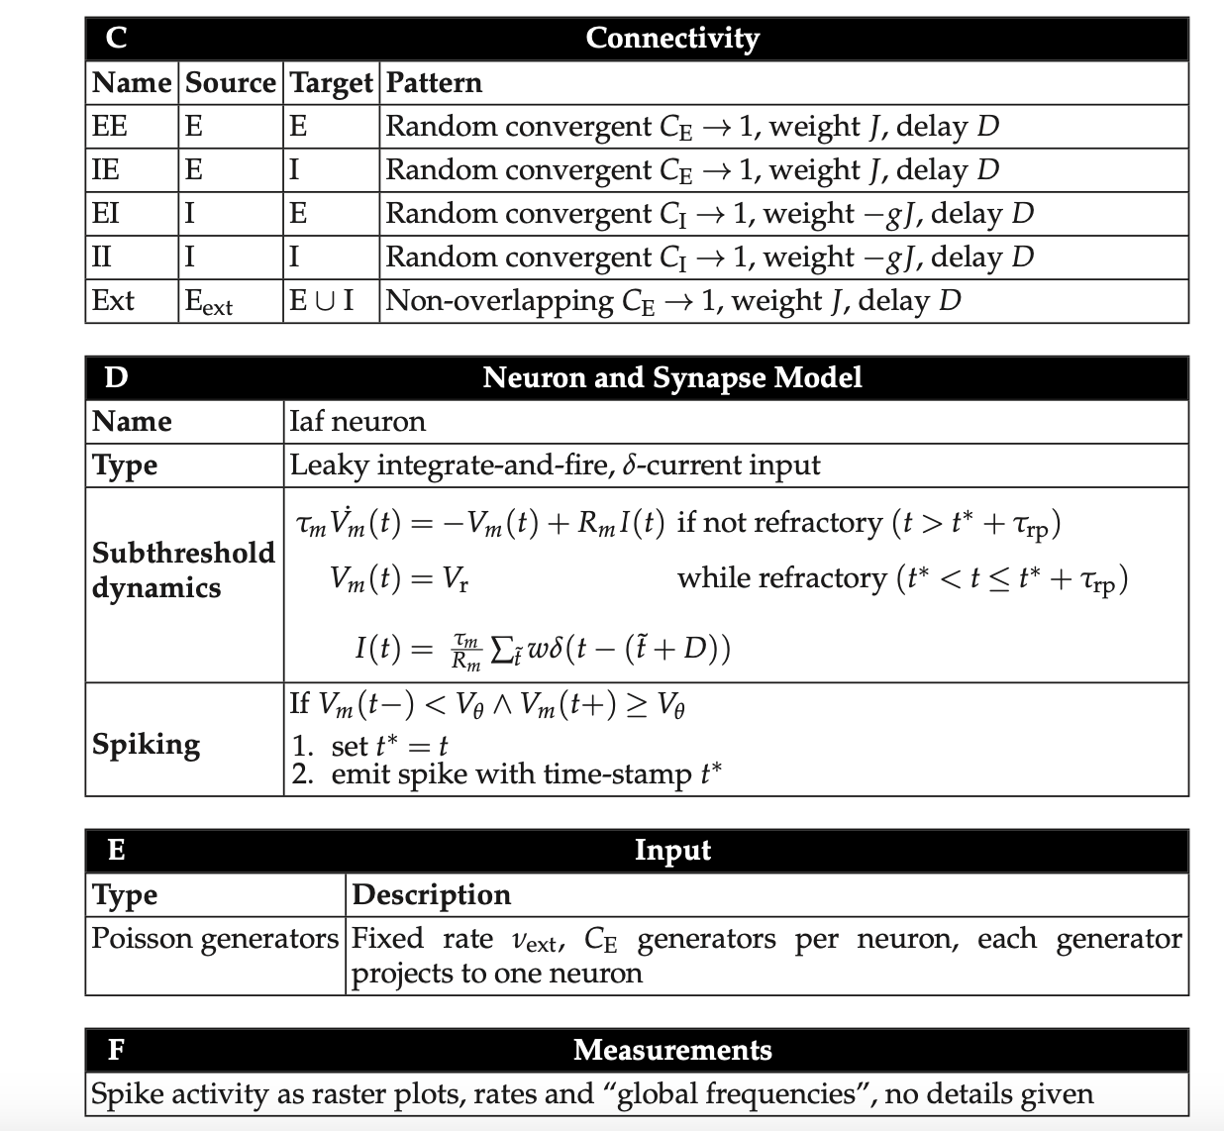
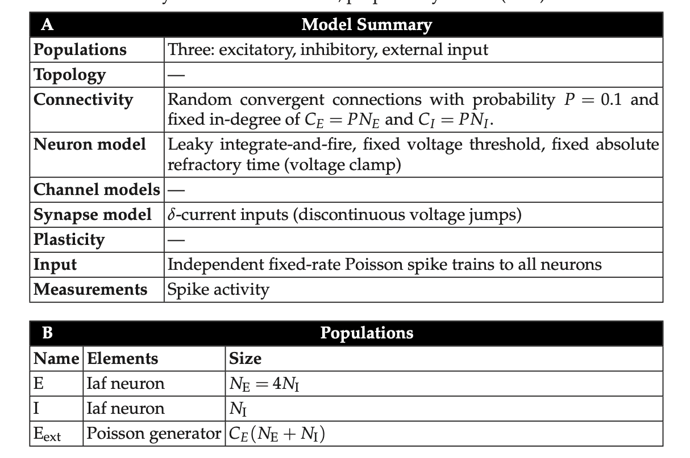
Brunel network - Summary

Slide 12
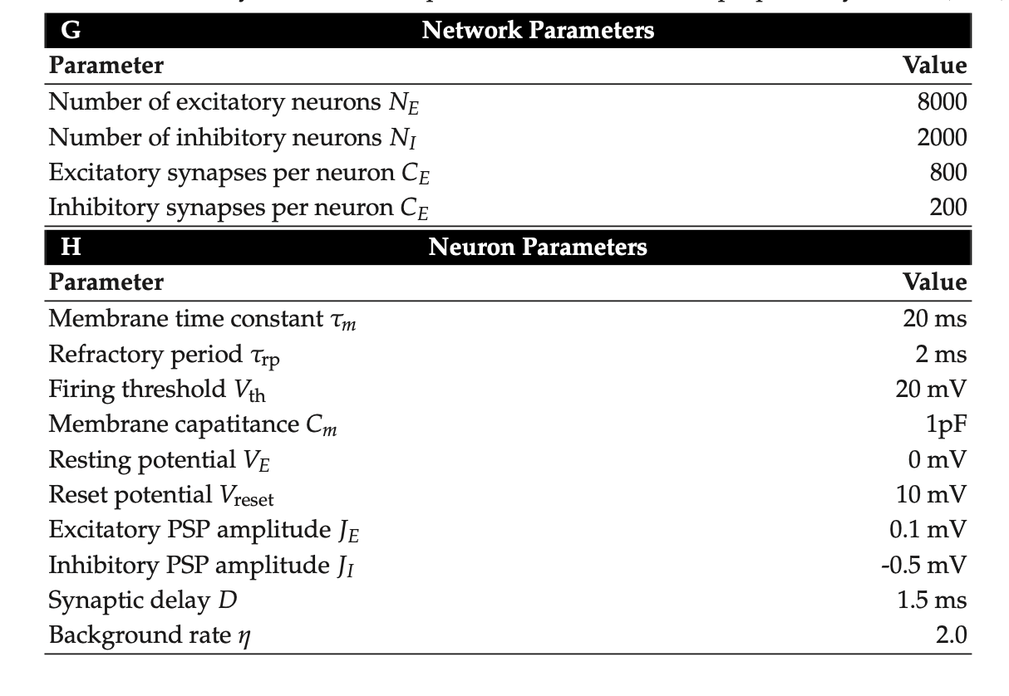
Brunel network - Summary

Slide 13
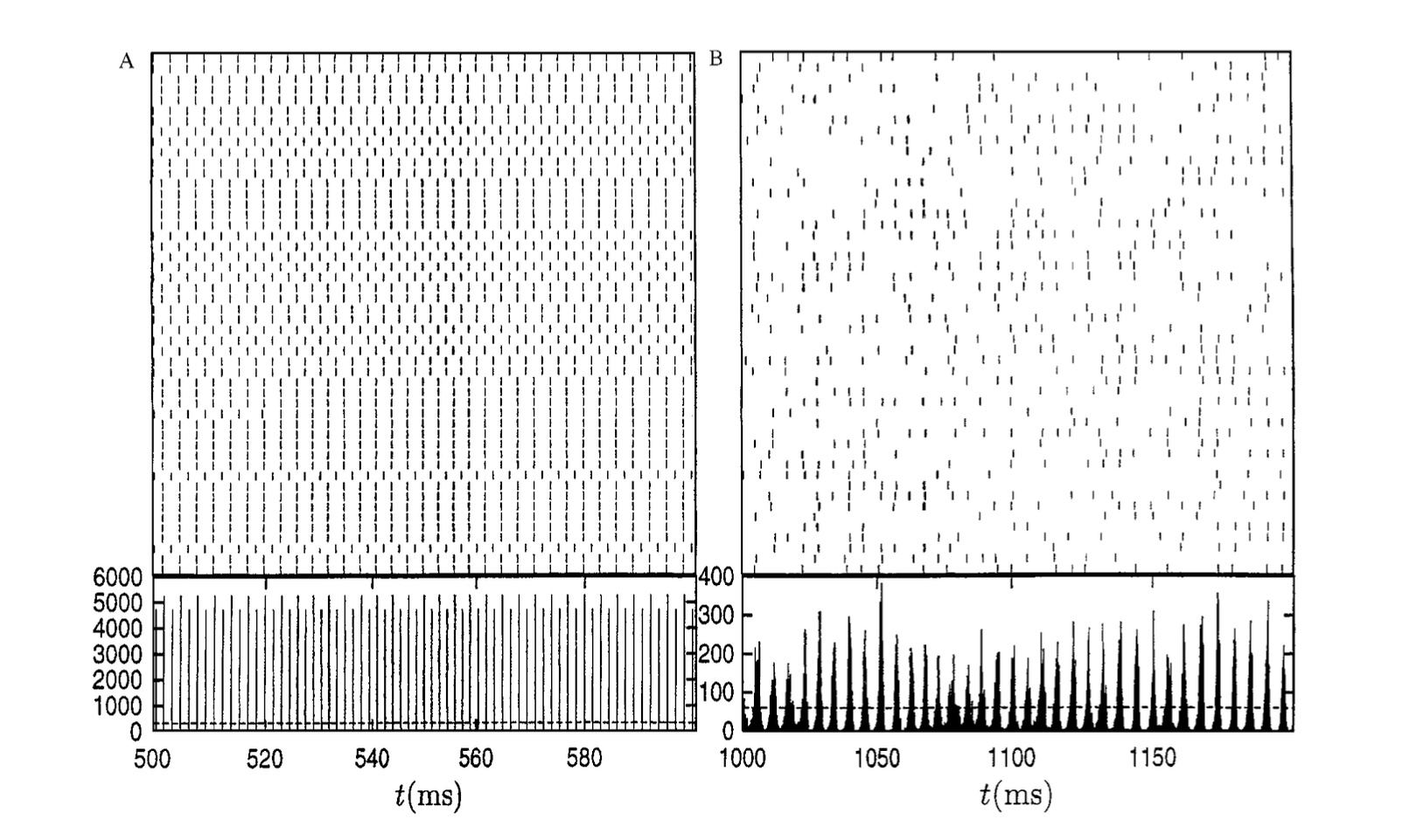
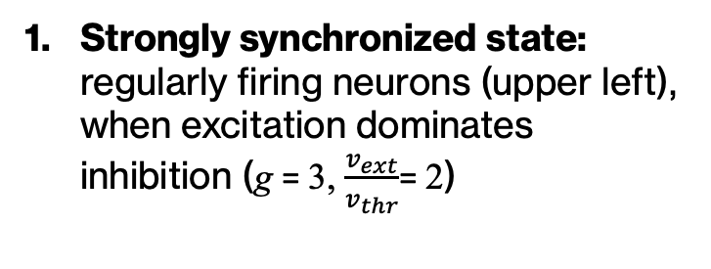
Brunel network - States
Strongly synchronized state: regularly firing neurons (upper left), when excitation dominates inhibition (g = 3, $\frac{v_{ext}}{v_{thr}}$= 2)

Slide 14
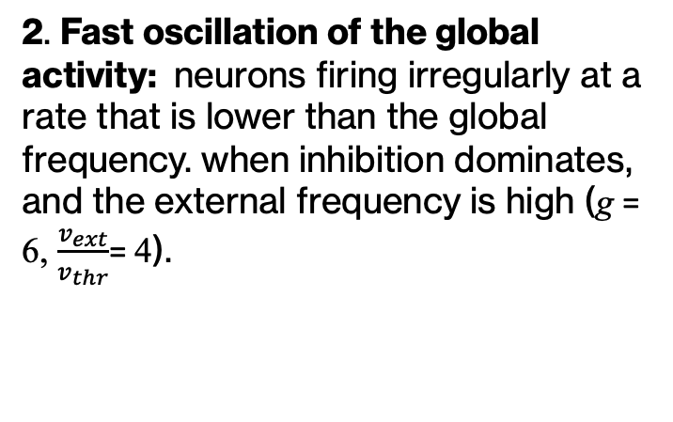
Brunel network - States
2. Fast oscillation of the global activity: neurons firing irregularly at a rate that is lower than the global frequency. when inhibition dominates, and the external frequency is high (g = 6, $\frac{v_{ext}}{v_{thr}}$= 4).

Slide 15
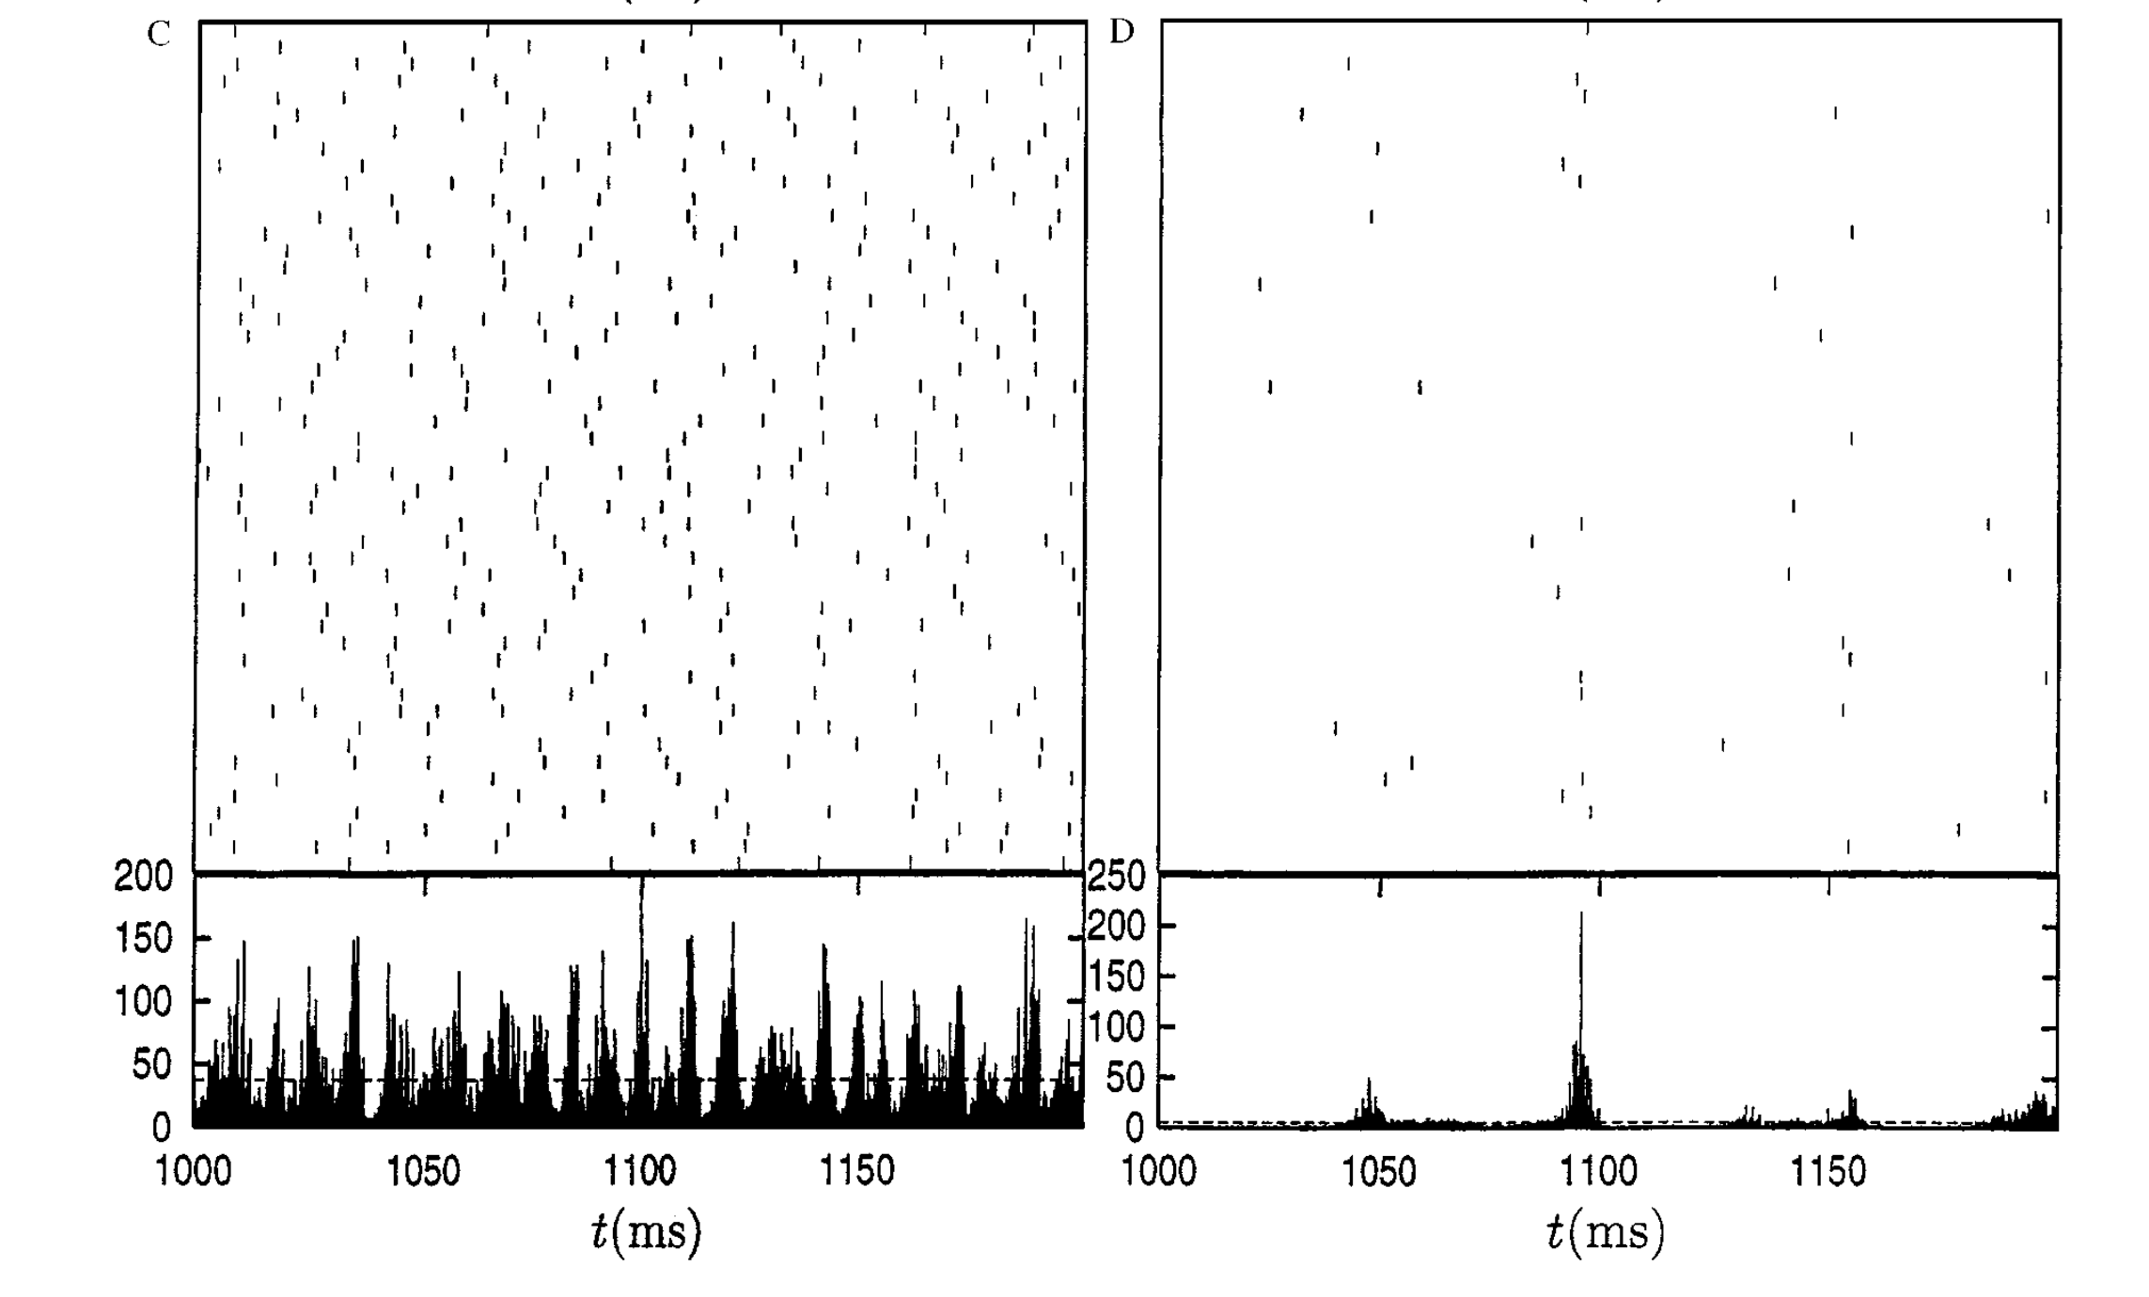
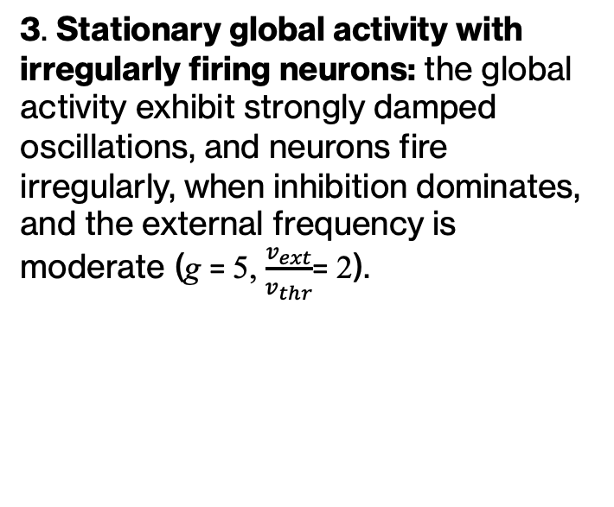
Brunel network - States
3. Stationary global activity with irregularly firing neurons: the global activity exhibit strongly damped oscillations, and neurons fire irregularly, when inhibition dominates, and the external frequency is moderate (g = 5, $\frac{v_{ext}}{v_{thr}}$= 2).

Slide 16

Brunel network - States
4. Slow oscillation of the global activity: neurons firing irregularly at very low rates . When inhibition dominates, and the external frequency is below but close to threshold (g = 4.5, $\frac{v_{ext}}{v_{thr}}$= 0.9).

Slide 17
TRY WITH THE TUTORIALS →

