Slide 1


Current Status of the Simulation of Radiative Effects with McMule
Maria Leibelt
Technical University of Munich
AMBER Weekly Meeting
22.05.2026

Slide 2
Project Overview and Progress
Topic: Simulation of Radiative Effects for the AMBER Proton Radius Measurement with McMule
Learning to work with McMule with support from Marco Rocco
Simulation of LO and NLO processes
Especially investigating the real-photon emission process
Investigation of the impact of different cuts on the kinematic
Cuts used to obtain the results in this presentation:

Slide 3
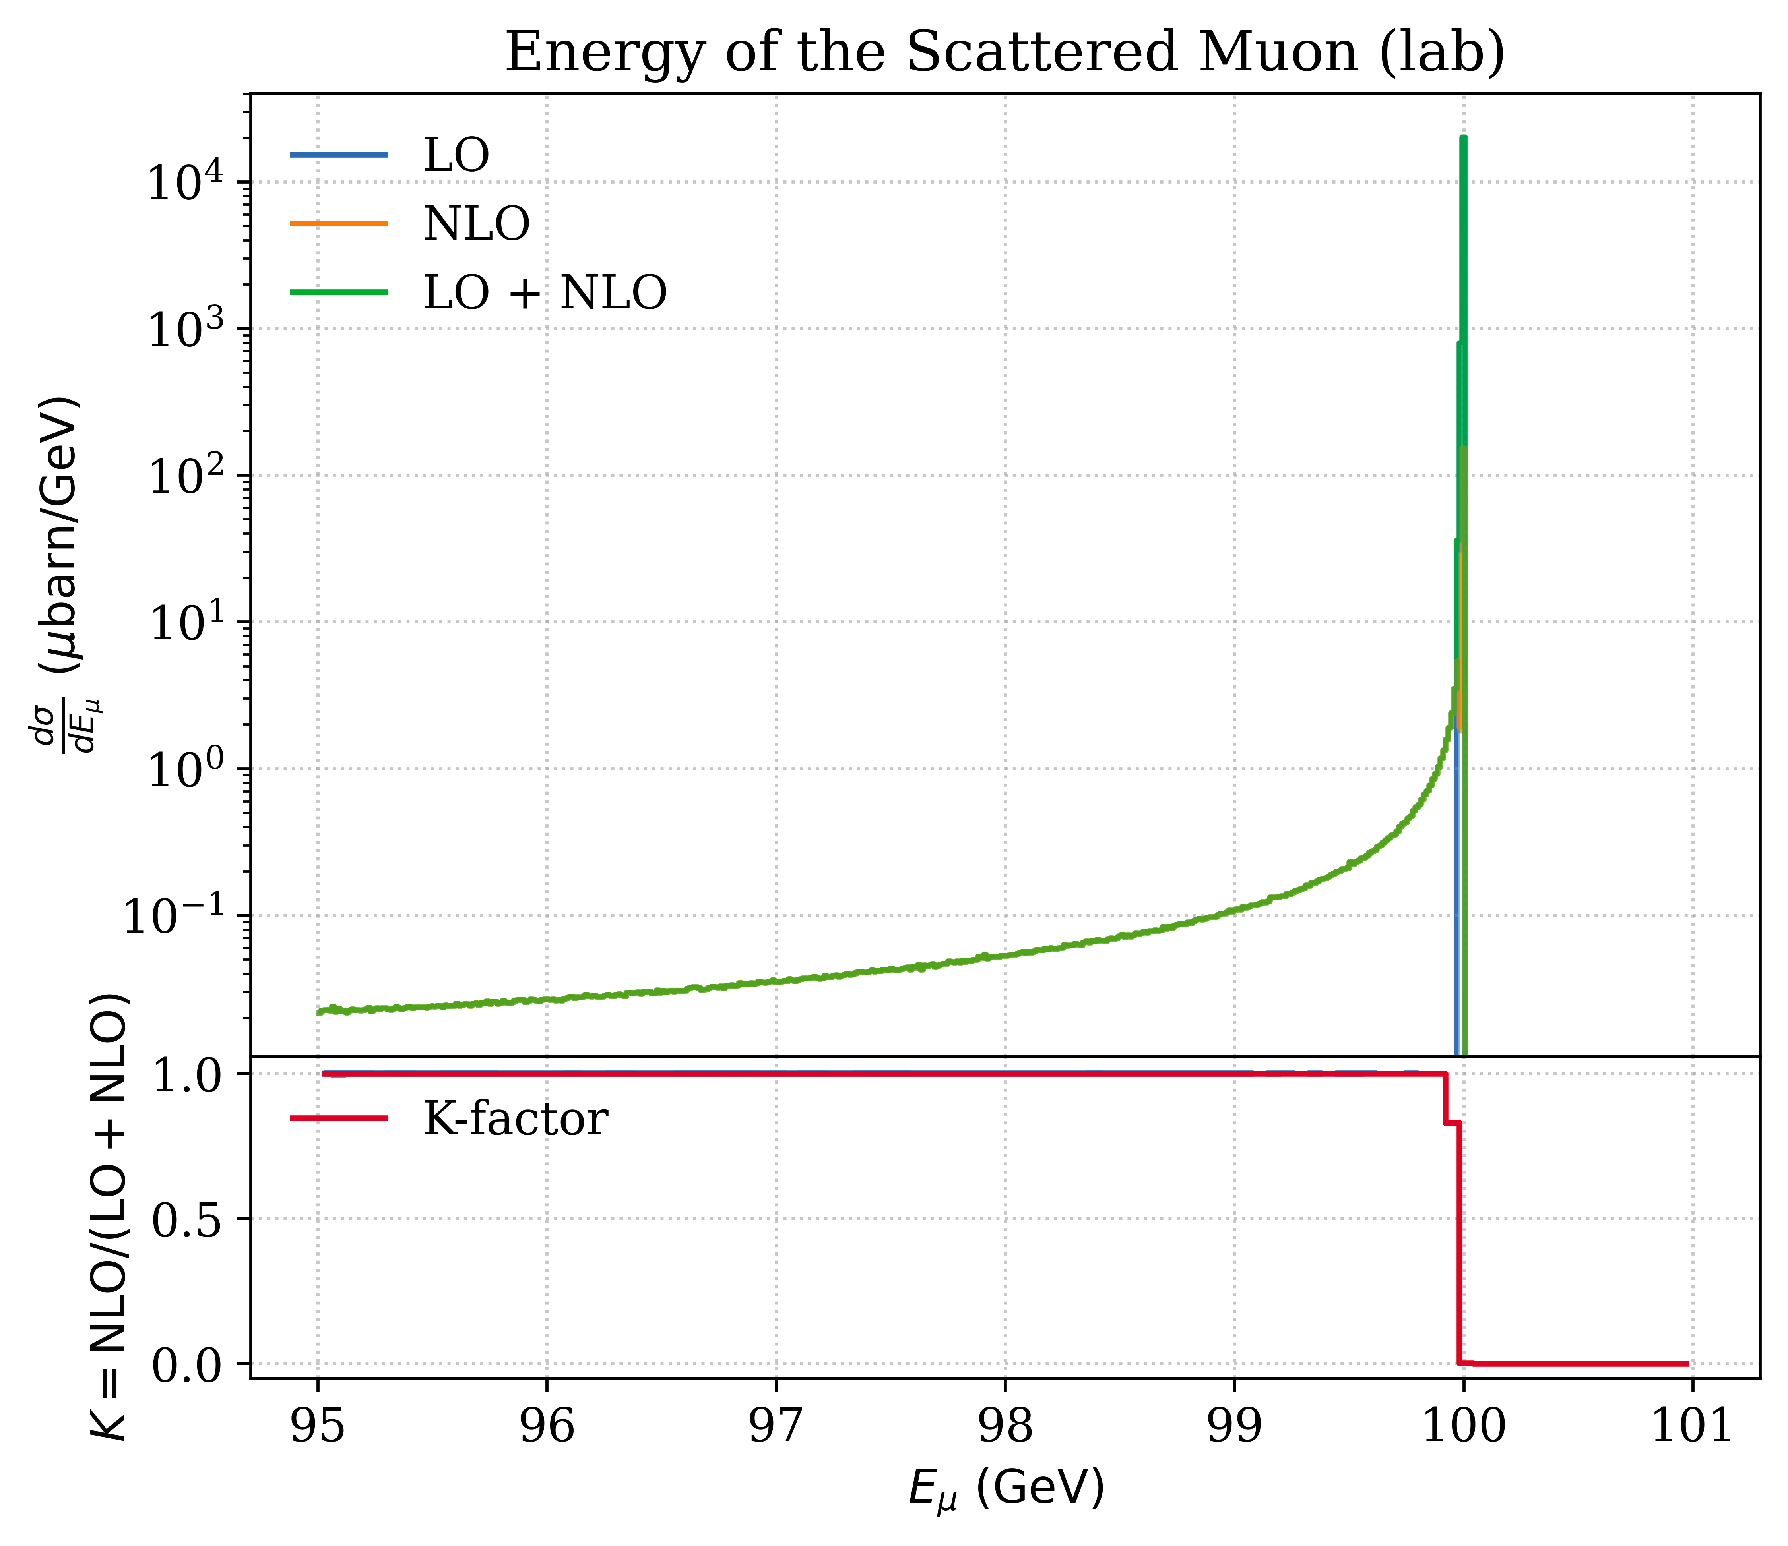
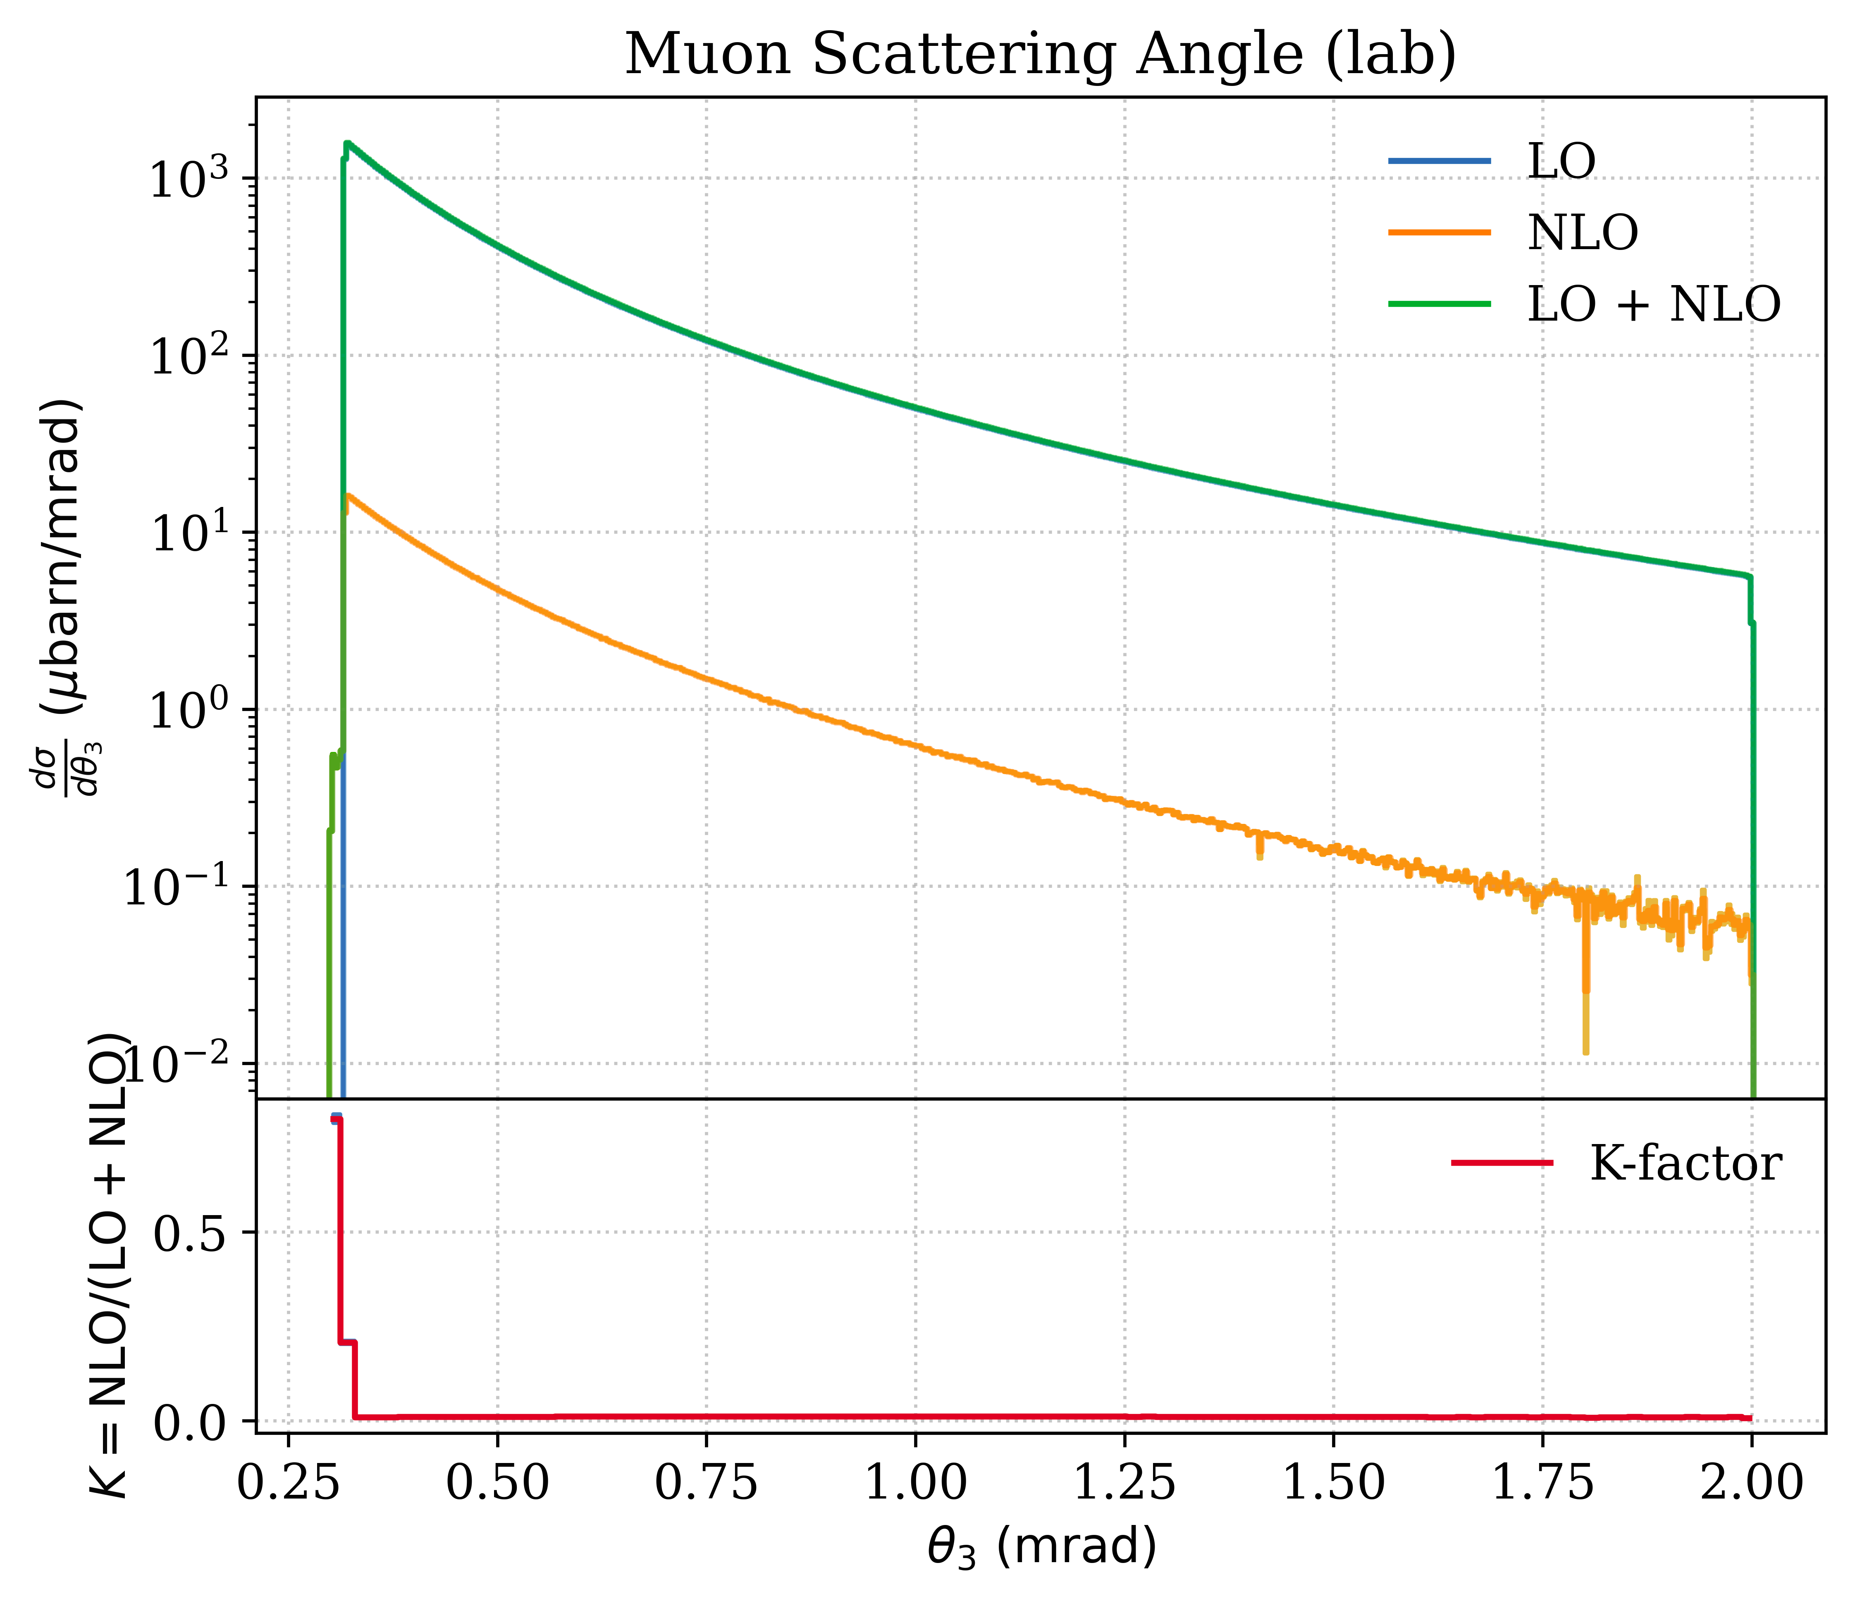
Muon: Energy & Scattering Angle

Slide 4
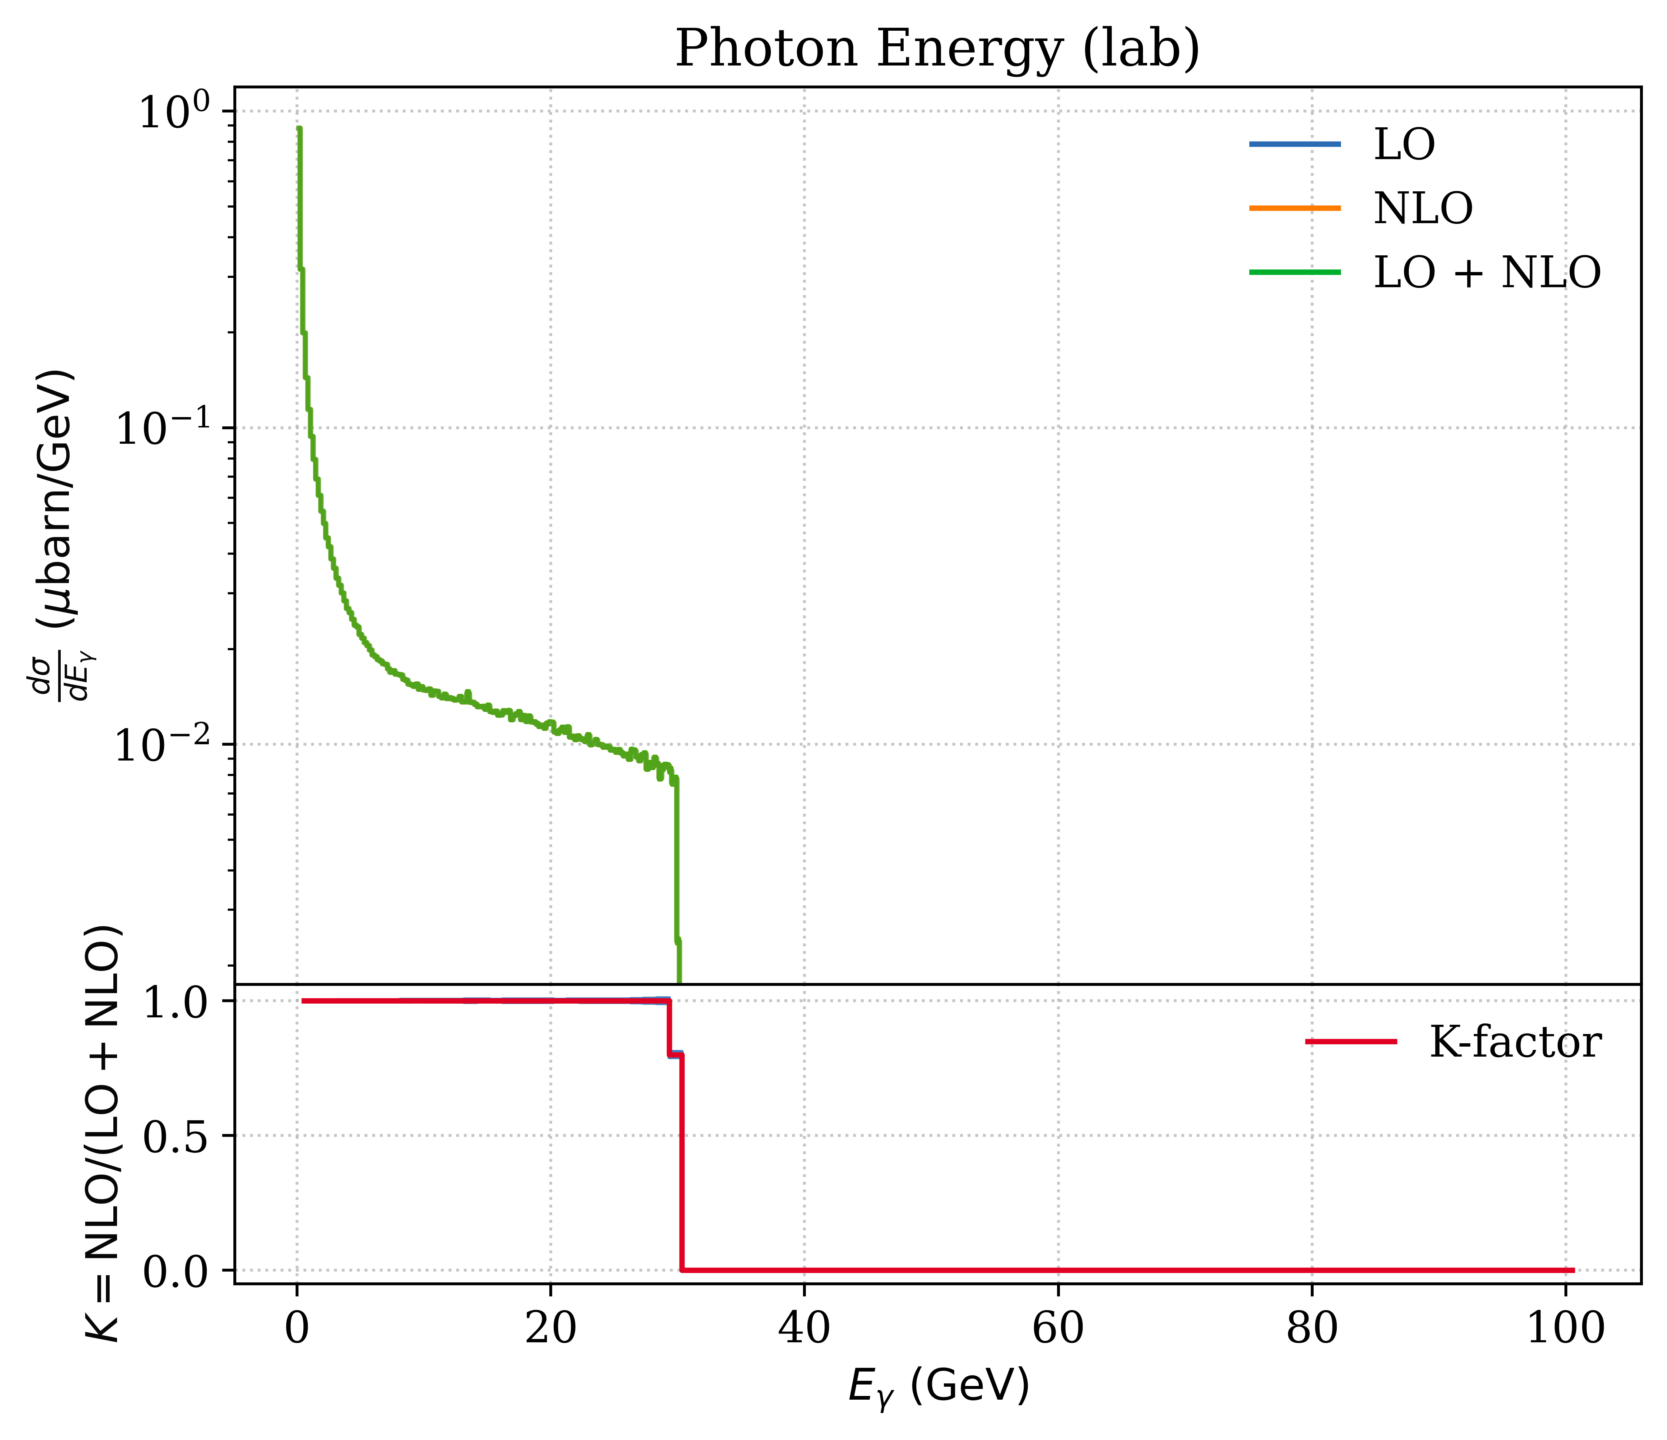
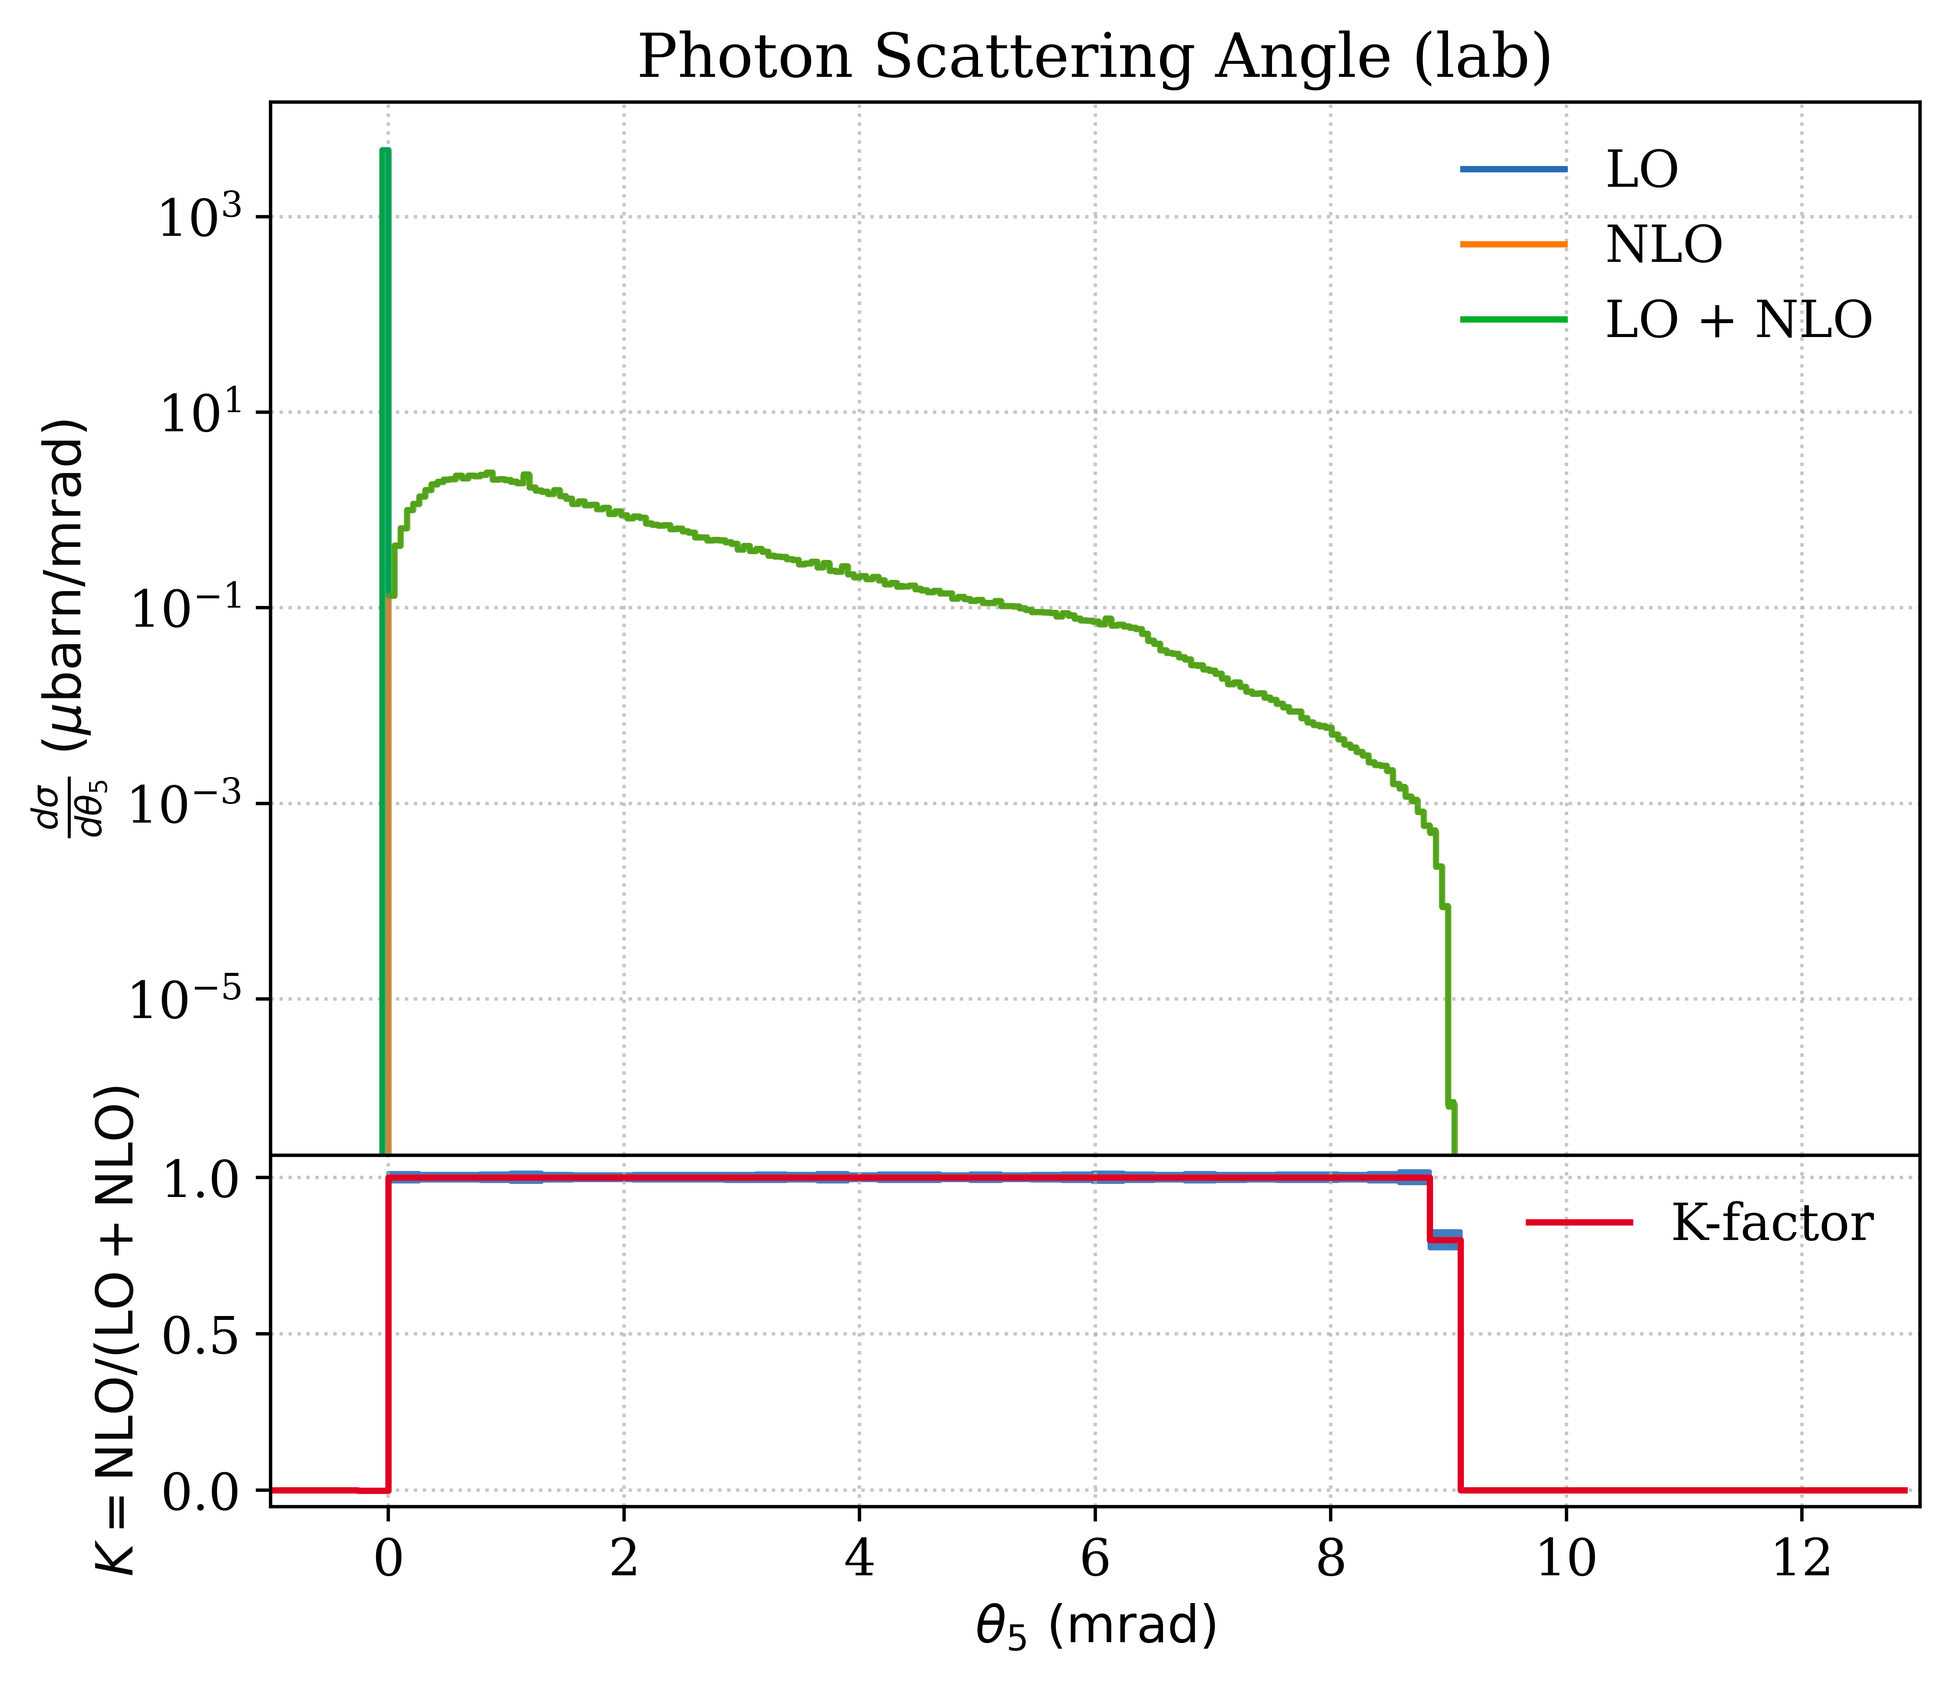
Photon: Energy & Scattering Angle

Slide 5
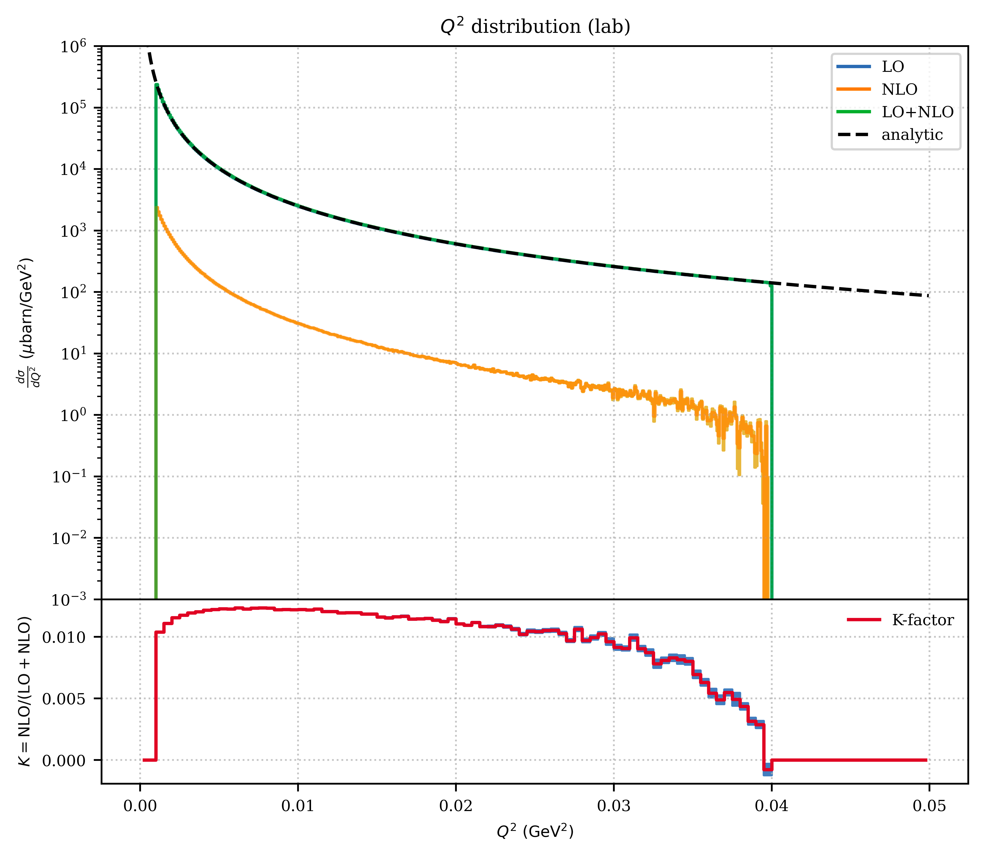
Momentum Transfer

Slide 6
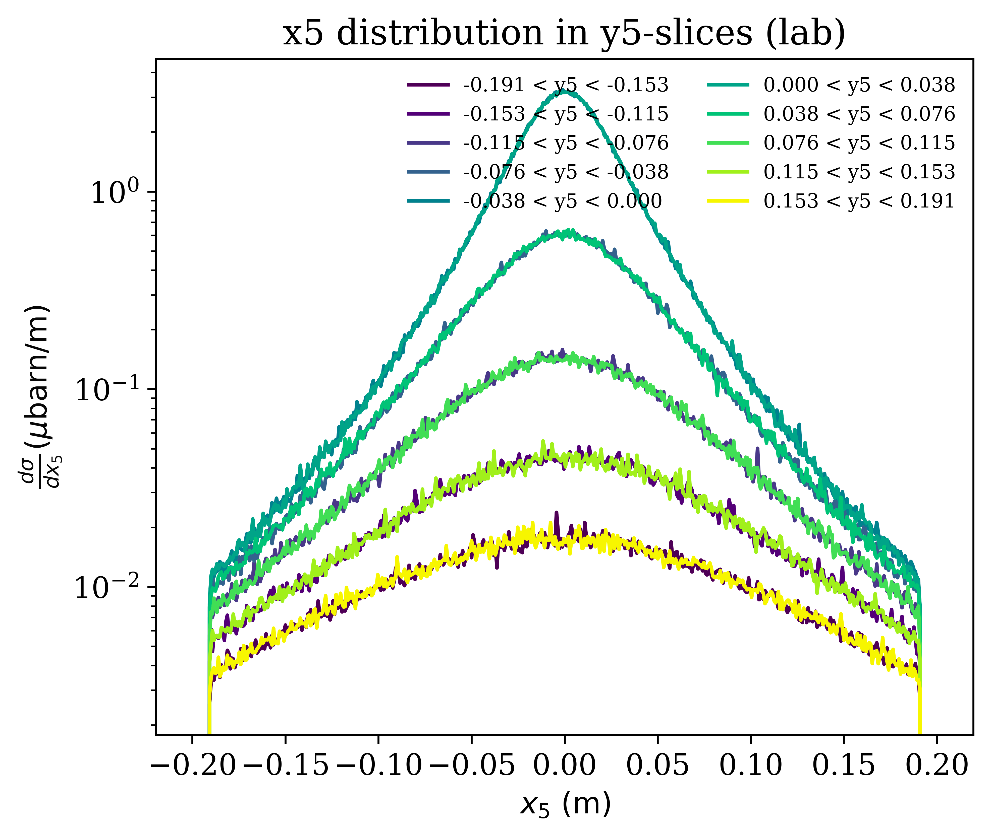
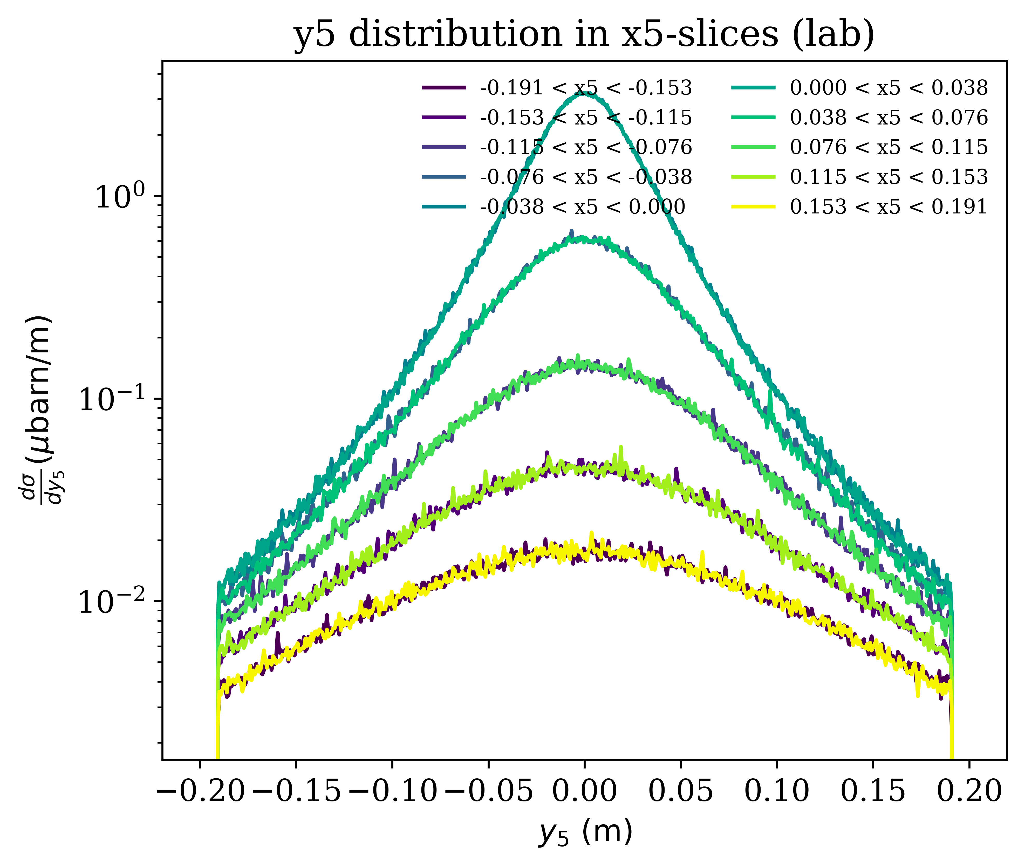
Where Photons Hit the ECAL

Slide 7
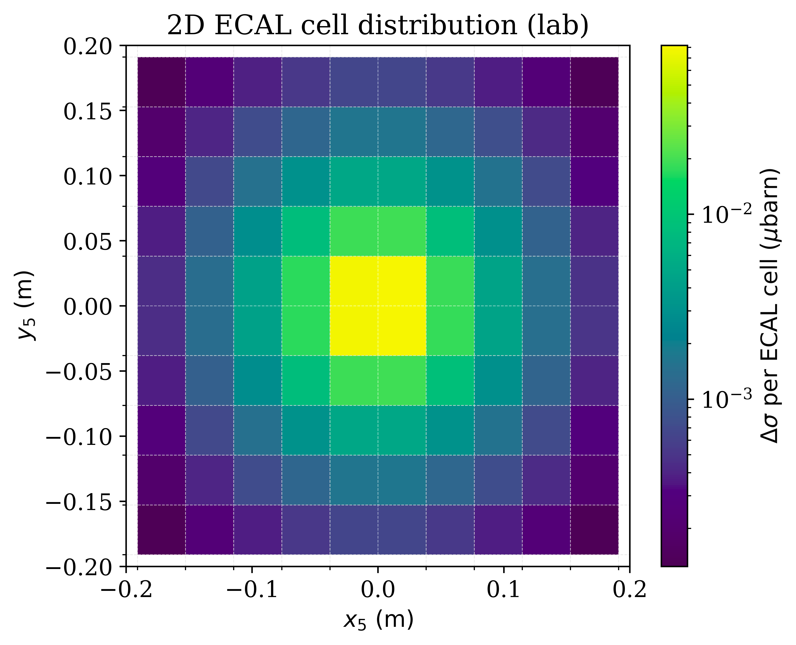
Expected Photon Cross Section on ECAL

Slide 8
Expected Cross Sections and Count Rates
Photon Energy | 100 MeV | 200 MeV | 500 MeV
[mb] | 0.250567 | 0.250567 | 0.250566
[1/s] | 42.53652 | 42.53653 | 42.53642
[mb] | 0.000091 | 0.000080 | 0.000082
[1/s] | 0.0154 | 0.0136 | 0.0139
[mb] | 0.00284 | 0.00283 | 0.00283
[mb] | 0.253407 | 0.253396 | 0.253397
Count rate input values:
Target length: 80 cm
Hydrogen pressure: 20 bar
2.687 x10¹⁹ protons/cm³
Beam intesity: 2 x10⁶ 1/s
The number of integration points (Runtime) has a significant impact on the result and its accuracy! →Under Investigation
The real-photon process contributes at the ~0.03% level

Slide 9
BACKUP

Slide 10
Used Equations
def calculate_rate(sigma_mb):
ltarget = 80 #cm
Hpres = 20 #bar
Npvol = 2.687*1e19 #Protons/cm^3
Ibeam = 2*1e6 #1/s
Np = Npvol * 2 * (Hpres/1.013) * ltarget #Protons/cm^2 (target thickness)
rate = sigma_mb * 1e-27 * Np * Ibeam
return rate #1/s

