Slide 1
COLOR BLOCK
assistive app for the colorblind

Slide 2
Literature Review

Slide 3
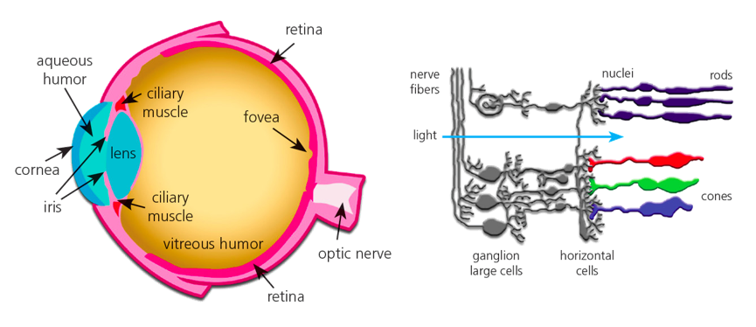
Perception to Everything

Slide 4
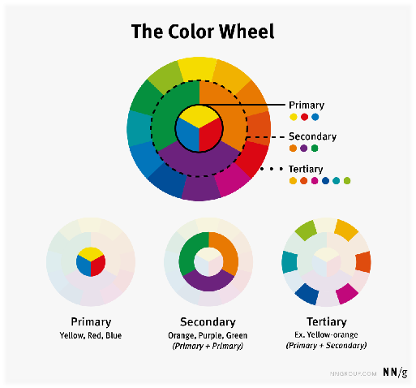
Color
Groups

Slide 5
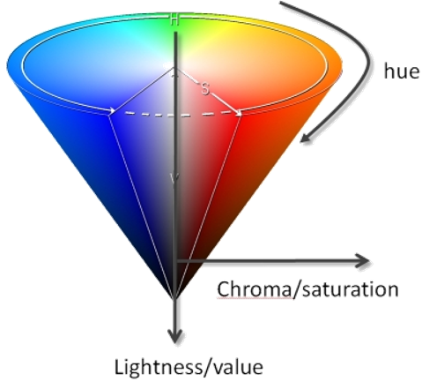
Color Characteristics
Hue : The appearance of color itself –blue
Saturation : Purity of Color
Lighting : Brightness of Color

Slide 6
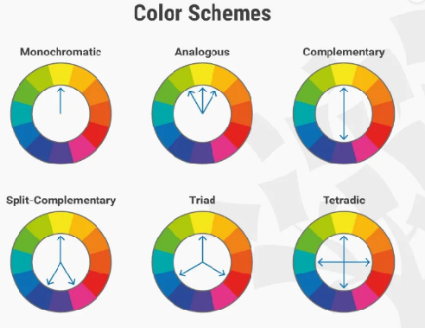
Color
Theory
Do the colors go along ?

Slide 7


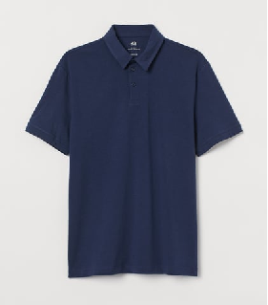


Our Application
matching ?

Slide 8
Market Analysis

Slide 9
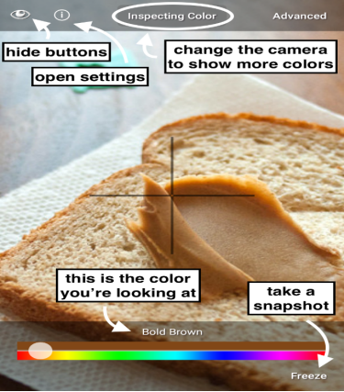
Color Blind Pal
Easy usage of common color names
Freeze and inspect
Use the phone as a portal

Slide 10
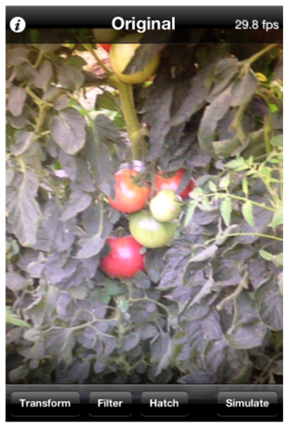
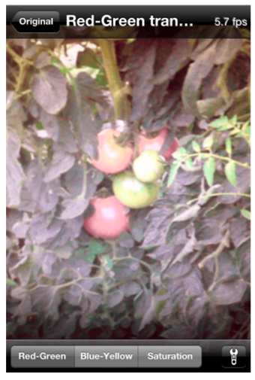
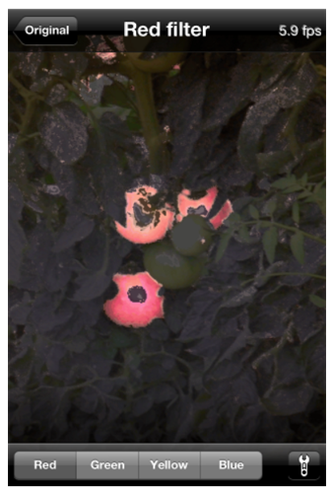
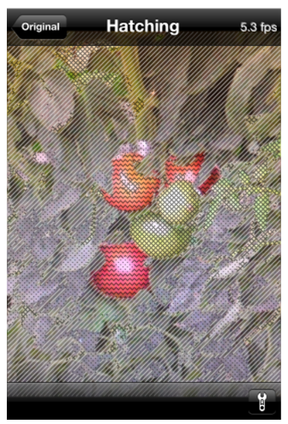
Visolve App
brighter transformations

Slide 11
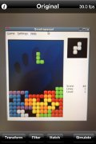
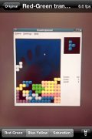
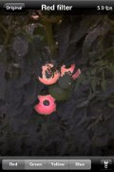
Red-Greeen transform
brightter reds // darker greens
Blue-Yellow transform
brighter blues // darker yellows
Filtering
darkerns all but the specified colors
Hatching
drawing hatch patterns depending on colors
Saturation increase

Slide 12
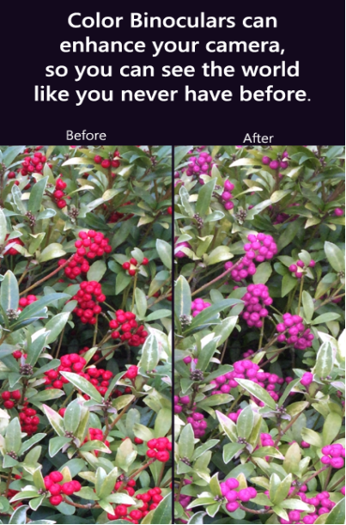
Color Binoculars
Distinguish colors in everyday lives
Replacing difficult color combinations
Supports all types of color blindness

Slide 13
THANK YOU
team 19

