Slide 1
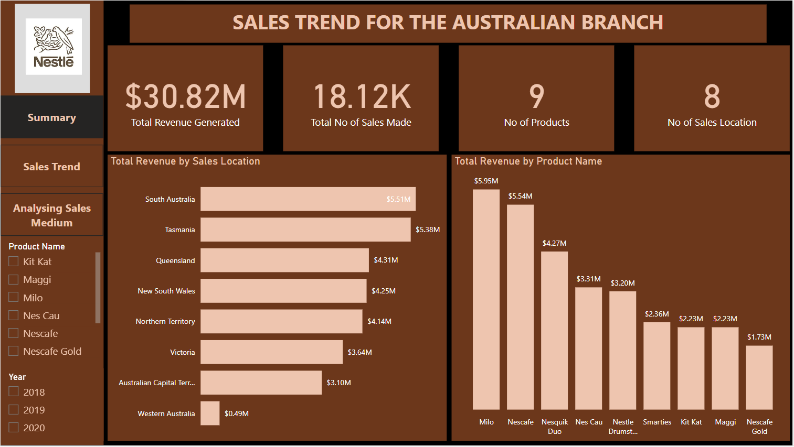

Slide 2
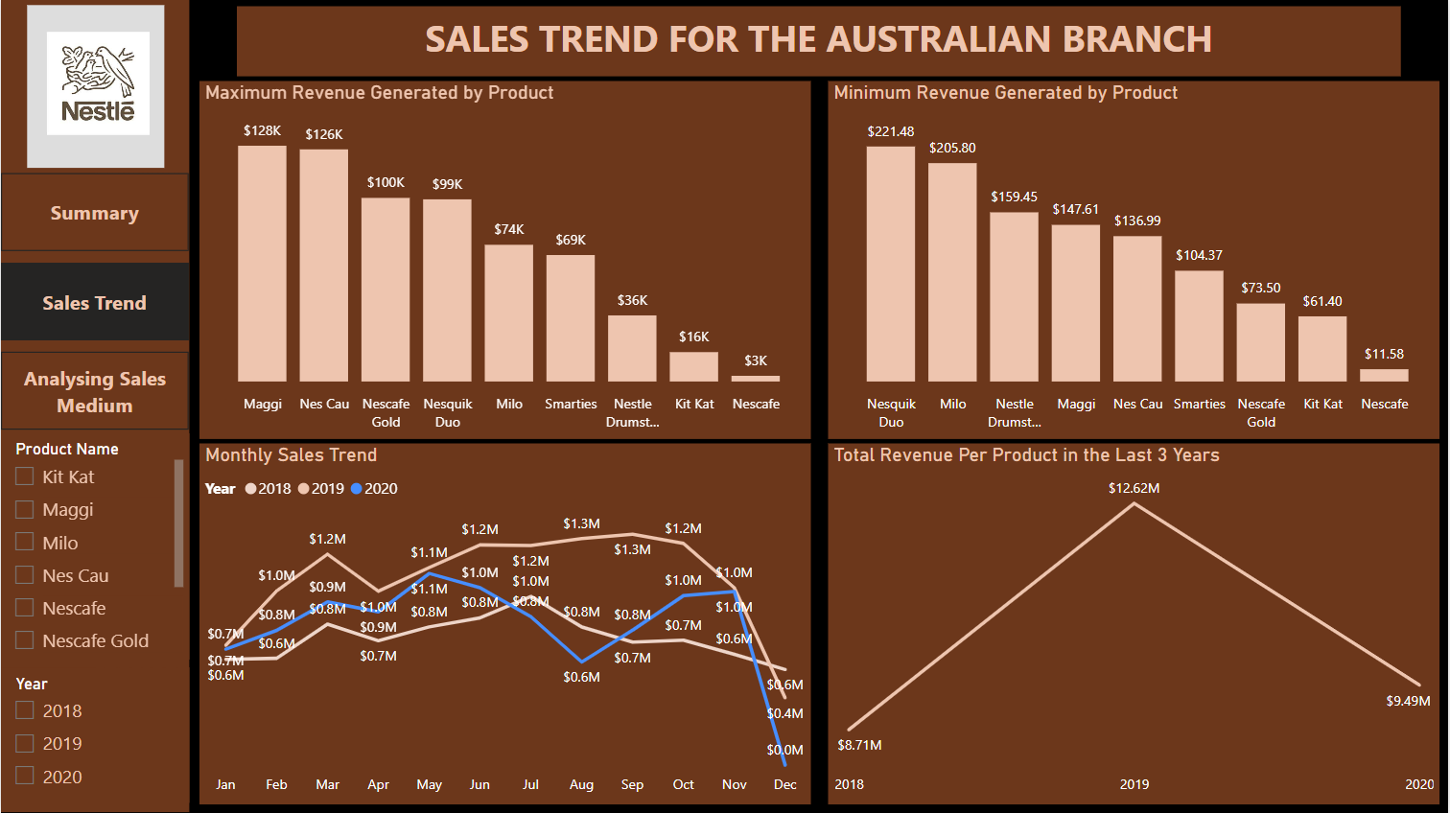

Slide 3
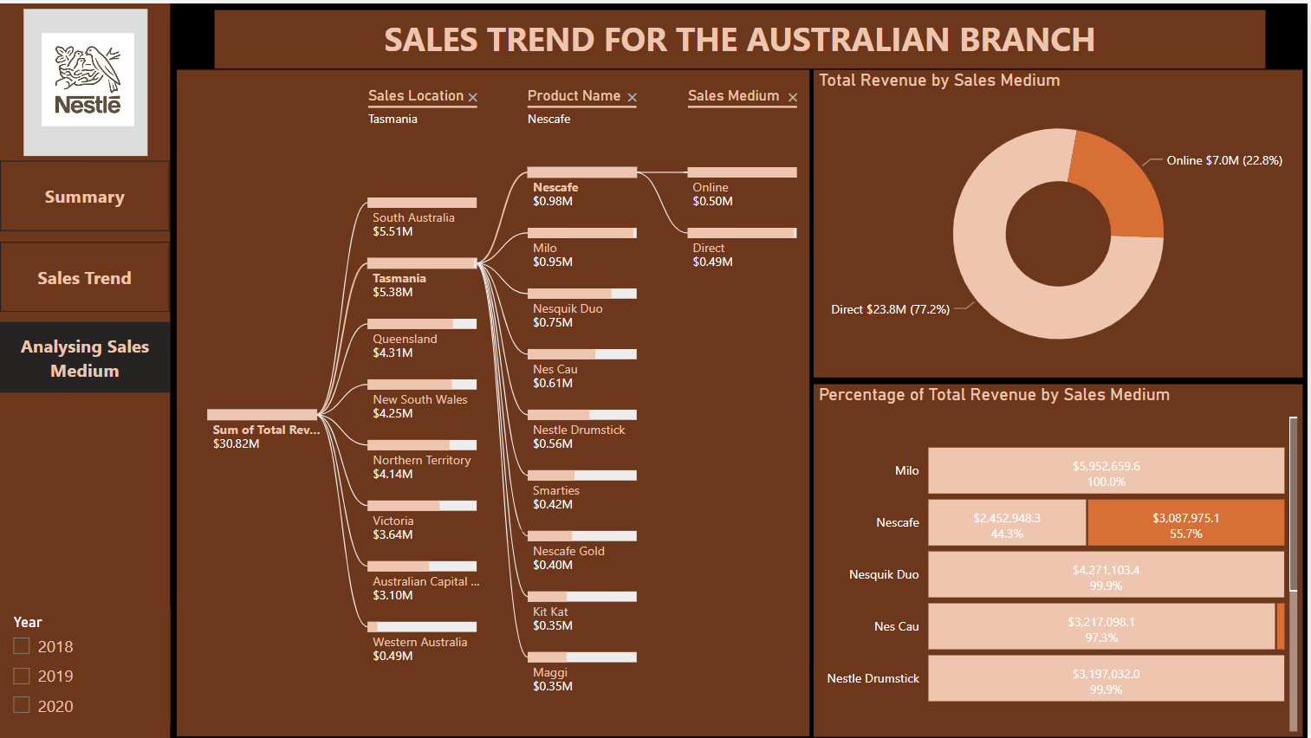

Slide 4
INSIGHTS
The total revenue generated by the company in the past three years is $30.8M. We generated the highest revenue in 2019 while the lowest revenue was generated in 2018. However, 2018 made the highest sales compared to other years.
The top 2 branches with the highest revenue generated are South Australia and Tasmania while Western Australia generates the lowest revenue.
Nescafe Gold proved to be the product with the average least generated revenue in the last three years, while Milo has the average highest generated revenue.
The products that generated the maximum revenue in a day were Maggi, Nes Cau, and Milo in 2018, 2019, and 2020 respectively. However, the product that generated the minimum revenue in the three years is Nescafe.
The revenue generated by all products declines drastically from November to December in most years.
The revenue generated by Kit Kat increases from January to June but starts to decline afterward.
The revenue generated by Maggi always declines in May and tries to pick up afterward. However, it was highest in Nov 2020.
The revenue generated by Milo is a bit steady until June but it starts to decline in July. It tries to pick up in October but fails.

Slide 5
INSIGHTS
Nes Cau generated the highest revenue between March and May.
Nescafe generated more revenue between July, August, and September.
Nescafe Gold generated zero revenue from January to March 2019 and 2020.
The revenue generated by Nesquik Duo reduces from July to September and nose-dives from October to December.
Milo and Nesquik Duo generated a constantly increasing revenue throughout the years. Every other product increased in 2019 and dropped in 2020 except Smarties.
The direct sales medium generated the highest revenue compared to the online sales medium.
Most of the revenue generated from Kit Kat and Nescafe is through the online sales medium.
Milo only generates revenue through the direct sales medium while Nesquik Duo, Nes Cau, and Nestle drumstick generate over 95% of its revenue through the direct sales medium.
Nestle Gold generates its revenue through a mixture of online and direct sales mediums.

