Slide 1

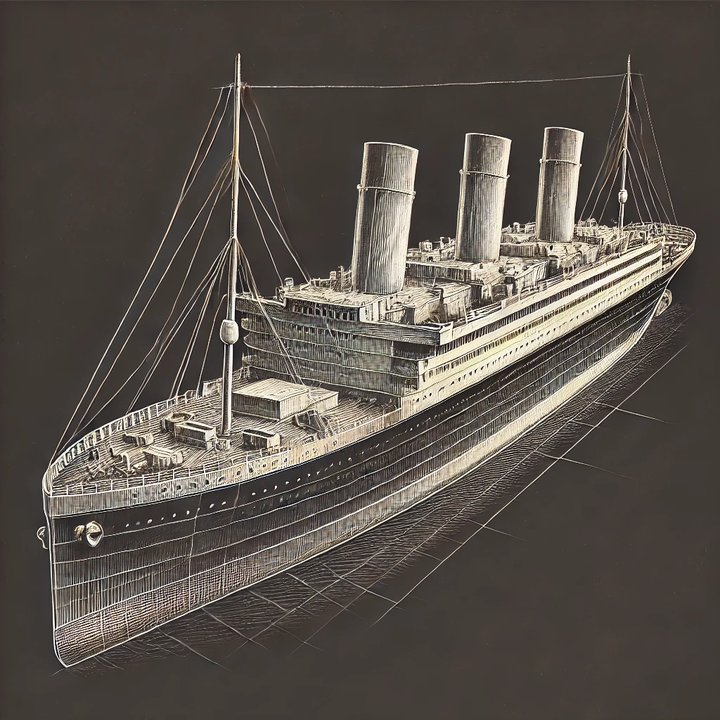
Data Mining : Titanic Dataset Analysis by. Mariam gorgy
Sir \ Amit

Slide 2
Objective : The objective of this project is to perform exploratory data analysis and machine learning modeling on the Titanic dataset to predict the survival outcomes of passengers. The analysis will include univariate, bivariate, and multivariate approaches, as well as the comparison of classification models.
Introduction

Slide 3
Dataset Overview: The Titanic dataset consists of records for passengers aboard the Titanic. Each record contains information on various attributes related to the passengers and their journey
Columns

Slide 4
Columns (Variables) in the Dataset:
PassengerId (Numerical): A unique identifier for each passenger.
Survived (Numerical): Binary value indicating whether the passenger survived (1) or not (0).
Pclass (Numerical): The class of the passenger (1st, 2nd, or 3rd class).
Name (Categorical): The name of the passenger.
Sex (Categorical): The gender of the passenger (male or female).
Age (Numerical): The age of the passenger.
SibSp (Numerical): The number of siblings or spouses the passenger had aboard the Titanic.
Parch (Numerical): The number of parents or children the passenger had aboard the Titanic.
Ticket (Categorical): The ticket number of the passenger.
Fare (Numerical): The fare the passenger paid for the ticket.
Cabin (Categorical): The cabin number assigned to the passenger.
Embarked (Categorical): The port where the passenger boarded the ship (C = Cherbourg, Q = Queenstown, S = Southampton).
( 6 numerical & 5 categorical)

Slide 5
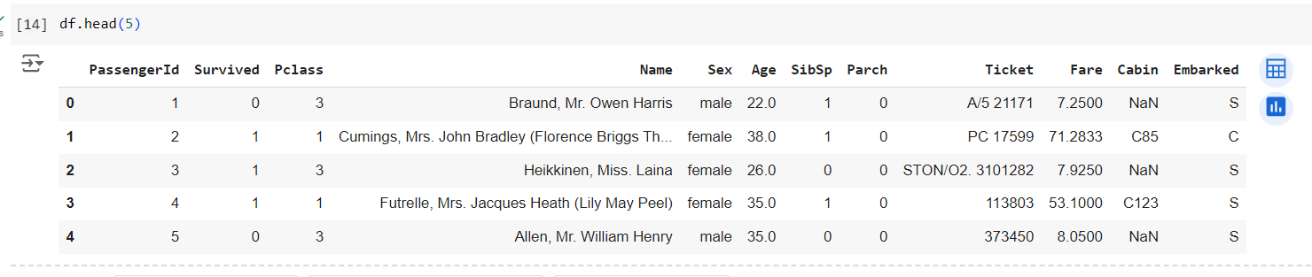
These variables will be analyzed and processed to predict the survival of the passengers using various machine learning techniques. Univariate and bivariate analyses will help uncover trends, while classification models such as logistic regression and decision trees will be employed for predictive modeling.
As we can see the dataset consists of 891 rows and 12 columns.

Slide 6
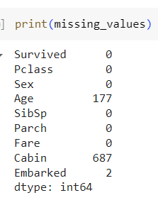


Exploratory Data Analysis (EDA)
Missing Values
Age: 177 missing values.
Cabin: 687 missing values.
Embarked: 2 missing values.
Columns like Cabin have a significant number of missing values, making them less useful for predictive modeling without appropriate imputation
I dropped the 'Name', 'PassengerId', and 'Ticket' columns because they don't impact survival prediction. These columns are identifiers or unique values, which don't add value to the model. This helps streamline the dataset for better prediction.
There is no duplication in the dataset

Slide 7
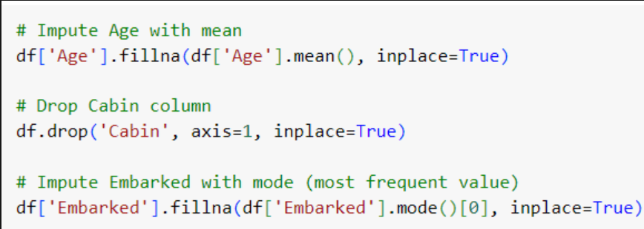
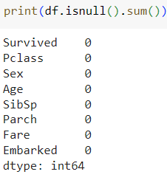
Exploratory Data Analysis (EDA)
Dropped columns: Removed the 'Cabin' column due to excessive missing values.
Handled missing data:
Imputed missing 'Age' values using the mean.
Imputed missing 'Embarked' values using the mode (most frequent value).
Checked for remaining missing values: Ensured no remaining missing values after the imputations.
Now data is cleaned and no missing Data as shown

Slide 8
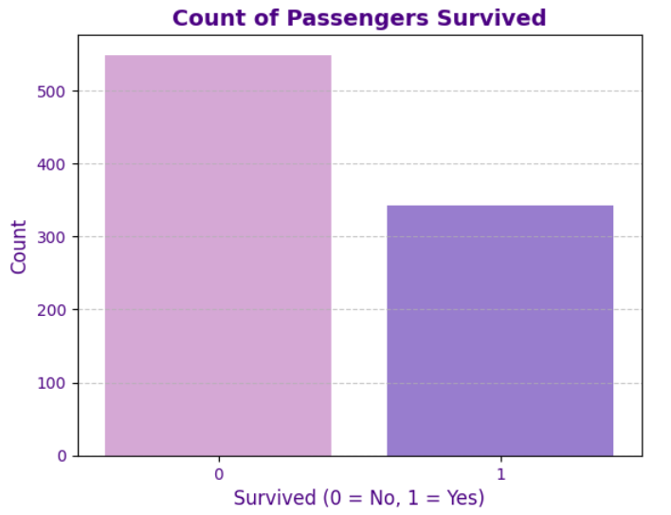
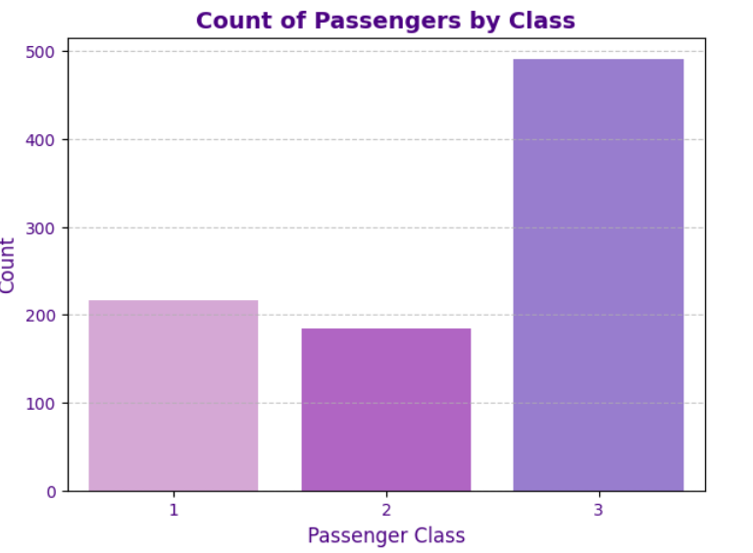
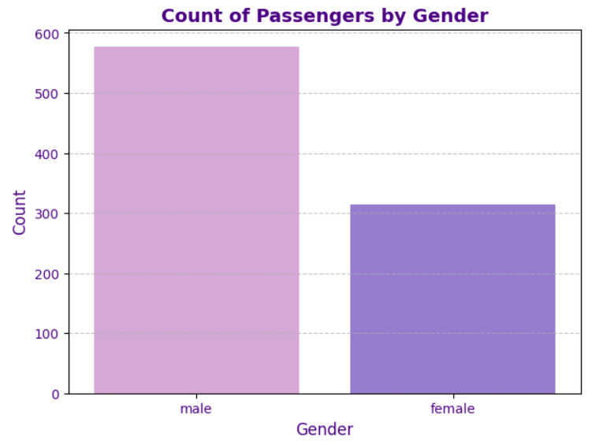
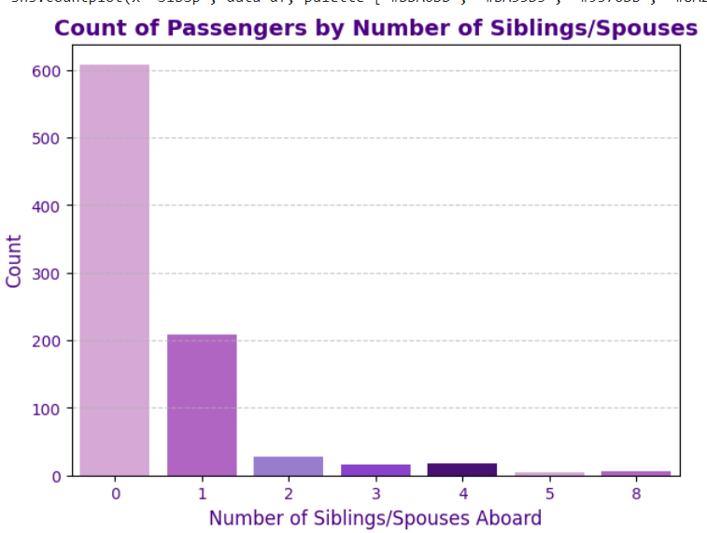
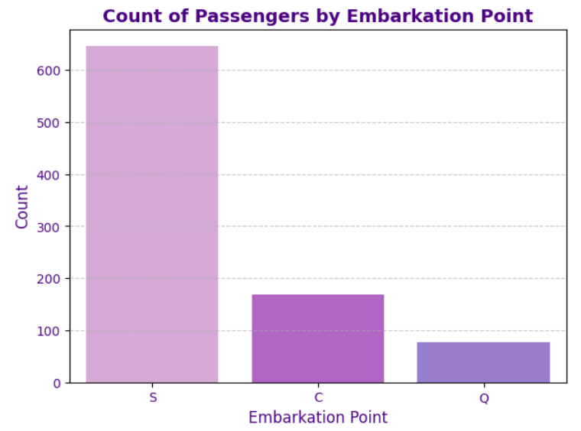
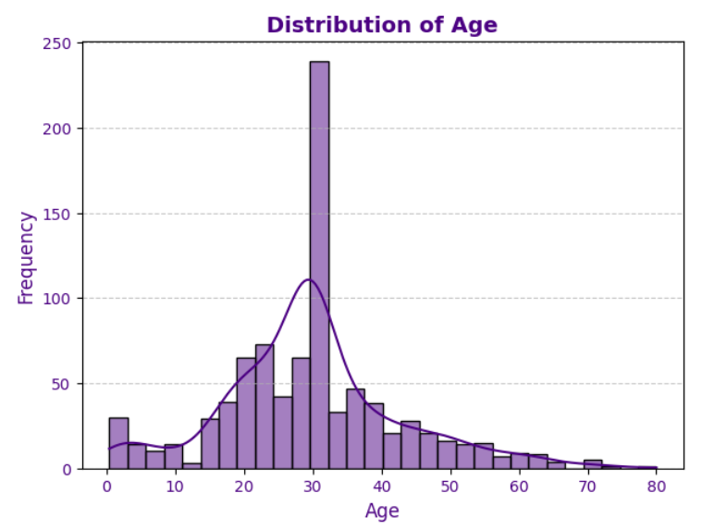
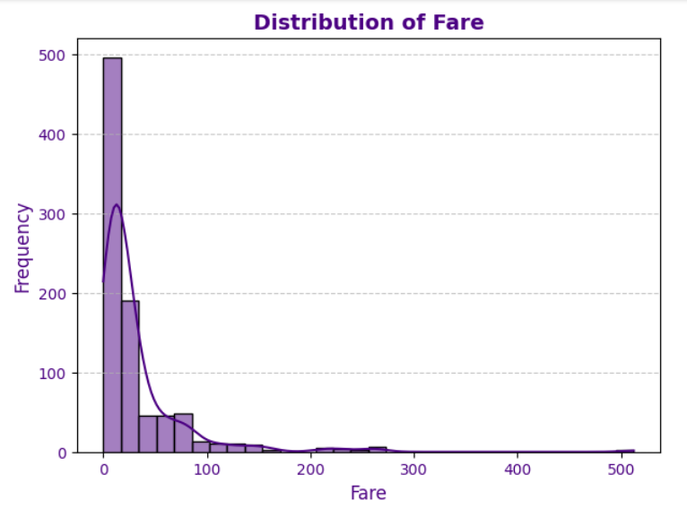
Univariate analysis & visualizations to examines a single variable to summarize and find patterns in the data, of distribution, central tendency, and variability.
Seaborn

Slide 9
This bar chart shows that more passengers did not survive (0) than those who survived (1), with significantly more fatalities.
This chart shows most passengers had no siblings or spouses aboard, with fewer having one or more.
This chart shows that most passengers traveled in 3rd class, followed by 1st class, with the fewest in 2nd class.
This chart shows most passengers had no siblings or spouses aboard, with fewer having one or more.
This chart shows that most passengers boarded from Southampton, followed by Cherbourg and Queenstown.
This chart shows that there were significantly more male passengers than female passengers on board.

Slide 10
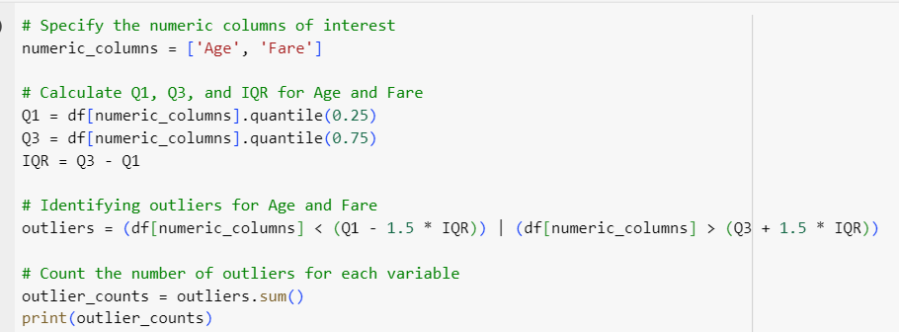
7. Outlier detection: Use the Tukey method to identify outliers.
I implemented a function to detect outliers using Tukey's method (based on the IQR). The function identifies outliers that fall below Q1 - 1.5 IQR or above Q3 + 1.5 IQR. I applied this function to the 'Age' and 'Fare' columns of the dataset to detect any data points that deviate significantly from the norm.
The results show:
66 outliers in the Age column.
116 outliers in the Fare column.
These outliers may impact the analysis, as they represent values that are significantly different from the rest of the data. Further steps may include handling or removing these outliers to improve model accuracy

Slide 11
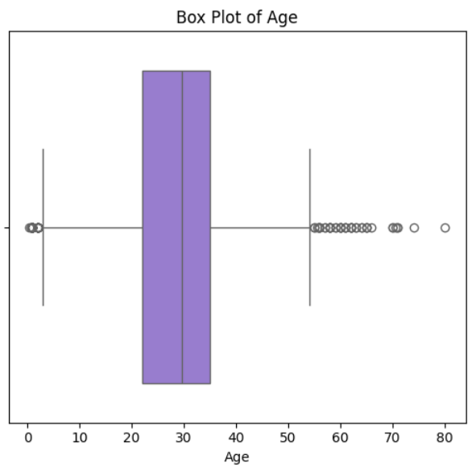
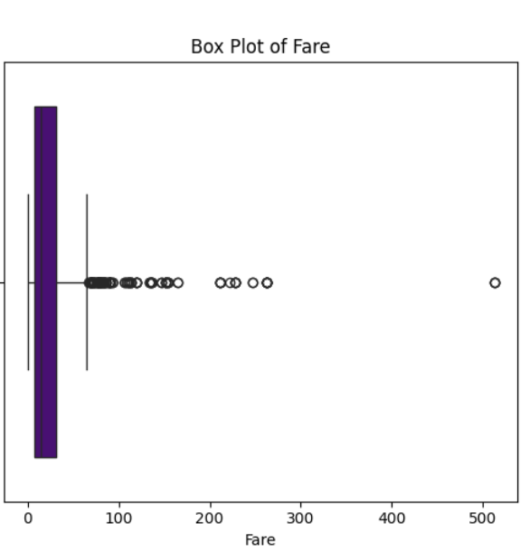
Box Plot of 'Age':
This box plot shows the distribution of ages, highlighting the median and interquartile range. Outliers—values outside the whiskers—represent ages significantly higher or lower than most passengers. The majority of passengers are aged between 20 and 40, with outliers below 10 and above 60.
Box Plot of 'Fare':
This box plot shows the distribution of fares paid. Most fares are below 100, with several outliers exceeding 200. A few extreme outliers are seen, with fares going over 500.

Slide 12
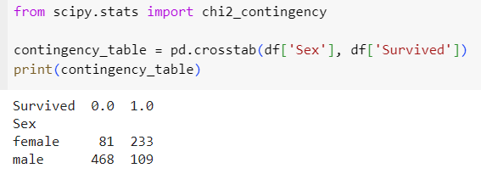
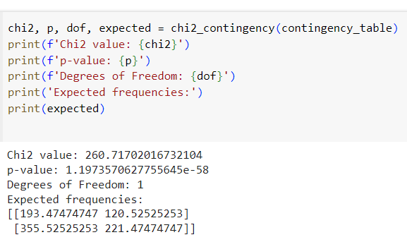

8.1.Chi-square test for independence between two categorical variables
The data shows a clear difference in survival rates between males and females. Of the females, 233 survived while only 81 did not survive. In contrast, the majority of males did not survive, with 468 fatalities and only 109 survivors. This suggests that females had a significantly higher chance of survival compared to males in this dataset.
Chi2 value (260.72): A high value indicating a strong difference between observed and expected frequencies.
p-value (1.19e-58): the very low p-value suggests a strong association between gender and survival on the Titanic.
p-value (1.56e-06) is very small, This suggests that having siblings or spouses aboard did have an impact on survival rates.

Slide 13
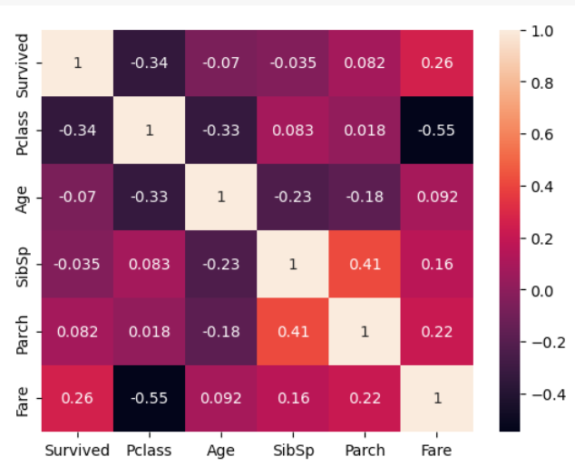
8.2 - Correlation analysis to examine relationships between two numeric variables I use correlation matrix
From the heatmap, the variables most strongly related to survival are:
Pclass: It has a negative correlation (-0.34) with survival, meaning passengers in lower classes (higher Pclass numbers) were less likely to survive.
Reason: Higher-class passengers (1st class) had better access to lifeboats and were prioritized during the evacuation.
Fare: It has a positive correlation (0.26) with survival, indicating that passengers who paid higher fares were more likely to survive.
Reason: Higher fare-paying passengers were generally in higher classes, with better cabin locations and priority during evacuation.

Slide 14
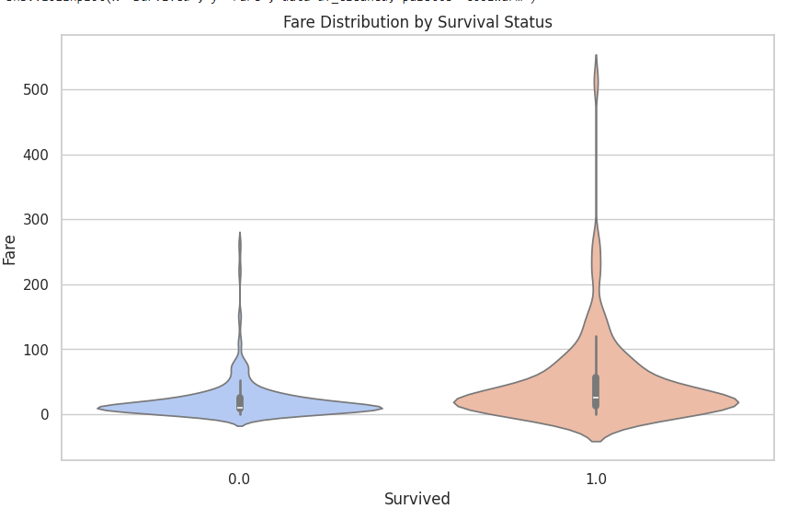
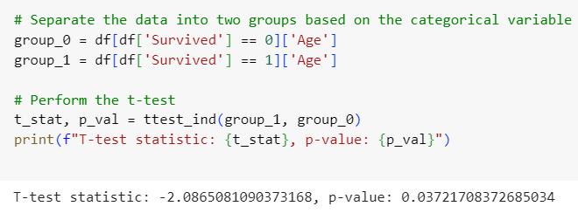
8-3T-test or Mann-Whitney U test to compare means between two groups.
The Violin Plot shows the distribution of Age
In this step, I performed a T-test to compare the mean ages of passengers who survived and those who did not. I first separated the data into two groups based on the 'Survived' column (0 = not survived, 1 = survived), and then I ran the T-test to check if the difference in ages between the two groups is statistically significant. The T-test results include the T-statistic and p-value , which help assess whether age is a significant factor in survival.
Both groups are mostly aged between 20 and 40, but survivors have a slightly higher concentration in this range, indicating younger passengers had a better chance of survival.
based on the T-test result (p-value: 0.037), age is statistically significant in determining survival, meaning that age is a factor that influenced survival. The data suggests that younger passengers had a higher chance of survival compared to older passengers.

Slide 15
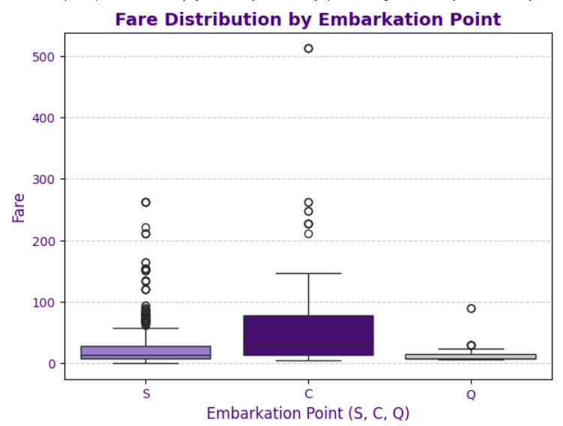
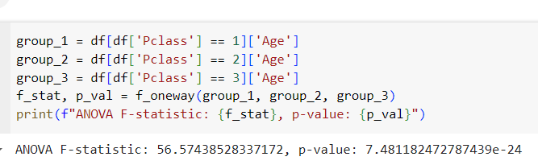
8.4 Analysis of Variance (ANOVA) to compare means across multiple groups.
The box plot shows the Fare distribution by Embarkation Point (S, C, Q). Passengers who embarked from Cherbourg (C) paid significantly higher fares on average compared to those who embarked from Southampton (S) and Queenstown Q
indicates that embarkation point influenced the fare prices passengers paid. which suggests that many of them were likely traveling in higher classes
A one-way ANOVA test was performed to compare the mean fares among these groups. The F-statistic (56.57) and the p-value (7.48e-24) indicate that the differences in fare across the three embarkation points are statistically significant.

Slide 16
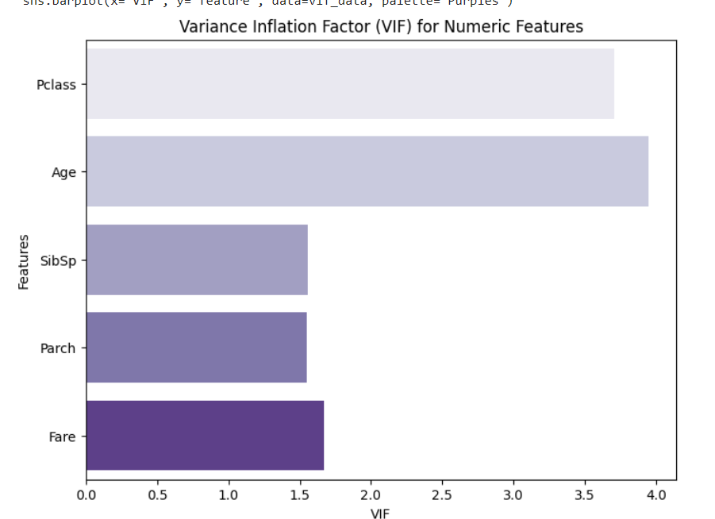
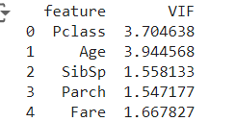
9.Check for presence of collinearity and multi-collinearity and address it appropriately. VIF
calculated the Variance Inflation Factor (VIF) for the numerical columns (excluding 'Survived') to check for multicollinearity between the features. A higher VIF value indicates a higher correlation with other features, and you printed the VIF values to identify potential multicollinearity in the dataset.
This bar plot visualizes the (VIF) for different numeric features in the dataset. The Age (3.94) and Pclass (3.70) features have the highest VIF values, indicating some multicollinearity-y with other variables, though it's not severe. Features like SibSp (1.55), Parch (1.55), and Fare (1.67) show lower VIF values, suggesting minimal multicollinearity and making them reliable for use in the model.
And indicating little to no multicollinearity.

Slide 17
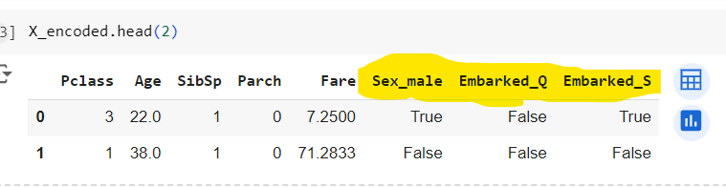
10. Encode the data if required (if there are categorical independent variables).
Target variable y is set to 'Survived', independent variables X are created by removing 'Survived’,
use one-hot encoding converts categorical data into numerical columns.
The new columns are now binary, such as Sex_male and Embarked_Q/S, where True or False
This allows the model to process categorical data in numerical form, making it ready for analysis.

Slide 18
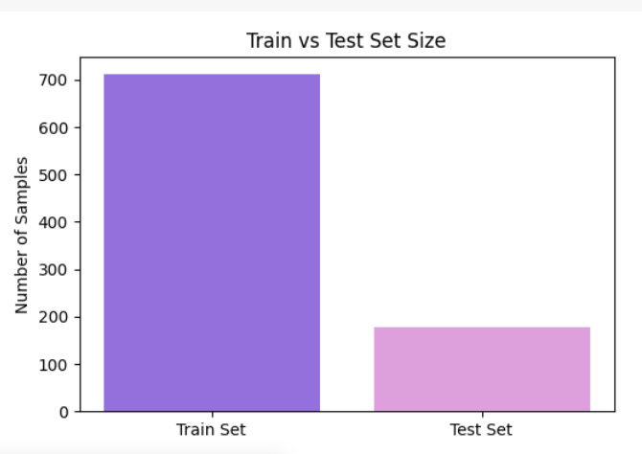
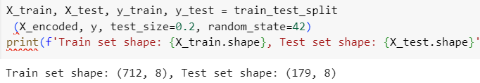
11. Split the dataset into training and testing subsets.
This bar chart shows the division of the dataset into two parts: the training set (used to teach the model) and the test set (used to evaluate the model). The larger bar represents the training set, which has around 700 samples, while the smaller bar represents the test set, with about 180 samples
This bar chart shows the division of the dataset into two parts: the training set (used to teach the model) and the test set (used to evaluate the model). The larger bar represents the training set, which has around 700 samples, while the smaller bar represents the test set, with about 180 samples
712 samples with 8 features for training
179 samples with 8 features for
that 80% of the data is used for training the model, and 20% is reserved for testing its accuracy

Slide 19
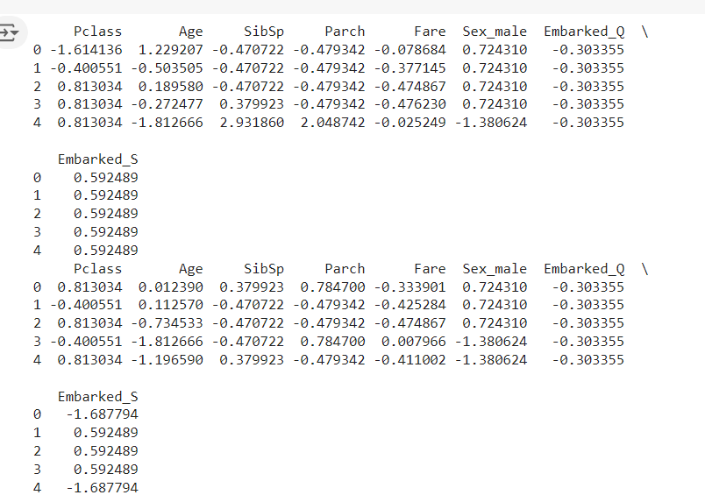
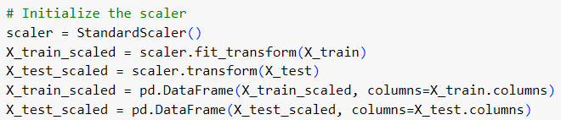
12. Scale the training data and use the same scaler to also scale the test data.
the standardized (or scaled) values of the features in the Titanic dataset. Each feature, such as Pclass, Age, Fare, etc., has been transformed to have a mean of 0 and a standard deviation SD of 1.
standardizing
Standardization
ensures that all features are on the same scale, making sure that no single variable dominates the others because of its larger value range, which improves model performance.
Initialize, fitting, Transformation

Slide 20
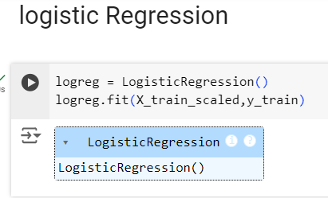
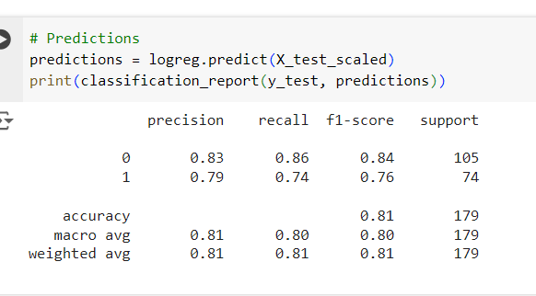
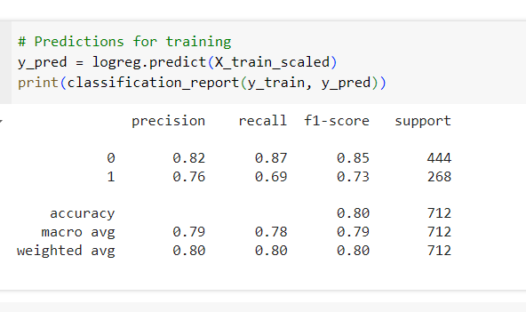
13. Select one categorical variable as the target. Conduct logistic regression and decision tree analysis to predict it and compare the performance of the two models. Logistic Regression (Training and Testing) Comparing
Training Set Accuracy "The model was successfully trained using the scaled training data and achieved an accuracy of 80%
test dataset (X_test_scaled)
After training the Logistic Regression model, it achieved 80% accuracy. The model predicts class '0' (not survived) more accurately than class '1' (survived), which aligns with the imbalance in the dataset Testing Set Accuracy: 81%
Test Set Predictions : "This section shows the predictions for the test data. The Logistic Regression model achieved 81% accuracy. The model predicts class '0' (not survived) with better precision and recall than class '1' (survived), indicating some imbalance in predicting the 'survived' class

Slide 21
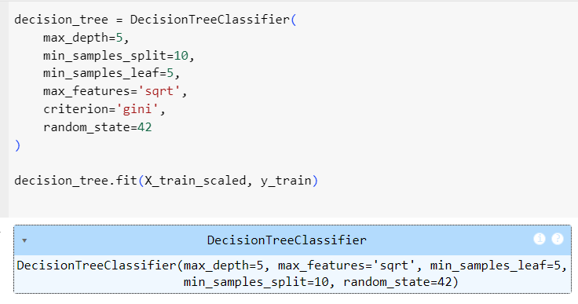
13 logistic regression and decision tree analysis to predict
shows the initialization and fitting of the Decision Tree Classifier model on the training data.
The Decision Tree Classifier achieved 83% accuracy on the training data and 80% accuracy on the test data.
- It performed better for class '0' (not survived) with high recall: 96% (training) and 90% (test).
- For class '1' (survived), recall was lower: 61% (training) and 66% (test).

Slide 22
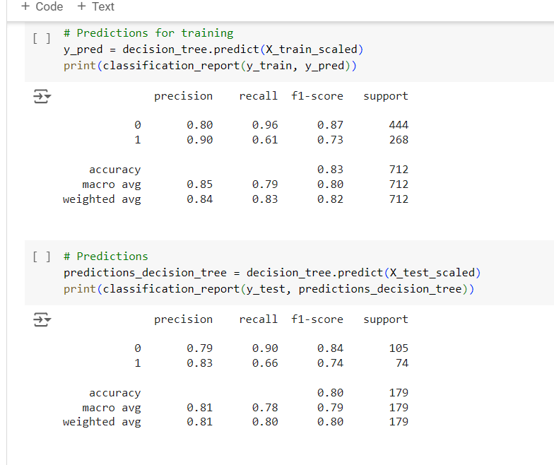
13 logistic regression and decision tree analysis to predict
shows the classification reports for both the training and testing datasets, which summarize the precision, recall, and f1-scores for the predictions made by the Decision Tree model.
summarizes the precision, recall, and f1-scores for both classes ('0' and '1') on the training and test datasets.
Class '0' (not survived) had a high recall of 96% (training) and 90% (test).
Class '1' (survived) had a lower recall of 61% (training) and 66% (test), showing some imbalance in predicting survivors.

Slide 23

14. Select one continuous variable as the target. Conduct Linear Regression and Regression Tree to predict it and compare the performance of the two models.
Check for validity of assumptions (LINE) Check for overfitting and take steps to address it.
the Linear Regression model has an extremely low MSE of 1.7527696046061498e-28, indicating it may have overfitted the data, capturing even minor fluctuations that don't generalize well. In contrast, the Decision Tree Regressor has an MSE of 0.226165897988827, which suggests a better balance between capturing patterns and avoiding overfitting. However, the Decision Tree might still benefit from tuning to improve its accuracy.
In conclusion, while Linear Regression may seem more accurate, it likely overfits the Titanic data, making the Decision Tree a more reliable model.

Slide 24
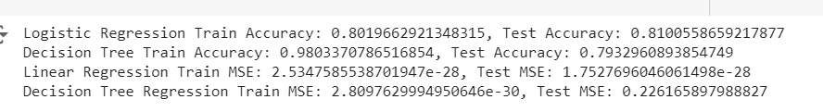
14. Select one continuous variable as the target. Conduct Linear Regression and Regression Tree to predict it and compare the performance of the two models.
Check for validity of assumptions (LINE) Check for overfitting and take steps to address it.
Model Performance Comparison:
Logistic Regression:
Training Accuracy: 80.2%
Test Accuracy: 81.1%
This shows the model generalizes well to the test data, with a slightly better performance on the test set.
Decision Tree:
Training Accuracy: 98.0%
Test Accuracy: 79.3%
The decision tree overfits the training data, achieving very high accuracy but a lower test accuracy, indicating potential overfitting.
Linear Regression (MSE):
Training and Test MSE are extremely low, indicating that the model fits almost perfectly to the data.
Decision Tree Regression (MSE):
Training MSE: 2.81e-30
Test MSE: 0.226
While the model performs well on the training data, the test MSE is higher, which suggests some overfitting in the regression as well.

Slide 25
Thank YOU

