Slide 1
Recommendation System for Stack Overflow Questions
Mariama oliveira

Slide 2
Agenda
Introduction
Problem Statement
Project Goals
Dataset
Experiment
Evaluation
Results
Conclusion

Slide 3

It is a Q&A forum for programmers
28 million users, host more than 24 million questions, 36 million answers
In January 2025, over 25,000 new questions were posted on the platform, but in January 2020, which saw more than 147,000 posts

Slide 4
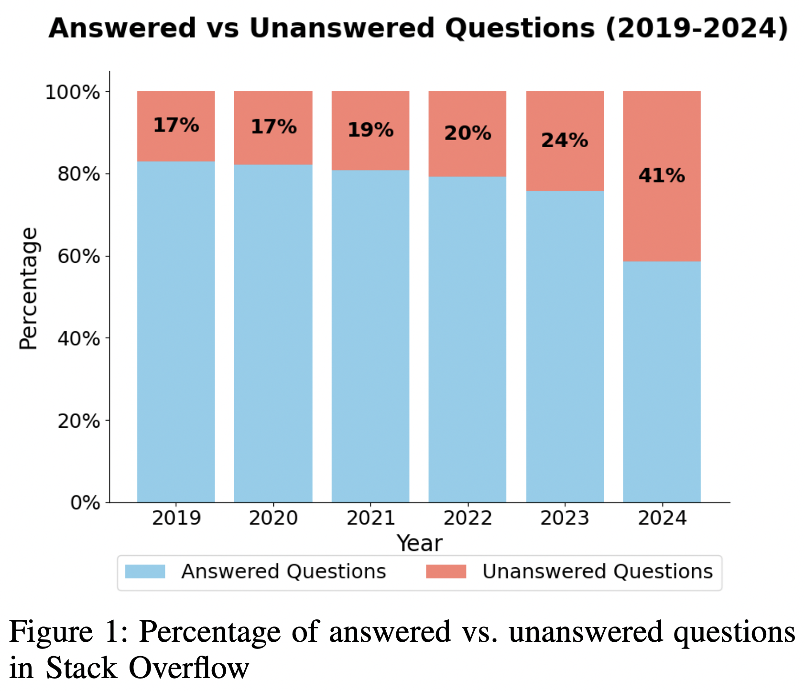
Problem statement
As fewer people utilize these tools, it becomes even more essential to identify the right users who can provide answers aligned with their expertise.

Slide 5
Project goals
Primary goal
Explore classical approaches to leverage recommendation systems that can suggest appropriate answerers for new questions posted on the Stack Overflow platform.
Secondary goals
Extraction and creation of a database using real data from Stack Overflow questions and answers.
Utilization of a language model to leverage content-based recommendation.

Slide 6
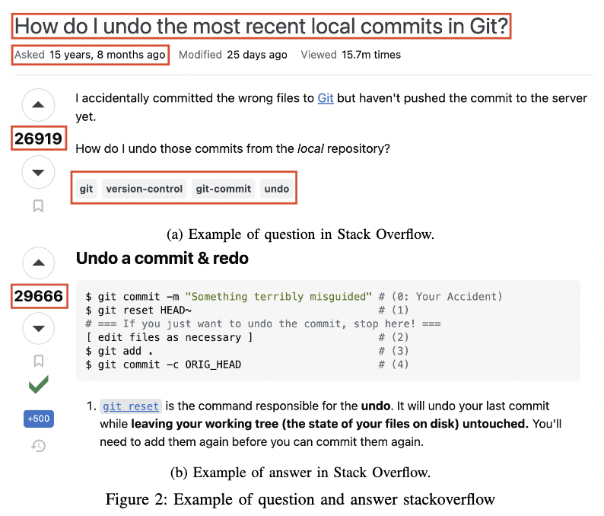
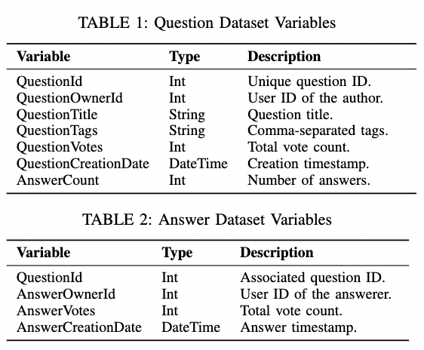
dataset
878,718 questions and1,105,677 answers

Slide 7
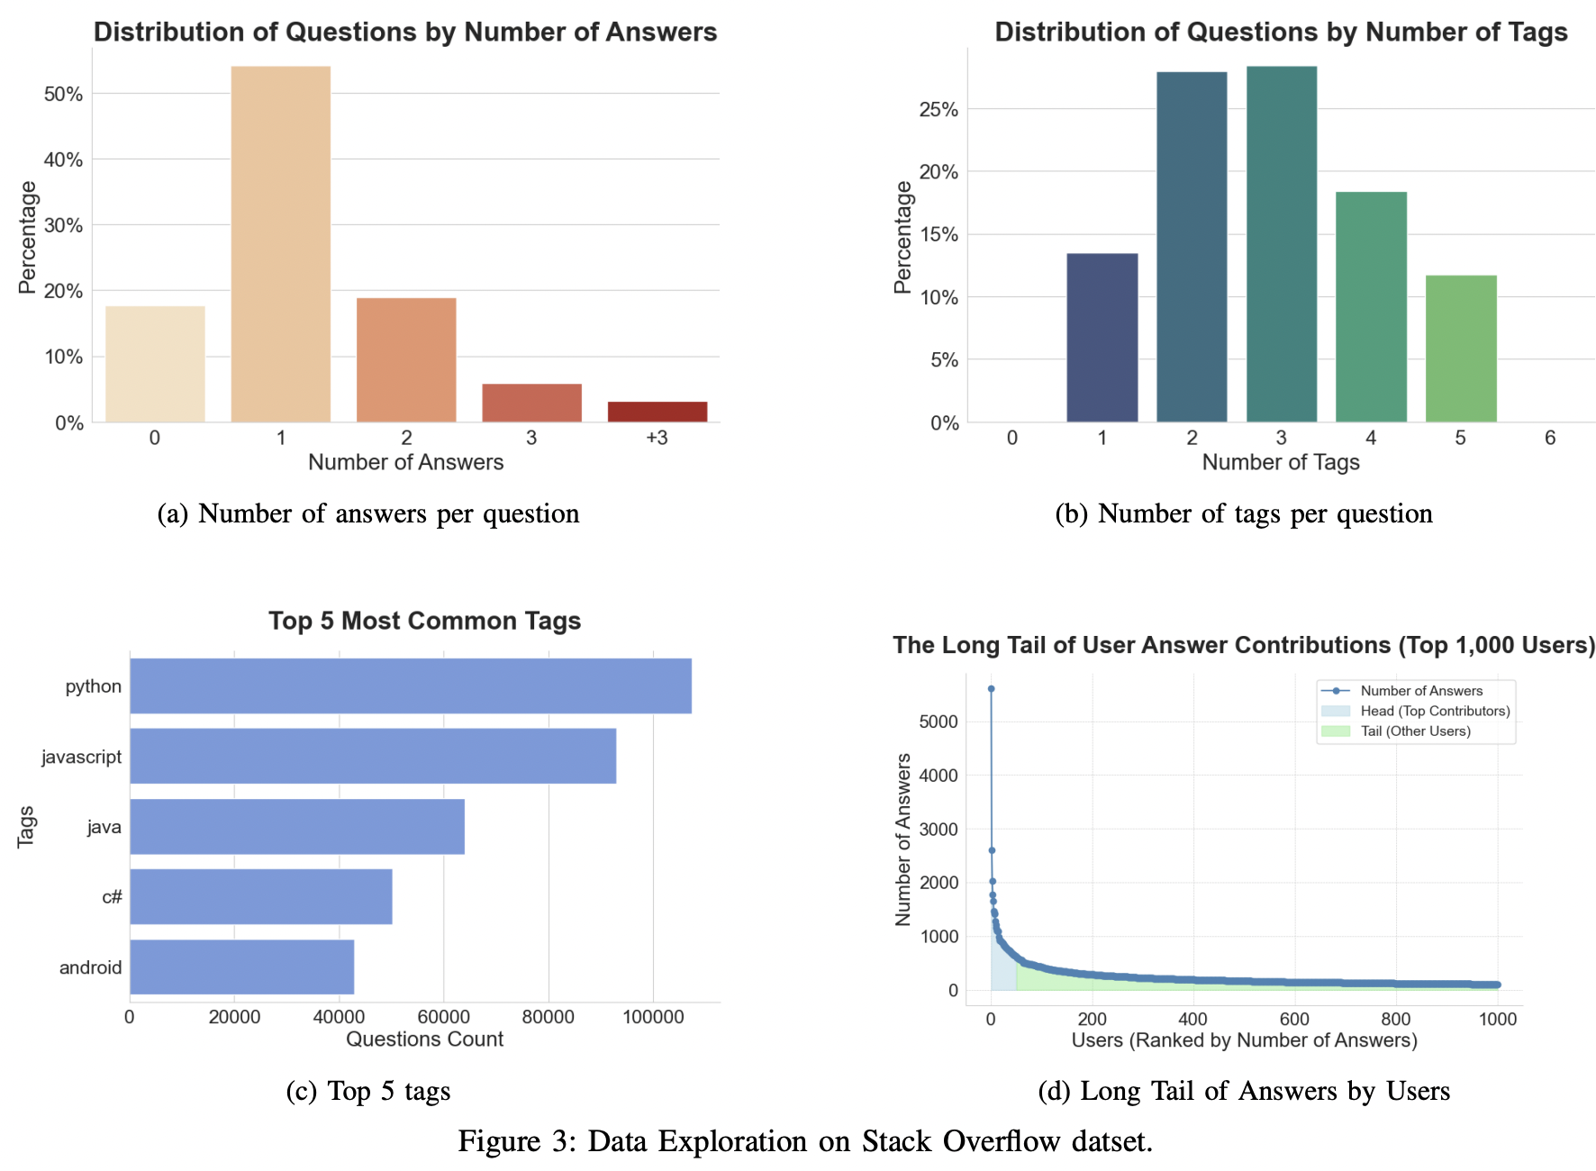

Slide 8
Experiment
Collaborative-based Filtering
Setup 1: User-Tag Interaction
Content-based Filtering
Setup 2: User-Tag Interaction
Setup 3: User Profile Title Embeddings*
Setup 4: Individual Questions Title Embeddings*
Setup 5: Individual Questions Title Embeddings + Tag Embeddings*
*They all utilized the same model Sentence Transforms model (all-MiniLM-L6-v2)

Slide 9
SETup 1 – collaborative
User-Tag Matrix
Tag-Tag Similarity
 | Python | Java | C++ | JavaScript | SQL
User_1 | 0 | 0 | 1 | 2 | 0
User_2 | 0 | 0 | 0 | 4 | 8
User_3 | 2 | 0 | 0 | 1 | 0
User_4 | 0 | 0 | 0 | 9 | 0
User_5 | 3 | 0 | 7 | 6 | 0
 | Python | Java | C++ | JavaScript | SQL
Python | 1.0 | 0.95 | 0.73 | 0.6 | 0.16
Java | 0.16 | 1.0 | 0.0 | 0.0 | 0.0
C++ | 0.0 | 0.0 | 1.0 | 0.0 | 0.0
JavaScript | 0.18 | 0.0 | 0.52 | 1.0 | 0.29
SQL | 0.61 | 0.0 | 0.0 | 0.37 | 1.0

Slide 10
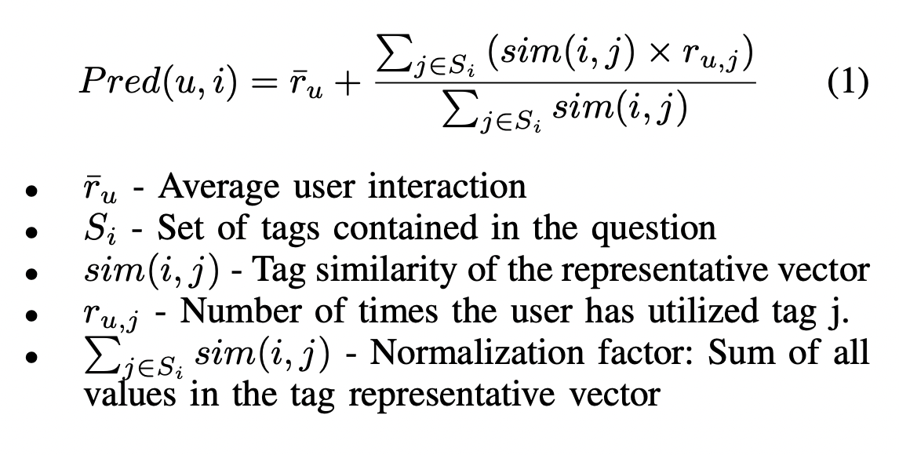
SETup 1 – collaborative

Slide 11
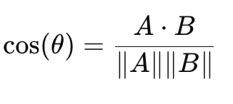
SETup 2 – content
User-Tag Matrix
New Question Vector
 | Python | Java | C++ | JavaScript | SQL
User_1 | 0 | 0 | 1 | 2 | 0
User_2 | 0 | 0 | 0 | 4 | 8
User_3 | 2 | 0 | 0 | 1 | 0
User_4 | 0 | 0 | 0 | 9 | 0
User_5 | 3 | 0 | 7 | 6 | 0
 | Python | Java | C++ | JavaScript | SQL
New Question | 1 | 0 | 0 | 0 | 1

Slide 12
SETup 3 – content – User profile (nLP)
Extract the embedding of the title of all questions
Average the embeddings of the questions of each user (user profile)
Get the embedding of the new question
Calculate cosine similarity
Embedding of the titles of the new question
Question Title
Embedding of the titles of all
questions answered by the user
Question Title
Embedding averaged
Question Title
Average Embeddings
Question Title

Slide 13
SETup 4 – content – question (nLP)
Extract the embedding of the title of all questions
Get the embedding of the new question
Calculate the cosine of each old question with the new question
→ Identify the user with highest similarity
Embedding of the titles of the new question
Question Title
Embedding of the title of a
question answered by the user
Question Title

Slide 14
SETup 5 – content – question + Tag (nLP)
Extract the embedding of the title of all questions + the embedding of the tags of that question
Concatenate both embeddings
Get the embedding of the new question (title + tag)
Calculate the cosine of each old question with the new question
→ Identify the user with highest similarity
Embedding of the title of the new question
Embedding of the tags of the new question
+
Question Title
“java android”
Embedding of the title of a
question answered by the user
Embedding of the tags of the
question answered by the user
+
Question Title
“python pandas iterator”

Slide 15
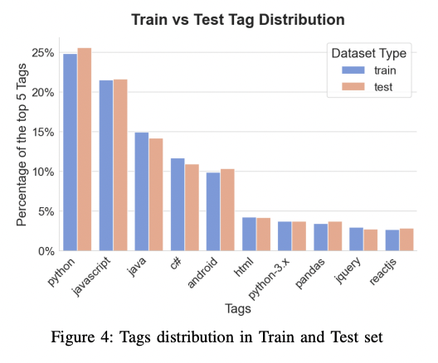
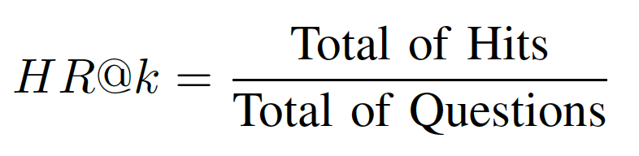
evaluation
90% train, 10% test in chronological order

Slide 16
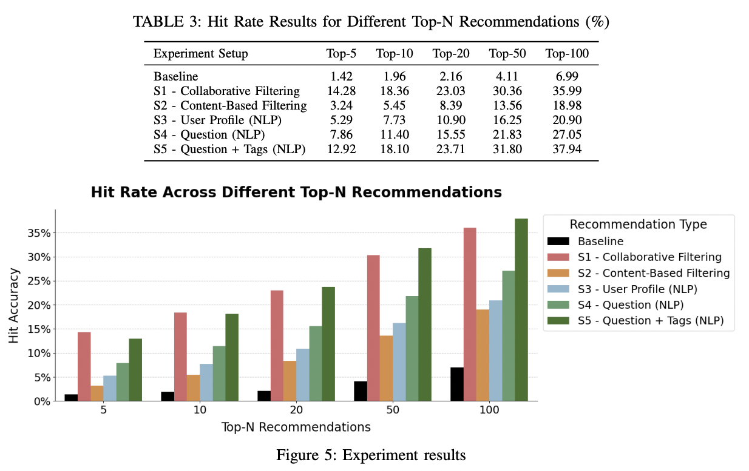
results

Slide 17
conclusion
Setup 1 and Setup 5 were the best approaches even though they have different ways to provide recommendations
Tags are essential to provide good recommendations
All the approaches demand too much memory
→ Use of sparse matrices, but not possible for embeddings

Slide 18
conclusion
The collaborative might perform better when the title is not very informative
The content-based approach might be more indicated when we do not have many users in the system
Hybrid approach
Taking into account other features such as upvotes, temporal activity in the system
Verify the diversity of answers → Avoid only highly engaged users

