Slide 1
Store Rewards & Points
Blockchain Reward System
Team:
Ahmed Tarek
Nada Walied
Mariam Abdelfattah
Salma Salah
Marina Shenouda

Slide 2
Project Idea
• Blockchain-based reward system
• Users earn RPC coins
• Redeem coins for items

Slide 3
System Architecture
• Smart Contract (Solidity)
• Web3 Backend
• CLI & GUI
• Data Analysis & Testing

Slide 4
Features
• Custom coin (RPC)
• Admin control
• User purchases
• Activity tracking
• CSV export

Slide 5
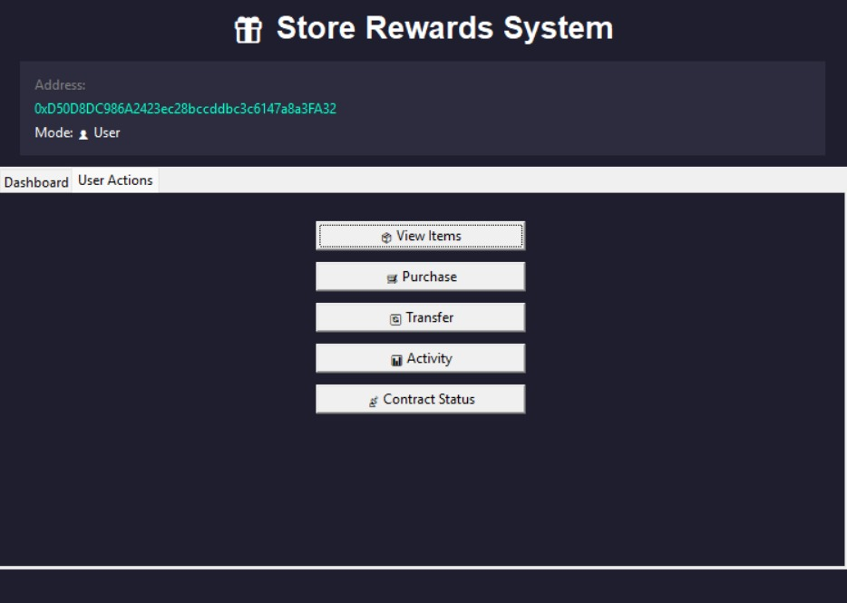
GUI - User Interface

Slide 6
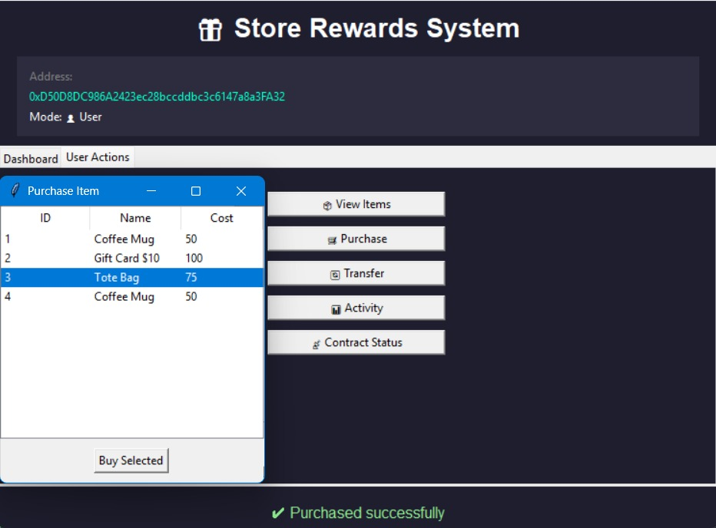
GUI - Purchase Flow

Slide 7
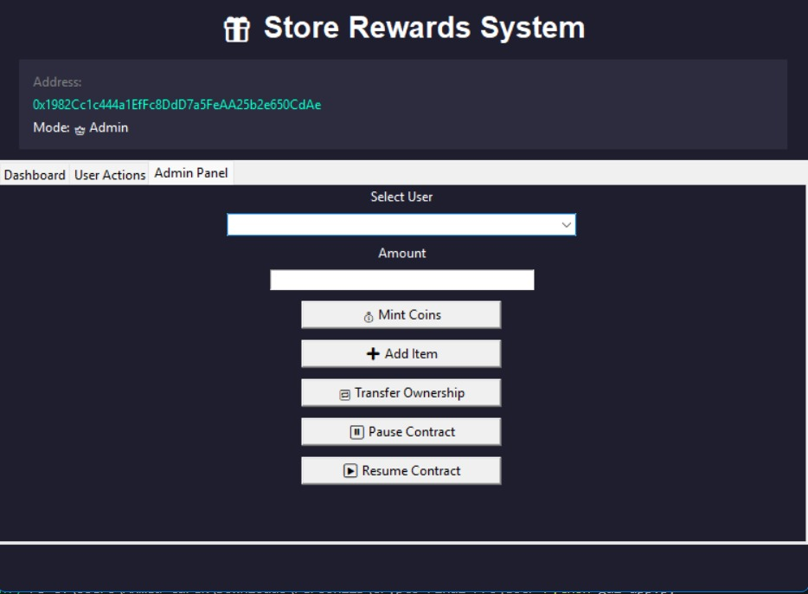
GUI - Admin Panel

Slide 8
Security & Conclusion
• Admin-only actions
• Pause/Resume
• Secure & transparent system

