Slide 1
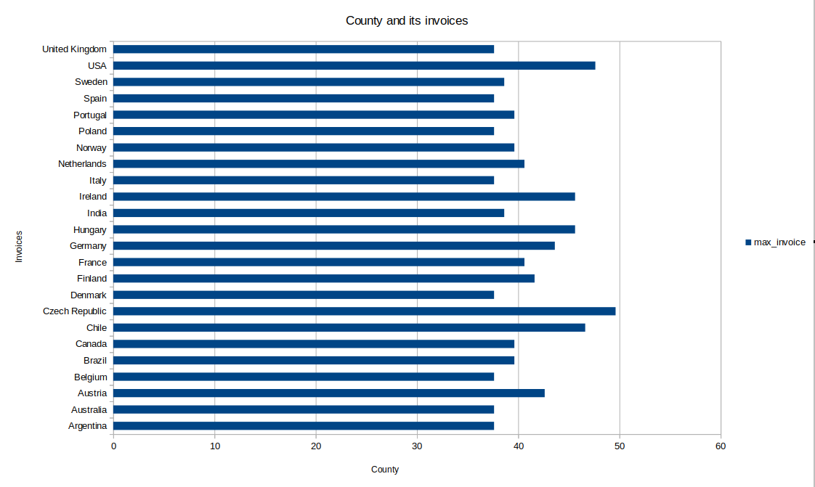
Countries with its maximum Invoices
<visualization>
The chart shows each county with its
maximun Invoices, it is clear that
‘Czech Republic’ has the most
second ‘USA’ then, ‘Chile’.

Slide 2
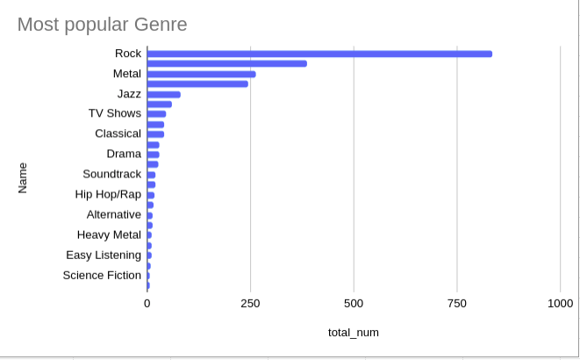
The most popular genre
We can see the “Rock” music is the most popular genre and “Science Fiction” and “Rock and Roll” are the least popular.

Slide 3
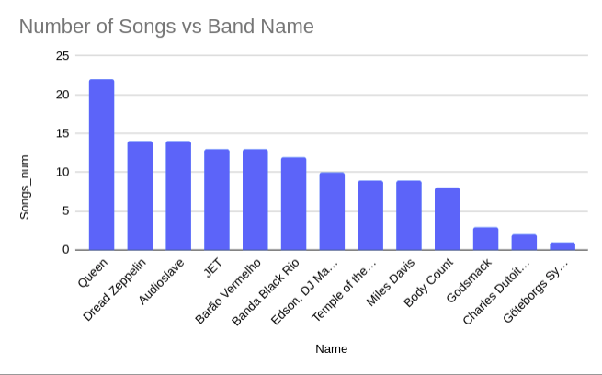
The Jazz band that has the most number of songs
<visualization>
It is shown that the “Queen” band has the most number of Jazz tracks.

Slide 4
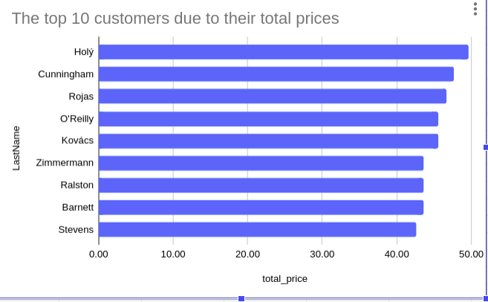
The top 10 customers due to their total invoices
<visualization>
The customer who spent the most according to invoices was Customer 6 ”Holy”, with 49.62 in purchases.

