Slide 1





Sally Homsi
Mariam Ali
Crop Yield Forecasting with Machine Learning

Slide 2



Why Predict Crop Yield?
Farmers and agencies need reliable, early estimates of harvest volume to plan logistics, pricing, and food security — but yield depends on dozens of interacting climate and soil factors that are hard to reason about by hand.

Slide 3


From Raw Data to Prediction
Our pipeline moves through four stages: merging real climate, pesticide, and yield records from FAO/World Bank, cleaning genuine missing values and encoding country/crop identity, training two regression models, then validating predictions on unseen future years.

Slide 4

The Dataset
.
50,051 merged country-crop-year records (1990-2013) across 101 countries and 10 crops, described by 4 features: rainfall, pesticides, temperature, and year — before cleaning real missing values

Slide 5

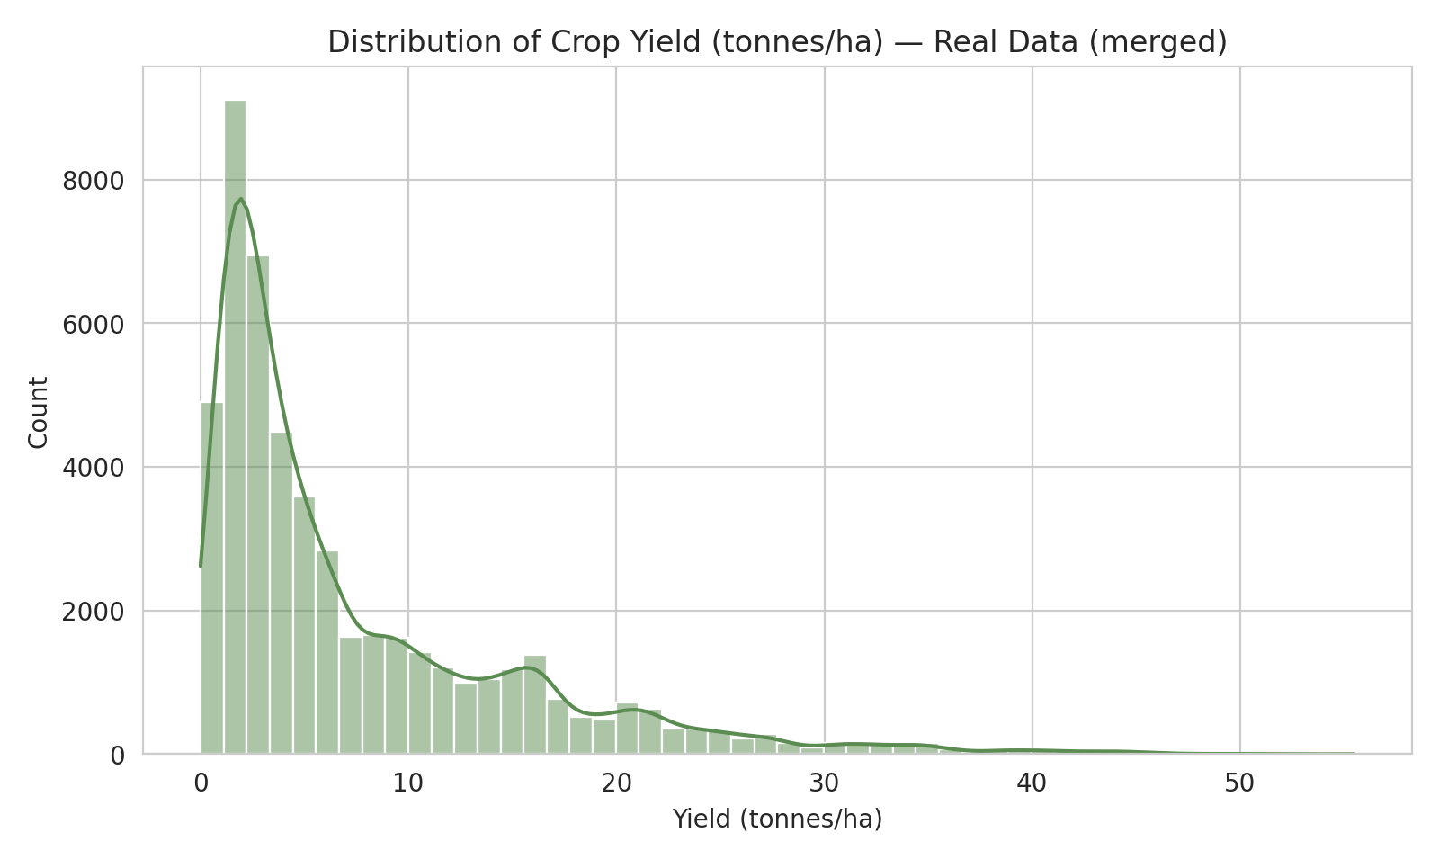
Exploring the Yield Distribution
Most country-crop records yield under 10 tonnes per hectare (median 4.3 t/ha), with a long right tail led by high-yield crops like potatoes and cassava.

Slide 6
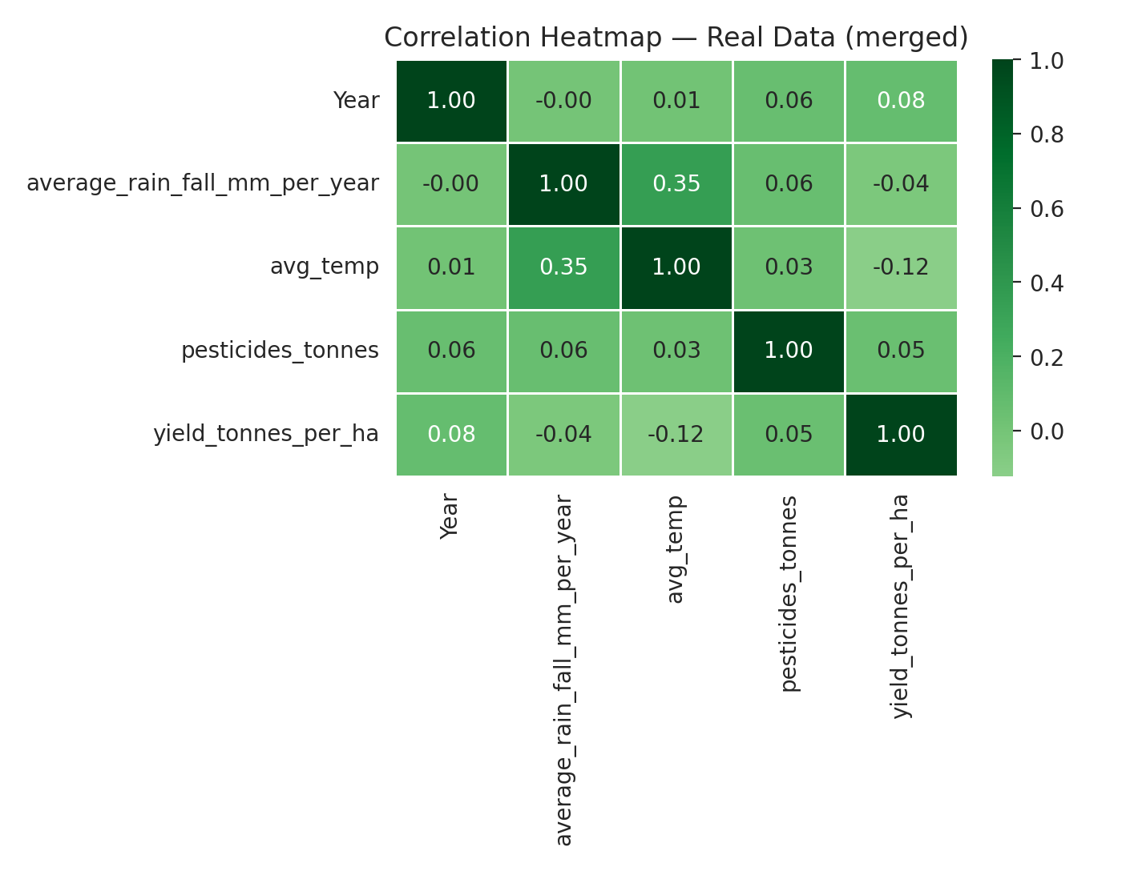
Feature Correlations
None of the 4 numeric features correlate strongly with yield alone (all under 0.13) — temperature has the strongest (negative) link, confirming yield here is driven more by country and crop than by climate.

Slide 7
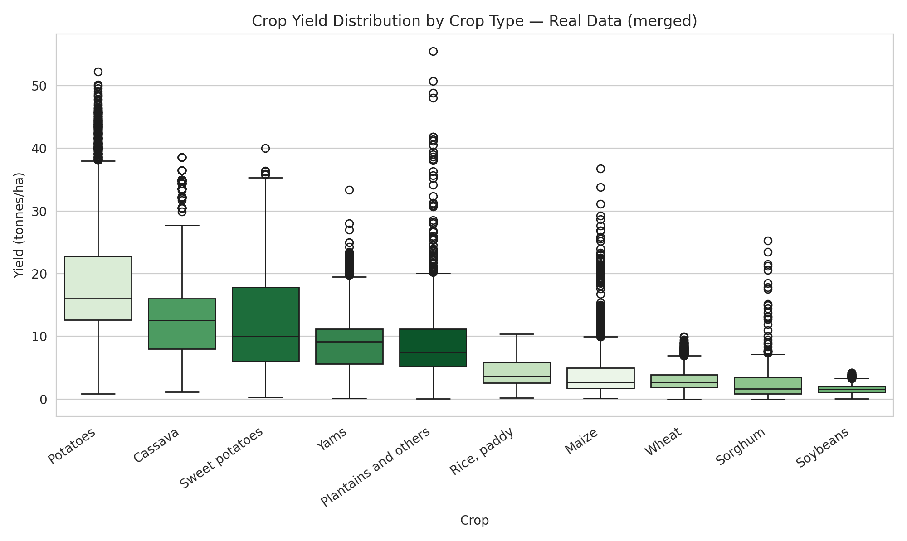
Yield by Crop Type
Potatoes and cassava show by far the highest median yields, while grains like sorghum, soybeans, and maize cluster much lower — crop type alone spans a huge range.

Slide 8
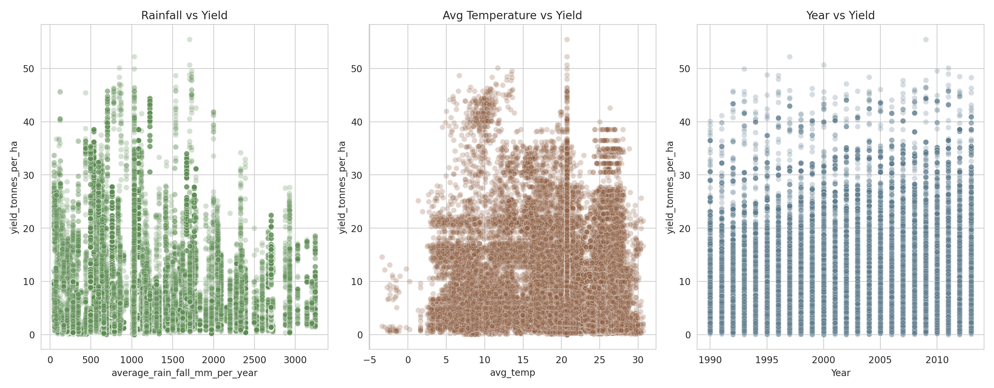
Climate Drivers of Yield
Rainfall and temperature show only weak, noisy relationships with yield on their own; yield edges up slightly over time (Year), hinting at gradual gains in farming technology.

Slide 9

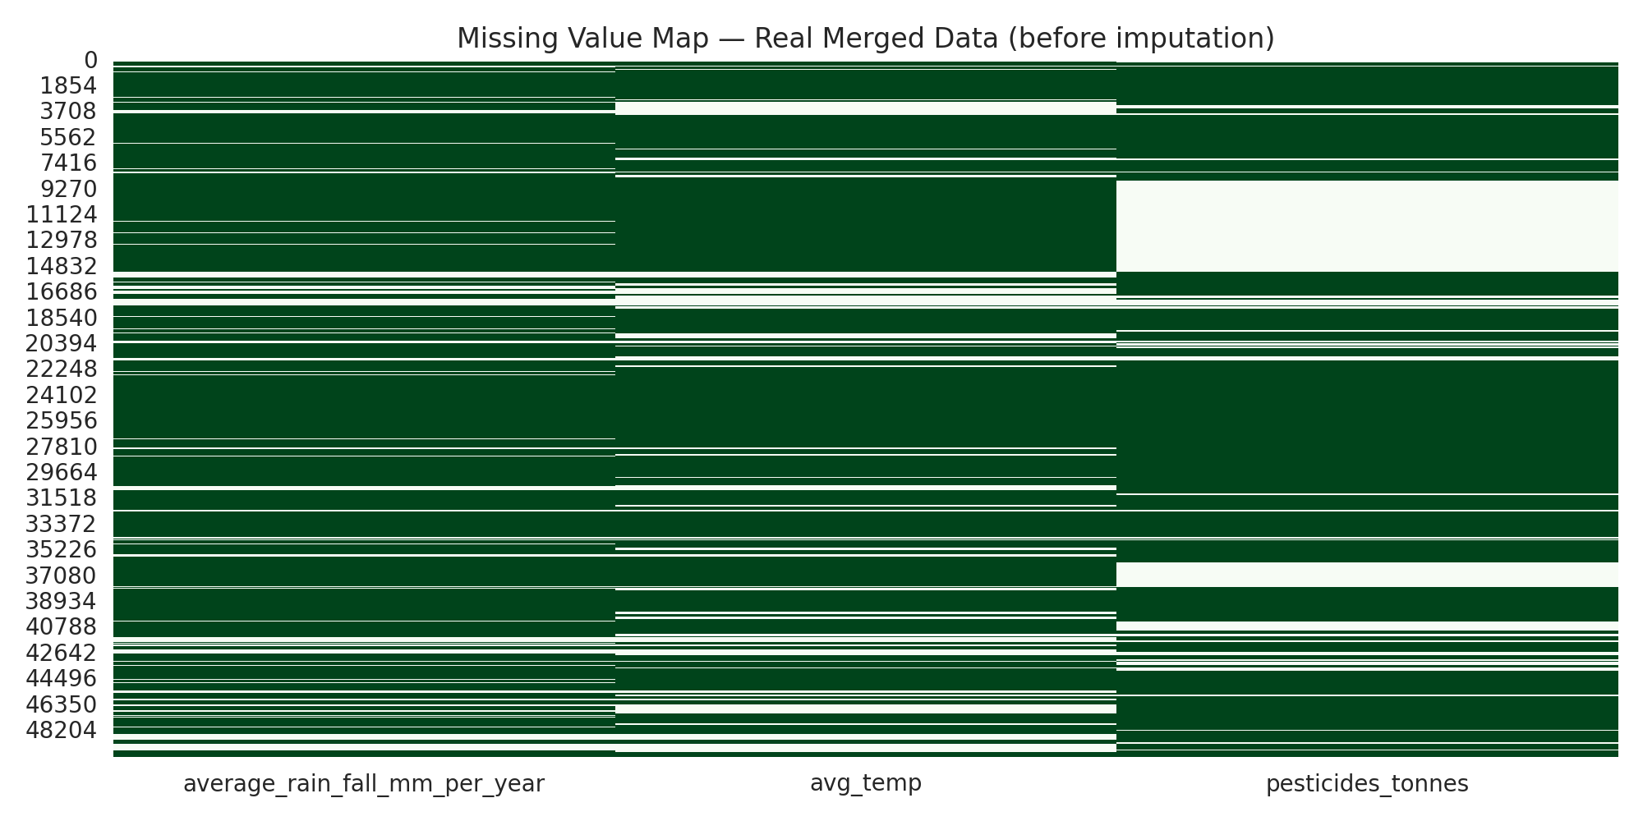

Handling Missing Data
Merging 4 real FAO / World Bank sources left genuine gaps — 14.6% missing rainfall, 20.5% missing temperature, and 25.7% missing pesticide data — filled in using median imputation, just like our synthetic pipeline.

Slide 10


Two Models, One Target
After imputing the real missing values, data was split chronologically (train: 1990–2008, validation: 2009–2011, test: 2012–2013) to avoid leaking future years into training. Countries and crops were one-hot encoded since XGBoost and Random Forest both need numeric inputs, and label encoding would falsely imply an order between countries.

Slide 11
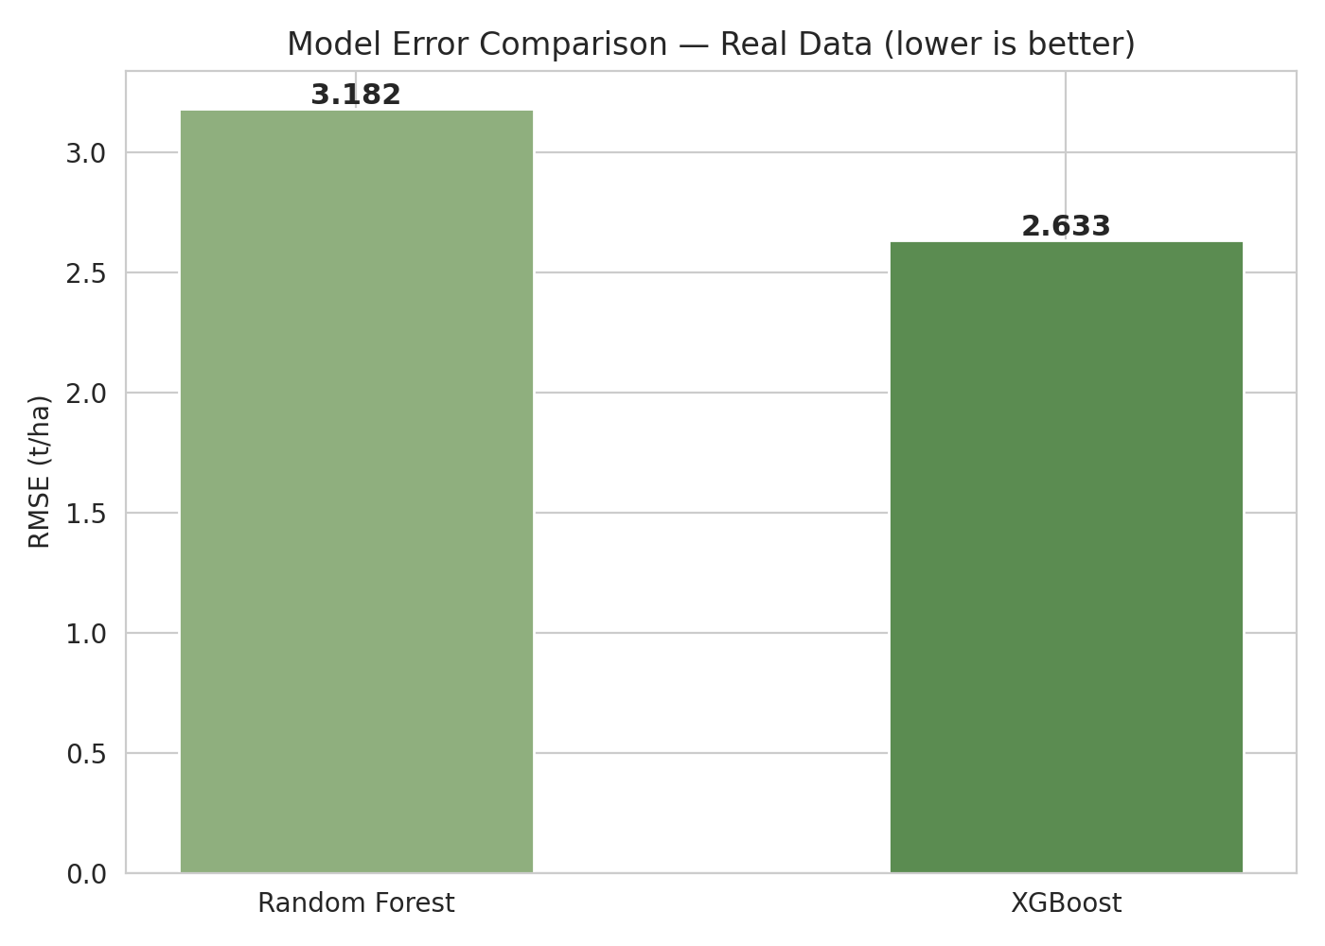
Model Accuracy Compared
XGBoost reached a lower RMSE (2.63 vs 3.18 t/ha) and higher R² (0.91 vs 0.86) than Random Forest on unseen 2012–2013 data.

Slide 12
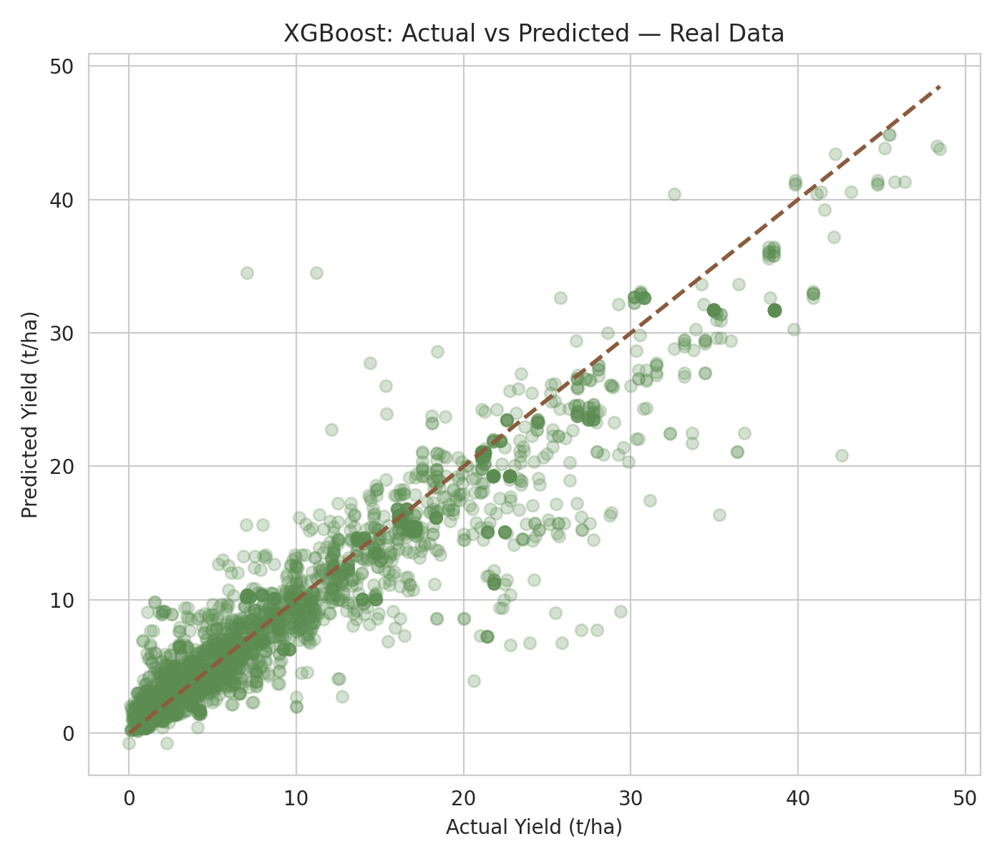

Predictions vs Reality
Points near the dashed line are accurate forecasts from the XGBoost model.

Slide 13
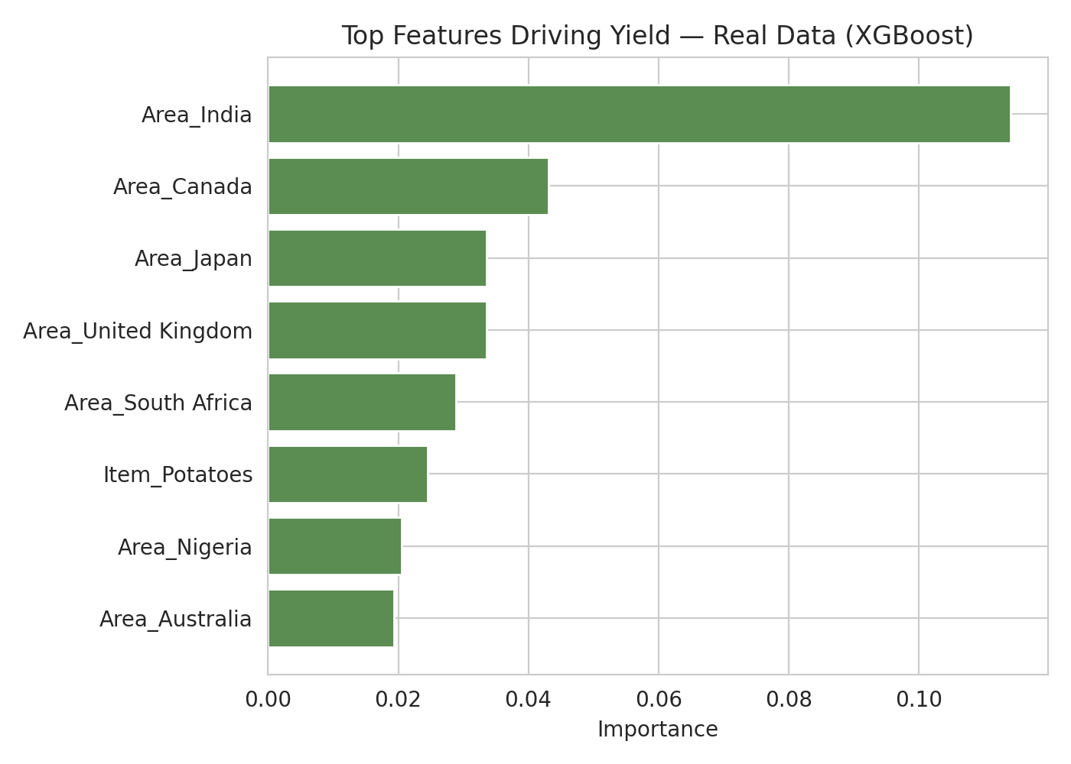


What Drives the Prediction
Country identity and crop type dominate the model’s decisions — India, Canada, and Japan stand out, alongside crops like potatoes.

Slide 14

Key Takeaways
Gradient boosting (XGBoost) again outperformed bagging (Random Forest) — and after properly merging 4 real sources and imputing genuine gaps (15–26% missing per column), both models still explain most of the variance in yield (R² up to 0.91). Country identity and crop type, not weather alone, remain the strongest predictors, reflecting real differences in farming technology across nations. Next step: add finer-grained soil and satellite data to explain the remaining variance.

Slide 15
THANK YOU FOR YOUR attention☺

