Slide 1
Dash Data visualization

Slide 2
Outline
Background – why Dash?
What is Dash & how does it work
A data visualization example

Slide 3
Background
Data analysis in AI project
Reading, Processing and Visualizing
Interactivity and possibility to share my work -> Dash!

Slide 4
What is Dash?
Open-source framework by Plotly
Create interactive dashboards in web browser
Written on top of Flask, Plotly.js, and React.js
Notes:
https://www.tutorialspoint.com/python_web_development_libraries/python_web_development_libraries_dash_framework.htm

Slide 5
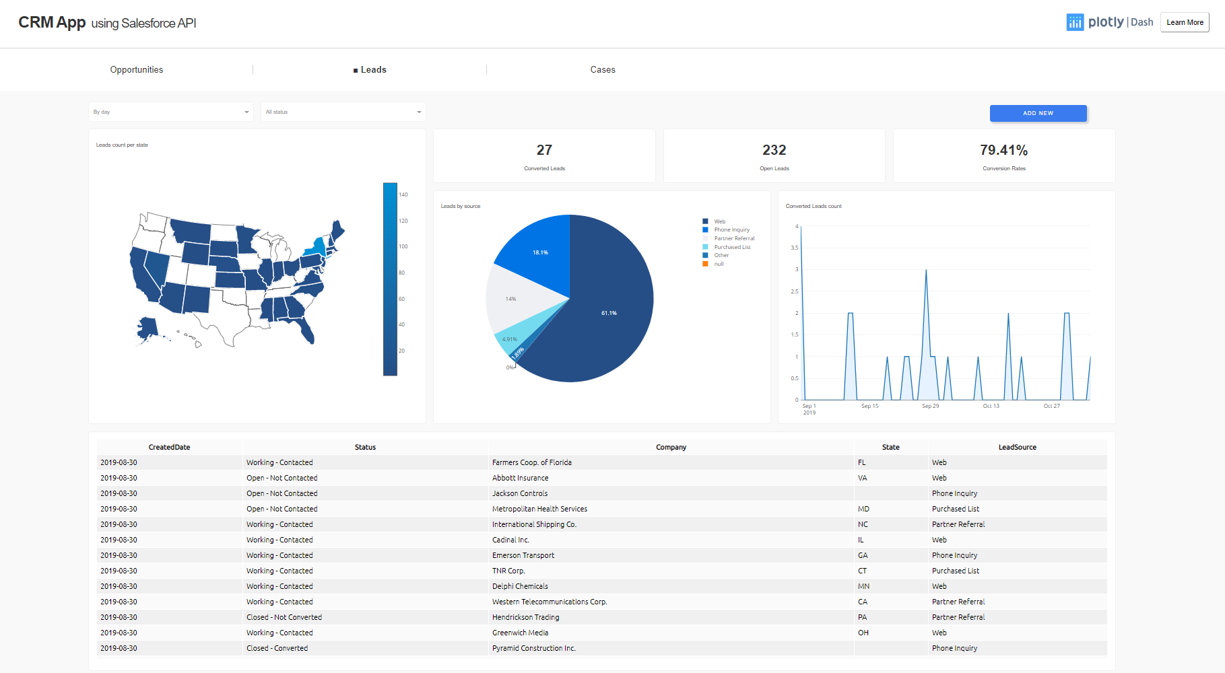
https://dash-gallery.plotly.host/dash-salesforce-crm/

Slide 6
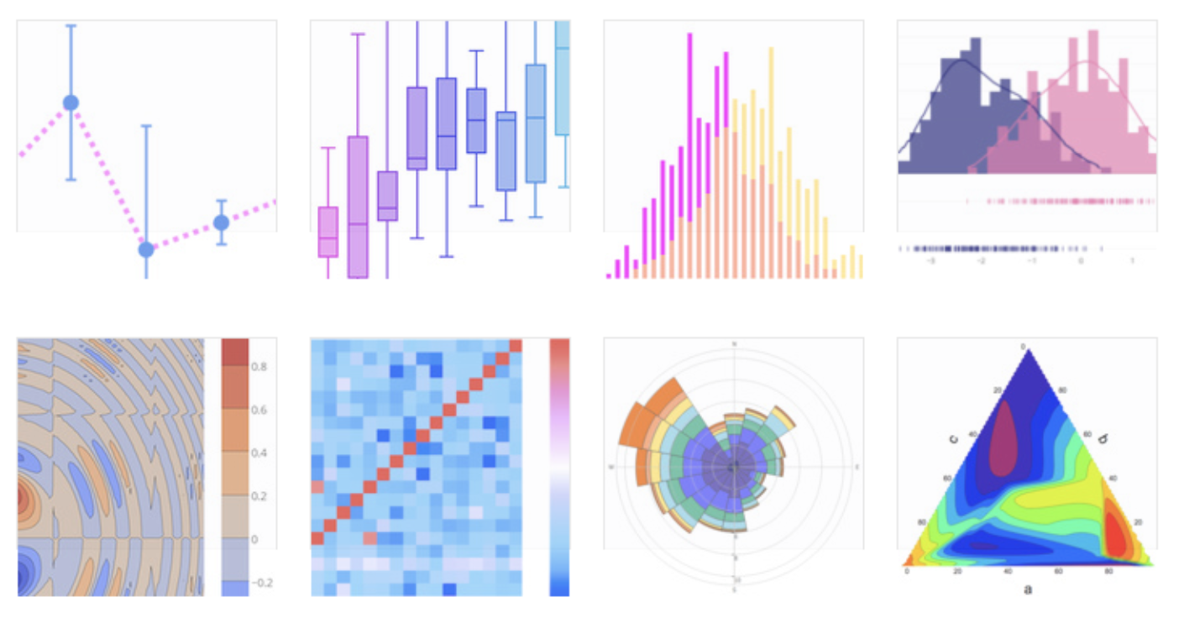
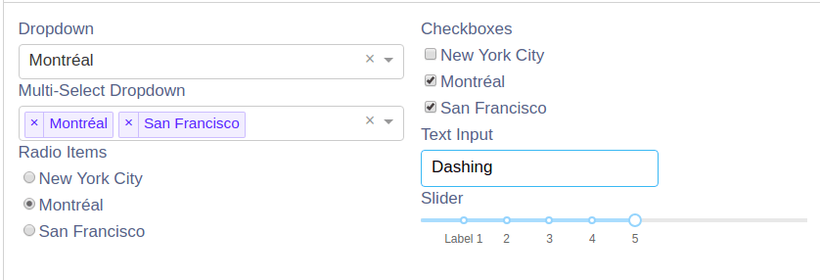
How does it work?
Layout – the looks
Callbacks – the functionality
Components – the building blocks
https://www.datacamp.com/community/tutorials/learn-build-dash-python
https://towardsdatascience.com/5-neat-dash-apps-made-by-the-dash-community-9b37852456f3

Slide 7
A simple app
http://127.0.0.1:8050/

Slide 8
The code behind

Slide 9
Try it out
https://github.com/mariamarkovska/dash-workshop-20191204

