Slide 1

Gym Database Management System
Under the guidance of:
Prof. Wu-Ping Simon Wang
Team 10:
Doudou Nan
Maria Mathew
Soumya Murugendrappa

Slide 2

Content:
Mission Statement
Introduction
Entities and ERD
Database Implementation
Tables &Table-level Constraints
Column Encryption
Computed Columns
Views
Functions
Tableau Reports

Slide 3

To maintain branch-wise customer and billing information and calculate annual turnover of each branch to find the most profitable branch

Slide 4




Introduction
Stores and maintains information of branches, employees, payments, customers, income, discount, classes, enrollments, equipment, equipment maintenance records, etc.
Tracking salary payment of employees, maintenance fee of equipment and membership billing of customers to analysis the profits.
Allow storage of enrollment information to determine the popularity of fitness classes.
SSMS

Slide 5
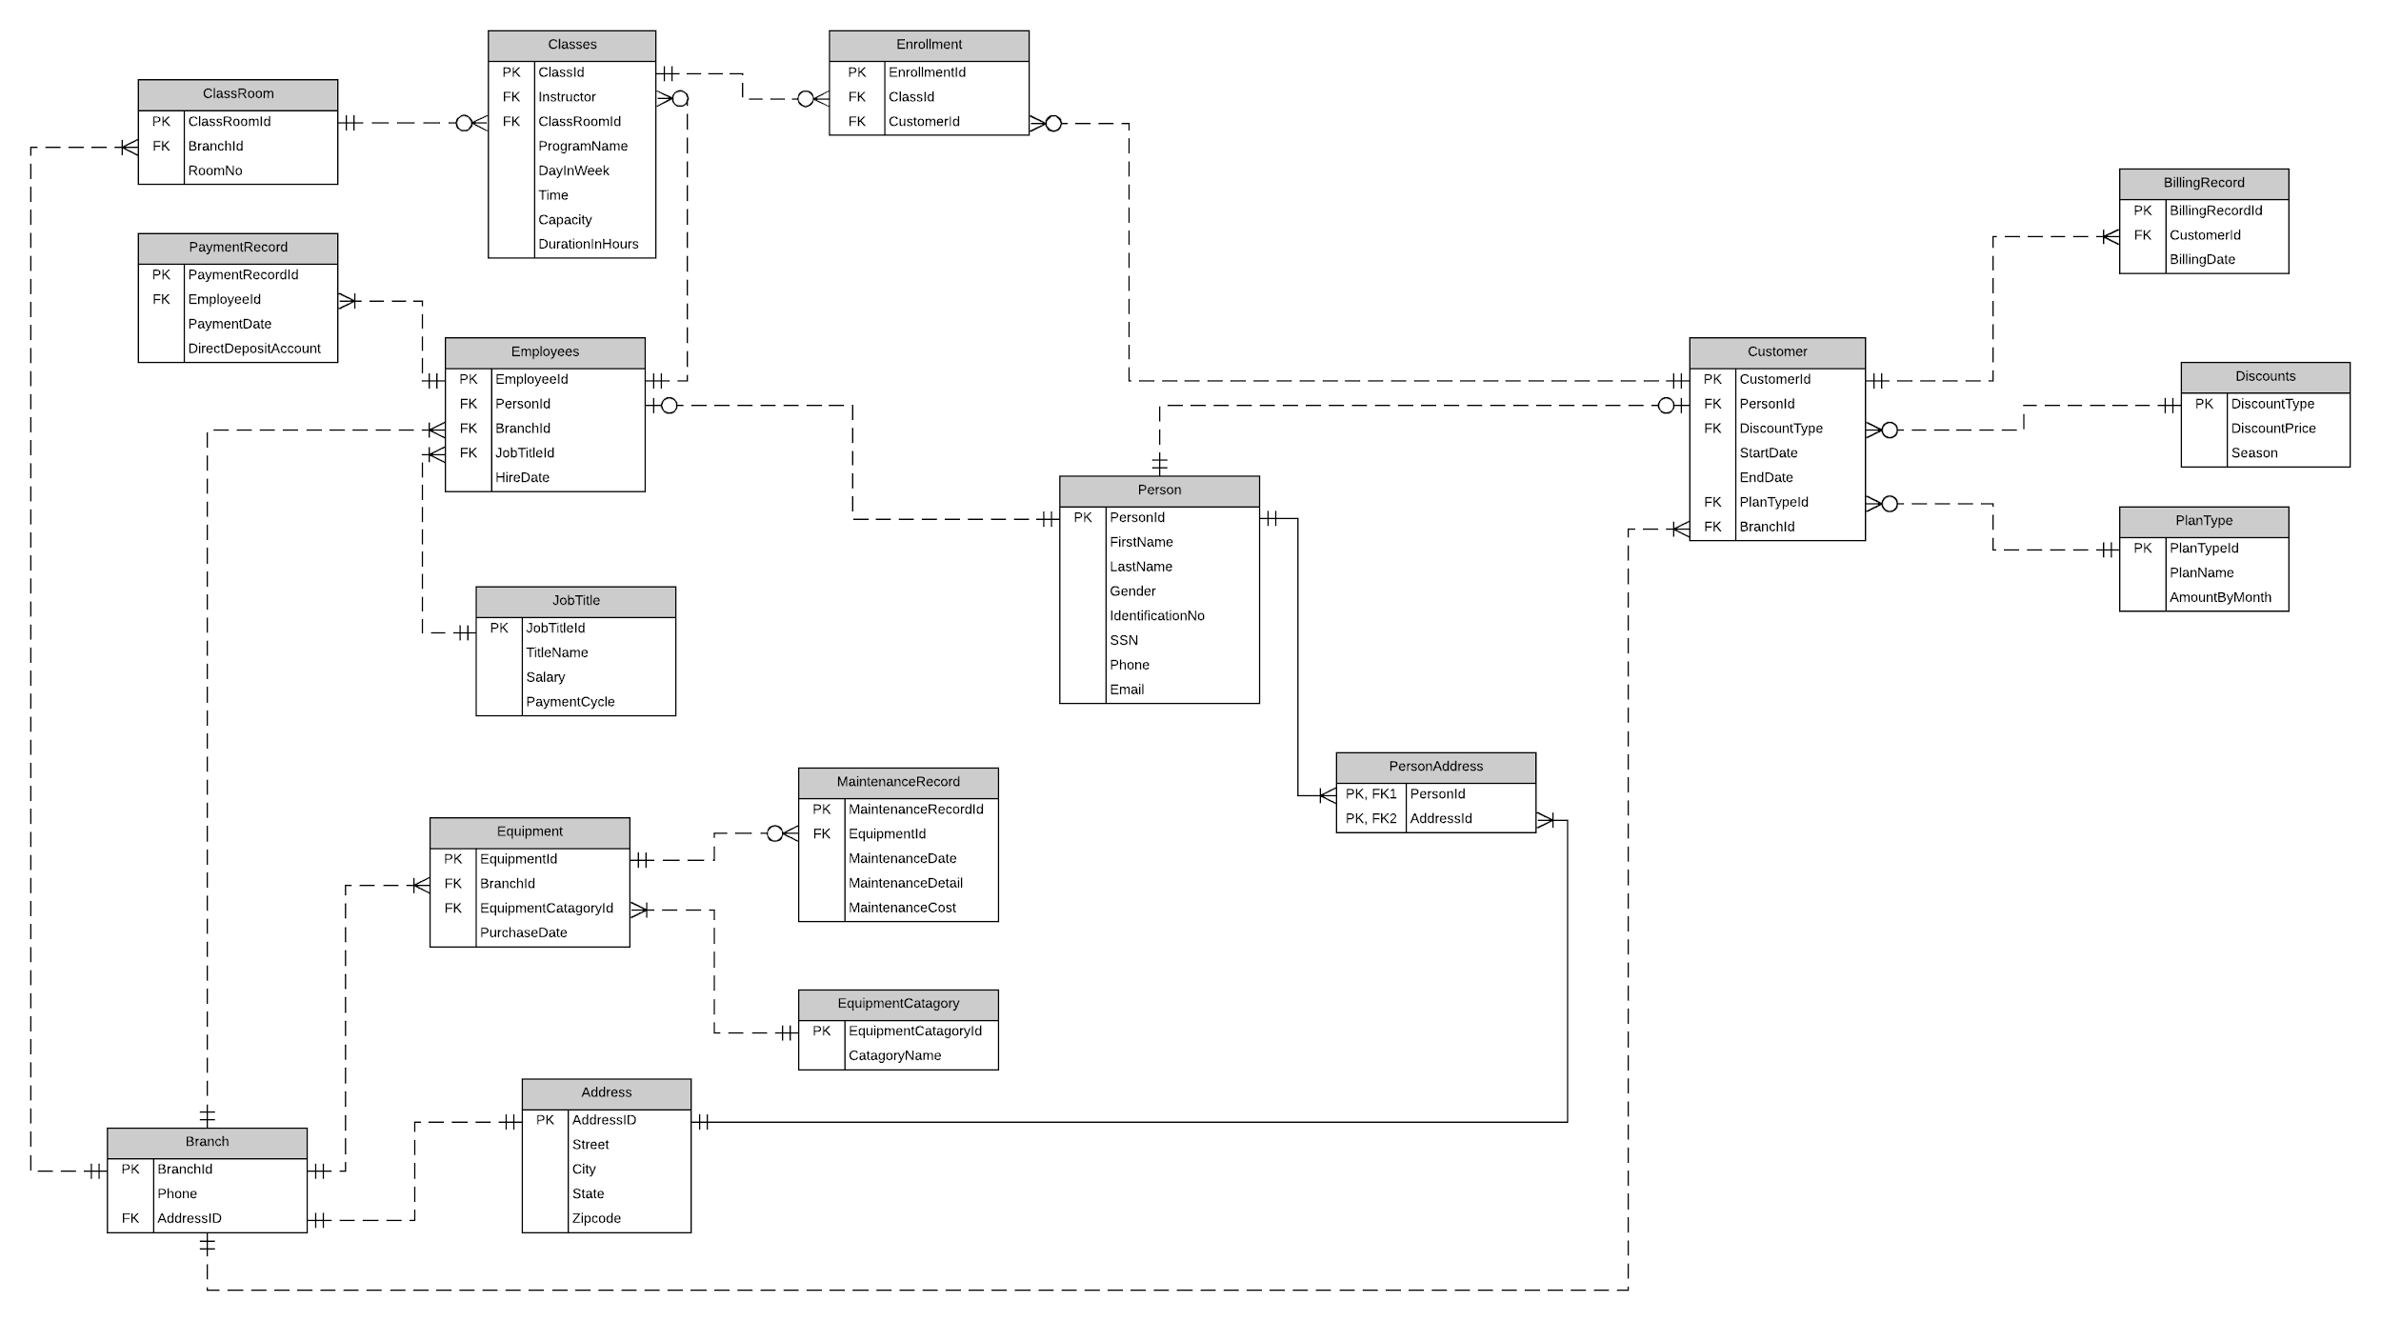
ERD

Slide 6
ERD

Slide 7
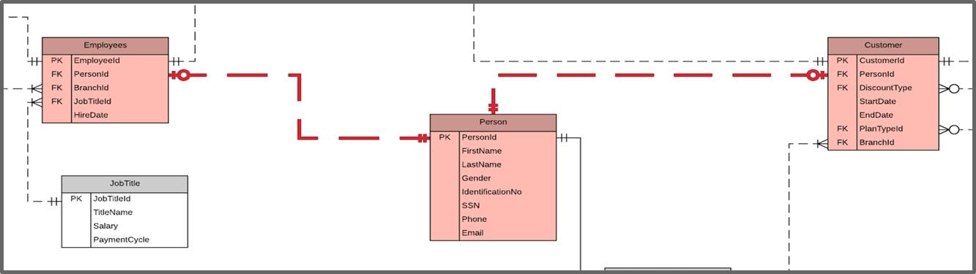
Highlights in Our Design
Highlights in Our Design
Normalized to Third Normal Form

Slide 8
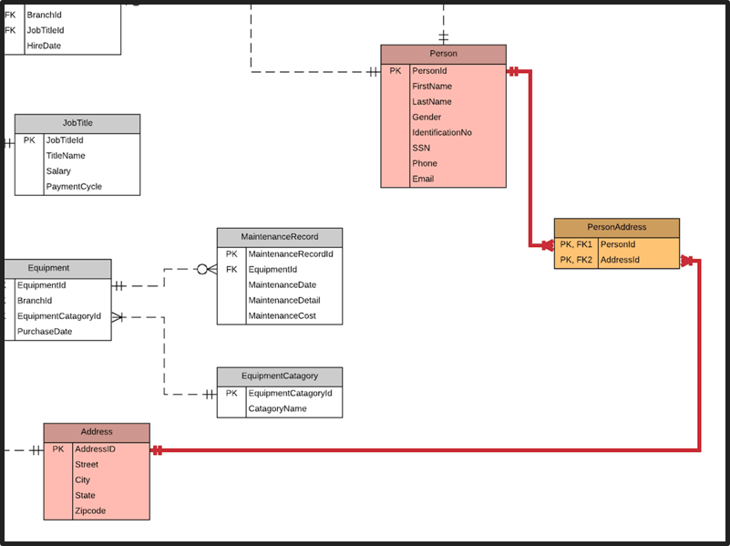
Highlights in Our Design
Highlights in Our Design
Handled many to many relationship between Person and Addresses

Slide 9
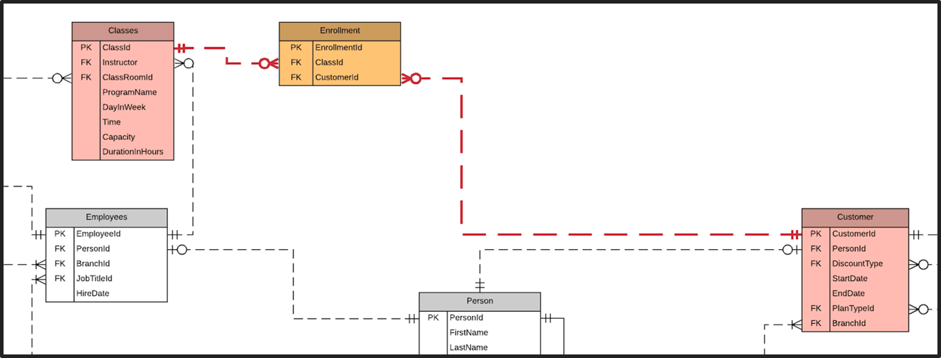
Highlights in Our Design
Highlights in Our Design
Use a surrogate key for the Enrollment entity to implement the non-identifying relationships between Customers and Classes (FK CustomerId and ClassId is not null)

Slide 10
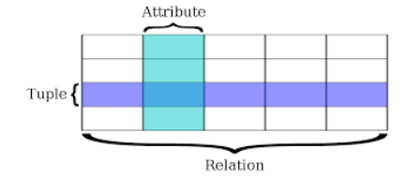
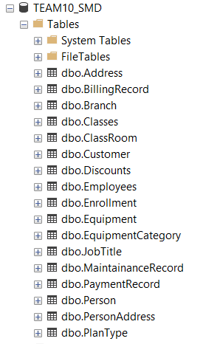
Tables
Database consist of one or more tables.
Each tables are made up of Tuple and Attribute
Each Tuple is uniquely identified by Primary Key.
GYM
DATABASE

Slide 11
Tables
Syntax
Example 1
CREATE TABLE database_name.table_name(
Column1 datatype,
Column2 datatype,
Column3 datatype,
….
);
CREATE TABLE dbo.Address
(
[AddressID] [varchar](15) NOT NULL PRIMARY KEY,
[Street] [varchar](100) NOT NULL,
[City] [varchar](100) NOT NULL,
[State] [varchar](50) NOT NULL,
[ZipCode] [int] NOT NULL
)
Example 3
Example 2
CREATE TABLE [dbo].[PersonAddress]
(
[PersonId] [varchar](15) NOT NULL,
[AddressId] [varchar](15) NOT NULL,
PRIMARY KEY([PersonID],[AddressID]),
FOREIGN KEY([PersonID]) REFERENCES [PERSON]([PersonID]),
FOREIGN KEY([AddressID]) REFERENCES [ADDRESS]([AddressID])
);
CREATE TABLE dbo.Person
(
[PersonId] [varchar](15) NOT NULL PRIMARY KEY,
[FirstName] [varchar](50) NOT NULL,
[LastName] [varchar](20) NOT NULL,
[Gender] [varchar](2) NOT NULL,
[IdentificationNo] [nvarchar](10) NOT NULL,
[SSN] [nvarchar](20) NOT NULL,
[Phone] [bigint] NOT NULL,
[Email] [nvarchar](50) NOT NULL
);

Slide 12
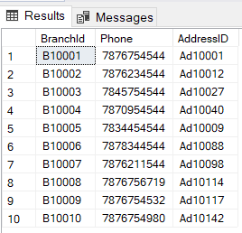
Tables
INSERT INTO Table_Name VALUES(‘Column1_Value’,‘Column2_Value’)
SELECT * FROM DBO.BRANCH
INSERT INTO [Branch] VALUES('B10001',7876754544,'Ad10001');
INSERT INTO [Branch] VALUES('B10002',7876234544,'Ad10012');
INSERT INTO [Branch] VALUES('B10003',7845754544,'Ad10027');
INSERT INTO [Branch] VALUES('B10004',7870954544,'Ad10040');
INSERT INTO [Branch] VALUES('B10005',7834454544,'Ad10009');
INSERT INTO [Branch] VALUES('B10006',7878344544,'Ad10088');
INSERT INTO [Branch] VALUES('B10007',7876211544,'Ad10098');
INSERT INTO [Branch] VALUES('B10008',7876756719,'Ad10114');
INSERT INTO [Branch] VALUES('B10009',7876754532,'Ad10117');
INSERT INTO [Branch] VALUES('B10010',7876754980,'Ad10142');

Slide 13
Table Level Constraint
Enforces business rules on tables
Ensures the accuracy and reliability of the data in the database
Constraints could be either on a column level or a table level
Constraints | Column Level | Table Level
Not Null | Yes | No
Primary Key | Yes | Yes
Unique | Yes | Yes
Foreign Key | Yes | Yes
Check | Yes | Yes

Slide 14
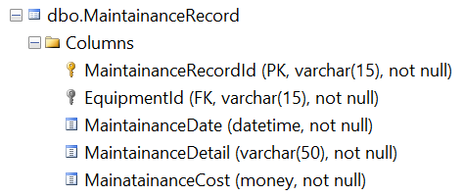
Table Level Constraint
CREATE FUNCTION checkMaintenanceDate
(@EquipmentID VARCHAR(15))
RETURNS DATETIME
AS
BEGIN
DECLARE @PurchaseDate DATETIME
SELECT @PurchaseDate=PurchaseDate
FROM Equipment
WHERE EquipmentID=@EquipmentID
RETURN @PurchaseDate
END
ALTER TABLE [dbo].[MaintainanceRecord]
ADD CONSTRAINTConstraint_GreaterThanPurchaseDate
CHECK (dbo.checkMaintenanceDate(EquipmentID) < MaintainanceDate)

Slide 15
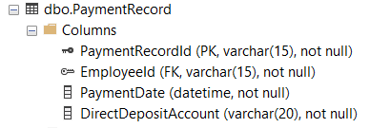
Table Level Constraint
CREATE FUNCTION checkPayDate(@EmployeeID VARCHAR(15))
RETURNS DateTime
AS
BEGIN
DECLARE @HireDate DATETIME
SELECT @HireDate=HireDate FROM Employees
WHERE EmployeeID=@EmployeeID
RETURN @HireDate
END
ALTER TABLE PaymentRecord
ADD CONSTRAINT Constraint_GreaterThanHireDate
CHECK(dbo.checkPayDate(EmployeeID) < PaymentDate)

Slide 16
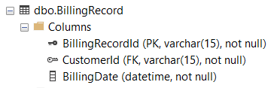
Table Level Constraint
CREATE FUNCTION checkBillingDate(@CustomerID VARCHAR(15))
RETURNS DATETIME
AS
BEGIN
DECLARE @StartDate DATETIME
SELECT @StartDate=StartDate FROM [Customer]
WHERE CustomerID=@CustomerID
RETURN @StartDate
END
CREATE FUNCTION checkBillingDate2(@CustomerID VARCHAR(15))
RETURNS DATETIME
AS
BEGIN
DECLARE @EndDate DATETIME
SELECT @EndDate=EndDate FROM [Customer]
WHERE CustomerID=@CustomerID
RETURN @EndDate
END
ALTER TABLE BillingRecord
ADD CONSTRAINT Constraint_BetweenStartAndEndDate
CHECK((dbo.checkBillingDate(CustomerID)<BillingDate)
and (dbo.checkBillingDate2(CustomerID)>BillingDate))

Slide 17
Column Encryption
Allows user to encrypt a specific information or attributes
Requires a database master key
Requires a certificate that is protected by the database master key
A symmetric key that is used for both encryption and decryption

Slide 18
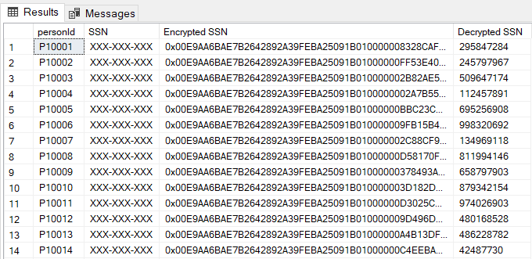
Column Encryption
CREATE MASTER KEY ENCRYPTION BY
PASSWORD = '<Crackme>';
CREATE CERTIFICATE personSSN
WITH SUBJECT = 'Employee Social Security Numbers';
CREATE SYMMETRIC KEY SSN_Key_01
WITH ALGORITHM = AES_256
ENCRYPTION BY CERTIFICATE personSSN;
ALTER TABLE dbo.[Person]
ADD EncryptedNationalIDNumber varbinary(250);
OPEN SYMMETRIC KEY SSN_Key_01
DECRYPTION BY CERTIFICATE personSSN;
UPDATE dbo.[Person]
SET EncryptedNationalIDNumber = EncryptByKey(Key_GUID('SSN_Key_01'),[SSN] ) WHERE SSN NOT IN('XXX-XXX-XXX') ;
UPDATE dbo.[Person]
SET SSN='XXX-XXX-XXX'
WHERE SSN IS NOT NULL;
OPEN SYMMETRIC KEY SSN_Key_01
DECRYPTION BY CERTIFICATE personSSN;
SELECT personId,[SSN], EncryptedNationalIDNumber
AS 'Encrypted SSN',
CONVERT(nvarchar, DecryptByKey(EncryptedNationalIDNumber))
AS 'Decrypted SSN'
FROM dbo.[Person]
ORDER byBY personId;

Slide 19
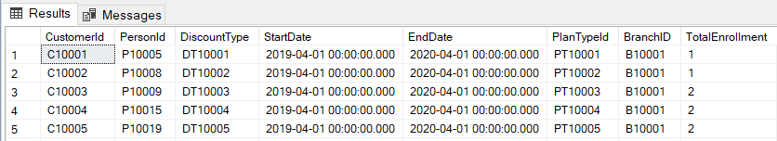
Computed Columns
CREATE FUNCTION TotalClassEnrollment
(@InputCustomerId VARCHAR(20))
RETURNS INT
AS
BEGIN
DECLARE @TotalEnrollment INT;
SELECT @TotalEnrollment = COUNT(e.EnrollmentId)
FROM dbo.Enrollment e
WHERE e.CustomerId = @InputCustomerId;
RETURN @TotalEnrollment;
END
ALTER TABLE dbo.Customer
ADD TotalEnrollment
AS (dbo.TotalClassEnrollment(CustomerId));

Slide 20
Views
Virtual Table
Created by query joining one or more tables
Set of named columns and rows of data
Helps limit data access to specific users
Syntax:

Slide 21
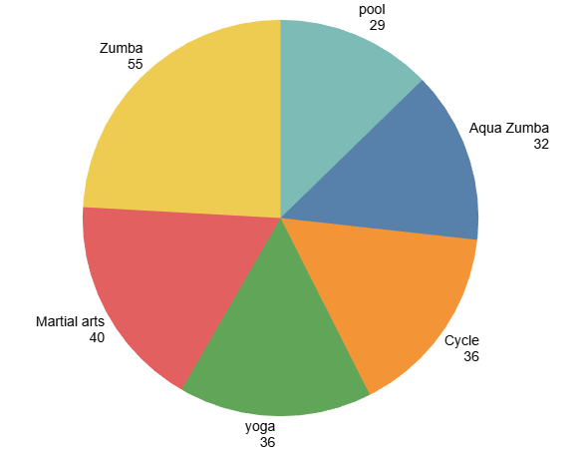
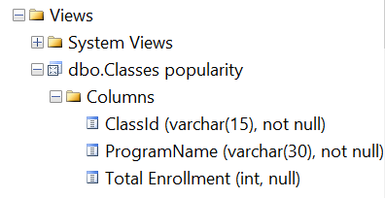
Views
CREATE VIEW [dbo].[Classes popularity] AS
SELECT cl.ClassId, cl.ProgramName, COUNT(en.EnrollmentId) AS [Total Enrollment]
FROM dbo.Classes cl
JOIN dbo.Enrollment en
ON cl.ClassId = en.ClassId
GROUP BY cl.ClassId, cl.ProgramName;

Slide 22
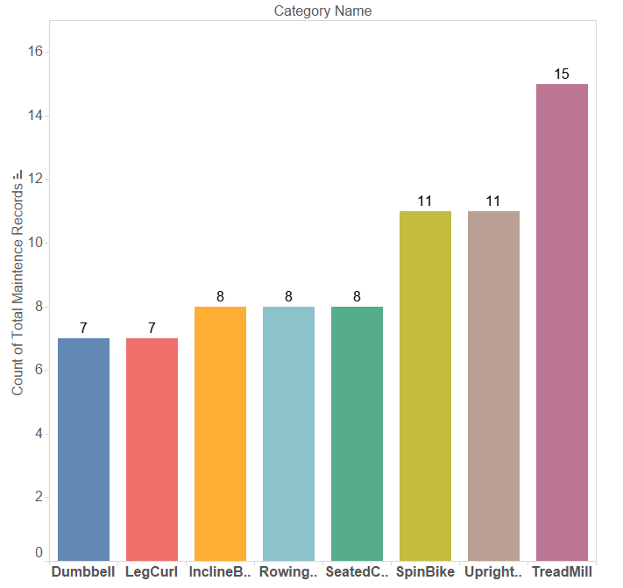
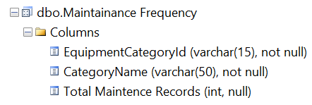
Views
CREATE VIEW [dbo].[Maintainance Frequency] AS
SELECT ec.EquipmentCategoryId, ec.CategoryName,
COUNT(mr.MaintainanceRecordId)
AS[Total Maintenance Records]
FROM dbo.EquipmentCategory ec
JOIN dbo.Equipment ep
ON ec.EquipmentCategoryId = ep.EquipmentCategoryId
JOIN dbo.MaintainanceRecord mr
ON ep.EquipmentId = mr.EquipmentId
GROUP BY ec.EquipmentCategoryId, ec.CategoryName;

Slide 23
Functions
Transact-SQL routine that accepts parameters
Can have only input parameters
Can be used with SQL SELECT/WHERE/HAVING statements
Must return a single value (scalar or table)
Types of UDFs:
Table-valued functions
Scalar-valued functions

Slide 24
Functions
Profit = Total Income – Total Payment – Total Maintenance Fee
Total Income Calculation
Customer
PlanType
Discounts
Total Payment Calculation
PaymentRecord
Employees
JobTitle
Total Maintenance Fee Calculation
MaintenanceRecord
Equipment

Slide 25
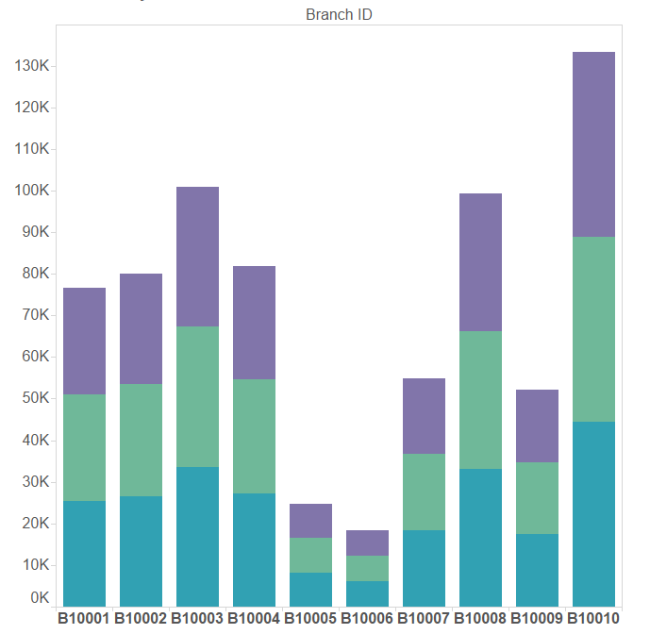
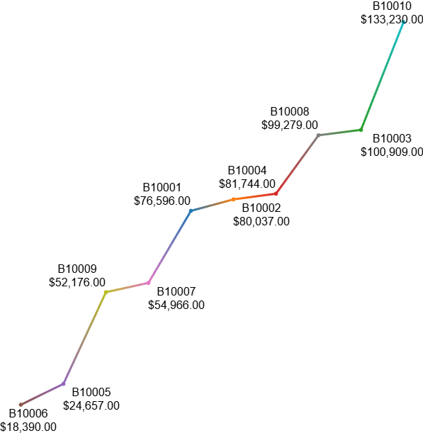

Functions
Total Profit Per Branch for last 3 months
Total Profit Per Branch for the year 2019

Slide 26
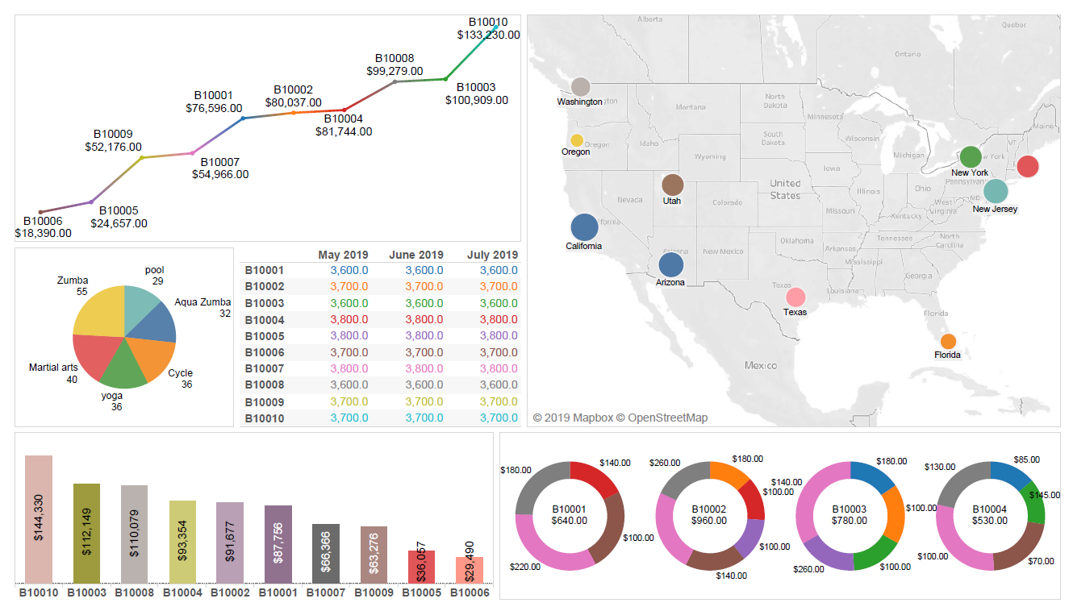
Tableau Dashboard

Slide 27

Thank You !!!

Slide 28


