Slide 1
Genre Prediction of Books by their cover
Team: 5 Stars
Akash Katakam
Harshitha Sanikommu
Maria Mathew
Nikhil Kashid
Soumya Murugendrappa

Slide 2
Problem Statement
Given the images of book covers including both fiction and non fiction images, we have to predict Genre of books.
There are around 12000 images in total which belong to 5 different categories as follows, our goal is to predict which genre does each image belongs to. "Comics & Graphic Novels", "Cookbooks", "Kids Books", "Mystery Thriller& Suspense", "Science Fiction & Fantasy"

Slide 3
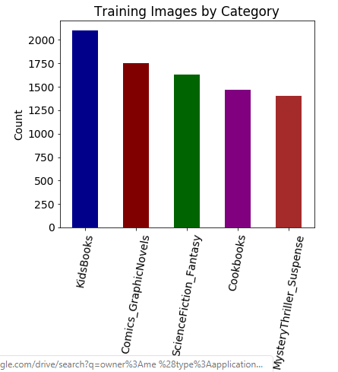
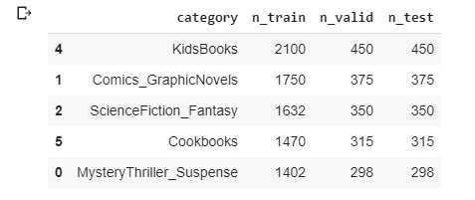
Images Data and it’s distribution

Slide 4
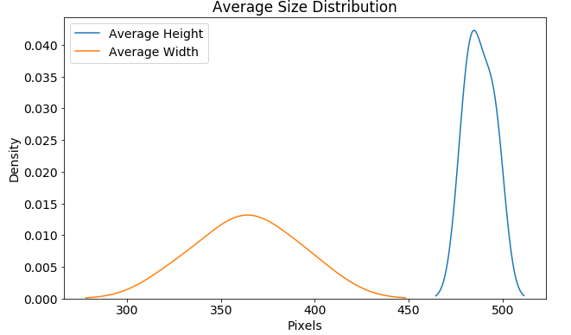
Image size distribution

Slide 5
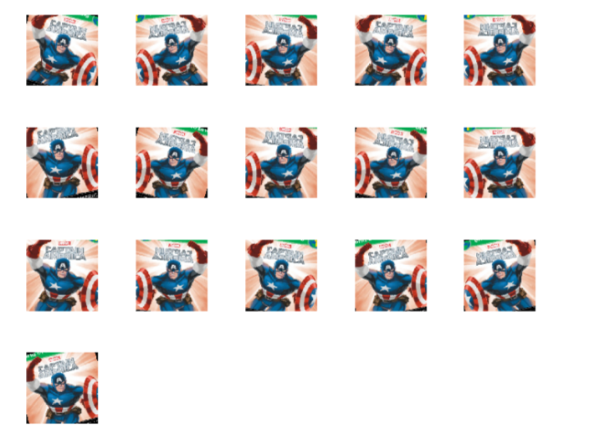
Data Augmentation

Slide 6
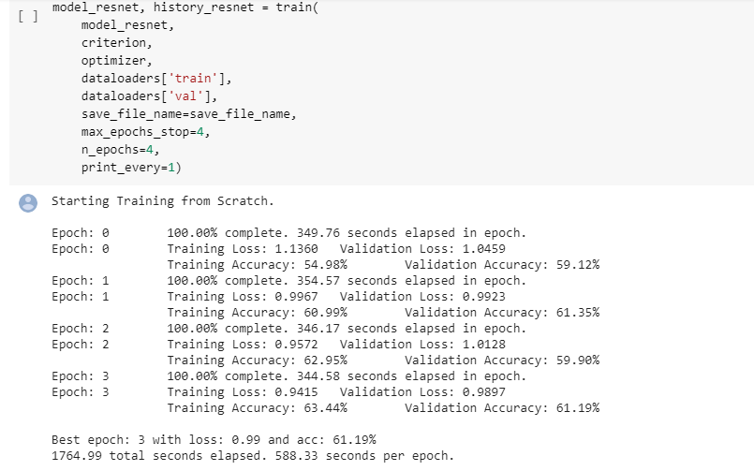
RESNET training model

Slide 7
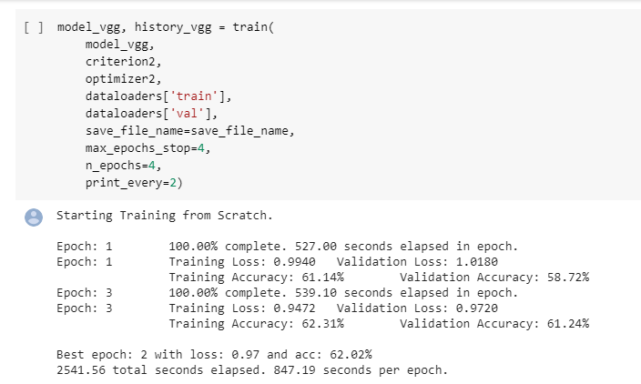
VGG Training model

Slide 8
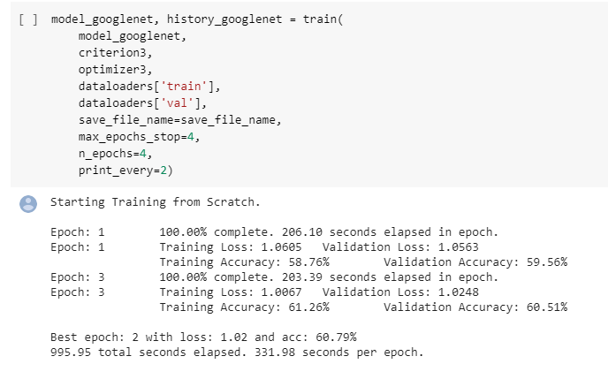
Googlenet training model

Slide 9
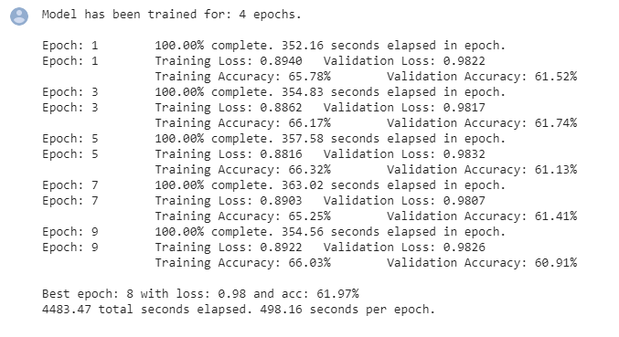
Finalized Resnet model after hyper-parameter tuning

Slide 10
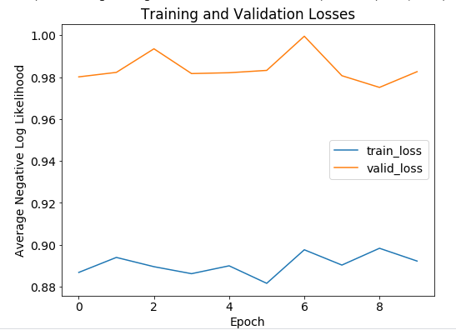
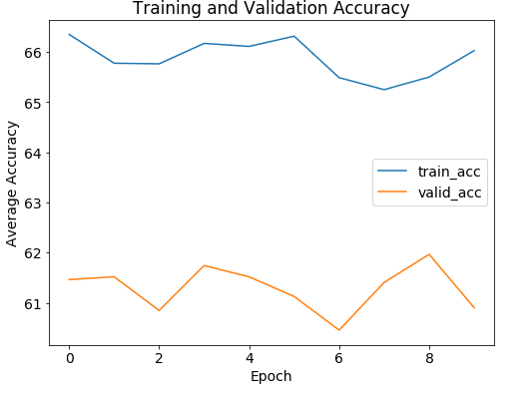
Training and validation Results for Resnet

Slide 11
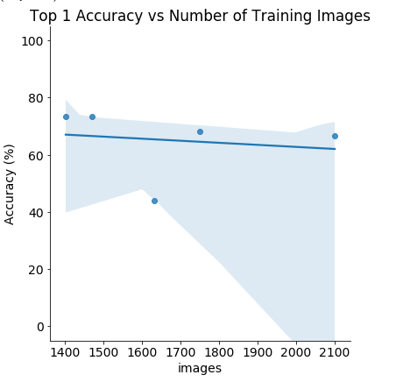
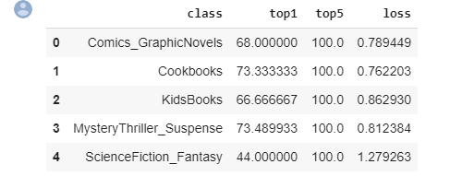
Evaluation of Model Over test data

Slide 12
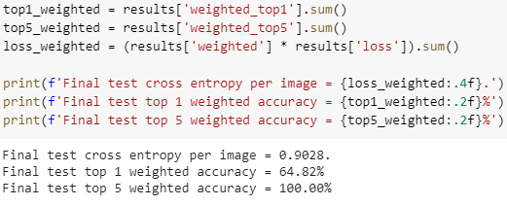
Final accuracy accounting for frequencies

Slide 13
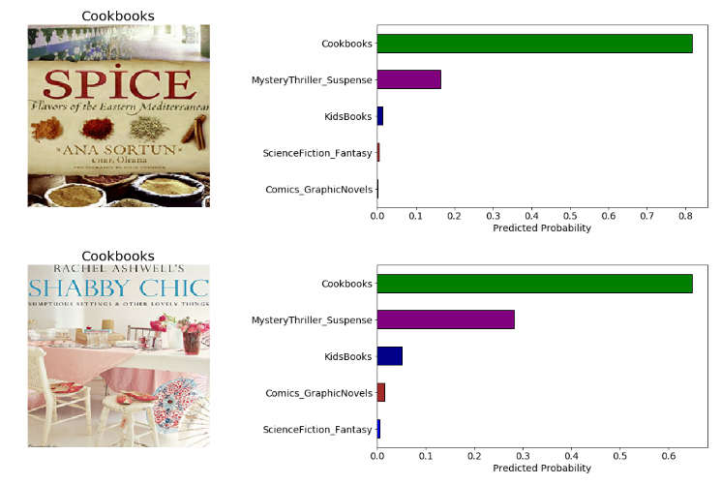
Prediction display

Slide 14
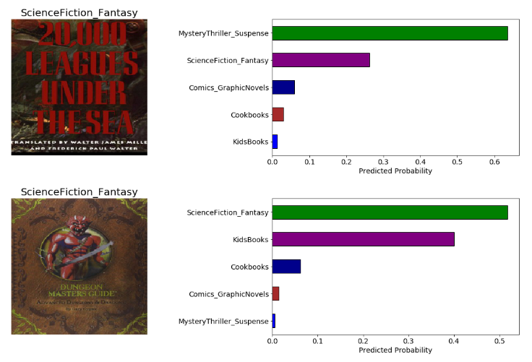
Prediction display

Slide 15
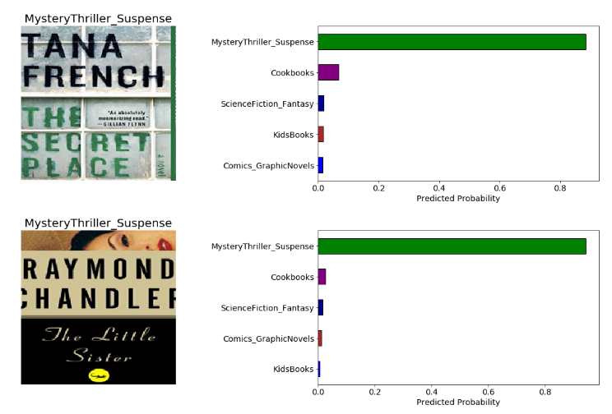
Prediction display

Slide 16
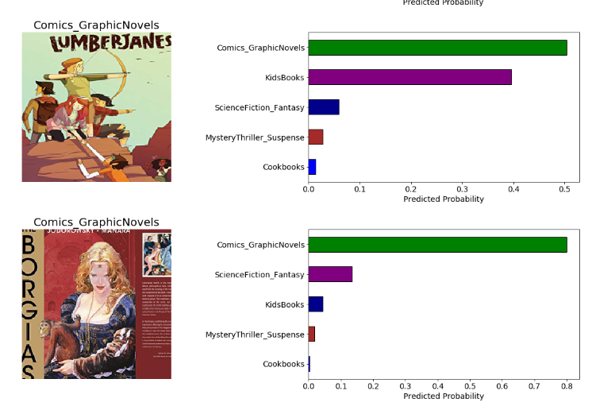
Prediction display

Slide 17
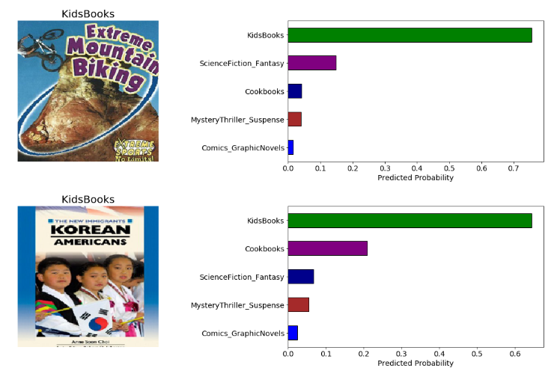
Prediction display

Slide 18
Conclusion:
We are able to make predictions of book covers with an accuracy of 64.82% using Resnet model. We also explored different Transfer Learning models to train the data and choose the best model to test our resultant data.

Slide 19
References:
https://towardsdatascience.com/judging-a-book-by-its-cover-1365d001ef50
https://www.learnopencv.com/image-classification-using-transfer-learning-in-pytorch/
https://towardsdatascience.com/a-comprehensive-hands-on-guide-to-transfer-learning-with-real-world-applications-in-deep-learning-212bf3b2f27a
https://github.com/WillKoehrsen/pytorch_challenge
Link to data:
https://drive.google.com/drive/folders/1s0NBlCHIpVcLQpT4Th8HmvLTnkrgC9hL?usp=sharing

