Slide 1

Session 3
CSS

Slide 2
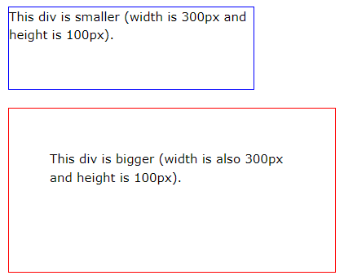
CSS Box Sizing
The CSS box-sizing property allows us to include the padding and border in an element's total width and height.
Without the CSS box-sizing Property
By default, the width and height of an element is calculated like this:
width + padding + border = actual width of an element height + padding + border = actual height of an element
This means: When you set the width/height of an element, the element often appears bigger than you have set (because the element's border and padding are added to the element's specified width/height).
The following illustration shows two <div> elements with the same specified width and height:

Slide 3
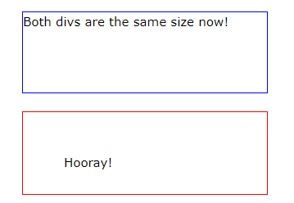
With the CSS box-sizing Property
The box-sizing property allows us to include the padding and border in an element's total width and height.
If you set box-sizing: border-box; on an element, padding and border are included in the width and height:
.div1 { width: 300px; height: 100px; border: 1px solid blue; box-sizing: border-box; } .div2 { width: 300px; height: 100px; padding: 50px; border: 1px solid red; box-sizing: border-box; }
* { box-sizing: border-box; }

Slide 4
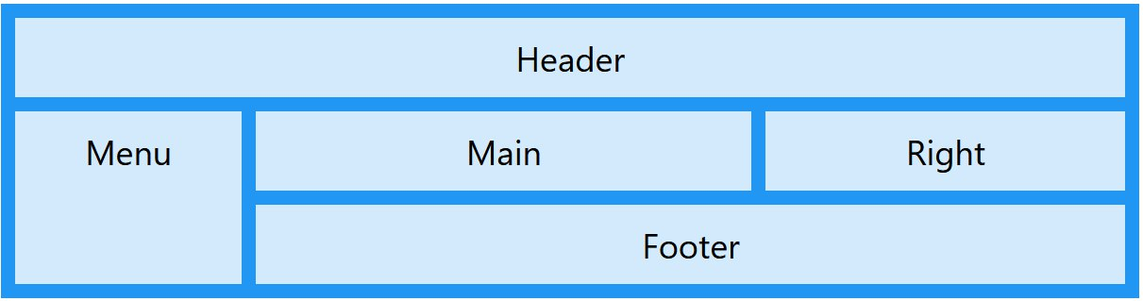
Grid : layout module .

Slide 5
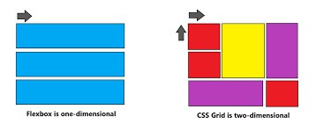
The difference between flexbox and grid :

Slide 6
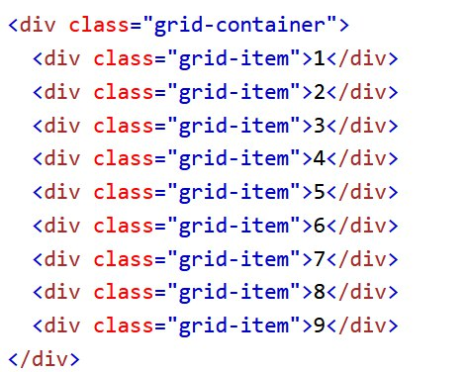
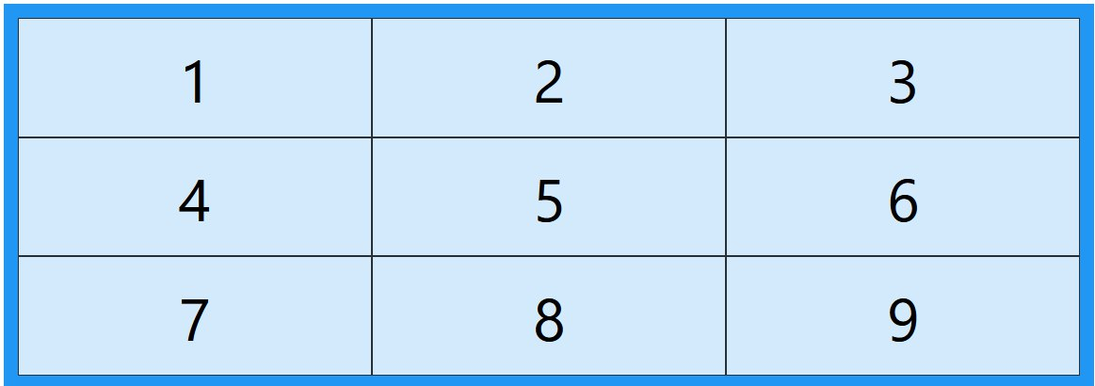
Grid Elements
A grid layout consists of a parent element, with one or more child elements.

Slide 7
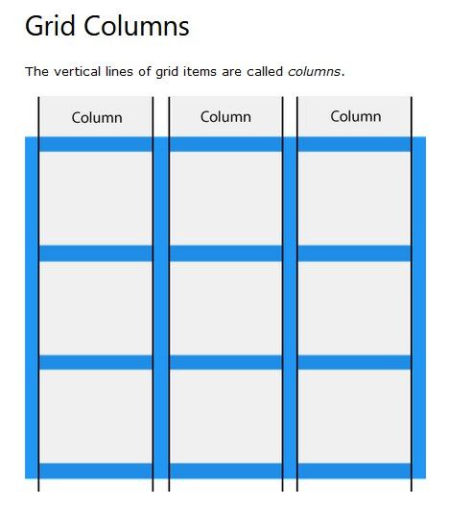
Display Property
.grid-container { display: grid; }
1-Grid Columns
The vertical lines of grid items are called columns.

Slide 8
The grid-template-columns Property
The grid-template-columns property defines the number of columns in your grid layout, and it can define the width
of each column.
The value is a space-separated-list, where each value defines the width of the respective column.
If you want your grid layout to contain 4 columns, specify the width of the 4 columns, or "auto“
if all columns should have the same width
.grid-container { display: grid; grid-template-columns: auto auto auto auto; }

Slide 9
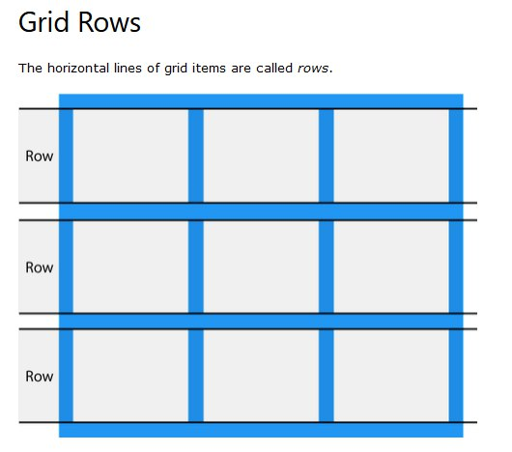
2-Grid Rows
The horizontal lines of grid items are called rows.

Slide 10
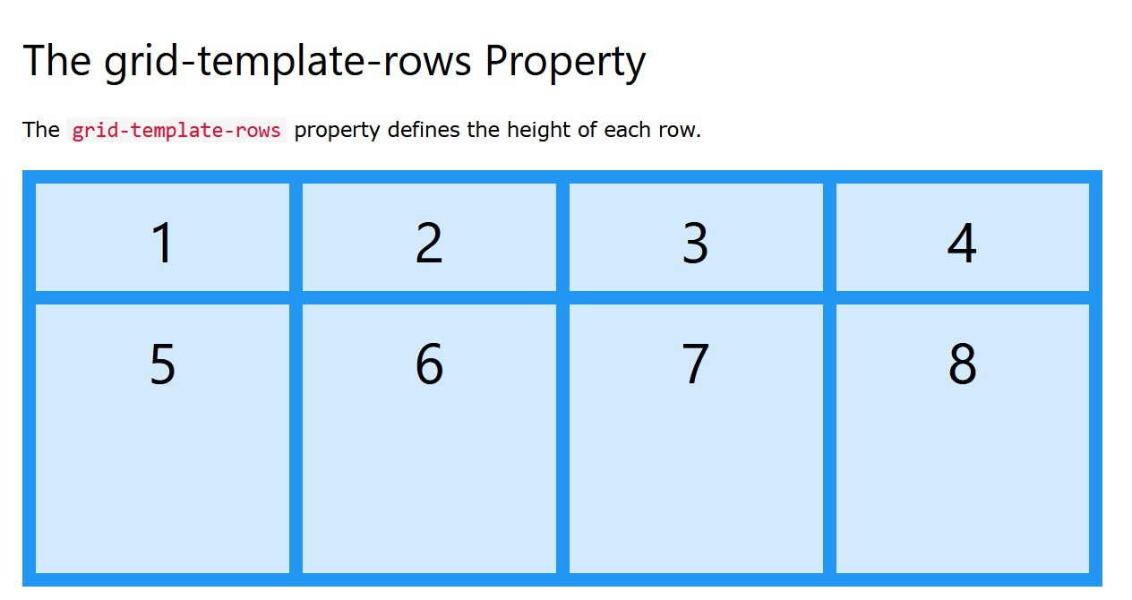
The grid-template-rows Property
.grid-container { display: grid; grid-template-rows: 80px 200px; }

Slide 11
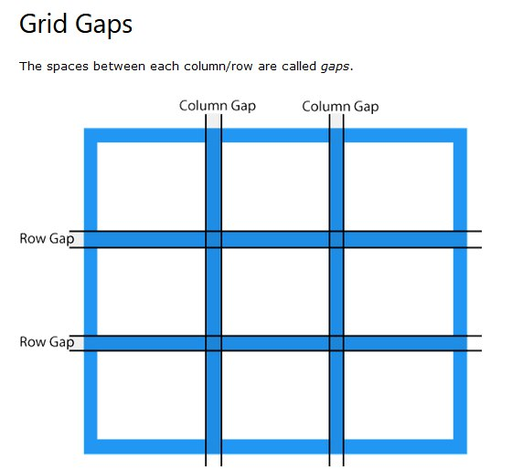
3-Grid Gaps
The spaces between each column/row are called gaps.
.grid-container { display: grid; column-gap: 50px; }
.grid-container { display: grid; row-gap: 50px; }
Short hand :
gap: row column;
.grid-container { display: grid; gap: 50px 100px; }

Slide 12
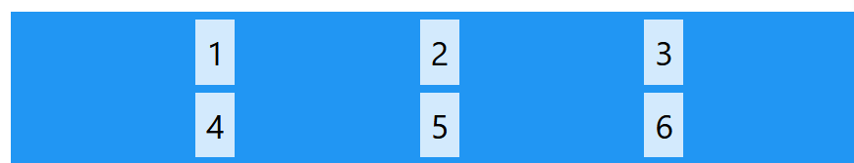
The justify-items

Slide 13
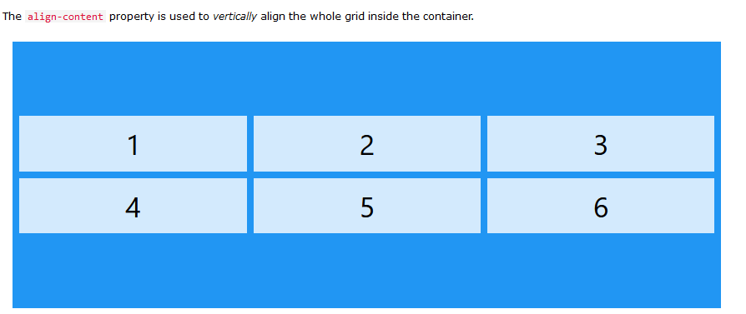
The align-items Property

Slide 14
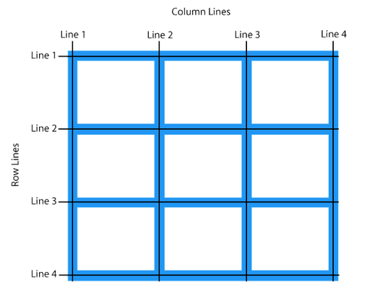
4-Grid Lines
The lines between columns are called column lines.
The lines between rows are called row lines.
.item1 { grid-column-start: 1; grid-column-end: 3; }
.item1 { grid-row-start: 1; grid-row-end: 3; }

Slide 15

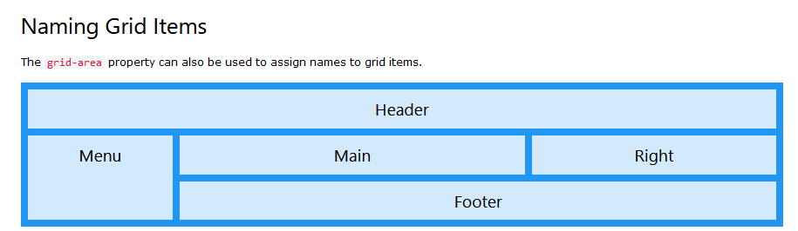
Gird template area :

Slide 16
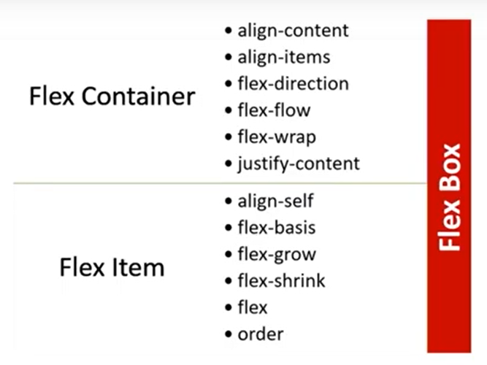

Slide 17
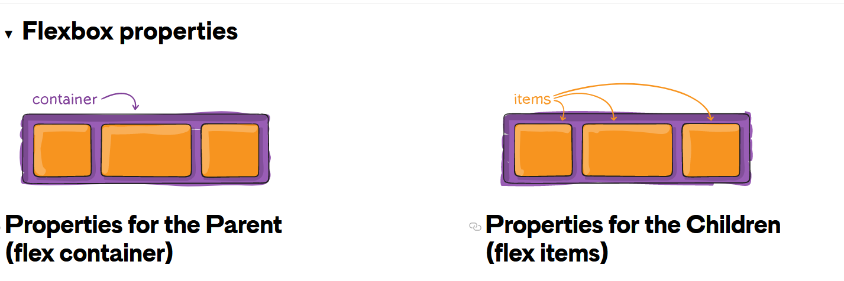

Slide 18
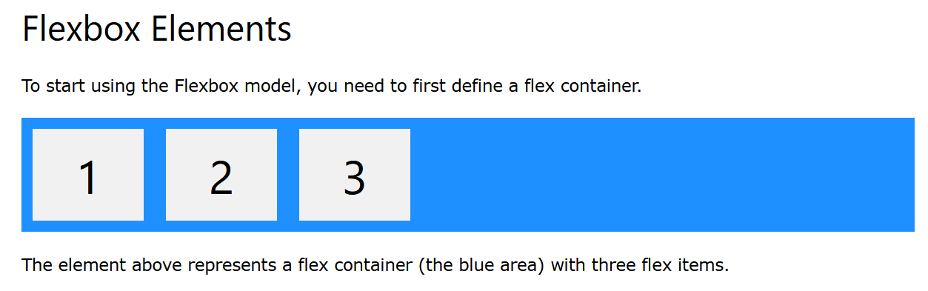
FLEXBOX :
1-Parent Element (Container):

Slide 19
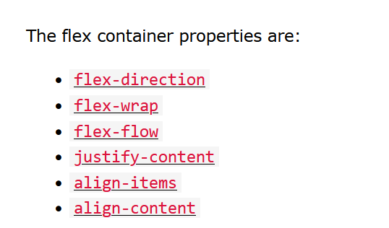
1-Parent Element (Container):

Slide 20
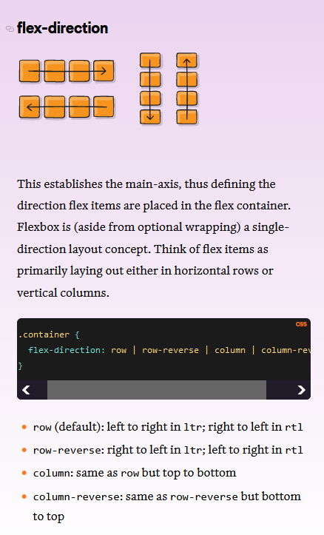
Flex direction :
The flex-direction property defines in which direction the container wants to stack the flex items.

Slide 21
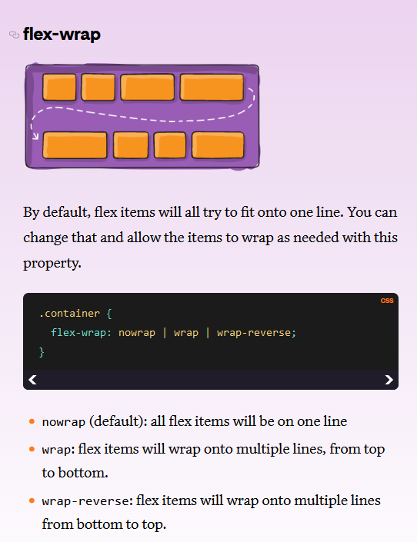
Flex wrap:
The flex-wrap property specifies whether the flex items should wrap or not.
The examples below have 12 flex items, to better demonstrate the flex-wrap property.

Slide 22
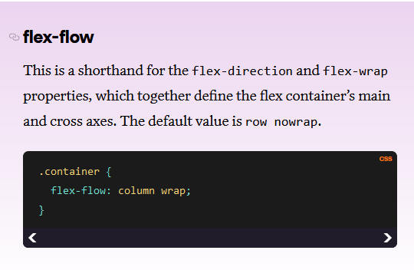
Flex flow:
The flex-flow property is a shorthand property for setting both the flex-direction and flex-wrap properties.

Slide 23
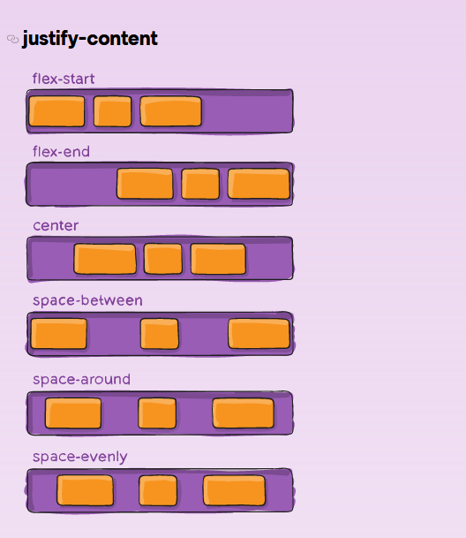
Justify content:
The justify-content property is used to align the flex items:

Slide 24
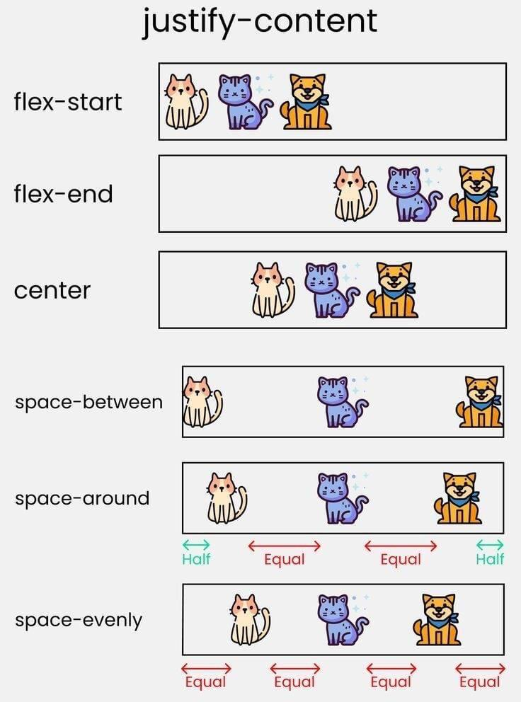

Slide 25
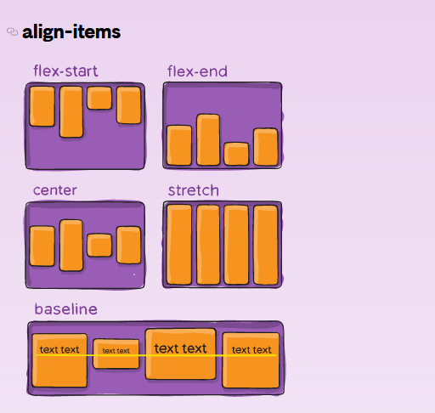
Align items :
The align-items property is used to align the flex items.

Slide 26
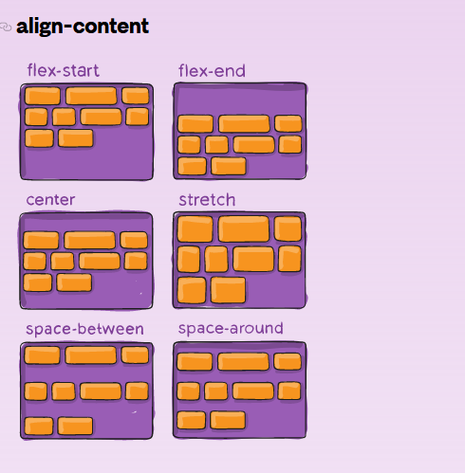
Align content :
The align-content property is used to align the flex lines.

Slide 27
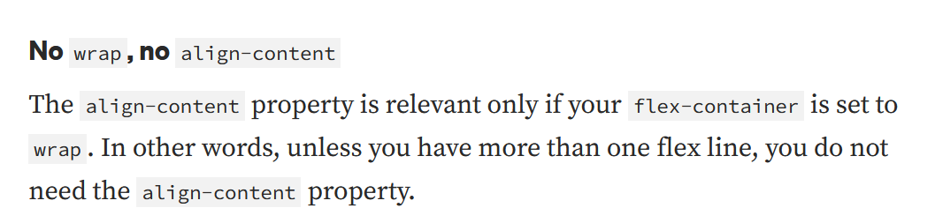

Slide 28
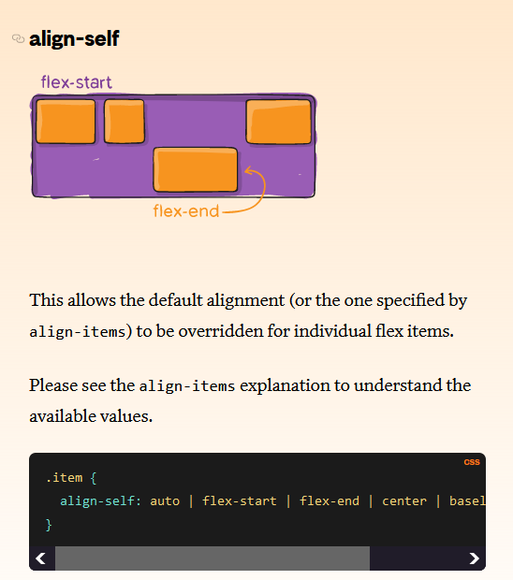
The flex item properties are:
Align-self :

Slide 29
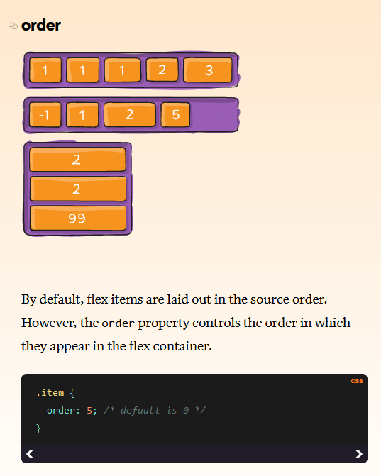
The flex item properties are:
Order:

Slide 30
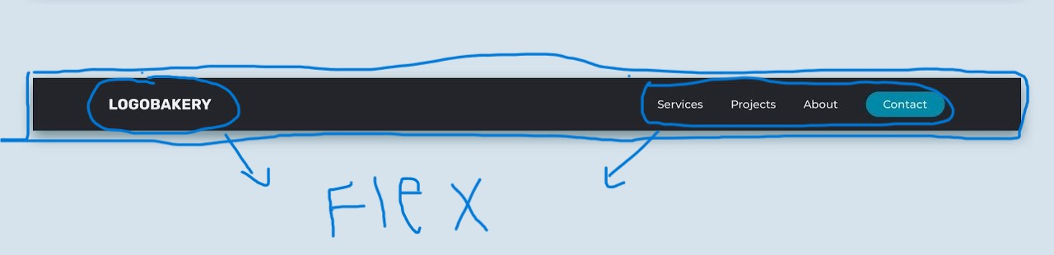
How to Structure the page
Example 1

Slide 31
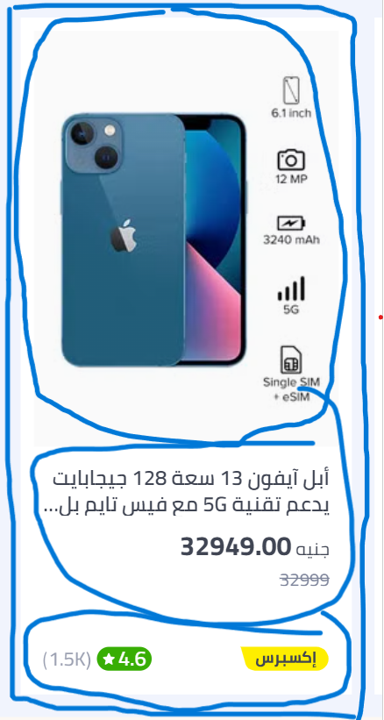
Example 2

Slide 32
CSS Variables
The var() function is used to insert the value of a CSS variable.
CSS variables have access to the DOM, which means that you can create variables with local or global scope, change the variables with JavaScript, and change the variables based on media queries.
A good way to use CSS variables is when it comes to the colors of your design. Instead of copy and paste the same colors over and over again, you can place them in variables.
Syntax of the var() Function
The var() function is used to insert the value of a CSS variable.
The syntax of the var() function is as follows:
var(--name, value)

Slide 33
How var() Works
First of all: CSS variables can have a global or local scope.
Global variables can be accessed/used through the entire document, while local variables can be used only inside the selector where it is declared.
To create a variable with global scope, declare it inside the :root selector.
The :root selector matches the document's root element.
To create a variable with local scope, declare it inside the selector that is going to use it.
The following example is equal to the example above, but here we use the var() function.
First, we declare two global variables (--blue and --white). Then, we use the var() function to insert the value of the variables later in the style sheet:
:root { --blue: #1e90ff; --white: #ffffff; } body { background-color: var(--blue); } h2 { border-bottom: 2px solid var(--blue); } .container { color: var(--blue); background-color: var(--white); padding: 15px; } button { background-color: var(--white); color: var(--blue); border: 1px solid var(--blue); padding: 5px; }
Advantages of using var() are:
makes the code easier to read (more understandable)
makes it much easier to change the color values

Slide 34
What is Responsive Web Design?
-Responsive web design makes your web page look good on all devices.
-Responsive web design uses only HTML and CSS.

Slide 35
-Web pages can be viewed using many different devices: desktops, tablets, and phones. Your web page should look good, and be easy to use, regardless of the device.
Designing For The Best Experience For All Users :
-Web pages should not leave out information to fit smaller devices, but rather adapt its content to fit any device

Slide 36
What is a Media Query?
-Media query is a CSS technique introduced in CSS3.
Max-width:1000px => (0:1000px)
Min-width:400px=>(400px:…..)
@media (condition) {
//block of code;
}

Slide 37

-Always Design for Mobile First
-Mobile First means designing for mobile before designing for desktop or any other device (This will make the page display faster on smaller devices).
-This means that we must make some changes in our CSS.
-Instead of changing styles when the width gets smaller than 768px, we should change the design when the width gets larger than 768px. This will make our design Mobile First

Slide 38
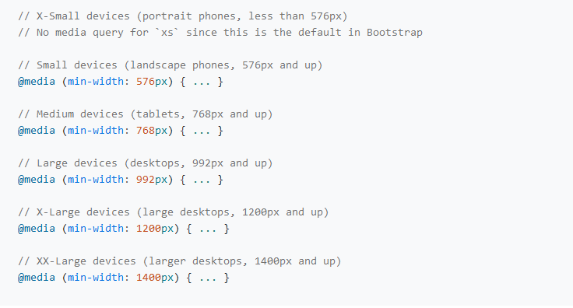
-Responsive design standards:

Slide 39
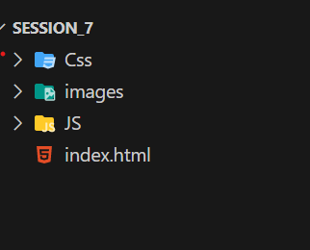
File Structure

Slide 40
Teams:
Merna Hana & Amira Mahmoud
Mariam Faried& Hadeer Mohamed
Ahmed Mahmoud & Ahmed Behiry
Fayrouz Nasser & Habiba Emad
Nouran Yasser & Mariem Walid
Abdelrahman Mohamed & Ahmed Khfaga
Amer Ammar

