Slide 1

Linked Lists
Work in progress (Sept 10)
I need to finish editing together the video
(+ animations?) for this lecture, here are the
slides so far.
Written by Rachel J. Morris, last updated Sep 10, 2017

Slide 2

About
At this point, we’ve worked with arrays to store a lot of the same type of data. There are other types of structures we can use to store data (thus, data structures), so let’s get into our first non-array one: Linked Lists, which use dynamic variables and a chaining structure to get around some of the shortfalls of arrays.

Slide 3

Topics
1. Review: Pointers
2. Dynamic Array
vs. Linked List
3. Stepping through Linked List functionality
  PushBack
  PushFront
  PopBack
  PopFront
  GetFront
  GetBack

Slide 4
1. Review: Pointers

Slide 5

1. Review: Pointers
Before we jump straight into building Linked Lists, let’s review how we can use pointers.
Our Linked Lists will use both dynamic variables (dynamically allocating memory for a single variable, as-needed), as well as pointing to addresses of variables that already exist, with the address-of operator &.
Notes
Address-of operator: &
(<number>/42)

Slide 6
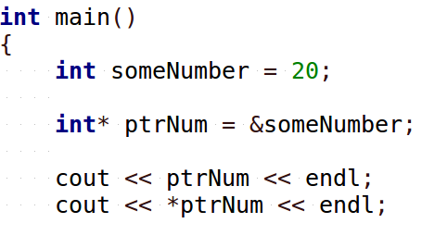
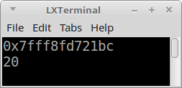
1. Review: Pointers
Pointers are just a type of variable that stores addresses. No matter how we’re using a pointer, that’s what it all boils down to.
Notes
Address-of operator: &
Display address ptrNum is pointing to.
De-reference the pointer to get the value of the item it is pointing to.
(<number>/42)

Slide 7
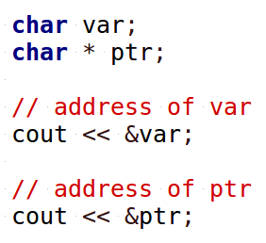
1. Review: Pointers
Every variable has an address, and we can look at what that address is with the address-of operator, &.
Notes
Address-of operator: &
Even pointers have addresses – they are, after all, variables that store some data at some location in memory!
(<number>/42)

Slide 8
1. Review: Pointers
Every variable has an address, and we can look at what that address is with the address-of operator, &.
Notes
Address-of operator: &
Even pointers have addresses – they are, after all, variables that store some data at some location in memory!
(<number>/42)

Slide 9
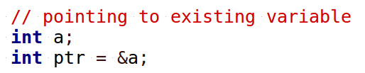
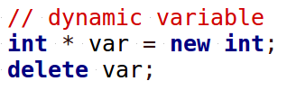
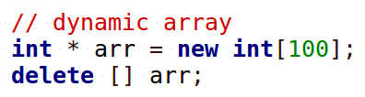
1. Review: Pointers
Notice the different ways we can use pointers...
Notes
Address-of operator: &
Ways to use ptrs:
Point to existing var
ptr = &b;
Dynamic variable
TYPE* ptr = new TYPE;
Dynamic array
TYPE* ptr = new TYPE[size];
(<number>/42)

Slide 10
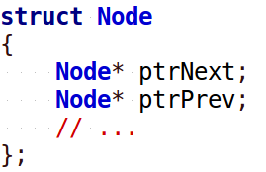
1. Review: Pointers
With a linked list, our element Nodes will have pointers to other existing nodes, such as “ptrPrevious” and “ptrNext”.
Notes
Address-of operator: &
Ways to use ptrs:
Point to existing var
ptr = &b;
Dynamic variable
TYPE* ptr = new TYPE;
Dynamic array
TYPE* ptr = new TYPE[size];
(<number>/42)

Slide 11
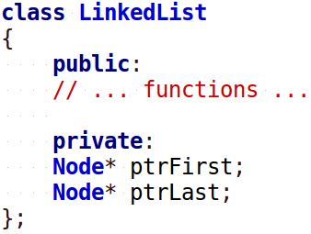
1. Review: Pointers
We will have an over-arching “LinkedList” class that will also contain pointers to the first Node (and possibly the last Node)…
Notes
Address-of operator: &
Ways to use ptrs:
Point to existing var
ptr = &b;
Dynamic variable
TYPE* ptr = new TYPE;
Dynamic array
TYPE* ptr = new TYPE[size];
(<number>/42)

Slide 12
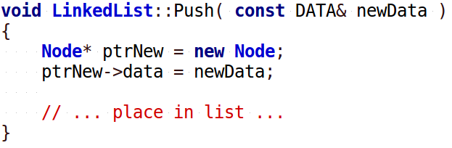
1. Review: Pointers
When we need a new item in our List, then we use the new keyword to allocate memory for a new item.
Notes
Address-of operator: &
Ways to use ptrs:
Point to existing var
ptr = &b;
Dynamic variable
TYPE* ptr = new TYPE;
Dynamic array
TYPE* ptr = new TYPE[size];
(<number>/42)

Slide 13
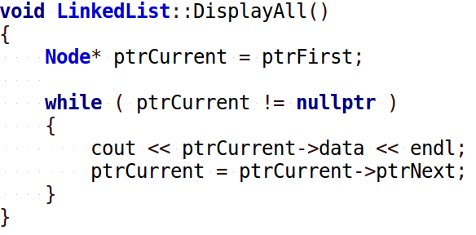
1. Review: Pointers
And when we’re traversing the list, we will use another pointer to walk through all the nodes, one at a time. As it moves forward, the pointer is updated to point to the next Node in the list.
Notes
Address-of operator: &
Ways to use ptrs:
Point to existing var
ptr = &b;
Dynamic variable
TYPE* ptr = new TYPE;
Dynamic array
TYPE* ptr = new TYPE[size];
(<number>/42)

Slide 14
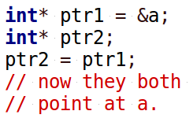
1. Review: Pointers
If you use an assignment statement between two pointers, the pointer on the LHS (left-hand-side) will now point to the same place as the pointer on the RHS (right-hand-side).
Notes
Address-of operator: &
Ways to use ptrs:
Point to existing var
ptr = &b;
Dynamic variable
TYPE* ptr = new TYPE;
Dynamic array
TYPE* ptr = new TYPE[size];
(<number>/42)

Slide 15
1. Review: Pointers
Also, if a pointer is poing to an object, and you want to access the original items’ member functions and variables, you need to use the arrow operator ->.
Notes
Address-of operator: &
Ways to use ptrs:
Point to existing var
ptr = &b;
Dynamic variable
TYPE* ptr = new TYPE;
Dynamic array
TYPE* ptr = new TYPE[size];
(<number>/42)

Slide 16
1. Review: Pointers
If you need to further review pointers, I have three lecture videos from a previous course:
1. Pointers
https://www.youtube.com/watch?v=Jlr6nSzFdGo
2. Memory Management
https://www.youtube.com/watch?v=GxDETB16Clk
3. Dynamic Variables & Arrays
https://www.youtube.com/watch?v=oqnFZ9TfeDo
Notes
Address-of operator: &
Ways to use ptrs:
Point to existing var
ptr = &b;
Dynamic variable
TYPE* ptr = new TYPE;
Dynamic array
TYPE* ptr = new TYPE[size];
(<number>/42)

Slide 17
2. Dynamic Array vs.
Linked List

Slide 18
2. Dynamic Array vs. Linked List
Previously, we implemented a class that used a dynamic array to store its data.
When the Push or Insert function was called, it would check to see if the array was full, and if it was, it would Resize the array.
Notes
(<number>/42)

Slide 19
2. Dynamic Array vs. Linked List
The resizing process includes the steps:
Create a new dynamic array of a larger size
Copy all the contents from the old (small) array to the new (large) array
Free up the memory from the old array
Update the pointer to point to the new (large) array.
Notes
(<number>/42)

Slide 20
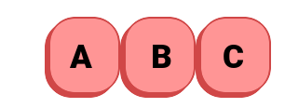

2. Dynamic Array vs. Linked List
Every time the array had to be resized, the program would have to stop, allocate more memory, then copy over all the data.
If our structure were storing large objects (such as classes with lots of variables or arrays within them), this could be costly.
Notes
Dynamic Array
Resize is costly
(<number>/42)

Slide 21

2. Dynamic Array vs. Linked List
On the other hand, accessing specific elements of the dynamic array at some given index was not expensive at all.
Since arrays are contiguous in memory, accessing an item at some index is almost instantaneous.
Notes
Dynamic Array
Resize is costly
Access is cheap
&arr
+0*size
&arr
+1*size
&arr
+2*size
&arr
+3*size
&arr
+4*size
&arr
+5*size
(<number>/42)

Slide 22
2. Dynamic Array vs. Linked List
So does the instantaneous access time make up for the costly insert/resize time?
It depends on what you’re implementing!
If your program accesses data a lot more than it inserts new data, then this could be a good trade-off.
If your program inserts data more often than it accesses it, then this would be inefficient.
Notes
Dynamic Array
Resize is costly
Access is cheap
Whether to use is a design decision.
(<number>/42)

Slide 23


2. Dynamic Array vs. Linked List
With a Linked List, we start with a List object and no memory allocated for any elements.
Notes
Dynamic Array
Resize is costly
Access is cheap
Whether to use is a design decision.
Linked List
Wraps element data in “Nodes”
LinkedList
We have a second class – a Node – defined, which will actually store the data.
Push( … )
Pop()
Get()
Clear()
IsEmpty()
Size()
Node* ptrFirst
Node* ptrLast
int itemCount
Node
Node* ptrNext
Node* ptrPrev
TYPE data
(<number>/42)

Slide 24
2. Dynamic Array vs. Linked List
Any time we add a new item to the Linked List, we allocate memory for that new Node at that time, then have our List point to it.
Notes
Dynamic Array
Resize is costly
Access is cheap
Whether to use is a design decision.
Linked List
Wraps element data in “Nodes”
Node
*
*
LinkedList
ptrFirst
ptrLast
(<number>/42)

Slide 25
2. Dynamic Array vs. Linked List
As we keep pushing new data to the LinkedList, new Nodes are created each time.
Notes
Dynamic Array
Resize is costly
Access is cheap
Whether to use is a design decision.
Linked List
Wraps element data in “Nodes”
Node
Node
Node
*
*
LinkedList
ptrFirst
ptrLast
(<number>/42)

Slide 26
2. Dynamic Array vs. Linked List
A Doubly- Linked List keeps track of the first and last Nodes, and then each Node keeps track of its next and previous Nodes. This is all done with pointers.
Notes
Dynamic Array
Resize is costly
Access is cheap
Whether to use is a design decision.
Linked List
Wraps element data in “Nodes”
Pointers are used to build a “chain”
Node
Node
Node
*
*
LinkedList
ptrFirst
ptrLast
(<number>/42)

Slide 27
2. Dynamic Array vs. Linked List
Because we only allocate memory for the list as-needed, then the elements of the list can be (and are!) non-contiguous in memory.
Notes
Dynamic Array
Resize is costly
Access is cheap
Whether to use is a design decision.
Linked List
Wraps element data in “Nodes”
Pointers are used to build a “chain”
0x7ffcda9dd430
0x7ffc2c9c25e0
0x7ffd016428d0
0x7fff6d022af0
0x7fffbf5f15e0
Node
Node
Node
Node
Node
*
*
LinkedList
ptrFirst
ptrLast
(<number>/42)

Slide 28
2. Dynamic Array vs. Linked List
This also means we don’t have to pause and resize anything when a new item is added; we don’t have to maintain the elements’ contiguousness.
The efficiency of pushing on a new item is the same every time.
Notes
Dynamic Array
Resize is costly
Access is cheap
Whether to use is a design decision.
Linked List
Wraps element data in “Nodes”
Pointers are used to build a “chain”
Elements are non-contiguous
Node
Node
Node
Node
Node
*
*
LinkedList
ptrFirst
ptrLast
(<number>/42)

Slide 29
2. Dynamic Array vs. Linked List
Notes
Dynamic Array
Resize is costly
Access is cheap
Whether to use is a design decision.
Linked List
Wraps element data in “Nodes”
Pointers are used to build a “chain”
Elements are non-contiguous
&arr
+0*size
&arr
+1*size
&arr
+2*size
&arr
+3*size
&arr
+4*size
&arr
+5*size
However, because they are non-contiguous,
we cannot access items as simply as with arrays.
Node
Node
Node
Node
Node
*
*
LinkedList
ptrFirst
ptrLast
(<number>/42)

Slide 30
2. Dynamic Array vs. Linked List
To find an item at some position in the list, we have to start at the beginning and “walk” over to it.
Notes
Dynamic Array
Resize is costly
Access is cheap
Whether to use is a design decision.
Linked List
Wraps element data in “Nodes”
Pointers are used to build a “chain”
Elements are non-contiguous
Traversing the list is slower
Node
Node
Node
Node
Node
*
*
LinkedList
ptrFirst
ptrLast
(<number>/42)

Slide 31
2. Dynamic Array vs. Linked List
We would create a pointer to keep track of the Node we’re currently looking at, and an integer counter to keep track of how many Nodes we’ve looked at…
Notes
Dynamic Array
Resize is costly
Access is cheap
Whether to use is a design decision.
Linked List
Wraps element data in “Nodes”
Pointers are used to build a “chain”
Elements are non-contiguous
Traversing the list is slower
Counter = 0
Walker
Node
Node
Node
Node
Node
*
*
LinkedList
ptrFirst
ptrLast
(<number>/42)

Slide 32
2. Dynamic Array vs. Linked List
We would begin by having our “Walker” pointer point to the first item, and our counter set to 0.
Notes
Dynamic Array
Resize is costly
Access is cheap
Whether to use is a design decision.
Linked List
Wraps element data in “Nodes”
Pointers are used to build a “chain”
Elements are non-contiguous
Traversing the list is slower
Counter = 0
Walker
“Is 0 the index we want?”
Node
Node
Node
Node
Node
*
*
LinkedList
ptrFirst
ptrLast
(<number>/42)

Slide 33
2. Dynamic Array vs. Linked List
Since each Node points to the next Node, we simply update the Walker pointer as we go…
Notes
Dynamic Array
Resize is costly
Access is cheap
Whether to use is a design decision.
Linked List
Wraps element data in “Nodes”
Pointers are used to build a “chain”
Elements are non-contiguous
Traversing the list is slower
Counter = 1
Walker
“Is 1 the index we want?”
Node
Node
Node
Node
Node
*
*
LinkedList
ptrFirst
ptrLast
(<number>/42)

Slide 34
2. Dynamic Array vs. Linked List
Since each Node points to the next Node, we simply update the Walker pointer as we go…
Notes
Dynamic Array
Resize is costly
Access is cheap
Whether to use is a design decision.
Linked List
Wraps element data in “Nodes”
Pointers are used to build a “chain”
Elements are non-contiguous
Traversing the list is slower
“Is 2 the index we want?”
“ok, return
the data stored
by this Node.”
Counter = 2
Walker
Node
Node
Node
Node
Node
*
*
LinkedList
ptrFirst
ptrLast
(<number>/42)

Slide 35
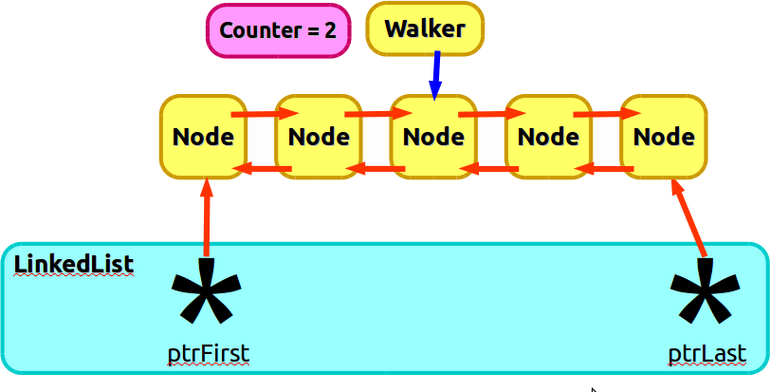
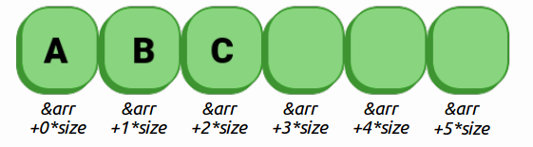
2. Dynamic Array vs. Linked List
We will go over this functionality step-by-step in a moment, but because we have to start at the first Node, and keep moving forward by 1 until we get where we need to go, the access time of a Linked List is more costly than with an array.
Notes
Dynamic Array
Resize is costly
Access is cheap
Whether to use is a design decision.
Linked List
Wraps element data in “Nodes”
Pointers are used to build a “chain”
Elements are non-contiguous
Traversing the list is slower
(<number>/42)

Slide 36


2. Dynamic Array vs. Linked List
Selecting one or the other means having to make the design decision: Are you going to be accessing items more often, or inserting data more often?
The idea of coming up with different ways to add, store, and access data, and the efficiency of each, is the central theme of data structures.
Notes
Dynamic Array
Resize is costly
Access is cheap
Whether to use is a design decision.
Linked List
Wraps element data in “Nodes”
Pointers are used to build a “chain”
Elements are non-contiguous
Traversing the list is slower
(<number>/42)

Slide 37
2. Dynamic Array vs. Linked List
One last thing relating to Linked Lists…
there are several different kinds!
We are going to implement a Doubly Linked List, where each Node points to its next item and previous item.
A Singly Linked List is where each Node only points forward to its next item.
There are also Circularly Linked Lists, where the last Node of the list points to the first Node as its next item.
Notes
Dynamic Array
Resize is costly
Access is cheap
Whether to use is a design decision.
Linked List
Wraps element data in “Nodes”
Pointers are used to build a “chain”
Elements are non-contiguous
Traversing the list is slower
(<number>/42)

Slide 38
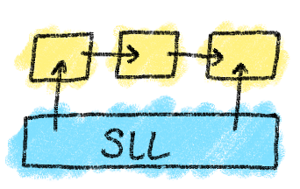
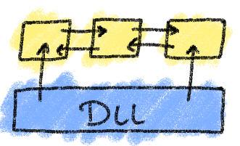
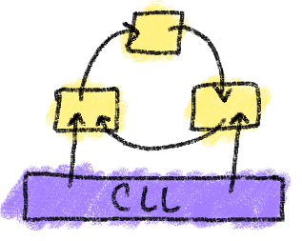
2. Dynamic Array vs. Linked List
Notes
Dynamic Array
Resize is costly
Access is cheap
Whether to use is a design decision.
Linked List
Wraps element data in “Nodes”
Pointers are used to build a “chain”
Elements are non-contiguous
Traversing the list is slower
I think the Doubly Linked List is easiest to grasp, and if you are able to understand how it works, you can probably figure out how to write the same kinds of functions for Singly- and Circularly- Linked Lists.
(<number>/42)

Slide 39
3. Stepping through
Linked List functionality

Slide 40
2. Functionality - Classes
Notes
The LinkedList
(<number>/42)

Slide 41
Conclusion

Slide 42
Conclusion
We did a thing.
Next time we do more things.

